Slide 1
Urban Agriculture
Erik Chevrier
Critique & Solutions
September 25, 2020

Slide 2
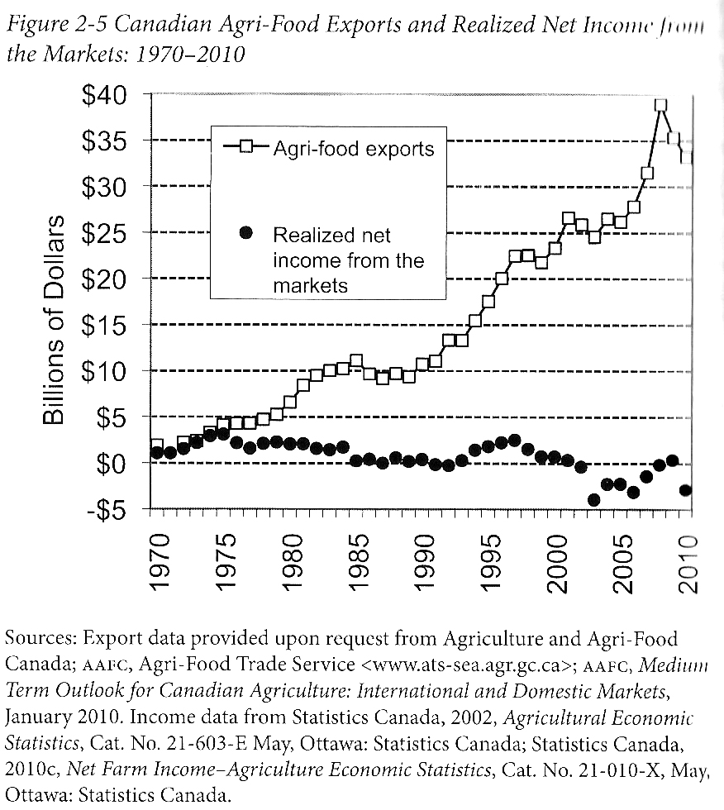
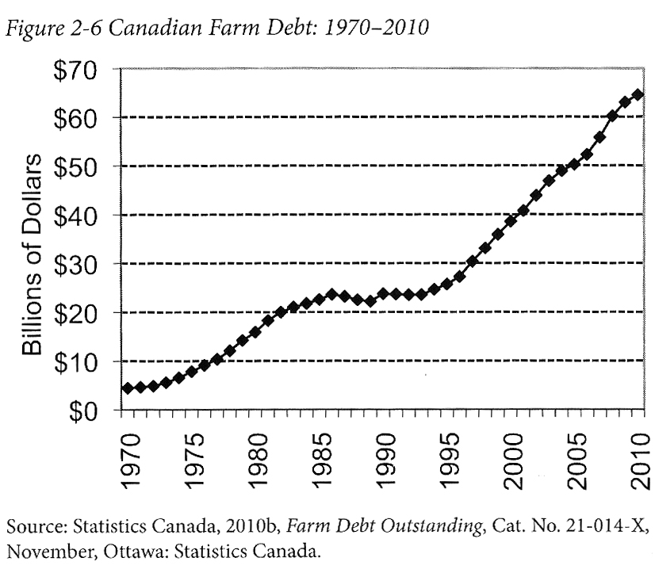
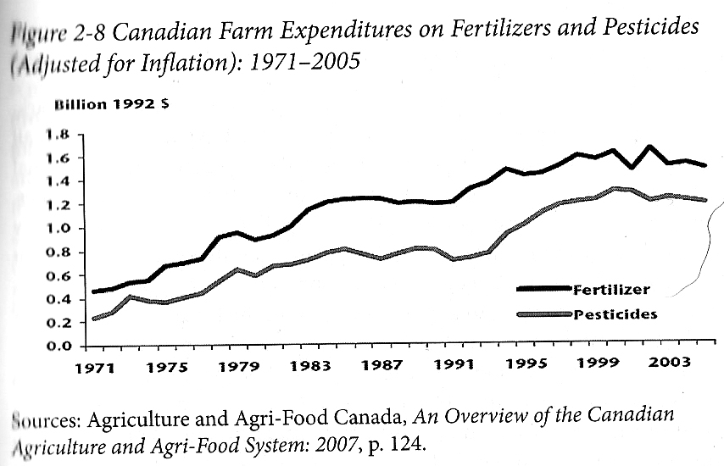
Who Benefits from Our Food System Economically?
Qualman, D. (2011) Advancing Agriculture by Destroying Farms? The State of Agriculture in Canada, pp. 20 – 42. In, Wittman, H., Desmarais, A. A., & Wiebe, N. (2011) Food Sovereignty in Canada: Creating Just and Sustainable Food Systems, Fernwood Publishing

Slide 3
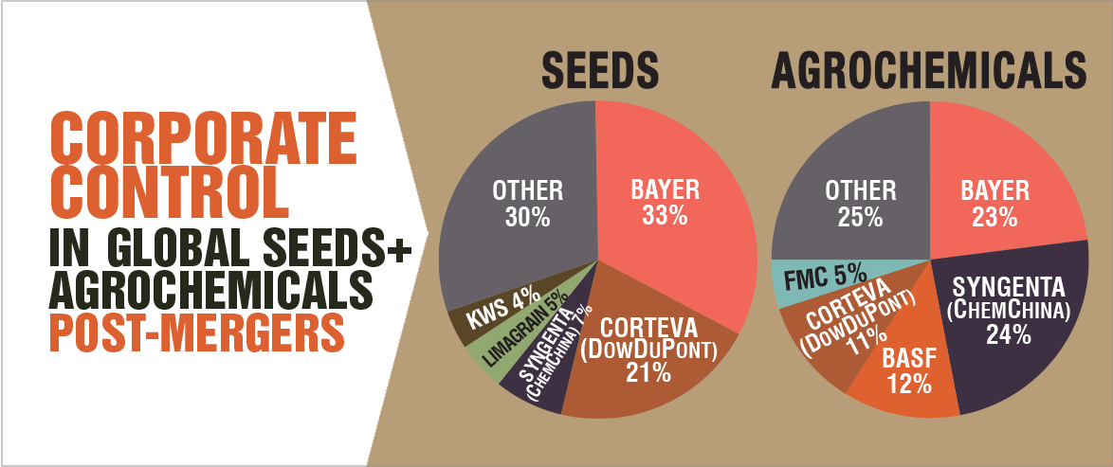
Only A Few Large Corporations Own Most of the Agrochemical Market https://cban.ca/gmos/issues/corporate-control/

Slide 4
Companies of War, Destruction and Death
These are a few examples:
Monsanto still uses chemicals that were used to kill people, but in our food
  Monsanto Ghostwriting Academic Papers
  Is Round-Up safe to drink?
  Farmer won lawsuit against Monsanto – Glyphosate causes cancer
  The World According to Monsanto
  Monsanto is now owned by Bayer who used to be part of I.G. Farben, manufacturing poisonous gas (Zyklon B) for concentration camps during the World War.
Dow Chemical Invented Agent Orange
BASF was also part of IG Farben a company who worked with the Nazis and tested chemicals and drugs on people including Zyklon B
Dow Chemical now owns Union Carbide who was responsible for a large devastating explosion in Bhopal, India:
  The Bhopal disaster: Toxic legacy
  One Night in Bhopal
  The Bhopal Disaster

Slide 5
Issues With Our Current Food System
Issues with food security – there are over 800 million people starving in the world today!
Issues with food sovereignty – peasants and farmers are being affected by trade agreements and food dumping!
Issues with genetic modification process – epigenetics matter!
Issues with use of herbicides – glyphosates are being identified as cancer causing!
Issues with privatization – restricted access!
Issues with cost on farmers – family farms are not sustainable!
Issues with reduction of biodiversity – we are destroying nature!
Issues with unwanted genetics spreading onto non-GMO farms – lawsuits!
Issues with loss of Indigenous farming methods – on stolen land!
Issues with soil arability – we are killing our soil!
Issues with killing pollinators – fruits need bees!
Issues with water ‘dead zones’ – we are polluting our water!
Issues with corporate concentration of agribusinesses – former war companies are now food chemical companies!
Issues with health – our food contains toxins!
Foundations on structural racism, colonialism and patriarchy – glaring systemic issues!
Rising cost of seed and chemicals – we don’t need to buy seeds!
Research funding being directed to GMOs instead of traditional breeding methods – ‘science’ is not only about GMOs!
Pest and weed resistance to Bt crops and glyphosate!
There are so many more critiques!

Slide 6
Is The Food System Broken?
Calls to “fix a broken food system” assume that the capitalist food system used to work well. This assumption ignores the food systems long, racialized history of mistreatment of people of colour. The food system is unjust and unsustainable, but it is not broken. It functions precisely as the capitalist food system has always worked, concentrating power in the hands of the privileged minority and passing off the social and environmental “externalities” disproportionately to racially stigmatized groups. (Holt-Gimenez, 2017, p. 160)
How we produce and consume determines how our society is organized, but how we organize socially and politically can also determine how we produce and consume. The implications of this are profound: our food systems are vessels of unmatched social and economic power and pivotal sites for systemic transformation. (Holt-Gimenez, 2017, p. 214)
Holt-Gimenez, E. (2017) A Foodie’s Guide to Capitalism: Understanding the Political Economy of What We Eat, Monthly Review Press, New York.

Slide 7
Some More Specific Solutions?
1 – (RE)CONNECT WITH FOOD!
2 – Prioritize our biosphere and social systems over markets.
3 – Participate in progressive and radical food movements.
4 – Get involved with urban agriculture and/or collective food initiatives.

Slide 8
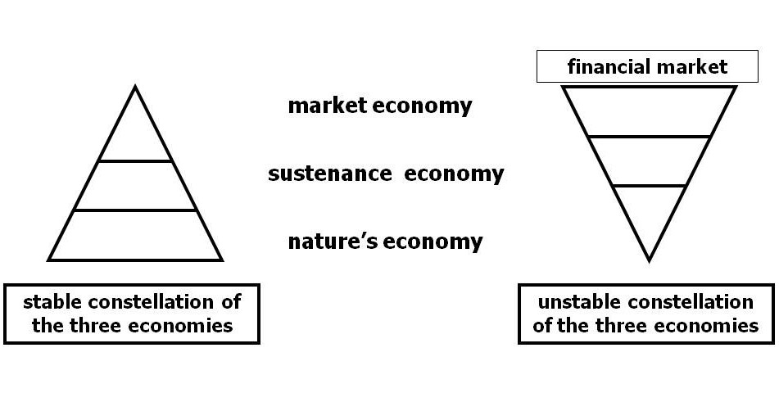
Living Economies – Vandana Shiva

Slide 9
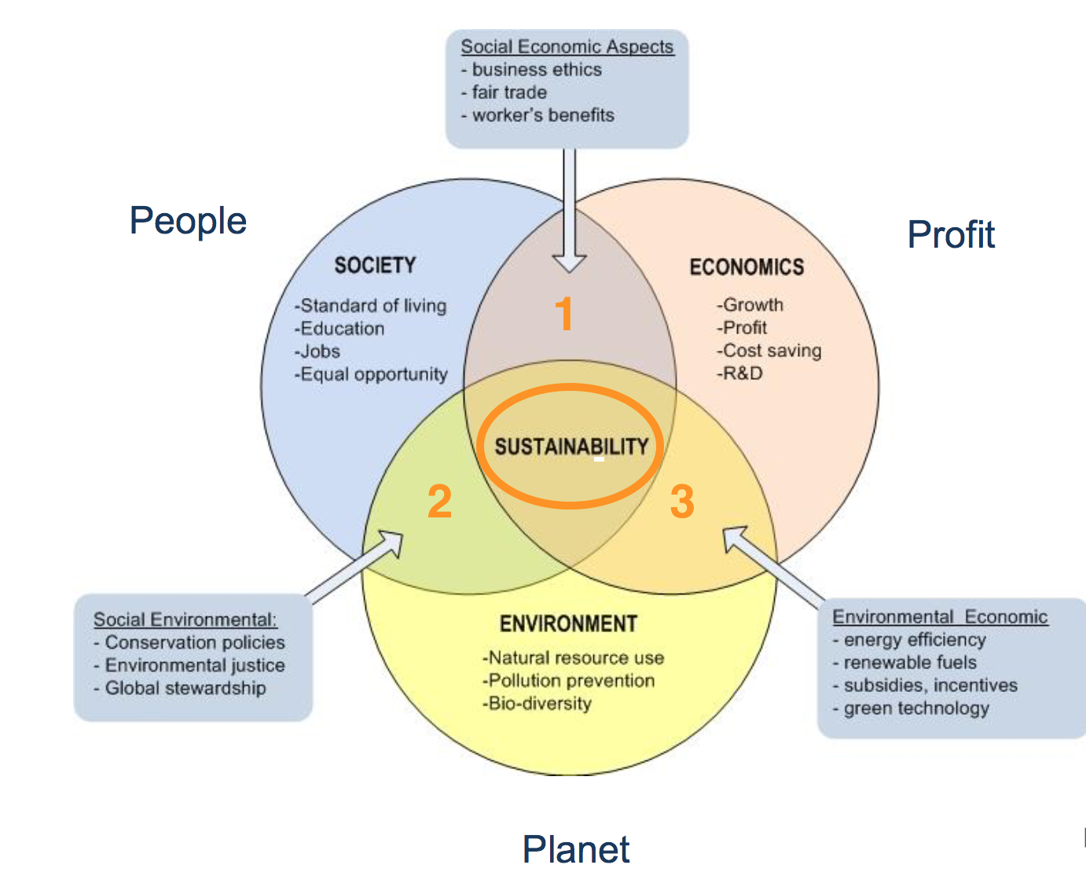
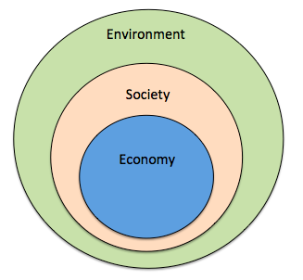
Prioritize the Biosphere and Social Relations Over the Market
Triple Bottom line
Nested model

Slide 10
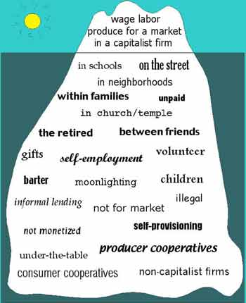
Take back the Economy
Gibson Graham
Gibson-Graham, J.K., Cameron, J., Healy, S. (2013) Take Back the Economy: An Ethical Guide for Transforming Communities, University of Minnesota Press
Katherine Gibson Interview Playlist

Slide 11
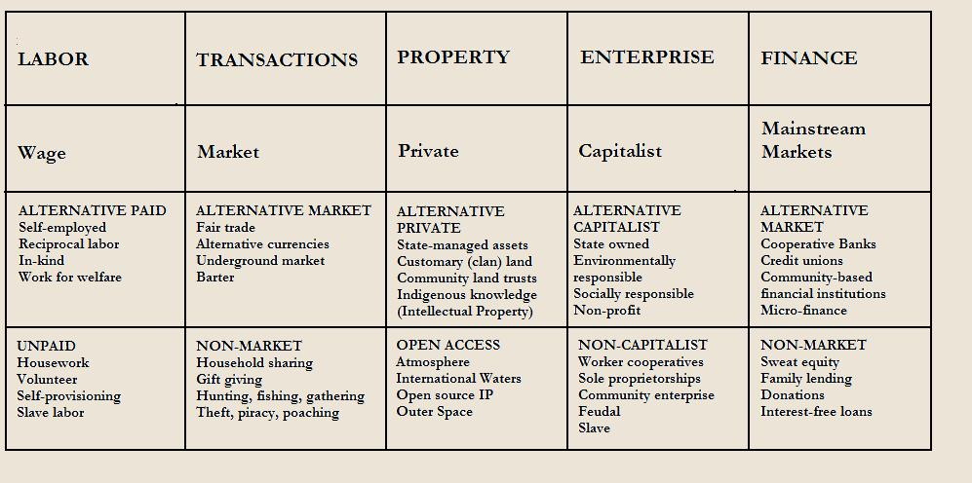
Take back the Economy
Gibson-Graham, J.K., Cameron, J., Healy, S. (2013) Take Back the Economy: An Ethical Guide for Transforming Communities, University of Minnesota Press

Slide 12
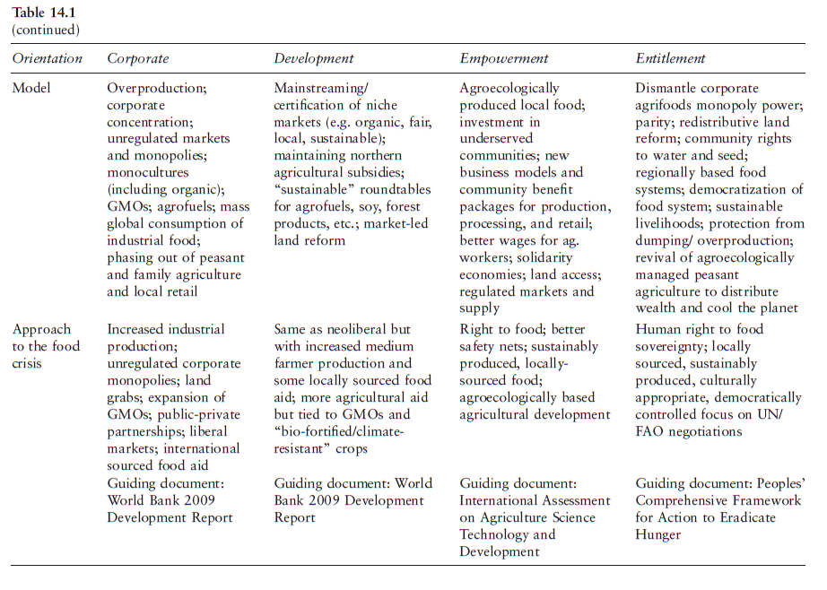

Slide 13
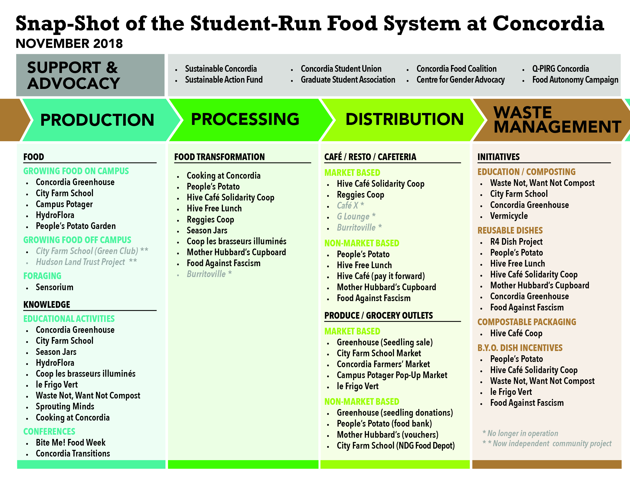

Slide 14
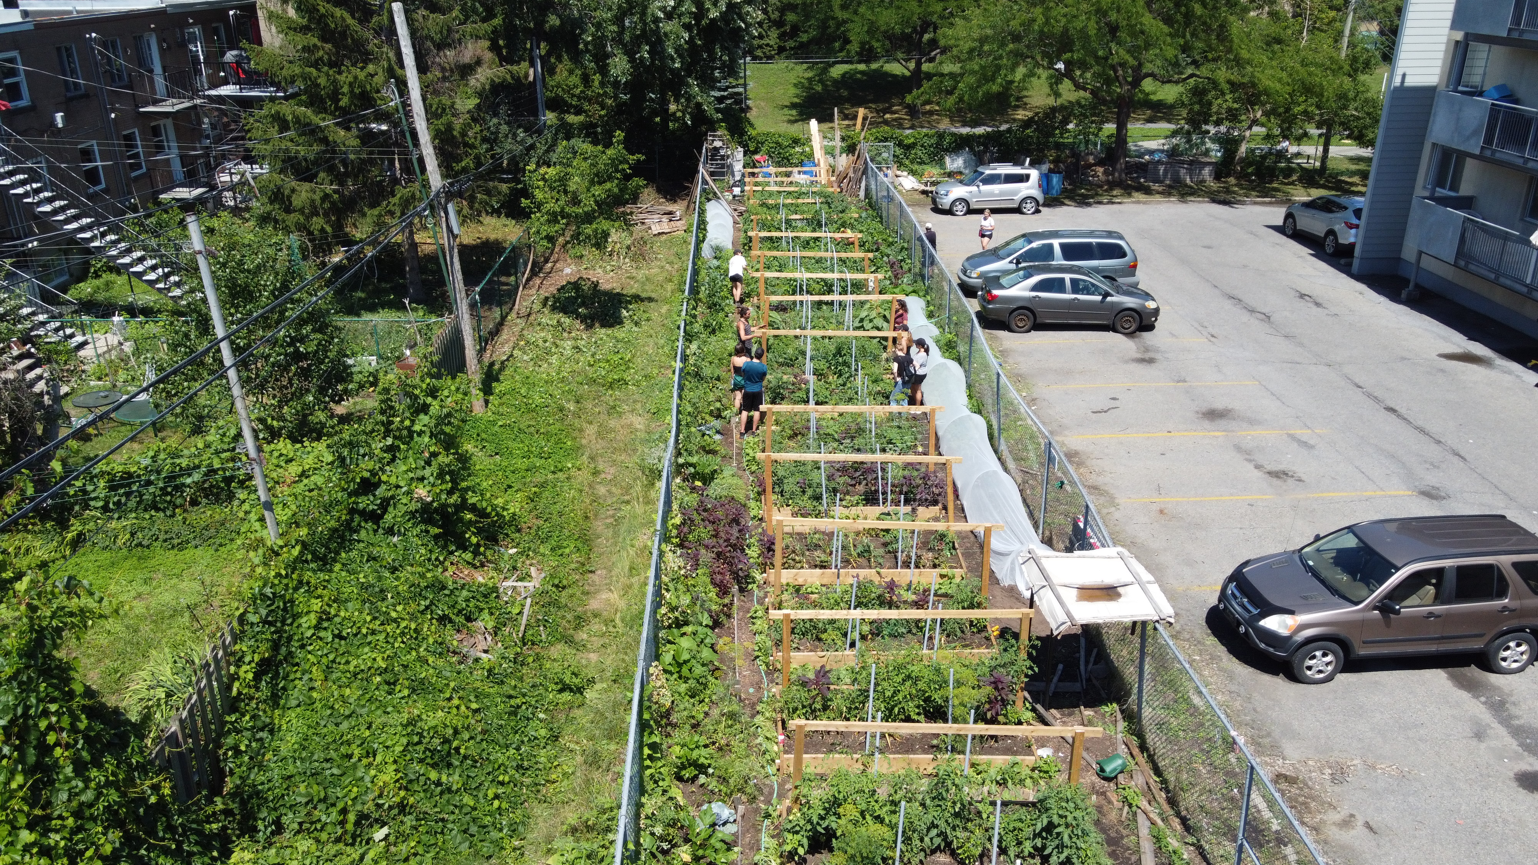

Slide 15
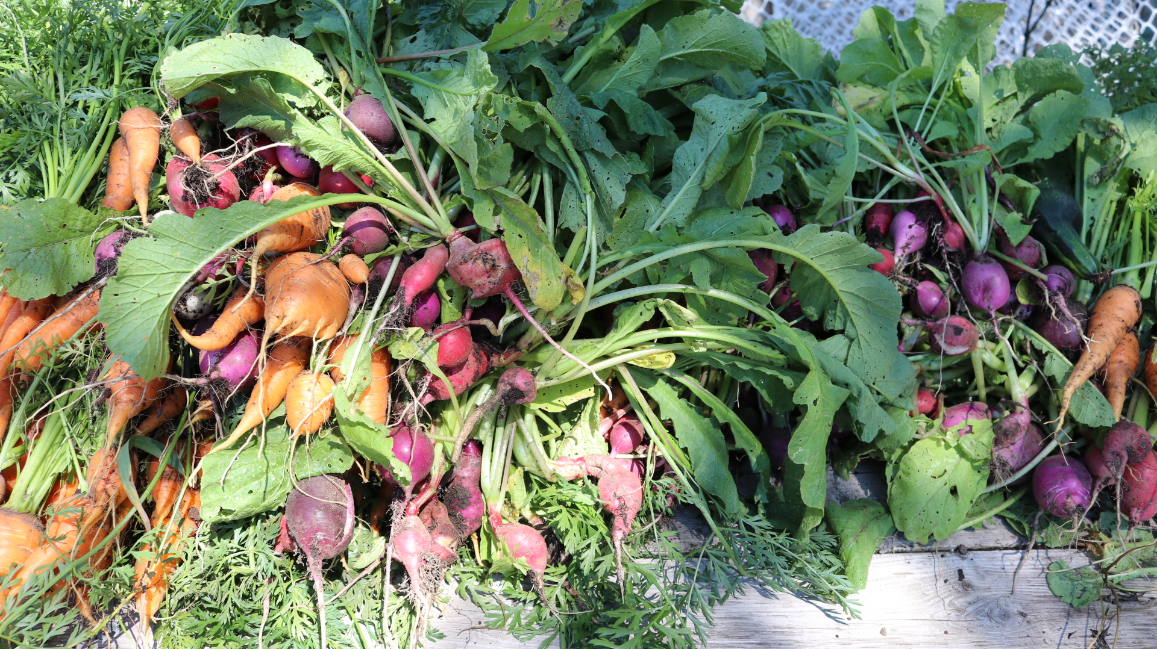

Slide 16
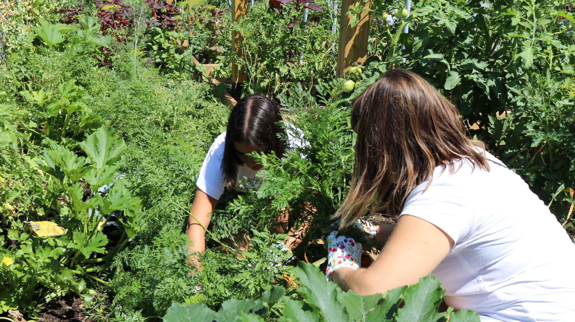

Slide 17
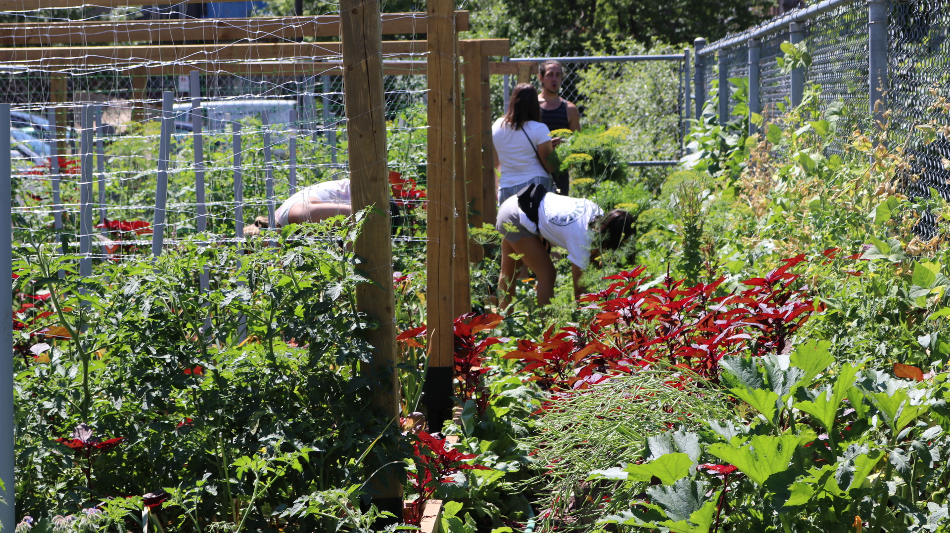

Slide 18
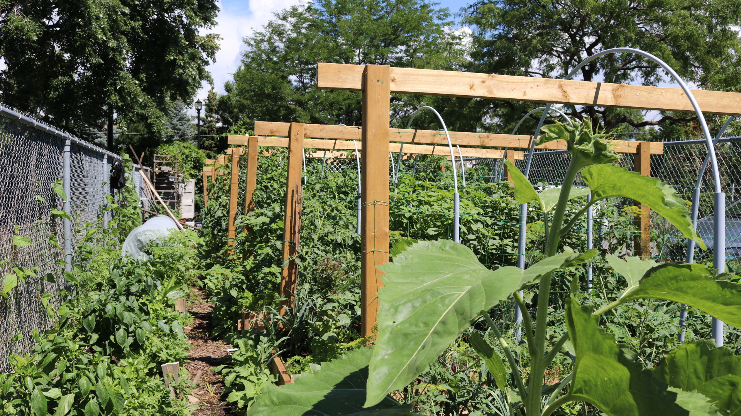

Slide 19
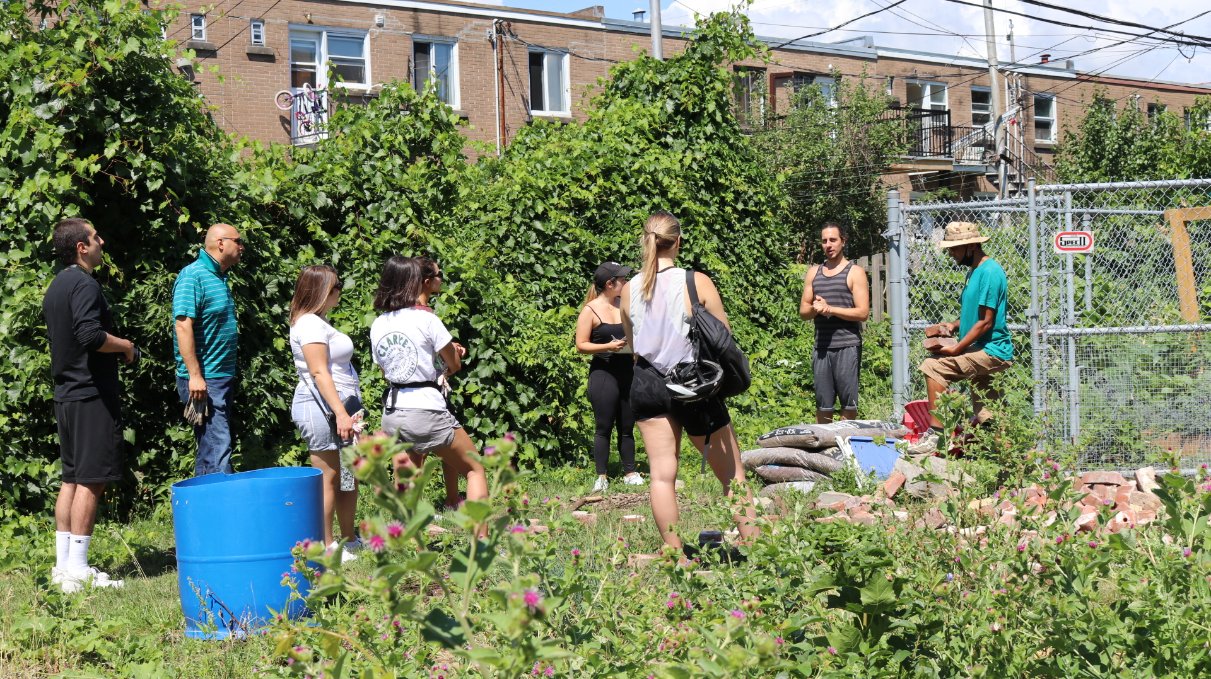

Slide 20
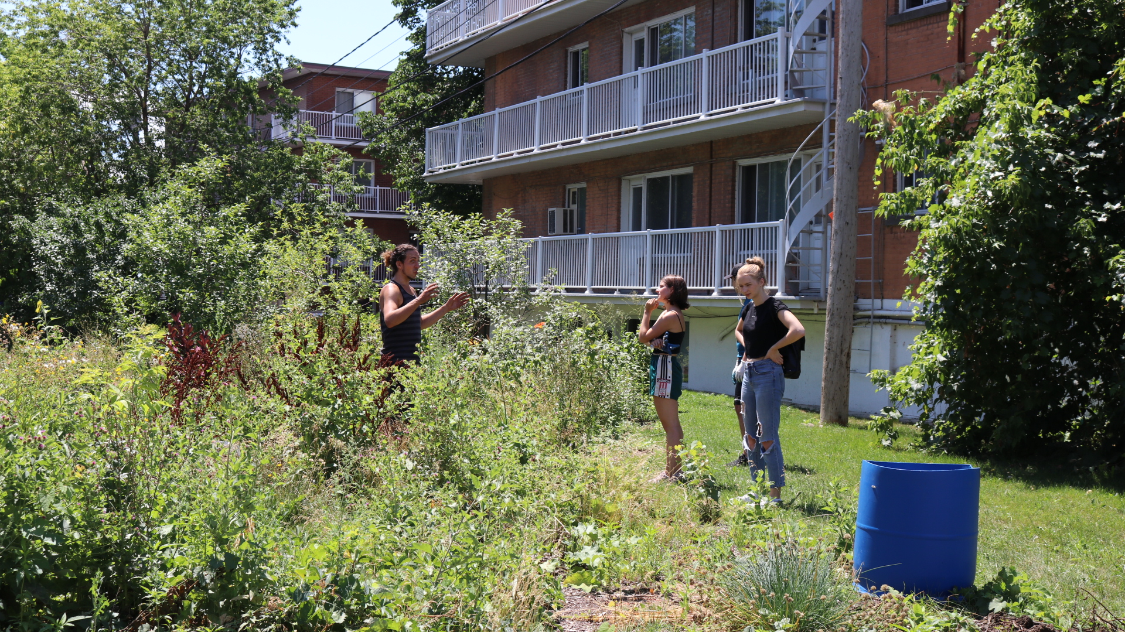

Slide 21
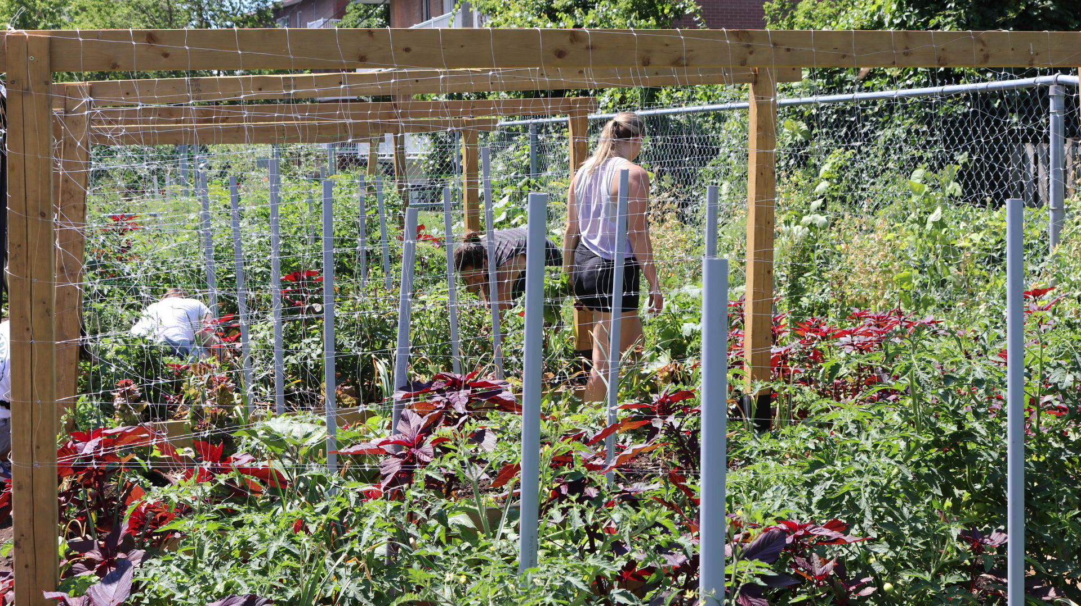

Slide 22
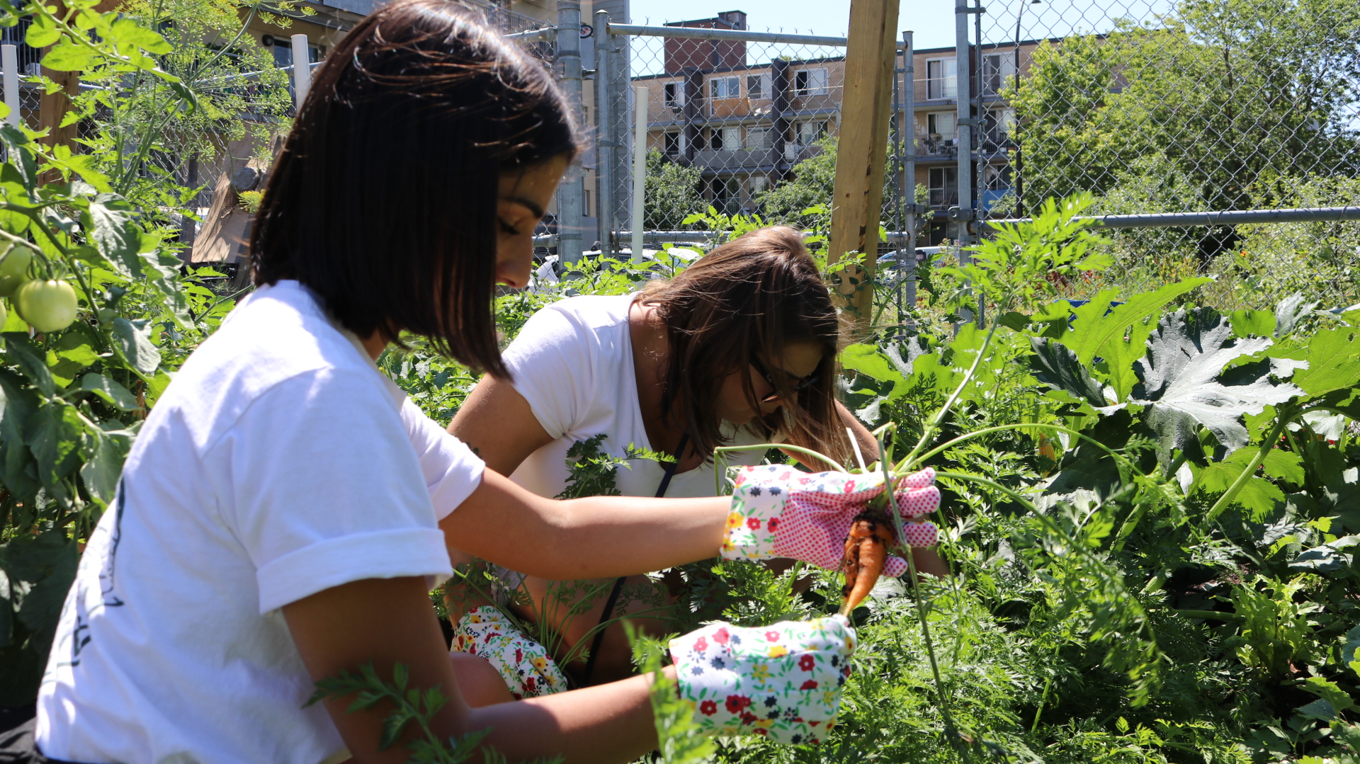

Slide 23
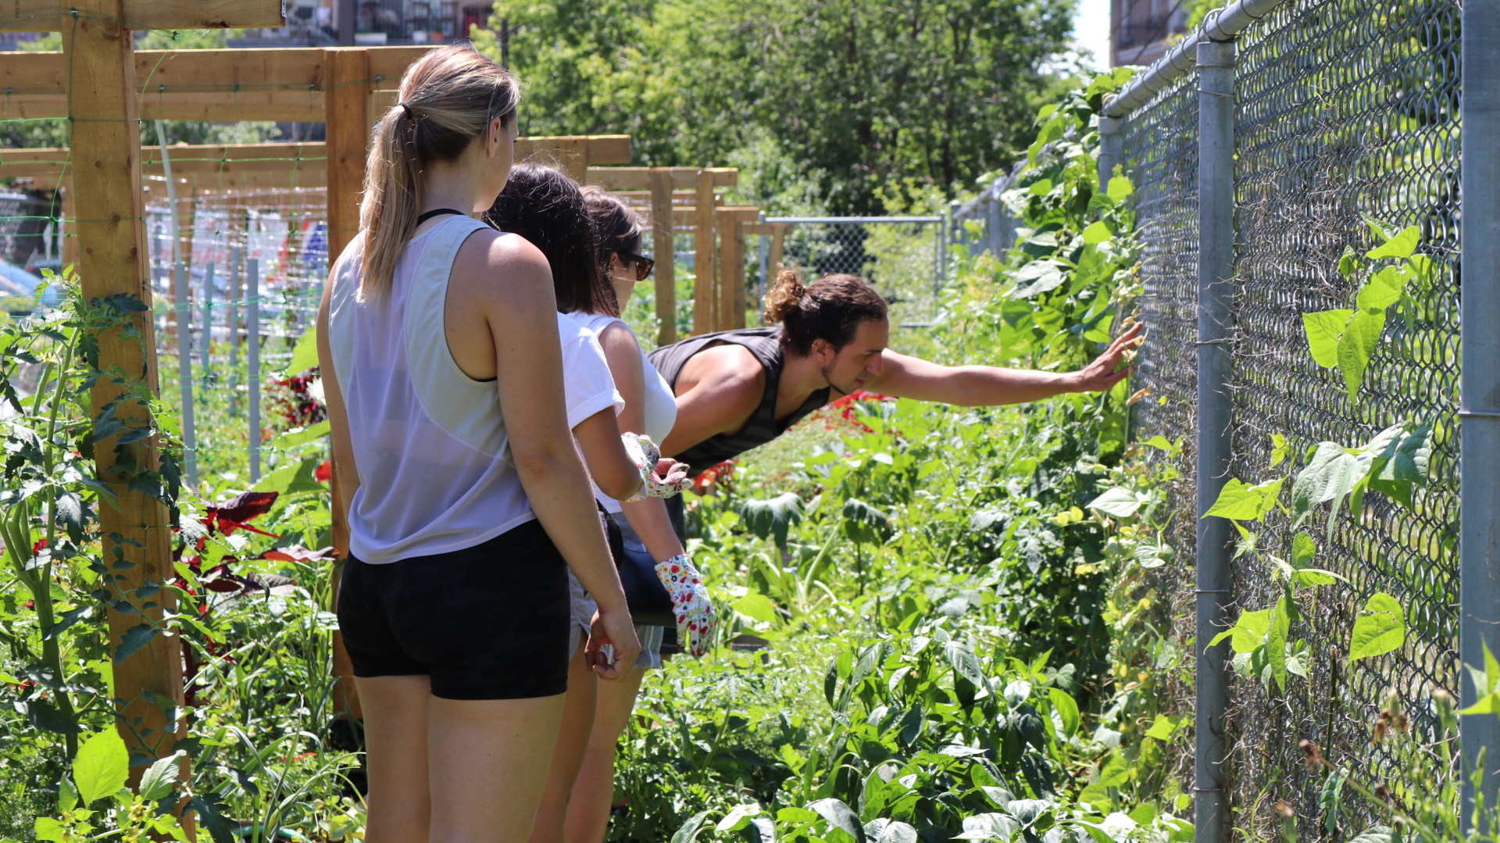

Slide 25
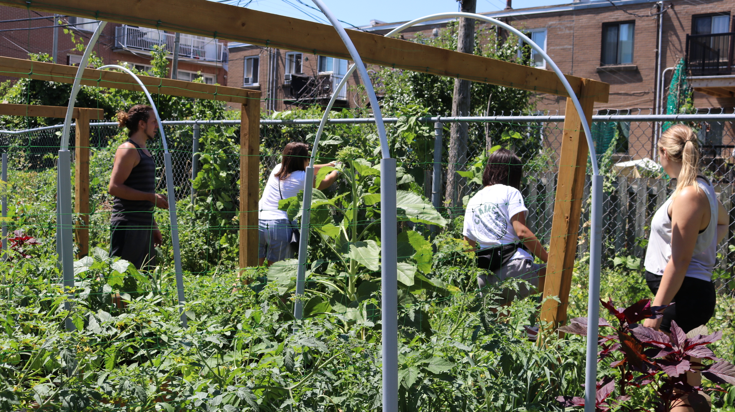

Slide 26
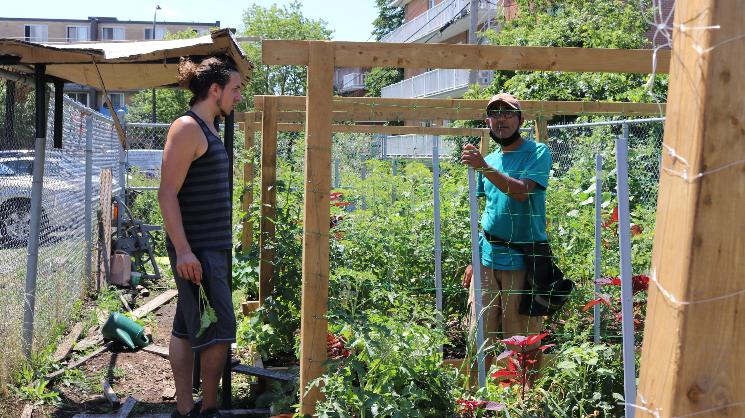

Slide 27
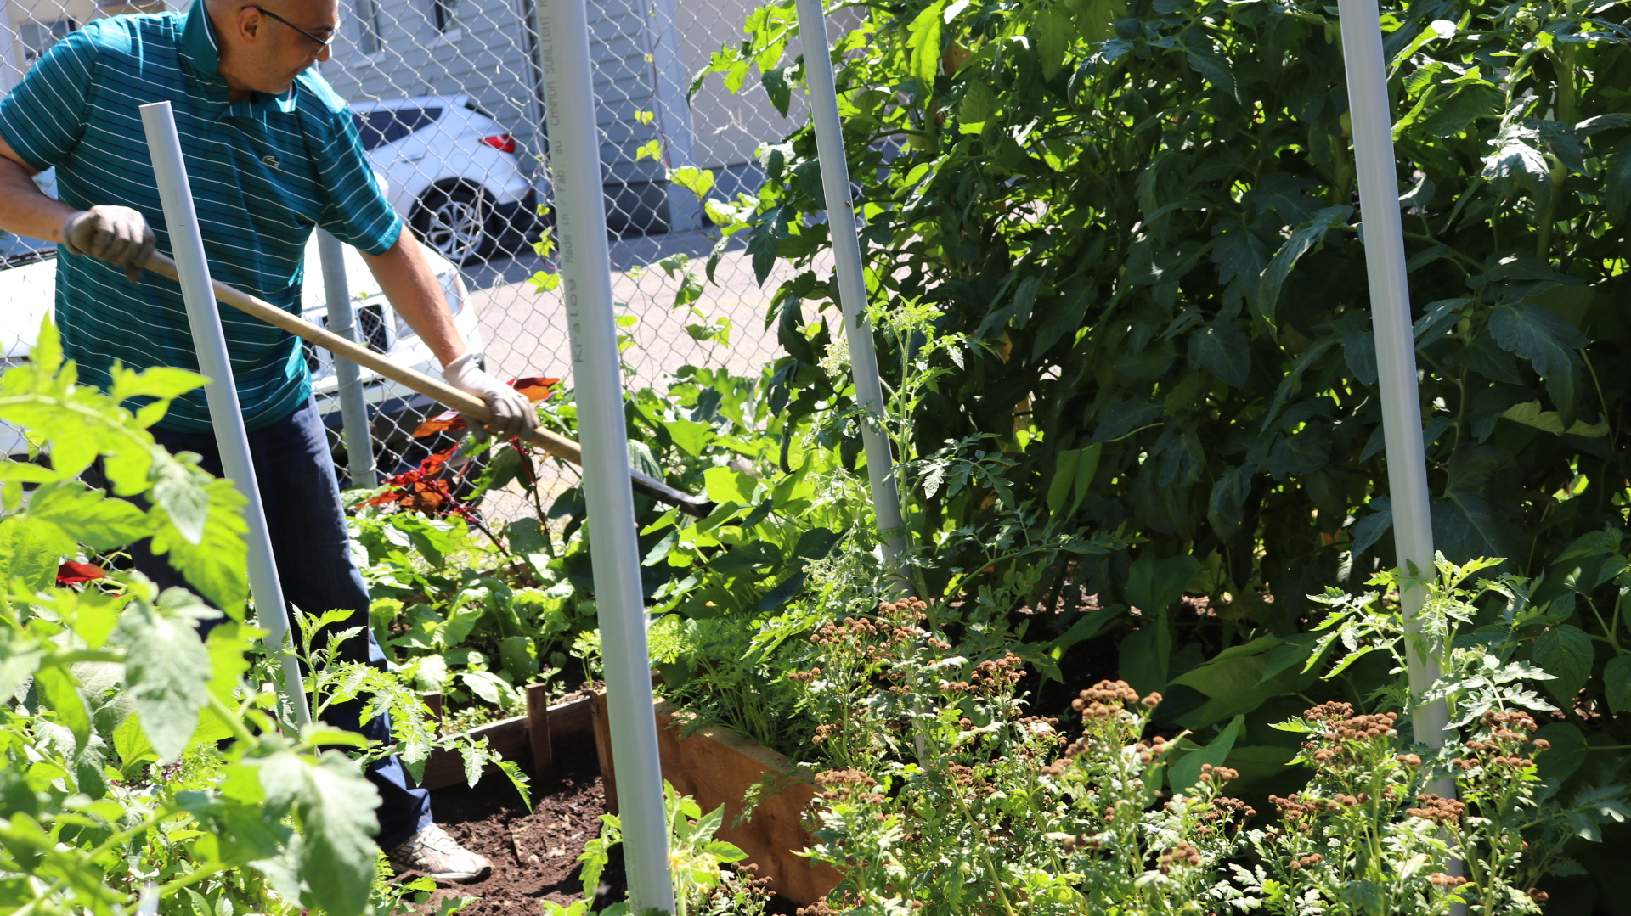

Slide 28
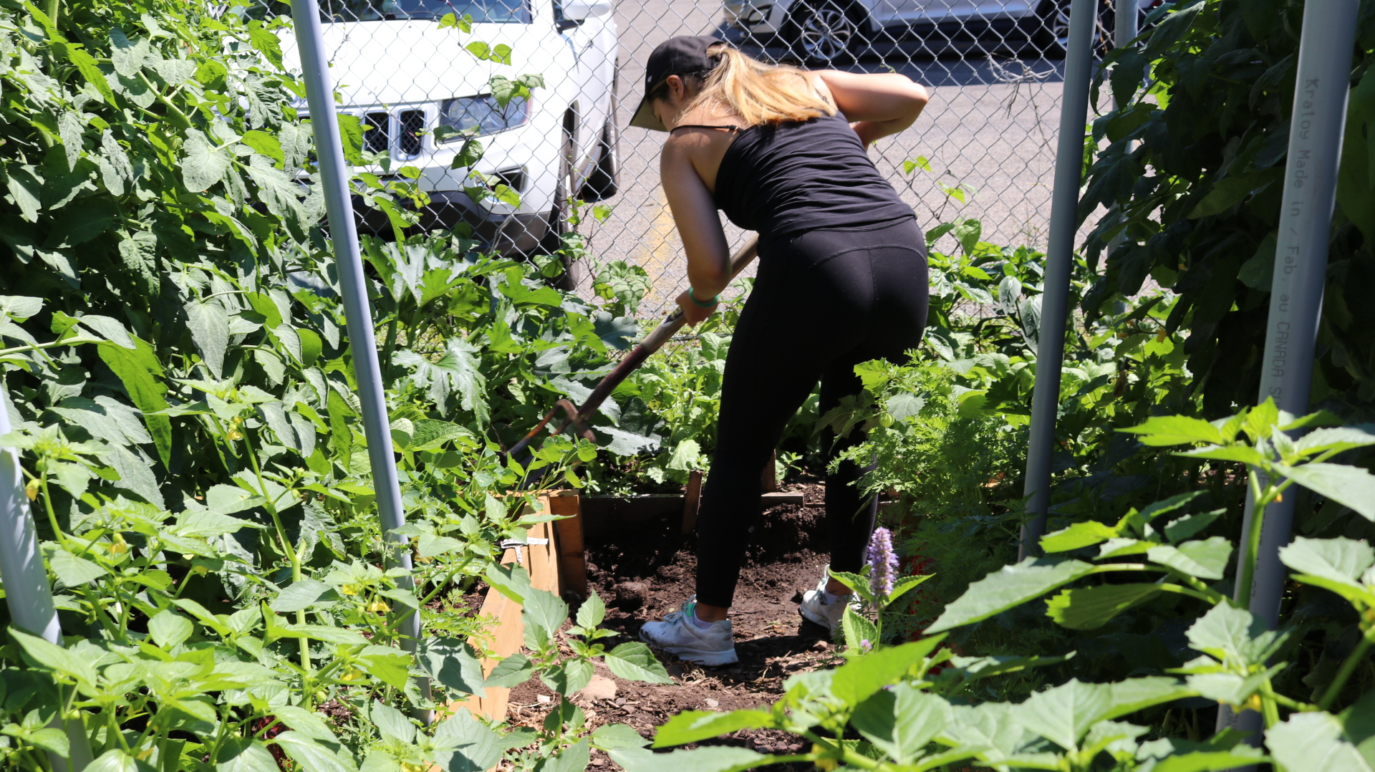

Slide 29
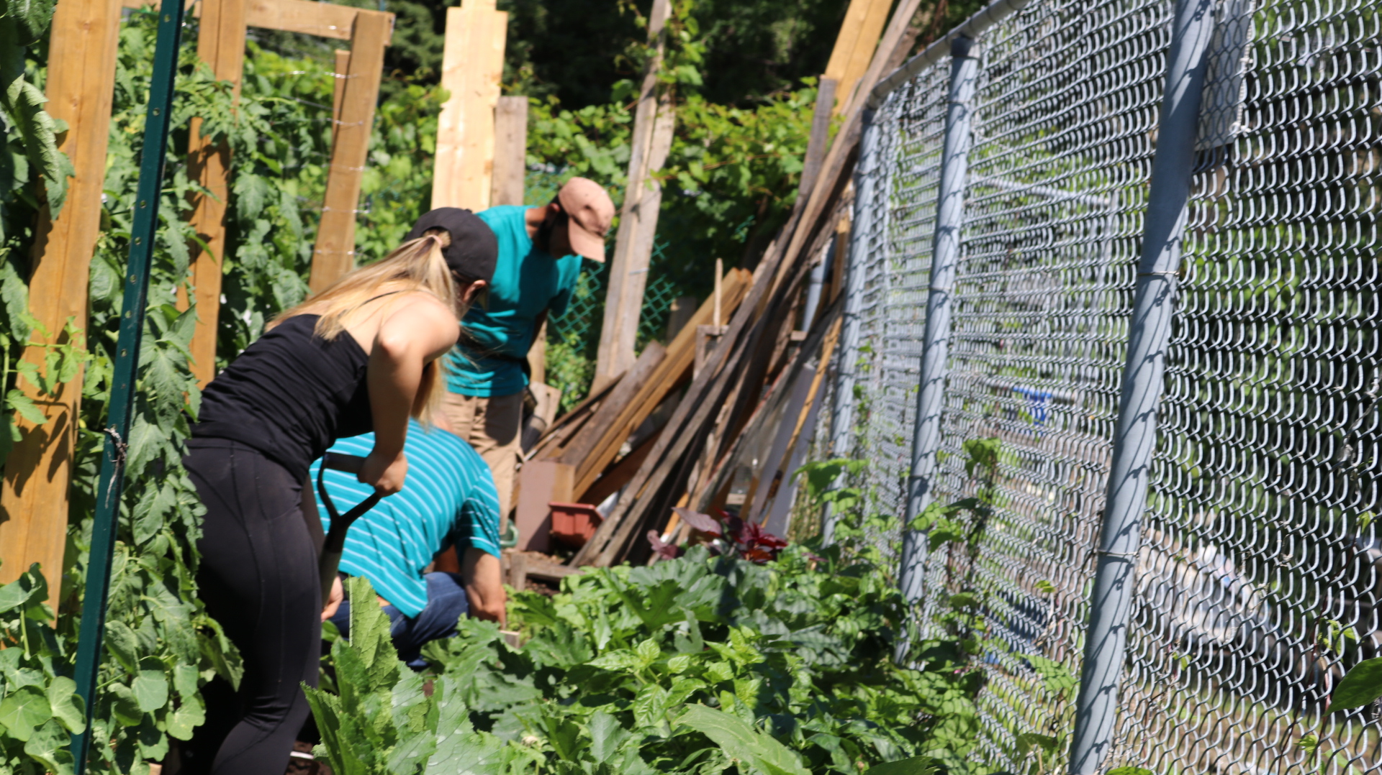

Slide 30
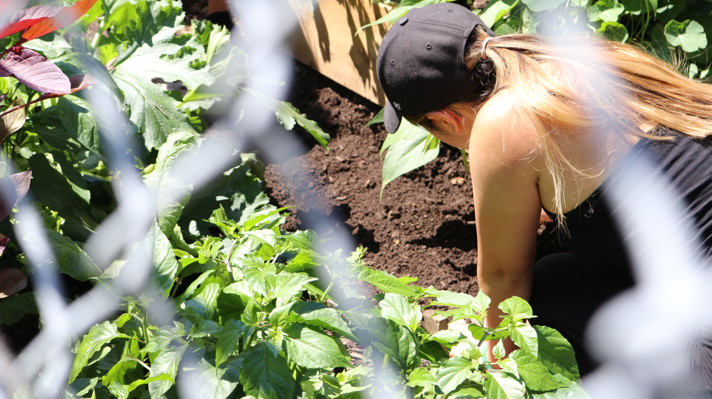

Slide 31
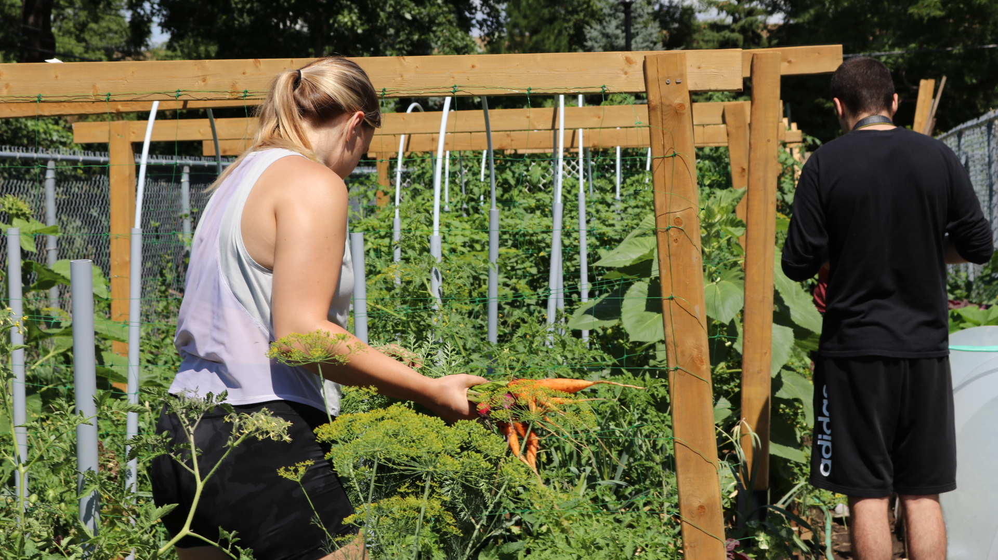

Slide 32
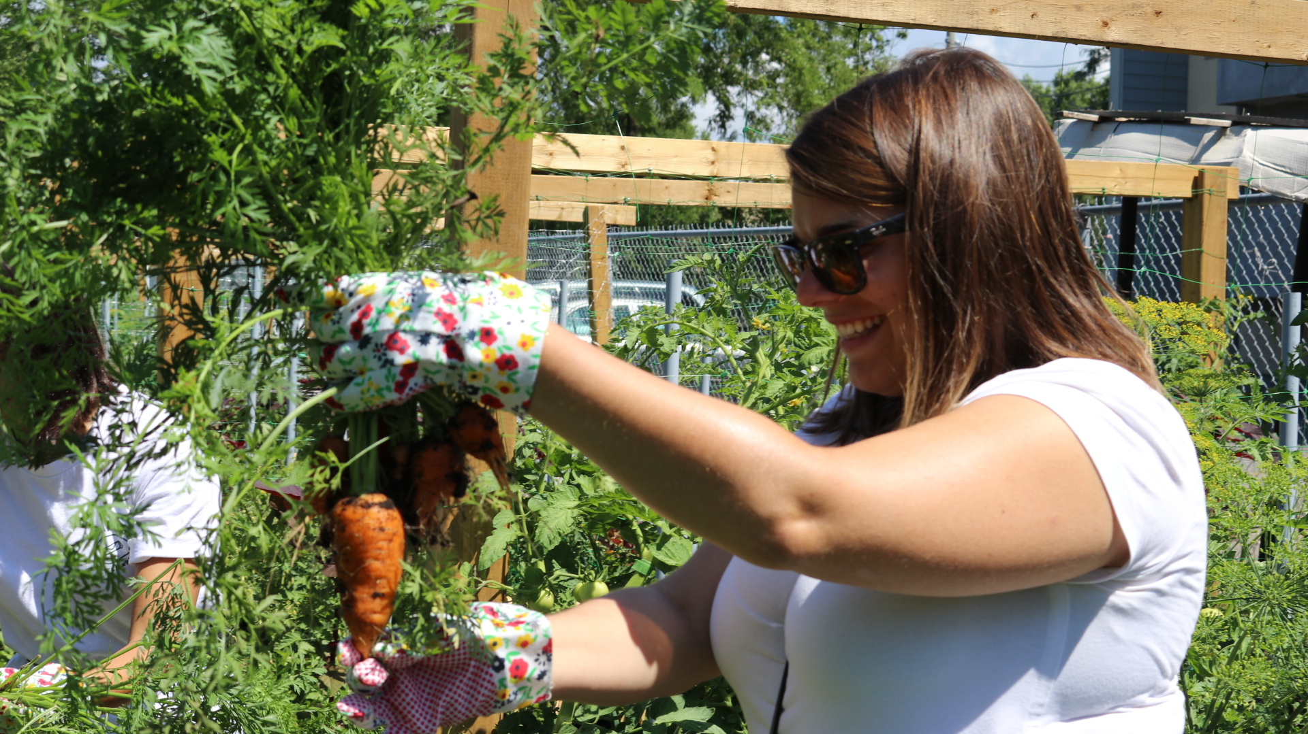

Slide 33
