Slide 1
Fundamentals of Social Psychology
Introduction to social psychology
September 15th, 2020
Erik Chevrier

Slide 2
What is Social Psychology?
Social psychology is the scientific study of the way which people’s thoughts, feelings, and behaviours are influenced by the real or imagined presence of other people. (Aronson, E. Wilson, T. D., Fehr, B, Akert, R. M., 2017)
Critical social psychology challenges social institutions, practices and power relations – including the discipline of psychology – that contribute to forms of inequality and oppression. (Gough, B., McFadden, M., McDonald, M., 2013)
Methodologies and assumptions:
Traditional social psychology – Empiricism, experiments, hypothesis testing, belief in objective reality, focus on the individual and individual difference, tries to explain human nature through social relations.
Critical social psychology – Action-based research, discourse analysis, adopts particular positions instead of embracing objectivity, reflexivity, individual embedded in social relations, linked to Marxist theories, linked to feminist theories.

Slide 3
Theories of Knowledge
Dominant social psychology approach:
Epistemology – A term meaning “theory of knowledge,” which gets at the how we know about the social world that lies behind all theoretical approaches. (Frampton, Kinsman, Thompson, Tileczek, (2006))
Empiricism
Critical psychology view:
Ontology – Assumptions relating to how the social comes into being that inform all theories and ways of writing the social. (Frampton, Kinsman, Thompson, Tileczek, (2006))
Shifting epistemology

Slide 4
What is Social Psychology?
Psychological social psychology (PSP) – The individual is at the center of the analysis
Sociological social psychology (SSP) – The social dimensions are at the center of the analysis

Slide 5
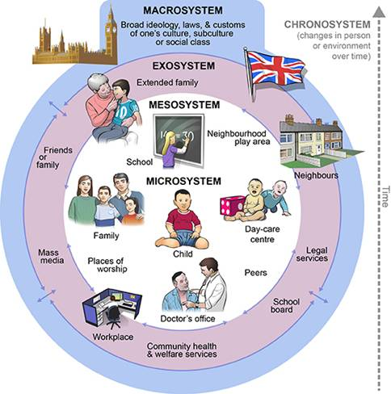
Ecological Systems Theory of Development

Slide 6
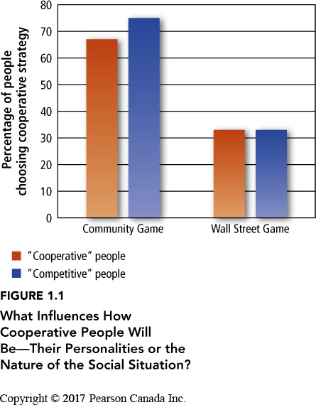
Cooperation vs Competition
Liberman, Samuels and Ross (2004)

Slide 7
Ecological Systems Theory of Development

Slide 8
Why Focus on Traditional Perspectives in Social Psychology?
Social psychologists have learned a great deal about social behaviour
Knowledge of social psychology can be practical for people in daily life and in their occupations
Social psychology can be used to have a positive impact on people’s lives
People are social animals, understanding social psychology can help people interact more effectively

Slide 9
Why Understand Critical Social Psychology?
Social psychology can be used to control people
Advertising
Political campaigns
Propaganda creation
Social psychology can be used to reinforce power relations
Evolutionary psychologists have reinforced negative views about women and LGTBTQ+ in society
Psychology as a field demonizes certain types of activities, like LGBTQ+ practices and non-capitalist activities
Psychology as a field is influenced by capitalist relations (publishing & research funding)
Methods in social psychology can be questioned
Can an experiment be ‘objective’ if it is interpreted by a subject?
The more we control experiments, the less it represents reality.
Samples matter – Psychology experiments are notorious for using student samples
Subjective experience matters too – Qualitative research is also important
The founder of social psychology Kurt Lewin is also the founder of action-based research
The world is in constant change (fluidity) and is interconnected

Slide 10
What is Social Psychology?
Aronson, Wilson, Fehr, Akert (2017)
The goal of social psychology is to identify universal properties of human nature that make everyone susceptible to social influence, regardless of social class or culture.
Social psychology – Level of analysis is the individual in the context of society.
Sociology – Is more concerned with broad societal factors that influence events in a society.
Personality psychologists – Focus on individual differences.
Behaviourism – A school of psychology maintaining that to understand human behaviour, you need to consider the reinforcing properties of the environment.
Gestalt psychology – A school of psychology stressing the importance of studying the subjective way in which an object appears in people’s minds, rather than the objective physical attributes of the object
Social cognition – How people think about themselves and the social world, more specifically, how people select, interpret, remember, and use social information. Cognitive approach to social psychology.
Gough, McFadden, McDonald (2013)
In striving to measure particular concrete aspects of social situations and individual responses to these, social psychological research manufacture and promote a de-socialized conception of the individual.
Culture is taken as accidental and local, while psychological processes are depicted as fixed and universal.

Slide 11
The Power of Social Interpretation
How do we understand social situations?
Construal – the way people perceive, comprehend, and interpret the social world.
Naïve Realism – the conviction that all of us perceive things ‘as they really are’.
Everyone can easily misperceive a situation
How can we determine what ‘folk-wisdom’ or ‘common sense’ explanations vs valid explanations of social behaviour?
Power of the situation
Oversimplification
Behaviourism cannot fully explain social behaviour because it is important to look at the situation from the viewpoint of the people in it, to see how they construe the world around them.
Gestalt approaches had a positive influence on social psychology.
The whole is different from the sum of parts.
Focus on the phenomenology of the perceiver.
Kurt Lewin, Kurt Kofka, Wolfgang Kohler, Max Wertheimer

Slide 12
The Power of the Situation
Fundamental attribution error – the tendency to explain people’s behaviour in terms of personality traits and to underestimate the power of the situation.
Example of fundamental attribution error = victim blaming
Gough, McFadden, McDonald (2013)
Social problems cannot only be explained by individual factors. Social and cultural factors must be taken into account.
Somewhat ironically for research on sexism, it is women who are held responsible for inequitable and seemingly unchangeable working practices.
According to a study by Jackson et al (1992): concluding that women have lower career expectations.
Women anticipate taking more time off work than men
They recognized the ‘reality’ of unequal pay and conditions more then men do
They perceive relatively low levels of pay as more fair than do men
They compare themselves more with other women than men
Concluding that women have lower career expectations

Slide 13
Where do Construals Come From
Two motives are important for the formation of construals:
The need to feel good about ourselves
The need to be accurate
Self esteem approach: we need to feel good about ourselves
Most people need to maintain reasonably high self-esteem (people’s evaluations of their own self worth)
Given the choice of distorting the world in order to feel good about themselves and representing the world accurately, people often take the first option.
Justifying past behaviour
Suffering and self-justification
Think of a time where you protected your self-esteem and maintained a ‘wrong’ position in order to feel good about yourself.

Slide 14
Where do Construals Come From
Two motives are important for the formation of construals:
The need to be right about ourselves
The need to be accurate
Social cognition approach: need to be accurate
Social cognition researchers begin with the assumption that people try to view the world as accurately as possible.
Self-fulfilling prophesies sometimes hinder our construal of a social situation
Think of a time you were ‘accurate’ but it affected your or someone else’s self-esteem.

Slide 15
Social Psychology and the Social Problem
Aronson, Wilson, Fehr, Akert (2017)
Most psychologists have another reason [not just understanding social influence] for studying causes of social behaviour, to contribute to the solution of the social problem.
Social psychologists have been interested in such social problems as the reduction of hostility, prejudice and increase in altruism generosity.
Gough, McFadden, McDonald (2013)
The critical spotlight cast on the institutional and disciplinary role of social psychology as bolstering existing inequalities of power by leaving them unexamined.
The social psychologist performs the role of social engineer helping to maintain the status quo by concentrating the gaze on individuals and not society.
Obsessive emphasis on quantified detail without context, on progressively finer and finer measurements of smaller and smaller problems, leaving us knowing more and more about less and less.

Slide 16
Some Considerations to Keep in Mind
Objectivity vs subjectivity
Parts vs whole
Representation vs reality
Process vs structure

Slide 17
Interesting Videos
MK Ultra Experiments
The Century of Self

Slide 18
Learning Check
What is a construal? Where do construals come from? What two motives guide construals?
What is social psychology? What is critical social psychology?
According to Liberman, Samuels and Ross (2004), what happens when a social situation is framed as cooperative or competitive? What happens with people who are considered more cooperative or more competitive in typical social situations?
What are variations of social psychology? What are related disciplines? Compare and contrast them.
Why focus on traditional methods in social psychology? Why study critical social psychology? According to Gough, McFadden, McDonald (2013), what are limitations to ‘traditional’ social psychology?
What is epistemology and ontology?
What is the fundamental attribution error? How does it apply to social situations?
Compare and contrast the views of social psychology and critical social psychology in response to addressing social issues.

