Slide 1
Fundamentals of Social Psychology
Conformity
Erik Chevrier
www.erikchevrier.ca

Slide 2
Conformity
A change in behaviour as a result of the real or imagined influence of other people
Can override survival behaviours
People are more influenceable than they believe
Produces positive and negative consequences
Informational Social Influence – Conforming because we believe that others’ interpretation of an ambiguous situation is more correct than ours and will help us choose an appropriate course of action.
Normative Social Influence – The influence of other people that leads us to conform in order to be liked and accepted by them; this type of conformity results in public compliance with the group’s beliefs and behaviours but not necessarily in private acceptance.
Public Compliance – Conforming to other people’s behaviour publicly, without necessarily believing in what they are doing or saying.
Private Acceptance – Conforming to other people’s behaviour out of a genuine belief that what they are doing or saying is right.

Slide 3
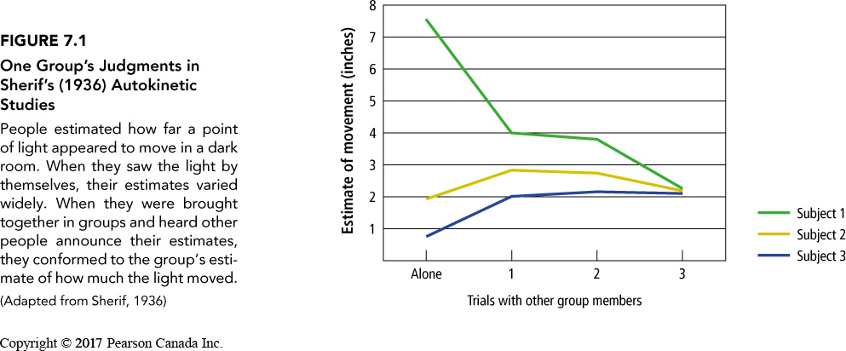
Informational Social Influence
Conforming because we believe that others’ interpretation of an ambiguous situation is more correct than ours and will help us choose an appropriate course of action.
Muzafer Sherif
Autokinetic Effect
Situations most likely to produce informational social influence
When the situation is ambiguous
When the situation is a crisis
Contagion – The rapid transmission of emotions or behaviour through a crowd
When other people are experts
Mass psychological illness – The occurrence of similar physical symptoms for which there is no known physical or medical cause in a group of people

Slide 4
Concerns With Informational Social Influence
Information shapes our social reality – we can be led astray
Informational social influence can ‘backfire’
War of the Worlds
Orson Wells Press Conference
Informational social influence can cause mass hysteria

Slide 5
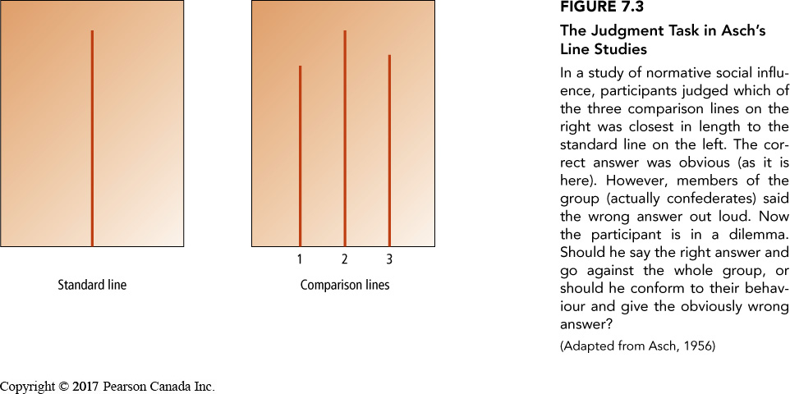
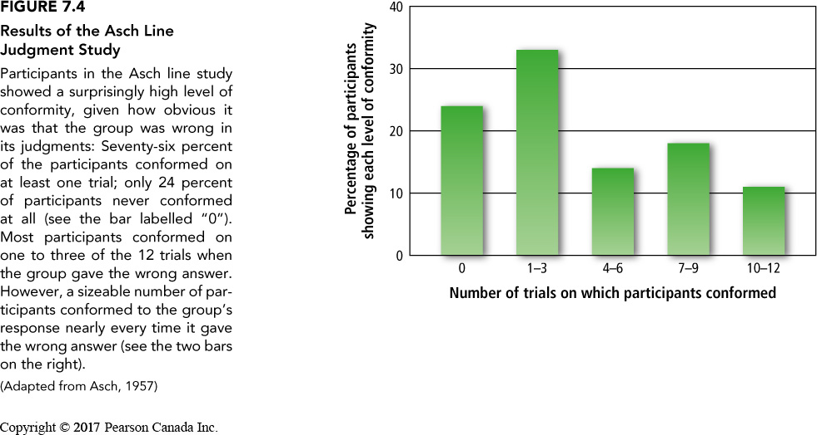
Normative Social Influence
The influence of other people that leads us to conform in order to be liked and accepted by them; this type of conformity results in public compliance with the group’s beliefs and behaviours but not necessarily in private acceptance.
Social Norms – The implicit or explicit rules a group has for the acceptable behaviours, values, and beliefs of its members.
Conformity and Social Approval
Solomon Asch – Conformity experiment
Conformity dropped when people were asked to write down response on piece of paper
It is possible to resist social influence
Be aware
Take action
Idiosyncrasy credits

Slide 6
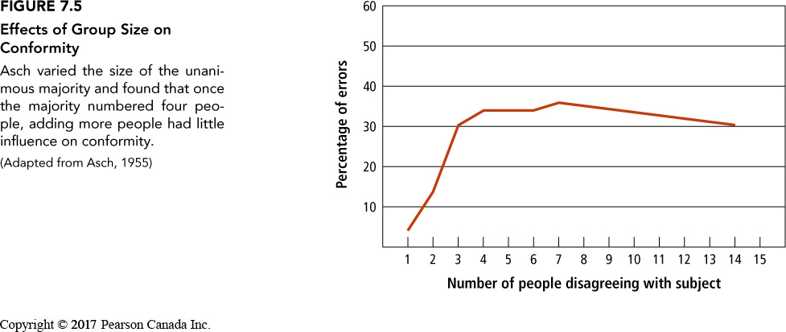
Social Impact Theory
The theory that conforming to social influence depends on the strength of the group, its immediacy, and the number of other people in the group.
The likelihood that you will respond to social influence from other people depends on three variables:
Strength – How important is the group to you? Immediacy – How close is the group to you in space and time during the influence attempt? Number – How many people are in the group?
Conformity will increase as strength and immediacy increases
Group size matters – conformity increases until about 5 – 7 people then gradually reduces
Unanimous decisions are more influential
Dissent from someone else helps people resist influence
Slight gender differences – can be attributed to social norms about gender
Uncertainty leads to more conformity
Fear of rejection can lead to more conformity
Culture affects how people value and succumb to social influence

Slide 7
Minority Influence
The case in which a minority of group members influences the behaviour or beliefs of the majority
Key is consistency over time and between ‘minority’ group members
Minorities influence people through informational social influence
Public compliance and private acceptance

Slide 8
Compliance
A change in behaviour in response to a direct request from another person
Door-in-the-face technique – A technique to get people to comply with a request whereby people are presented first with a large request, which they are expected to refuse, and then with a similar, more reasonable request, to which it is hoped they will accept
Reciprocity norm – a social norm by which the receipt of something positive from another person requires you to reciprocate, ort behave similarly, in response
Foot-in-the door technique – A technique to get people to comply with a request, whereby people are presented first with a small request, to which they are expected to acquiesce, followed by a larger request, to which it is hoped they will also acquiesce.
Change in self-perception – People are influenced by their behaviour and adopt values about ‘helping others’
Lowballing – An unscrupulous strategy whereby a salesperson induces a customer to agree to purchase a product at a very low cost, and then subsequently raises the price; frequently, the customer will still make the purchase at the inflated price.
Illusion of irreversibility
Anticipation of event
Convenience of completing the transaction rather than starting over somewhere else
Strategic Self-anticonformity (aka. reverse psychology)
To elicit reaffirming messages
To elicit attitudinal or behavioural compliance from another person

Slide 9
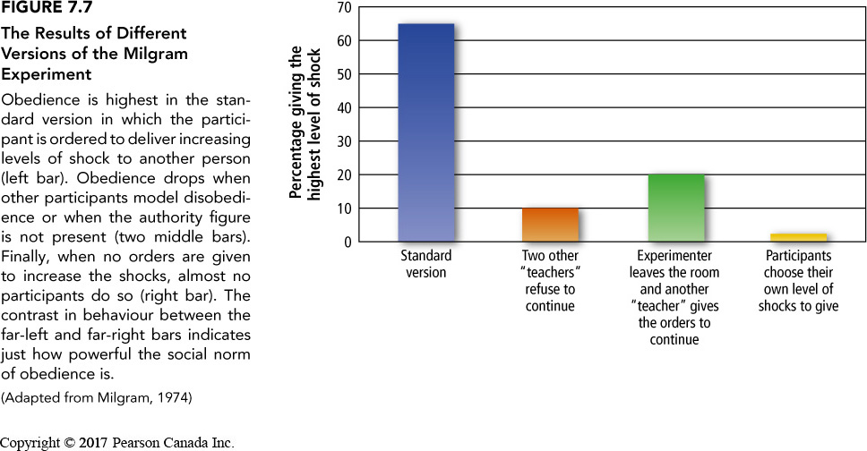
Obedience
Conformity in response to the commands of an authority figure
Stanley Milgram Shock Experiment
Short Video
Normative social influence
Informational social influence
Importance of expertise

Slide 10
Why We Obey
Automatic processing – not paying attention
Self-Justification
Not about aggression
People can resist influence

Slide 11
The Psychology of Influence
Robert Cialdini
Six weapons of influence
1 – Reciprocation
2 – Commitment and consistency
3 – Social proof
4 – Liking
5 – Authority
6 – Scarcity

Slide 12
The Power of Suggestion
An Inquiry Into How People Are Affected by Profuse Amounts of Publicity: A Multidisciplinary Approach
Advertising as a suggestion – Page 26
Suggestions can bypass critical thought because there is no direct request to refuse

Slide 13
A Critical Look at Social Influence
Critical look at (behaviour = sum of individual + the situation)
Experiments do not account for political and social norms
Experiments can reveal overarching power relations in society
Experiments don’t always replicate cross culturally
We must also take into consideration culture, time, place and prevailing normative beliefs
We must take into consideration institutions
Reflexive nature of social norms

Slide 14
Learning Check
What is conformity, obedience, and compliance?
What is private acceptance and public compliance?
What is informational social influence? What factors contribute to informational social influence?
What is normative social influence? What factors contribute to normative social influence?
What does the Asch line experiment reveal?
What is a contagion and mass psychogenic illness? How do they manifest?
What are differences in social influence? i.e. gender? Culture? Other variables?
What are consequences of normative social influence?
What is minority social influence? How does it work?
What are different compliance techniques? How do they work?
What is strategic self-anticonformity? How is it used?
What does Milgram’s experiments reveal?
What are reasons people obey?

Slide 15
Questions or Concerns?
Have a great day!

