Slide 1
Fundamentals of Social Psychology
Interpersonal Attraction
Erik Chevrier
www.erikchevrier.ca

Slide 2
What Causes Attraction?
Making and maintaining friendships, and having positive warn relationships lead to happiness.
Relatedness is a psychological need.
Absence of meaningful relationships with others makes people feel lonely, worthless, hopeless, helpless, powerless, and alienated.
A central human motivation is “self-expansion” – a desire to overlap or blend with another person, so that you have access to the person’s knowledge, insights, and experiences that broaden and deepen our own experiences in life.

Slide 3
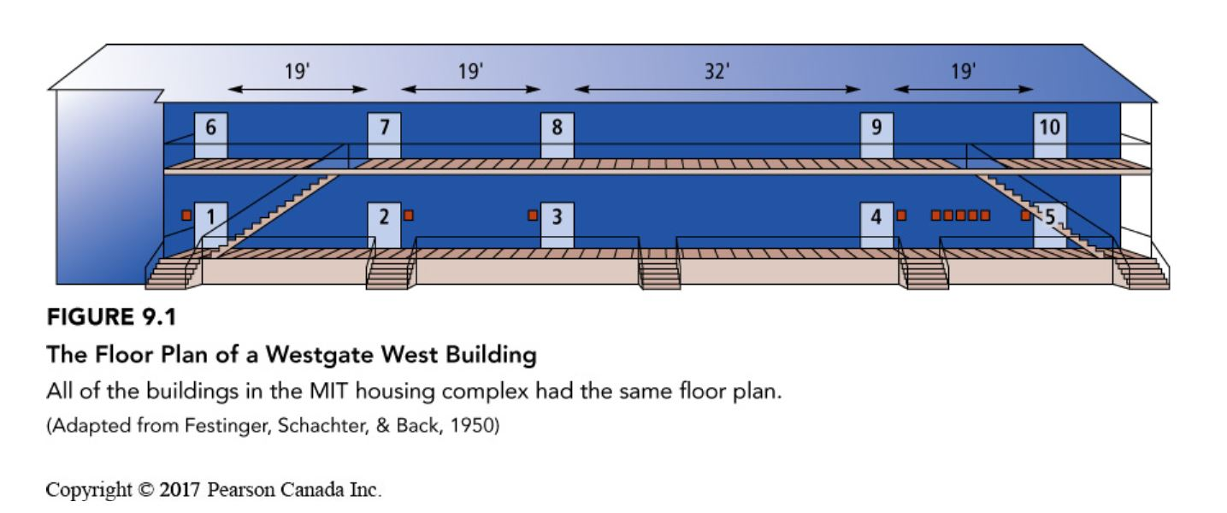
What Causes Attraction?
Propinquity Effect – The finding that the more we see and interact with people, the more likely they are to become our friends.
Mere Exposure Effect – The more exposure we have to a stimulus, the more apt we are to like it.
Forming Relationships Online –
‘rich get richer’
social compensation hypothesis
65% mentioned someone who lived in the same building
41% next door
22% two doors down
10% end of hall
Functional distance a factor too

Slide 4
What Causes Attraction?
Similarity:
We are attracted to people who are similar to us.
Values, attitudes, personalities (in mutual friendships), attachment style, leisure activities, interpersonal style and communication skills.
Stronger in individualist cultures.
Why?
We think similar people will be inclined to like us.
People who are similar to us provide social validation.
Rewards-of-interaction – we like to be around people we agree with (i.e. echo chambers).
Attraction can lead to perceptions of similarity too, although perceptions are not always accurate.
Complementarity – attraction to people who are opposite to us – is not well supported.

Slide 5
What Causes Attraction?
Reciprocal liking – When you like someone, and that person likes you.
Physical attractiveness and liking – we like people who we are physically attracted to.
Effects occur automatically and are controlled.
Physical attractiveness is a strong predictor of liking.
Strong agreement (even culturally) on what constitutes an attractive face.
We make positive assumptions about people we find attractive.
Attractiveness more important in individualistic cultures.
Media plays a (reflexive) role on what is considered attractive culturally – i.e. media reflects and creates culture.
Attraction and the Misattribution of Arousal – When someone makes a mistaken inference about what is causing them to feel the way they do.

Slide 6
Forming Close Relationships
Companionate Love – feelings of intimacy and affection we feel towards someone with whom our lives are deeply intertwined.
Passionate Love – involves an intense longing for another person.
Gender differences?
Men fall in love faster and report more romantic beliefs and rate passionate/romantic love more than women
Women report more companionate views towards love
Differences are not all that meaningful
Culture and Love
Collective societies – passionate love less important
Take into consideration families and friends in defining love
Love defined more by partner satisfaction
Individualist societies – passionate love more important
Critique
LGBTQ+ issues left out of textbook
Gender and sex are different constructs according to disciplines outside of psychology – gender refers to cultural generalizations of sex roles and performed behaviour, while sex refers to biological traits.

Slide 7
Boyd, D., Johnson, P., Bee, H. (2015) Lifespan Development, Fifth Canadian Edition, Pearson, Toronto

Slide 8
Why do we Love?
Evolutionary theories:
‘Fitness’ – reproductive success.
Mate selection different for men and women
Women = High cost – more careful selection (ambition, industriousness, earning potential)
Men = Low cost – less selective (attractiveness, fertility, youthfulness)
Critiques:
Evolutionary theories are untestable - they give a good story to data.
Evolutionary research can perpetuate and/or legitimize problematic behaviour towards women
Media reflects and influences how we understand cultural norms and social roles
Social status of men and women are still not ‘equitable’, these studies can be explained by lack of equity
LGBTQ+ perspectives not considered

Slide 9
Attachment Styles
Attachment Theory:
The theory that our behaviour in adult relationships is based on our experiences as infants with our parents or caregivers.
People with different attachment styles use different coping mechanisms with conflict
Critique:
We can have different kinds of attachment with different people
Can be best conceptualized as schemas
People can learn healthier ways to relate to others
Secure attachment
An attachment style characterized by trust, lack of concern with being abandoned, and the view that one is worthy of love.
Task oriented conflict resolution style
Avoidant attachment
An attachment style characterized by a suppression of attachment needs because attempts to be intimate have been rebuffed; people with this style find it difficult to develop intimate relationships.
Use passive aggressive conflict resolution styles
Fearful – A type of avoidant attachment in which close relationships are avoided because of mistrust and fears of being hurt.
Dismissive avoidant – A type of attachment in which the person is self-sufficient and clams not to need close relationships.
Anxious/ambivalent attachment
An attachment style characterized by a concern that others will not reciprocate, resulting in higher-than-average anxiety.
Use passive, emotion-focused conflict resolution strategies that focus on relationship distress

Slide 10
Maintaining Close Relationships
Social exchange theory – the theory that how people feel about a relationship depends on their perceptions of the rewards and costs of the relationship, the kind of relationship they deserve, and the probability that they could have a better relationship with someone else.
Reward/cost ratio – the notion that there is a balance between the rewards that come from the relationship and the personal cost of maintaining the relationship; if the ratio is not favourable, the result is the dissatisfaction with the relationship.
Comparison level – people’s expectations about the level of rewards and costs that they deserve.
Comparison level for alternatives – people’s expectation about the level of rewards and costs they would receive in an alternative relationship.
Investment Model – the theory that people’s commitment to a relationship depends on their satisfaction with the relationship in terms of rewards, costs, and comparison level for alternatives; and how much they have invested (tangible & intangible) in the relationship that would be lost if they leave it (see next slide).

Slide 11
Investment Model of Commitment

Slide 12
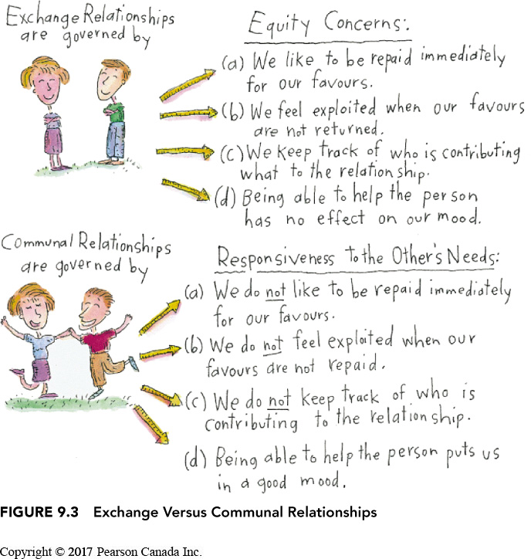
Equity Theory
Equity theory – the theory that people are happiest with relationships in which the rewards and costs that a person experiences and the contributions that they make to the relationship are roughly equal to the rewards, costs, and contributions of the other person.
Exchange relationships – relationships governed by the need for equity.
Communal relationships – relationships in which people’s primary concern is being responsive to the other person’s needs.

Slide 13
Maintaining Close Relationships
Role of commitment:
People who report low commitment also report more attraction to ‘alternatives’
People who report high commitment engage in ‘relation maintenance efforts’ and report less attraction to ‘alternatives’
People who report high commitment are more likely to forgive transgressions
Relationship identification relates to commitment
Relationship commitment can be primed
Positive illusions (idealization of our romantic relationships and partners in order to maintain that relationship) – we maintain our relationship by finding redeeming features in our partner.
The more partners idealize each other, the more satisfying the relationship
Self-fulfilling prophecy
Sex differences?
Men less likely to express commitment to current partner
Women hold more positive illusions about their partner

Slide 14
Ending Close Relationships
Why we end relationships:
No longer present
Dissimilarity
Fatal attraction – qualities that were attractive are no longer attractive (better alternatives)
Social exchange – rewards are low
Equity – Inequitable relations
Boredom
Breaking up
Harder for the person who was ‘dumped’ – especially if their commitment level was high
Instigator can feel guilt or unhappiness
Less hard if there are interesting alternatives
People often use passive avoidance strategies
Four strategies:
Withdrawal/avoidance, positive tone, manipulation strategies, open confrontation.

Slide 15
Learning Check
What causes attraction?
What is the propinquity effect?
What is the mere exposure effect?
What is the rich get richer and social compensation hypothesis?
Why does similarity cause attraction?
What is reciprocal liking? Why is this important?
What does physical attraction have to do with liking someone? Why is this important?
What does the misattribution of arousal have to do with liking?
How do we form close relationships?
What is companionate and passionate love?
What are the components of Steinberg's theory of love? What is fatuous love? What is companionate love? What is romantic love? What is consummate love?
Why do we love? What are evolutionary theories of love? What are some critiques of evolutionary theories of love?
What are the three main attachment styles? What do attachment styles say about forming adult relationships? How do we develop attachment styles? What are the two forms of avoidant attachment styles?
How do we maintain close relationships?
What is the investment model of commitment?
What is equity theory? What is a communal and exchange relationship?
What is the role of commitment in maintaining close relationships?
How do we end close relationships? With lovers? With friends?

Slide 16
Questions or Concerns?
Have a great day!

