Slide 1
Fundamentals of Social Psychology
Prejudice and racism
Erik Chevrier
www.erikchevrier.ca

Slide 2
Ecological Systems Theory of Development

Slide 3
Defining Racism (Headley, 2006)
According to Headley (2006) racism has been a difficult concept to define because disagreements have occurred over:
What is racist?
The definition of racism itself
People have used the word differently over time, within a culture, between different ethnic groups, and across cultures.
According to Bartz (2018) race refers to: a socially constructed category of people who share biologically transmitted traits that members of a society considers important.
According to Bartz (2018) ethnicity refers to: a shared cultural heritage.

Slide 4
Definitions of Racism (Unzueta, Lowery, 2008)
Racism is defined as an individual and institutional conception.
As an individual conception racism:
Racism suggests that only radical minorities unlucky enough to encounter bigots are affected by racism.
Solution to racism is therefore, identify and educate racists
From this perspective, individuals are only implicated in the problem if they harbor or act upon thoughts of racism
As an institutional conception:
Racism is propagated by institutional practices and policies that produce disparate outcomes for different racialized groups.
From this perspective, all people are affected by racism – some are advantaged while others are disadvantaged.

Slide 5
Definitions of Racism (Bartz, 2018)
Terms to consider:
Privilege – Those who benefit from racism and enjoy privilege simply because of their position in society and the power that is bestowed to that position.
i.e. white privilege, economic privilege, etc.
Micro-Aggressions – Brief, everyday exchanges that send discriminating messages to an individual because they belong to a racial minority.
Micro-assaults – are verbal and non-verbal explicit racially derogatory behaviours based on explicit bias purposefully intended to prompt negative feelings in those at whom they are aimed.
Aware and deliberate.
Micro-insults – are indirect verbal and non-verbal actions based on implicit bias that communicate stereotypical beliefs.
Senders are not aware they are being racist
Micro-invalidations – are communications that exclude, negate, or nullify the thoughts, feelings or experiential reality of a radical-ethnic minority individual.
Aware and deliberate
Environmental micro-aggressions – are widespread insensitive symbols, like mascots, as well as white people occupying a majority of the country’s powerful and honorable positions.

Slide 6
Definitions of Racism (Paradies, 2006)
Racism can be thought of as many types of oppression which, along with its dialectical opposite, privilege, can be based on a range of social characteristics, including gender (sexism), sexuality (heterosexism), physical and mental able-ness (ableism), age (ageism), class (classism), nationality, body size/shape, criminality, religion, language/accent among others.
Privilege/oppression can be defined as: A societal system which actors are divided along socially constructed dimensions with power unevenly distributed.
Privilege/oppression and racism can vary in terms of power:
Absolute
Relative

Slide 7
Prejudice
A hostile or negative attitude toward people in a distinguishable group based solely on their membership in that group.
Affective component
Involves positive or negative affect
Cognitive Component – Stereotype
Behavioural Component – Discrimination
Attitude – evaluations of people, objects or ideas.

Slide 8
Cognitive Component
Stereotype – A generalization about a group of people in which identical characteristics are assigned to virtually all members of the group, regardless of actual variation among the members
Resistant to change
Stereotyping does not necessarily lead to negative or harmful behaviours
Traits or characteristics of a group that people are most likely to talk about are traits that become part of the stereotype of the group – ‘gossip value’

Slide 9
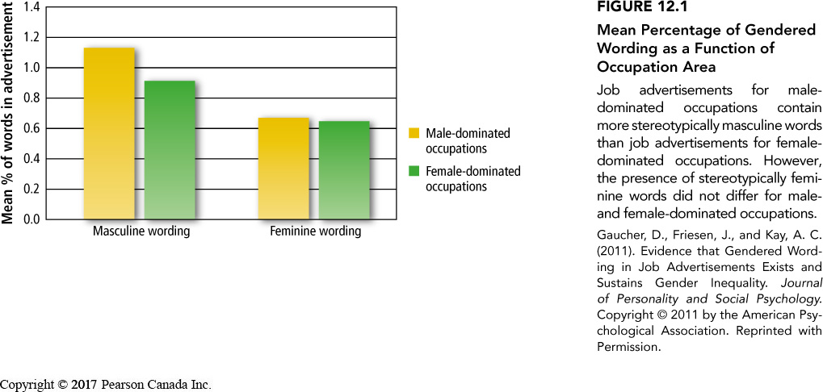
Stereotypes of Gender
Two forms of sexism:
Hostile sexism – hold negative stereotypes of women
Benevolent sexism – hold positive stereotypes of women
Have you experienced any of these forms of sexism?
Gender based stereotypes are established at an early age

Slide 10
Discrimination: Behavioural Component
Discrimination – Unjustified negative or harmful action towards a member of a group simply because of his or her membership in that group
Examples: Housing, schools, court rooms, body type, sexual orientation, etc.

Slide 11
Implicit Racism
Modern racism – Outwardly acting unprejudiced while inwardly maintaining prejudice attitudes
Racist attitudes may surface if someone feels ‘safe’, are intoxicated or stressed
Modern racism scale – measures subtle racism
i.e. minorities are getting too demanding in their push for special rights
Modern homonegativity scale
Modern Prejudiced Attitudes Towards Aboriginals Scale
Implicit Prejudices can be measured using the Implicit Association Test (IAT)
Critiques of IAT
Does not measure emotions but salience of the word associated with it
IAT does not measure prejudice but picks up familiarity effect
IAT may make people more aware of prejudices causing them to be more uncomfortable and less friendly when engaging with people from ‘different group’

Slide 12
What Causes Prejudice
First step – Creation of groups – form social identity
We make sense of our social world by creating groups, taxonomies and categories
In-Group Bias – The tendency to evaluate in-group members more positively than out-group members
People give more favourable ratings to people in their group
Out-group members are seen more negatively
Minimal group – The tendency to favour the in-group while denigrating the out-group is so pervasive that people show this bias even under the most minimal conditions.
Stronger when people choose their groups, however trivial criteria can still create in-groups with strangers
Second step – Having a social identity contributes to feelings of self-esteem

Slide 13
Social Identity
People who strongly identify with a group are more likely to:
favour the group
When the group’s identity is threatened, people attempt to restore it
discriminate an out-group
When people’s group identities are threatened, they are more likely to discriminate against someone from an out-group

Slide 14
Self-Esteem Benefits
Social identity gives people a self-esteem boost
Those who discriminate against out-groups get boosts in self-esteem
When self-esteem is threatened, people are more likely to ‘put down’ the out-group as a means of restoring feelings of self-worth.
Having high self-esteem can prevent people from ‘putting down’ the out-group

Slide 15
Implications of Social Categorization for Reducing Prejudice
Reinforce a common identity – we are all people
Emphasize superordinate groups that members of in and out groups belong
Eliminate the ‘us’ vs ‘them’ mentality
Self-affirmation theory – A theory suggesting that people will reduce the impact of a dissonance-arousing threat to their self-concept by focusing on and affirming their competence on some dimension unrelated to the threat.
people who have affirmed themselves in some way, are less likely to need to boost their self-esteem by ‘putting down’ members of an out-group
What are the implications of giving people boosts in self-esteem in order to prevent discrimination against ‘out-groups’?

Slide 16
Activation of Stereotypes
When stereotypes are activated, they can cause people to behave in ways that are harmful to members of an out-group
i.e. shootings of black males by police officers
How are stereotypes produced/reinforced?

Slide 17
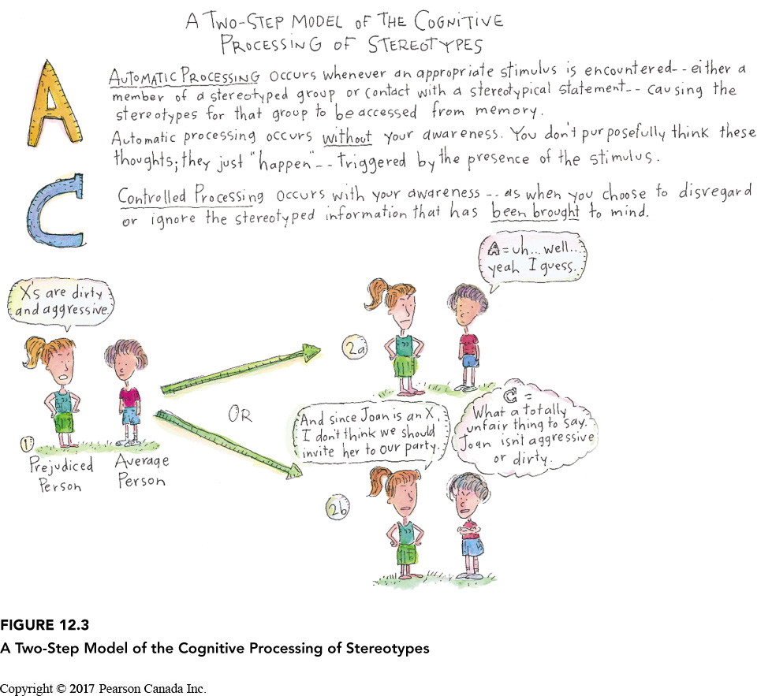
Automatic vs Controlled Processing of Stereotypes
Two-step model of cognitive processing →
Those who are more willing to control prejudice are less likely to show prejudice
We can selectively activate and inhibit stereotypes in service of self-enhancement

Slide 18
Reducing Prejudice by Revising Stereotypes
Stereotypes are very resistant to change
People hang on to stereotypes in the face of contradictory evidence
When faced with contradictory evidence, people sometimes create a new subtype for this deviant member.
Stereotypes can eventually change when people come in contact with many examples that are inconsistent with the stereotype

Slide 19
Affect and Mood
Emotions elicited by a particular group are the most important determinate of our level of prejudice.
Prejudice is also a product of our symbolic beliefs – the perception that a particular group promotes or hinders the values we cherish and a product of behavioural experiences with members of that group.
The more negative emotion people feel while interacting with a particular group, the more prejudice they have towards that group.
Mood can also affect prejudice.
People in a bad mood are more likely to display prejudice
Prejudice reduction should focus on changing people’s feelings towards an out-group

Slide 20
Attributional Biases
Fundamental attribution error – Attributing personality factors to someone’s behaviour instead of situational explanations.
Ultimate attribution error – Our tendency to make dispositional attributions about an entire group of people.
When people conform to our stereotype, we tend to blind ourselves to clues about why they might have behaved the way they did. We attribute their behaviour to their personality/disposition rather than the situation.

Slide 21
Realistic Conflict Theory
The theory that limited resources leads to conflict among groups and result in increased prejudice and discrimination.
When resources are scarce, we are more threatened by out-groups
Economic recession and prejudice towards immigrants are positively correlated.
Experimental evidence too….p. 368 and 369.

Slide 22
Reducing Prejudice by Fostering Common Goals
Muzafer Sherif (1961) Boy Scout Camp
Sherif – Robbers Cave – Realistic Conflict Theory
Reducing prejudice
Eliminate competitive games
Promote non-competitive social contact
Create mutual interdependence – a situation in which two or more groups need each other to accomplish superordinate goals.

Slide 23
Pressure to Conform: Normative Rules
Many people uphold discriminatory behaviour in order to conform to, or fit in, with a majority view.
Injunctification – A motivated tendency to see things the same status quo (the way things are) as the most desirable state of affairs.
Motivated to justify the current system.
React negatively to people who don’t conform to prevailing social norms.

Slide 24
Individual Differences in Prejudice
Right-Wing Authoritarianism – Three clusters of attitudes.
Authoritarian submission – high degree of submission to authority figures in society
Authoritarian aggression – aggression towards groups that are seen as legitimate targets by authority figures
Conventionalism – high degree of conformity to the rules and conventions that are established by authority figures
How to combat right-wing authoritarianism…
Create awareness that attitudes have changed towards particular out-group.
Social pressure
Encourage interaction with out-group

Slide 25
Individual Differences in Prejudice
Religious Fundamentalism – Belief in the absolute literal truth of one’s religious beliefs.
People with a ‘religious quest’ tend to be less prejudice
Social Dominance Orientation – People who believe that people are inherently unequal and it is acceptable for some groups in society to be treated better than others.
Prejudice reduction can backfire if explained that people should be treated equally
Some success with ‘shared identity’

Slide 26
Self-Fulfilling Prophecies

Slide 27
How to Eliminate/Reduce Racism
Depends on what type of racism we want to address.
Individual prejudice – Contact can reduce prejudice with six conditions.
Six conditions
Mutual interdependence
Common goal
Equal status
Friendly informal setting
Learning about multiple members of the outgroup
Create social norms that promote equality among the group
Institutions – dismantle oppressive institutions – create and re-create unoppressive conditions

Slide 28
Learning Check!
Who is Jane Elliott? How did she address prejudice in her classroom? What is prejudice? What components make up prejudice? What is a stereotype? How does a stereotype work? What are different kinds of sexism? How do they manifest? What is discrimination? Provide examples of discrimination? What is implicit racism? How does it manifest? How is it measured? What are critiques of these measurements? What causes prejudice? What is social identity? How does it relate to prejudice? How does self-esteem relate to prejudice? How does the text book suggest that we can reduce prejudice? What are consequences of activating stereotypes? What are automatic vs controlled processes involved in prejudice and stereotyping? What is the two step model of cognitive processing? What is a meta stereotype? What does meta-stereotypes infer about prejudice reduction strategies? What are ways to reduce prejudice by revising stereotypes? How does affect and mood affect prejudice? What is the ultimate attribution error? What is realistic conflict theory? Please recount Muzafer Sherif ‘s experiment and discuss the implications of his experiment. How do normative rules affect prejudice? What are individual differences in prejudice? How can prejudice become a self fulfilling prophecy? What is stereotype threat and what effects does it produce? How can we overcome it? How do we reduce prejudice through contact? What other factors need to be present? What is the jigsaw classroom? What is the extended contact hypothesis?

Slide 29
Learning Check
Please define racism. What are individual and institutional forms of racism?
What is race? What is ethnicity?
What is privilege?
What are micro-aggressions? Name and define the four types of micro-aggressions.
What are absolute and relative forms of privilege, racism and oppression?
How can we eliminate/reduce racism?

Slide 30
Sources
Paradies, Y. C. (2006) Defining, Conceptualizing and Characterizing Racism in Health Research, Critical Public Health, 16, 2, pp. 143 – 157.
Unzueta, M., Lowery, B. S. (2008) Defining Racism Safely: The role of self-image maintenance on white Americans’ conceptions of racism, The Journal of Experimental Psychology, 44, pp. 1491 – 1497.
Headley, C. (2006) Philosophical Analysis and the Problem of Defining Racism, Philosophia Africana, 9, 1, pp. 1 – 16.
Bartz, D. E. (2018) Racism – The Enemy of Diversity in PreK-12 Schools, National Forum of Teachers Education Journal, 28, 3, pp. 1 – 12.
Aronson, E. Wilson, T. D., Fehr, B, Akert, R. M. (2017) Social Psychology, Sixth Canadian Edition, Pearson.
Gough, B., McFadden, M., McDonald, M. (2013), Critical Social Psychology: An Introduction, Second Edition, Palgrave Macmillan.

Slide 31
Jane Elliott
Blue eyes brown eyes experiment
Shorter video

Slide 32
Questions or Concerns?
Have a great day!

