Slide 1
Advertising and the Consumer Culture
Erik Chevrier
January 18th, 2021
Introduction to course – advertising and consumer society

Slide 2
What is Advertising?
Advertising is a product whose purpose is to sell other products/and or ideas.
Advertising provides a source of revenue to media companies and is a form of media itself.
Advertising is a creation of artistic expression, but one controlled by commercial/political interests.
Advertising reflects and creates culture simultaneously – it is designed to reflect social interactions but, in the process, it influences social behaviour.
Advertising is loved and hated by people.
Advertisers are always trying to find new ways to capture the attention of their audience and at the same time, people also watch ads for pleasure.
Many people don’t believe that they are personally affected by advertising, yet, they insist that it affects everyone else.
Advertising is pervasive in industrialized nations and consists of a plethora of commercial signs and symbols that communicate ideas and meaning – mainly to sell products and services and/or political ideas.
Attention is what advertisers seek but oversaturating the adverting environment causes people to pay less attention to advertising.
Anyone with a social media account and a following!
What is advertising to you?

Slide 3
What is Advertising?
You are a commodity to be sold to advertisers!
We Deliver Young People
YUL-LAB
Advertising and the End of the World

Slide 4
How Does this Apply to Advertising?
Advertising is NOT good or bad. It has intended and unintended, positive and negative consequences, that we are aware and unaware of, that are created with helpful and/or harmful intentions.
To understand advertising and consumer culture, a critical, multidimensional approach is best.

Slide 5
Critical Multidimensional Model
Richard Johnson What is Cultural Studies Anyways, Social Text, (1986-87)

Slide 6
Critical Multidimensional Model
Paul Nesbitt-Larking. Politics, Society and the Media (2nd Edition). Broadview Press. 2009.

Slide 7
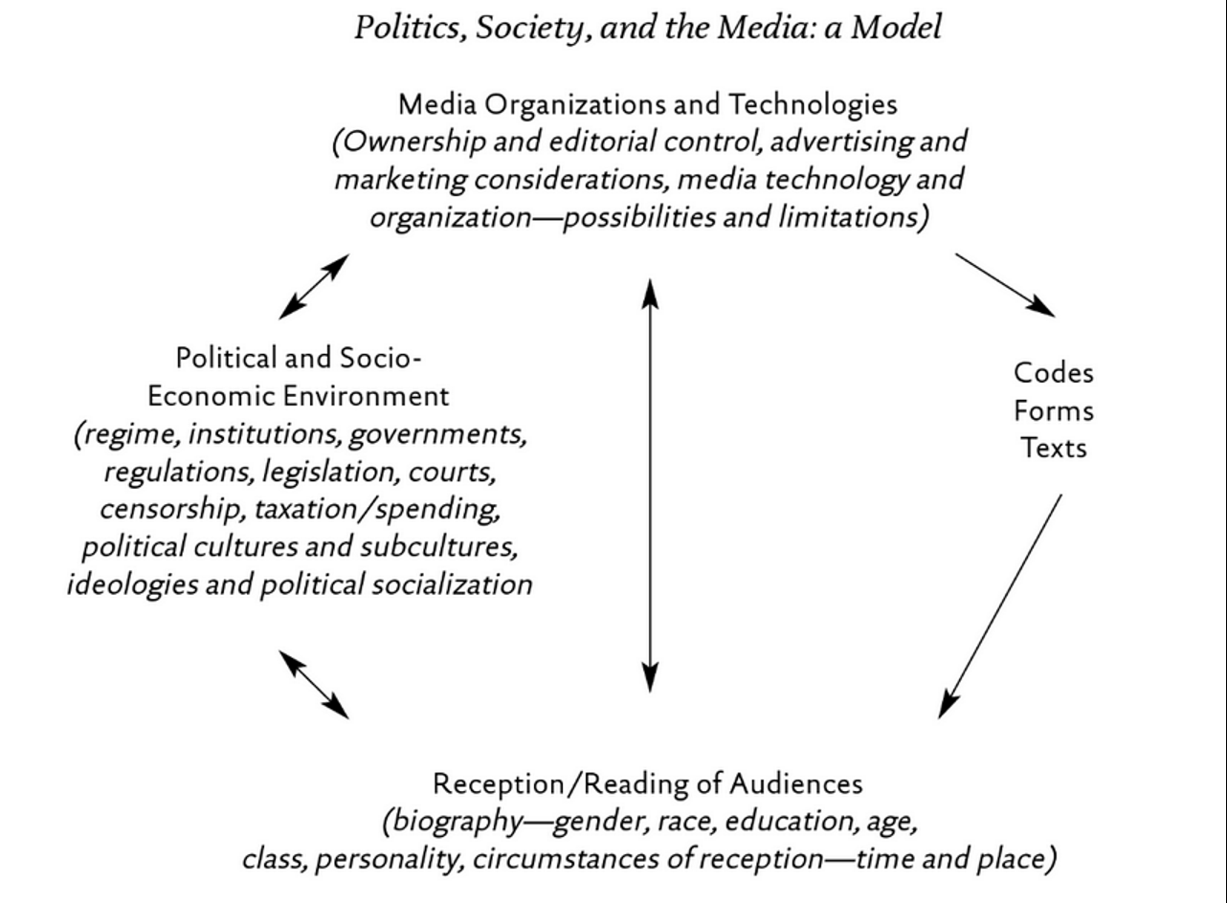
Critical Multidimensional Models

Slide 8
Compare and contrast ad campaigns!
Dove
Dove Evolution Video
Dove Onslaught Video
Axe
Axe Music Video
Axe Television Ad Diner Party
Axe Television Ad Dentist

