Slide 1
Advertising and the Consumer Culture
Erik Chevrier
January 25, 2021
Consumption Habits

Slide 2
Discussion – What kind of a consumer are you? How do you acquire that you want and need?
Are you impulsive or plan purchases?
Are you a compulsive consumer?
Do you prioritize ethical products?
Do you self-produce anything?
Do you have an income source?
Do you shop more for necessity or pleasure?
Do you shop to change your moods?
Do you hold material items in high regards (are you materialistic)?
What do you spend your money on? Daily? Weekly? Monthly? Yearly? Future Plans?
Do you prioritize fair trade?
Do you use any alternative currencies?
Do you participate in barter networks?
Do you buy stuff on the illegal market?
Do you get state allocations?
Do you steal things?

Slide 3
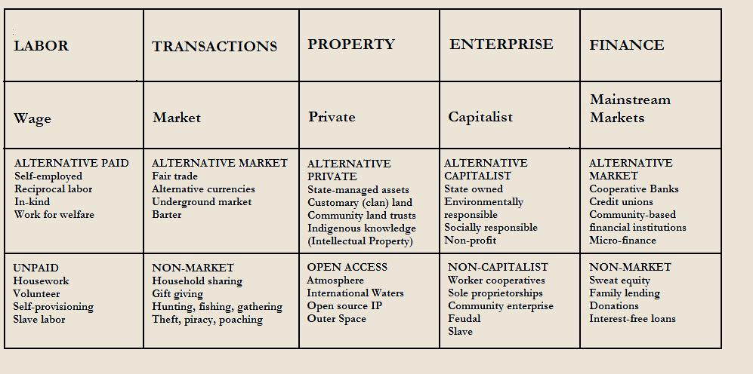
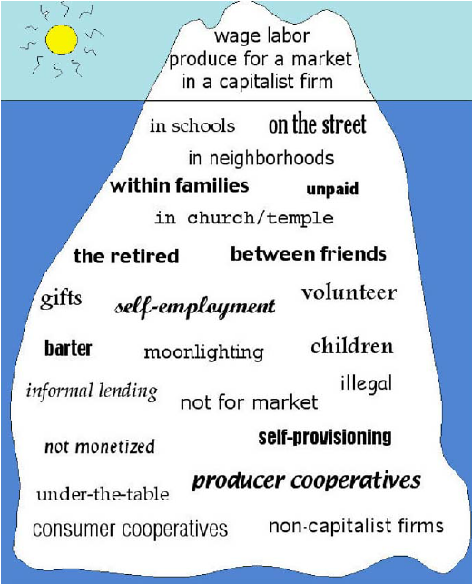
Ways to get Goods
Polanyi
Markets
Redistribution
Householding/self-provisioning
Reciprocity

