Slide 1
Advertising and the Consumer Culture
Erik Chevrier
January 25, 2021
Introduction to advertising and the consumer culture

Slide 2
Discussion
What is culture?
What makes up a culture?
How does advertising relate to culture?

Slide 3
What is Culture?
Raymond Williams
A general process of intellectual, spiritual and aesthetic development.
A particular way of life, whether of a people, period or group.
The works and practices of intellectual and especially artistic activity.
Nesbitt-Larking
The general process of intellectual, spiritual, and artistic development of a people.
The entire way of life of a people, in terms of those practices and facts through which they express their meaning.
High culture – the works and practices of intellectual artistic activity
Culture is the way of life of a people, in particular their evolving ideas, beliefs, and values as they are understood, communicated and represented.
Bennett
Culture consists of all those practices (or activities) that signify; that is, which produce and communicate meaning by the manipulation of signs in socially shared and conventionalized ways.

Slide 4
Critical Multidimensional Model
Richard Johnson What is Cultural Studies Anyways, Social Text, (1986-87)

Slide 5
Critical Multidimensional Model
Paul Nesbitt-Larking. Politics, Society and the Media (2nd Edition). Broadview Press. 2009.

Slide 6
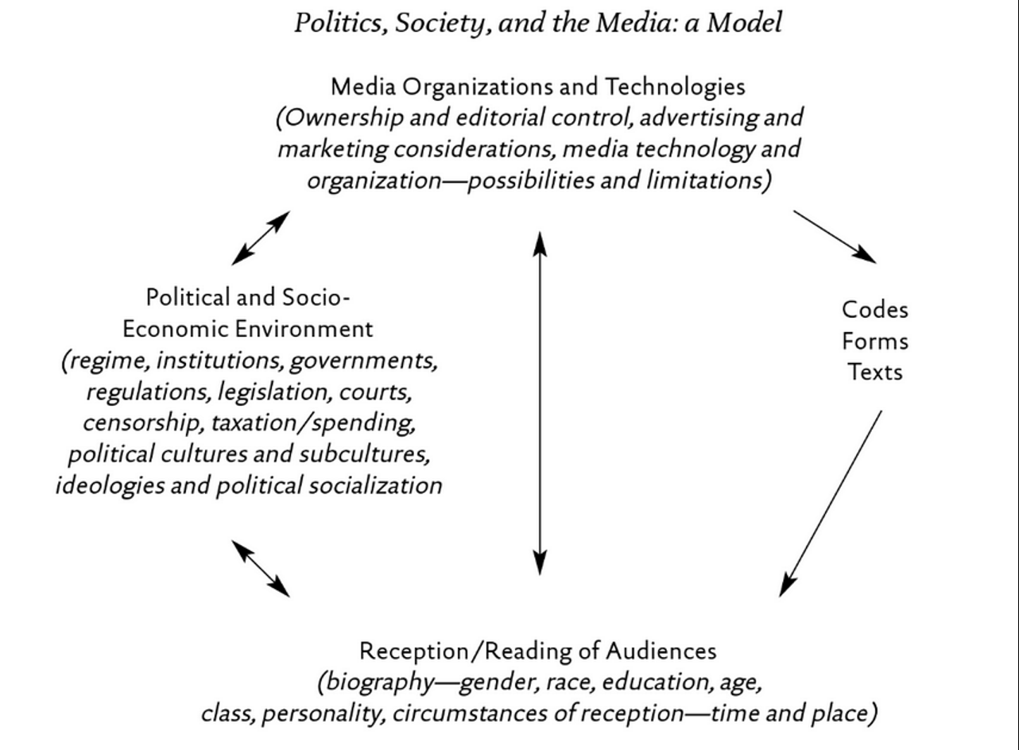
Critical Multidimensional Model

Slide 7
Let’s Analyze the New Nike Ad
Colin Kaepernick Nike Commercial
Nike - Whatever (Colin Kaepernick parody)
Colin Kaepernick Memes

Slide 8
Compare and contrast ad campaigns!
Dove
Dove Evolution Video
Dove Onslaught Video
Axe
Axe Music Video
Axe Television Ad Diner Party
Axe Television Ad Dentist

Slide 9
Social Communication in Advertising Table 1.1 Cultural Frames That Summarize The Development of Media, Marketing and Advertising

Slide 10
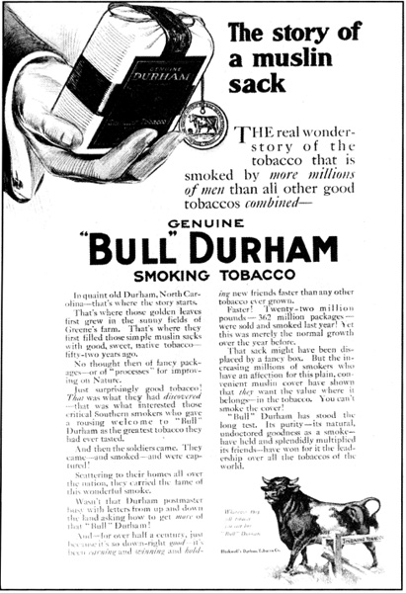
Social Communication in Advertising Table 1.1 Cultural Frames That Summarize The Development of Media, Marketing and Advertising

Slide 11
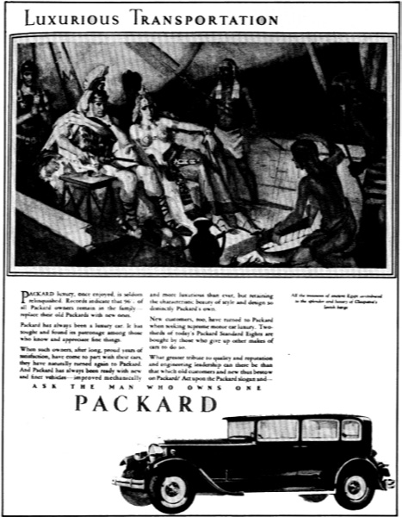
Social Communication in Advertising Table 1.1 Cultural Frames That Summarize The Development of Media, Marketing and Advertising

Slide 12
Social Communication in Advertising Table 1.1 Cultural Frames That Summarize The Development of Media, Marketing and Advertising

Slide 13
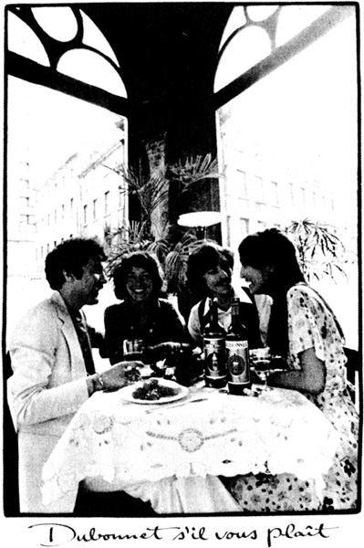
Social Communication in Advertising Table 1.1 Cultural Frames That Summarize The Development of Media, Marketing and Advertising

Slide 14
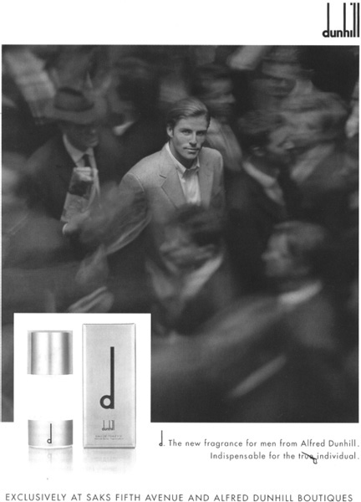
Social Communication in Advertising Table 1.1 Cultural Frames That Summarize The Development of Media, Marketing and Advertising

Slide 15
Learning Check
What is culture? What do Williams, Nesbitt-Larking, Bennett define culture as?
How does Richard Johnson define a cultural product? Describe Johnson’s model. Use an example to illustrate Johnson’s model.
Describe Nesbitt-Larking’s Politics, Society and the Media model. Use an example to illustrate Nesbitt-Larking’s Politics, Society and the Media model.
In Social Communication in Advertising, Table 1.1 defines Cultural Frames That Summarize the Development of Media, Marketing and Advertising:
1 – What are the marketing and advertising strategies for each period? 2 – When were the periods and what media was dominant for advertising? 3 – What are the elements in the ads for each period? 4 – What are the cultural frames for goods for each period? 5 – What are the metaphoric emotive themes in the ads for each period?

