Slide 1
Advertising and the Consumer Culture
Analyzing Advertisements
Erik Chevrier
February 1, 2021

Slide 2
Encoding vs Decoding
To decode, we must make inferences about the encoding process:
Most of the time, we do not know:
The intensions of the encoders
The reason behind using certain ‘codes’ over others
The market/demographic research used to make the ‘codes’
The thought process of those who produced the ‘codes’
To understand the encoding/decoding process, we should take into account:
Intended and unintended effects
Positive and negative effects

Slide 3
Advertising Codes, Contexts and Conventions
Factors that are important for ad construction, operation and analysis:
Context
National, cultural, surrounding media
Diverse and in constant state of change
Medium
Communication channel
Different codes and conventions
Institutional limitations and possibilities
Modern advertising usually consists of integrated, multimedia campaigns
Identify different contexts and media channels and discuss how this may affect encoding and decoding, codes and conventions of advertisements.

Slide 4
Semiotics
Semiotics:
Is an analytic method that complements context and medium specificity, by focusing on broad cultural processes by which meaning is produced and communicated across a range of cultural forms.
Is the study of how meaning is produced and reproduced within a society
Provides us with powerful tools for analyzing advertisements as well as helping us gain some distance from everyday practices of communication of meaning, so that we can look at them, with new eyes and understand them in new ways.
Involves ‘unnatural tasks’ (Bignell, 1997) such as abstracting the ad from its environment, and then breaking it down into constituent parts (signs), working out what they mean and how they’re organized, then trying to determine potential ambiguities or alternative readings.

Slide 5
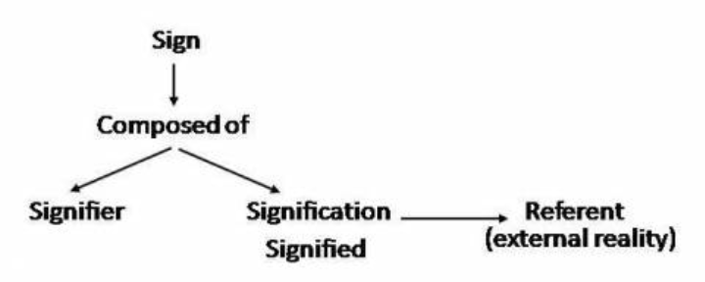
Semiotics
Sign – Most basic discrete unit of meaning
Word, colour, sound, set of lines, shapes,
Like atoms, we can dissect individual units
Assemblages – Collections of signs (that carry meaning)
Texts
Ferdinand de Saussure – Understand power and flexibility of language as a social construction through which meaning is organized.
Language is a structure that allows for flexibility and consistency.
Meaning between signifier and signified is arbitrary
(flexible and consistent)
Meaning is produced through cultural conventions
Langue – Giant system of grammar and vocabulary
Parole – Grammar and vocabulary can be manipulated

Slide 6
Analyzing the Meaning of Ads
Bignell (1997)
Break down ads into constituent signs and coherent signs
Parts vs sum of parts vs complete whole
Denotative meaning of a sign
Obvious, literal meaning of the sign
Connotative meaning of a sign
Symbolic, seemingly secondary, more metaphorical meanings
More socially conditioned
Anchorage
Barthes – Use of captions or slogans in order to lock down (anchor) one possible meaning out of the many offered by the images
Words, logos, etc.
Volkswagen ad – Portaloo Hearse
Meanings of signs and symbols are not natural – they are constructed, not universal, not eternal and arbitrary.

Slide 7
Analyzing Advertisements
Static Advertisements
Print & digital
Are easier to analyze than motion pictures
Digital static ads rely on web-browser technology
Toyota ‘Elevate’ ad
Video Advertisements
2014 Toyota Corolla Commercial: 'Style Never Goes Out of Style’
Television, internet, film, product placement
More costly
More complex
24 frames per second (24 static images)
Sound
Story
Breaks television ‘flow’ to stand out
2014 Toyota Corolla Commercial: 'Style Never Goes Out of Style’
Digital Advertising
Interactive
Static ads and videos are part of integrative campaigns
Video game ads
Branded reward tokens

Slide 8
Mythology and Ideology
Mythology is concerned with the idea that signs are never natural or neutral, but rather always attain their connotations in relation to particular histories and culture.
Anchorage is part of mythology
Barthes – Interested in the ways in which meanings reflect the social and cultural arrangements of power and communicate unspoken understandings about how the social world works.
How is meaning embodied in a sign?
Ideology
Is a set of beliefs, values, ideas and feelings that shape how we understand, approach, and engage with the world around us.
It is always at work, it informs every action and idea in a society
Advertising implies a particular vision of the world.
Unpacking problems or obstacles
Reinforcing representations of social relations (gender, class, etc.)
Understanding priming, schemas, and controlled vs automatic processing is important

Slide 9
Ecological Systems Theory of Development

Slide 10
Unpacking Freedom, Gender and Ideology
Kia Sportage

Slide 11
Deciphering Advertisements (Jib Fowles, (1996) Deciphering Advertisements)
Context for the ad
Product category?
Which medium does it appear?
Who is the intended audience?
Implications for the ad
What is the ad implying about relationships between people?
What is this ad saying about identity and gender relations?
What does the ad convey about social status?
What kind of cultural beliefs are displayed in the ad?
How does the ad attempt to commodify human experience?
Looking at the ad
What are the aesthetic properties of the ad?
Photograph or drawing (retouching?)
What is in the foreground?
What is the commodity?
Subtract the commodity and look at the ad’s symbolic appeal
List various elements pictured in the symbolic appeal
What are the meanings of these symbols in relation to the intended audience?
What are the inferred states of mind of humans in the ads?
Where is the space in which the ad is situated?
What is the timeframe in which the ad is situated?
Consider the ad as a narrative, can we tell the story?
What is missing?
Does the symbolic appeal idealize anything?
Imagine someone looking at the ad, what state of mind would they be in? What does the ad supplement to their state?
Is there intertextual referents from something earlier?
What is in frame, what is framed out?

Slide 12
Levi's – Go Forth - Video

Slide 13
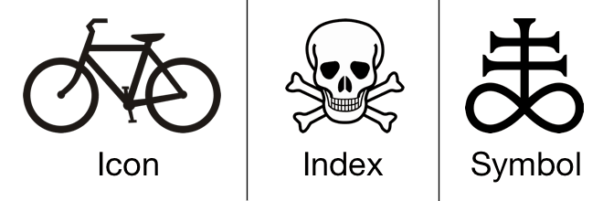
Other Important Points
Signs come in 3 forms
Icons – Resemble objects to which they refer
Indexes – Signs that are immediately implied in their referent
Symbols – Bear no obvious resemblance to their referents but come to be associated to them

Slide 14
Media Fantasy Becomes Reality
Jean Baudrillard
The media – especially when the content is fictional and fantastic – are more real than the world they proport to represent.
The symbolic structure of the media is so powerful that the meaning is dissolved as mere content is relegated to the demands of form.
Verisimilitude - They appear to be real.
Mark Poster
Mediation is becoming so intense and worked over that ‘reality’ is consistently in question
Nesbitt-Larking
Forms that blend reality:
Infotainment
Docudrama
‘Faction’ – blending fact from fiction
Reality television
News/entertainment spoof

Slide 15
The Power of Words and Suggestion
The power of words in regard to memory
An Inquiry Into How People Are Affected by Profuse Amounts of Publicity: A Multidisciplinary Approach
Advertising as a suggestion – Page 26
Suggestions can bypass critical thought because there is no direct request to refuse

Slide 16
Automatic Thinking – Low Effort Thinking
Automatic thinking – Is thought that is generally unconscious, unintentional, involuntary, and effortless.
Schemas – Mental structures people use to organize their knowledge about the social world themselves and that influence the information people notice, think about, and remember.
We tend to fill in the blanks with SCHEMA-CONSISTENT INFORMATION.
How People are Affected By Profuse Amounts of Publicity? – Advertising and Priming
Activity – Automatic Thinking!

Slide 17
Accessibility and Priming
Accessibility – The extent to which schemas and concepts are at the forefront of people’s minds and are, therefore, likely to be used when making judgments about the social world.
Schemas can be accessible for three reasons:
1 – Some schemas are chronically accessible because of past experience – these schemas are constantly active and ready to use to interpret ambiguous situations.
2 – Schemas can be accessible because they are related to a current goal.
3 – Schemas can become temporary accessible because of our recent experiences.
Priming – The process by which recent experiences increase the accessibility of a schema, trait, or concept.
Words have to be accessible and applicable to act as a prime.
Schemas may be quite resistant to change
Schemas are influenced by culture
Perception Without Awareness (PWA) – Daren Brown – How to Control a Nation – Toy Story
How to Control a Nation Full Video
The Art of Misdirection
Advertising makes consumption schemas continuously accessible. Advertising primes our consumer drives.

Slide 18
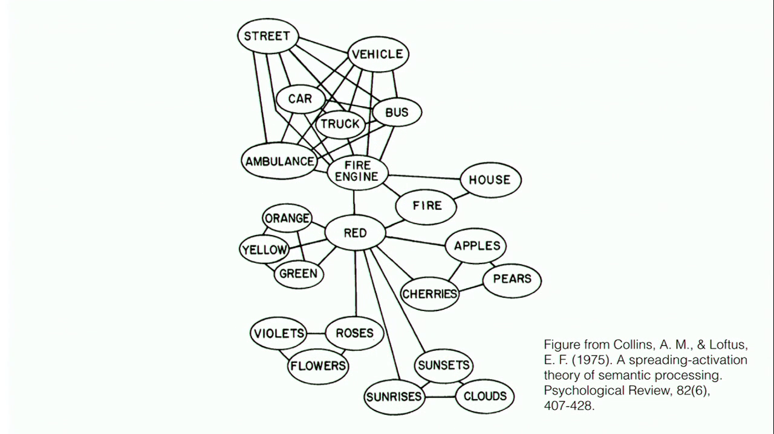
Cognitive Model & Schemas
Cognitive Model
Semantic Processing – Spreading Activation

Slide 19
Learning Check
What is encoding and decoding of advertising? Why is this important? What are factors that are important for ad construction, operation and analysis? What is the importance of the medium, contexts, codes and conventions? What is an integrated ad campaign? What is an example of an integrated ad campaign? What are static ads? What is an example of a static ad? How can we analyze static ads? What is a video advertisement? What is particular about analyzing video advertisements? What is an example of a video ad? What is television flow? What is the goal of an ad in relation to flow? What is a digital advertisement? What is particular about analyzing digital ads? What is an example of a digital ad? What is meant by advertising interactivity and a feedback loop? What is a semiotic analysis? What is a sign? What are assemblages? Who is Ferdinand de Saussure and what was he known for? What did de Saussure say about language and parole? What did de Saussure say about the relationship between the signifier and signified? What are critiques of semiology? What are denotative and connotative meanings of signs? What is anchorage? What does Barthes say about anchorage? What does mythology and ideology have to do with advertising? What is a mythological analysis? What is an ideological analysis? What are three categories that are used by Fowels to decipher advertising? What are five examples of questions Fowels recommends asking? What are icons, indexes, and symbols? What is priming? Why is priming important in advertising?

