Slide 1
Advertising and the Consumer Culture
History of Advertising and Consumer Culture
Erik Chevrier
February 8, 2021

Slide 2
Early Capitalism
(1600 - 1800)
Little to no leisure time for working class
Feudal and monarchial systems being replaced by capitalism
Expropriation of peasants from agricultural communities to cities and towns
Rampant poverty
Mostly subsistence wages
Work mainly done by hand or with assistance from basic machines and animals
People mainly consumed what they needed to survive

Slide 3
Middle Capitalism
(Late 1800 - 1950)
Development of more advanced machinery
Fordism & the introduction of more efficient assembly line practices
Workers are better paid
Work hours were reduced (more leisure time)
Introduction of psychology into advertising (1920s)
Workers are able to consume luxury items over and above what they need to survive

Slide 4
Later Capitalism
(1950 - today)
Rapid advancement of science and technology
Built obsolescence
Global expansion of industrialized capitalism
Expansion of products and services
Consumption is a central part of the market
Advanced advertising techniques
Workers must be able to continuously consume in order for the capitalist market to function

Slide 5
History of Advertising
Rise of modern advertising
Begin at about late 1600 in France billboard
1700 – Newspaper & magazine & Advertising agencies as brokers
1900 – Sears & Cosmopolitan Magazine
1920 – Psychology & Ed Bernays & Radio
1950 – Television & motion picture
1980 – Internet & data mining
2000 – Product integration & interactive advertising
Today – Multiple profuse convergent network (clutter)

Slide 6
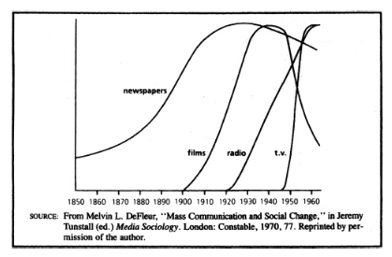
History of Media

Slide 7
History of Advertising
Advertising and Consumer Society (Holm, 2017)
Four Moments in advertising history
First Moment: Origins of industrial development
  Pre capitalist societies had art forms but these cannot be considered advertising
  Factors that led to the development of advertising
    Urbanization (expropriation from agricultural communities to cities)
    Rationalization (reformation of time and space)
    Mass production and distribution (development of industrialization and capitalism)
    Mass media (development and proliferation of mass media)
  Beginning of consumer society
    New division of labour
    New way of understanding products
    Increases in production needed to be matched by increases in consumption
  People start defining themselves by their consumption
    Purchase way to a better life
  Promote general use of advertising
  Advertising agencies were space brokers

Slide 8
History of Advertising
Advertising and Consumer Society (Holm, 2017)
Four Moments in advertising history
Second Moment: Professionalism, consolidation and redemption
  Consolidation of advertising agencies
    Lack of professionalism, accountability and organization
      False claims in patent medicine
  Fear of advertising
  Development of ‘full service’ agencies
    Market research, creative art, space brokers – 1920s
    More respected profession
      N.W. Ayer and Sons
        Factual copy
        Research – demographics and brand preference
      John. E. Powers
        Plain speech & fine writing is offensive
      John E. Kennedy
        Reason why advertising

Slide 9
History of Advertising
Advertising and Consumer Society (Holm, 2017)
Four Moments in advertising history
Third Moment: Manipulation, creativity, and globalization
  Booming consumer culture of 1950s
  Industry seen as repetitive, monotonous, and dull
  Fear of advertising
    Vince Packard – The Hidden Persuaders
    James Vicary – Subliminal Advertising Fiasco
  Creative Revolution
  Television ads
    Emotional ads

Slide 10
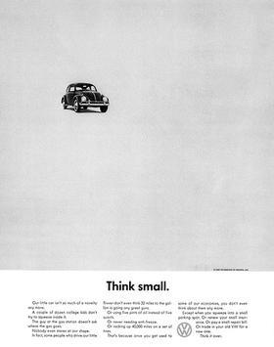
Think Small Ad Volkswagen
Bill Bernbach (BBD)

Slide 11
History of Advertising
Advertising and Consumer Society (Holm, 2017)
Four Moments in advertising history
Fourth Moment: Digital advertising, algorithms, and data-surveillance
  Move towards globalization
    Mergers between companies and advertising agencies (mega agencies)
  Online advertising
  Search engine optimization – SEO
    Google – AdWords (algorithms)
  Old ad format integrated into ‘new’ media
    Seeking new methods
  Social media and viral ads
    Facebook & Spotify, etc.
    Data mining
    People share content

Slide 12
Learning Check
What is particular about early capitalism, middle capitalism, and later capitalism?
Describe a ‘brief history’ of advertising.
Describe the history of media chart.
According to Holm: What are the four moments in advertising history? What was the first advertising? What is particular about the development of industrialization and mass society (what were the four major developments)? What is particular about the beginning of consumer society and how does this relate to advertising? What is the problem with patent medicine and how did that relate to advertising? What is a full-service agency and how did this differ from traditional advertising agencies? How did advertisers search for respectability? What does Holm mean by the fear of advertising and what caused this fear? What did the first online advertising look like? What is algorithmic advertising? What is particular about social media and viral advertising? What is the changing nature of advertising?
What are examples of ads from each moment in advertising history?

