Slide 1
Advertising and the Consumer Culture
Advertising Effectiveness – Tricks and tips
Erik Chevrier

Slide 2
Tips and Tricks
You need to attract and retain attention
Influencers
Celebrities
Sensory stimuli
Curated content
Short, to the point
Branded content
High rankings on Google
Be relevant
Become part of a social network
Native advertising
Guerilla marketing/viral stunts
Understand your target audience
Repetition

Slide 3
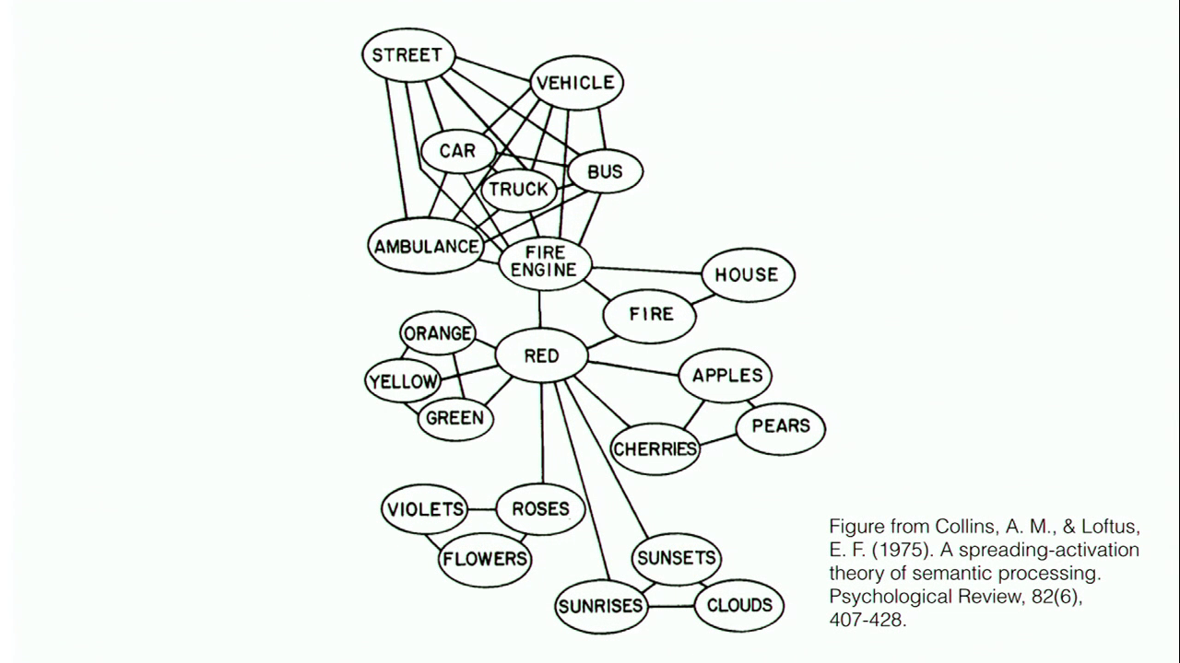
Cognitive Model & Schemas
Cognitive Model
Semantic Processing – Spreading Activation

Slide 4
Accessibility and Priming
Accessibility – The extent to which schemas and concepts are at the forefront of people’s minds and are, therefore, likely to be used when making judgments about the social world.
Schemas can be accessible for three reasons:
1 – Some schemas are chronically accessible because of past experience – these schemas are constantly active and ready to use to interpret ambiguous situations.
2 – Schemas can be accessible because they are related to a current goal.
3 – Schemas can become temporary accessible because of our recent experiences.
Priming – The process by which recent experiences increase the accessibility of a schema, trait, or concept.
Words have to be accessible and applicable to act as a prime.
Schemas may be quite resistant to change
Schemas are influenced by culture
Perception Without Awareness (PWA) – Daren Brown – How to Control a Nation – Toy Story
How to Control a Nation Full Video
The Art of Misdirection
Advertising makes consumption schemas continuously accessible. Advertising primes our consumer drives.

Slide 5
Automatic Thinking – Low Effort Thinking
Automatic thinking – Is thought that is generally unconscious, unintentional, involuntary, and effortless.
Schemas – Mental structures people use to organize their knowledge about the social world themselves and that influence the information people notice, think about, and remember.
We tend to fill in the blanks with SCHEMA-CONSISTENT INFORMATION.

Slide 6
The Psychology of Influence
Robert Cialdini
Six weapons of influence
1 – Reciprocation
2 – Commitment and consistency
3 – Social proof
4 – Liking
5 – Authority
6 – Scarcity

Slide 7
Changing Values and Attitudes
Values:
Desirable, trans-situational goals, varying in importance, that serve as a guiding principles in people’s lives
Attitudes:
An internal state that, given the occurrence of certain stimulus events, will ultimately result in some sort of response or behaviour.
Cognitive dissonance:
Cognitive dissonance is a state of psychological tension occurring when thoughts, beliefs, attitudes, and/or behaviours are in conflict with each other.
Key Factors:
Ratio of dissonance Importance of factors in dissonance
Avoiding dissonance
1 – Modify 2 – Change importance 3 – Rationalize 4 – Add new consonant beliefs to bolster

Slide 8
Conformity
A change in behaviour as a result of the real or imagined influence of other people
Can override survival behaviours
People are more influenceable than they believe
Produces positive and negative consequences
Informational Social Influence – Conforming because we believe that others’ interpretation of an ambiguous situation is more correct than ours and will help us choose an appropriate course of action.
Normative Social Influence – The influence of other people that leads us to conform in order to be liked and accepted by them; this type of conformity results in public compliance with the group’s beliefs and behaviours but not necessarily in private acceptance. Conformity experiment
Public Compliance – Conforming to other people’s behaviour publicly, without necessarily believing in what they are doing or saying.
Private Acceptance – Conforming to other people’s behaviour out of a genuine belief that what they are doing or saying is right.

Slide 9
Compliance
A change in behaviour in response to a direct request from another person
Door-in-the-face technique – A technique to get people to comply with a request whereby people are presented first with a large request, which they are expected to refuse, and then with a similar, more reasonable request, to which it is hoped they will accept
Reciprocity norm – a social norm by which the receipt of something positive from another person requires you to reciprocate, ort behave similarly, in response
Foot-in-the door technique – A technique to get people to comply with a request, whereby people are presented first with a small request, to which they are expected to acquiesce, followed by a larger request, to which it is hoped they will also acquiesce.
Change in self-perception – People are influenced by their behaviour and adopt values about ‘helping others’
Lowballing – An unscrupulous strategy whereby a salesperson induces a customer to agree to purchase a product at a very low cost, and then subsequently raises the price; frequently, the customer will still make the purchase at the inflated price.
Illusion of irreversibility
Anticipation of event
Convenience of completing the transaction rather than starting over somewhere else
Improving the deal: When a product is offered at a high price, then after a brief pause, another product is offered to the deal or the price is reduced
Strategic Self-anticonformity (Reverse Psychology)
To elicit reaffirming messages
To elicit attitudinal or behavioural compliance from another person

Slide 10
The Power of Words
The power of words in regards to memory

Slide 11
The Power of Suggestion
An Inquiry Into How People Are Affected by Profuse Amounts of Publicity: A Multidisciplinary Approach
Advertising as a suggestion – Page 26
Suggestions can bypass critical thought because there is no direct request to refuse

