Slide 1
Economic Restructuring
Erik Chevrier
September 15th, 2021

Slide 2
What is Capitalism?
What features of an economic, social and political system does capitalism have?

Slide 3
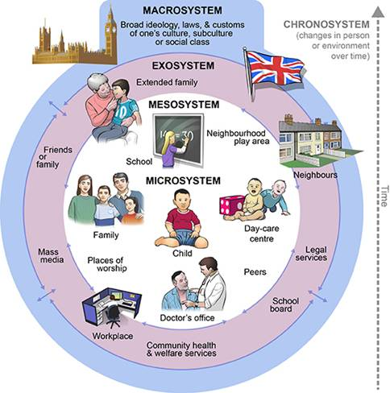
Ecological Systems Theory of Development

Slide 4
What is Capitalism?
Markets Profit Private ownership of the means of production Money based system Financial markets Private property Alienation Exploitation Wage Labour Externalities Expendable work force Inequality Advertising Consumerism Firms Institutions Imperialism Colonialism Exchange Free (non-slave) labour Cycles and crisis Growth Competition
What does post-capitalism/anti-capitalism mean?

Slide 5
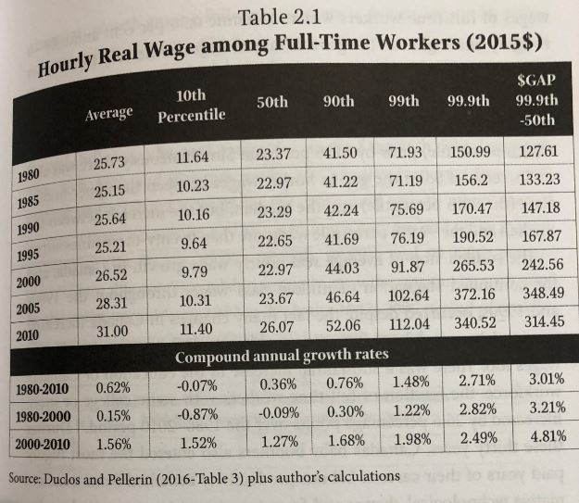
Real Hourly Wages Osberg, L. (2018) The Age of Increasing Inequality – The Astonishing Rise of Canada’s 1%, James Lorimer and Company.

Slide 6
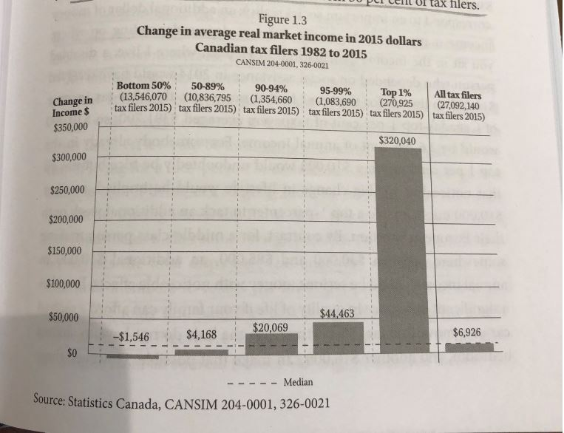
Real vs Market Income Osberg, L. (2018) The Age of Increasing Inequality – The Astonishing Rise of Canada’s 1%, James Lorimer and Company.

Slide 7
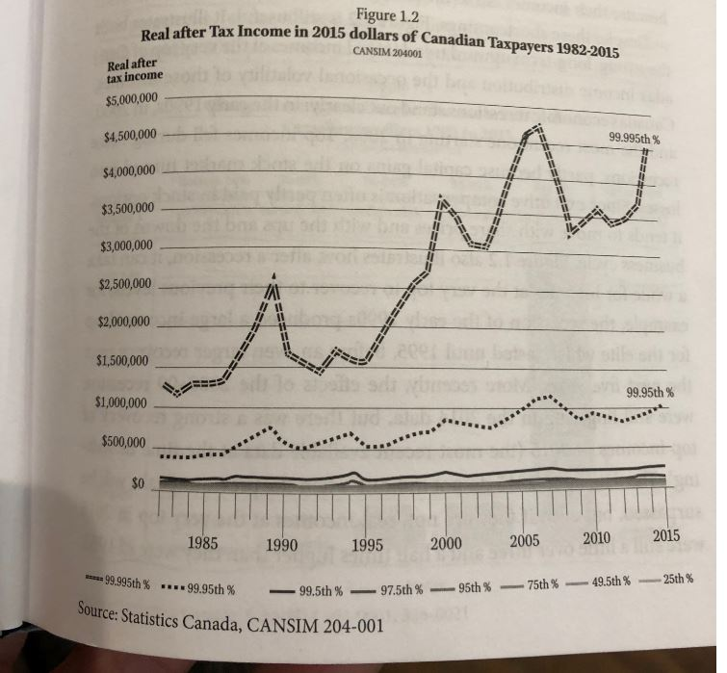
Real Income Osberg, L. (2018) The Age of Increasing Inequality – The Astonishing Rise of Canada’s 1%, James Lorimer and Company.

Slide 8
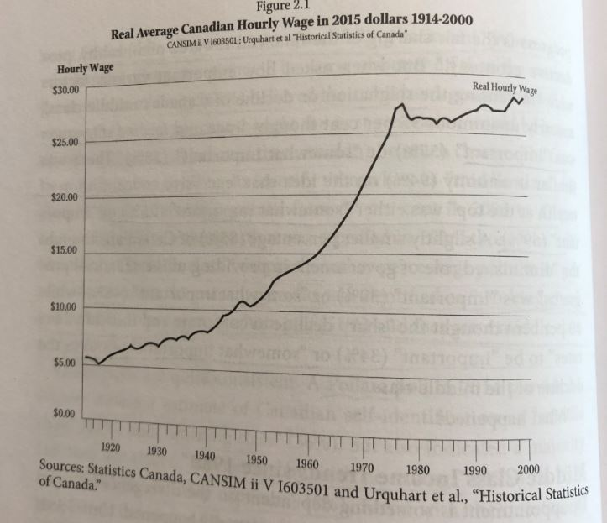
Average Wage Osberg, L. (2018) The Age of Increasing Inequality – The Astonishing Rise of Canada’s 1%, James Lorimer and Company.

Slide 9
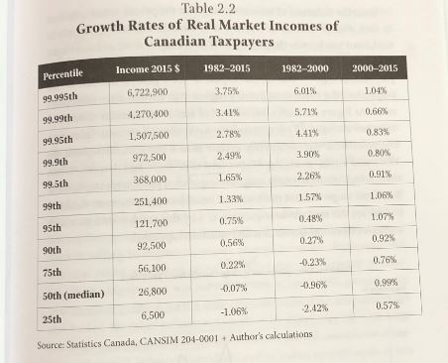
Growth Rates of Real Market Incomes Osberg, L. (2018) The Age of Increasing Inequality – The Astonishing Rise of Canada’s 1%, James Lorimer and Company.

Slide 10
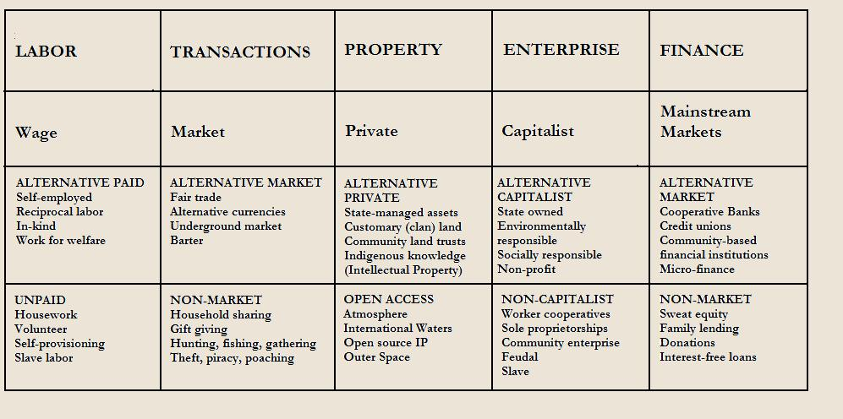
Gibson Graham – Take back the Economy Gibson-Graham, J.K., Cameron, J., Healy, S. (2013) Take Back the Economy: An Ethical Guide for Transforming Communities, University of Minnesota Press

Slide 11
See You Next Week
Form reading groups…
Questions? Concerns?

