Slide 1
Economic Restructuring
Erik Chevrier
September 29th, 2021

Slide 2
Check in and Updates
Student-Led Seminars
Sign Up (groups of 2)
Reminder Blog 1 is Due on October 13th

Slide 3
What is an Enterprise?
Legal forms of enterprises in Quebec
Sole proprietorship
Business corporation (corporation)
General partnership (G.P.)
Limited partnership (L.P.)
Joint venture (or undeclared partnership)
Non-profit legal person
Syndicate of co-ownership
Association
Group of persons
Cooperative
Trust that operates a commercial enterprise

Slide 4
Diverse Enterprise

Slide 5
Diverse Enterprises
The chapters provide examples of:
Worker cooperatives
Self-managed enterprises/worker-recuperated enterprises
Community enterprise
Eco-social enterprises
Social enterprise in value repair
Anti-mafia enterprise
State and community enterprise
Independent and small businesses

Slide 6
Social Enterprises Quebec Act

Slide 7
Social Entrepreneurship

Slide 8
Discussion
What is a cooperative?
What is a non-profit organization?
What types of non-profits and cooperatives exist?
How do cooperatives and non-profits operate?
What are strengths, weaknesses, opportunities, and threats to these types of organizations?

Slide 9
What do enterprises produce?
Types of Value (Roland, Lanuda (2013), Regenerative Enterprise)
Social capital
Material capital
Financial capital
Living capital
Intellectual capital
Experiential capital
Spiritual capital
Cultural capital

Slide 10
Diverse Enterprise

Slide 11
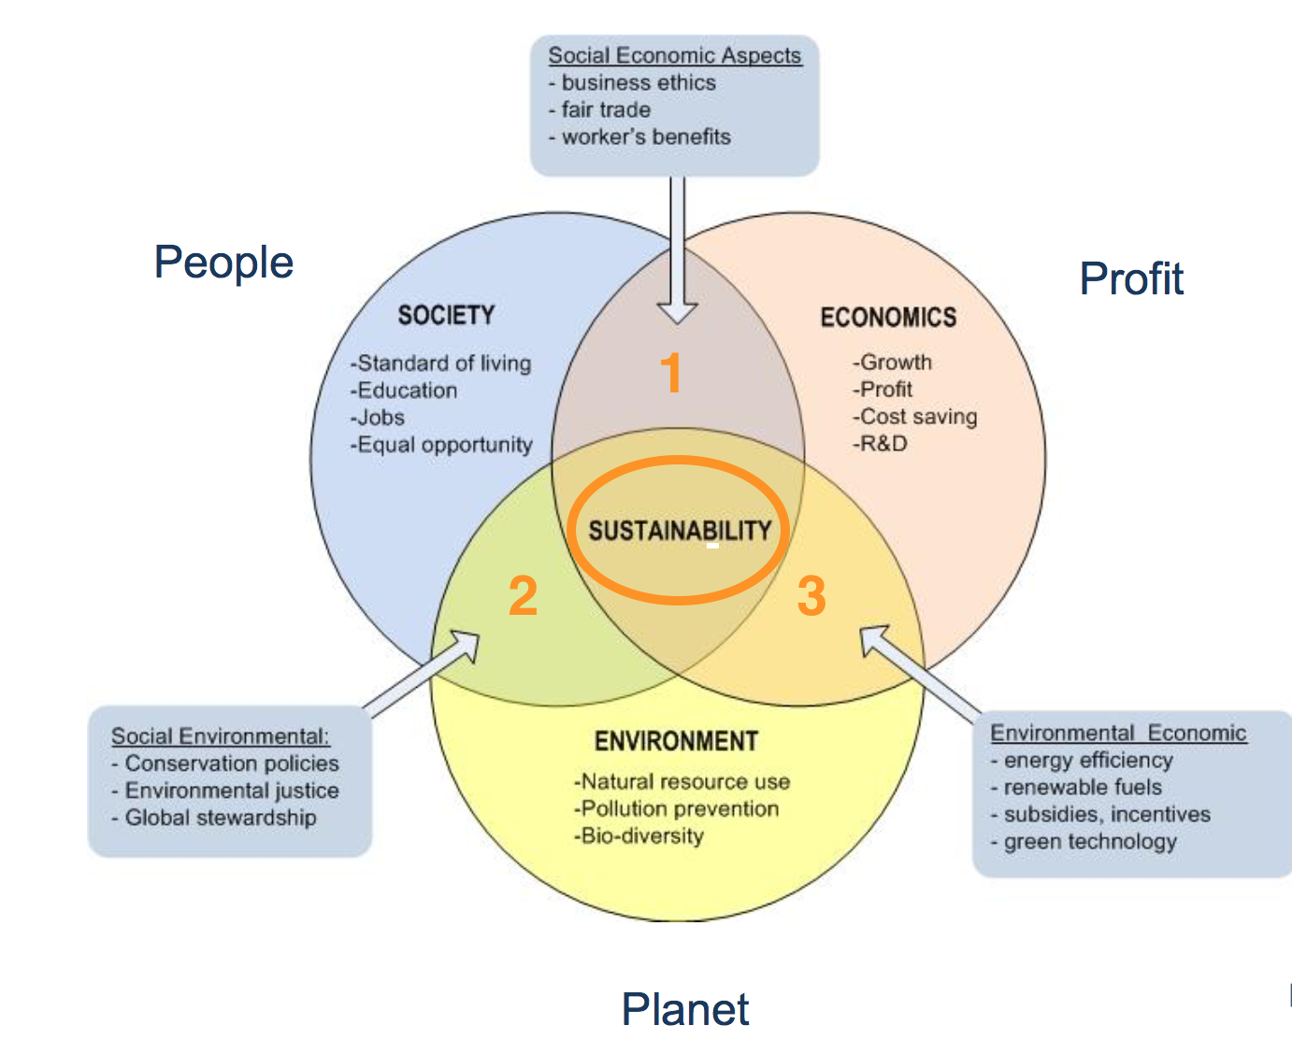
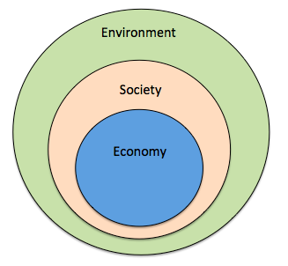
Strong vs Weak Sustainability
Triple Bottom line
Nested model

Slide 13
Discussion About Readings
Chapter 2 – Framing: The Diversity of Enterprise
Chapter 3 – Worker Cooperatives
Chapter 4 – Self-Managed Enterprise: Worker-Recuperated Cooperatives in Argentina and Latin America
Chapter 5 – Community Enterprise: Diverse Designs for Community-Owned Energy Infrastructure
Chapter 6 – Eco-Social Enterprises: Ethical Business in a Post-Socialist Context
Chapter 7 – Enterprising New Worlds: Social Enterprise and the Value of Repair
Chapter 8 – Anti-mafia Enterprise: Italian Strategies to Counter Violet Economies
Chapter 9 – State and Community Enterprise: Negotiating Water Management in Rural Ireland

Slide 14
Instructions
Get into groups of about 3 people
Discuss the chapter and prepare a 5-minute presentation summarizing the article.
You may go anywhere on campus, but you must come back to the classroom at 4:15 PM.

Slide 15
See You Next Week!
If you are interested in exploring more about enterprises, please watch:
The Corporation 1 and 2

