Slide 1
Economic Restructuring
Erik Chevrier
September 8, 2021

Slide 2
Introduction
What is your name?
What is something interesting about you?
What do you expect to get out of this course?
Why did you take this course?
What is your level of experience with topics related to ‘economic restructuring’?
What is your interest level in topics related to ‘economic restructuring’?
What specific topics are you interested you most? What topics interest you least?

Slide 3
Aristotle Aristotle. Aristotle in 23 Volumes, Vol. 21, translated by H. Rackham. Cambridge, MA, Harvard University Press; London, William Heinemann Ltd. 1944.
Chrematistics – art of acquisition – limitless accumulation unnatural and problematic
Oikonomia – management of the household – true form of an economy

Slide 4
Karl PolanyiPolanyi, K. (2001) The Great Transformation; The Political and Economic Origins of Our Time, Beacon Press
Types of economic practices:
Markets (exchange)
Household economy
Redistribution
Reciprocity

Slide 5
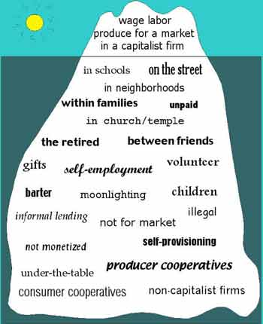
Gibson Graham – Take back the Economy Gibson-Graham, J.K., Cameron, J., Healy, S. (2013) Take Back the Economy: An Ethical Guide for Transforming Communities, University of Minnesota Press
Katherine Gibson Interview Playlist

Slide 6
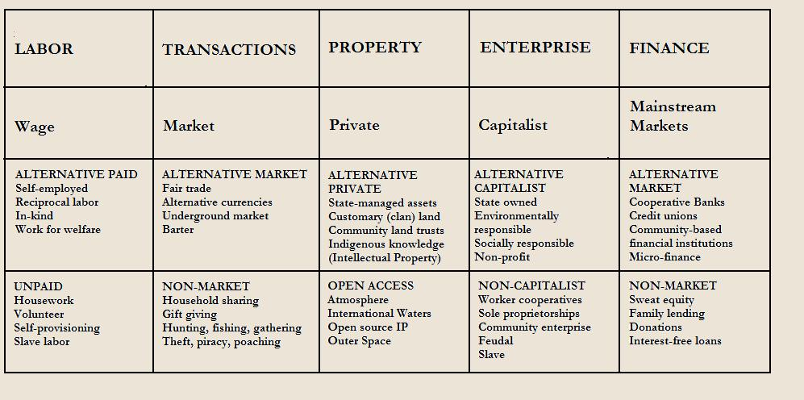
Gibson Graham – Take back the Economy Gibson-Graham, J.K., Cameron, J., Healy, S. (2013) Take Back the Economy: An Ethical Guide for Transforming Communities, University of Minnesota Press

Slide 7
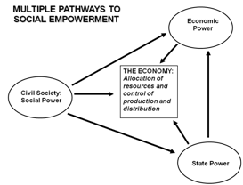
Envisioning Real Utopias – Erik Olin Wright Olin Wright, E. (2010) Envisioning Real Utopias, Verso

Slide 8
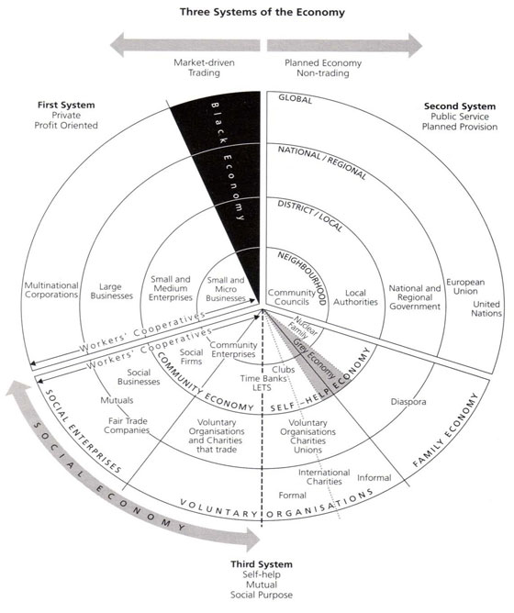
Three Systems of an Economy – John Pierce Pearce, J. (2009) Social Economy: Engaging as a Third System, In Amin, A. The Social Economy; International Perspectives on Economic Solidarity, p. 26.

Slide 9
Importance of Action Based Research
Why are action based projects important?
It is important to challenge the problematic dominant epistemological understandings of food.
Instead we should produce ontological formations of the world we want by co-creating and co-recreating social relations that produce positive outcomes on people and the planet.
Action based learning theories incorporate students and facilitators as co-learners and co-collaborators. Together, they learn by doing. They also connect with the community.
Epistemology – A term meaning “theory of knowledge,” which gets at the how we know about the social world that lies behind all theoretical approaches. (Frampton, Kinsman, Thompson, Tileczek, (2006))
Ontology – Assumptions relating to how the social comes into being that inform all theories and ways of writing the social. (Frampton, Kinsman, Thompson, Tileczek, (2006))

Slide 10
The Dominant Epistemological View of Food?
The world has or will soon have the agricultural technology available to feed the 8.3 billion people anticipated in the next quarter of a century. The more pertinent question today is whether farmers and ranchers will be permitted to use that technology. Extremists in the environmental movement, largely from rich nations and/or the privileged strata of society in poor nations, seem to be doing everything they can to stop scientific progress in its tracks. It is sad that some scientists, many of whom should or do know better, have also jumped on the extremist environmental bandwagon in search of research funds. When scientists align themselves with antiscience political movements or lend their name to unscientific propositions, what are we to think? Is it any wonder that science is losing its constituency? We must be on guard against politically opportunistic, pseudo-scientists…
Borlaug, N., E. (2000) Ending World Hunger. The Promise of Biotechnology and the Threat of Antiscience Zealotry, Plant Physiology, 124(2) pp. 488.

Slide 11
Critique of Dominant Epistemological View of Food
When poisons are introduced into agriculture to control pests, or when GMOs are introduced under the argument of “feeding the world,” the justification given is always “science”. But “science” does not have a singular entity, and it did not come into existence within a vacuum. Today, what we generally refer to as “science” is in fact Western, mechanistic, reductionist modern science, which became the dominant practice of understanding the world during the Industrial Revolution and has continued as the dominant paradigm….To shape the industrial system in the form of new, violent technologies, and to shape the capitalist system in the form of new, profit-driven economics, a certain type of science was promoted and privileged as the only scientific knowledge system. Two scientific theories came to dominate this new, industrial paradigm, and they continue to shape practices of food, agriculture, health, and nutrition even today. The first is a Newtonian-Cartesian idea of separation: a fragmented world made of fixed, immutable atoms…The second significant theory that has framed the knowledge paradigm for industrial agriculture is Darwin’s theory of competition as the basis for evolution…The Newtonian-Cartesian theory of fragmentation and separation and the Darwinian paradigm of competition, have led to a nonrenewable use of Earth’s resources, a nonsustainable model for food and agriculture, and an unhealthy model of health and nutrition. An emphasis on the legitimacy of these arguments as the sole “scientific” approach has created a knowledge apartheid by discounting the knowledge of Mother Earth.
Shiva, V. (Shiva, V. (2016) Who Really Feeds the World, North Atlantic Books, pp. 4 – 7.

Slide 12
Questions or Concerns?
Thanks!
Have a great day!

