Slide 1
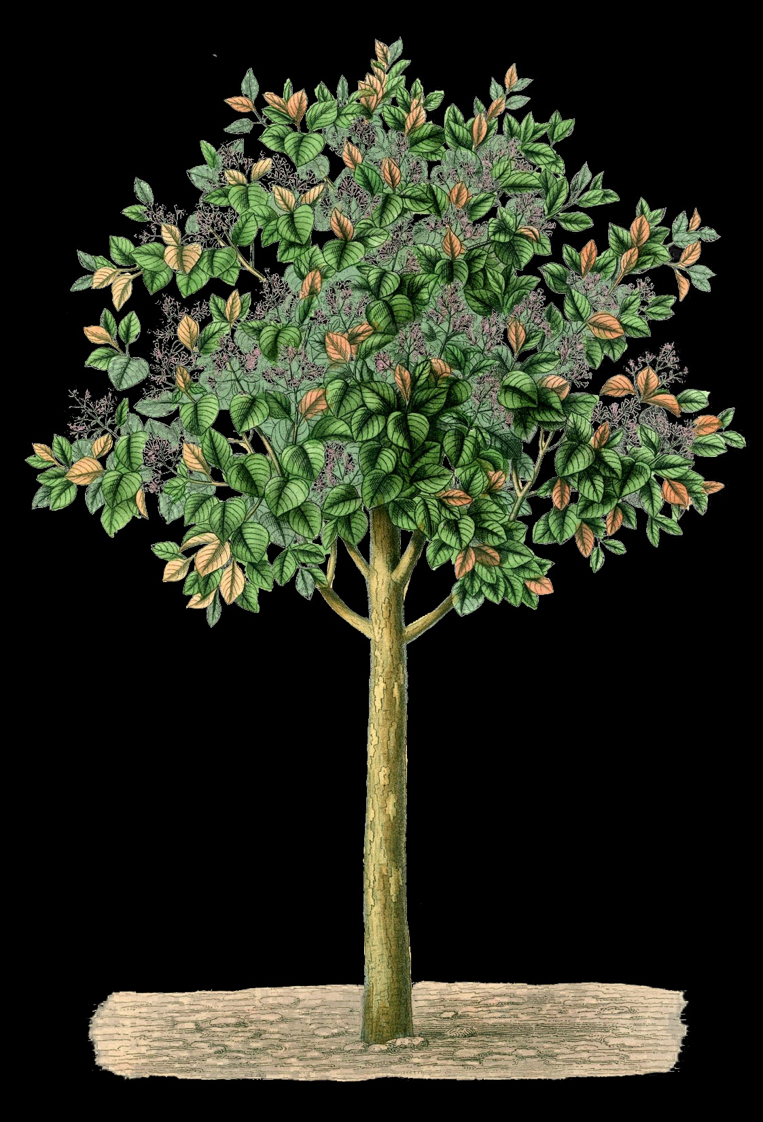
Can trees cause gentrification?

Slide 2
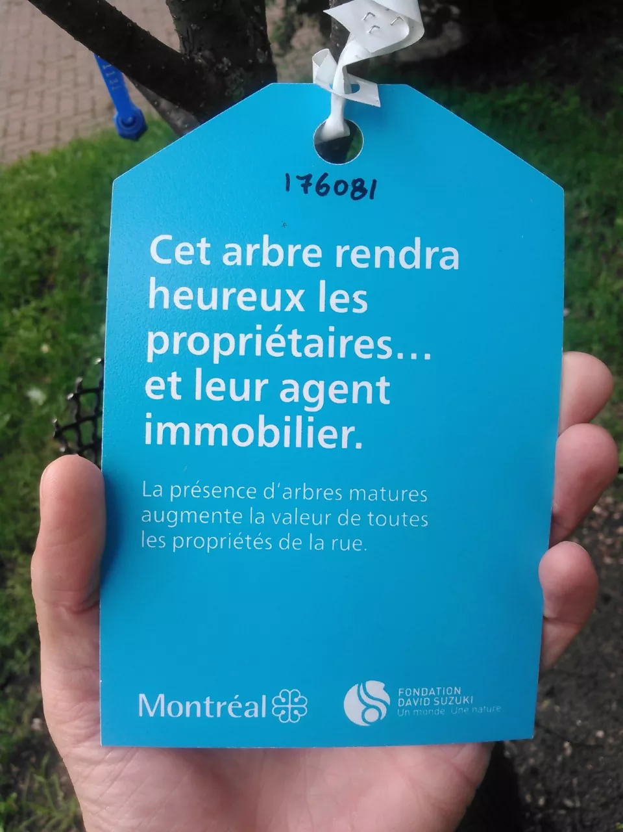
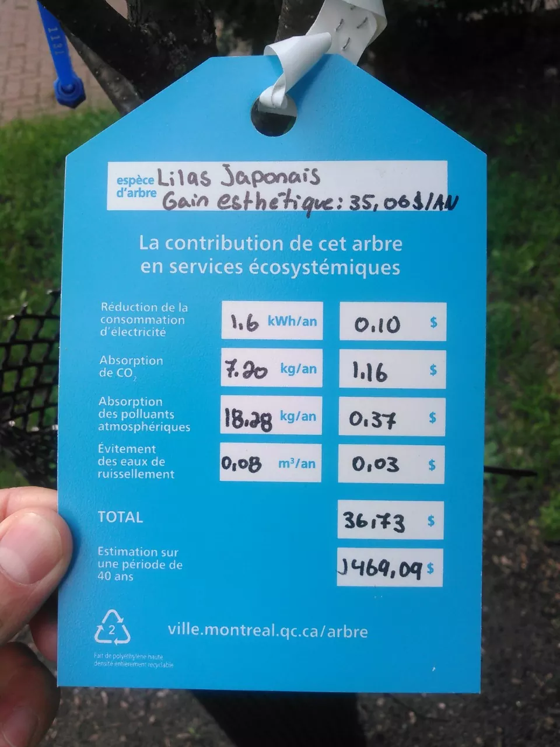
Studies have found that planting more trees can increase property values by up to 7%
Notes:
This tree makes landlords happy… and their real estate agent.

Slide 3
Green gentrification
Increase in property values associated with greening projects, leading to displacement.

Slide 4
Parks, urban agriculture, bicycle lanes, farmers’ markets, and mass transit may all contribute to gentrification.

Slide 5
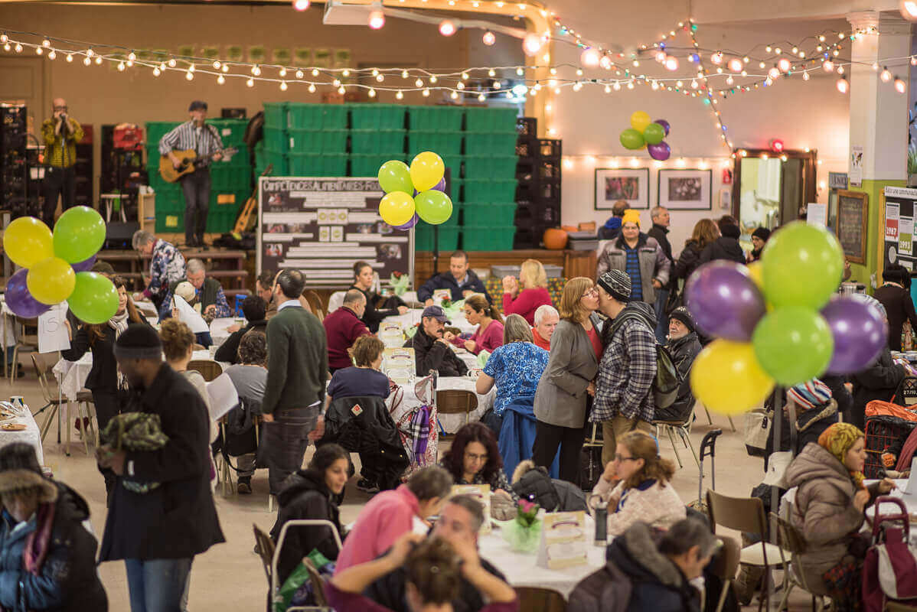
The Depot, Notre-Dame-de-Grâce

Slide 6
The Depot, Notre-Dame-de-Grâce

Slide 7
How can The Depot minimise their possible role in green gentrification?
Best practices
What have other organisations done?

Slide 8
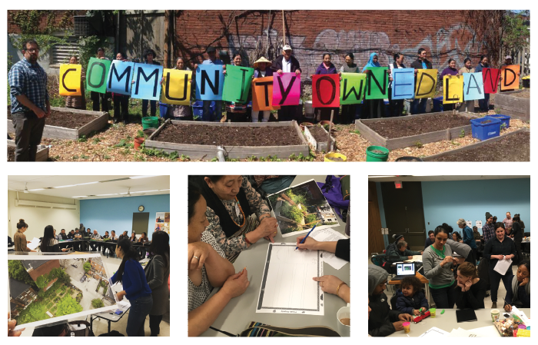
Example 1 Milky Way Garden, Toronto

Slide 9
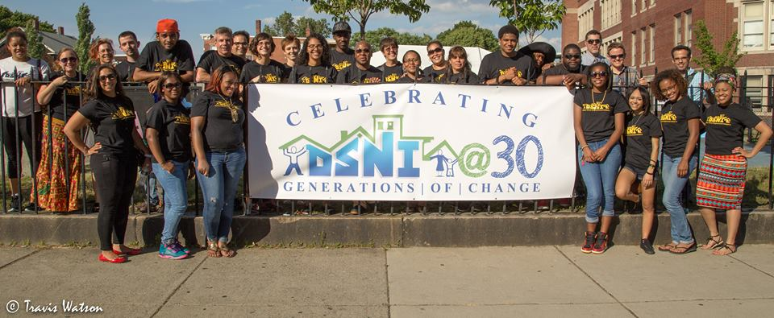
Example 2 Dudley Street Neighbourhood Initiative

