Slide 1
Economic Restructuring
Erik Chevrier
October 6th, 2021

Slide 2
Check in and Updates
1 – Blogs Due Next Week
2 – Student-Led Seminars begin on October 20th

Slide 3
Framing Questions
What do you want?
What do you need?
How can you get these things?

Slide 4
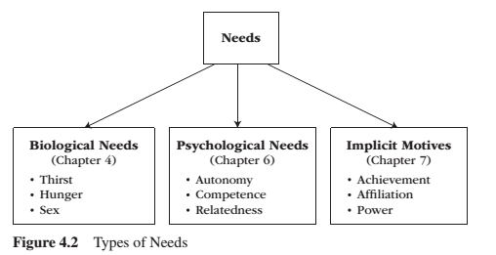
Needs
Need – A condition within the person that is essential and necessary for growth, well-being and life.
Deficiency needs – Are responses to a state of deprivation and generate tension-packed, urgency-laden emotions, such as pain, relief, anxiety, frustration, stress, etc.…
Growth needs – Gently guide behaviour toward a developmental trajectory of growth and well-being. They typically generate positive emotions, such as interest, enjoyment, hope and vitality.

Slide 5
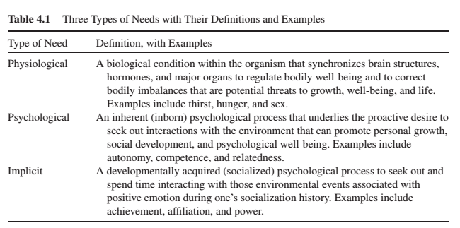
Needs

Slide 6
Diverse Labour

Slide 7
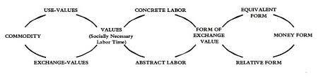
Marx Capital Volume 1

Slide 8
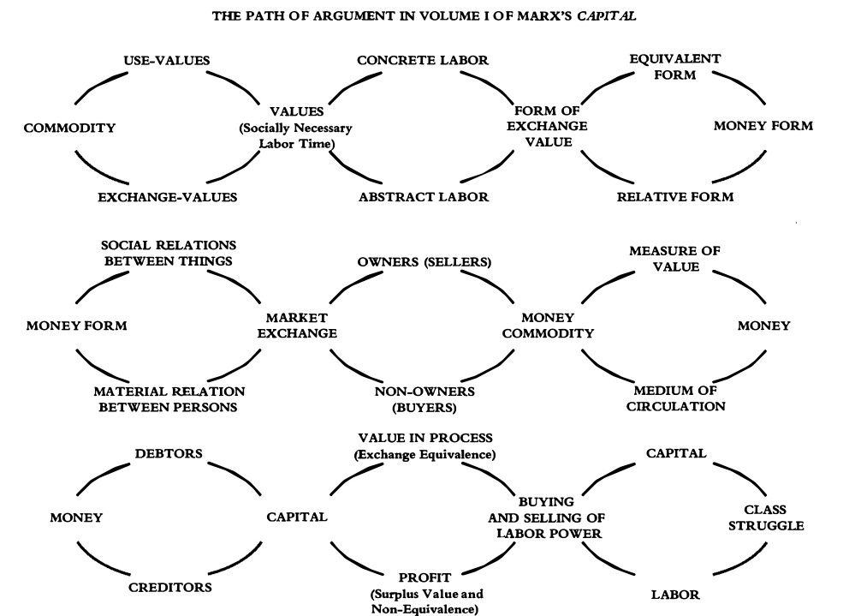
Marx Capital Volume 1

Slide 9
Surplus Value
/
Constant Capital & Variable Capital
Relative Surplus & Absolute Surplus

Slide 10
Discussion About Readings
Chapter 12 – Framing Essay: The Diversity of Labour
Chapter 13 – Precarious Labour: Russia’s ‘Other’ Transition
Chapter 14 – The Persistence of Informal Unpaid Labour: Evidence from UK Households
Chapter 15 – Paid and Unpaid Labour: Feminist Economic Activism in a Diverse Economy

Slide 11
Instructions
Get into groups of about 3 people
  Discuss the chapter and prepare a 5-minute presentation summarizing the article.
  Please prepare a discussion by addressing topics mentioned in the chapter with ‘ethical’ ways of transforming the economy via labour.
You may go anywhere on campus, but you must come back to the classroom at 4:15 PM.

Slide 12
See You Next Week!
Questions, concerns?

