Slide 1
Economic Restructuring
Final Report
Erik Chevrier
www.erikchevrier.ca

Slide 2
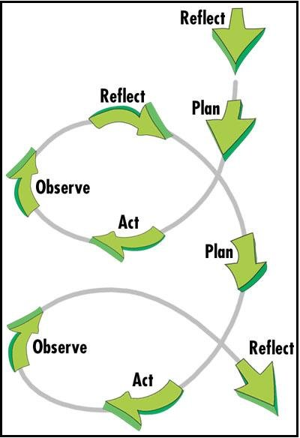
Observe and Reflect
You are at the final stages of the first project spiral. The goal of the final project is for you to observe and reflect on your project.

Slide 3
Final Report Type
You may submit the final report in three formats:
1 – A summary of an interview
2 – Final paper
3 – Report about the work you accomplished

Slide 4
Report About the Work You Accomplished
You must submit one group report.
The report must answer the following questions.
1 – What was your ’project’?
2 – What motivated you to partake in the ‘project’? (why is the topic important)?
2 – Did you meet your goals, objectives, targets? (what were your goals, objectives and targets)?
3 – What was successful about your ’project’?
4 – What could be improved if you were to do the ‘project’ again?
5 – What effects did your project generate in the community? (i.e. positive, negative, intended, unintended)?
6 – What is your succession plan?

Slide 5
Category | F | D | C | B | A
Clarity of Description of ‘project’ | No attempt to describe the ‘project’ your group performed. | Description of ’project’ not clear. | Description of ’project’ somewhat clear. | Description of ’project’ clear, concise and specific. | Description of ’project’ is extremely clear, concise, and specific.
Clarity of Description of the Motivation for the ‘project’ | No attempt to describe the motivation for the ‘project’ your group performed. | Description of the motivation for the ’project’ is not clear. | Description of the motivation for the ’project’ is clear. | Description of the motivation for the ’project’ is clear, concise and specific. | Description of the motivation for the ’project’ is extremely clear, concise, and specific.
Clarity of Description for Targets, Goals and Objectives. | No attempt to describe the targets, goals and objectives | Description of the targets, goals and objectives is not clear. | Description of the targets, goals and objectives is clear. | Description of the targets, goals and objectives is clear, concise, and specific. | Description of the targets, goals and objectives is extremely clear, concise, and specific.
Quality of Re-Envisioning of ‘project’ | No attempt to provide a re-envisioning of the ‘project’. | Below average re-envisioning of the ‘project’. | Good re-envisioning of the ‘project’. | Excellent re-envisioning of the ‘project’. | Well above average re-envisioning of the ‘project’ that refers to classroom resources used to plan the ‘project’ - i.e. SMART analysis, project strategies, etc.
Quality of Succession Plan of ‘project’ (if applicable) | No attempt to provide a succession plan (and there should have been one). | Below average succession plan. | Good succession plan. | Excellent succession plan. | Well above average succession plan.
Assessment of Success, Failures and effects | No attempt to provide an assessment of the success, failures and effects of the ‘project’. | Below average assessment of the successes, failures, and effects of the ‘project’. | Good assessment of the successes, failures and effects of the ‘project’. | Excellent assessment of the successes, failures and effects of the ‘project’. | Well above average assessment of the successes, failures and effects of the ‘project’ that refers to classroom resources used to plan the ‘project’ - i.e. SMART analysis analysis, project strategies, etc.
Clarity of Paper | Report is not clear or legible. | Format is awkward and hard to follow. Proposal does not flow well. Proposal is not structured well. | Format is awkward but easier to follow. Proposal flows somewhat well. Proposal is structured somewhat well. | Format is easy to follow. Proposal flows well. Proposal structured well. | Format is easy to follow and interesting to read. Proposal flows extremely well. The structure of the proposal is outstanding.
Grammar and Sentence Structure | Multiple grammar mistakes making the paper not legible. | Multiple grammar mistakes making it difficult to read. | Several grammar mistakes but it is still clear to read. | One or two grammar mistakes but they do not impair reading experience. | No spelling or grammar mistakes. report is easy to read and flows well.

Slide 6
Interview Report and Presentation
Interview a social entrepreneur or someone involved with a social enterprise or social innovation project.
The goal of the interview is to assess three components:
1 – The organization/project
Questions should address governance, funding, structure, labour, social purpose, etc..
2 – Motivation of interviewee for being part of a social economy enterprise
Questions should assess motivating factors that caused the interviewee to have started a social enterprise. If the interviewee didn’t start the organization/project, what factors motivated them to work in the social economy?
3 – Learning from Practitioners
What lessons can your interviewee provide about achieving success and/or avoiding failure from their experience with a social economy organization/project?

Slide 7
Organization of Interview and Research Report
Reports must include:
An introduction to why this diverse economies topic is important? Contextualize the group/topic by performing a literature review.
A brief overview of the methodology used to conduct the interview or gather information for the report.
Report the findings of the interview or literature review. Summarize the interview or literature review.
Provide a discussion linking the topics addresses in the introduction with the findings derived from the interview or literature review.
Please do not just write out the questions and provide answers but write a research paper about your findings.
Here is an example of a short research report.

Slide 8
Category | F | D | C | B | A
Introduction | No real attempt at providing a literature review or contextualizing the area of social economy of the chosen organization/project. | The proposal provides a below average overview of literature contextualizing the area of economic diversity of the chosen organization/project. | The introduction provides an average overview of literature contextualizing the area of economic diversity of the chosen organization/project. | The introduction provides an above average overview of literature contextualizing the area of economic diversity of the chosen organization/project. | The introduction provides a well above average overview of literature contextualizing the area of economic diversity of the chosen organization/project.
Methodology | No report of methodology. | Methodology is not clear. Questions are not on point. | Methodology is clear. Questions are on point. | Methodology is well explained. Questions are well constructed and on point. | Methodology is extremely well explained. Questions are extremely well constructed and completely on point.
Clarity and Structure | No structure or clarity. | The proposal is not clear, concise, and/or specific. proposal does not flow well. proposal not well structured. | The proposal is somewhat clear, concise, and specific. proposal flows somewhat well. proposal somewhat well structured. | The proposal is clear, concise, and specific. proposal flows well. proposal is well structured. | The proposal is extremely clear, concise, and specific. proposal flows extremely well. The structure of the proposal is outstanding.
Grammar and Sentence Structure | Multiple grammar mistakes making the paper not legible. | Multiple grammar mistakes making it difficult to read. | Several grammar mistakes but it is still clear to read. | One or two grammar mistakes but they do not impair reading experience. | No spelling or grammar mistakes. proposal is easy to read and flows well.
Resources | No classroom readings are referenced. | For the interview: Only one additional source/classroom reading is referenced. For the research report: One to three additional source/classroom reading is referenced. External references are somewhat valid or reliable. References are not used correctly. | For the interview: Two or three external sources/classroom readings are referenced. For the research report: Four to six additional source/classroom reading is referenced. External references are valid and reliable. References are somewhat used correctly. | For the interview: Four or five external sources/classroom readings are referenced. For the research report: Seven to ten additional source/classroom reading is referenced. External references are valid and reliable. References are used correctly. | For the interview: Six or more external sources/classroom readings are referenced. For the research report: Eleven to fifteen additional source/classroom reading is referenced. External sources are extremely reliable, valid, useful and completely on point. All references are used correctly.

