Slide 1
Food and Culture
Introduction to Food and Culture
January 17, 2022
www.erikchevrier.ca

Slide 2
Discussion
What is food?
What is culture?
What is the link between food and culture?

Slide 3
What is Culture?
Raymond Williams
A general process of intellectual, spiritual and aesthetic development.
A particular way of life, whether of a people, period or group.
The works and practices of intellectual and especially artistic activity.
Nesbitt-Larking
The general process of intellectual, spiritual, and artistic development of a people.
The entire way of life of a people, in terms of those practices and facts through which they express their meaning.
High culture – the works and practices of intellectual artistic activity
Culture is the way of life of a people, in particular their evolving ideas, beliefs, and values as they are understood, communicated and represented.
Bennett
Culture consists of all those practices (or activities) that signify; that is, which produce and communicate meaning by the manipulation of signs in socially shared and conventionalized ways.

Slide 4
What is Food Culture?
Food culture refers to the practices, attitudes, and beliefs as well as the networks and institutions surrounding the production, distribution, and consumption of food.
It encompasses the concepts of foodways, cuisine, and food system and includes the fundamental understandings a group has about food, historical and current conditions shaping that group’s relationship to food, and the ways in which the group uses food to express identity, community, values, status, power, artistry and creativity. It also includes a groups’ definitions of what items can be food, what is tasty, healthy, and socially appropriate for specific subgroups or individuals and when, how, why, and with whom those items can or should be consumed.
Source Dr. Long

Slide 5
You Are What You Eat (Johnston, J., & Cappeliez, S. (2012) You Are What You Eat: Enjoying (and Transforming) Food Culture. In Critical Perspectives in Food Studies Second Ed. (2012), Koc, M., Sumner, J., Winson, A. Oxford University Press.
Spillman
Human process of meaning-making generating artifacts, categories, norms, values, practices, rituals, symbols, worldviews, ideas, ideologies, and discourses.
institutions
specific or defined group
part of everyday interactions
how social interactions convey meaning and how meaning is interpreted.
Anne Swidler
Culture is toolkit or repertories
A realistic cultural theory should lead us to understand that people are not passive ‘cultural dopes’ but rather active, sometimes skilled users of culture whom we actually observe
Culture should be viewed as a collection of culturally defined elements
From a reparatory, individuals can pick elements that sustain habitual behaviors or select tools to explore new ways of acting in the world
People have agency but are also led by cultural norms

Slide 6
Food and Culture a Reader
Meaning and practice
Food and Identity
Global and Local Food Production
Food Politics

Slide 7
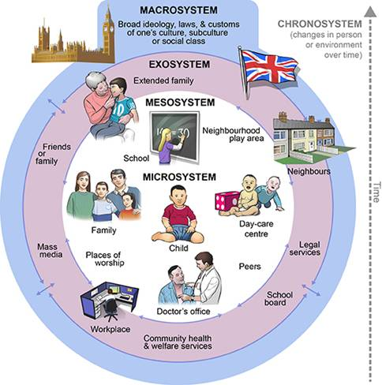
Ecological Systems Theory of Development

Slide 8
You Are What You Eat (Johnston, J., & Cappeliez, S. (2012) You Are What You Eat: Enjoying (and Transforming) Food Culture. In Critical Perspectives in Food Studies Second Ed. (2012), Koc, M., Sumner, J., Winson, A. Oxford University Press.
Giddens
Practical consciousness – Tacit understandings and intuitive decisions people make as they go about daily routines but they can’t always directly express.
Discursive consciousness – Formal articulations and rationalizations for actions.
Bourdieu
Habitus – Tastes become internalized and converted into a disposition that generates meaningful practices and meaning-giving perceptions
Habitus typically translates people’s social class into their embodied taste preferences that may give them advantages later on in life.

Slide 9
What Does it Mean to Eat Your Cultural Identity?
IGA Tim Horton's I am Canadian I am not Canadian

Slide 10
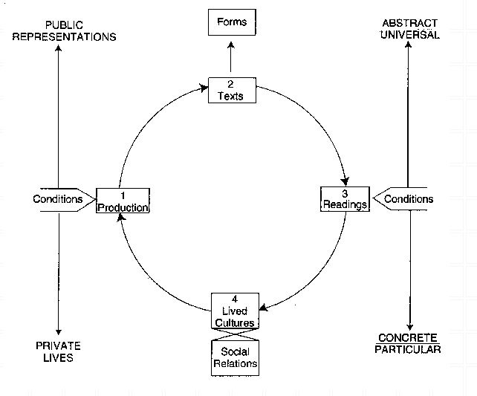
General Framework
Richard Johnson What is Cultural Studies Anyways, Social Text, (1986-87)

Slide 11
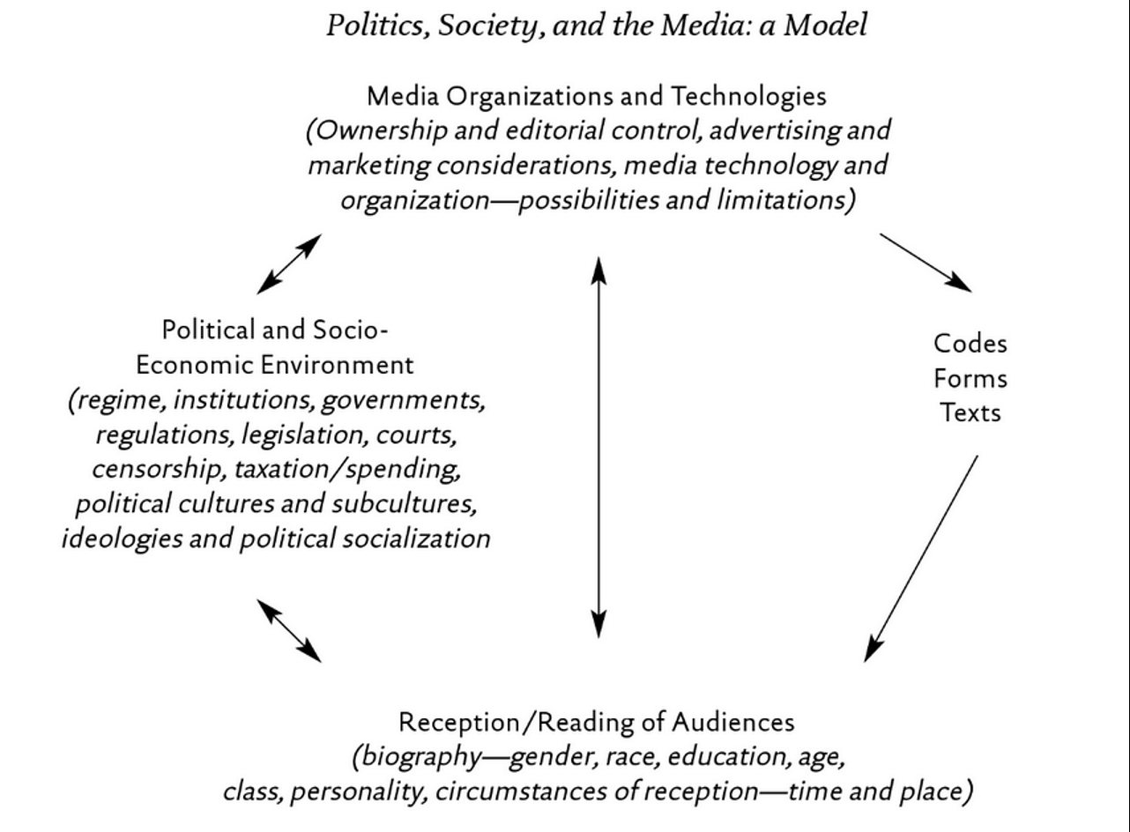
Critical Multidimensional Model
Paul Nesbitt-Larking. Politics, Society and the Media (2nd Edition). Broadview Press. 2009.

Slide 12
Analyze a brand of Breakfast Cereals Through One of These Models

Slide 13
Please Think About and Answer the Following Questions
How does culture influence eating practices? More concretely, what kinds of food culture promotes healthy, environmentally friendly choices? What kinds of food culture undermine these choices?
When (and how frequently) do food choices involve conscious awareness and how many choices are more automatic?
What factors motivate consumers to consume sustainable foods produced with fair labour practices (e.g. fair-trade chocolate)?

Slide 14
Thanks!
Have a great week! Don’t forget to keep your plant healthy!

