Slide 1
Food and Sustainability
Erik Chevrier
January 6, 2022

Slide 2
Introduction – Let’s Talk About Food
What is your name? Tell the group about yourself in two minutes!
What type of food consumer are you?
What’s your favourite/least favourite food? Why?
Do you have any specific dietary needs (vegan, vegetarian, allergies, etc.)?
Are you a conscientious food consumer? Why? Why not?
What experience do you have producing food (gardening, farming, etc.)?
What experience do you have transforming/processing food (cooking)?
What experience do you have preserving food (canning, fermenting, etc.)?
What experience do you have with waste management (composting, repurposing, etc.)?

Slide 3
What does it Mean to Have a Sustainable Diet?
Is your diet sustainable?

Slide 4
What does it Mean to Have a Sustainable Diet?
The term sustainability has lost meaning because it has been used for corporate/political greenwashing.
We need to refocus the conversation on what we are sustaining.
Sustainability refers to the perpetuation of something…the something is the important factor!
Instead we should ask:
What social, environmental and political conditions does our food practices sustain?
Effects can be positive and/or negative
Intended and/or unintended
We can be aware and/or unaware of these effects
Effects can take place on a macro and/or micro level

Slide 5
Is Your Diet Sustainable?
Digging deeper, we can ask:
Political economic conditions:
What were the labour conditions of the farmers that produced your food?
What social inequalities are expressed via your food consumption?
Individual and Social Health
How does your diet contribute to your individual health?
How does your diet impact the health of the community and the world at large?
Environmental Health
How does your diet affect biodiversity?
What is the environmental impact of your diet?

Slide 6
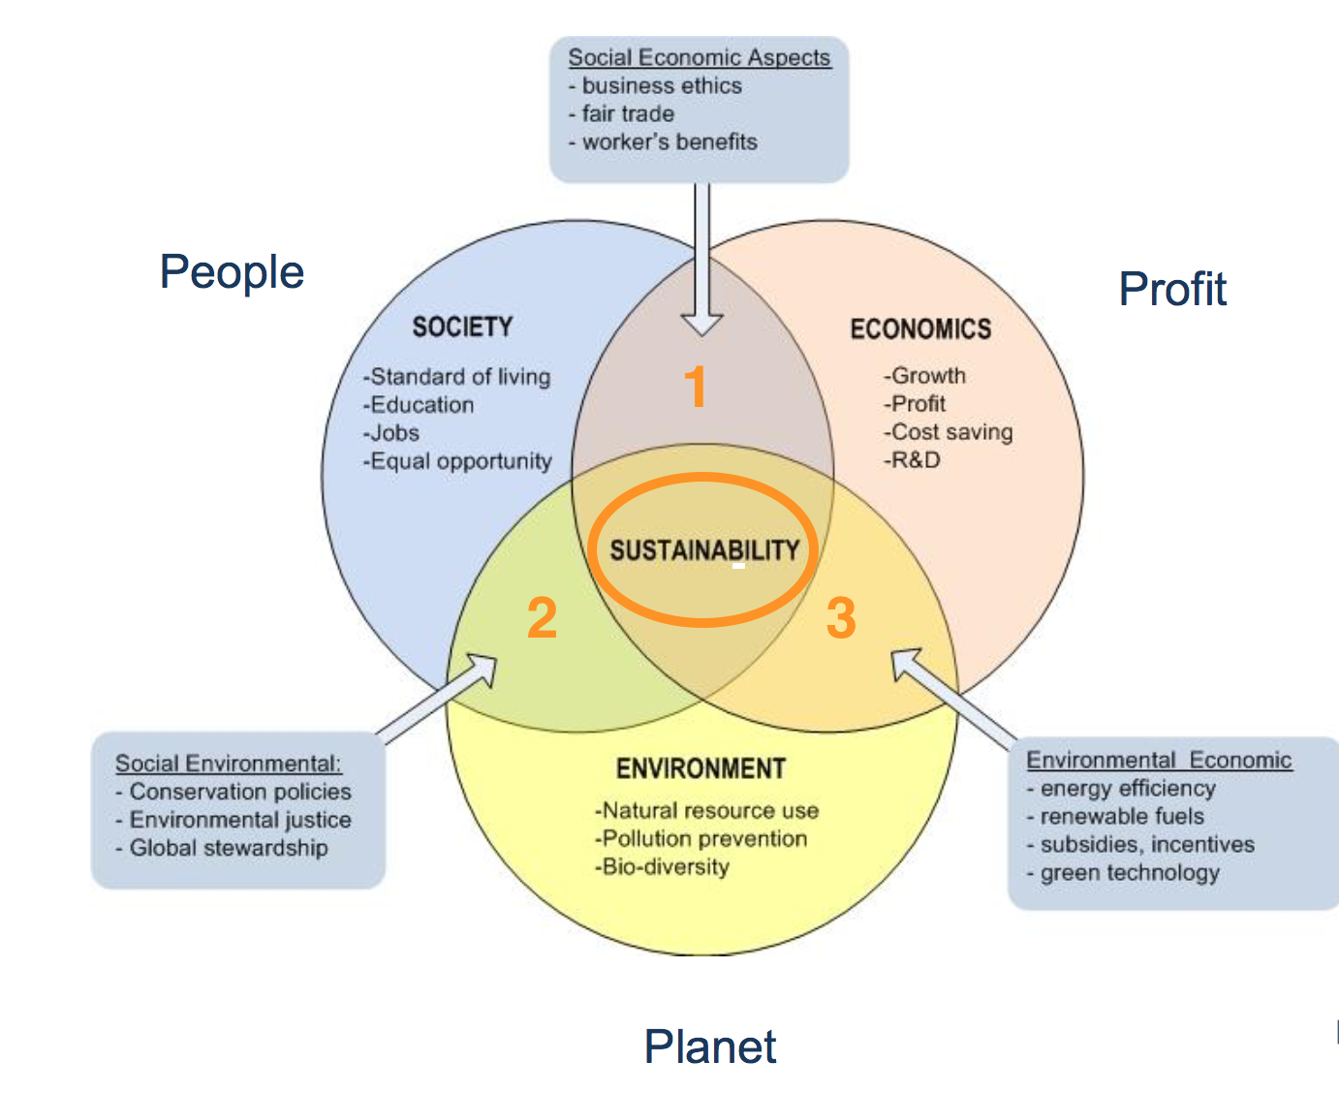
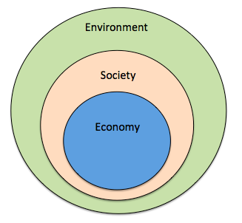
Prioritize the Biosphere and Social Relations Over the Market
Triple Bottom line
Nested model

Slide 7
Measuring and Meeting Expectations
Why did you take this course?
What do you want to get out of this course?
What aspects of food and sustainability interest you?
What excites you about the course?
What issues do you foresee with the course?
How do you expect to do in the course?

Slide 8
Activity Planting a Seed
Like a seed grows into a plant, we will all grow intellectually together as a class.
Take care of your plant and we’ll take care of each other’s intellectual and social needs during this course.
Your plant will need water, room to grow, light and nutrients (if it grows big).
How can you grow a plant group discussion…

Slide 9
Questions or Concerns?
Thanks!
Have a great day!
Before Next Class – Plant a Seed

