Slide 1
Food and Sustainability
Community Service Learning Project Proposal
Erik Chevrier

Slide 2
Assignments
Community Service Project (20 Points): This assignment aims to give students hands-on experience by participating with sustainable food initiatives. Students must form a group; however, they may choose to work on something in a group that already exists and/or create something with like-minded people outside the classroom. Students will form clusters and contribute to the project based on their area of expertise. For example, someone with great research skills could get involved with the research portion of the project, someone with media skills can build media infrastructure, someone with great interpersonal communication skills can be the mobilizer, among other tasks. Students will be evaluated based on the depth of their involvement with the project, their deliverables, clearly reporting their contribution to the project, and linking the project to the course material.
Proposal (10 Points): (Due February 24th)
Community Service Learning Project Proposal: Students must submit a proposal that describes the project, discuss their anticipated involvement, outline deliverables that will be performed by the student, provide a clear timeline for what they will accomplish, discuss the importance of the project and link the project to course material.

Slide 3
Action-Research Possibilities
1 – Students can contribute to updating the Concordia Food Groups Research Project maps www.concordiafoodgroups.ca
2 – Students can participate in developing Coop CultivAction
  Research on beneficial native plant varieties to add to the Duff-Court Farm perennial garden
  Annotated bibliography on benefits and limitations to urban agriculture
  Microgreens (only a few)
  Create new food initiative
    Kombucha
    Berry growing and smoothy bar
    Campus bakery
    Get the Concordia Farmers Market going again
    Get Campus Potager going again
    Waste management, compost, transformation/preservation, fermentation
    COVIQ Premier Moisson
3 – Students can volunteer with a campus-community organization in or around Concordia.
  Meal Exchange/Concordia Food Coalition
  People’s Potato
  Hive Free Lunch
4 – Students can find another food organization to work with in their local area.
5 – Students can create a new community food initiative at Concordia University or in the community at large.

Slide 4
Action Research Proposal
The proposal must:
  Provide a summary of what each person plans on contributing to the project
  Provide a summary of goals, objectives and targets you would like to achieve
  Provide a way to evaluate whether you meet your goals, objectives and targets
  Provide a summary of key strategies you will employ to accomplish your goals and objectives
  Please provide a timeline of your tasks and when you will complete each task
  Link project (or process) to readings and/or other sources
  If you want to get funding, you may Complete the SAF Application Form

Slide 5
Importance of Action Based Research
Why are action-based projects important?
  It is important to challenge the problematic dominant epistemological understandings of capitalism.
  Instead we should produce ontological formations of the world we want by co-creating and co-recreating social relations that produce positive outcomes on people and the planet.
  Action based learning theories incorporate students and facilitators as co-learners and co-collaborators. Together, they learn by doing. They also connect with the community.
Epistemology – A term meaning “theory of knowledge,” which gets at the how we know about the social world that lies behind all theoretical approaches. (Frampton, Kinsman, Thompson, Tileczek, (2006))
Ontology – Assumptions relating to how the social comes into being that inform all theories and ways of writing the social. (Frampton, Kinsman, Thompson, Tileczek, (2006))

Slide 6
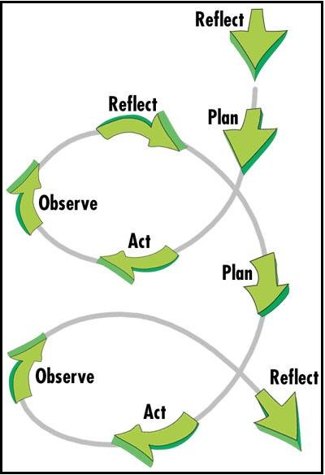
Changing the World Via Action Research

Slide 7
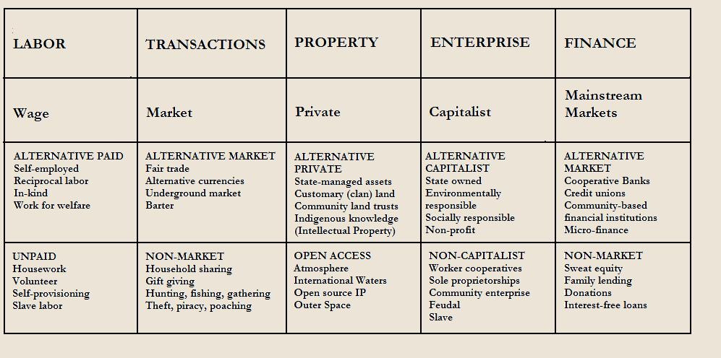
Take back the Economy
Gibson-Graham, J.K., Cameron, J., Healy, S. (2013) Take Back the Economy: An Ethical Guide for Transforming Communities, University of Minnesota Press

Slide 8
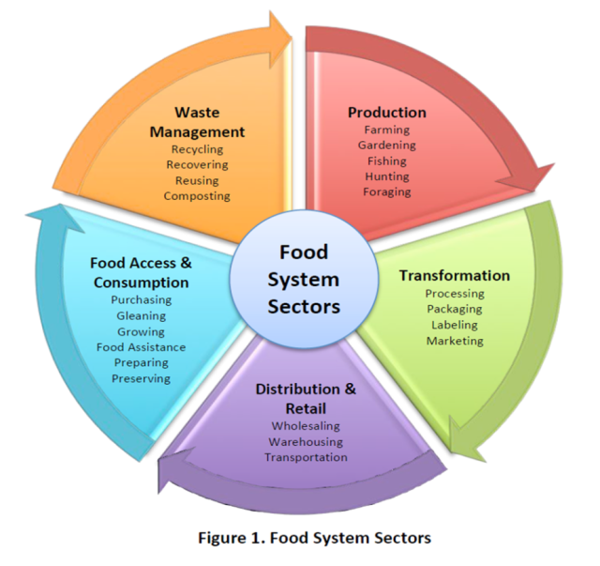

Slide 9
Mapping Community Food Systems
PRODUCTION | PROCESSING | DISTRIBUTION | WASTE MANAGEMENT | SUPPORT
Food | Cook | Market | Compost - Soil Building | Funding
Tools | Prepare | Redistribution | Water saving - Irrigation | Space
Knowledge | Ferment | Reciprocity | Seed Saving - Seed Sewing | Labour
Social Capital | Preserve | Self/community provisioning | Re-purpose food
 | Transform
 | Freeze/store
 | Dehydrate
 | Can

Slide 10
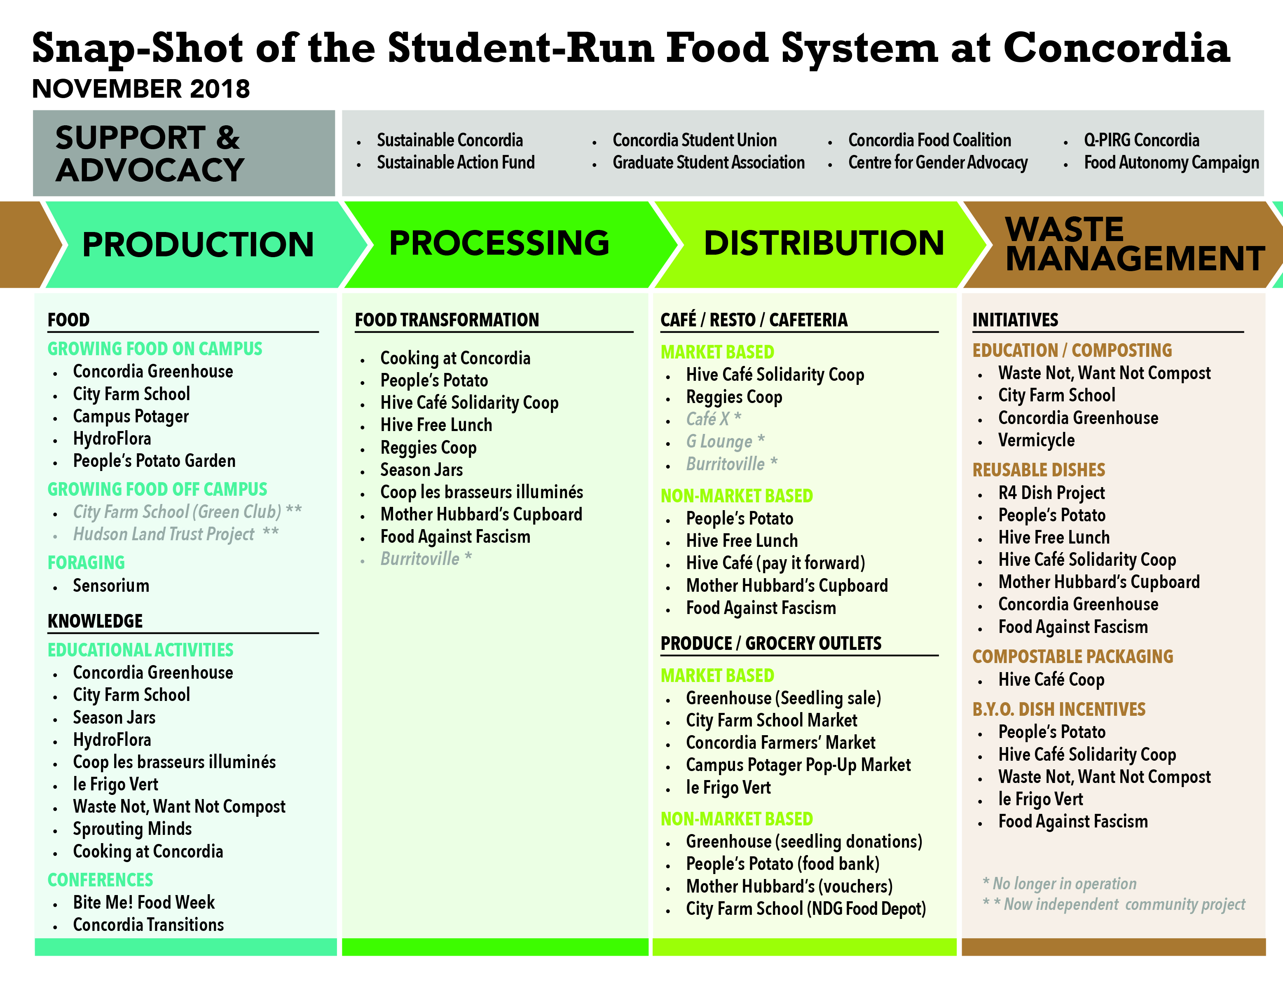

Slide 11
Category | D | C | B | A
Clarity of Ideas | Proposal is not clear, concise and specific. Ideas are not well developed. | Proposal is somewhat clear, concise and specific. Ideas are somewhat developed. | Proposal is clear, concise and specific. Ideas are well developed. | Proposal is extremely clear, concise and specific. Ideas are exceptionally well developed.
Clarity of Written Proposal | Format is awkward and hard to follow. Proposal does not flow well. Proposal is not structured well. | Format is awkward but easier to follow. Proposal flows somewhat well. Proposal is structured somewhat well. | Format is easy to follow. Proposal flows well. Proposal structured well. | Format is easy to follow and interesting to read. Proposal flows extremely well. The structure of the proposal is outstanding.
Quality of Ideas | Proposal does not address key issues relating to economic restructuring, as discussed in class or via the readings. The idea needs to be reworked. Proposal projects no impact in the community. Provides a superficial overview of the issue. | Proposal slightly address key issues relating to economic restructuring , as discussed in class or via the readings. The idea is acceptable but should be slightly tweaked. Proposal projects a slight impact in the community. Provides an overview of the issue. | Proposal address key issues relating to economic restructuring, as discussed in class or via the readings. The idea is acceptable as is. Proposal projects to have an impact in the community. Provides a well researched overview of the issue. | Proposal address key issues relating to economic restructuring, as discussed in class or via the readings with accuracy and precision. Proposal projects a meaningful impact in the community. Provides an in-depth, well researched overview of the topic. The idea is great!
Grammar and Sentence Structure | Multiple grammar mistakes making it difficult to read. | Several grammar mistakes but it is still clear to read. | One or two grammar mistakes but they do not impair reading experience. | No spelling or grammar mistakes. Article is easy to read and flows well.
Clarity of Action Plan | The proposal does not have a clear action plan. The proposal does not outline your involvement in the project nor does it provide a clear indication of what sources you will use to gather information. | The proposal has a vague action plan. The proposal provides a vague outline your involvement in the project and a vague indication of what sources you will use to gather information. . | The proposal has a clear action plan. The proposal provides a clear outline your involvement in the project and a clear indication of what sources you will use to gather information. | The proposal has a clear, concise, specific action plan. The proposal provides an exceptionally clear outline your involvement in the project and an exceptionally clear indication of what sources you will use to gather information.
Resources | No external sources/classroom readings are referenced. External references are not valid or reliable. References are not used correctly. | Only one external source/classroom reading is referenced. External references are somewhat valid or reliable. References are used somewhat correctly. | Two or three external sources/classroom readings are referenced. External references are valid and reliable. References are used correctly. | Four or more external sources/classroom readings are referenced. External sources are extremely reliable, valid, useful and completely on point. All references are used correctly.
Analysis of Goals, Targets and objectives | Goals, targets and objectives are not clearly identified. Goals, targets and objectives are not realistic. Key strategies to meet goals, targets, and objectives are not appropriate. | Goals, targets and objectives are somewhat clearly identified. Goals, targets and objectives are somewhat realistic. Key strategies to meet goals, targets, and objectives are somewhat appropriate. | Goals, targets and objectives are clearly identified. Goals, targets and objectives are realistic. Key strategies to meet goals, targets, and objectives are appropriate. | Goals, targets and objectives are clearly identified and completely on point. Goals, targets and objectives are completely realistic and on point. Key strategies to meet goals, targets, and objectives are completely appropriate and on point.

