Slide 1
Advertising and the Consumer Culture
Community Service Learning Project and proposal
Erik Chevrier

Slide 2
Assignments
Community Service-Learning Project: The objective of this assignment is to give students hands on experience with creating promotional campaigns that enhance the Concordia community and community at large. Students will devise a media campaign to promote a social cause, social economy organization, non-profit and/or another community group. Students are encouraged to work with students from Erik Chevrier’s course Food and Sustainability, where students are expected to create social food cooperatives and/or food justice campaigns.
Students will form clusters and contribute to the project based on their area of expertise. Students will be evaluated based on the depth of their involvement with the project, their deliverables (which will be agreed upon in their proposal), clearly reporting their contribution to the project, an oral presentation summarizing their role in the project, and linking the project to the course material.

Slide 3
Proposal Instructions
You must submit a group and individual proposal.
The group report must:
Provide a description of your project
Provide a summary of goals, objectives and targets you plan on achieving (as a group and individually)
Provide a way to evaluate whether your group meet these goals, objectives and targets (as a group and individually)
Provide a summary of key media strategies your group will employ to accomplish the goals and objectives
Identify target audience, medium, messaging, SWOT analysis…
Please provide a timeline of the group and everyone's tasks and when you will complete each task
Link project (or process) to readings and/or other sources

Slide 4
Possible Projects
Coop CultivAction
Microgreen program
Duff-Court Urban Farm
Urban Agriculture Education Program
Promotional Material (videos, recipe blogs, etc.)
Work with campus group, project or campaign
Work with students from Food and Sustainability
Work with a local community social economy group/project

Slide 5
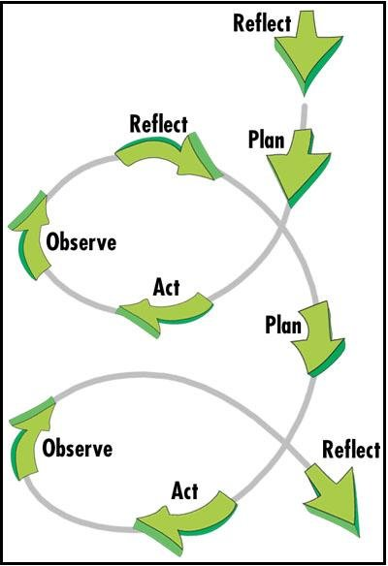
Marketing and Action Research

Slide 6
Marketing Plan for Community Organizations
1 – Define your marketing goals (Specific Measurable Attainable Relevant Timely)
2 – Understand your audiences
3 – Craft your key messages
4 – Choose, plan, and create your marketing strategies
5 – Analyze your marketing performance
Free Online Resource for ideas about how to promote community organizations/projects

Slide 7
Category | D | C | B | A
Clarity of Ideas | Proposal is not clear, concise and specific. Ideas are not well developed. | Proposal is somewhat clear, concise and specific. Ideas are somewhat developed. | Proposal is clear, concise and specific. Ideas are well developed. | Proposal is extremely clear, concise and specific. Ideas are exceptionally well developed.
Clarity of Written Proposal | Format is awkward and hard to follow. Proposal does not flow well. Proposal is not structured well. | Format is awkward but easier to follow. Proposal flows somewhat well. Proposal is structured somewhat well. | Format is easy to follow. Proposal flows well. Proposal structured well. | Format is easy to follow and interesting to read. Proposal flows extremely well. The structure of the proposal is outstanding.
Quality of Ideas | Proposal does not address key issues relating to needs of the organizations. The idea needs to be reworked. | Proposal slightly address key issues relating to needs of the organizations. The idea is acceptable but should be slightly tweaked. | Proposal address key issues relating to needs of the organizations. The idea is acceptable as is. | Proposal address key issues relating to the needs of the organizations, with accuracy and precision. The idea is great!
Grammar and Sentence Structure | Multiple grammar mistakes making it difficult to read. | Several grammar mistakes but it is still clear to read. | One or two grammar mistakes but they do not impair reading experience. | No spelling or grammar mistakes. Article is easy to read and flows well.
Clarity of Action Plan | The proposal does not have a clear action plan. The proposal does not outline your involvement in the project nor does it provide a clear indication of what objectives you will accomplish. | The proposal has a vague action plan. The proposal provides a vague outline your involvement in the project and a vague indication of what objectives you will accomplish. . | The proposal has a clear action plan. The proposal provides a clear outline your involvement in the project and a clear indication of what objectives you will accomplish. | The proposal has a clear, concise, specific action plan. The proposal provides an exceptionally clear outline your involvement in the project and an exceptionally clear indication of what objectives you will accomplish.
Resources | No external sources/classroom readings are referenced, or primary research done. External references are not valid or reliable. References are not used correctly. | Only one external source/classroom reading is referenced, or only superficial primary research is done. External references are somewhat valid or reliable. References are used somewhat correctly. | Two or three external sources/classroom readings are referenced, and primary research is well done. External references are valid and reliable. References are used correctly. | Four or more external sources/classroom readings are referenced, and primary research is well done and completely on point. External sources are extremely reliable, valid, useful and completely on point. All references are used correctly.
Analysis of Goals, Targets and objectives | Goals, targets and objectives are not clearly identified. Goals, targets and objectives are not realistic. Key strategies to meet goals, targets, and objectives are not appropriate. | Goals, targets and objectives are somewhat clearly identified. Goals, targets and objectives are somewhat realistic. Key strategies to meet goals, targets, and objectives are somewhat appropriate. | Goals, targets and objectives are clearly identified. Goals, targets and objectives are realistic. Key strategies to meet goals, targets, and objectives are appropriate. | Goals, targets and objectives are clearly identified and completely on point. Goals, targets and objectives are completely realistic and on point. Key strategies to meet goals, targets, and objectives are completely appropriate and on point.

Slide 8
Category | D | C | B | A

Slide 9
Category | D | C | B | A

