Slide 1
Advertising and the Consumer Culture
Advertising and the economy
Erik Chevrier
February 15th, 2022

Slide 2
What is Capitalism?
What features of an economic, social and political system does capitalism have?

Slide 3
What is Capitalism?
Markets
Profit
Private ownership of the means of production
Money based system
Financial markets
Private property
Alienation
Exploitation
Wage Labour
Externalities
Expendable work force
Inequality
Advertising
Consumerism
Firms
Institutions
Imperialism
Colonialism
Exchange
Free (non-slave) labour
Cycles and crisis
Growth
Competition
What does post-capitalism/anti-capitalism mean?

Slide 4
What is Capitalism?
Holm (2017) Advertising, Capitalism and Ideology
Weber’s Six Characteristics of Modern Capitalism
  Private ownership of property
  Free trade in markets
  Rational accounting practices
  Predictable and consistent legal systems
  Free (non-slave) labour
  A formal system for partial ownership of business and property
    Other mentions: Profit, trade, exchange.
Milton Friedman – Capitalism is the organization of the bulk of economic activity through private enterprise operating in a free market.
James Fulcher – Capitalism is essentially the investment of money in the expectation of making a profit. Capitalism requires the circulation of capital. It also is a system that produces profits.

Slide 5
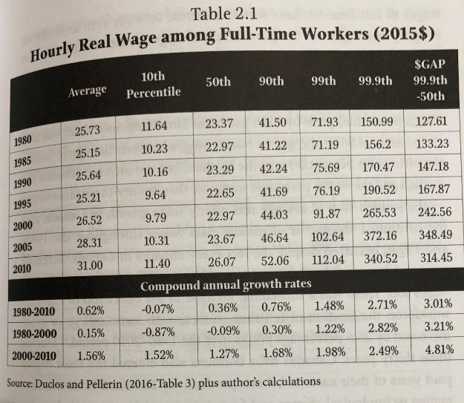
Real Hourly Wages
Osberg, L. (2018) The Age of Increasing Inequality – The Astonishing Rise of Canada’s 1%, James Lorimer and Company.

Slide 6
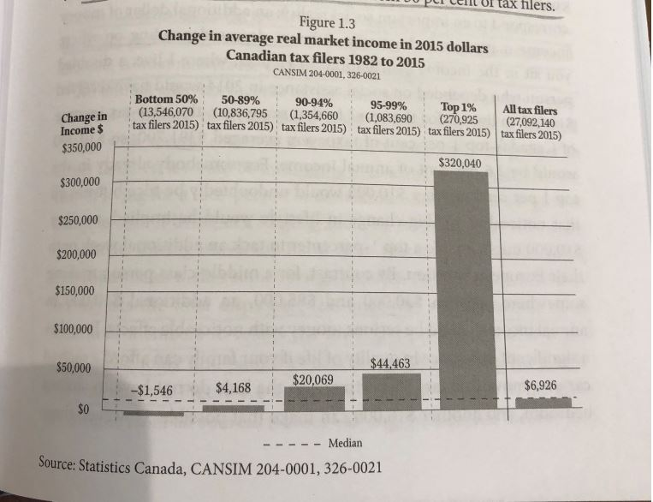
Real vs Market Income
Osberg, L. (2018) The Age of Increasing Inequality – The Astonishing Rise of Canada’s 1%, James Lorimer and Company.

Slide 7
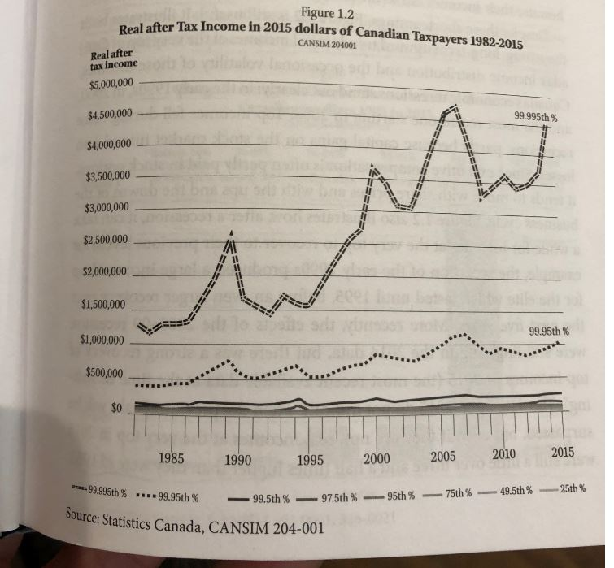
Real Income
Osberg, L. (2018) The Age of Increasing Inequality – The Astonishing Rise of Canada’s 1%, James Lorimer and Company.

Slide 8
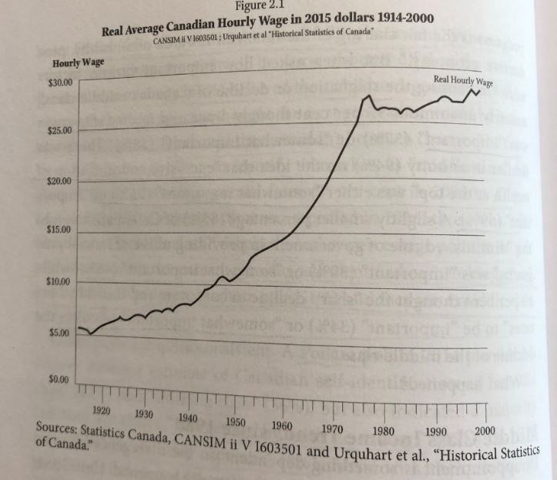
Average Wage
Osberg, L. (2018) The Age of Increasing Inequality – The Astonishing Rise of Canada’s 1%, James Lorimer and Company.

Slide 9
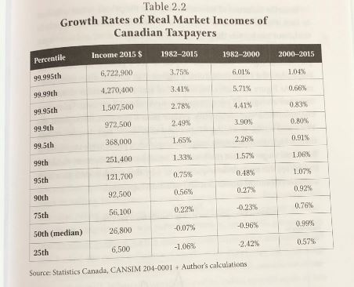
Growth Rates of Real Market Incomes
Osberg, L. (2018) The Age of Increasing Inequality – The Astonishing Rise of Canada’s 1%, James Lorimer and Company.

Slide 10
What is Political Economy?
Holm (2017) Advertising, Capitalism and Ideology
Political economy:
  The study of how economic relations inform and are informed by other aspects of society and culture.
  Economics influences not just the buying and selling of goods but also the wider and seemingly unrelated aspects of our society.
  One central methodology in media studies, whereby scholars seek to understand the textual forms, social influence, and political role of the media through the study of the economics of the media.
  Political economy looks at society as a totality – not different units like economics, culture, religion, sports, science, etc.

Slide 11
Aristotle Aristotle. Aristotle in 23 Volumes, Vol. 21, translated by H. Rackham. Cambridge, MA, Harvard University Press; London, William Heinemann Ltd. 1944.
Chrematistics – art of acquisition – limitless accumulation unnatural and problematic
Oikonomia – management of the household – true form of an economy

Slide 12
Karl MarxMarx, K. Capital Volume 1, Penguin Classics.
C – C – Basic barter
C – M – C – The way classical economists viewed basic barter with money
M – C – M’ – What really happens when barter systems incorporate money – Limitless accumulation
M – M’ – Usury capital system – Limitless accumulation

Slide 13
Karl PolanyiPolanyi, K. (2001) The Great Transformation; The Political and Economic Origins of Our Time, Beacon Press
Types of economic practices:
  Markets (exchange)
  Household economy
  Redistribution
  Reciprocity

Slide 14
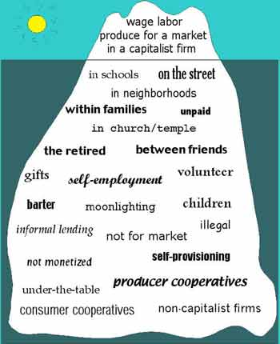
Gibson Graham – Take back the Economy Gibson-Graham, J.K., Cameron, J., Healy, S. (2013) Take Back the Economy: An Ethical Guide for Transforming Communities, University of Minnesota Press
Katherine Gibson Interview Playlist

Slide 15
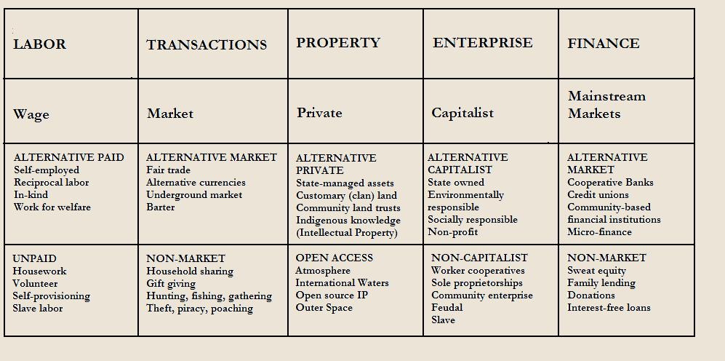
Gibson Graham – Take back the Economy Gibson-Graham, J.K., Cameron, J., Healy, S. (2013) Take Back the Economy: An Ethical Guide for Transforming Communities, University of Minnesota Press

Slide 16
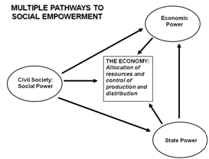
Envisioning Real Utopias – Erik Olin Wright
Olin Wright, E. (2010) Envisioning Real Utopias, Verso

Slide 17
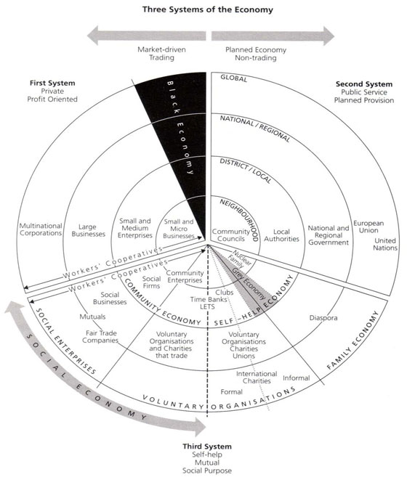
Three Systems of an Economy – John Pierce
Pearce, J. (2009) Social Economy: Engaging as a Third System, In Amin, A. The Social Economy; International Perspectives on Economic Solidarity, p. 26.

Slide 18
Discussion
How does Advertising Relate to Ideology and Capitalism?

Slide 19
Advertising, Capitalism and Ideology
Holm (2017) Advertising, Capitalism and Ideology
Marxism and Capitalism
Naturalizing Capitalism
Advertising and Ideology
  Raymond Williams – Official art of modern capitalism
Advertising as Ideological State Apparatus
  Louis Althusser – Reproduction of relations of production – Ideological state apparatus vs repressive state apparatus
Ideology in Practice
  Consumption becomes how people gain control over their everyday practices and master the world around them
  Example with Visa
  Fantasy and pleasure
  Focus on relation to consumption instead of production
  Self-realization through consumption
  Separate relations between consumption and production
Consumer Society and the Magic System
  Raymond Williams – Not materialist enough
Materialism – Utility vs ‘magic system’
Magic system and society of the spectacle
Selling Capitalism
  Capitalist realism vs socialist realism

Slide 20
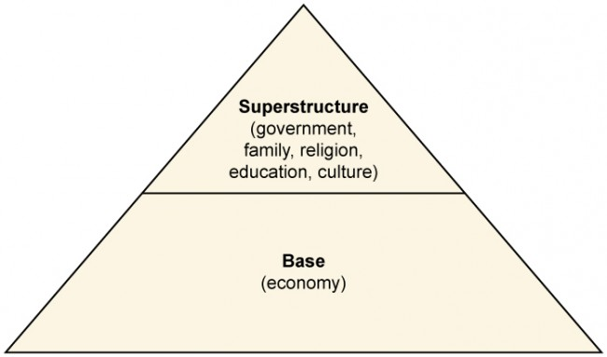
What is Ideology?
Holm (2017) Advertising, Capitalism and Ideology

Slide 21
Learning Check
According to Holm:
What is capitalism? What are the three definitions of capitalism (Weber, Friedman, Fulcher)? What is political economy? What is the Marxist view of capitalism? What is ideology? What is the base and superstructure and how does this relate to the logic of capitalism? How is capitalism naturalized and how does this relate to advertising and ideology? How is advertising described as an ideological state apparatus? What is the repressive state apparatus? What does ‘the magical system’ of consumer society refer to? What does Williams suggest about materialism and advertising? What does Debord mean by the ‘society of the spectacle’ and how does this relate to advertising? How does advertising sell capitalism? What is capitalist realism and socialist realism and how does this relate to advertising?
According to Aristotle, what is chrematistics and oikonomia?
According to Polanyi, what are four types of economic practices that are found in all societies?
What does Gibson-Graham mean by a ‘diverse economy’?
According to Olin Wright, what are the three powers that control the allocation of resources and production and distribution?
JOHN PEARCE AND THE STATISTICS FROM OSBERG WILL NOT BE ON THE EXAM

