Slide 1
Food and Culture
Recap on Food meaning and Practice
February 7, 2022
www.erikchevrier.ca

Slide 2
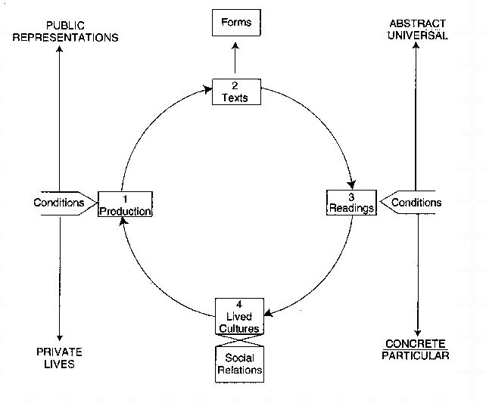
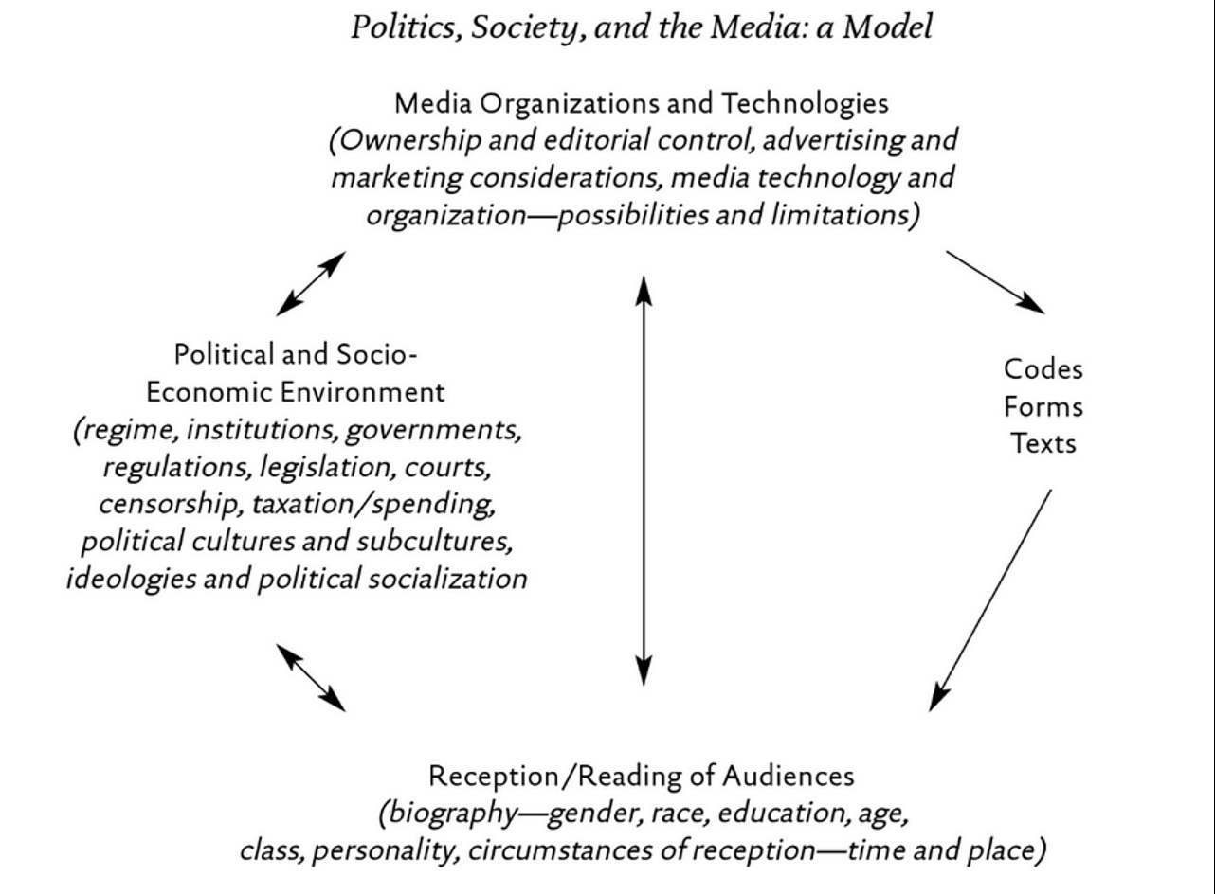
Analyze a Food Item by Using One of These Models

Slide 3
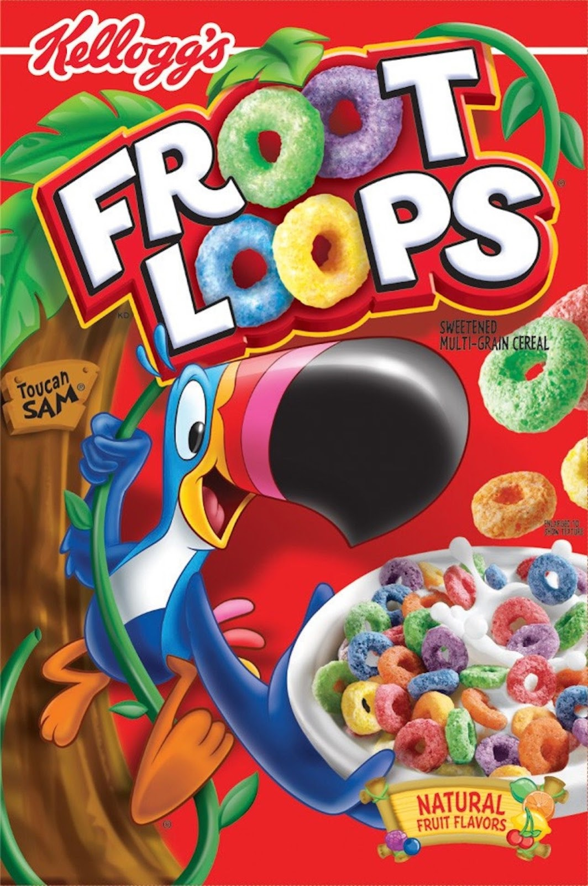

Slide 4
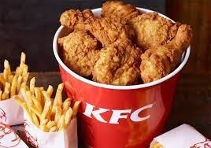

Slide 5
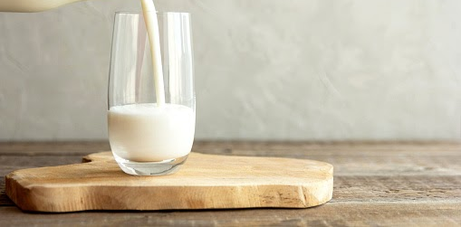

Slide 6
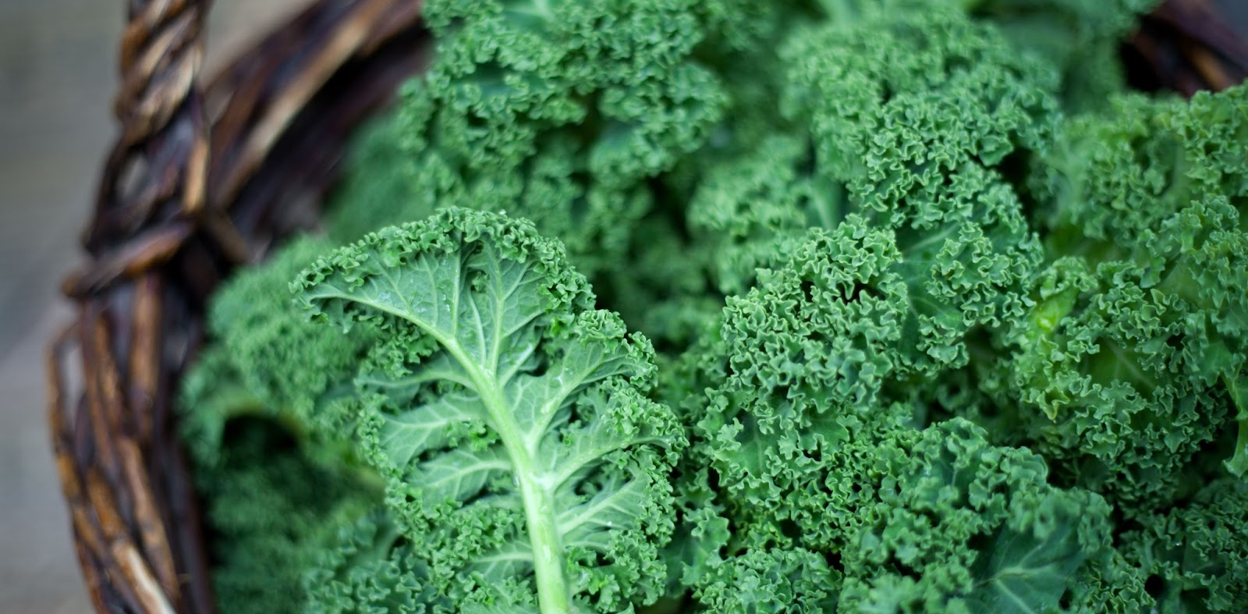

Slide 7
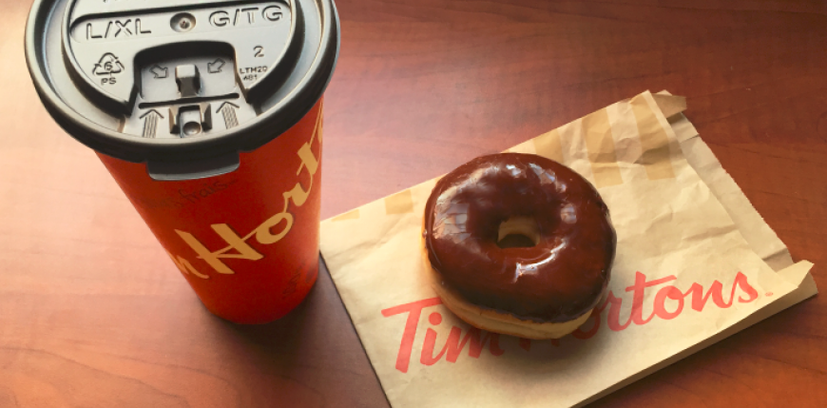

Slide 8
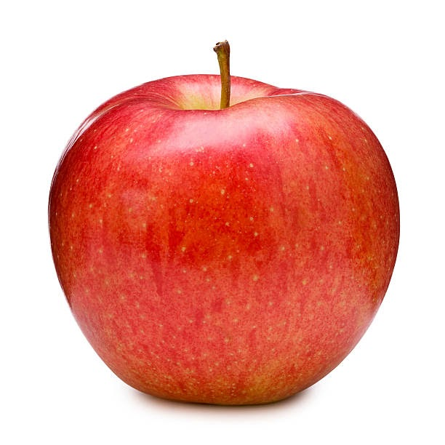

Slide 9
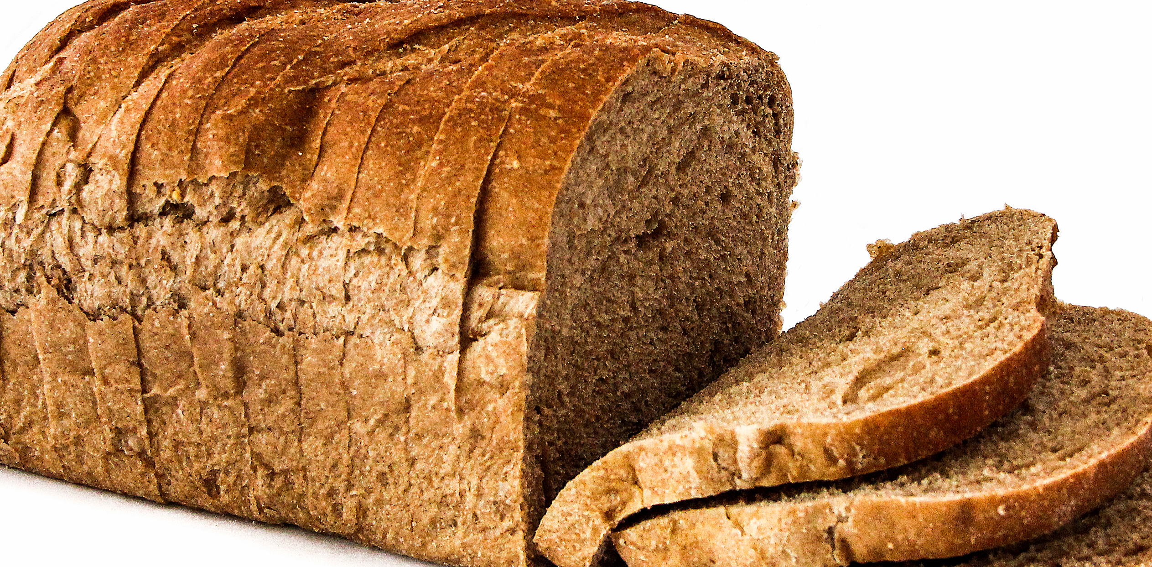

Slide 10
Thanks!
Have a great week! Don’t forget to keep your plant healthy!

