Slide 1
Food and Sustainability
Group Project Final Report
Erik Chevrier
www.erikchevrier.ca

Slide 2
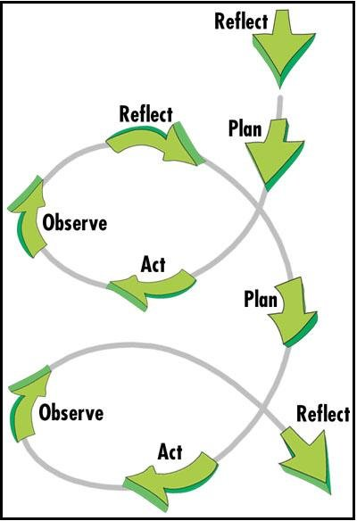
Observe and Reflect
You are at the final stages of the first project spiral. The goal of the final project is for you to observe and reflect on your project.

Slide 3
Report About the Work You Accomplished
You must submit one group report.
The report must answer the following questions.
1 – What was your ’project’?
2 – What motivated you to partake in the ‘project’? (why is the topic important)?
3 – Did you meet your goals, objectives, targets? (what were your goals, objectives and targets)?
4 – What was successful about your ’project’?
5 – What could be improved if you were to do the ‘project’ again?
6 – What effects did your project generate in the community? (i.e. positive, negative, intended, unintended)?
7 – What is your succession plan?

Slide 4
Category | F | D | C | B | A
Clarity of Description of ‘project’ | No attempt to describe the ‘project’ your group performed. | Description of ’project’ not clear. | Description of ’project’ somewhat clear. | Description of ’project’ clear, concise and specific. | Description of ’project’ is extremely clear, concise, and specific.
Clarity of Description of the Motivation for the ‘project’ | No attempt to describe the motivation for the ‘project’ your group performed. | Description of the motivation for the ’project’ is not clear. | Description of the motivation for the ’project’ is clear. | Description of the motivation for the ’project’ is clear, concise and specific. | Description of the motivation for the ’project’ is extremely clear, concise, and specific.
Clarity of Description for Targets, Goals and Objectives. | No attempt to describe the targets, goals and objectives | Description of the targets, goals and objectives is not clear. | Description of the targets, goals and objectives is clear. | Description of the targets, goals and objectives is clear, concise, and specific. | Description of the targets, goals and objectives is extremely clear, concise, and specific.
Quality of Re-Envisioning of ‘project’ | No attempt to provide a re-envisioning of the ‘project’. | Below average re-envisioning of the ‘project’. | Good re-envisioning of the ‘project’. | Excellent re-envisioning of the ‘project’. | Well above average re-envisioning of the ‘project’ that refers to classroom resources used to plan the ‘project’ - i.e. SMART analysis, project strategies, etc.
Quality of Succession Plan of ‘project’ (if applicable) | No attempt to provide a succession plan (and there should have been one). | Below average succession plan. | Good succession plan. | Excellent succession plan. | Well above average succession plan.
Assessment of Success, Failures and effects | No attempt to provide an assessment of the success, failures and effects of the ‘project’. | Below average assessment of the successes, failures, and effects of the ‘project’. | Good assessment of the successes, failures and effects of the ‘project’. | Excellent assessment of the successes, failures and effects of the ‘project’. | Well above average assessment of the successes, failures and effects of the ‘project’ that refers to classroom resources used to plan the ‘project’ - i.e. SMART analysis analysis, project strategies, etc.
Clarity of Paper | Report is not clear or legible. | Format is awkward and hard to follow. Proposal does not flow well. Proposal is not structured well. | Format is awkward but easier to follow. Proposal flows somewhat well. Proposal is structured somewhat well. | Format is easy to follow. Proposal flows well. Proposal structured well. | Format is easy to follow and interesting to read. Proposal flows extremely well. The structure of the proposal is outstanding.
Grammar and Sentence Structure | Multiple grammar mistakes making the paper not legible. | Multiple grammar mistakes making it difficult to read. | Several grammar mistakes but it is still clear to read. | One or two grammar mistakes but they do not impair reading experience. | No spelling or grammar mistakes. report is easy to read and flows well.

