Slide 1
Food and Sustainability
Food Commodities and Capitalism Erik Chevrier March 10, 2022 www.erikchevrier.ca

Slide 2
Discussion
What is capitalism?

Slide 3
What is Capitalism?
Markets Profit Private ownership of the means of production Money based system Financial markets Private property Alienation Exploitation Wage Labour Externalities Expendable work force Inequality Advertising Consumerism Firms Institutions Imperialism Colonialism Exchange Free (non-slave) labour Cycles and crisis Growth Competition Limited democracy (usually representational)

Slide 4
What is This?

Slide 5
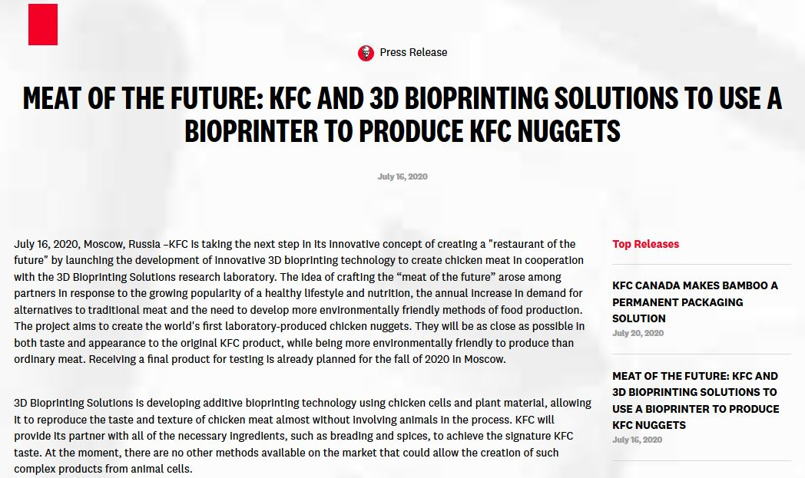

Slide 6
Commodification of Food
Commodity:
Cambridge English Dictionary
A substance or product that can be traded, bought, or sold.
A valuable quality
Oxford Dictionary
A raw material or primary agricultural product that can be bought and sold, such as copper or coffee.
A useful or valuable thing.
Myriam-Webster Dictionary
An economic good: such as
A product of agriculture
An article of commerce especially when delivered for shipment
A mass-produced unspecialized product commodity chemicals
Something useful or valued
Convenience, advantage
A good or service whose wide availability typically leads to smaller profit margins and diminishes the importance of factors (such as brand name) other than price
One that is subject to ready exchange or exploitation within a market

Slide 7
What is the Value of This? What determines the Value of a Food Commodity?

Slide 8
What is the Value of This? What determines the Value of a Food Commodity?

Slide 9
Commodification of Food
Marx circulation of commodities and money
C – C
C – M – C
M – C – M’
See Diagram on Board Regarding Marx’s Value Theory
Polanyi – ‘Fictitious Commodities’
Land
Labour
Money
…FOOD!

Slide 10
Value of a Food Commodity

Slide 11
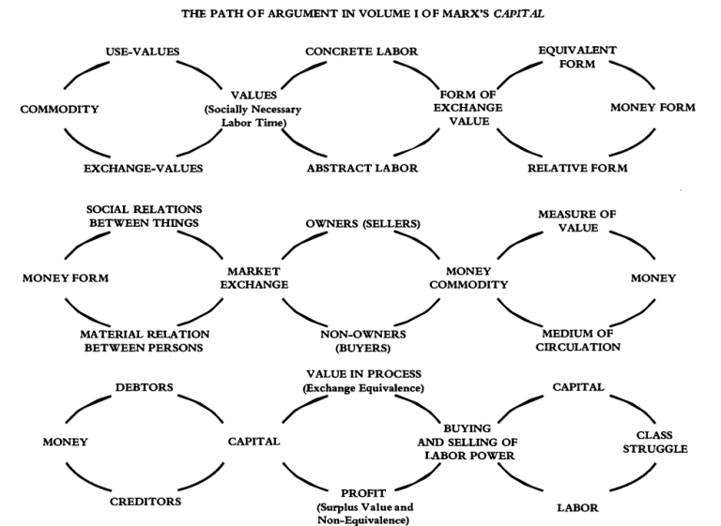
Value of a Food Commodity Visit David Harvey’s Website and/or Read Capital Volume 1

Slide 12
Value of a Food Commodity

Slide 13
Discussion
What does Holt-Giménez suggest about food being a special commodity?
How can we build a rights framework around food when it is treated as a commodity?
What are the conditions of food labour today and in the past?
How can we provide meaningful labour to farmers and not prevent people from eating?

Slide 14
Importance of Labour
Reproduction of the worker
Relative vs Absolute Surplus Value
Low prices = Low wages
Subsistence farming

Slide 15
Privatization of Food
GATT – General Agreement on Tariffs and Trade – 1947 – 1994
TRIPS Agreement
World Trade Organization – 1995
Vernon Hugh Bowman
Percy Schmeiser
Percy Schmeiser on Democracy Now
Monsanto vs Farmers
The World According to Monsanto

Slide 16
History of the Capitalist Food System
Rooted in Political Economy
Feudalism
Industrial Revolution
Creating enclosures
Separation from livelihood
Corn Laws 1815 (UK)
Mercantilism
Primitive Accumulation
Colonialism
Slavery

Slide 17
Food Regimes
First Regime – Colonialism
Regulation – uphold private property
Dispossession – of land and resources
Exploitation – of labourers
Technological development
Market expansion
Second Regime – Post-War
Over production
New Deal (in USA)
Parity (for farmers)
Migrant labourers
Green Revolution
Corporate Food Regime – Late 70’s Onwards
Profit
Neo-liberalism
Monopolies
Corporations
Globalization

Slide 18
Inequality Updates!!!
World Inequality Index
Videos
Crises of Capitalism
Beware, Fellow Plutocrats, the Pitchforks are Coming

Slide 19
Food Regimes (Wittman, 2011)

Slide 20
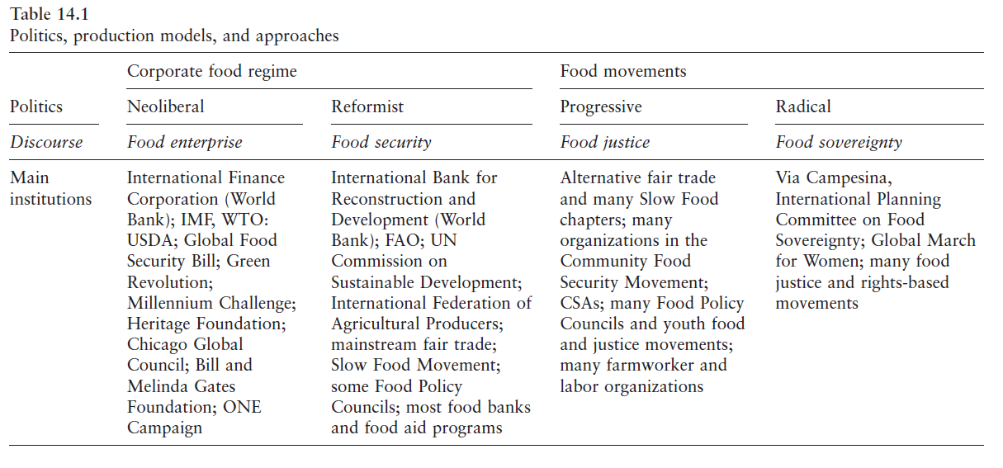

Slide 21
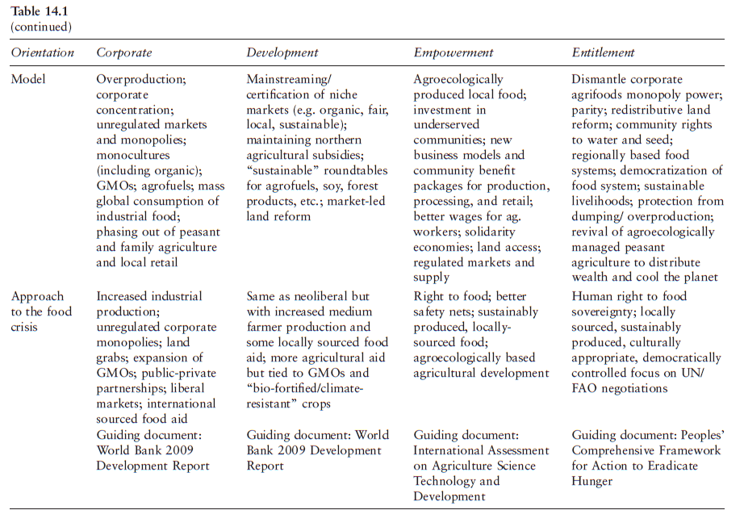

Slide 22
Take Back the Economy – Commons Toolkit Gibson-Graham, J.K., Cameron, J., Healy, S. (2013) Take Back the Economy: An Ethical Guide for Transforming Communities, University of Minnesota Press
Types of commons:
Biophysical – Exist naturally – i.e. rocks, soil, air, etc.
Cultural – Things shared by members of the same culture – i.e. language, musical heritage, symbols
Social – Things shared between members of a social system – i.e. education, health, political systems
Knowledge – Things people know – i.e. Indigenous ecological knowledge, scientific achievements
Ways to assess commons. To be a commons:
Access – Must be shared widely
Use – Must be negotiated by a community
Benefit – Must be distributed to the community and possibly beyond
Care – Must be performed by community members
Responsibility – Must be assumed by the community
Property – Must be collectively owned private property, state owned property and/or open access property

Slide 23
Discussion
How can we ‘re-common’ food?
How can we eliminate food insecurity?
How can we begin to decommodification of land and food?
How can farms be part of a social economy?

Slide 24
Video
Vandana Shiva – Ted Talk
Hero’s Sanctuary
Vandana Shiva on Food Sovereignty at Concordia

