Slide 1
Advertising and the Consumer Culture
Advertising Agencies
Erik Chevrier
March 15, 2022

Slide 2
Discussion
Who wants to work in advertising?
What is an advertiser?
  Tasks
  Jobs
  Types of employment
  Knowledge or skillset needed
  Salary

Slide 3
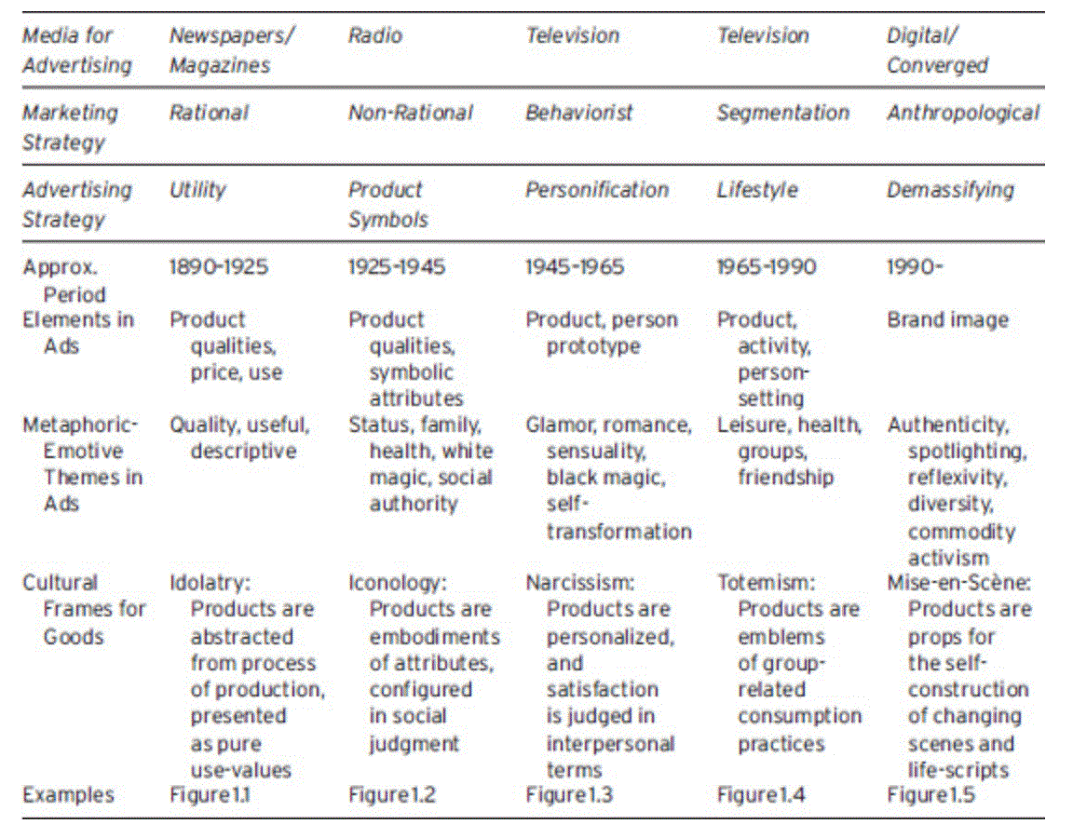
Social Communication in Advertising
Table 1.1 Cultural Frames That Summarize The Development of Media, Marketing and Advertising

Slide 4
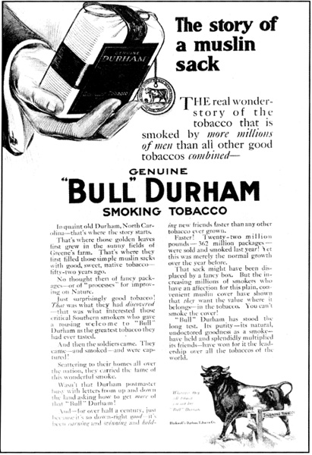
Social Communication in Advertising
Table 1.1 Cultural Frames That Summarize The Development of Media, Marketing and Advertising

Slide 5
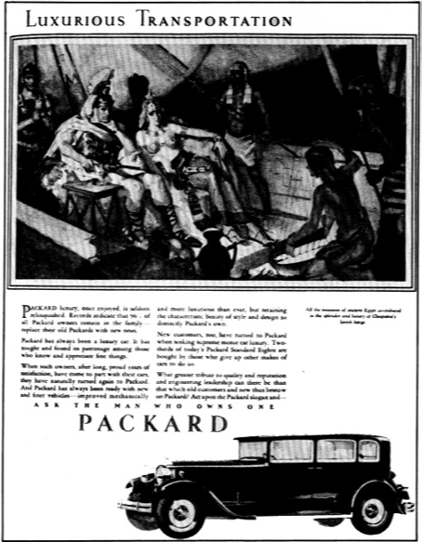
Social Communication in Advertising
Table 1.1 Cultural Frames That Summarize The Development of Media, Marketing and Advertising

Slide 6
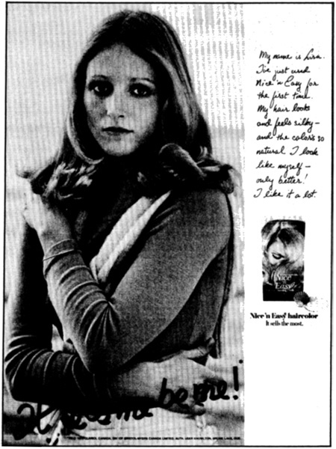
Social Communication in Advertising
Table 1.1 Cultural Frames That Summarize The Development of Media, Marketing and Advertising

Slide 7
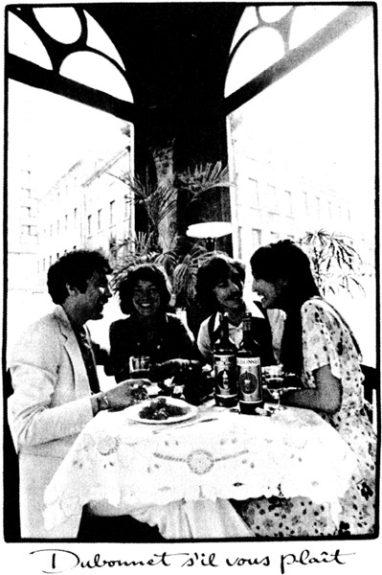
Social Communication in Advertising
Table 1.1 Cultural Frames That Summarize The Development of Media, Marketing and Advertising

Slide 8
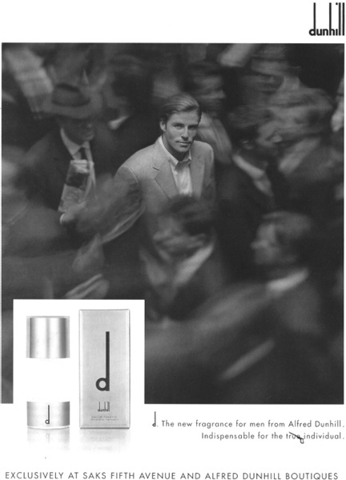
Social Communication in Advertising
Table 1.1 Cultural Frames That Summarize The Development of Media, Marketing and Advertising

Slide 9
History of Advertising
Advertising and Consumer Society (Holm, 2017)
Four Moments in advertising history
First Moment: Origins of industrial development
  Pre capitalist societies had art forms but these cannot be considered advertising
  Factors that led to the development of advertising
    Urbanization (expropriation from agricultural communities to cities)
    Rationalization (reformation of time and space)
    Mass production and distribution (development of industrialization and capitalism)
    Mass media (development and proliferation of mass media)
  Beginning of consumer society
    New division of labour
    New way of understanding products
    Increases in production needed to be matched by increases in consumption
  People start defining themselves by their consumption
    Purchase way to a better life
  Promote general use of advertising
  Advertising agencies were space brokers

Slide 10
History of Advertising
Advertising and Consumer Society (Holm, 2017)
Four Moments in advertising history
Second Moment: Professionalism, consolidation and redemption
  Consolidation of advertising agencies
    Lack of professionalism, accountability and organization
      False claims in patent medicine
  Fear of advertising
  Development of ‘full service’ agencies
    Market research, creative art, space brokers – 1920s
    More respected profession
      N.W. Ayer and Sons
        Factual copy
        Research – demographics and brand preference
      John. E. Powers
        Plain speech & fine writing is offensive
      John E. Kennedy
        Reason why advertising

Slide 11
History of Advertising
Advertising and Consumer Society (Holm, 2017)
Four Moments in advertising history
Third Moment: Manipulation, creativity, and globalization
  Booming consumer culture of 1950s
  Industry seen as repetitive, monotonous, and dull
  Fear of advertising
    Vince Packard – The Hidden Persuaders
    James Vicary – Subliminal Advertising Fiasco
  Creative Revolution
  Television ads
    Emotional ads

Slide 12
History of Advertising
Advertising and Consumer Society (Holm, 2017)
Four Moments in advertising history
Fourth Moment: Digital advertising, algorithms, and data-surveillance
  Move towards globalization
    Mergers between companies and advertising agencies (mega agencies)
  Online advertising
  Search engine optimization – SEO
    Google – AdWords (algorithms)
  Old ad format integrated into ‘new’ media
    Seeking new methods
  Social media and viral ads
    Facebook & Spotify, etc.
    Data mining
    People share content

Slide 13
Limits to Abstraction
What are limits to abstraction as pointed out by Holt in chapter 7, Advertising agencies: Organizations, agency and internal conflict?
What does Holm mean by the human touch of advertising?
What is the dual meaning of agency?
Why does Holm consider structures and agencies as part of a chicken-or-the-egg argument?

Slide 14
The Limits to Abstraction
Limits to abstraction include:
  Theories tend to offer a monolithic account
    i.e. profit motive
  Can present the world as determined by oppressive forces
    i.e. it cannot be resisted and cannot change
  Theories tend to offer a monolithic account
    i.e. profit motive
  Ads are made by real people
    Who have values, morals, political beliefs, and motivations
  Cronin (2004)
    Advertising is not an infallible commercial machine, inexorably generating and disseminating consistently persuasive promotional tools. Instead, advertising is much more complicated and piecemeal practice where the people involved are constantly working to justify themselves and their products in response to wider cultural changes.

Slide 15
Structure and Agency
Agency refers to:
  Business involved in the creation, planning, and placement of advertisements
  A central sociological term meaning that finds its complement and opposition in the idea of a structure
    The ability (or belief in the ability) of either humans or collective groups of humans to act in a conscious and reflexive manner to enact change in the world.
    Complementary term is structure – sets of rules that shape human behaviour in particular ways
  Circular Reasoning – Structures are the products of the actions of human agents; while on the other hand, the behaviour of agents is determined and shaped by structures.
  Structuralist thinkers place more emphasis on ‘institutions’ than on individual agency
  Main concern of structuralists in their view of advertising is capitalism
  We can also focus on the agency of people
  We need to account for both structure and agency

Slide 16

Ecological Systems Theory of Development

Slide 17
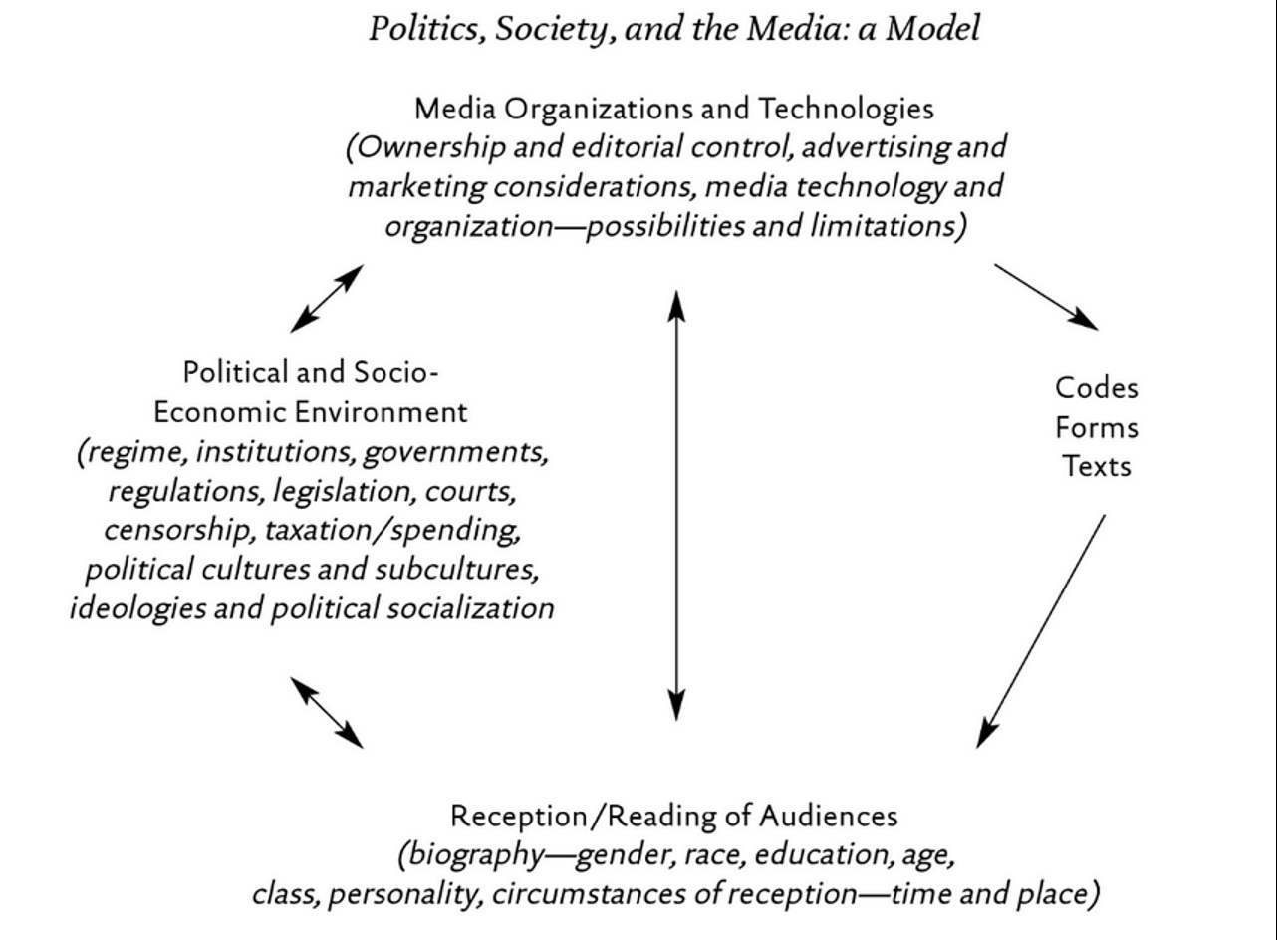
RECAP – Critical Multidimensional Model
Paul Nesbitt-Larking. Politics, Society and the Media (2nd Edition). Broadview Press. 2009.

Slide 18
Advertising Agencies Today
Advertising agencies are central corporate entities involved in the planning, production and placement of advertising.
  Different shapes and sizes – small firms to mega agencies
  List of the largest mega agencies
    WPP
    Omnicom Group
    Publicis Groupe
    Interpublic Group
    Dentsu
    Association of Creative Communications Agencies
    Get into groups and research these mega-agencies
    What brands (smaller agencies) do they have?
    What is their revenues?
    What is their history?
    What type of cooptation are they?
    Who owns these companies?

Slide 19
The Different Parts of An Agency
Full-Service Agency
  Media (buying and planning)
  Account management
  Creative (ad conception designers)
  Production (productive labourers)
  Account Planning (research)

Slide 20
Changing Agencies
Space Brokers
Full-Service Agency
Consolidation of full-service agencies to global mega corporations
Specialized agencies (unbundling = separation of media buying and creative-production)
Boutique agencies (media specialists)

Slide 21
Advertisers in their Voices
David Ogilvy (2004) – Confessions of an Advertising Man
  How to guide/memoir
  Wild west and gentleman's club
  A set of rules for principled success that extol the reader to live a life that is brave and principled
  Prepared to be risky
  Personal integrity, praise of virtues (positive outlook), faith in the individual over the committee, pragmatism over flair, generosity towards rivals, etc.
Jerry Della Femina (2010) – From Those Wonderful Folks Who Brought You Pearl Harbor
  Never-ending debaucherously party
  Freak fest
  Profanity, screaming, drinking, yelling
Luke Sullivan (2012) – Hey Whipple, Squeeze This!
  Guide to create successful advertisements
  Personal thrill of crafting responsible, engaging, successful advertisements
  Documentary: Art and Copy

Slide 22
Advertisers as a Demographic
Creative departments are typically made up of:
  Young, well resourced, well-educated, fashionable, urban elite who have high levels of cultural and aesthetic knowledge.
  Homogenous (white and from similar backgrounds)
  Slightly more females (but males hold the better paying, prestigious positions)
  Testosterone-dominated competitive environments

Slide 23
Conflict and Compromise in the Agency
What does Holm suggest about conflict and compromise in agencies?

Slide 24
Interesting Links
Newspaper Press Directory (1846)
Ad Forum
Advertising Archives UK

