Slide 1
Food and Sustainability
Food, Land and Property Erik Chevrier March 17, 2022 www.erikchevrier.ca

Slide 2
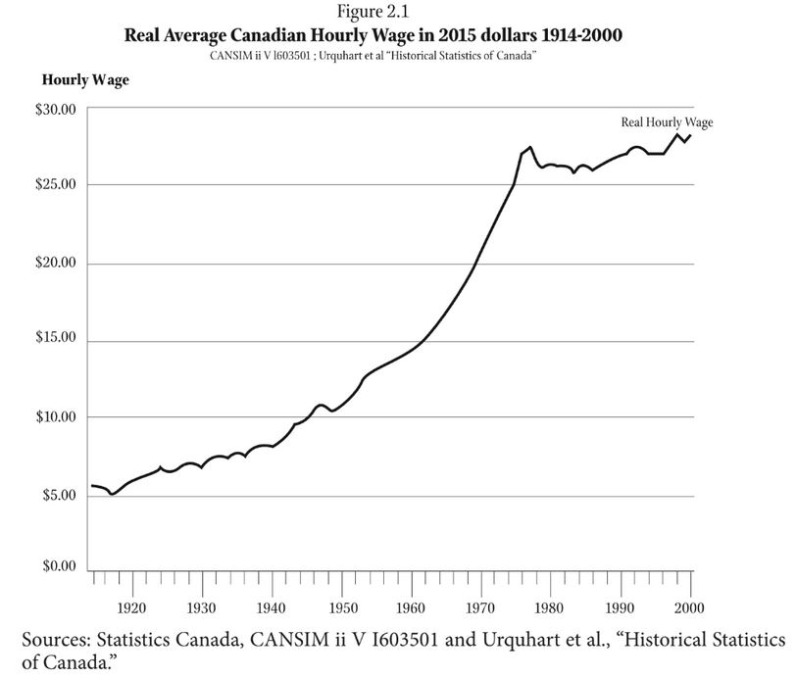

Slide 3
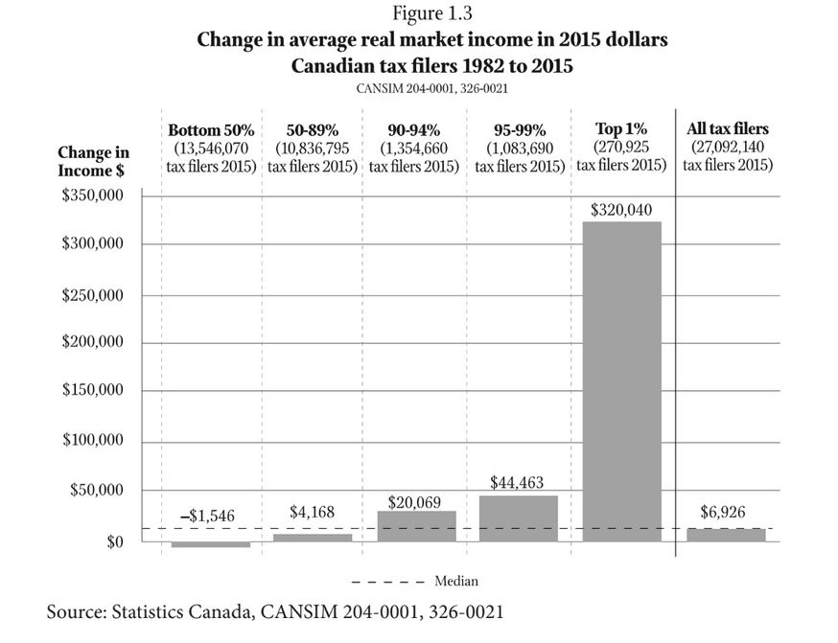

Slide 4
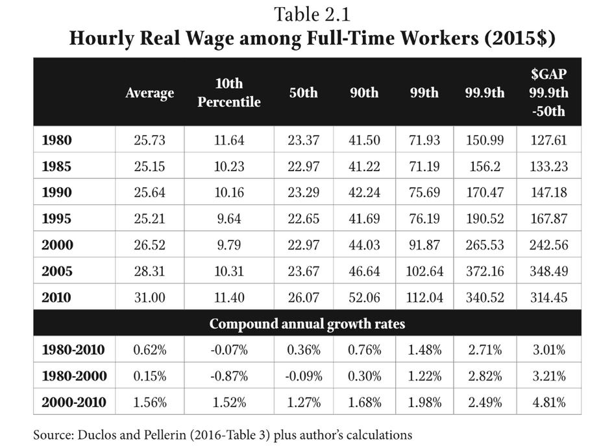

Slide 5
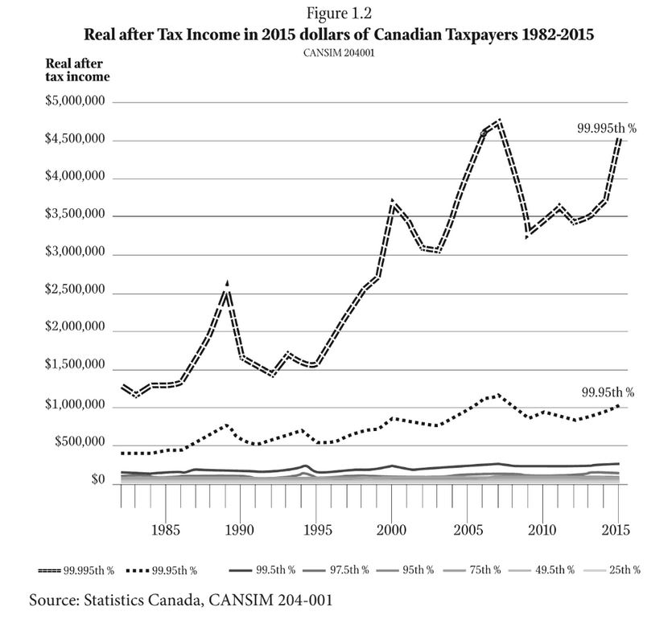

Slide 6
Land Grab Vandana Shiva (2015) Who Really Feeds the World? The Failures of Agribusiness and the Promise of Agroecology
European Union
1% control 20% of EU Farmland
3% control 50% of EU Farmland
80% of farms (small-scale) control 14.5% of EU Farmland
Between 2007 and 2010, small-scale farmers lost 17% of EU Farmland
Farmer suicide is linked to debt-induced landgrabs

Slide 7
Seed Sovereignty Vandana Shiva (2015) Who Really Feeds the World? The Failures of Agribusiness and the Promise of Agroecology
Farmer varieties of seeds are being replaced by:
High yielding varieties
Hybrid seeds – combined from crossing two genetically dissimilar parent species – cannot be replanted because next generations will give lower yields
GMOs

Slide 8
Violence Against Farmers Vandana Shiva (2015) Who Really Feeds the World? The Failures of Agribusiness and the Promise of Agroecology
Farmers are being criminalized for seed breeding, seed saving and seed sharing
Contribution to seed breeding is being erased – farmers have coevolved with nature
Patents lead to royalty collection
Contamination leads to lawsuits

Slide 9
Inequality Updates!!!
World Inequality Index
House Affordability Scores
Debt to Income
Videos
Crises of Capitalism
Beware, Fellow Plutocrats, the Pitchforks are Coming

Slide 10
Food is a Human Right
The Committee on Economic, Social and Cultural Rights in General Comment No. 12 also defined the obligations that States parties have to fulfill in order to implement the right to adequate food at the national level. These are as follows:
The obligation to respect existing access to adequate food requires States parties not to take any measures that result in preventing such access;
The obligation to protect requires measures by the State to ensure that enterprises or individuals do not deprive individuals of their access to adequate food;
The obligation to fulfill (facilitate) means the State must pro-actively engage in activities intended to strengthen people's access to and utilization of resources and means to ensure their livelihood, including food security;
Whenever an individual or group is unable, for reasons beyond their control, to enjoy the right to adequate food by the means at their disposal, States have the obligation to fulfill (provide) that right directly. This obligation also applies for persons who are victims of natural or other disasters.
Office of the High Commissioner UN

Slide 11
Food and Property
Commodity
Basis for wealth accumulation
Regulation and property
Appropriation of surplus value for the accumulation of wealth
Property, ownership and wealth are becoming increasingly concentrated

Slide 12
Private, Public and Common Property
Common property – belongs to the community
Public – belongs to everyone
Private – belongs to a person (or group of selected people)
Open-access – belongs to no one

Slide 13
REVIEW – Gibson Graham – Take back the Economy Gibson-Graham, J.K., Cameron, J., Healy, S. (2013) Take Back the Economy: An Ethical Guide for Transforming Communities, University of Minnesota Press

Slide 14
Take Back the Economy – Commons Toolkit Gibson-Graham, J.K., Cameron, J., Healy, S. (2013) Take Back the Economy: An Ethical Guide for Transforming Communities, University of Minnesota Press
Types of commons:
Biophysical –Exist naturally – i.e. rocks, soil, air, etc.
Cultural – Things shared by members of the same culture – i.e. language, musical heritage, symbols
Social – Things shared between members of a social system – i.e. education, health, political systems
Knowledge – Things people know – i.e. Indigenous ecological knowledge, scientific achievements
Ways to assess commons. To be a commons:
Access – Must be shared widely
Use – Must be negotiated by a community
Benefit – Must be distributed to the community and possibly beyond
Care – Must be performed by community members
Responsibility - Must be assumed by the community
Property – Must be collectively owned private property, state owned property and/or open access property

Slide 15
De-commodifying = Creating Commons Vandana Shiva (2015) Earth Democracy: Justice, Sustainability and Peace
Closing of commons = commodifying food:
1 – The exclusion of people from access to resources that had been their common property of held in common
2 – The creation of ‘surplus’ or ‘disposable’ people by denying rights of access to the commons that sustained them
3 – The creation of private property by the enclosure of common property
4 – The replacement of diversity that provides for multiple needs and performs multiple functions with monocultures that provide raw material 5 – The enclosure of minds and imagination, with the result that enclosures are defined and perceived as universal human progress, not as growth of privilege and exclusive rights for a few and dispossession and impoverished for the many
Terra nullius – Empty land

Slide 16
How Can We Expand the Commons?

Slide 17
Video
Food movements, climate resilience, social change – Eric Holt-Gimenez

