Slide 1
Advertising and the Consumer Culture
Advertising Effectiveness – Tricks and tips
Erik Chevrier

Slide 2
Tips and Tricks
You need to attract and retain attention
  Influencers
  Celebrities
  Extreme sensory stimuli
  Curated content
  Short, to the point
  Branded content
  High rankings on Google
  Be relevant
  Become part of a social network
  Native advertising
  Guerilla marketing/viral stunts
  Understand your target audience
  Repetition
  Emotion
  Relatedness
  Identity formation

Slide 3
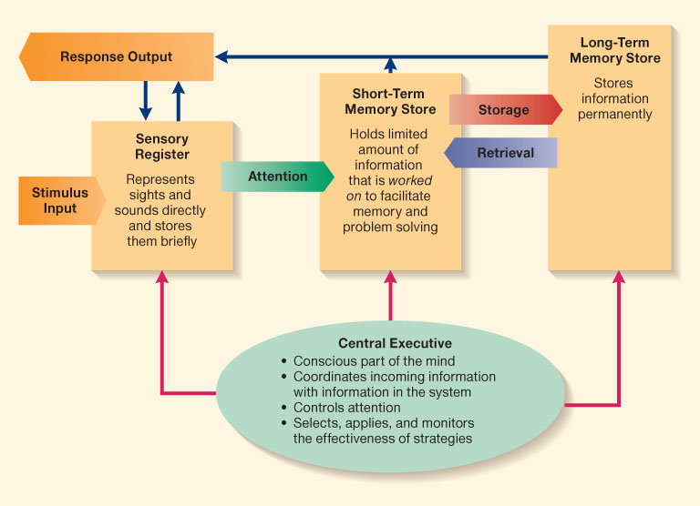
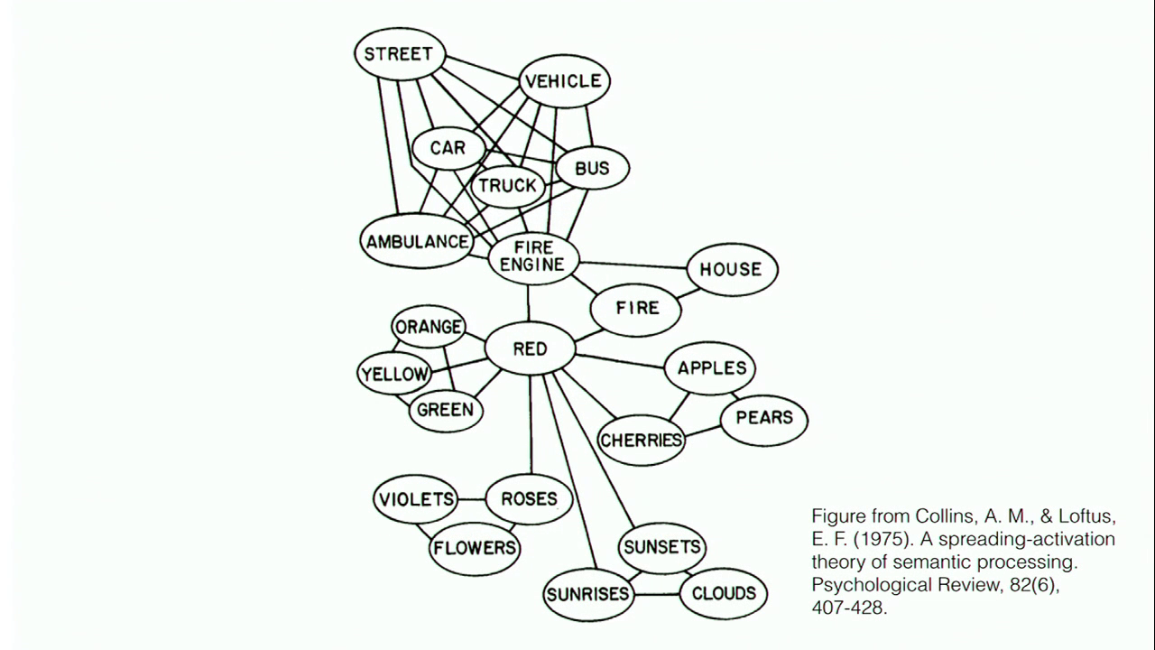
Cognitive Model & Schemas
Cognitive Model
Semantic Processing – Spreading Activation

Slide 6

What do Cows Drink?

Slide 7
Automatic Thinking – Low Effort Thinking
Automatic thinking – Is thought that is generally unconscious, unintentional, involuntary, and effortless.
Schemas – Mental structures people use to organize their knowledge about the social world themselves and that influence the information people notice, think about, and remember.
  We tend to fill in the blanks with SCHEMA-CONSISTENT INFORMATION.

Slide 8
Accessibility and Priming
Accessibility – The extent to which schemas and concepts are at the forefront of people’s minds and are, therefore, likely to be used when making judgments about the social world.
  Schemas can be accessible for three reasons:
    1 – Some schemas are chronically accessible because of past experience – these schemas are constantly active and ready to use to interpret ambiguous situations.
    2 – Schemas can be accessible because they are related to a current goal.
    3 – Schemas can become temporary accessible because of our recent experiences.
    Priming – The process by which recent experiences increase the accessibility of a schema, trait, or concept.
      Words have to be accessible and applicable to act as a prime.
      Schemas may be quite resistant to change
      Schemas are influenced by culture
    Perception Without Awareness (PWA) – Daren Brown – How to Control a Nation – Toy Story
    How to Control a Nation Full Video
    The Art of Misdirection
    Advertising makes consumption schemas continuously accessible. Advertising primes our consumer drives.

Slide 9
The Psychology of Influence
Robert Cialdini
Six weapons of influence
1 – Reciprocation
2 – Commitment and consistency
3 – Social proof
4 – Liking
5 – Authority
6 – Scarcity

Slide 10
Attitude
Attitudes are evaluations of people, objects or ideas.
Affectively Based Attitudes – An attitude based primarily on people’s emotions and feelings about the attitude object.
  Stem from people’s values, sensory reaction, and/or aesthetic reaction
  Have 3 things in common
    1 – They do not result from rational examination of the issue
    2 – They are not governed by logic
    3 – They are often linked to people’s values, so that trying to change them challenges those values
Cognitively Based Attitude – An attitude based primarily on a person’s beliefs about the properties of an object.
Behaviorally Based Attitude – An attitude based primarily on observations of how one behaves toward an attitude object.
  Self-perception theory – when our attitudes and feelings are uncertain or ambiguous, we infer these states by observing our behaviour and the situation in which it occurs.

Slide 11
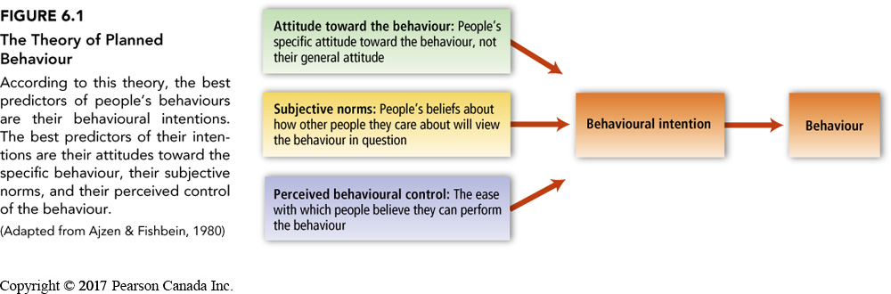
Theory of Planned Behaviour

Slide 12
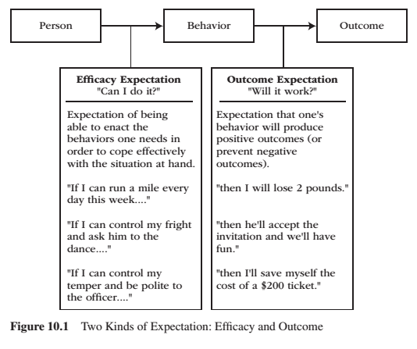
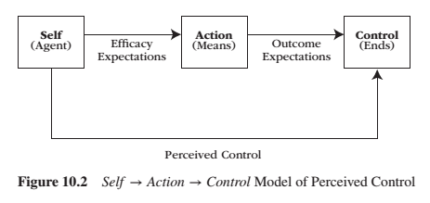
Perceived Behavioural Control
Reeve, J. (2015) Understanding Motivation and Emotion, 6th ed. John Wiley and Sons

Slide 13
Changing Values and Attitudes
Values:
Desirable, trans-situational goals, varying in importance, that serve as a guiding principles in people’s lives
Attitudes:
An internal state that, given the occurrence of certain stimulus events, will ultimately result in some sort of response or behaviour.
Cognitive dissonance:
Cognitive dissonance is a state of psychological tension occurring when thoughts, beliefs, attitudes, and/or behaviours are in conflict with each other.
Key Factors:
Ratio of dissonance
Importance of factors in dissonance
Avoiding dissonance
1 – Modify
2 – Change importance
3 – Rationalize
4 – Add new consonant beliefs to bolster

Slide 14
Extreme Behaviour – Rationalization Trap
The Push – Darren Brown
Trailer

Slide 15
Compliance
A change in behaviour in response to a direct request from another person
Door-in-the-face technique – A technique to get people to comply with a request whereby people are presented first with a large request, which they are expected to refuse, and then with a similar, more reasonable request, to which it is hoped they will accept
  Reciprocity norm – a social norm by which the receipt of something positive from another person requires you to reciprocate, ort behave similarly, in response
Foot-in-the door technique – A technique to get people to comply with a request, whereby people are presented first with a small request, to which they are expected to acquiesce, followed by a larger request, to which it is hoped they will also acquiesce.
  Change in self-perception – People are influenced by their behaviour and adopt values about ‘helping others’
Lowballing – An unscrupulous strategy whereby a salesperson induces a customer to agree to purchase a product at a very low cost, and then subsequently raises the price; frequently, the customer will still make the purchase at the inflated price.
  Illusion of irreversibility
  Anticipation of event
  Convenience of completing the transaction rather than starting over somewhere else
Improving the deal:
When a product is offered at a high price, then after a brief pause, another product is offered to the deal or the price is reduced
Strategic Self-anticonformity (Reverse Psychology)
  To elicit reaffirming messages
  To elicit attitudinal or behavioural compliance from another person

Slide 16
Conformity
A change in behaviour as a result of the real or imagined influence of other people
  Can override survival behaviours
  People are more influenceable than they believe
  Produces positive and negative consequences
Informational Social Influence – Conforming because we believe that others’ interpretation of an ambiguous situation is more correct than ours and will help us choose an appropriate course of action.
Normative Social Influence – The influence of other people that leads us to conform in order to be liked and accepted by them; this type of conformity results in public compliance with the group’s beliefs and behaviours but not necessarily in private acceptance. Conformity experiment
  Public Compliance – Conforming to other people’s behaviour publicly, without necessarily believing in what they are doing or saying.
  Private Acceptance – Conforming to other people’s behaviour out of a genuine belief that what they are doing or saying is right.

Slide 17
The Power of Words
The power of words to influence memory

Slide 18
The Power of Suggestion
An Inquiry Into How People Are Affected by Profuse Amounts of Publicity: A Multidisciplinary Approach
Advertising as a suggestion – Page 26
Suggestions can bypass critical thought because there is no direct request to refuse

Slide 19
Questions?
Have a great day!

