Slide 1
ecological economics
Project Proposal
Erik Chevrier

Slide 2
Assignments
Action Research Project (25%): The objective of this assignment is to give students hands on experience learning about ecological economics by participating with community members trying to create ethical economies and/or fight for social justice. Students will perform an action-based research project by creating a project, participating with an already existing initiative at Concordia University, attending a conference and/or writing an in-depth research report about a topic in ecological economics. Students will participate as a group project and submit the report as a group. Students will be evaluated based on the depth of their involvement with the project, clearly reporting the project, and an oral presentation of the project. Students may request to be evaluated separately, but must do so in the proposal.
Students must form a group; however, they may choose to work on something in a group that already exists and/or create something with like-minded people outside the classroom. Students will form clusters and contribute to the project based on their area of expertise. For example, someone with great research skills could get involved with the research portion of the project, someone with media skills can build media infrastructure, someone with great interpersonal communication skills can be the mobilizer, among other tasks. Students will be evaluated based on the depth of their involvement with the project, their deliverables, clearly reporting their contribution to the project, an oral presentation summarizing their role in the project, and linking the project to the course material.
Proposal (10%) (Due October 20th): Students will write a proposal for the action research project they want to partake in. Students must submit the proposal as a group. Students must (1) identify a group to participate with, a project to create, a conference to attend or draft a proposal for a literature review (2) describe the project/conference/paper, (3) outline a specific timeline for the project, (4) summarize the roles of each group member, (5) link the topic to class readings and other ecological economic issues. Conference reports and literature reviews require annotated bibliographies. These are general parameters, please see the next slides for more specific guidelines.

Slide 3
Project Possibilities
1 – Work with a group that creates positive environmental or social externalities. Examples include:
  Coop CultivAction
  MindHeartMouth
  Climate Justice Action
  The People’s Potato
  The Hive Free Lunch
  CUCCR
  Duff-Court Urban Farm/Les P’Tit Marchees
2 – Begin a campus or community project.
3 – Attend a Conference/Public Panel and Write a Report.
4 – Write an In-Depth Literature Review about a Topic in Ecological Economics

Slide 4
Begin a Project or Get Involved With an Existing Community Project
The proposal must:
  Describe the project
  Provide justification for why this topic is important and how it fits into ecological economics
  Provide a summary of what each person plans on contributing to the project
  Please provide a timeline of your tasks and when you will complete each task
  Provide a summary of goals, objectives and targets you would like to achieve
  Provide a way to evaluate whether you meet your goals, objectives and targets
  Provide a summary of key strategies you will employ to accomplish your goals and objectives
  Link project (or process) to readings and/or other sources
  If you want to get funding, you may Complete the SAF Application Form

Slide 5
Importance of Action Based Research
Why are action-based projects important?
  It is important to challenge the problematic dominant epistemological understandings of capitalism.
  Instead we should produce ontological formations of the world we want by co-creating and co-recreating social relations that produce positive outcomes on people and the planet.
  Action based learning theories incorporate students and facilitators as co-learners and co-collaborators. Together, they learn by doing. They also connect with the community.
Epistemology – A term meaning “theory of knowledge,” which gets at the how we know about the social world that lies behind all theoretical approaches. (Frampton, Kinsman, Thompson, Tileczek, (2006))
Ontology – Assumptions relating to how the social comes into being that inform all theories and ways of writing the social. (Frampton, Kinsman, Thompson, Tileczek, (2006))

Slide 6
The Dominant Epistemological View of Food?
The world has or will soon have the agricultural technology available to feed the 8.3 billion people anticipated in the next quarter of a century. The more pertinent question today is whether farmers and ranchers will be permitted to use that technology. Extremists in the environmental movement, largely from rich nations and/or the privileged strata of society in poor nations, seem to be doing everything they can to stop scientific progress in its tracks. It is sad that some scientists, many of whom should or do know better, have also jumped on the extremist environmental bandwagon in search of research funds. When scientists align themselves with antiscience political movements or lend their name to unscientific propositions, what are we to think? Is it any wonder that science is losing its constituency? We must be on guard against politically opportunistic, pseudo-scientists…
Borlaug, N., E. (2000) Ending World Hunger. The Promise of Biotechnology and the Threat of Antiscience Zealotry, Plant Physiology, 124(2) pp. 488.

Slide 7
Critique of Dominant Epistemological View of Food
When poisons are introduced into agriculture to control pests, or when GMOs are introduced under the argument of “feeding the world,” the justification given is always “science”. But “science” does not have a singular entity, and it did not come into existence within a vacuum. Today, what we generally refer to as “science” is in fact Western, mechanistic, reductionist modern science, which became the dominant practice of understanding the world during the Industrial Revolution and has continued as the dominant paradigm….To shape the industrial system in the form of new, violent technologies, and to shape the capitalist system in the form of new, profit-driven economics, a certain type of science was promoted and privileged as the only scientific knowledge system. Two scientific theories came to dominate this new, industrial paradigm, and they continue to shape practices of food, agriculture, health, and nutrition even today. The first is a Newtonian-Cartesian idea of separation: a fragmented world made of fixed, immutable atoms…The second significant theory that has framed the knowledge paradigm for industrial agriculture is Darwin’s theory of competition as the basis for evolution…The Newtonian-Cartesian theory of fragmentation and separation and the Darwinian paradigm of competition, have led to a nonrenewable use of Earth’s resources, a nonsustainable model for food and agriculture, and an unhealthy model of health and nutrition. An emphasis on the legitimacy of these arguments as the sole “scientific” approach has created a knowledge apartheid by discounting the knowledge of Mother Earth.
Shiva, V. (Shiva, V. (2016) Who Really Feeds the World, North Atlantic Books, pp. 4 – 7.

Slide 8
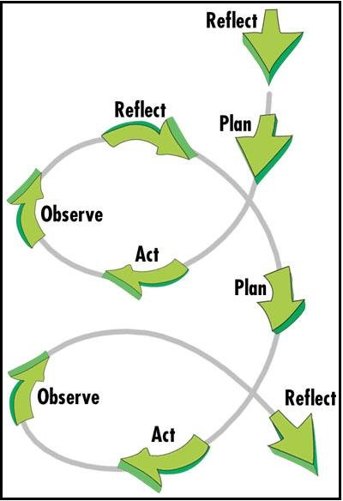
Changing the World Via Action Research

Slide 9
Attend a Conference/Public Panel and Write a Report
The proposal must:
  Describe the conference/panel
  Provide justification for why this topic is important and how it fits into ecological economics
  Provide a summary of what each person plans on contributing to the project
  Please provide a timeline of your tasks and when you will complete each task
  Provide a summary of what you expect to learn at the conference/panel and explain why
  Provide an annotated bibliography with at least 5 sources that will be used for your final report
  Link project (or process) to readings and/or other sources

Slide 10
Write an In-Depth Literature Review
The proposal must:
  Describe the topic your group chose
  Provide justification for why this topic is important and how it fits into ecological economics
  Provide a summary of what each person plans on contributing to the project
  Please provide a timeline of your tasks and when you will complete each task
  Provide a thesis statement that will be used in your final report
  Demonstrate how you will support your thesis statement
  Provide an annotated bibliography with at least 10 sources that will be used for your final report
  Link project (or process) to readings and/or other sources

