Slide 1
Ecological Economics
Alternative Lesson
State of the Economy and Inequality

Slide 2
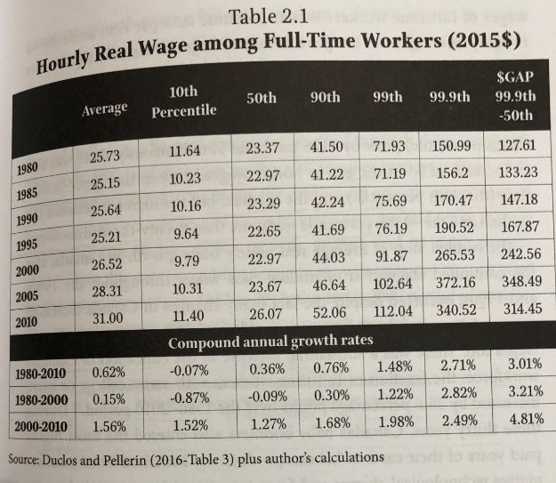
Real Hourly Wages
Osberg, L. (2018) The Age of Increasing Inequality – The Astonishing Rise of Canada’s 1%, James Lorimer and Company.

Slide 3
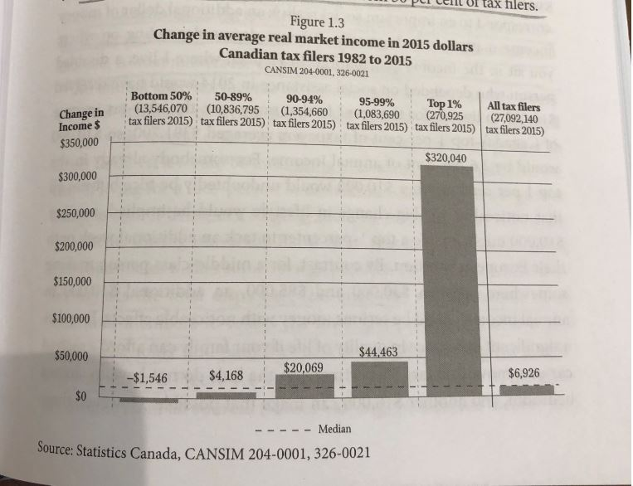
Real vs Market Income
Osberg, L. (2018) The Age of Increasing Inequality – The Astonishing Rise of Canada’s 1%, James Lorimer and Company.

Slide 4
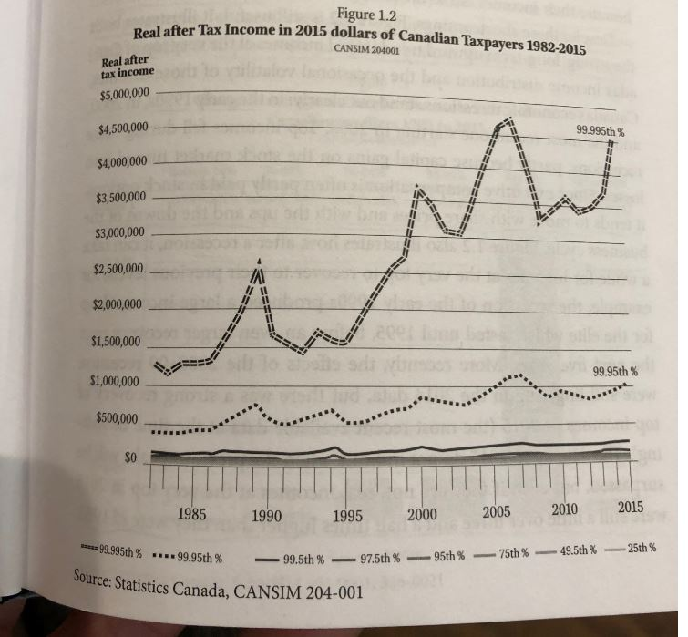
Real Income
Osberg, L. (2018) The Age of Increasing Inequality – The Astonishing Rise of Canada’s 1%, James Lorimer and Company.

Slide 5
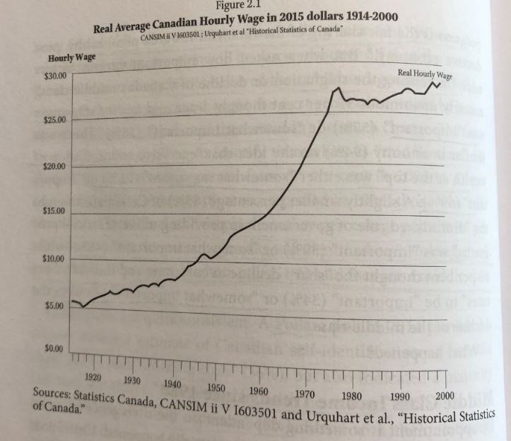
Average Wage
Osberg, L. (2018) The Age of Increasing Inequality – The Astonishing Rise of Canada’s 1%, James Lorimer and Company.

Slide 6
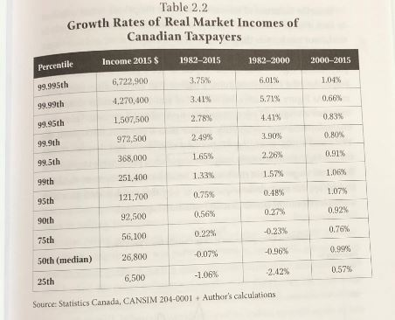
Growth Rates of Real Market Incomes
Osberg, L. (2018) The Age of Increasing Inequality – The Astonishing Rise of Canada’s 1%, James Lorimer and Company.

Slide 7
How is the Economy Doing?
Housing Affordability
Household Debt to Income Ratio
Consumer Credit
Private Sector Credit
Inequality in Canada
Inequality in Canada
World Inequality
Bank Bailouts During Economic Crisis
Kondratiev Cycles

Slide 8
Videos and Discussion
Crises of Capitalism
Beware, Fellow Plutocrats, the Pitchforks are Coming

