Slide 1
Ecological Economics
Needs and Wants
Erik Chevrier

Slide 2
Needs and Wants
Make a list of products that you need and want?
How do you know if a product can satisfy a real need?

Slide 3
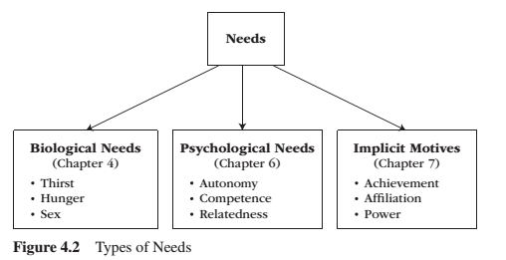
Needs
Need – A condition within the person that is essential and necessary for growth, well-being and life.
Deficiency needs – Are responses to a state of deprivation and generate tension-packed, urgency-laden emotions, such as pain, relief, anxiety, frustration, stress, etc.…
Growth needs – Gently guide behaviour toward a developmental trajectory of growth and well-being. They typically generate positive emotions, such as interest, enjoyment, hope and vitality.

Slide 4
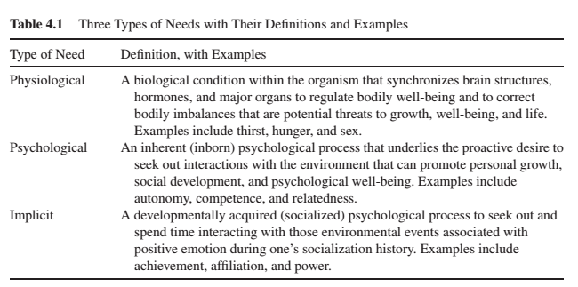
Needs

Slide 5
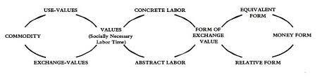
Marx Dialectic From Capital Volume 1

Slide 6
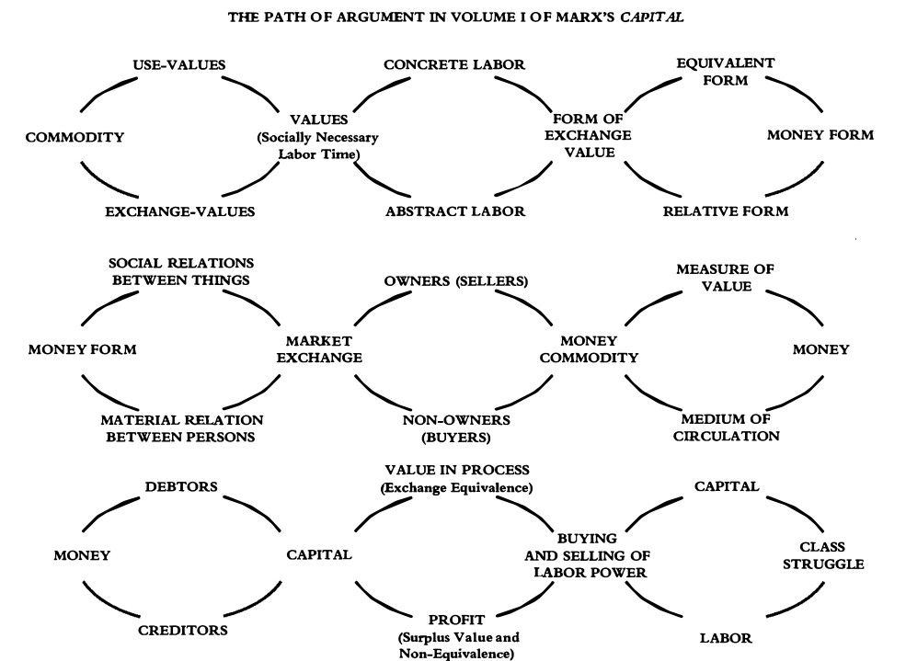
Marx Dialectic From Capital Volume 1

