Slide 1
Ecological Economics
Erik Chevrier
October 27, 2022

Slide 2
Ways to Change Our Current Social/Political/Economic System
- It fails and a new system is needed
- Ruptural (revolutionary)
- Interstitial (build alternatives)
- Symbiotic (social democratic, reformist)
Things to consider:
- Social reproduction
- Coercion
- Institutional rules
- Norms, customs, ideology and culture
- Material interests
-

Slide 3
Looking for Solutions
The Great Transformation
  History of economic practices and institutional patterns
    Markets – market pattern
    Reciprocity – cemetery
    Re-distribution – autocracy
    Householding – Oikonomia vs chrematistics
  Fictitious commodities
    Land
    Labour
    Money

Slide 4
Aristotle Aristotle. Aristotle in 23 Volumes, Vol. 21, translated by H. Rackham. Cambridge, MA, Harvard University Press; London, William Heinemann Ltd. 1944.
Chrematistics – art of acquisition – limitless accumulation unnatural and problematic
Oikonomia – management of the household – true form of an economy
Problem with Chrematistics:
- Limitless accumulation
- Conversion of nature into commodities

Slide 5
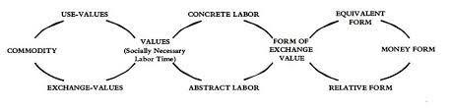
Marx Dialectic From Capital Volume 1

Slide 6
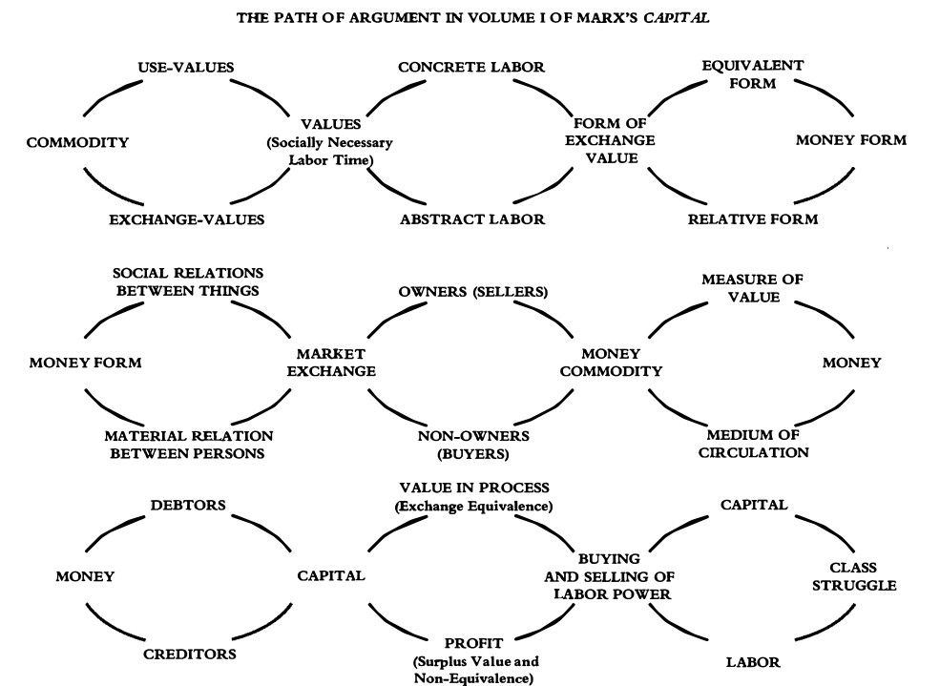
Marx Dialectic From Capital Volume 1

Slide 7
Limitless Accumulation
C – C
C – M – C
M – C – M
M – C – M’
M – M’

Slide 8
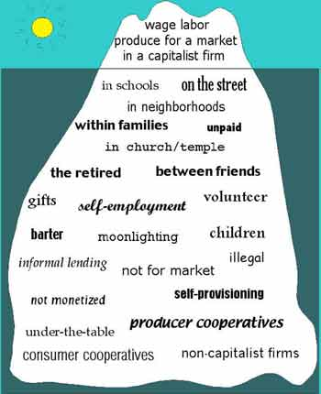
Gibson Graham – Take back the Economy Gibson-Graham, J.K., Cameron, J., Healy, S. (2013) Take Back the Economy: An Ethical Guide for Transforming Communities, University of Minnesota Press
Katherine Gibson Interview Playlist

Slide 9
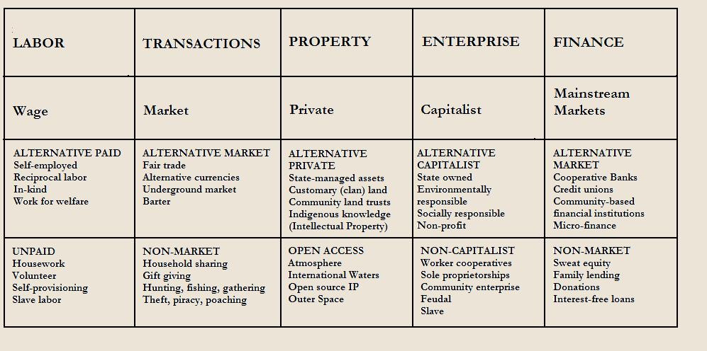
Gibson Graham – Take back the Economy Gibson-Graham, J.K., Cameron, J., Healy, S. (2013) Take Back the Economy: An Ethical Guide for Transforming Communities, University of Minnesota Press

Slide 10
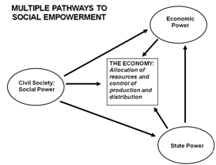
Envisioning Real Utopias – Erik Olin Wright
Olin Wright, E. (2010) Envisioning Real Utopias, Verso

Slide 11
Envisioning Real Utopias Olin Wright, E. (2010) Envisioning Real Utopias, Verso
Hot to transform the political/social/economy
- Theory of social reproduction
- Theory of gaps, cracks and contradictions within the process of social reproduction
- Theory of underlying dynamics and trajectory of unintended social change
- Theory of collective actors, strategies and struggles
Theories of social change must take into account these three factors:
Desirability
Viability
Achievability

Slide 12
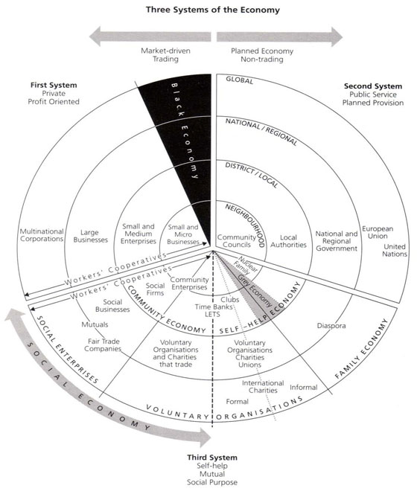
Three Systems of an Economy – John Pierce
Pearce, J. (2009) Social Economy: Engaging as a Third System, In Amin, A. The Social Economy; International Perspectives on Economic Solidarity, p. 26.

Slide 13
Interviews about Post-Capitalist Futures
Post Capitalist Possibilities
Katherine Gibson

Slide 14
Discussion
What are ways we can transform the political/social/economic system?

