Slide 1
Ecological Economics
Planetary Boundaries and Tipping Points
Erik Chevrier

Slide 2
Food and Sustainability
Is your diet sustainable? Why or why not?

Slide 3
Issues With Our Current Food System
Issues with food security – there are close to 1 billion people starving in the world today! Issues with food sovereignty – peasants and farmers are being affected by trade agreements and food dumping! Issues with genetic modification process – epigenetics matter! Issues with use of herbicides – glyphosates are being identified as cancer causing! Issues with privatization – restricted access! Issues with cost on farmers – family farms are not sustainable! Issues with reduction of biodiversity – we are destroying nature! Issues with unwanted genetics spreading onto non-GMO farms – lawsuits! Issues with loss of Indigenous farming methods – on stolen land! Issues with soil arability – we are killing our soil! Issues with killing pollinators – fruits need bees! Issues with water ‘dead zones’ – we are polluting our water! Issues with corporate concentration of agribusinesses – former war companies are now food chemical companies! Issues with health – our food contains toxins! Drain on resources – Over 50% of most countries’ fresh water supplies are used for agriculture! Major contributor to climate change – carbon and methane intensive farming! Foundations on structural racism, colonialism and patriarchy – glaring systemic issues! Rising cost of seed and chemicals – we don’t need to buy seeds! Research funding being directed to GMOs instead of traditional breeding methods – ‘science’ is not only about GMOs! Pest and weed resistance to Bt crops and glyphosate! There are so many more critiques!

Slide 4
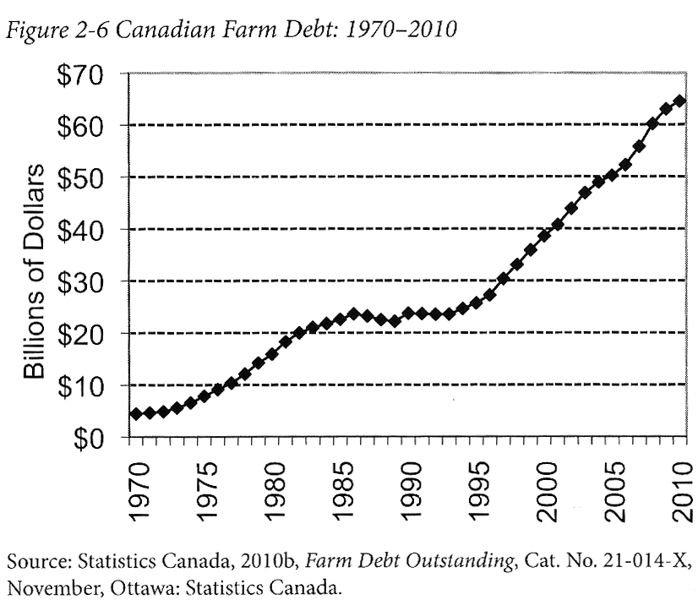
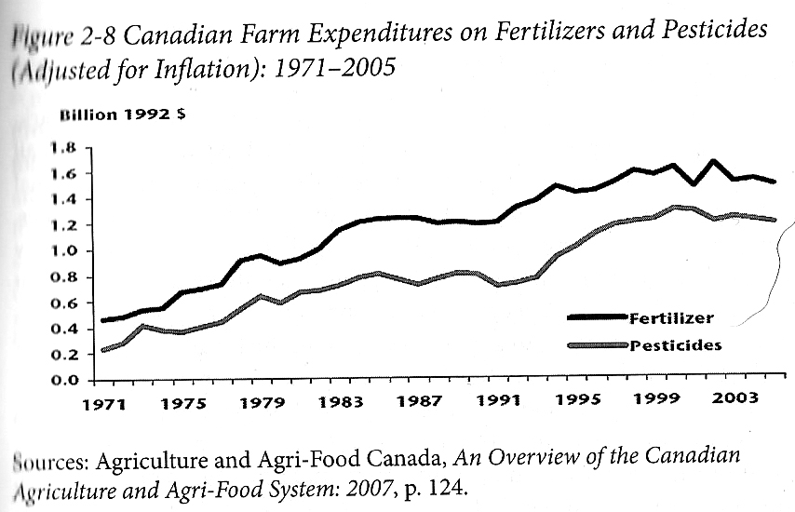
Who Benefits from Our Food System Economically? Qualman, D. (2011) Advancing Agriculture by Destroying Farms? The State of Agriculture in Canada, pp. 20 – 42. In, Wittman, H., Desmarais, A. A., & Wiebe, N. (2011) Food Sovereignty in Canada: Creating Just and Sustainable Food Systems, Fernwood Publishing

Slide 5
Only A Few Large Corporations Own Most of the Agrochemical Market https://cban.ca/gmos/issues/corporate-control/

Slide 6
Companies of War, Destruction and Death
These are a few examples:
Monsanto still uses chemicals that were used to kill people, but in our food
Monsanto Ghostwriting Academic Papers
Is Round-Up safe to drink?
Farmer won lawsuit against Monsanto – Glyphosate causes cancer
The World According to Monsanto
Monsanto is now owned by Bayer who used to be part of I.G. Farben, manufacturing poisonous gas (Zyklon B) for concentration camps during the World War.
BASF was also part of IG Farben a company who worked with the Nazis and tested chemicals and drugs on people including Zyklon B
Dow Chemical Invented Agent Orange
Dow Chemical now owns Union Carbide who was responsible for a large devastating explosion in Bhopal, India:
The Bhopal disaster: Toxic legacy
One Night in Bhopal
The Bhopal Disaster

Slide 7
How can we build a sustainable food system?
How can we change our food system to be more sustainable?

Slide 8
Reading Discussion
What is the Anthropocene? What evidence does the author presented to suggest that we have entered the Anthropocene Epoch? According to the author, when did the Anthropocene begin?
What does the author mean by great acceleration? What evidence does the author suggest that the great acceleration is taking place? What equity issues does the author refer to regarding the great acceleration?
What is a tipping point? What does the author suggest about climate change and tipping points?
What types of climates differentiate the Pleistocene and the Holocene? What are Milankovitch cycles? How do Milankovitch cycles relate to planetary metabolism? How is the climate of the Holocene different?
What are the nine planetary boundaries? How many has the author suggested we crossed?
What was the first near-catastrophe of Planet Earth in the last 100 years? What caused the near-catastrophe? How was this near-catastrophe avoided?
What is the new and deadly climate regime? How have the probability curves been affected by human activity? How are extreme weather patterns caused by change in climate variability?
What agreements have been made by international institutions to prevent/mitigate climate change? What climate projections are suggested by the author?

Slide 9
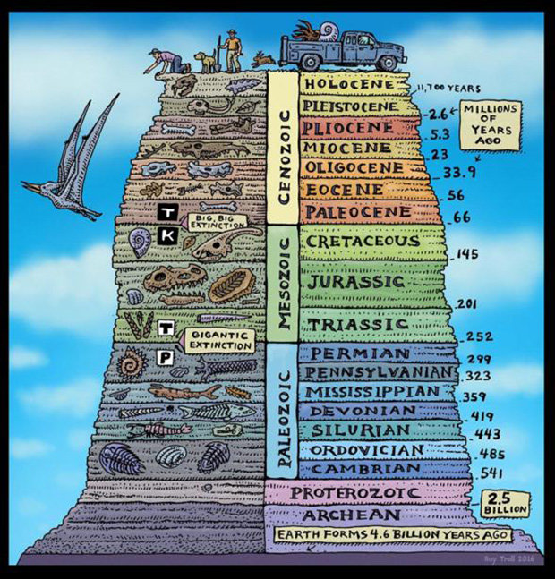

Slide 10
The Anthropocene
Human population has grown tenfold in three centuries
Humans are in the process of exhausting fossil fuel reserves that were generated over several hundred millions of years ago
Nearly 50% of the land surface has been transformed by human action
Synthetic nitrogen is being used in massive amounts
More than half the freshwater is being used directly and indirectly by humans
CO2 and CH4 have increased substantially
Costal and marine habitats have been dramatically altered, 50% of mangroves have been removed
22% of fisheries are overexploited and 44% more are at their limits
Biodiversity is reducing drastically
Rainforests are being destroyed at rapid rates
Widespread dam building for energy

Slide 12
Reports About Rapid Ecological Change
Millennium Ecosystem Assessment
International Geosphere-Biosphere Program
IPCC Reports

Slide 13
Global Temperature Rise
Global Temperature Rise
Ice Sheets Melting
Greenland Melting at Faster Rates
Artic Sea Ice Sheets Melting
Carbon Dioxide Production
Sea Level Rise
Ocean Heat

Slide 14
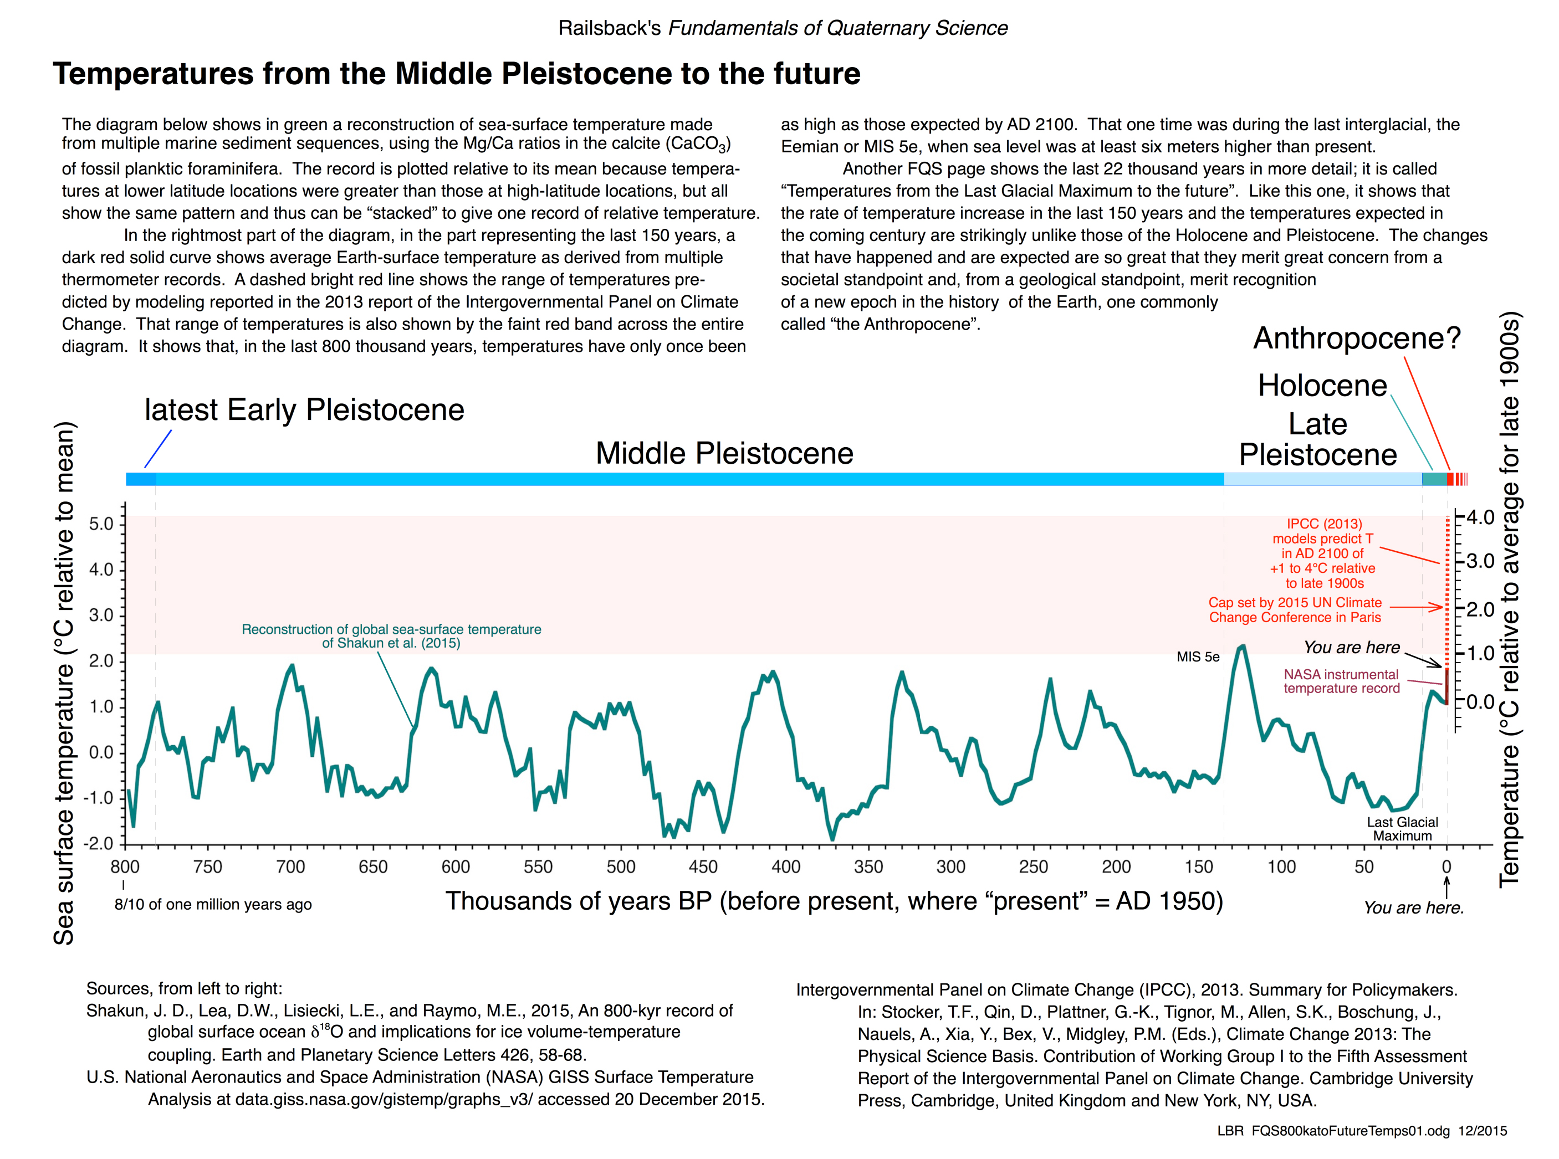

Slide 15
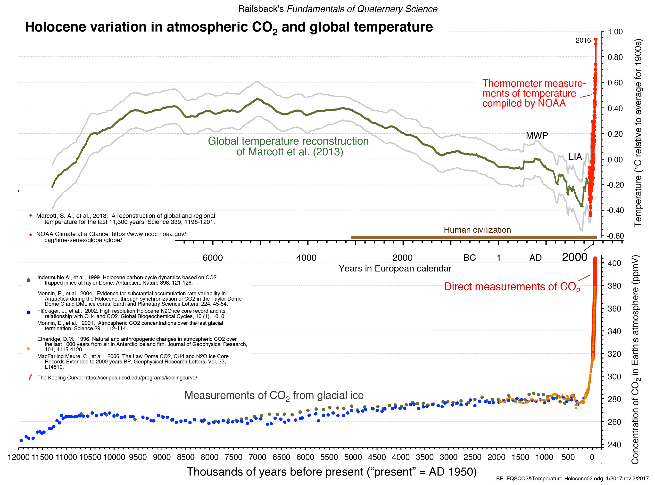

Slide 16
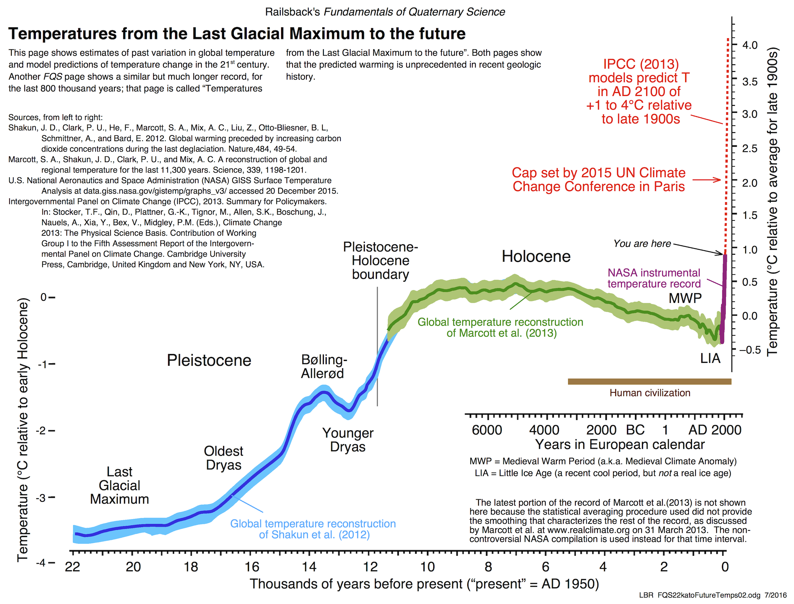

Slide 17
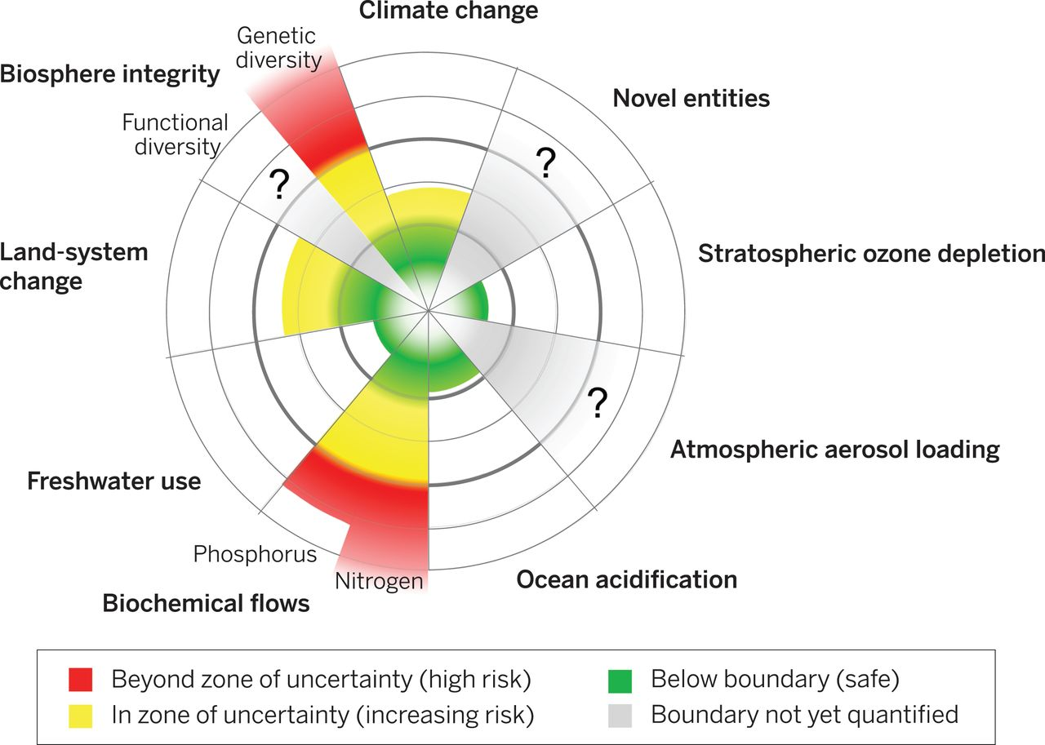
Full Article

Slide 18
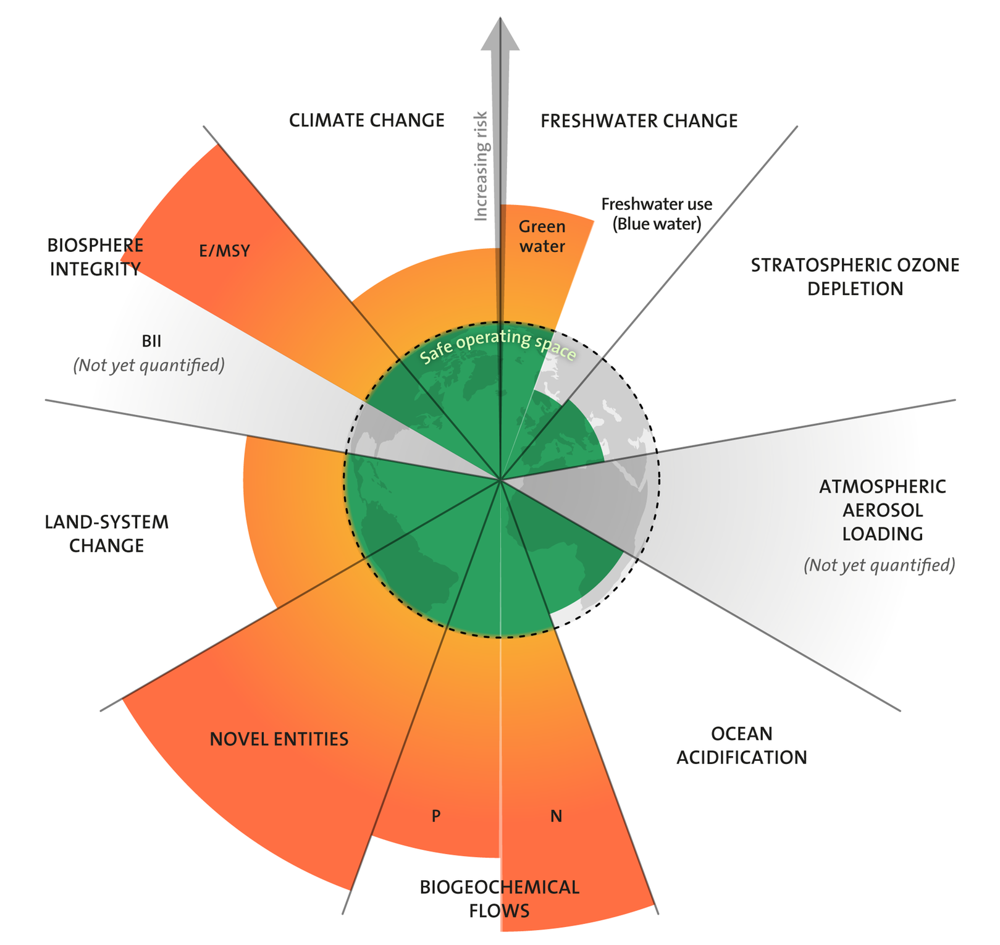
Source

Slide 19
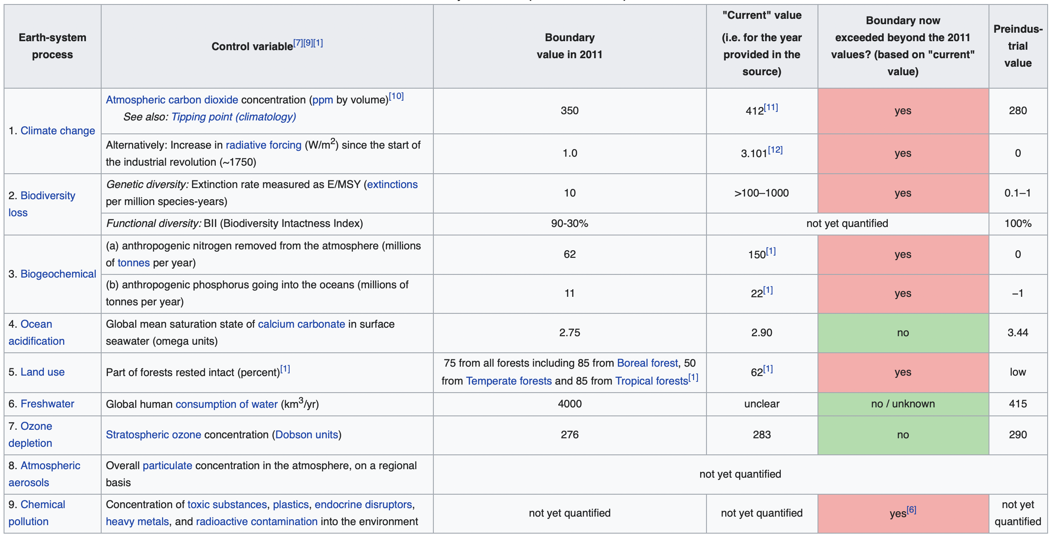

Slide 20
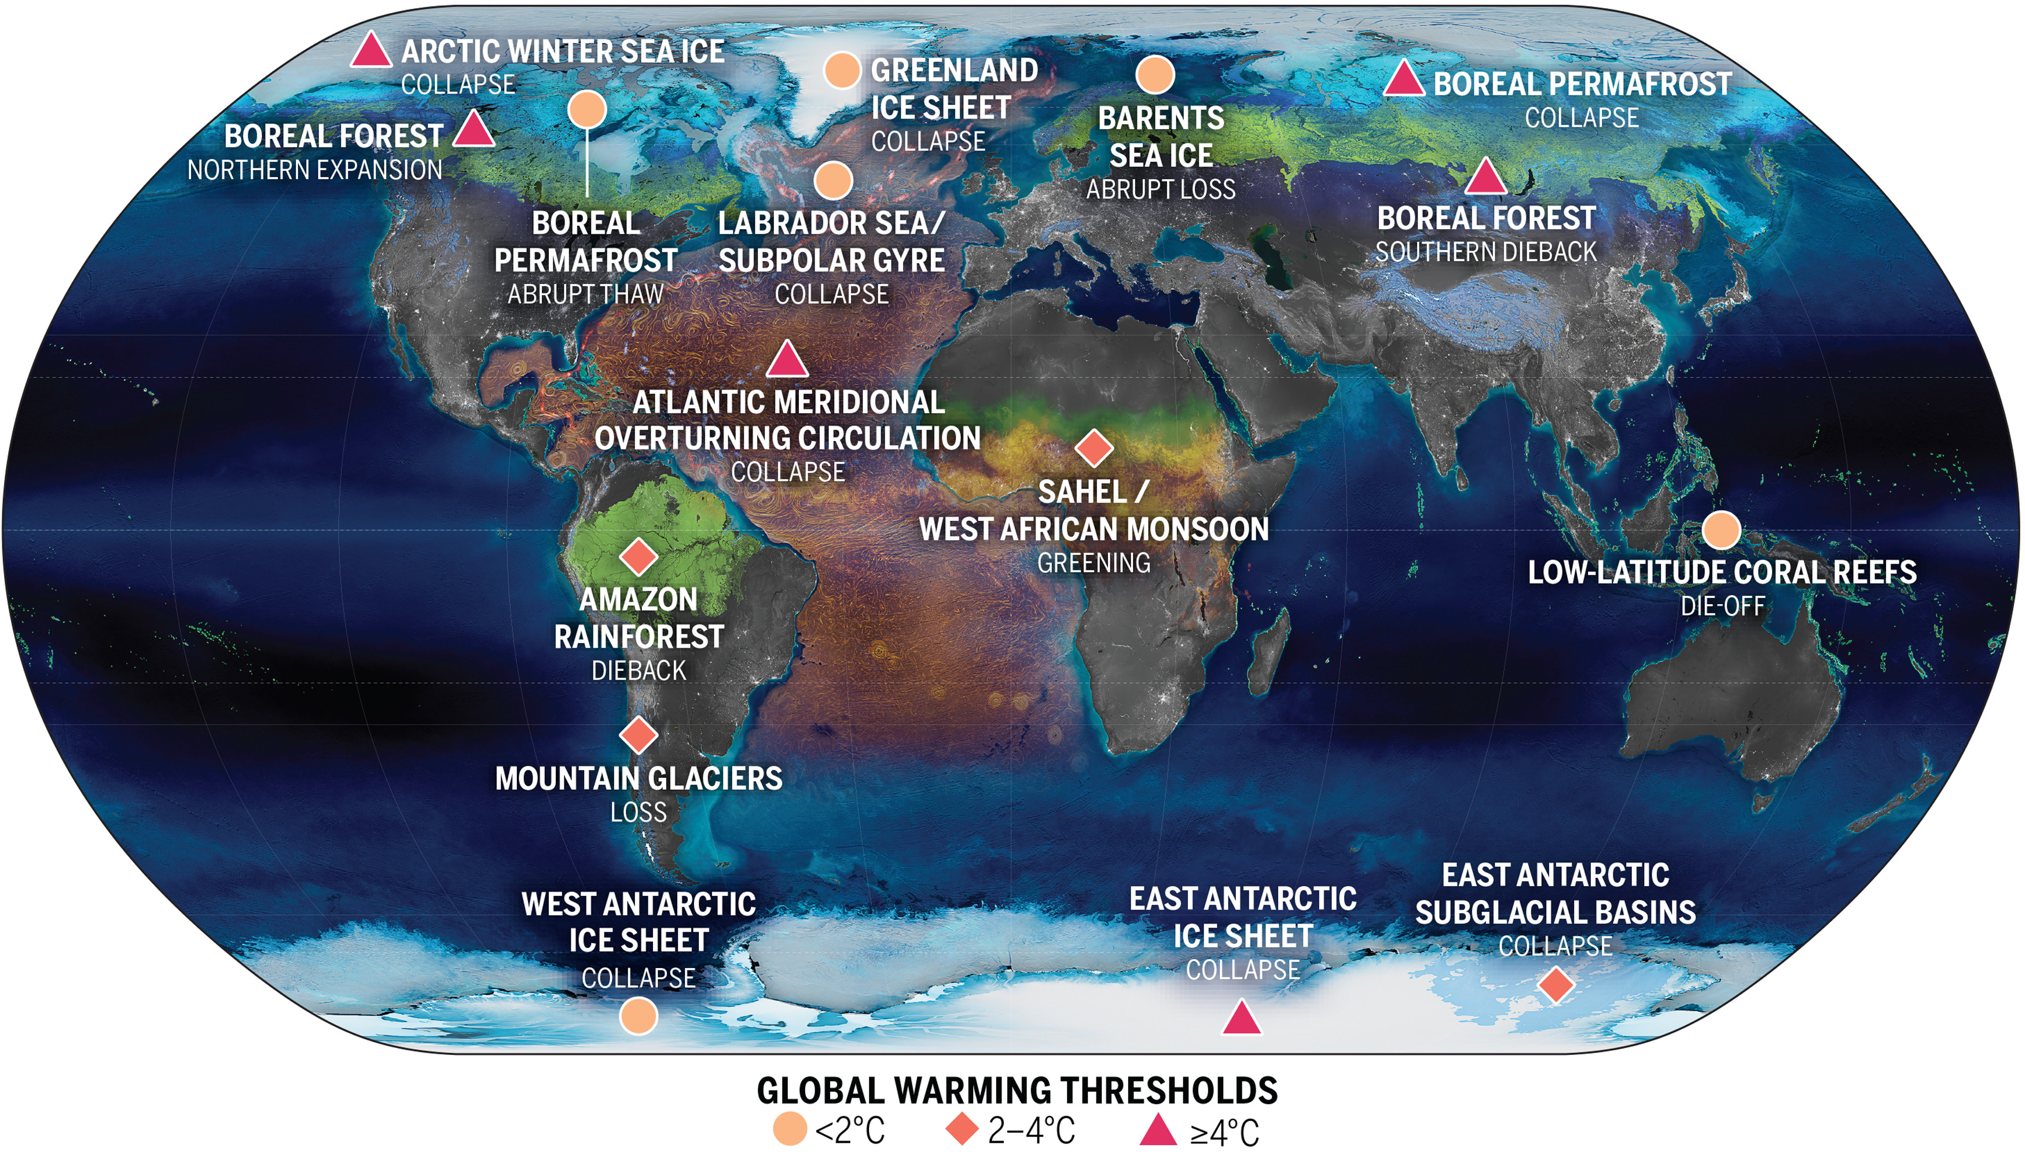

Slide 21
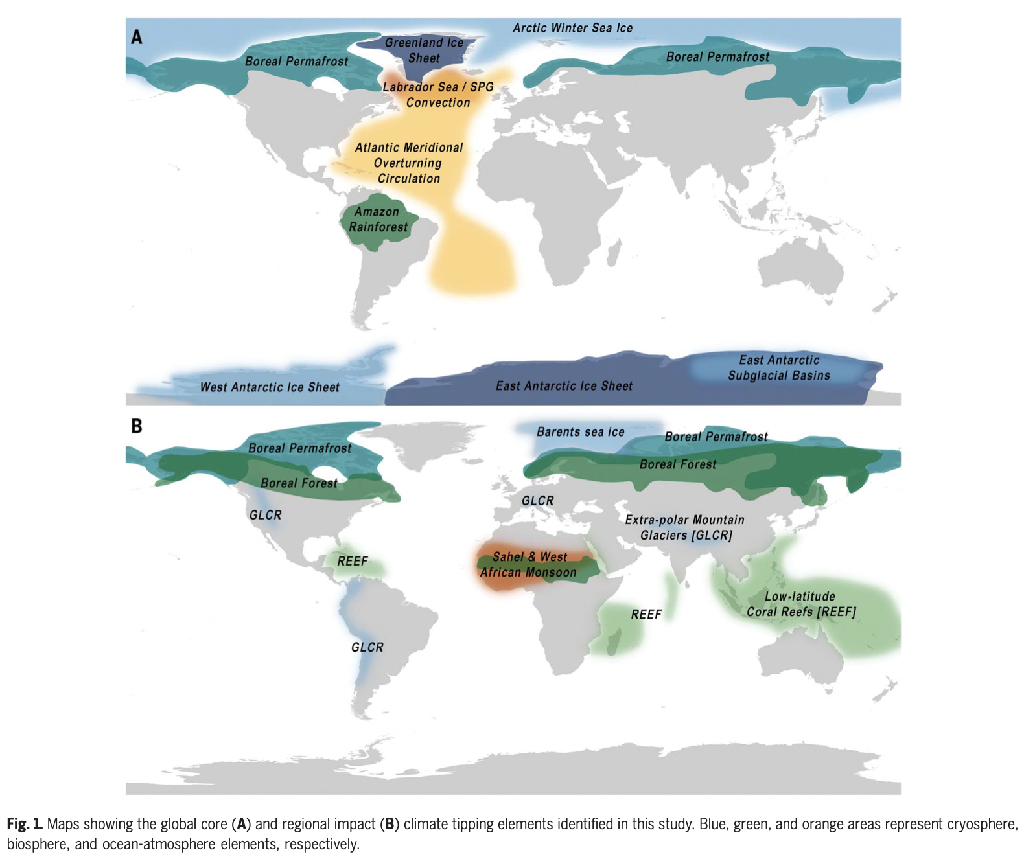

Slide 22
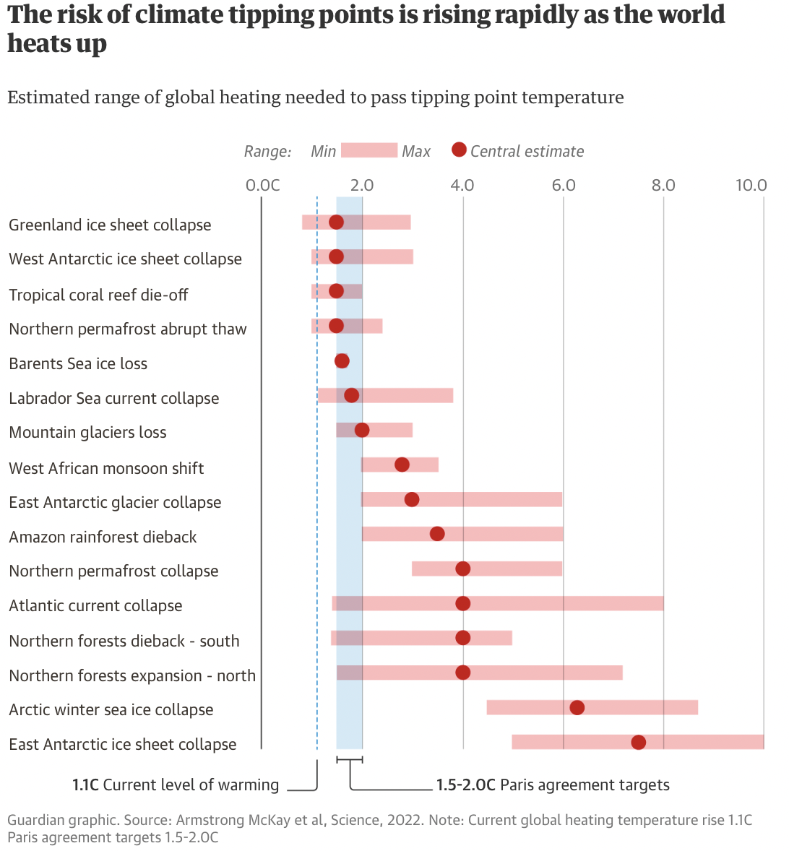

Slide 23
What to do about these problems?
Paris Agreemement
COP26
UN Sustainable Development Goals
Climate Action Tracker

Slide 24
Ecological Economics for the Anthropocene Suggestions for Change
1 – We should recognize that humans are part of Earth’s life systems, not separate from it.
2 – Legal policy regimes must be constrained by ecological considerations to avoid catastrophic outcomes and promote the flourishing of life with the socioeconomic sphere fully constrained within these ecological constraints.
3 – Boundaries-based laws and policies must permeate legal and policy regimes in systemic ways.
4 – Because human enterprise has already surpassed global ecological limits, legal and policy regimes should radically refocus on reduction of material and energy in the economy.
5 – Boundaries-based governance must be global but distributed fairly using principles of proportionality and subsidiarity, with protection of the global commons and public goods paramount and constraints on property rights and individual choice implemented as needed to keep the economy within ecological limits.
6 – Legal and policy regimes must ensure fair sharing of global resources for present and future generations.
7 – Boundary-based laws and policies must be binding and supranational with supremacy over legal regimes as necessary with rights of enforcement for non-state actors.
8 – A greatly expanded program of research and monitoring for improved understanding and continual adjustment of ecological boundaries and means for respecting them is needed to support boundary-based local and global governance.
9- Boundary-based governance approaches require precaution about crossing planetary boundaries, within margins of safety to ensure both that the boundaries are respected from local and global levels for life to flourish.
10 – Boundaries-based governance must be adaptive because ecosystems evolve constantly and because we need to get started on a comprehensive effort to constrain the economy within ecological limits.

Slide 25
Discussion
How can we get governments to be held accountable to international agreements?
What other measures can be taken to keep ecological boundaries within limits?
How can ecological economists address current ecological crises?
What can we learn from Brown and Timmerman’s recommendations for keeping the economy within planetary boundaries?

Slide 26
Questions?
Questions and/or concerns?

