Slide 1
Ecological Economics
Erik Chevrier
November 10, 2022

Slide 2
What is Value?
How much is your time worth in employment?
  What would be the minimum you would accept for an hourly/yearly salary?
    Why?
Think of an item of clothing you really like.
  What is the value of that item of clothing?
    Why?

Slide 3
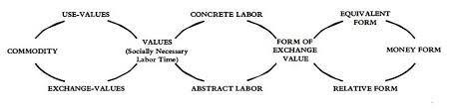
Marx Dialectic From Capital Volume 1

Slide 4
Limitless Accumulation
C – C
C – M – C
M – C – M’
M – M’

Slide 5
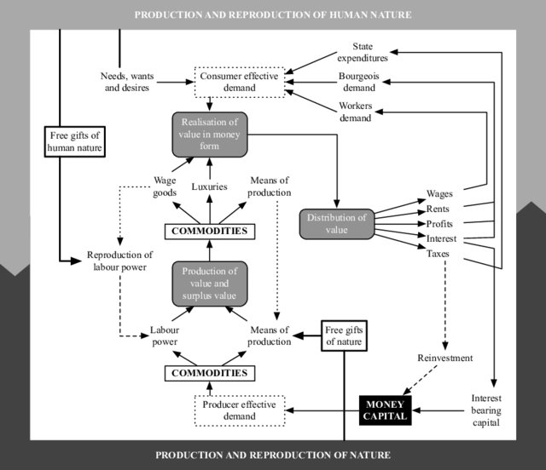
Rammelt, Crelis. (2019). The Spiraling Economy: Connecting Marxian Theory with Ecological Economics. Environmental Values. 29. 10.3197/096327119X15747870303881.

Slide 6
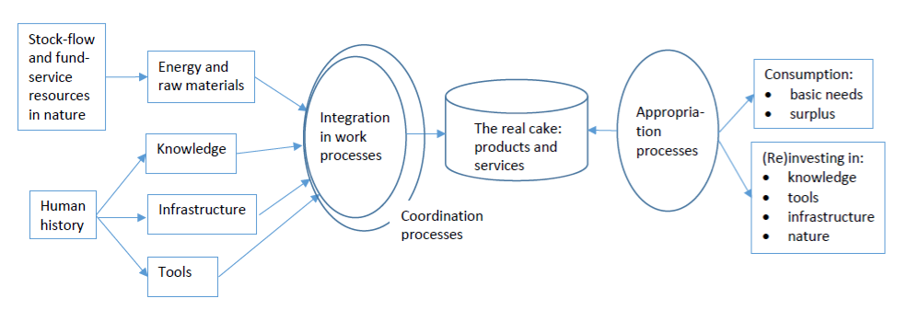

Slide 7
Many Types of Value
Social capital
Financial capital
Living capital
Intellectual capital
Experiential capital
Spiritual capital
Cultural capital
  Roland, E.C., Lanuda, G. (2013) Regenerative Enterprise. Optimizing for Multi-Capital Abundance

Slide 8
Discussion About Value
Social
What social values are often neglected when assessing economic value?
What factors are important when measuring the success of a society?
Individual
If you were to live on a deserted island for one month, what would you bring with you?
What are your favorite possessions?

Slide 9
What Economic Values Are Important?
OECD Data of Canada
  Article about OECD Well-Being Measurements
Here are some other well-known measures of social well-being:
Human Development Index,
Happiness Index
Life Expectancy
Democracy Index
Ecological Footprint

Slide 10
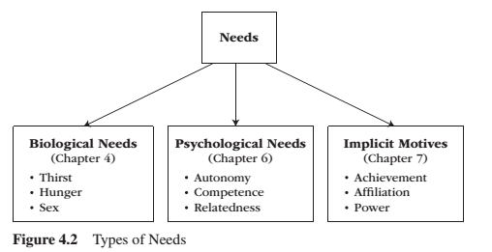
Needs
Need – A condition within the person that is essential and necessary for growth, well-being and life.
Deficiency needs – Are responses to a state of deprivation and generate tension-packed, urgency-laden emotions, such as pain, relief, anxiety, frustration, stress, etc.…
Growth needs – Gently guide behaviour toward a developmental trajectory of growth and well-being. They typically generate positive emotions, such as interest, enjoyment, hope and vitality.

Slide 11
Discussion Question?
What does it mean to re-embed the economy into social and biological systems?
How has the economy become dis-embedded from social and biological systems?
How can we re-embed economic systems into social and biological systems?

Slide 12
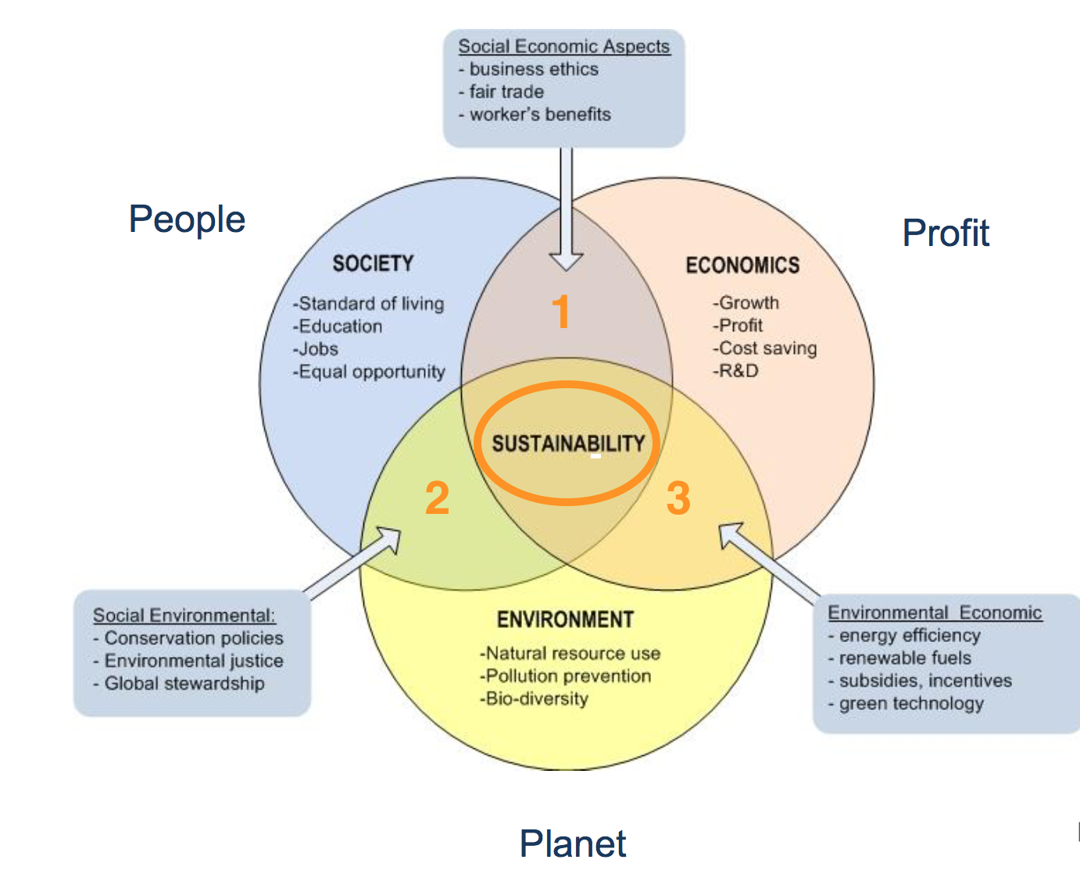
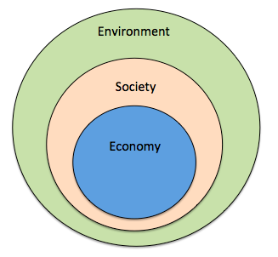
Triple Bottom Line vs Nested Models of Sustainability
Triple Bottom line
Nested model

Slide 13
What is Biophysical Socio-Economics?
  A field of ecological economics rooted in biophysical understandings of socio-economics
  Shared roots with ecological economics
  Begins with physiocrats and borrows from physics (laws of thermodynamics)
  Rejects classical and neoclassical economics based on the value of consumer preferences and markets
  Argue that neoclassical and classical economic theories do not reflect reality
  Looks at sources of goods and services in nature and energy and materials required to bring them to markets
  Strives to influence education, management and policy
  Strives to address conditions that threaten planetary boundaries
  Provides models to study transformations of nature to wealth, energy and material flows
  Provides a bridge for social sciences and natural sciences to overcome socially constructed ‘dualism’
  Focuses on systems, not the behaviour of individuals
  Focus on planetary and human well-being
  “The substantive meaning of economics derives from [human] dependence for [their] living upon nature and [their] fellows. It refers to the interchange with [their] natural and social environment, insofar as this results in supplying [them] with the means of material want satisfaction.”

Slide 14
Focus of Biophysical Socio-Economics
  Keep economic throughput within levels that the biophysical world can sustain
  Theory of embodied energy theory of economic value whereby the quantity of energy is directly and indirectly used to track the value of goods and services
  ‘Hubbert’ curves that determine availability of resources
  Views cultural development occurring when the amount of energy harnessed by people per capita; per year is increased; technology putting energy to work becomes more efficient; or both (technology, sociological and ideological).
  Part of a de-growth paradigm
  Studies energy return on energy used (EROI)
  Uses frameworks for performing biophysical analyses of socio-economic systems

Slide 15
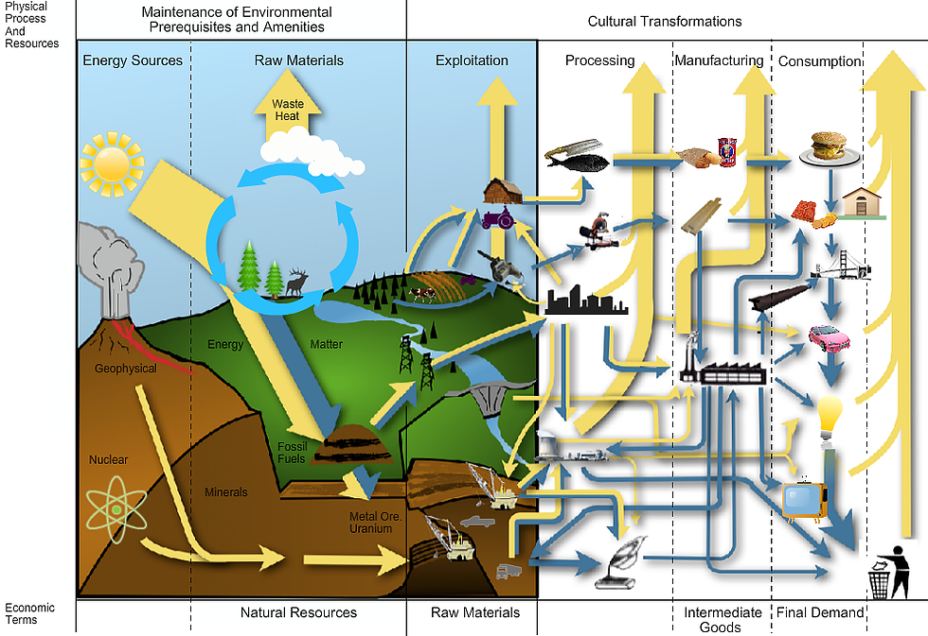

Slide 16
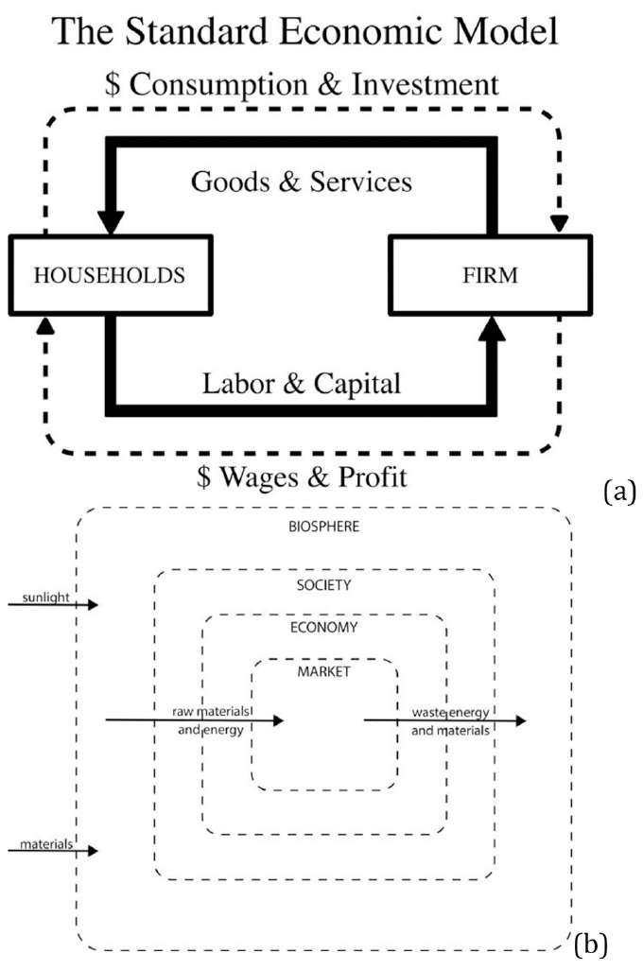

Slide 17
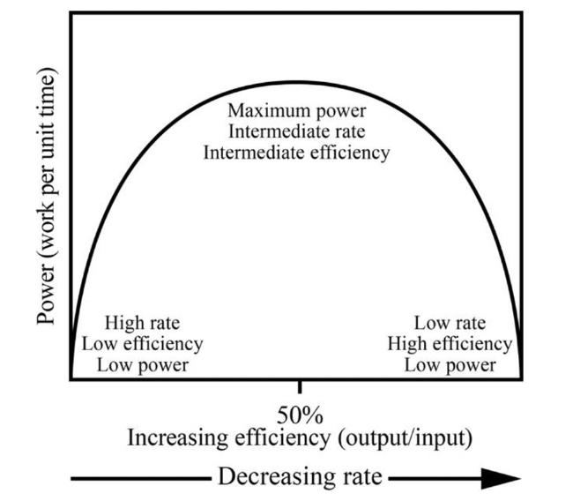
Maximum Power Principle
  During the self-organization, system designs develop and prevail that maximize power intake, energy transformation and those uses that reinforce production and optimum efficiency
  The intermediate point between rate and efficiency represents the maximum useful power output

Slide 18
Population-Economy-Environment Dynamics
  Doomsday predictions have existed for centuries (Malthus 1789) which have not come to pass
    Population migration
    Colonization
    Industrialization of agriculture
    Contraception
  Populations have seen significant increases
  Notions of sustainability must address balance of renewable energy with needs of the population

Slide 19
Money, Debt, and Finance
  Monetary systems rely on energy, especially debt-based systems
  Repaying debt requires future energy opportunities
  GDP cannot continually increase when the economy is built on a finite energy source

Slide 20
Biophysical Sustainability and Stabilizing Economic Growth
  Growth should respect planetary boundaries
  Should reflect renewable rates and processes of the global ecosystem
  Jevon’s Paradox – Increasing energy efficiency tends to lead to increasing energy and resource use often in new technologies
  Growth does not necessarily lead to increased well-being. In many cases it leads to the opposite

Slide 21
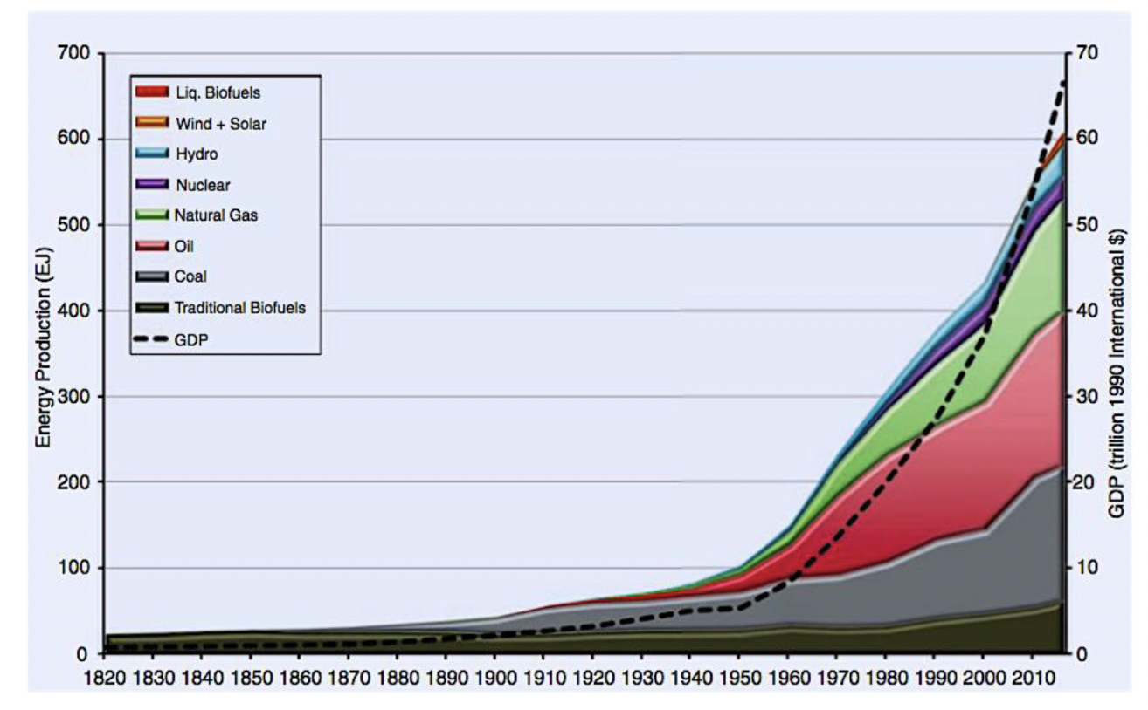

Slide 22
Financialization and Debt Crisis
  Financialization allows us to temporarily overcome biophysical limits of wealth creation by depleting the Earth’s stock of natural capital before it can regenerate
  Current financial models are prone to collapse because they are not grounded in biophysical realities
  Future energy is needed to pay for massive debts

Slide 23
Biophysical Plans for Sustainability
1 – State objectives (i.e., provide a high quality of life for a population)
2 – Assemble a database of critical biophysical parameters (i.e., energy resources, resource extraction, waste emissions, population growth, etc..
3 – Assess critical economic parameters (i.e., poverty, inequality, debt, etc.) and link each of these to the biophysical resources needed and waste generated
4 – Construct a comprehensive simulation or scenarios of the future. Acknowledge that this requires a high degree of uncertainty
5 – Make the right decisions: focus on allocating the available resources towards the stated objectives. Make sure they are flexible and focus on well-being instead of GDP indicators

Slide 24
Solutions
  Green New Deal
  Un Sustainability Goals
  Public Education
  Actions required for a biophysical sustainability
    Socio-economic changes
      Stabilize population size
      Stabilize economic size at a sustainable scale
      Just distribution of incomes and wealth
      Prioritize quality of life and happiness
    Technology changes
      Improve energy efficiency
      Move towards renewable energies
      Develop mass transportation
  Changing ourselves
    Raise consciousness about embodied energy
    Require labels of energy and resource requirements
    Restore the dignity of meaningful work
    Adjust our expectations
    Develop an ethic of respect for other living things

