Slide 1
Building Food Sovereign Communities
Erik Chevrier
Building Ethical Economies

Slide 2
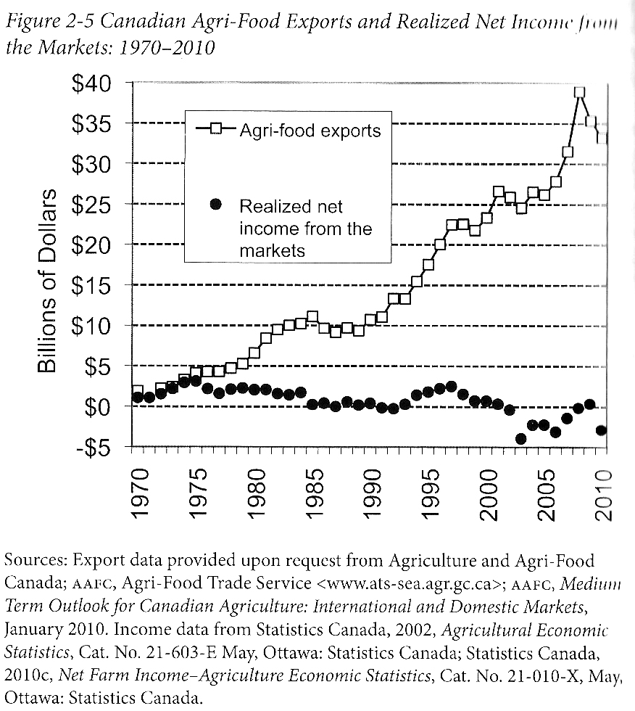
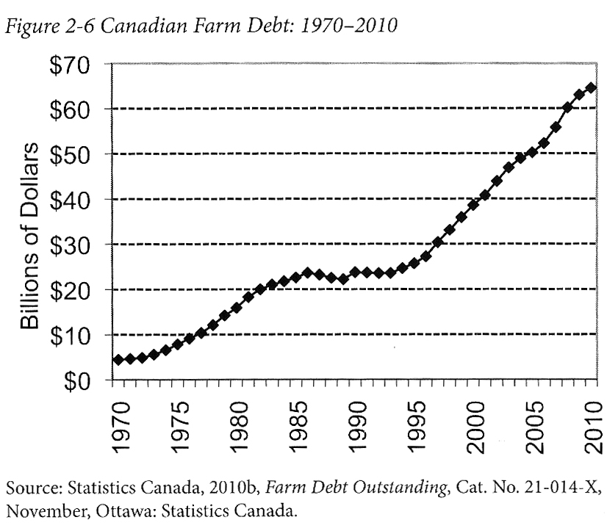
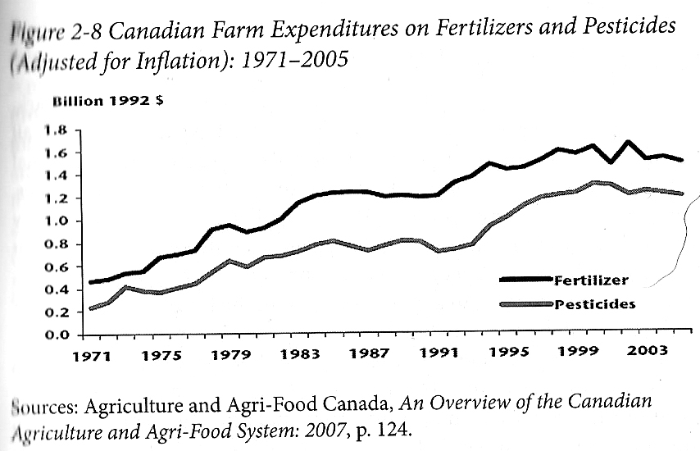
Who Benefits from Our Food System Economically?
Qualman, D. (2011) Advancing Agriculture by Destroying Farms? The State of Agriculture in Canada, pp. 20 – 42. In, Wittman, H., Desmarais, A. A., & Wiebe, N. (2011) Food Sovereignty in Canada: Creating Just and Sustainable Food Systems, Fernwood Publishing

Slide 3
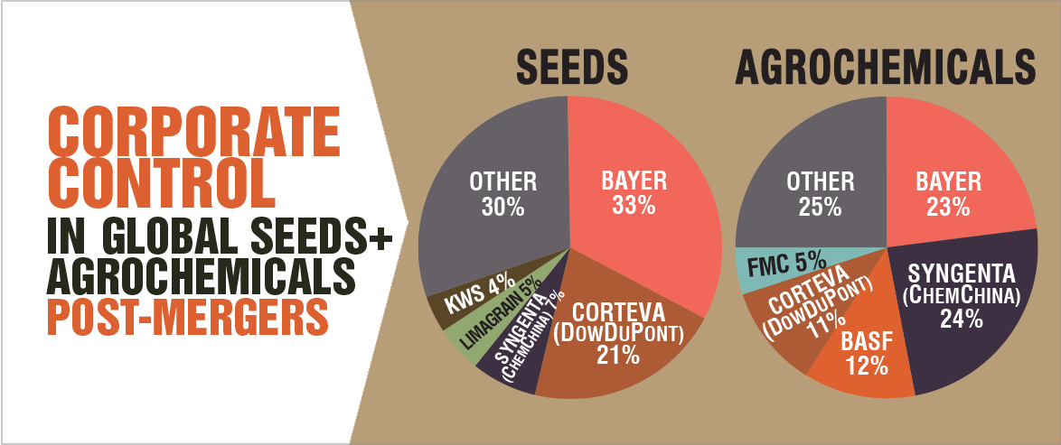
Only A Few Large Corporations Own Most of the Agrochemical Market https://cban.ca/gmos/issues/corporate-control/

Slide 4
Companies of War, Destruction and Death
These are a few examples:
Monsanto still uses chemicals that were used to kill people, but in our food
  Monsanto Ghostwriting Academic Papers
  Is Round-Up safe to drink?
  Farmer won lawsuit against Monsanto – Glyphosate causes cancer
  The World According to Monsanto
  Monsanto is now owned by Bayer who used to be part of I.G. Farben, manufacturing poisonous gas (Zyklon B) for concentration camps during the World War.
BASF was also part of IG Farben a company who worked with the Nazis and tested chemicals and drugs on people including Zyklon B
Dow Chemical Invented Agent Orange
Dow Chemical now owns Union Carbide who was responsible for a large devastating explosion in Bhopal, India:
  The Bhopal disaster: Toxic legacy
  One Night in Bhopal
  The Bhopal Disaster

Slide 5
Issues With Our Current Food System
Issues with food security – there are over 800 million people starving in the world today!
Issues with food sovereignty – peasants and farmers are being affected by trade agreements and food dumping!
Issues with genetic modification process – epigenetics matter!
Issues with use of herbicides – glyphosates are being identified as cancer causing!
Issues with privatization – restricted access!
Issues with cost on farmers – family farms are not sustainable!
Issues with reduction of biodiversity – we are destroying nature!
Issues with unwanted genetics spreading onto non-GMO farms – lawsuits!
Issues with loss of Indigenous farming methods – on stolen land!
Issues with soil arability – we are killing our soil!
Issues with killing pollinators – fruits need bees!
Issues with water ‘dead zones’ – we are polluting our water!
Issues with corporate concentration of agribusinesses – former war companies are now food chemical companies!
Issues with health – our food contains toxins!
Foundations on structural racism, colonialism and patriarchy – glaring systemic issues!
Rising cost of seed and chemicals – we don’t need to buy seeds!
Research funding being directed to GMOs instead of traditional breeding methods – ‘science’ is not only about GMOs!
Pest and weed resistance to Bt crops and glyphosate!
There are so many more critiques!

Slide 6
Is The Food System Broken?
Calls to “fix a broken food system” assume that the capitalist food system used to work well. This assumption ignores the food systems long, racialized history of mistreatment of people of colour. The food system is unjust and unsustainable, but it is not broken. It functions precisely as the capitalist food system has always worked, concentrating power in the hands of the privileged minority and passing off the social and environmental “externalities” disproportionately to racially stigmatized groups. (Holt-Gimenez, 2017, p. 160)
How we produce and consume determines how our society is organized, but how we organize socially and politically can also determine how we produce and consume. The implications of this are profound: our food systems are vessels of unmatched social and economic power and pivotal sites for systemic transformation. (Holt-Gimenez, 2017, p. 214)
Holt-Gimenez, E. (2017) A Foodie’s Guide to Capitalism: Understanding the Political Economy of What We Eat, Monthly Review Press, New York.

Slide 7
How Can We Build an Ethical Food Economy?

Slide 8
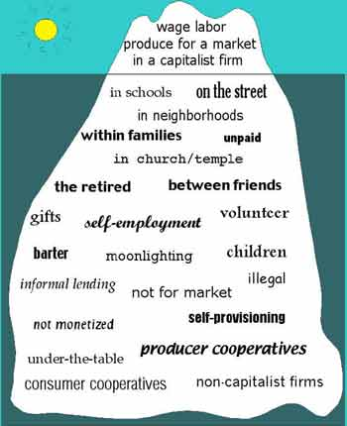
Take back the Economy
Gibson Graham
Gibson-Graham, J.K., Cameron, J., Healy, S. (2013) Take Back the Economy: An Ethical Guide for Transforming Communities, University of Minnesota Press
Katherine Gibson Interview Playlist

Slide 9
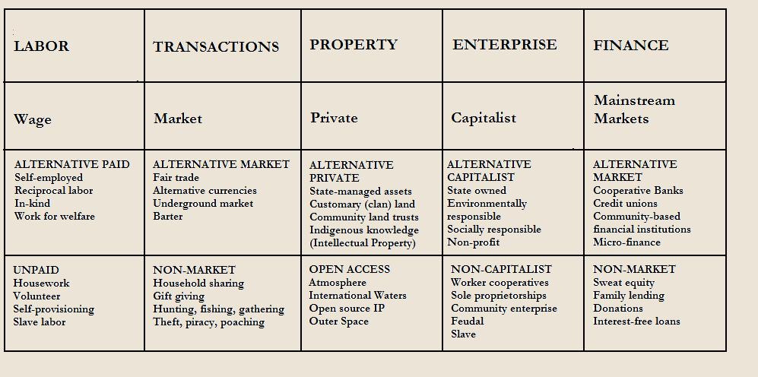
Take back the Economy
Gibson-Graham, J.K., Cameron, J., Healy, S. (2013) Take Back the Economy: An Ethical Guide for Transforming Communities, University of Minnesota Press

Slide 10
Who Benefits from Our Food System Economically?
Qualman, D. (2011) Advancing Agriculture by Destroying Farms? The State of Agriculture in Canada, pp. 20 – 42. In, Wittman, H., Desmarais, A. A., & Wiebe, N. (2011) Food Sovereignty in Canada: Creating Just and Sustainable Food Systems, Fernwood Publishing

Slide 11
What is an Economy?
Gibson-Graham, J.K., Cameron, J., Healy, S. (2013) Take Back the Economy: An Ethical Guide for Transforming Communities, University of Minnesota Press
Katherine Gibson Interview Playlist

Slide 12
Take back the Economy
Gibson Graham
Gibson-Graham, J.K., Cameron, J., Healy, S. (2013) Take Back the Economy: An Ethical Guide for Transforming Communities, University of Minnesota Press

Slide 13
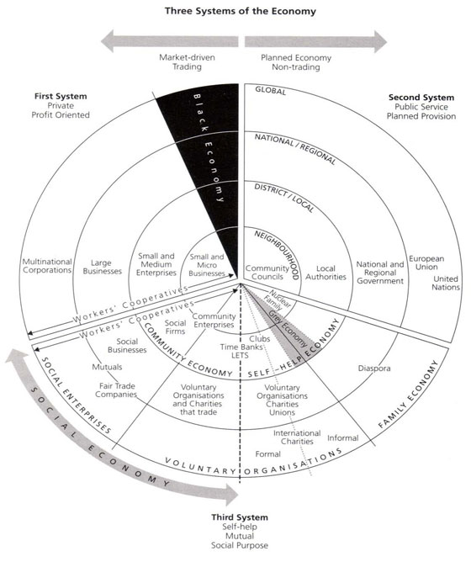
Three Systems of an Economy
Pearce, J. (2009) Social Economy: Engaging as a Third System, In Amin, A. The Social Economy; International Perspectives on Economic Solidarity, p. 26.

Slide 14
Types of Urban Agriculture
For-Profit
Not-For Profit
Subsistence Farms
Cooperatives
Hobby Farms
Squat Gardens
Edible Foraging
Community Gathering Places
Edible Landscapes

Slide 15
Market Farm Practices
Direct sales
  CSA
  Farmers market
  Other markets
Wholesale
  Distributers
  Restaurants
Other sales
  Transformed goods
  Compost and other values
  Education
Contradictions
  Labour vs food price
  Soil regeneration time vs market readiness
  Growing time vs productivity
  Food donations vs sales
  Farmers markets vs increased labour
  Food waste!
Market Secrets
  Cash crops
  Reduce inputs
  Reduce labour necessities
  Holistic approach

Slide 16
Non-Market Farm Practices
Volunteer labour
Community involvement
Foraging
Soil building
Incorporating animals
Funding sources
Contradictions
  Free labour vs viability
  Free food vs revenue
  Community involvement vs community interest
  Soil building vs time
  Animals vs care
  Funding sources vs stability
Non-Market Secrets
  Sweat equity
  Stable funding
  Improved community space
  Building a sense of community

Slide 17
Alternative Market Farm Practices
Cooperative ownership
Different types of membership
Hybrid of markets and non markets
Ethical principles (social economy)
Fair treatment of employees
Rooted in community
Market viability and non-market advantages
Contradictions
  Community value vs profit
  Volunteers and paid workers
  Markets vs donations
  Internal conflicts
Alternative Market Secrets
  Community support
  Can take positive elements of both
  More resilient to market failures
  Provides community benefits

Slide 18
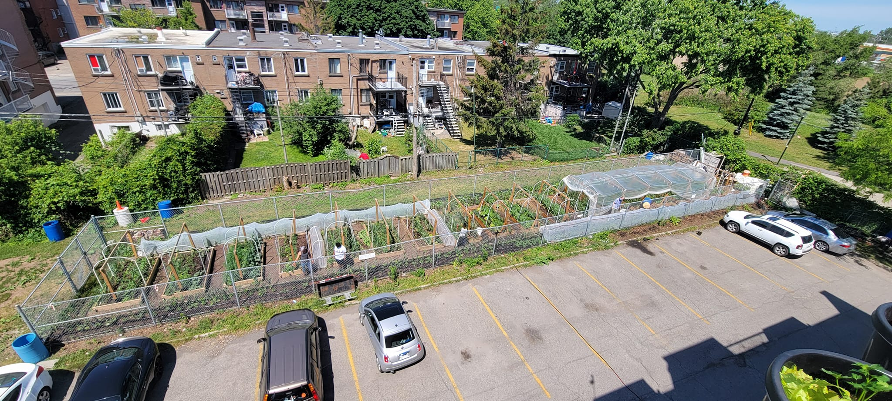

Slide 19
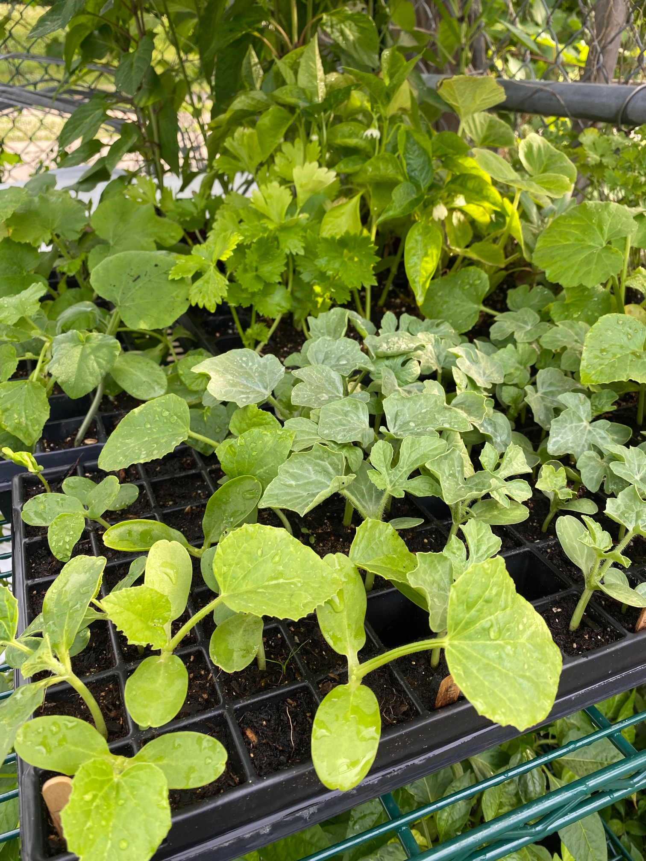
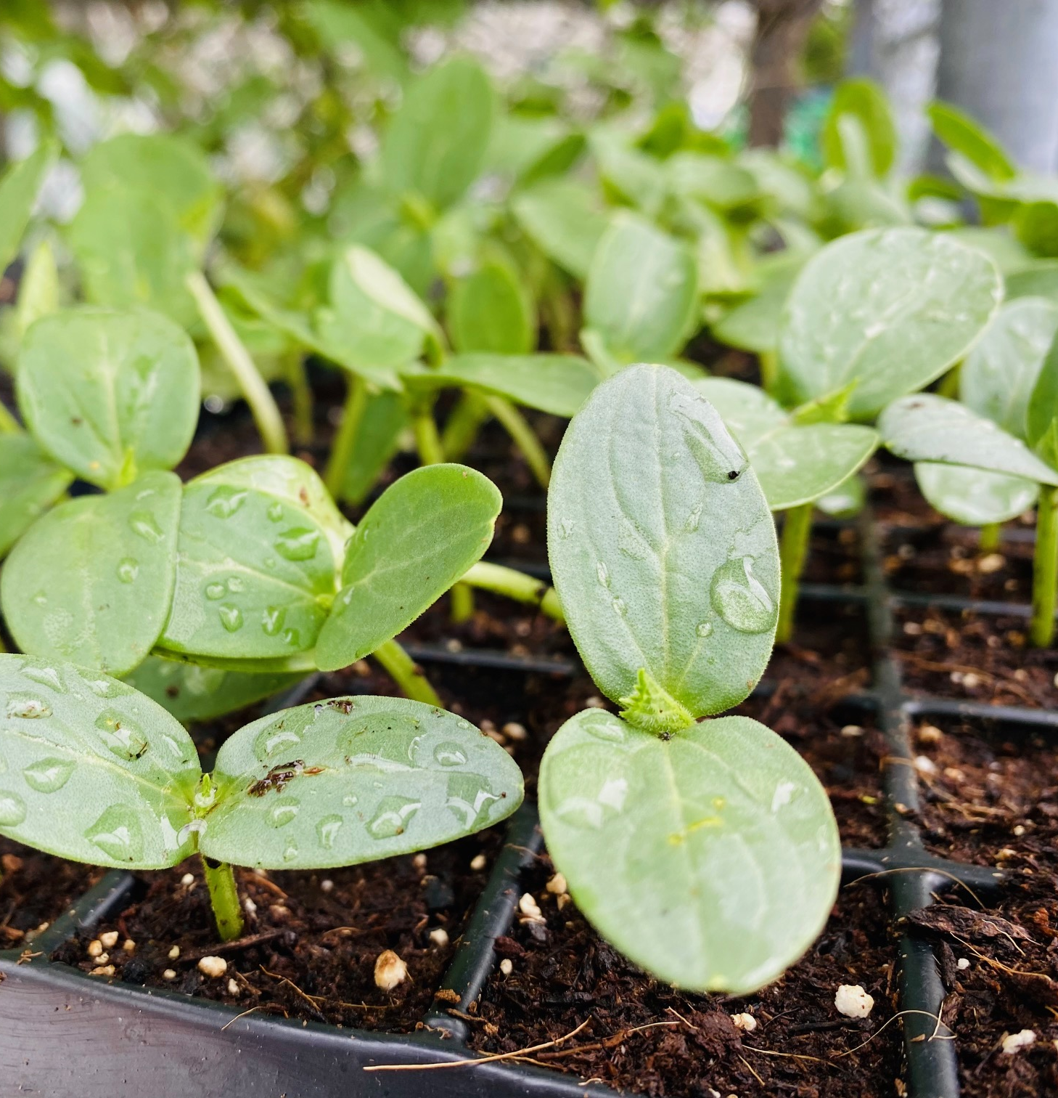

Slide 20
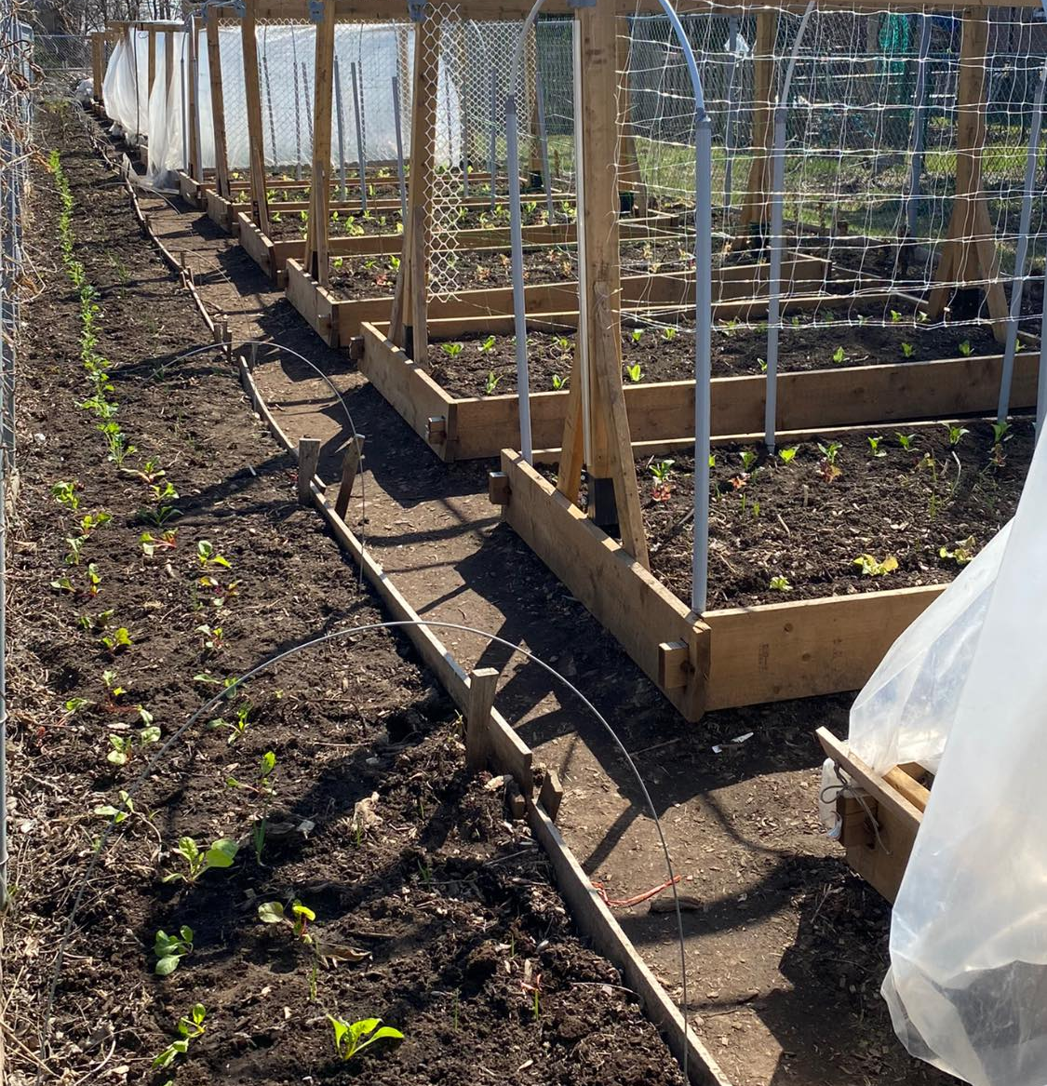
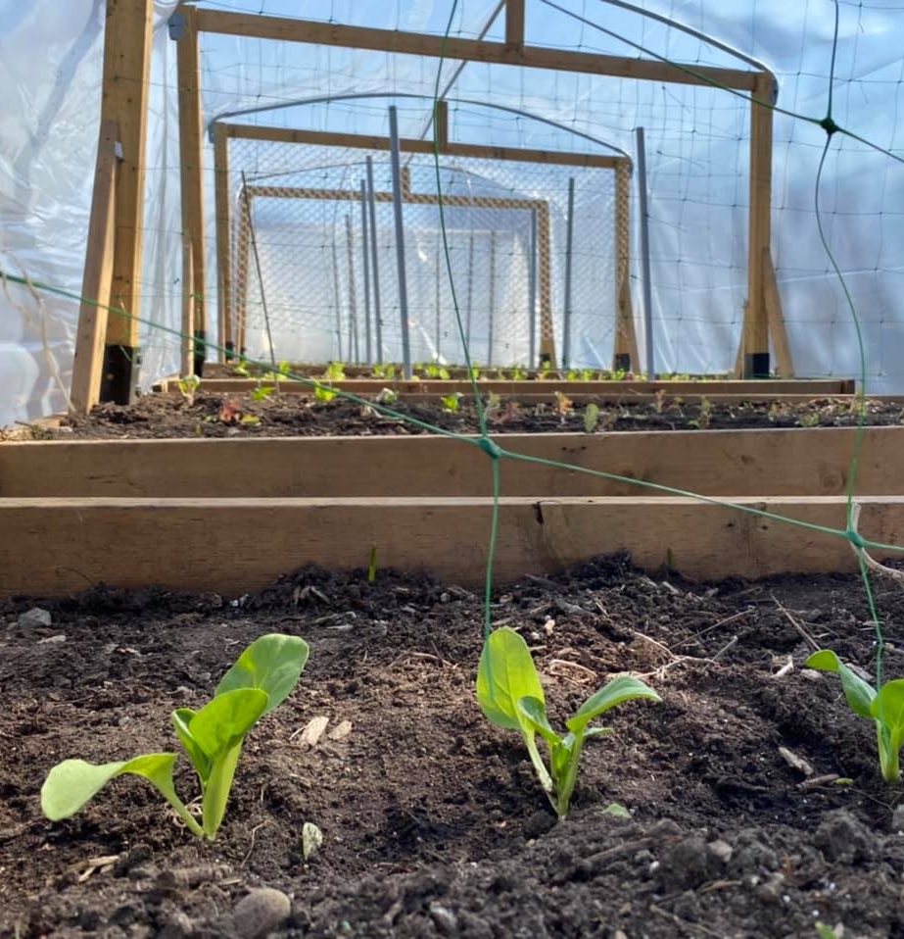

Slide 21
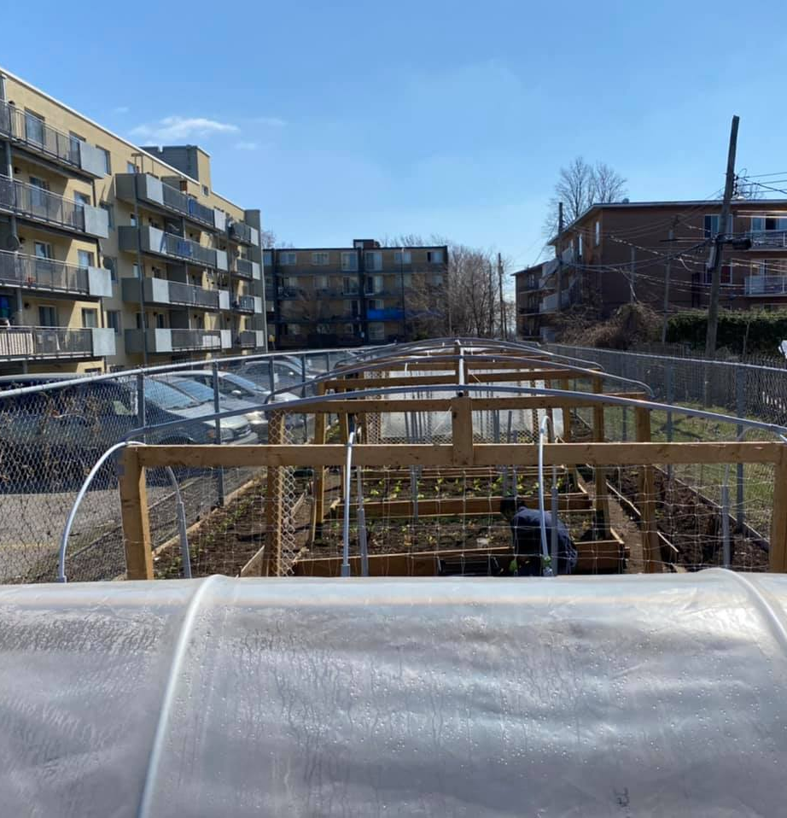
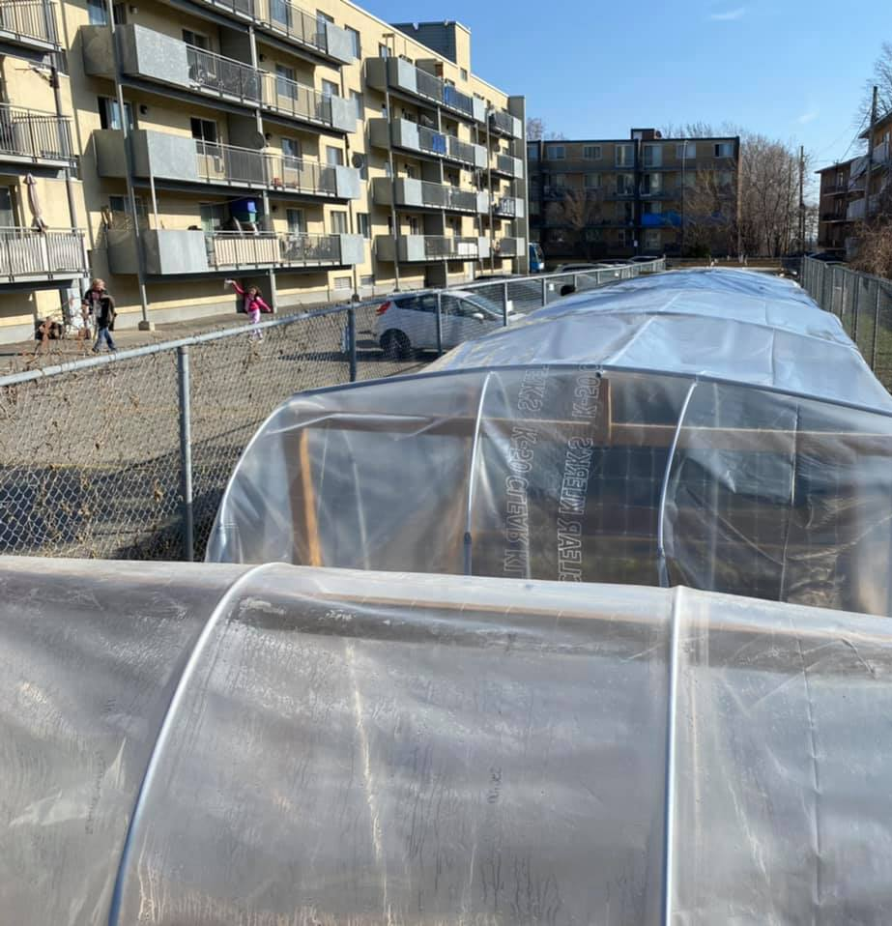

Slide 22
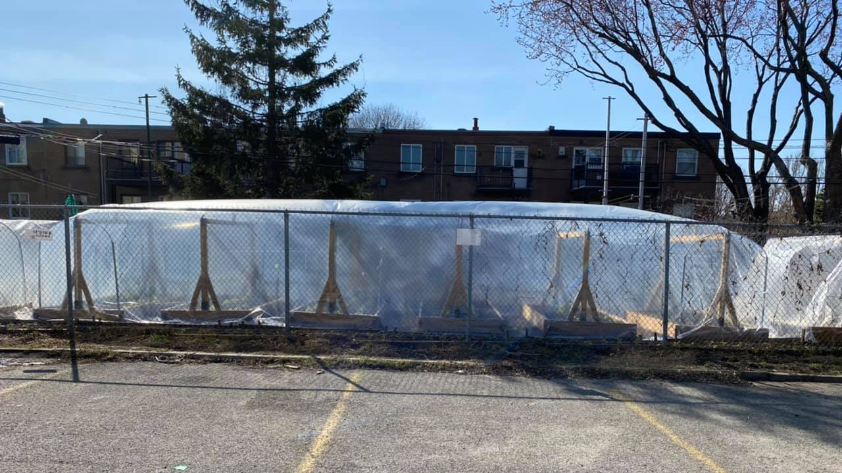

Slide 23
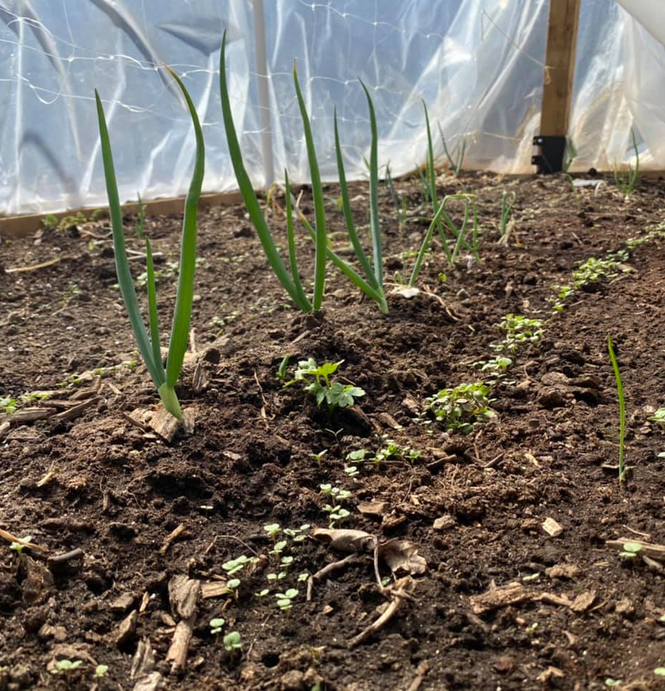
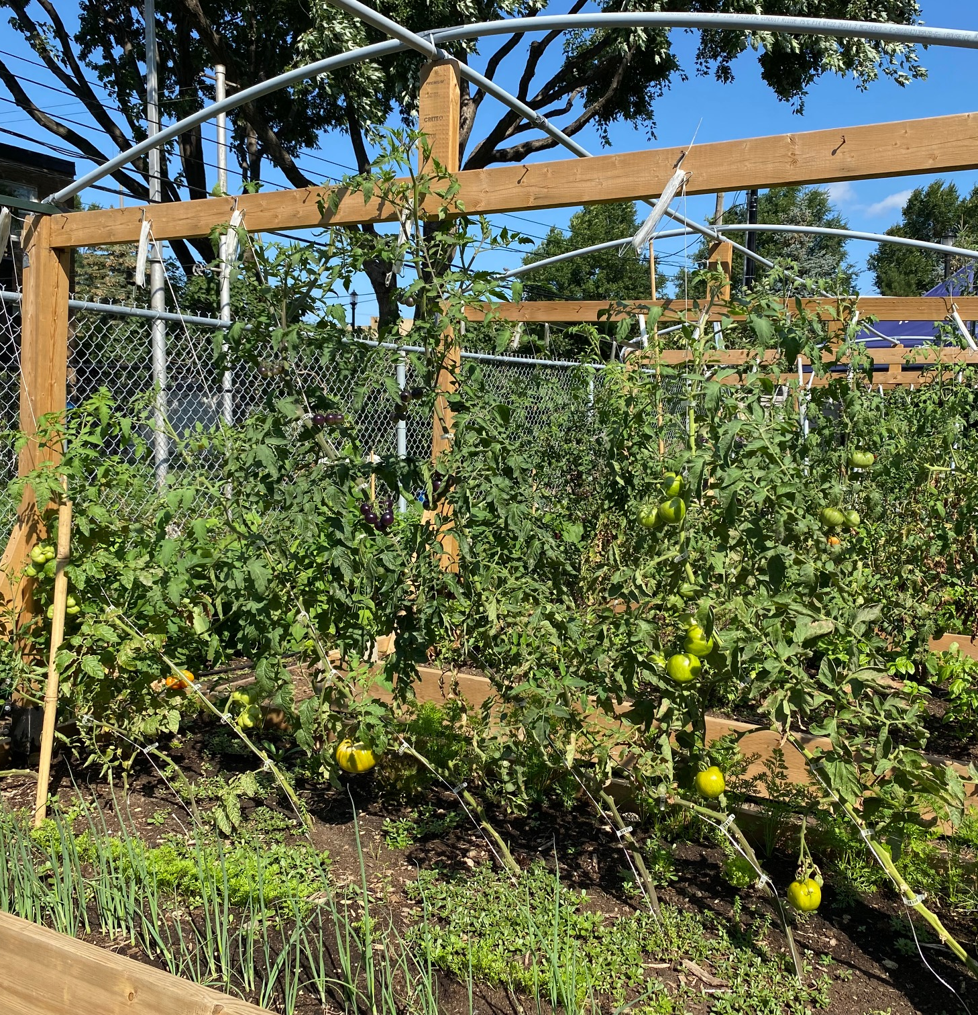

Slide 24
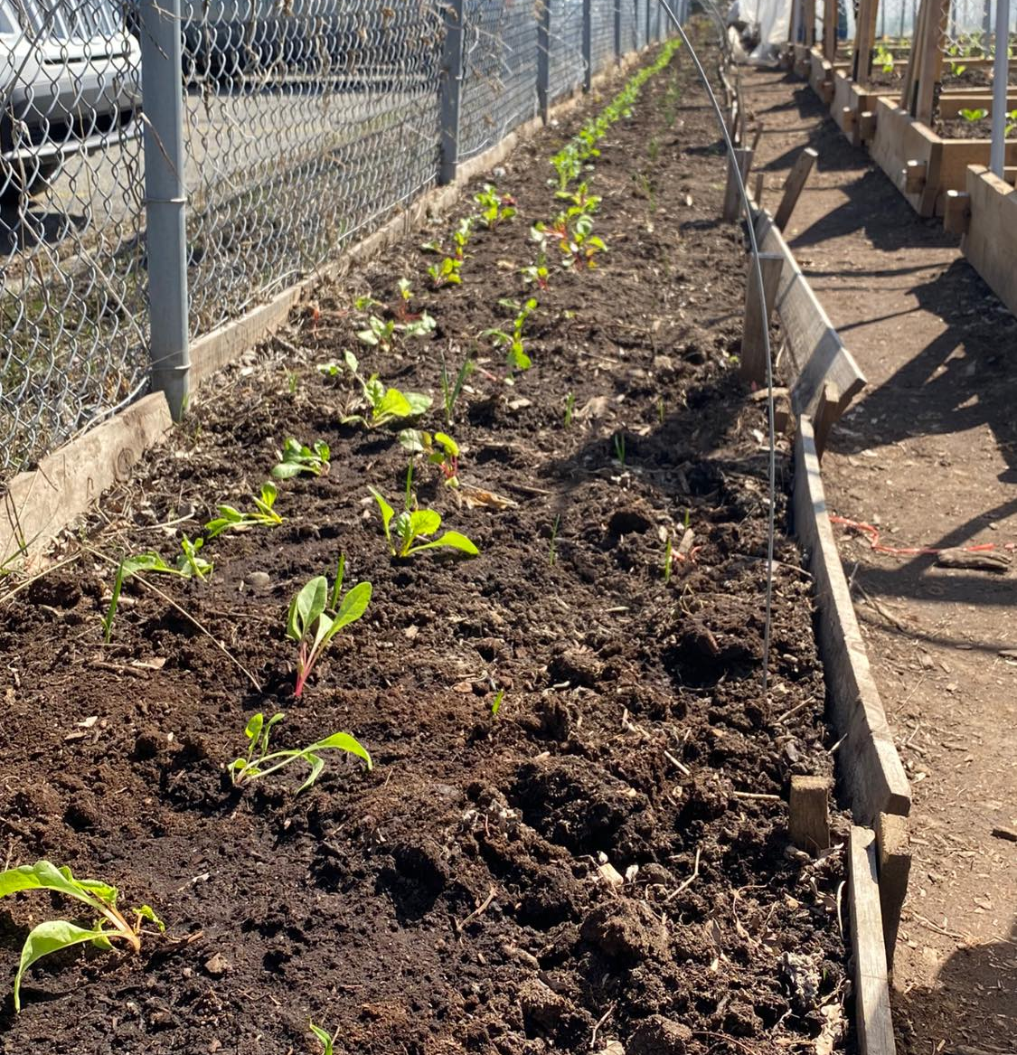
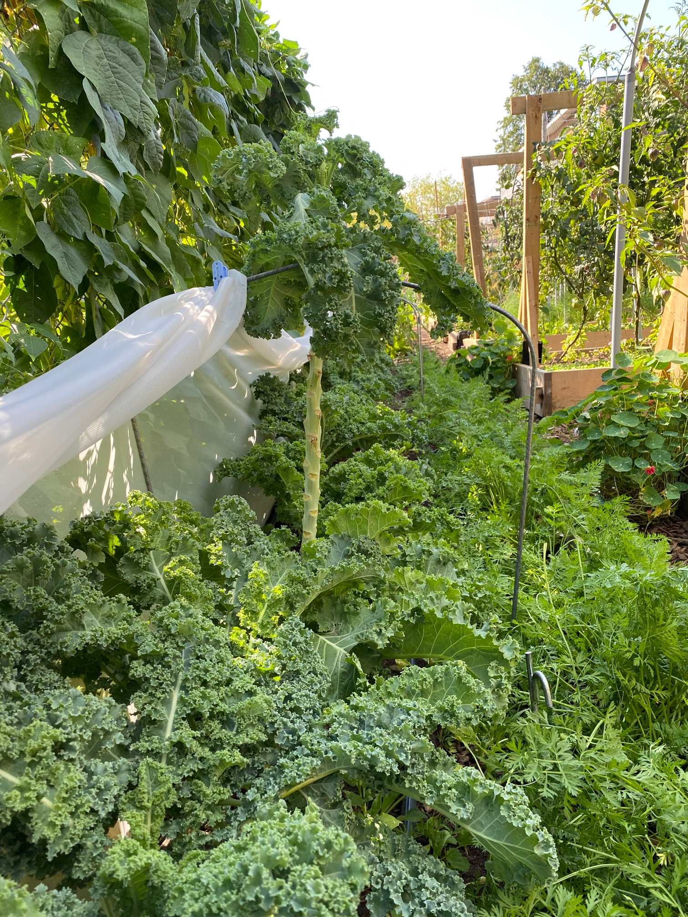

Slide 25
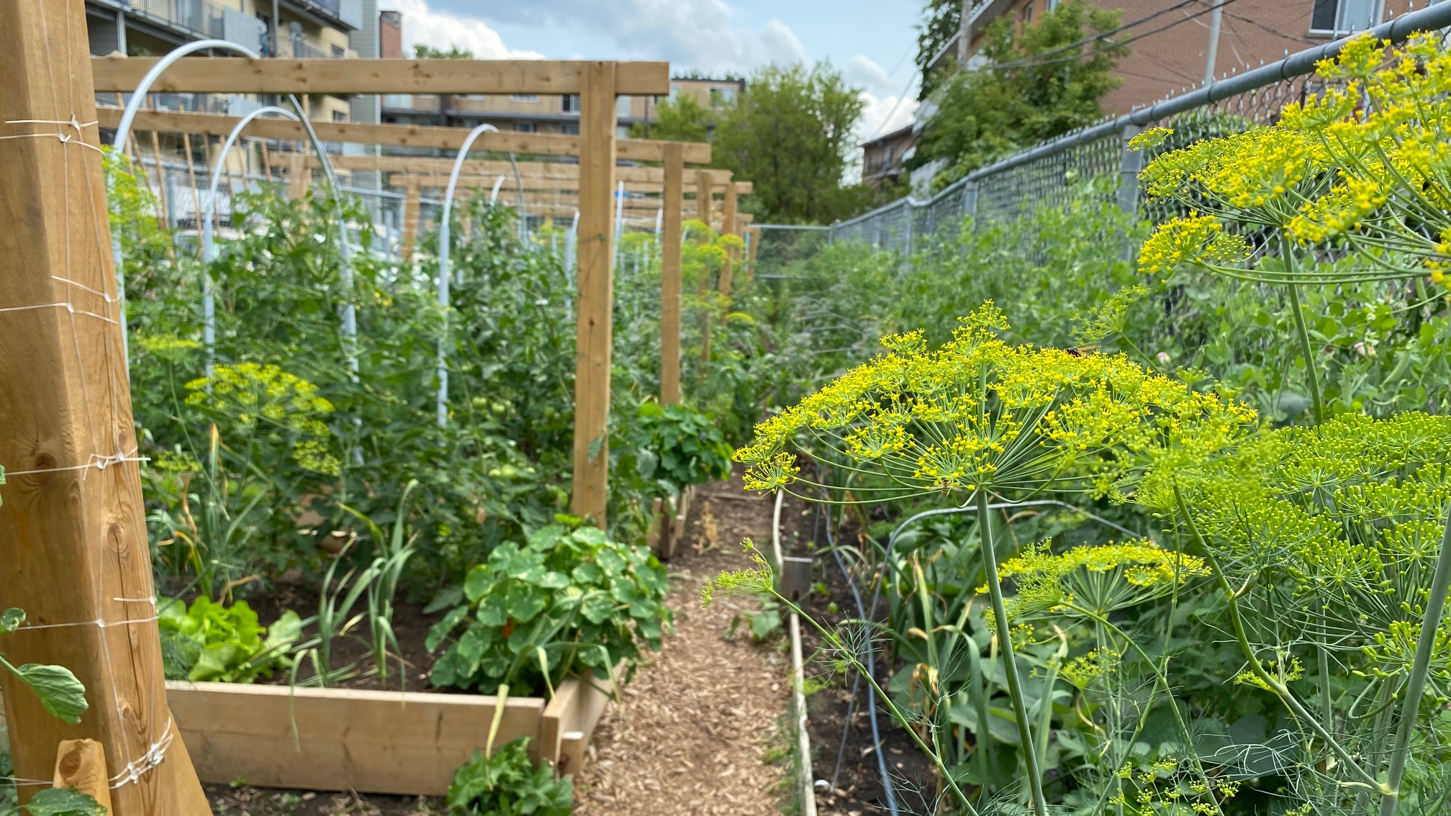

Slide 26
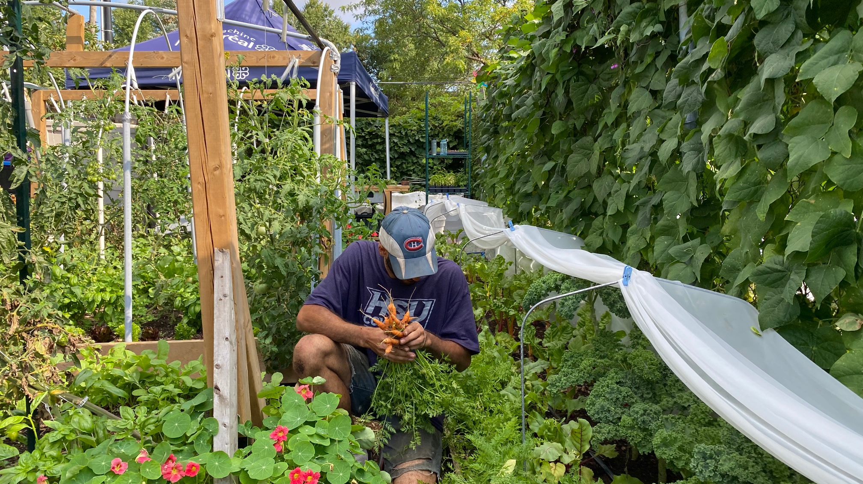

Slide 27
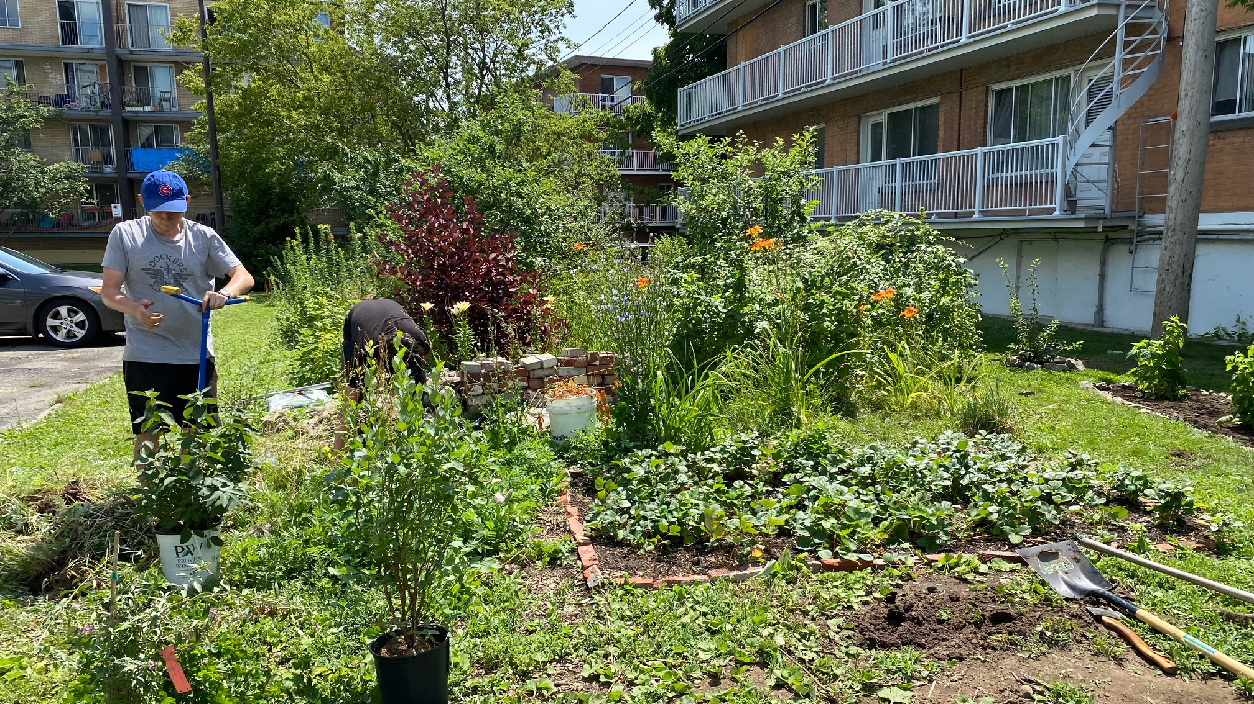

Slide 28
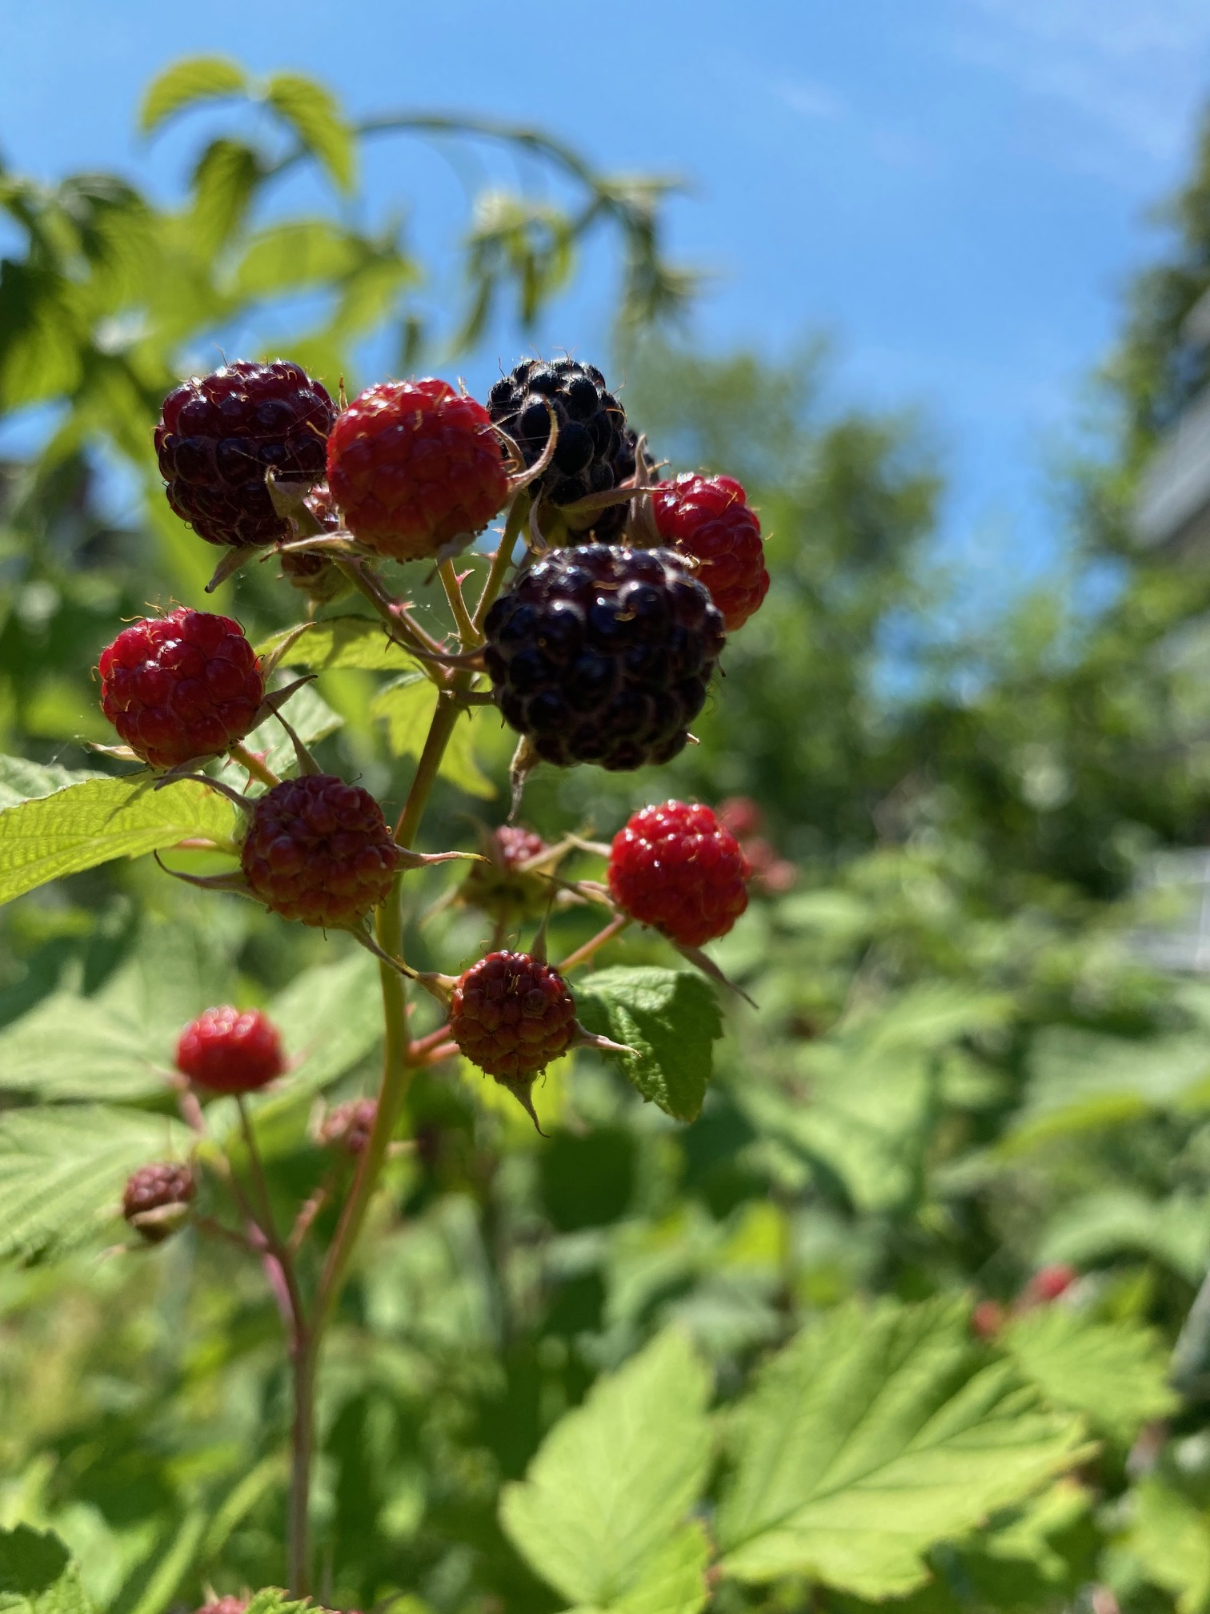
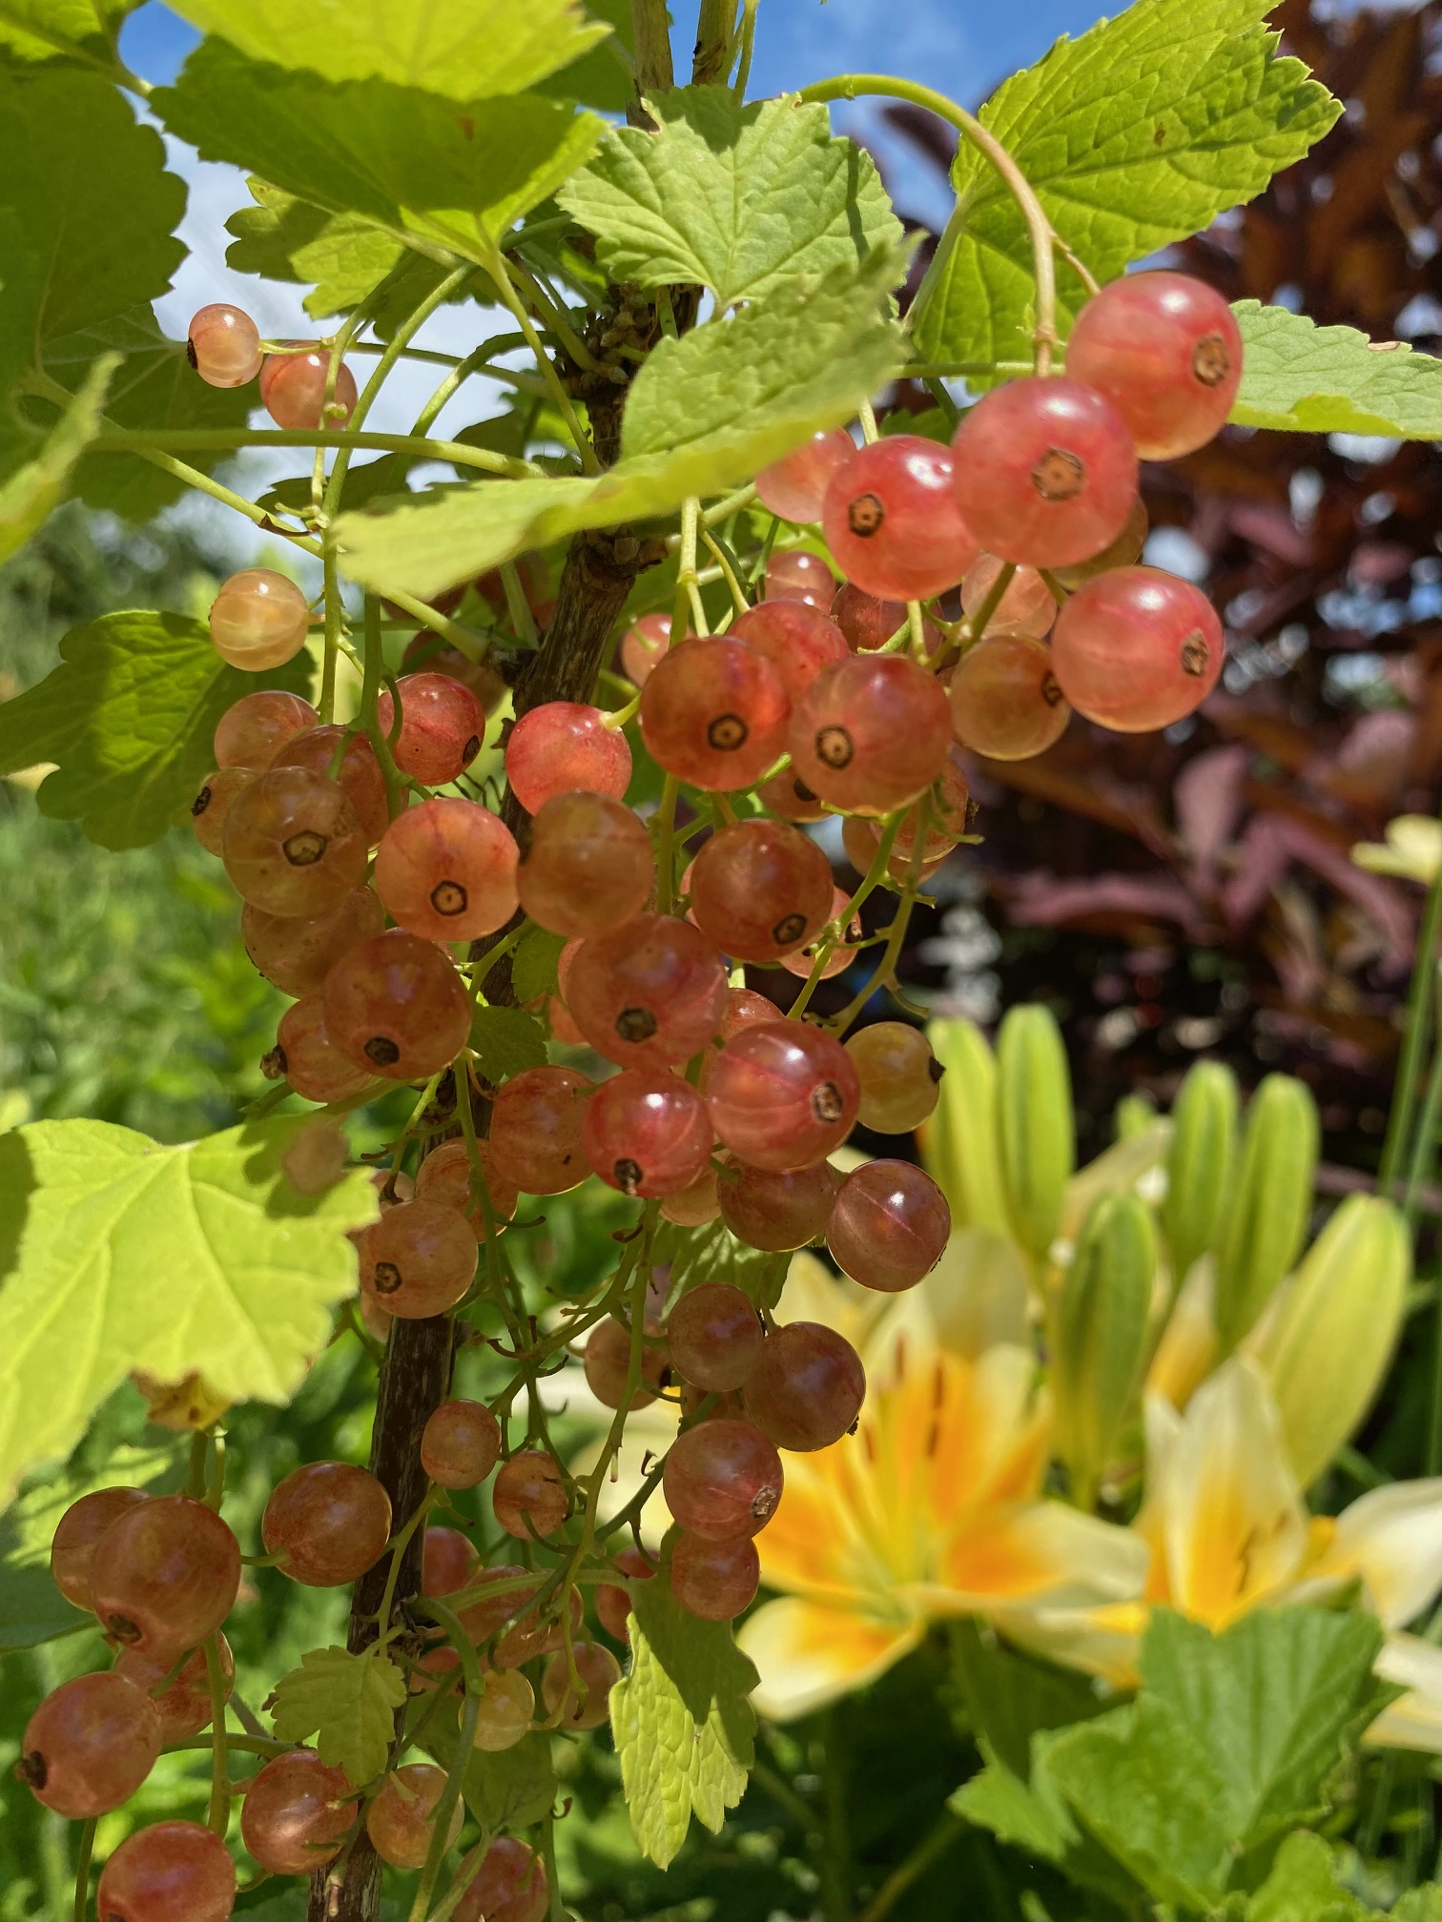

Slide 29
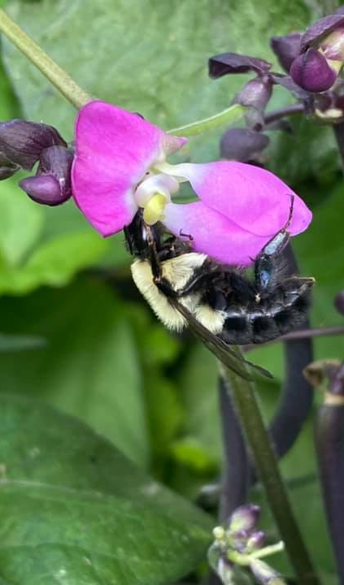
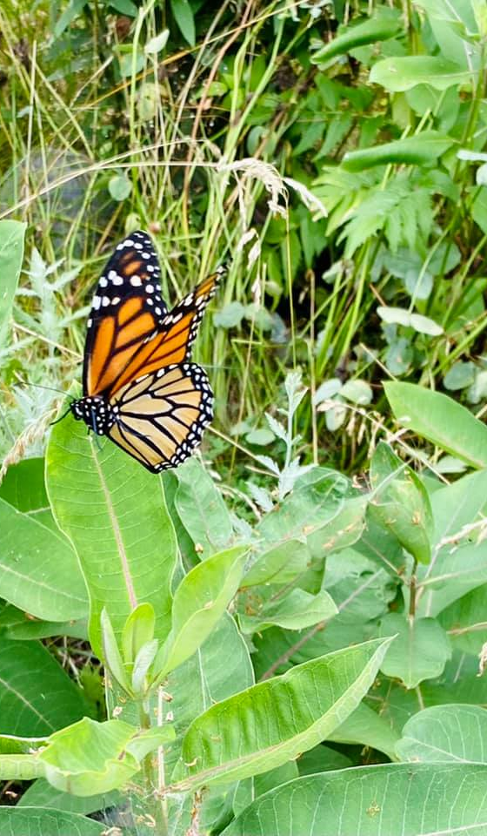
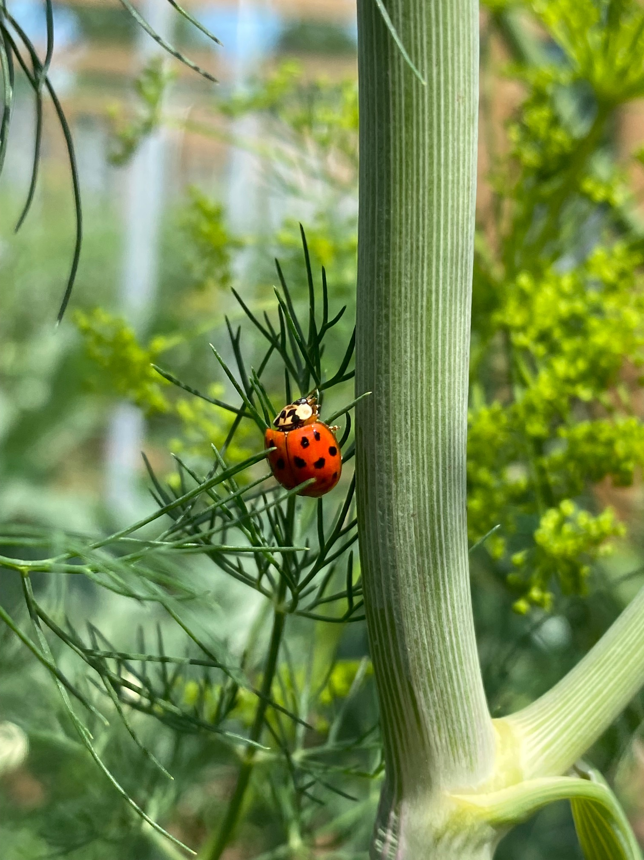

Slide 30
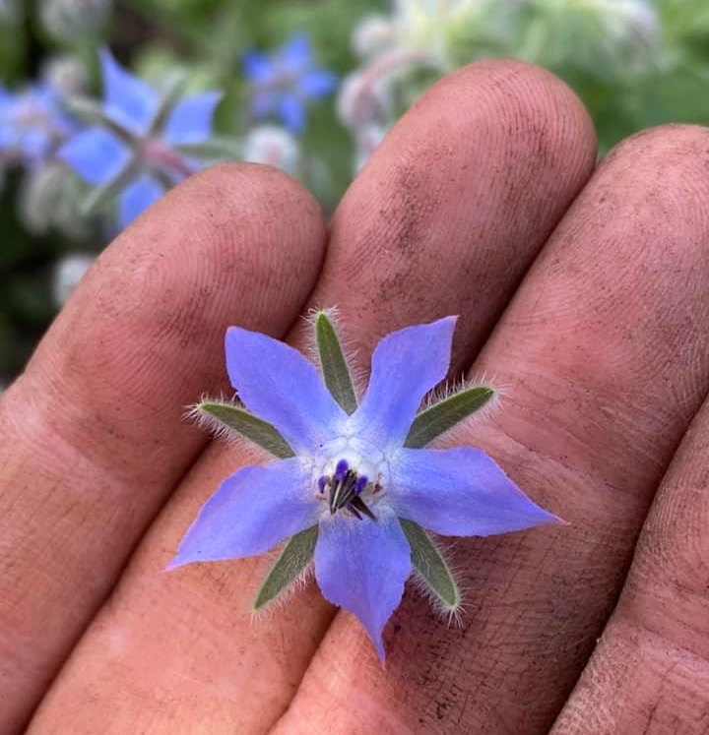
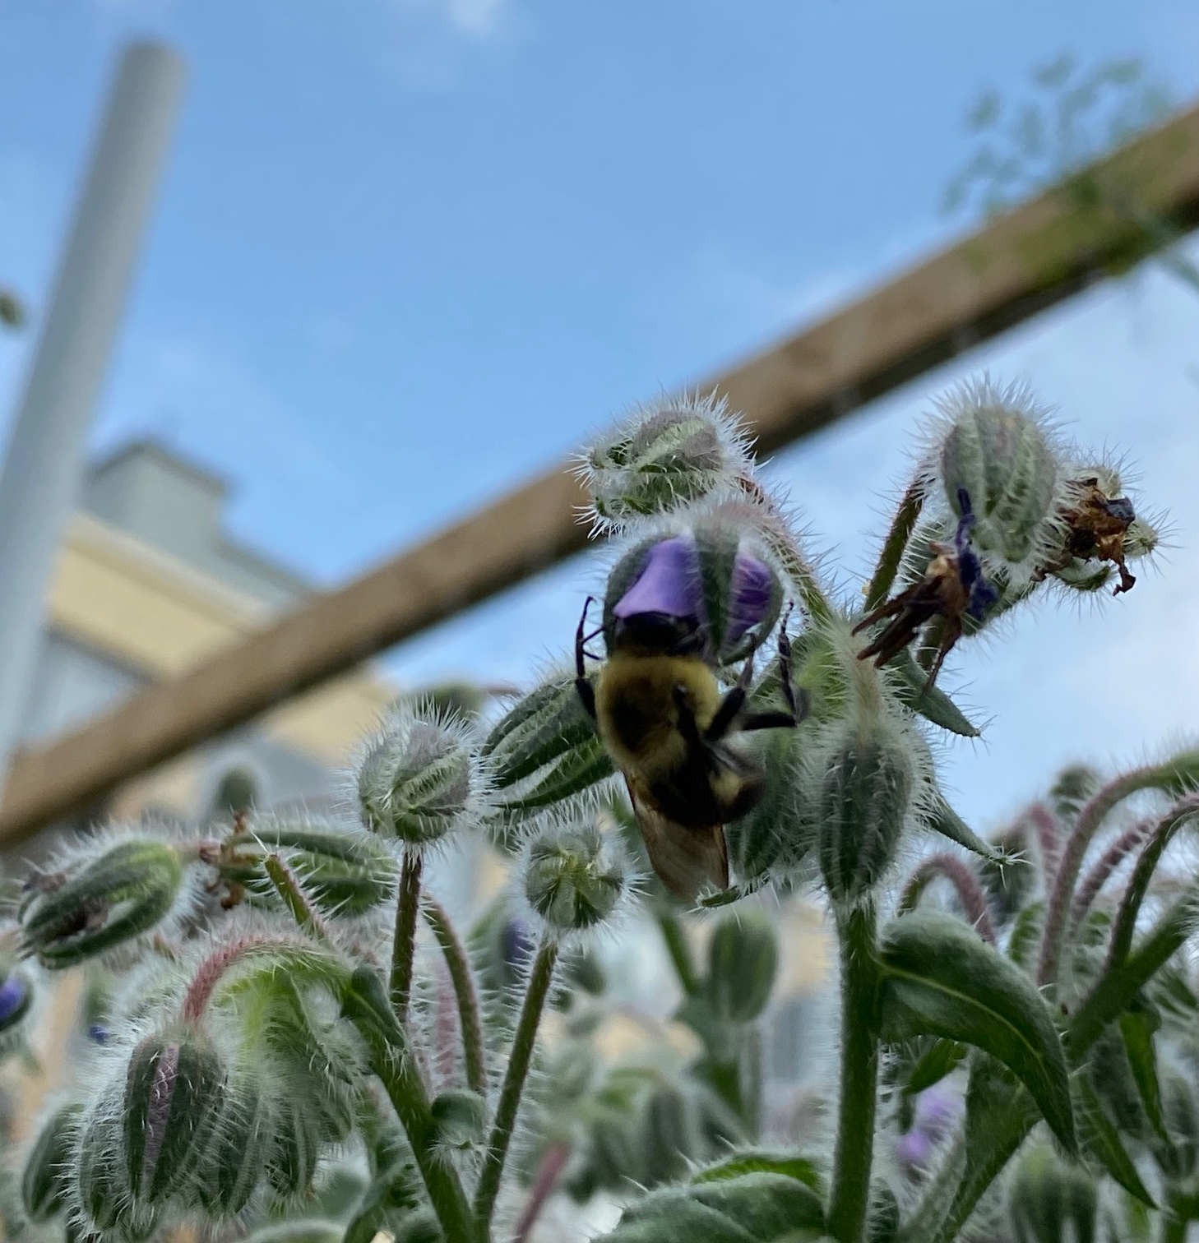

Slide 31
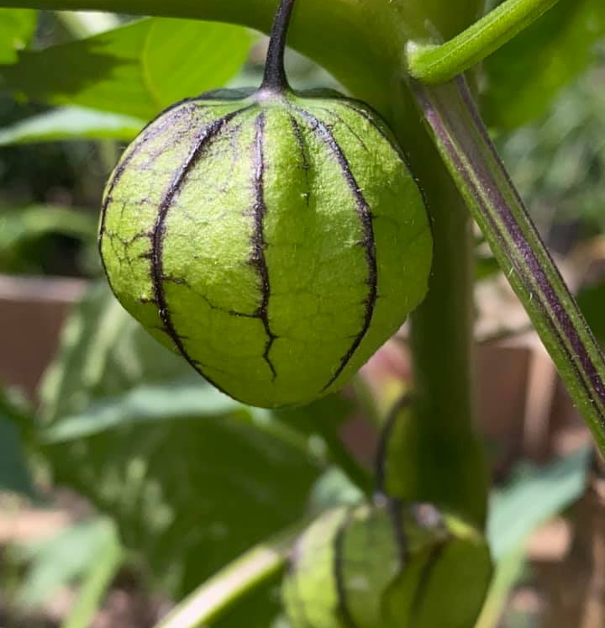
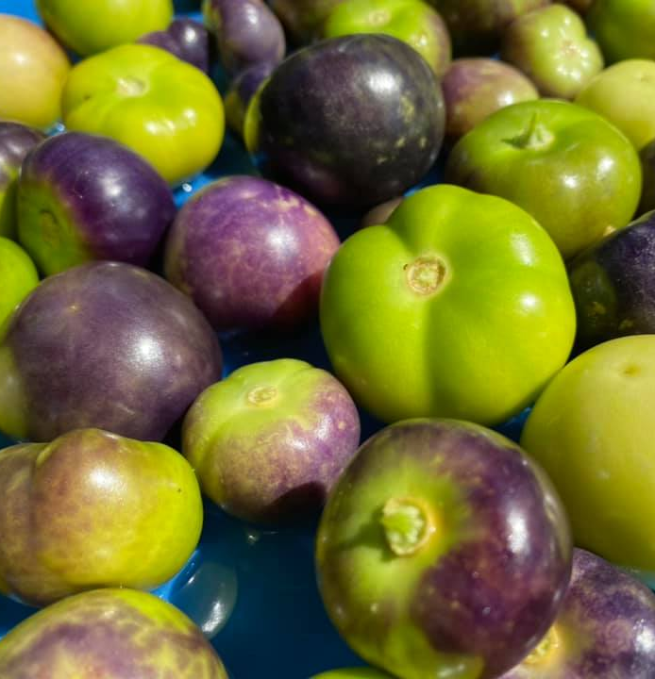

Slide 32
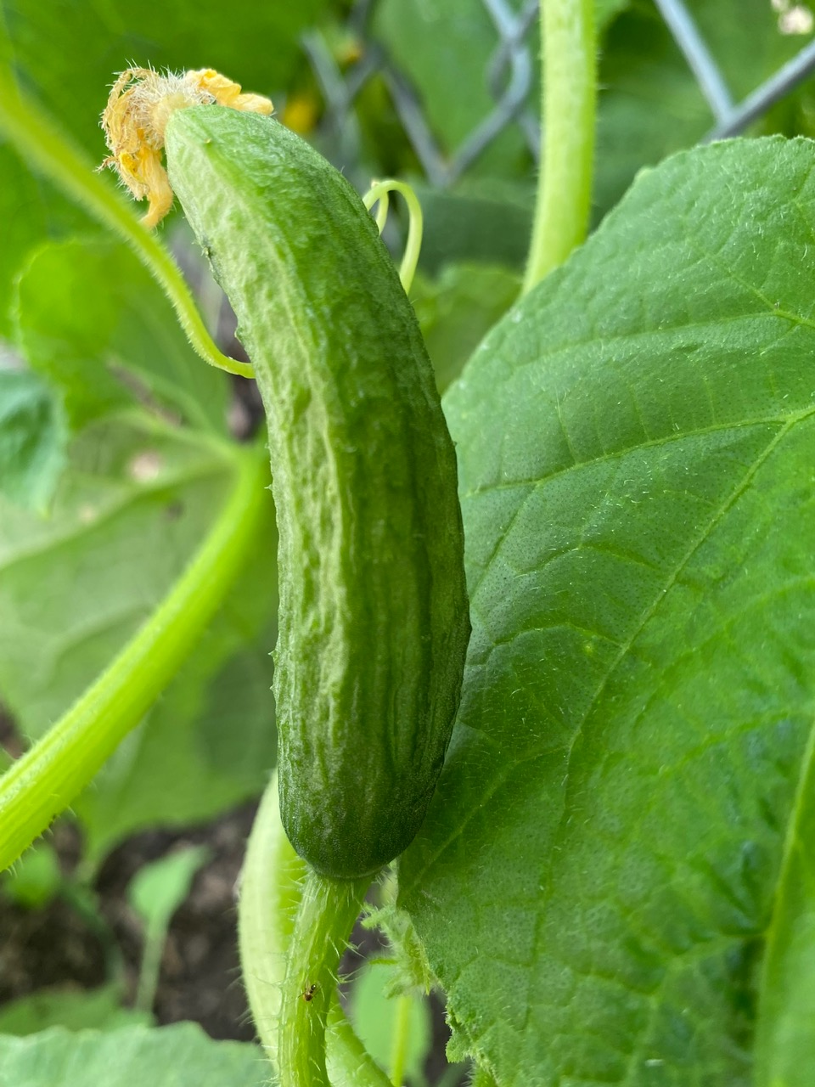
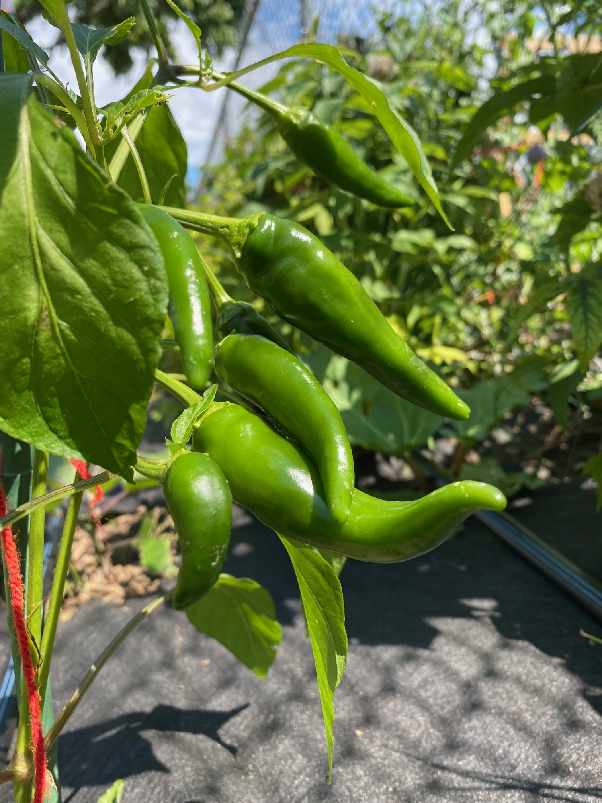

Slide 33
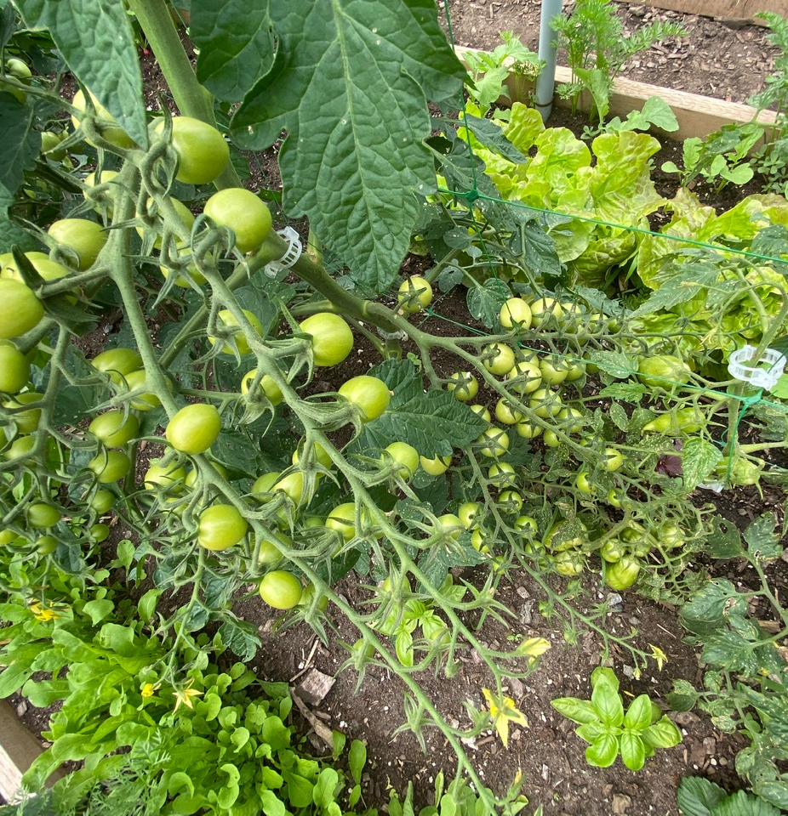
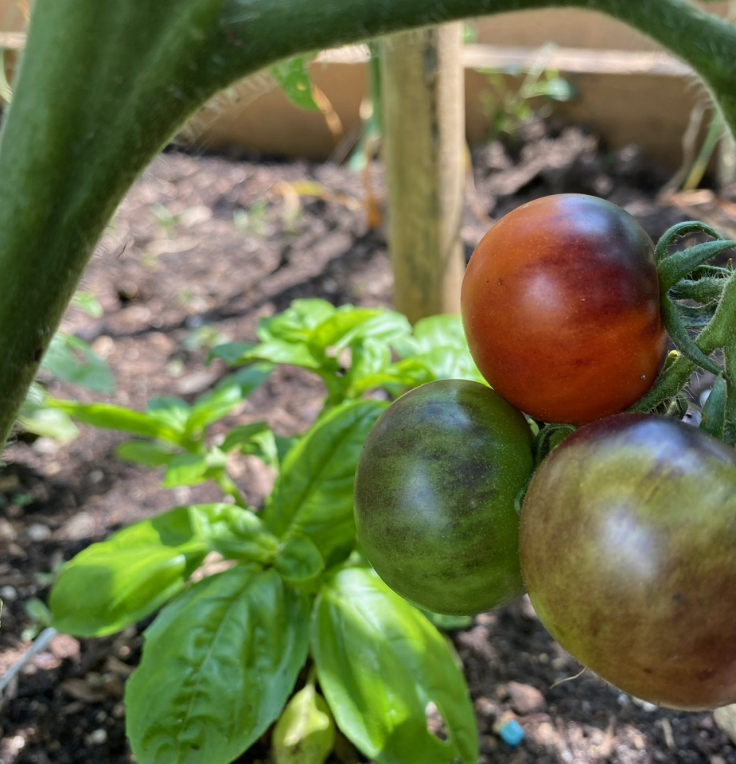

Slide 34
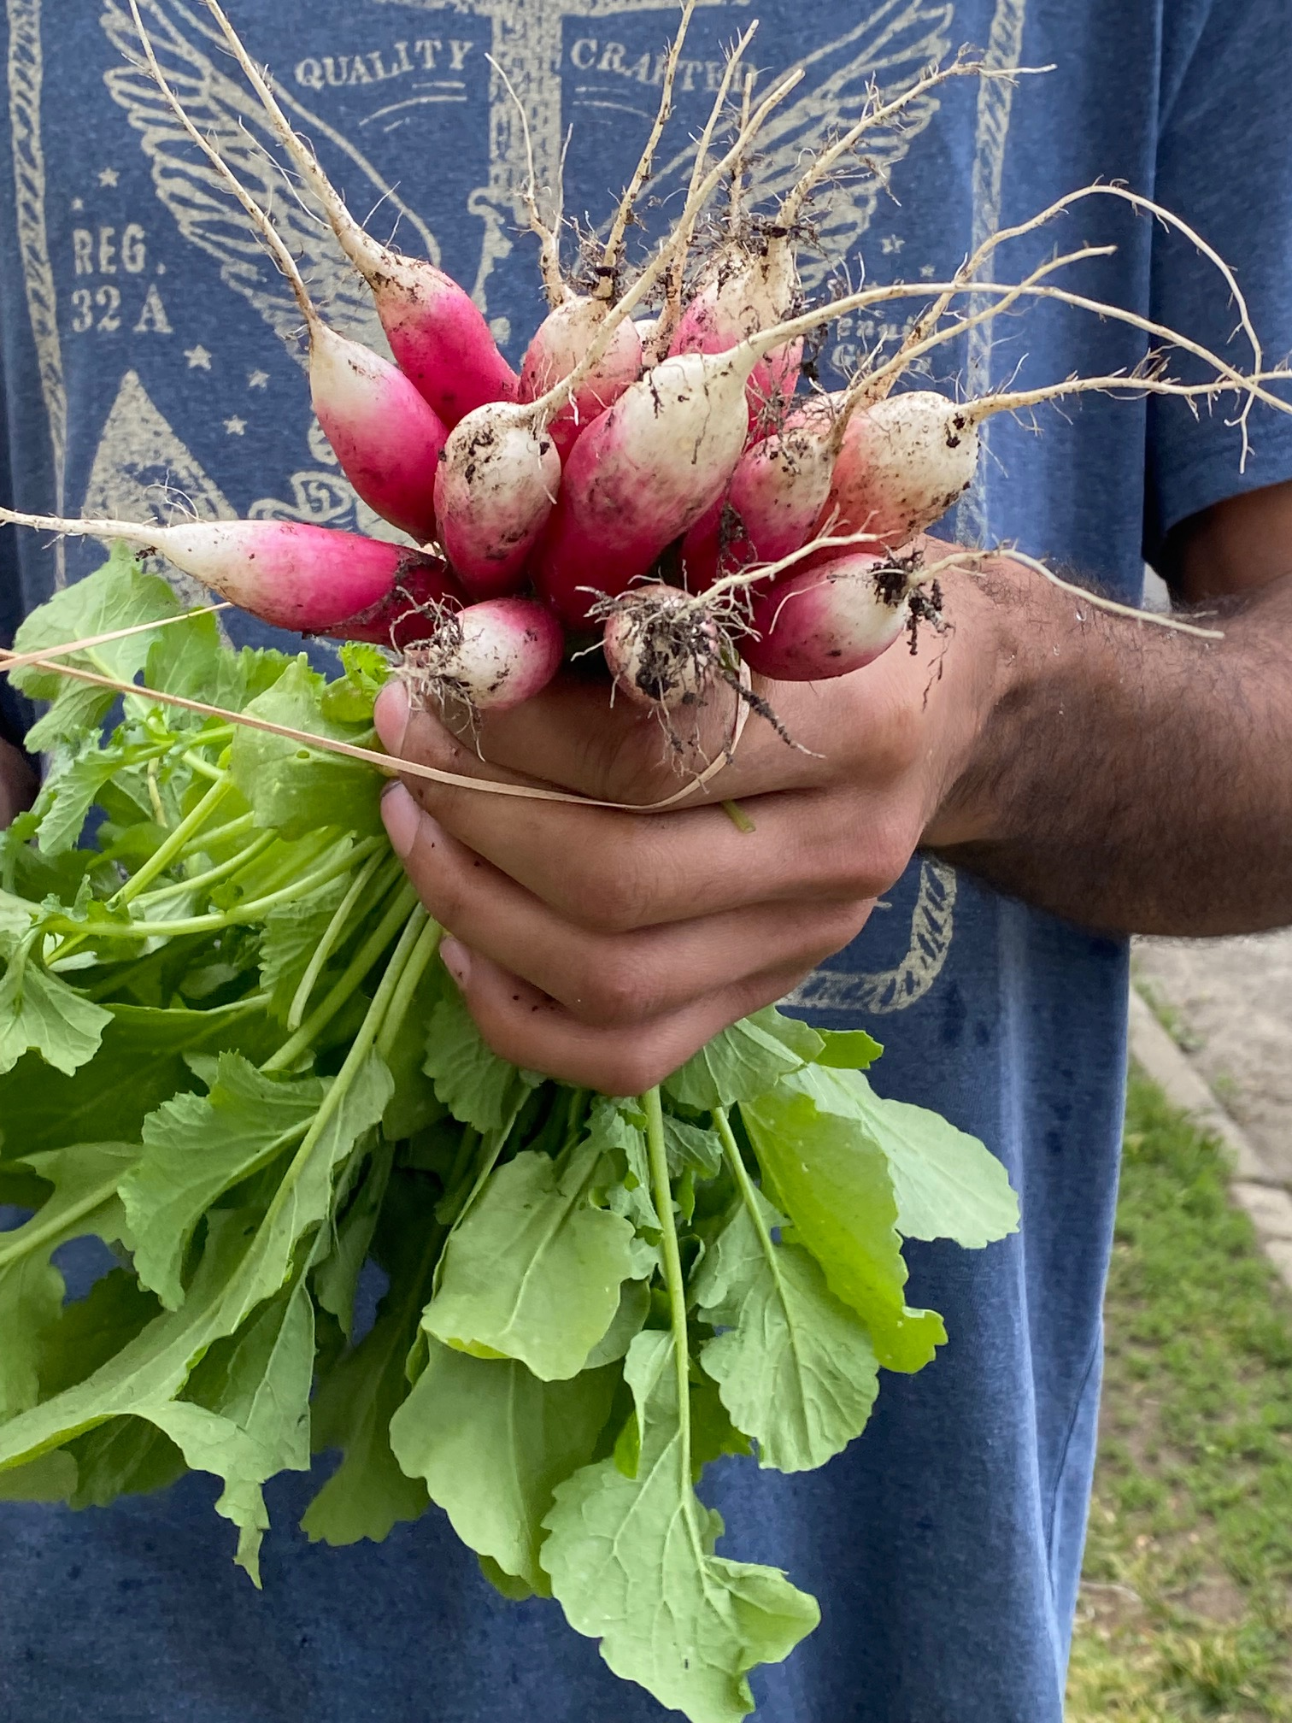
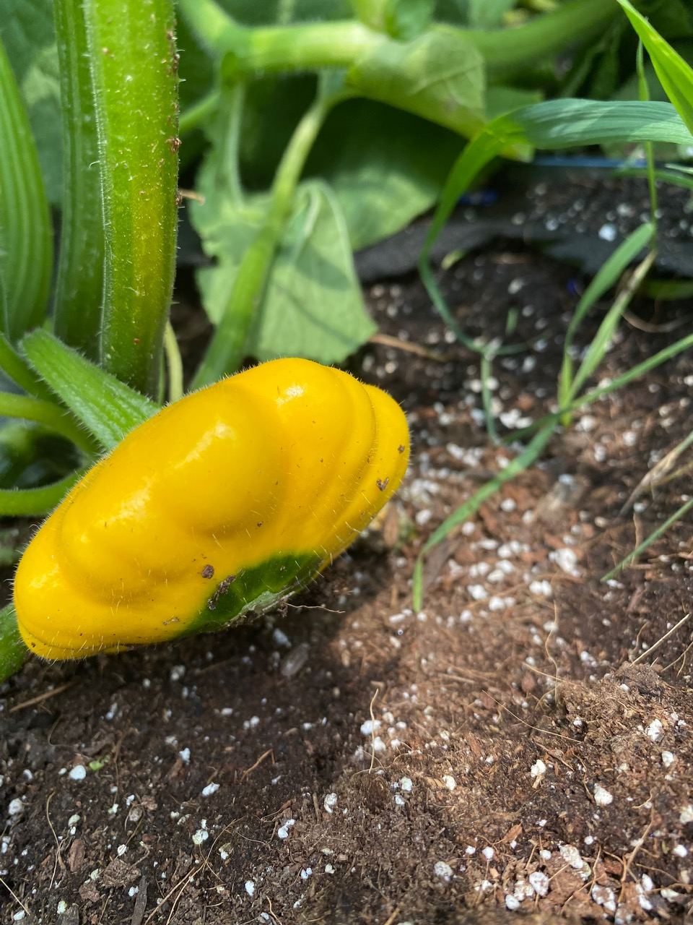

Slide 35
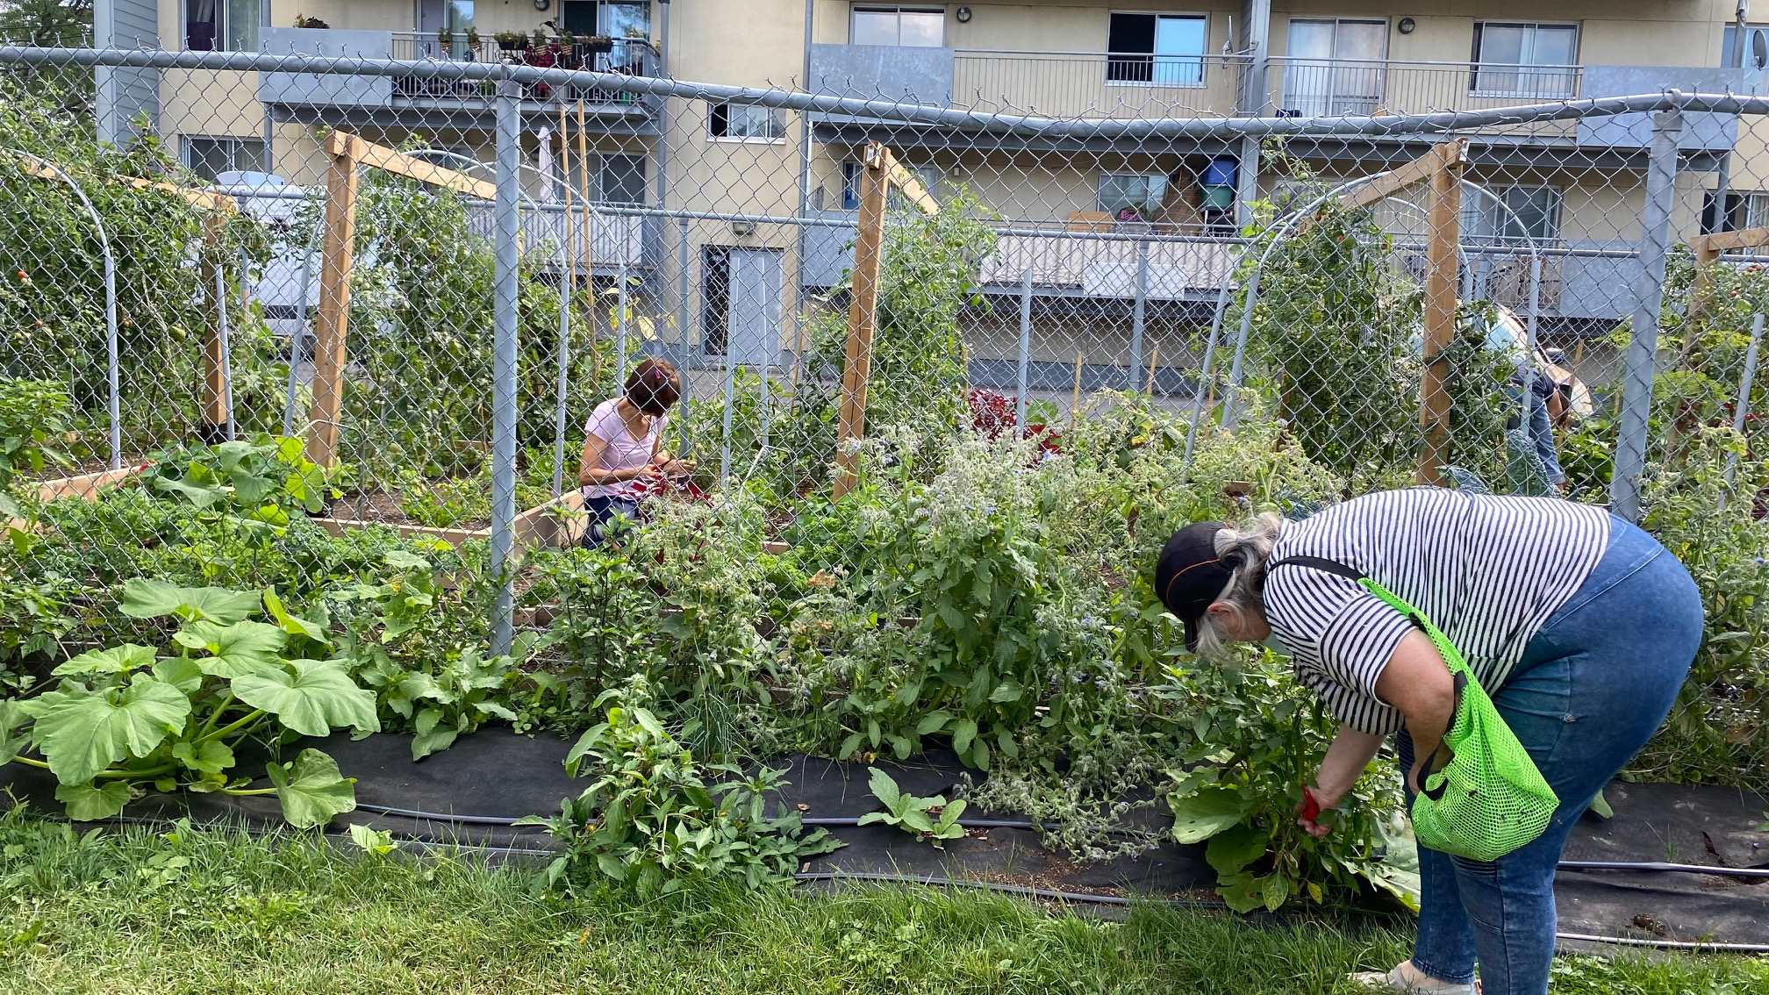

Slide 36
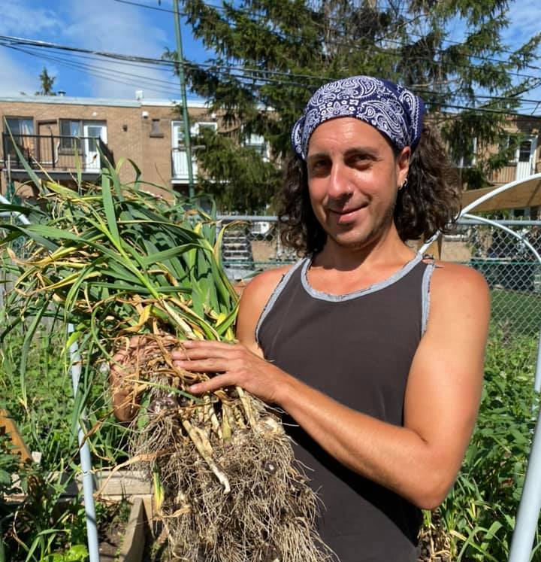
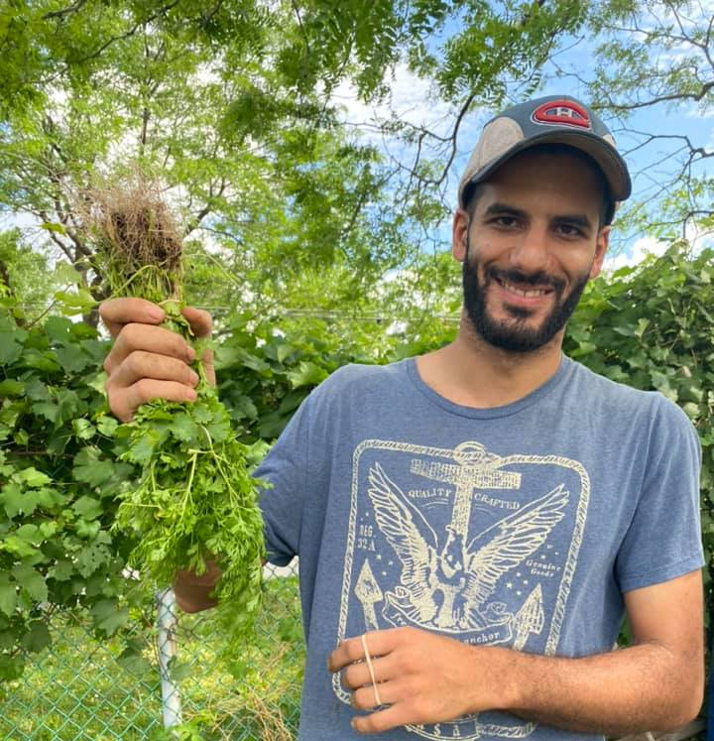

Slide 37
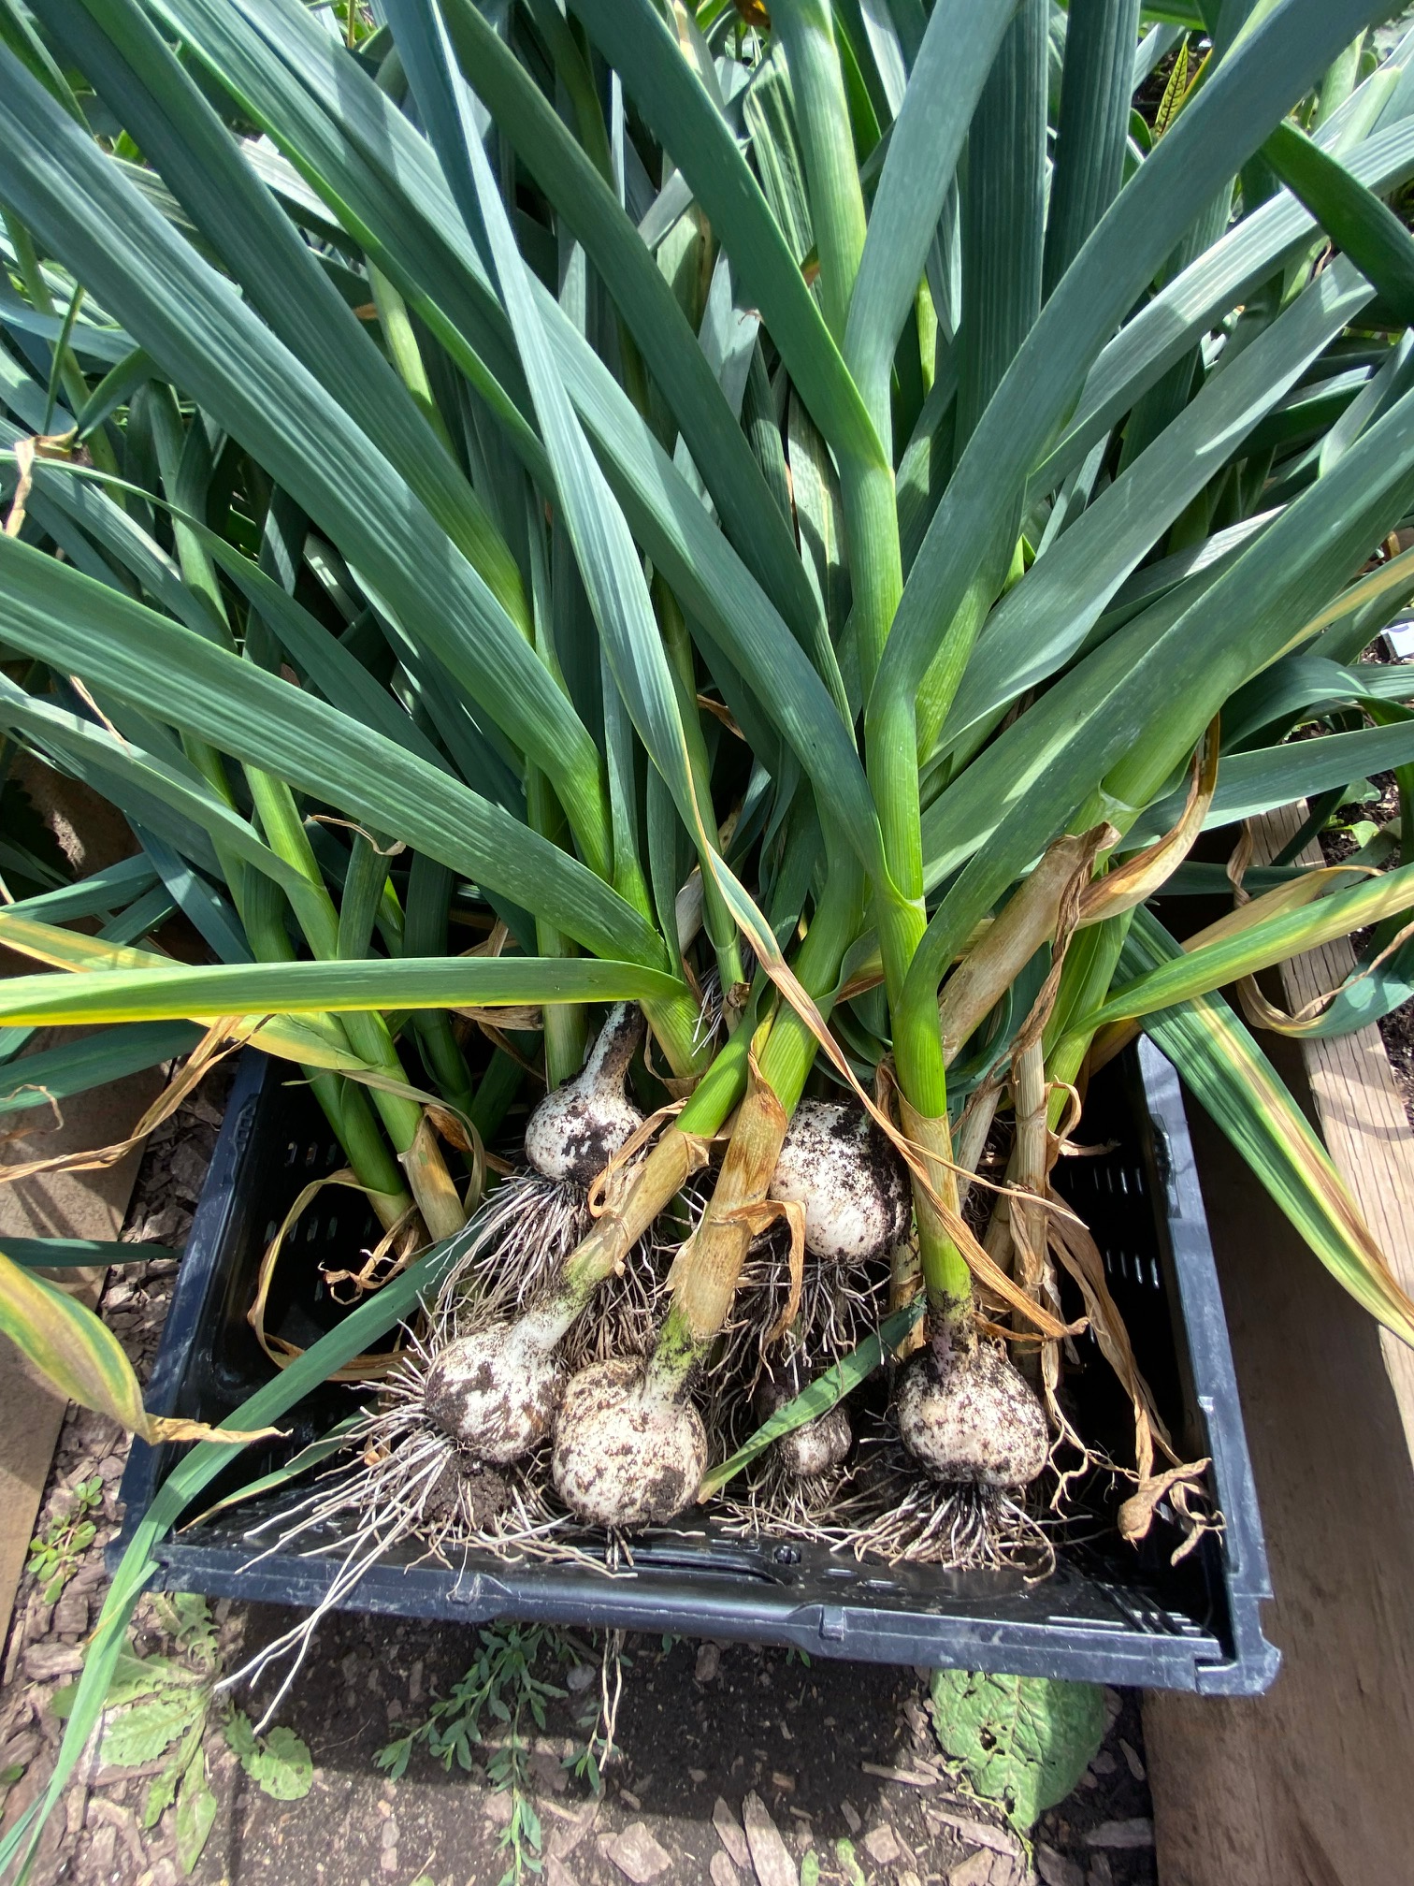
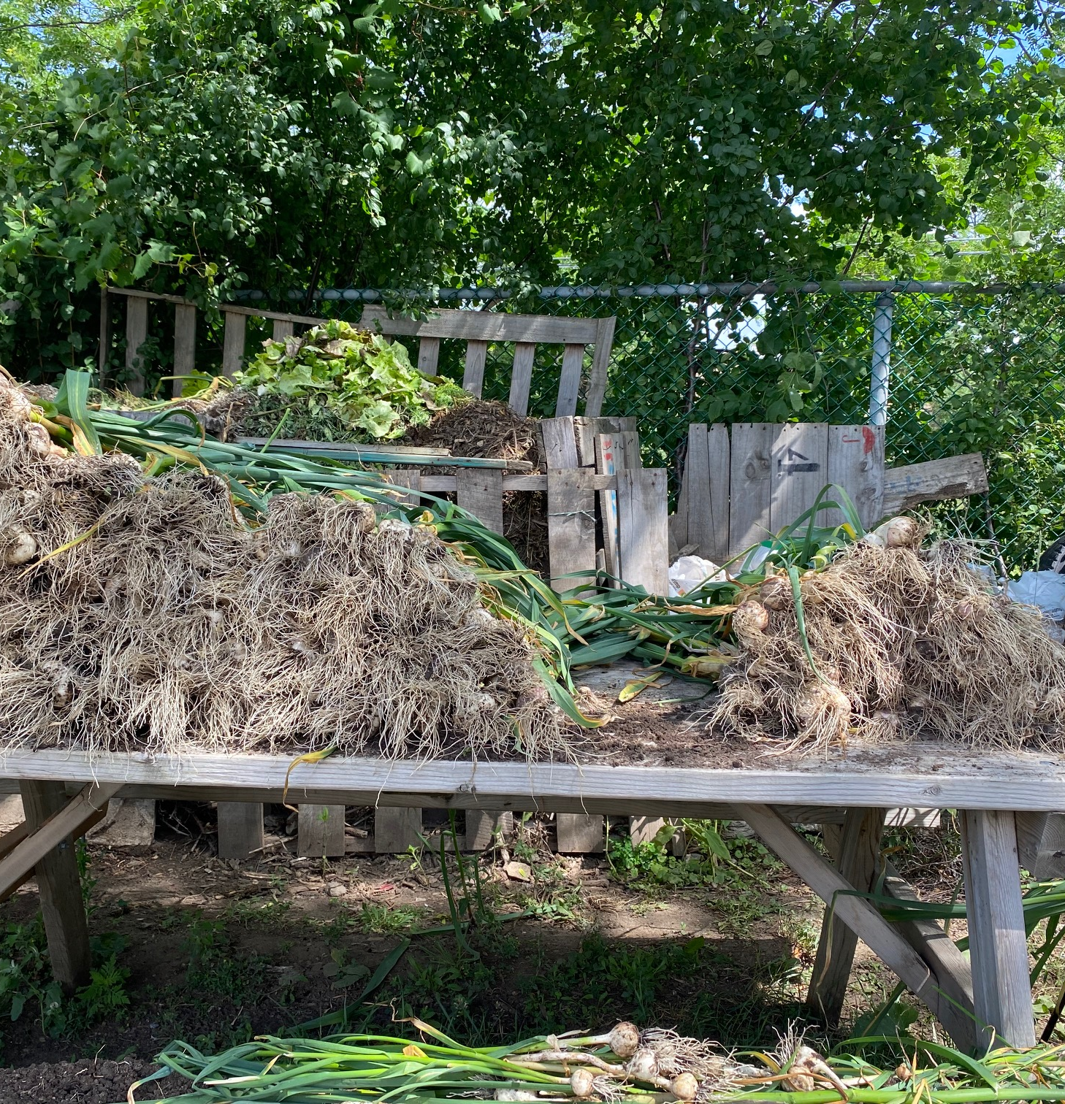

Slide 38
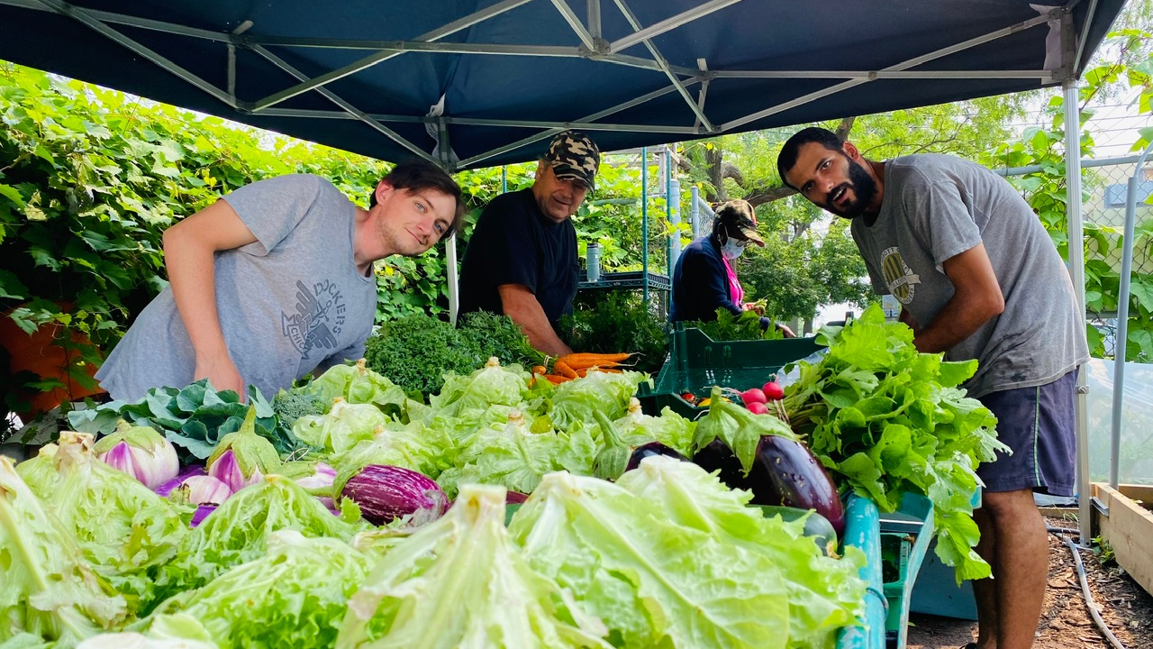

Slide 39
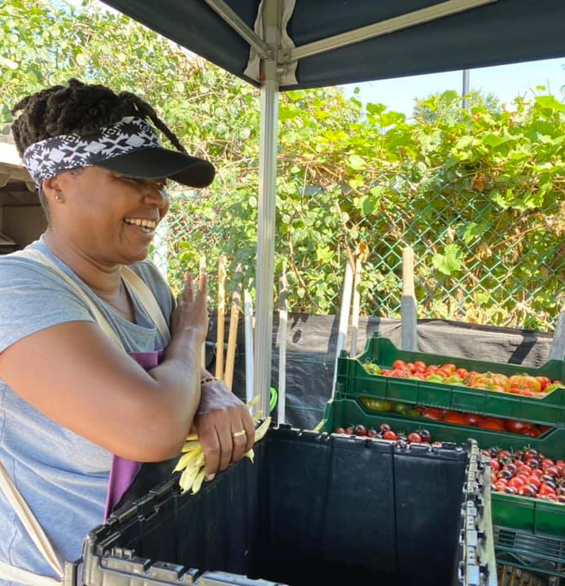
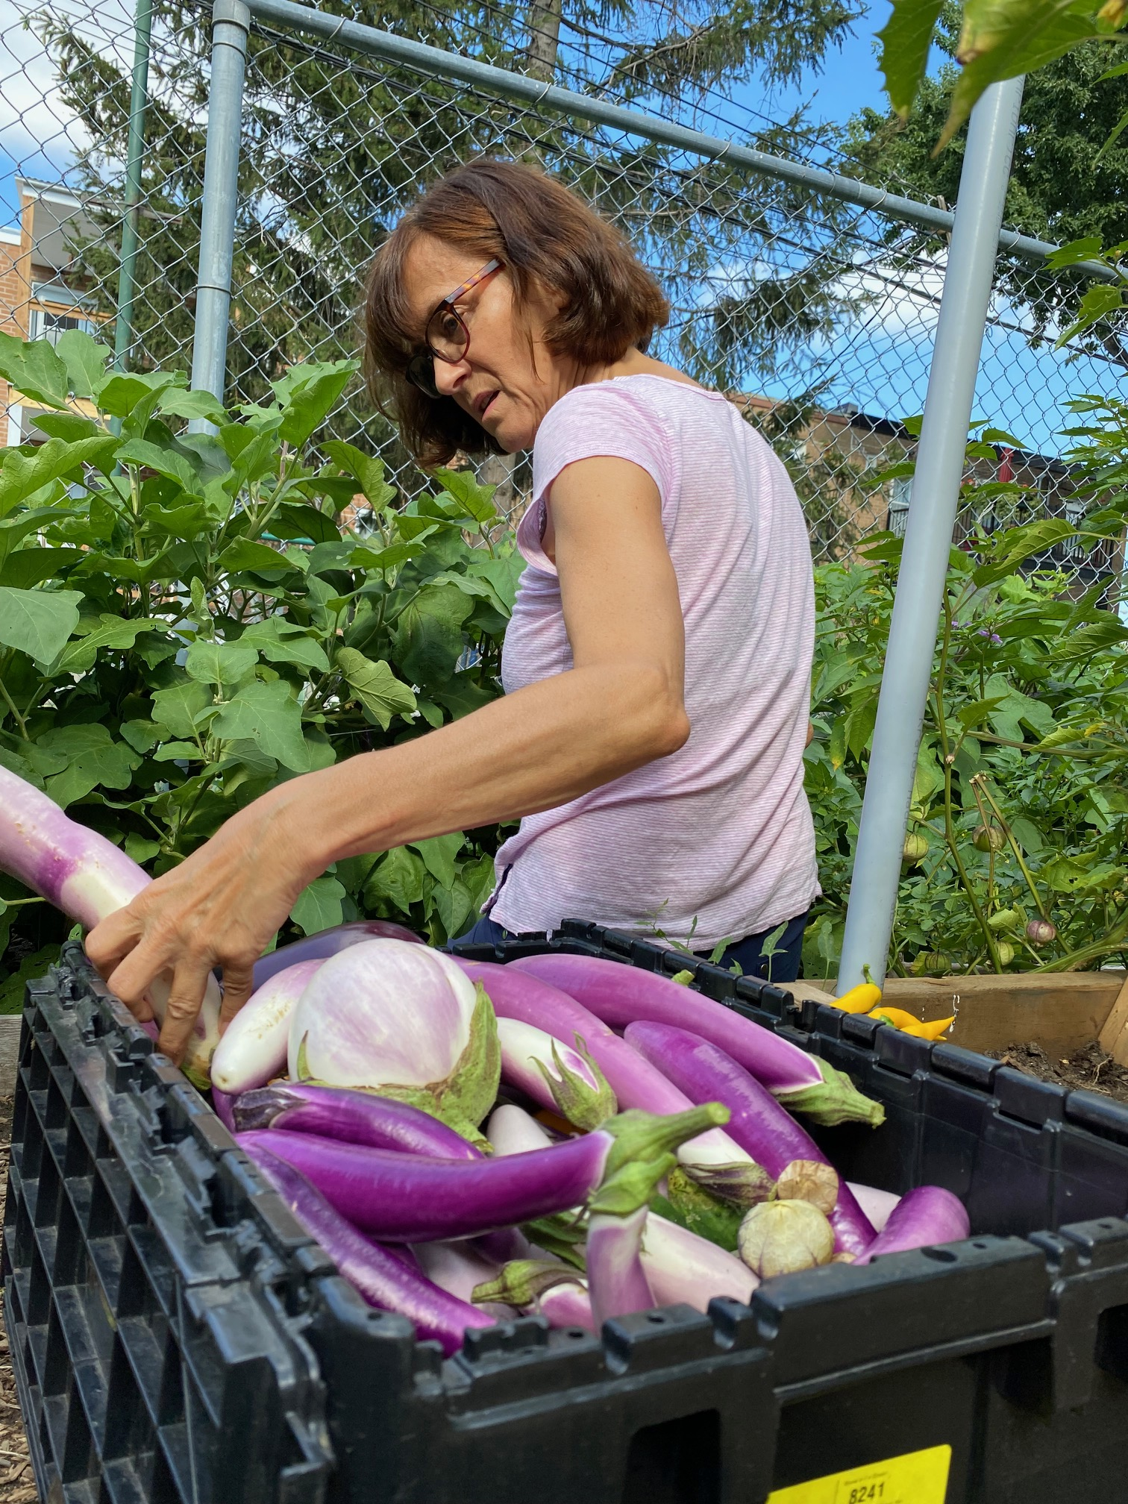

Slide 40
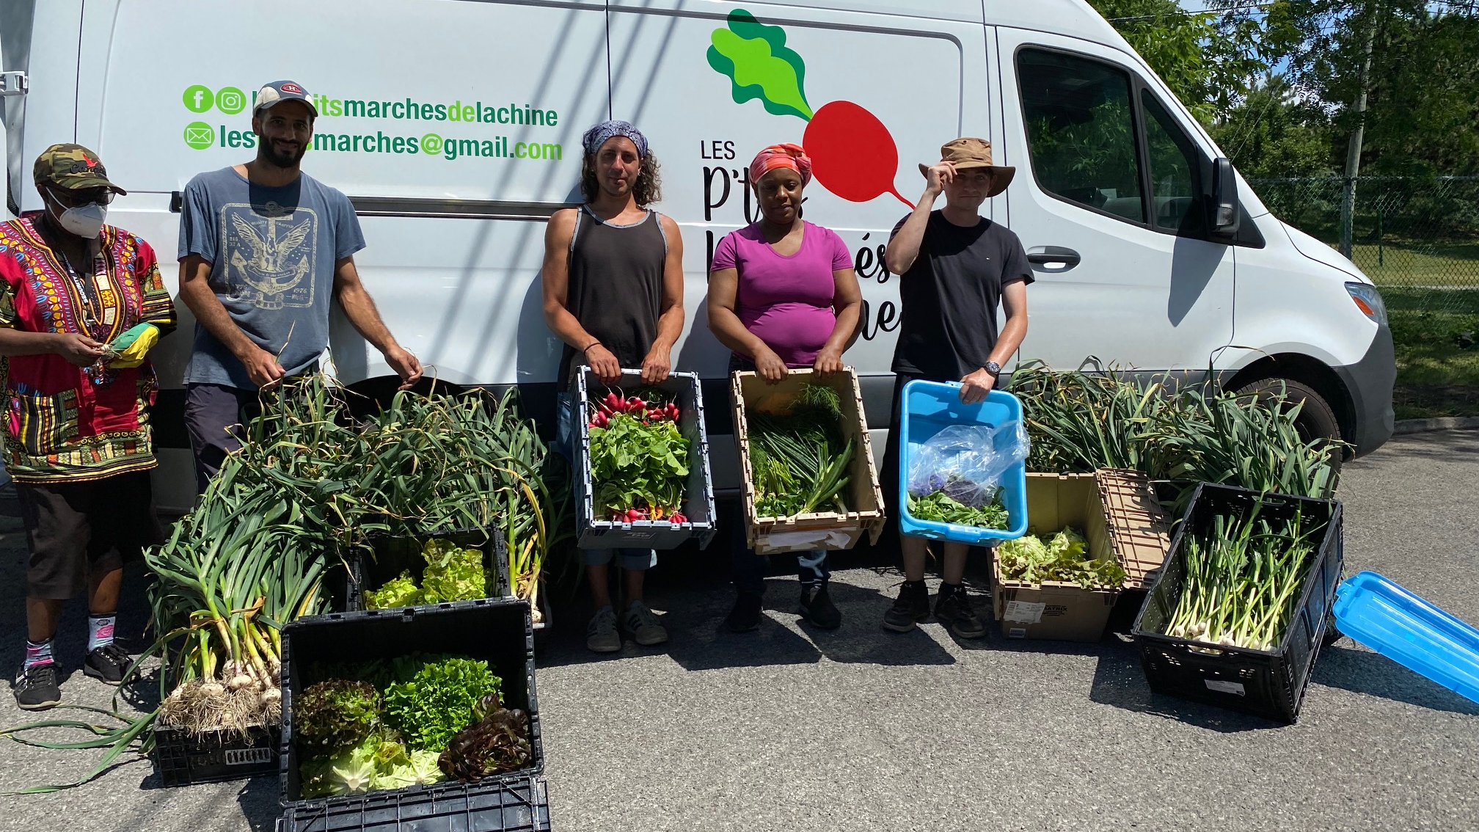

Slide 41
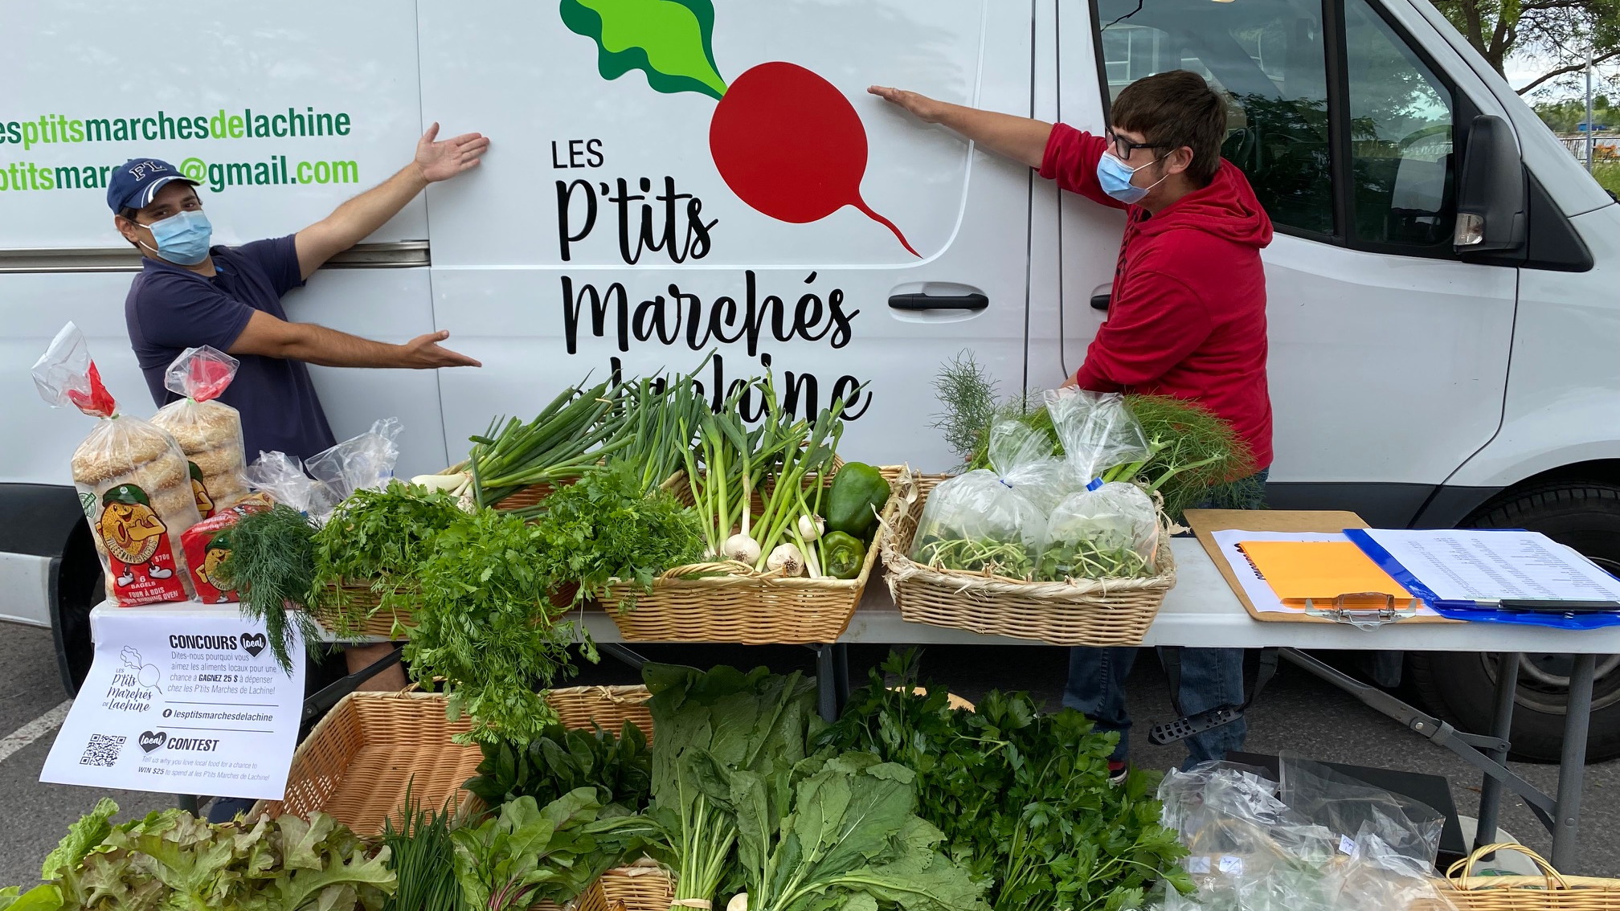

Slide 42
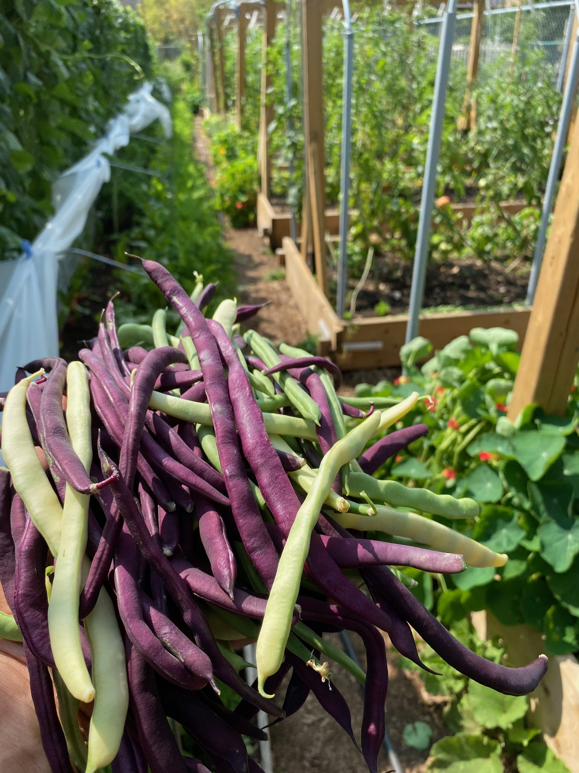
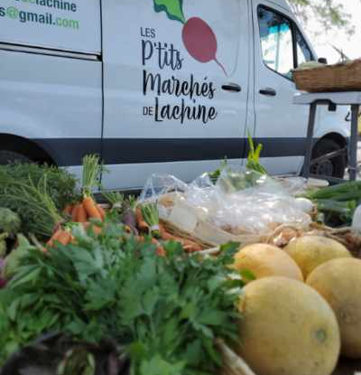

Slide 43
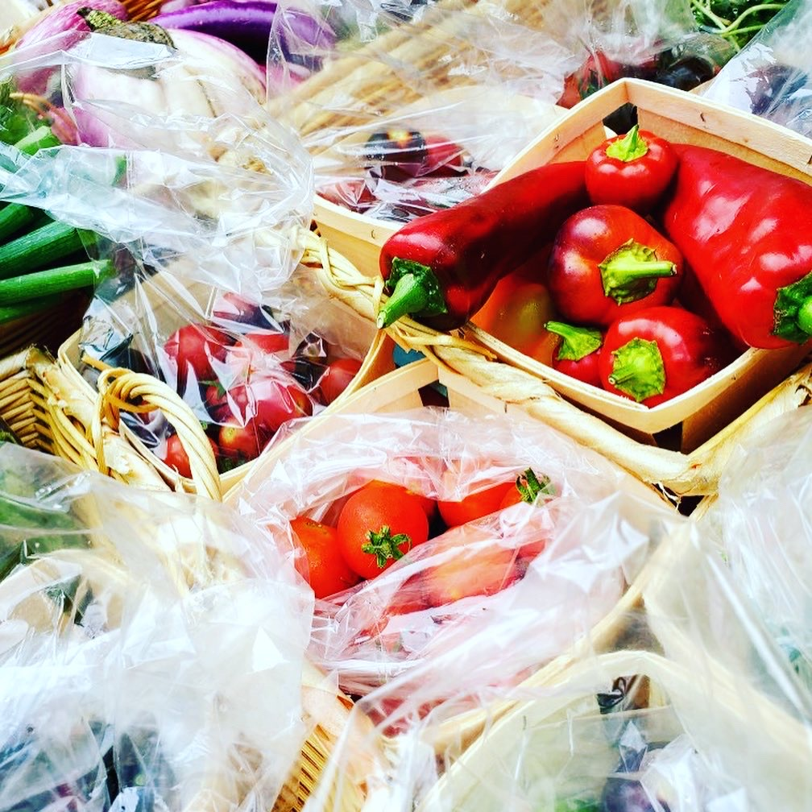


Slide 44



Slide 45


Slide 46
Mapping Community Food Systems
PRODUCTION | PROCESSING | DISTRIBUTION | WASTE MANAGEMENT | SUPPORT
Food | Cook | Market | Compost - Soil Building | Funding
Tools | Prepare | Redistribution | Water saving - Irrigation | Space
Knowledge | Ferment | Reciprocity | Seed Saving - Seed Sewing | Labour
Social Capital | Preserve | Self/community provisioning | Re-purpose food
 | Transform
 | Freeze/store
 | Dehydrate
 | Can

Slide 47


Slide 48

Building Food Sovereignty Through Action Research
Concordia Food Groups Project
Lachine Food System

Slide 49


Slide 50
Building a Food Sovereign Campus

Slide 51
Questions?
Have a great day!

