Slide 1
Building Food Sovereign Communities
Erik Chevrier
Critique of food system & Solutions

Slide 2
What does it Mean to Have a Sustainable Diet?
Is your diet sustainable?

Slide 3
What does it Mean to Have a Sustainable Diet?
The term sustainability has lost meaning because it has been used for corporate/political greenwashing.
We need to refocus the conversation on what we are sustaining.
Sustainability refers to the perpetuation of something…the something is the important factor!
Sustainability is an adjective/modifier (Sumner refers to Shearman 1990)
  Sustainability as a modifier points out contradictions (suggests that the status quo is not sustainable)
Instead we should ask:
  What social, environmental and political conditions does our food practices sustain?
    Effects can be positive and/or negative
    Intended and/or unintended
    We can be aware and/or unaware of these effects
    Effects can take place on a macro and/or micro level

Slide 4
What does it Mean to Have a Sustainable Diet?
Digging deeper, we can ask:
Political economic conditions:
  What were the labour conditions of the farmers that produced your food?
  What social inequalities are expressed via your food consumption?
Individual and Social Health
  How does your diet contribute to your individual health?
  How does your diet impact the health of the community and the world at large?
Environmental Health
  How does your diet affect biodiversity?
  What is the environmental impact of your diet?

Slide 5
The Basics
What is food?
  Substance with essential nutrients that sustain life
What is a food system?
  An interdependent web of activities that include production, processing, distribution, consumption, and disposal of food. (Sumner, 2017)
What do we mean by sustainability?
  We will explore this for the remainder of the course!

Slide 6
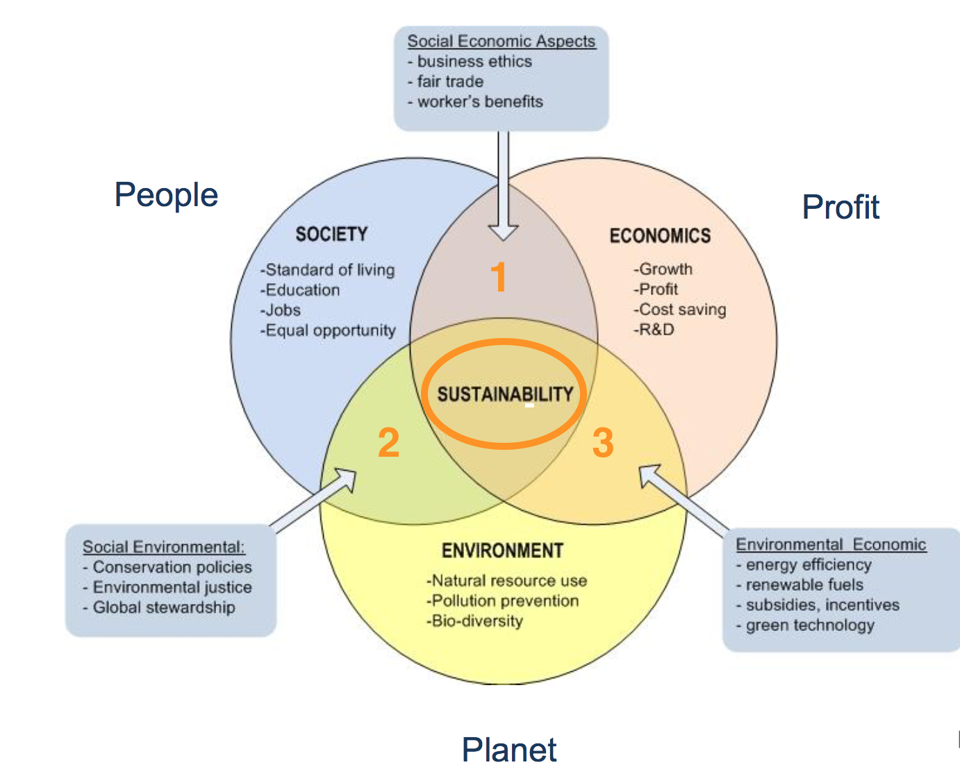
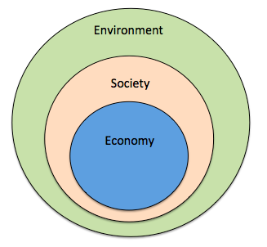
Prioritize the Biosphere and Social Relations Over the Market
Triple Bottom line
Nested model

Slide 7
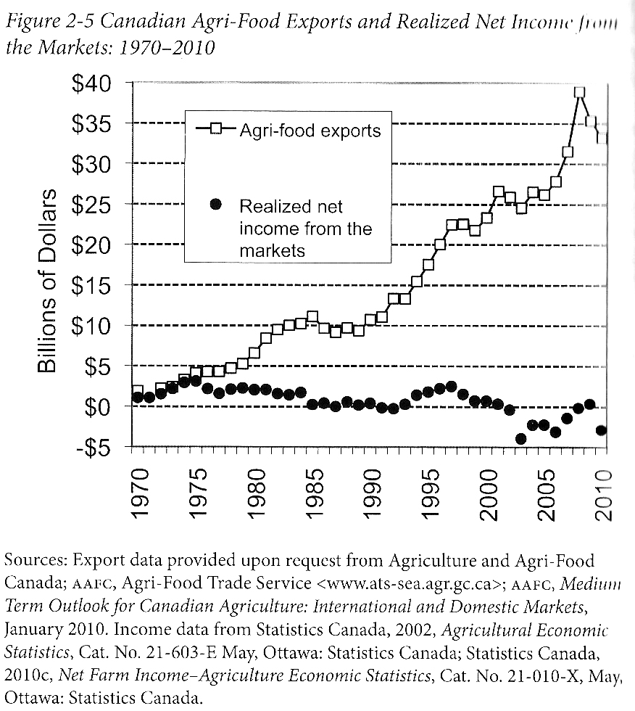
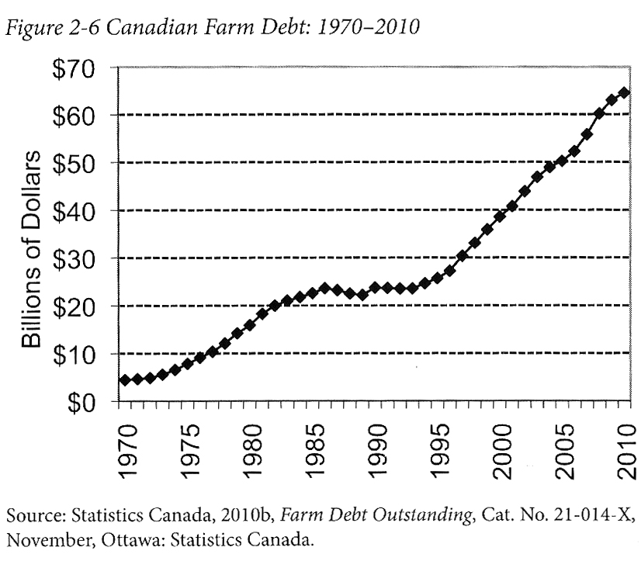
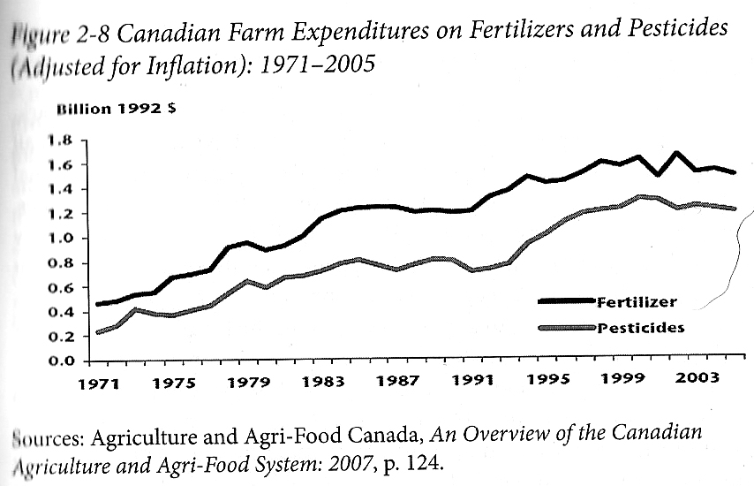
Who Benefits from Our Food System Economically?
Qualman, D. (2011) Advancing Agriculture by Destroying Farms? The State of Agriculture in Canada, pp. 20 – 42. In, Wittman, H., Desmarais, A. A., & Wiebe, N. (2011) Food Sovereignty in Canada: Creating Just and Sustainable Food Systems, Fernwood Publishing

Slide 8
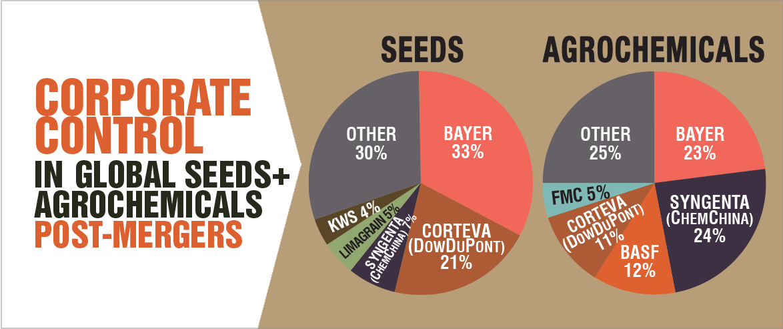
Only A Few Large Corporations Own Most of the Agrochemical Market https://cban.ca/gmos/issues/corporate-control/

Slide 9
Companies of War, Destruction and Death
These are a few examples:
Monsanto still uses chemicals that were used to kill people, but in our food
  Monsanto Ghostwriting Academic Papers
  Is Round-Up safe to drink?
  Farmer won lawsuit against Monsanto – Glyphosate causes cancer
  The World According to Monsanto
  Monsanto is now owned by Bayer who used to be part of I.G. Farben, manufacturing poisonous gas (Zyklon B) for concentration camps during the World War.
BASF was also part of IG Farben a company who worked with the Nazis and tested chemicals and drugs on people including Zyklon B
Dow Chemical Invented Agent Orange
Dow Chemical now owns Union Carbide who was responsible for a large devastating explosion in Bhopal, India:
  The Bhopal disaster: Toxic legacy
  One Night in Bhopal
  The Bhopal Disaster

Slide 10
Issues With Our Current Food System
Issues with food security – there are over 800 million people starving in the world today!
Issues with food sovereignty – peasants and farmers are being affected by trade agreements and food dumping!
Issues with genetic modification process – epigenetics matter!
Issues with use of herbicides – glyphosates are being identified as cancer causing!
Issues with privatization – restricted access!
Issues with cost on farmers – family farms are not sustainable!
Issues with reduction of biodiversity – we are destroying nature!
Issues with unwanted genetics spreading onto non-GMO farms – lawsuits!
Issues with loss of Indigenous farming methods – on stolen land!
Issues with soil arability – we are killing our soil!
Issues with killing pollinators – fruits need bees!
Issues with water ‘dead zones’ – we are polluting our water!
Issues with corporate concentration of agribusinesses – former war companies are now food chemical companies!
Issues with health – our food contains toxins!
Foundations on structural racism, colonialism and patriarchy – glaring systemic issues!
Rising cost of seed and chemicals – we don’t need to buy seeds!
Research funding being directed to GMOs instead of traditional breeding methods – ‘science’ is not only about GMOs!
Pest and weed resistance to Bt crops and glyphosate!
There are so many more critiques!

Slide 11
Is The Food System Broken?
Calls to “fix a broken food system” assume that the capitalist food system used to work well. This assumption ignores the food systems long, racialized history of mistreatment of people of colour. The food system is unjust and unsustainable, but it is not broken. It functions precisely as the capitalist food system has always worked, concentrating power in the hands of the privileged minority and passing off the social and environmental “externalities” disproportionately to racially stigmatized groups. (Holt-Gimenez, 2017, p. 160)
How we produce and consume determines how our society is organized, but how we organize socially and politically can also determine how we produce and consume. The implications of this are profound: our food systems are vessels of unmatched social and economic power and pivotal sites for systemic transformation. (Holt-Gimenez, 2017, p. 214)
Holt-Gimenez, E. (2017) A Foodie’s Guide to Capitalism: Understanding the Political Economy of What We Eat, Monthly Review Press, New York.

Slide 12

Problems – Symptoms – Root Causes

Slide 13
Some More Specific Solutions?
1 – (RE)CONNECT WITH FOOD!
2 – Prioritize our biosphere and social systems over markets.
3 – Participate in progressive and radical food movements.
4 – Be an active participant in the food system.
5 – Build food sovereign communities.

Slide 14
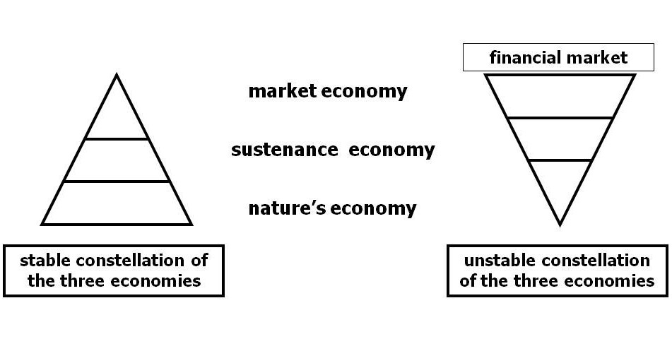
Living Economies – Vandana Shiva

Slide 15
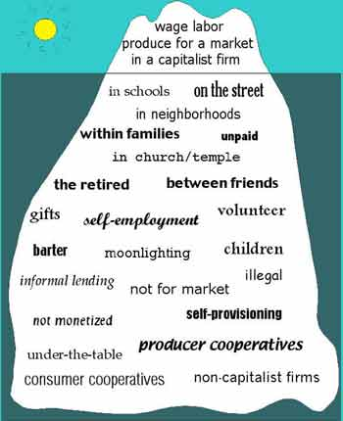
Take back the Economy
Gibson Graham
Gibson-Graham, J.K., Cameron, J., Healy, S. (2013) Take Back the Economy: An Ethical Guide for Transforming Communities, University of Minnesota Press
Katherine Gibson Interview Playlist

Slide 16
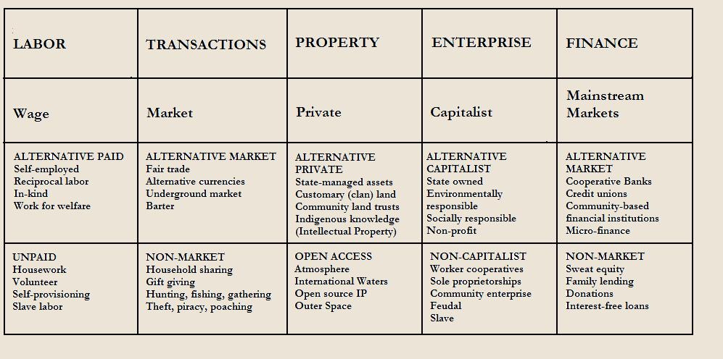
Take back the Economy
Gibson-Graham, J.K., Cameron, J., Healy, S. (2013) Take Back the Economy: An Ethical Guide for Transforming Communities, University of Minnesota Press

Slide 17
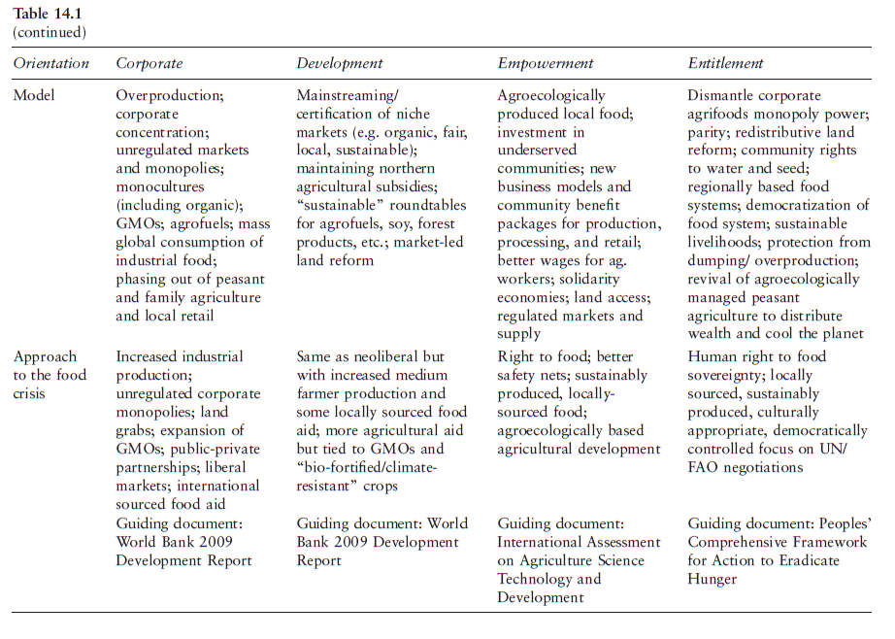
Corporate
Reformist
Food Justice
Food Sovereignty

Slide 18
Tangible Solutions?
One example:
CultivAction Solidarity Cooperative

Slide 19
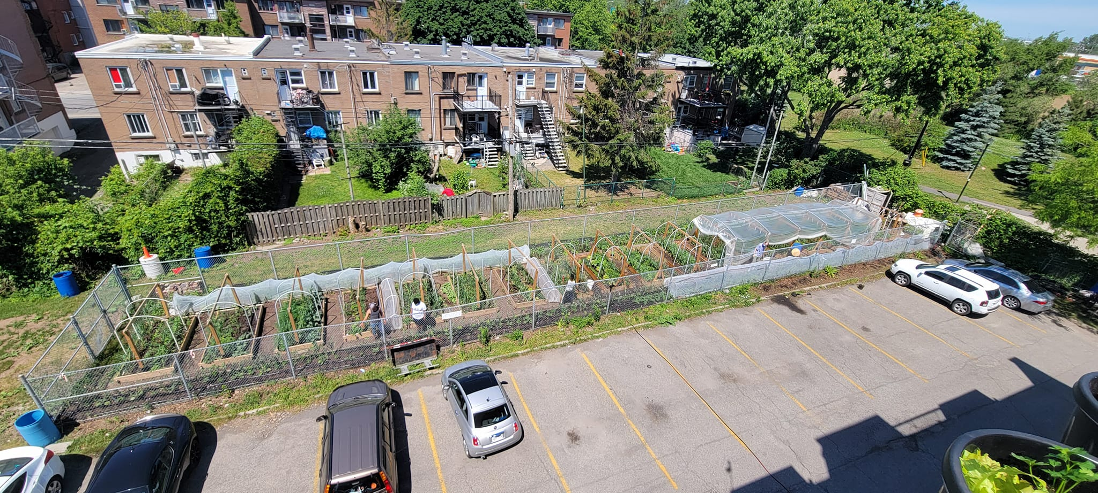

Slide 20
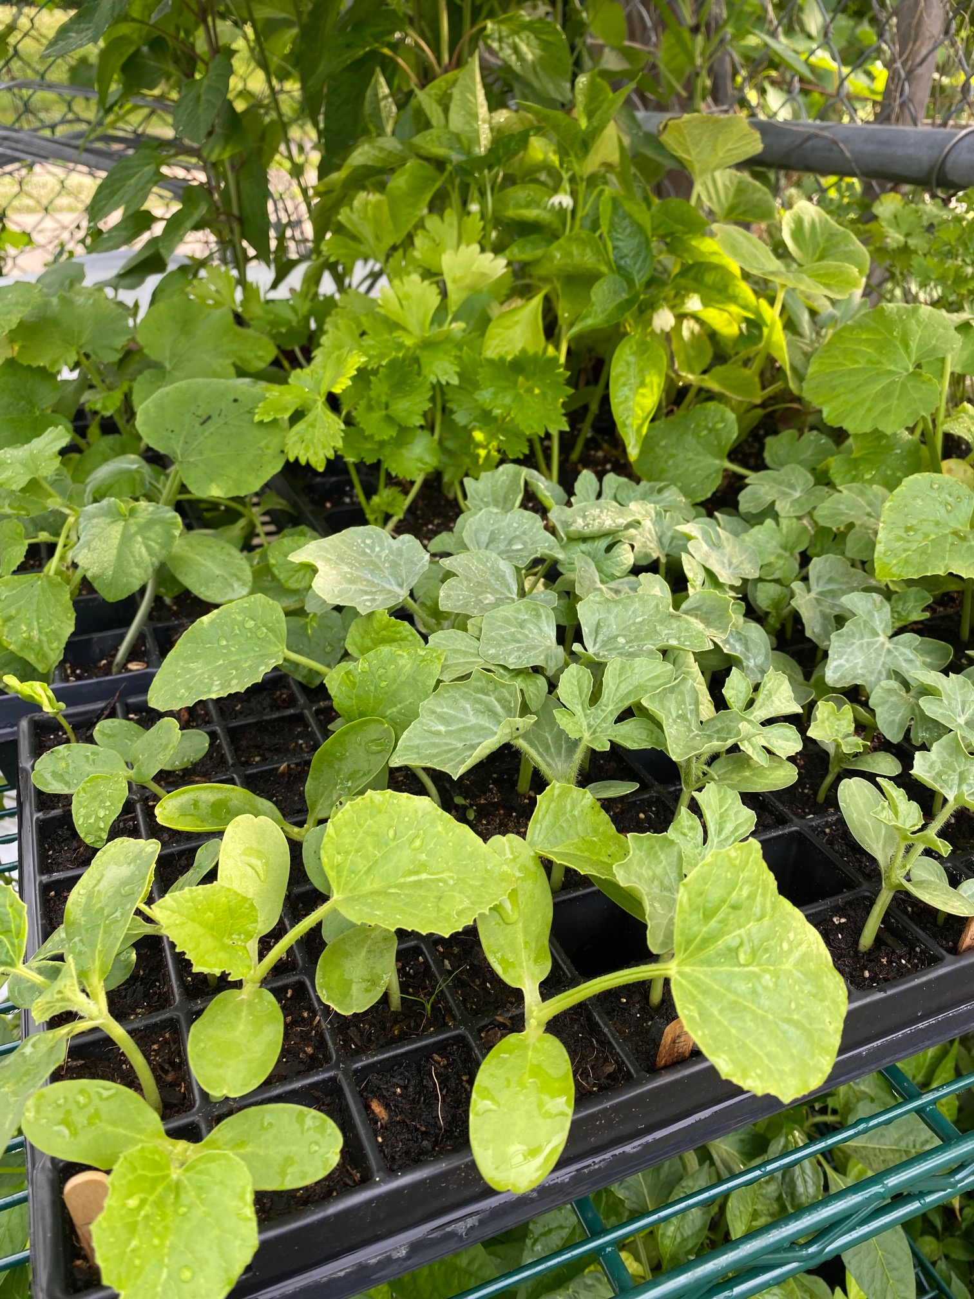
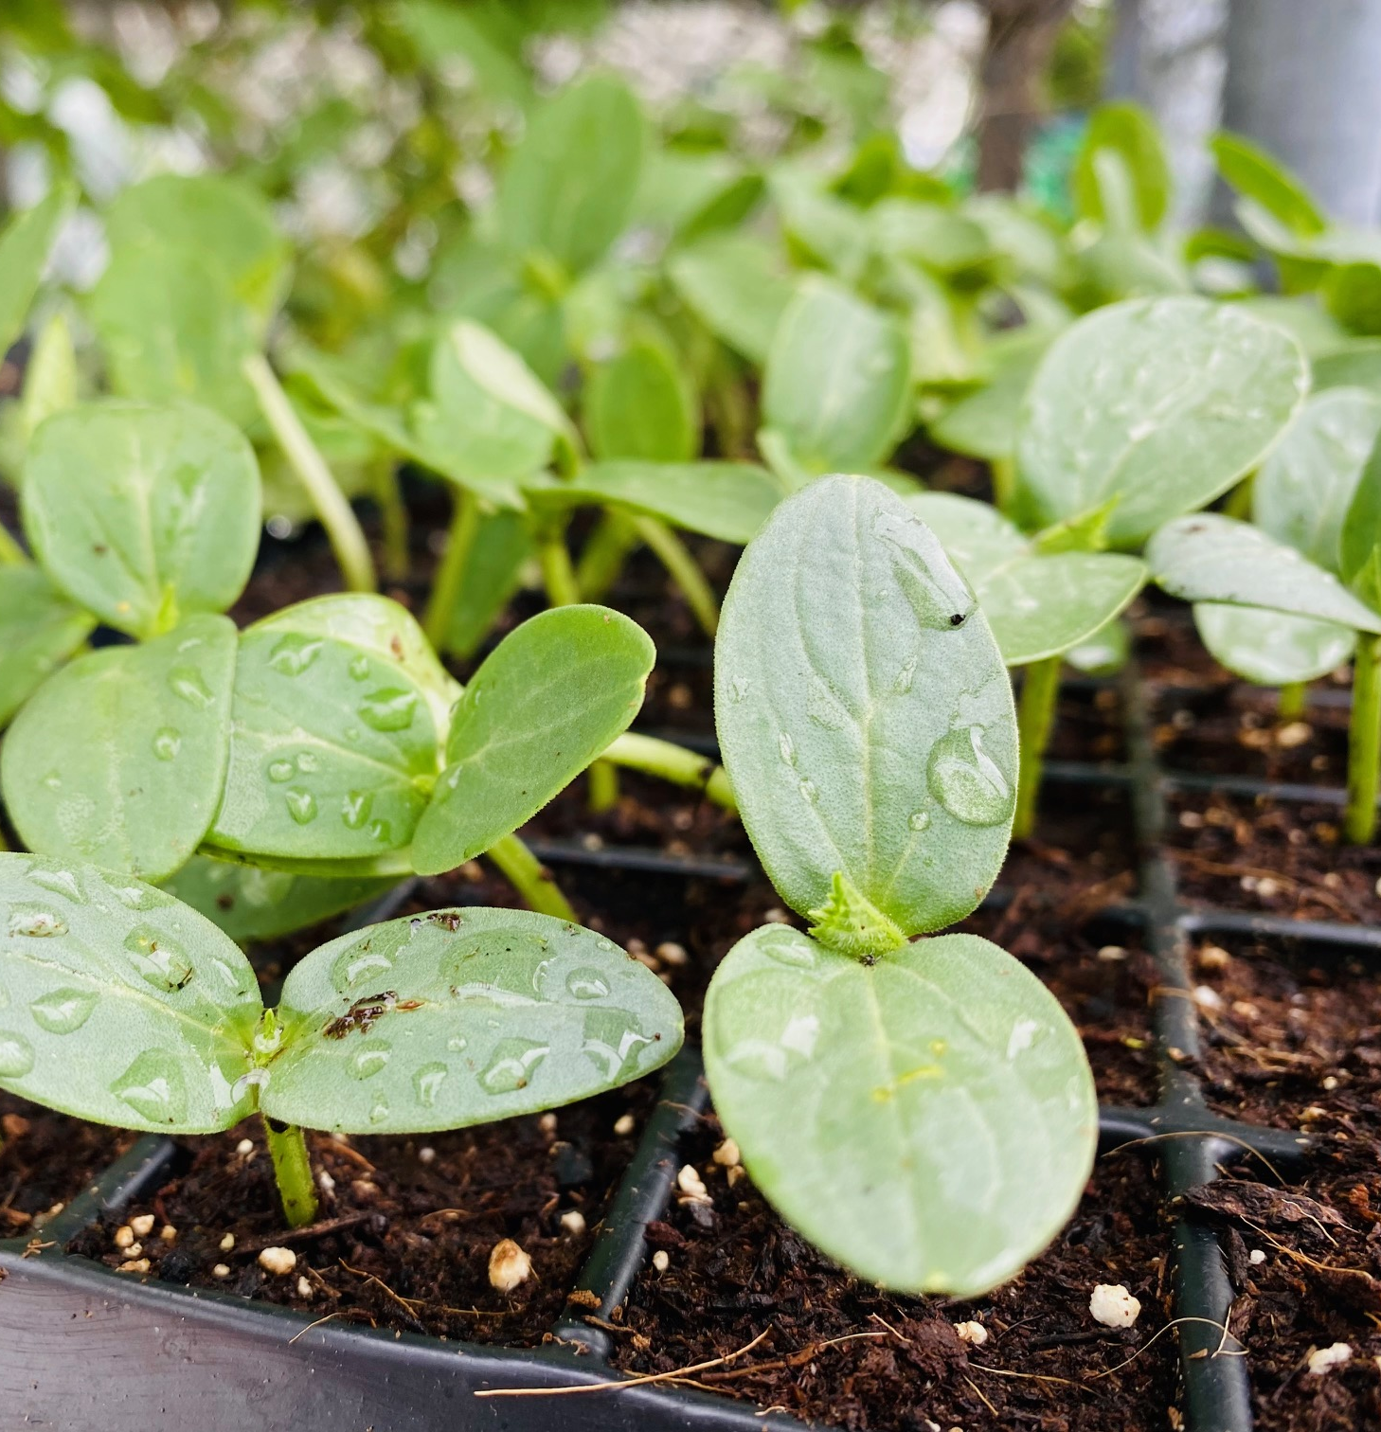

Slide 21
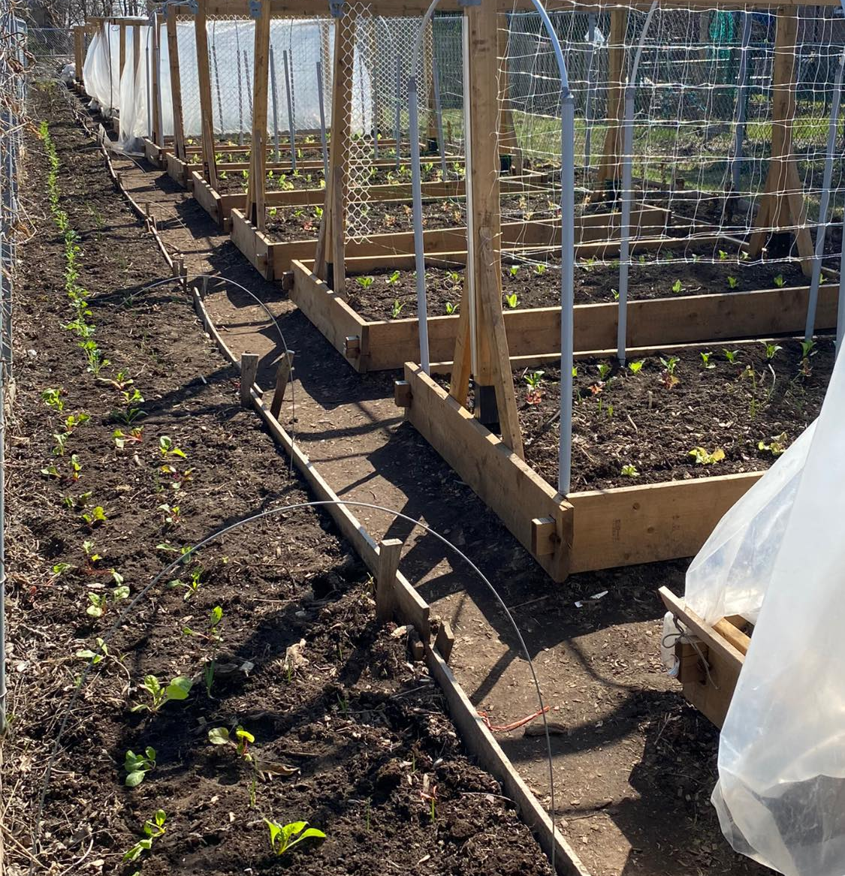
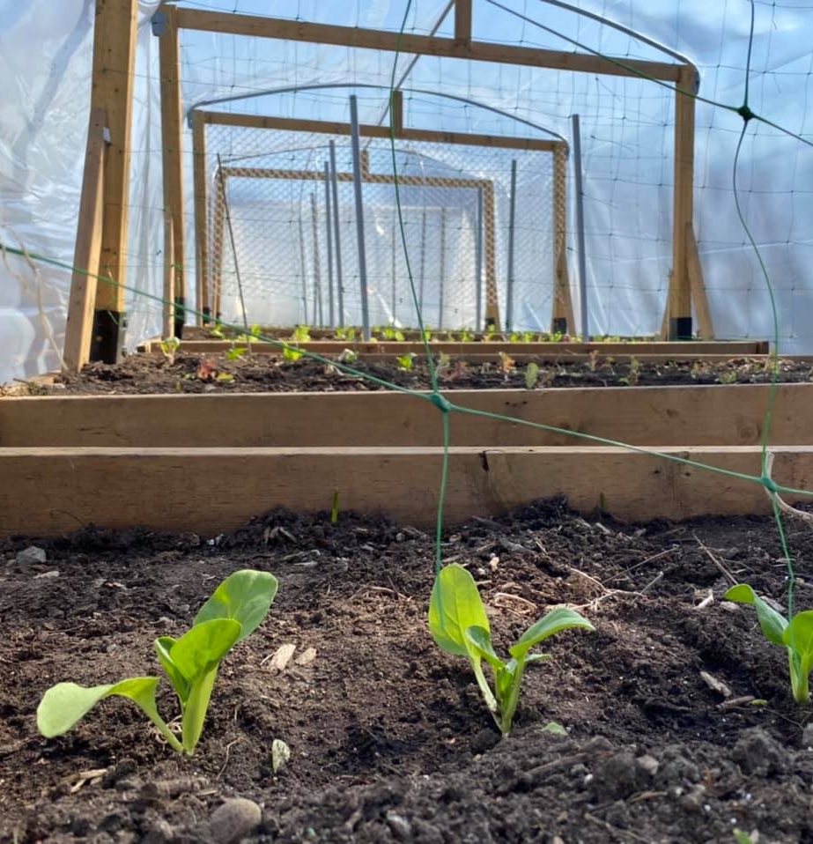

Slide 22
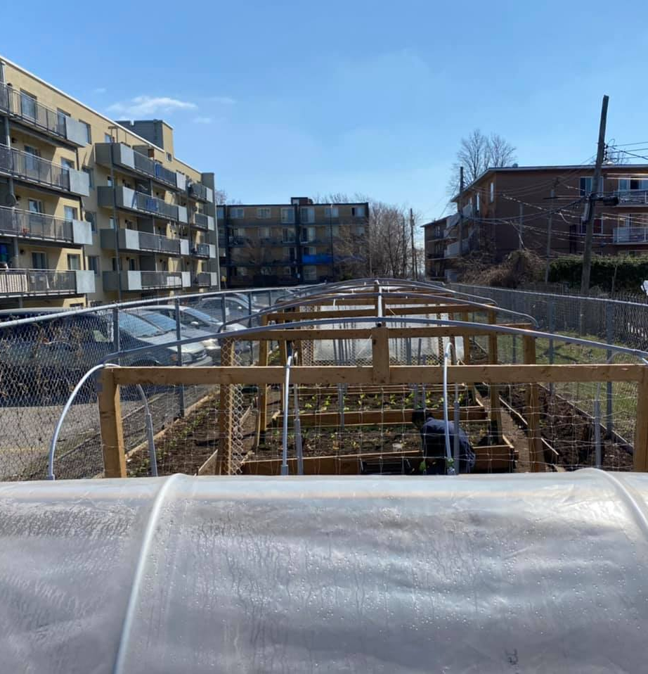
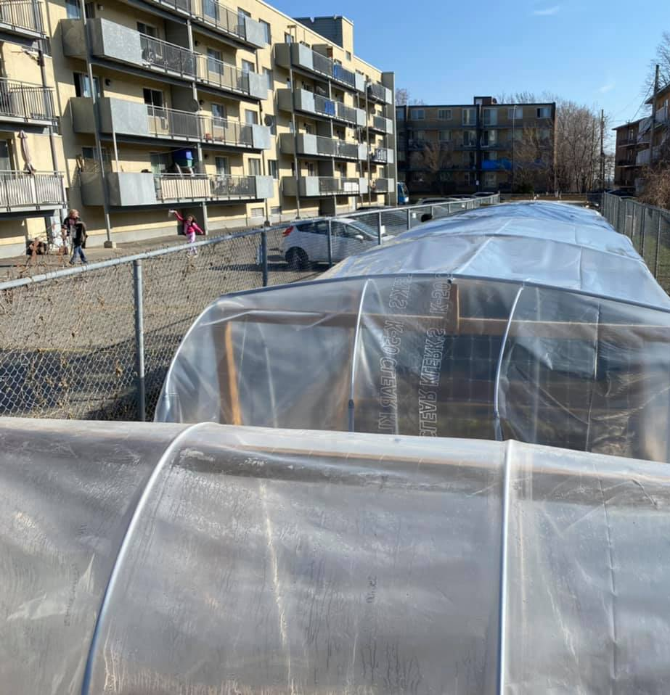

Slide 23
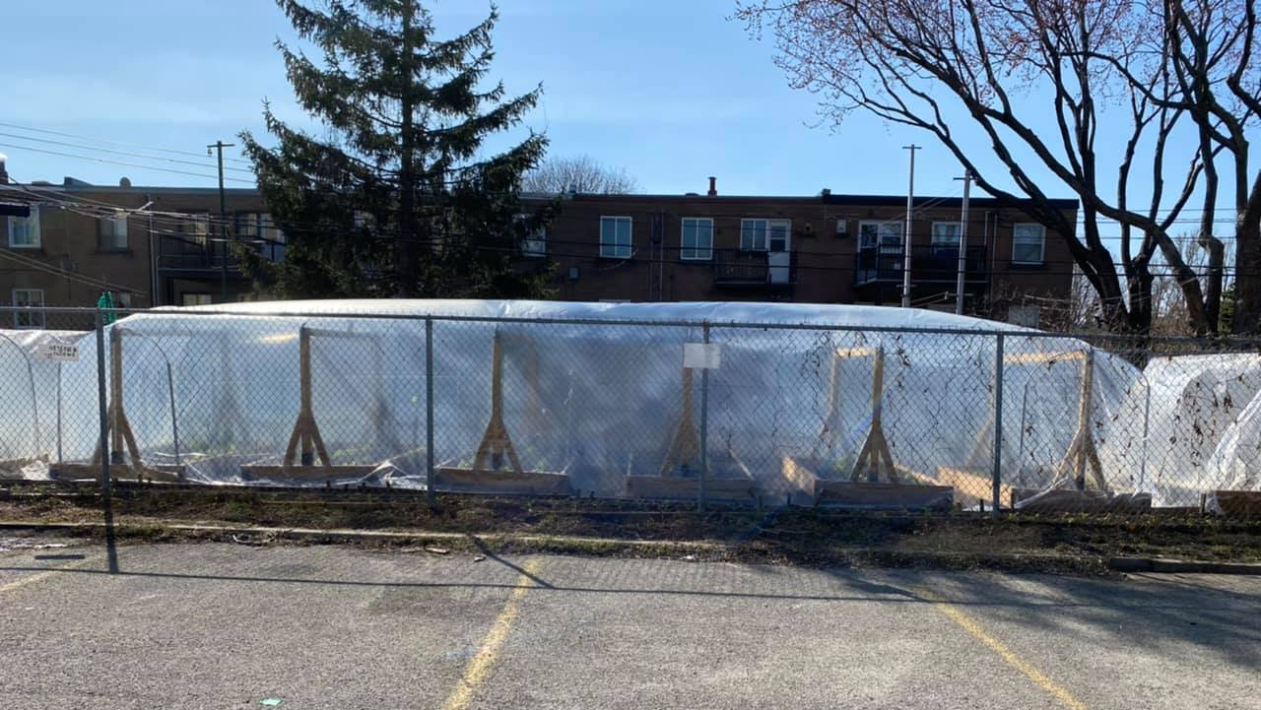

Slide 24
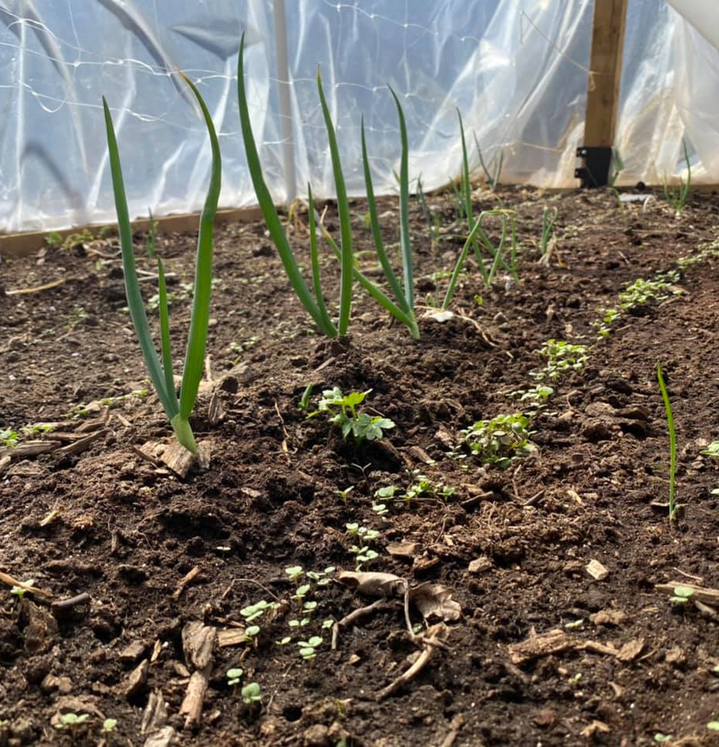
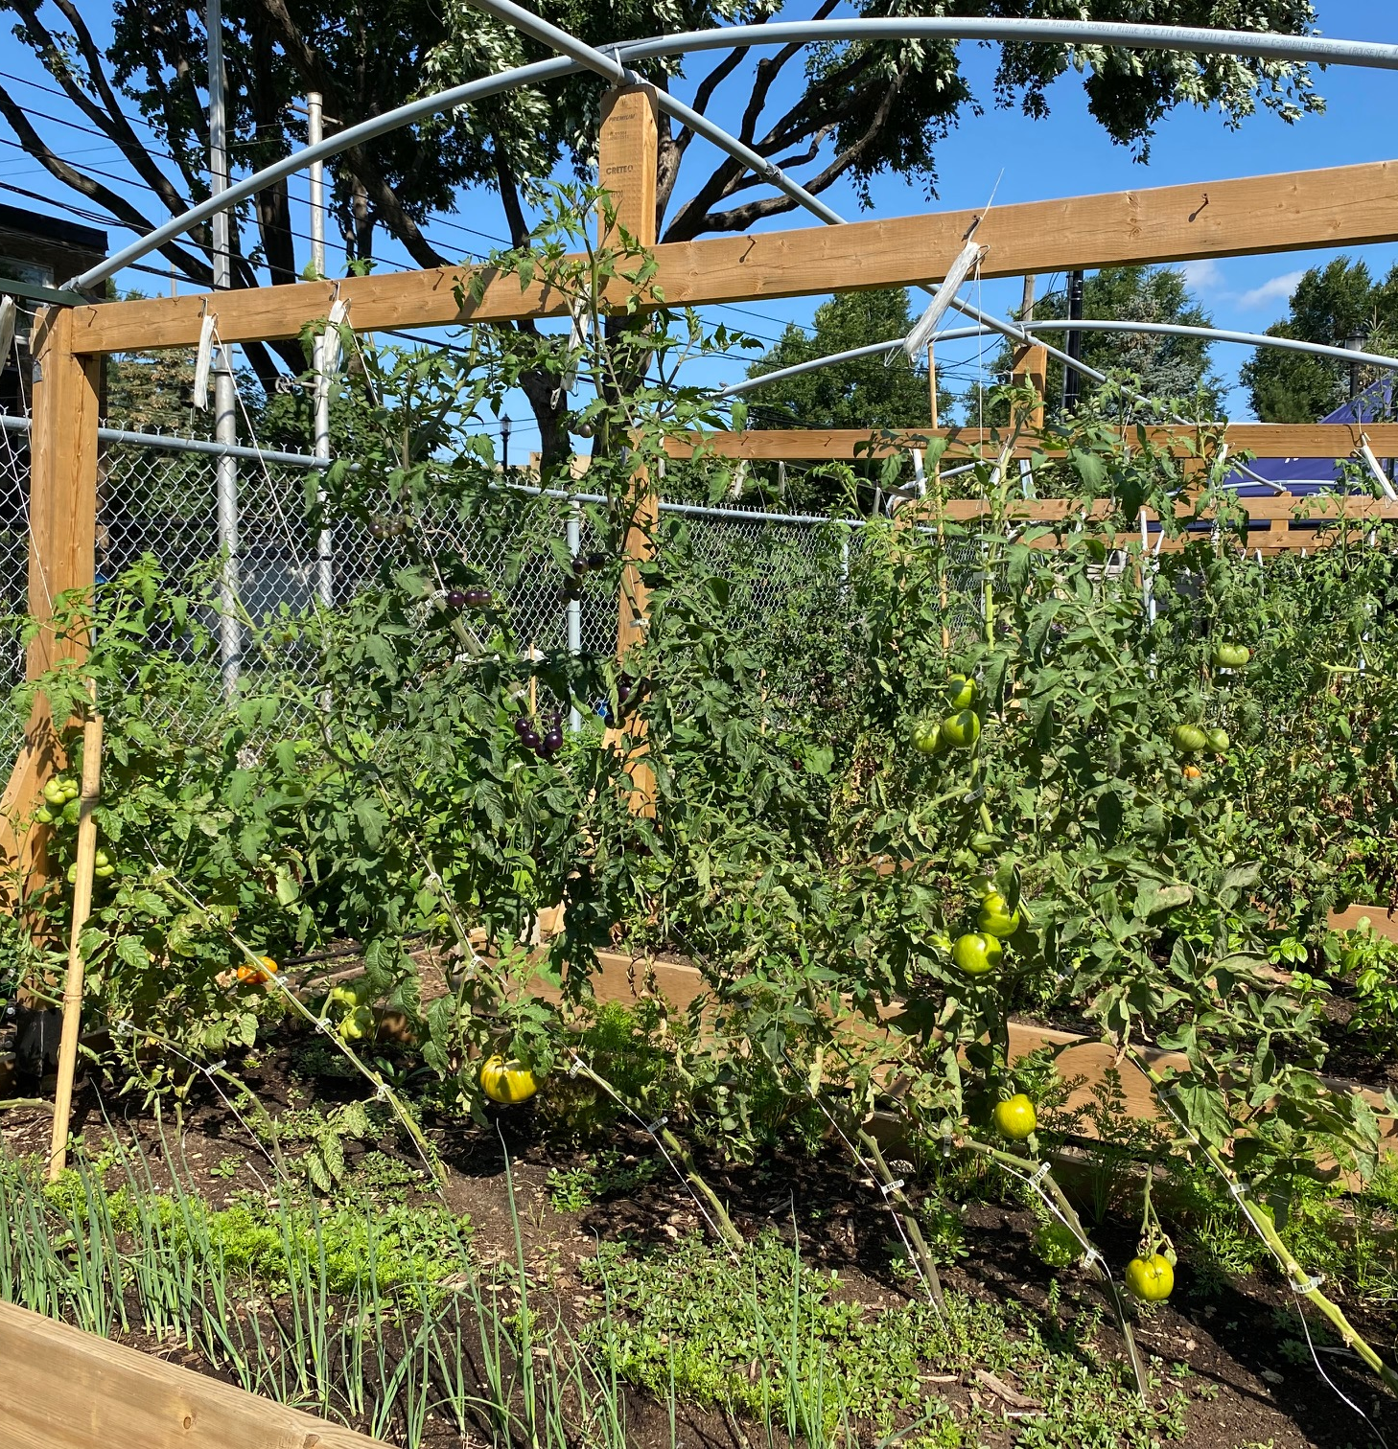

Slide 25
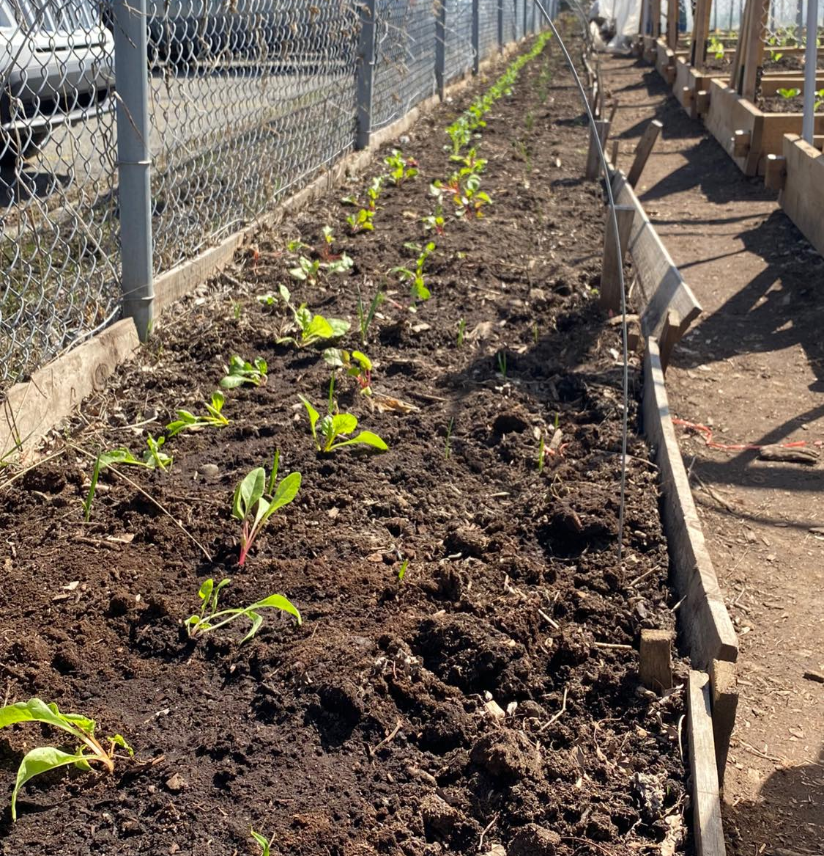
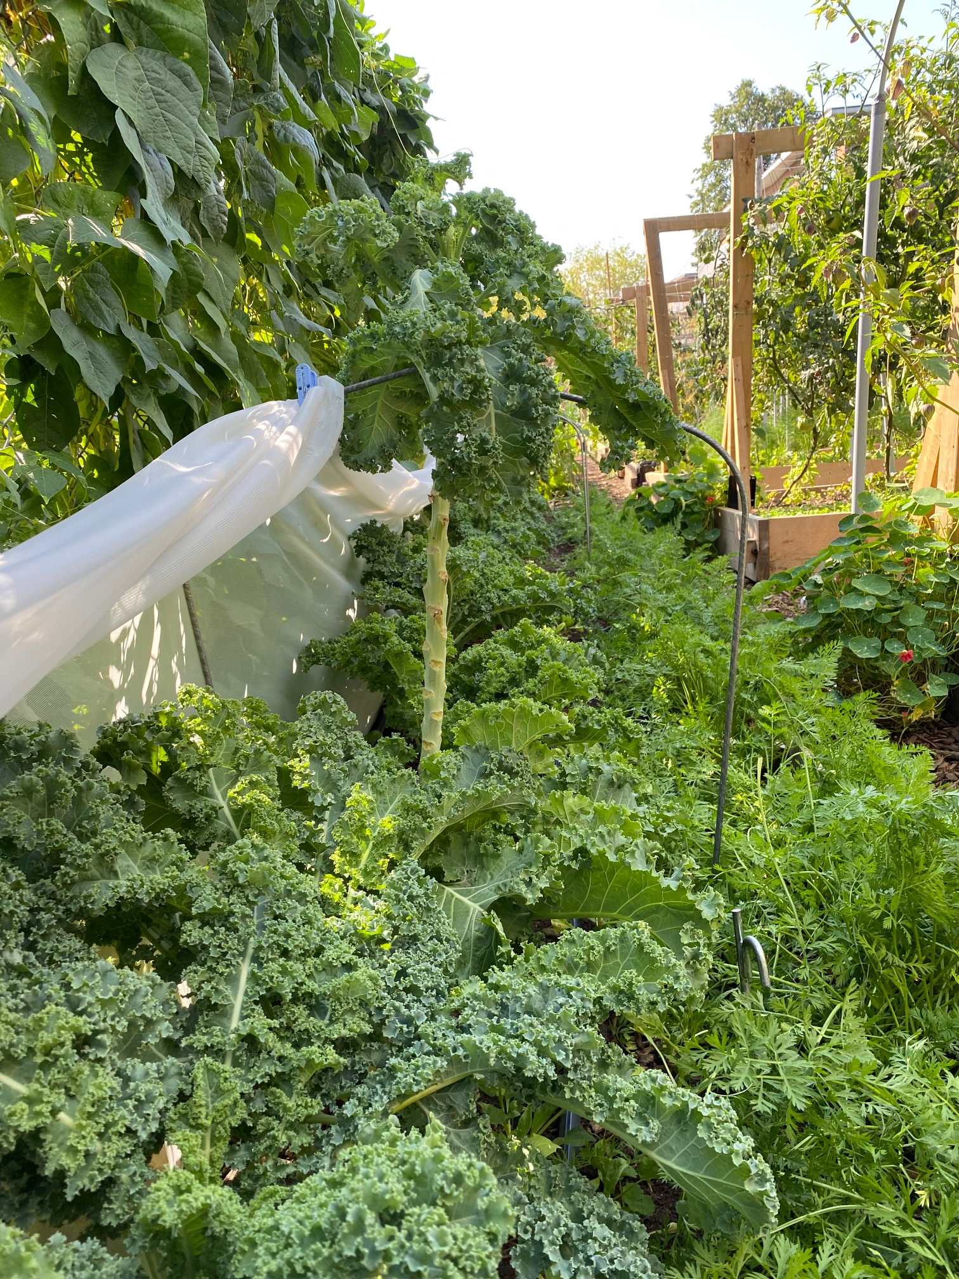

Slide 26
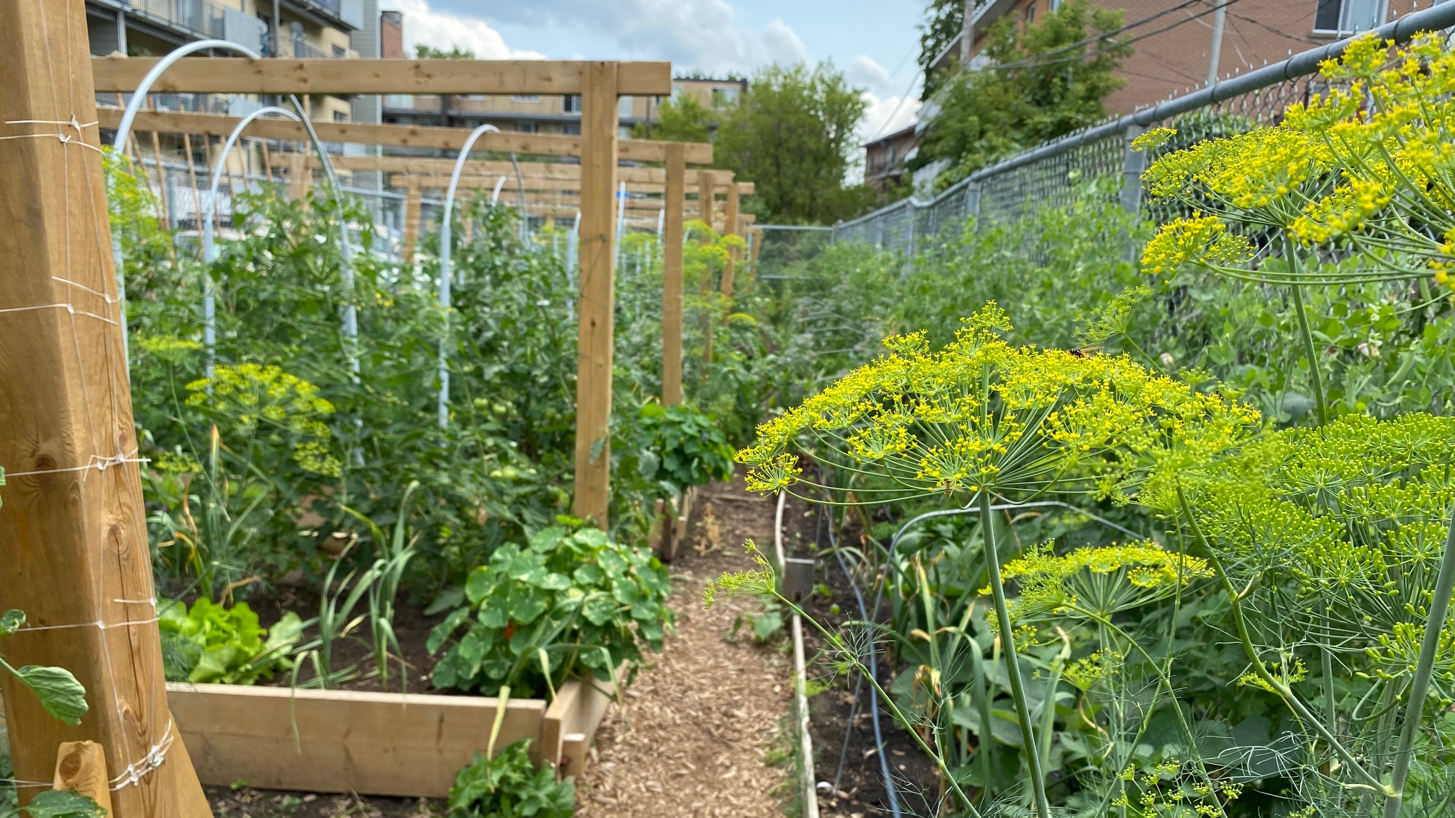

Slide 27
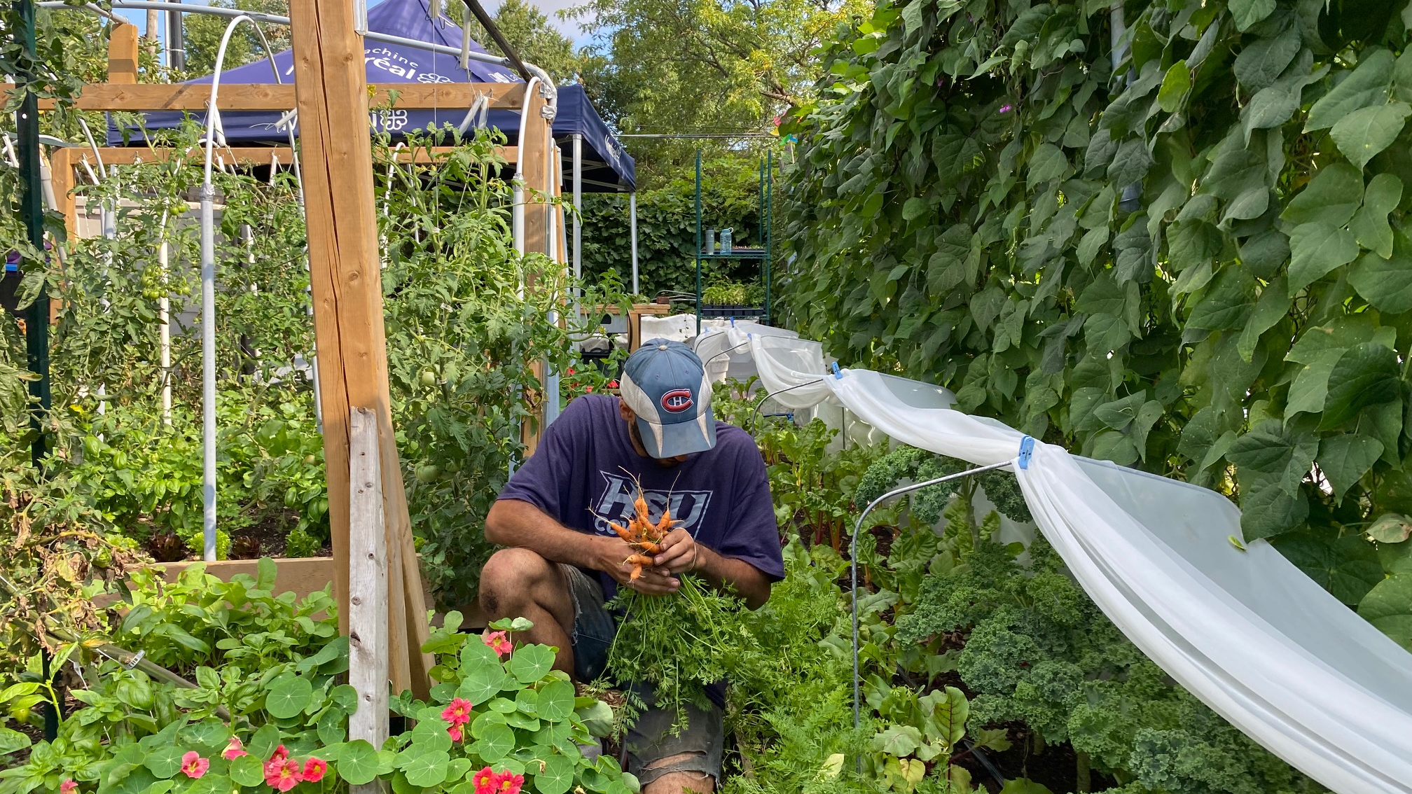

Slide 28
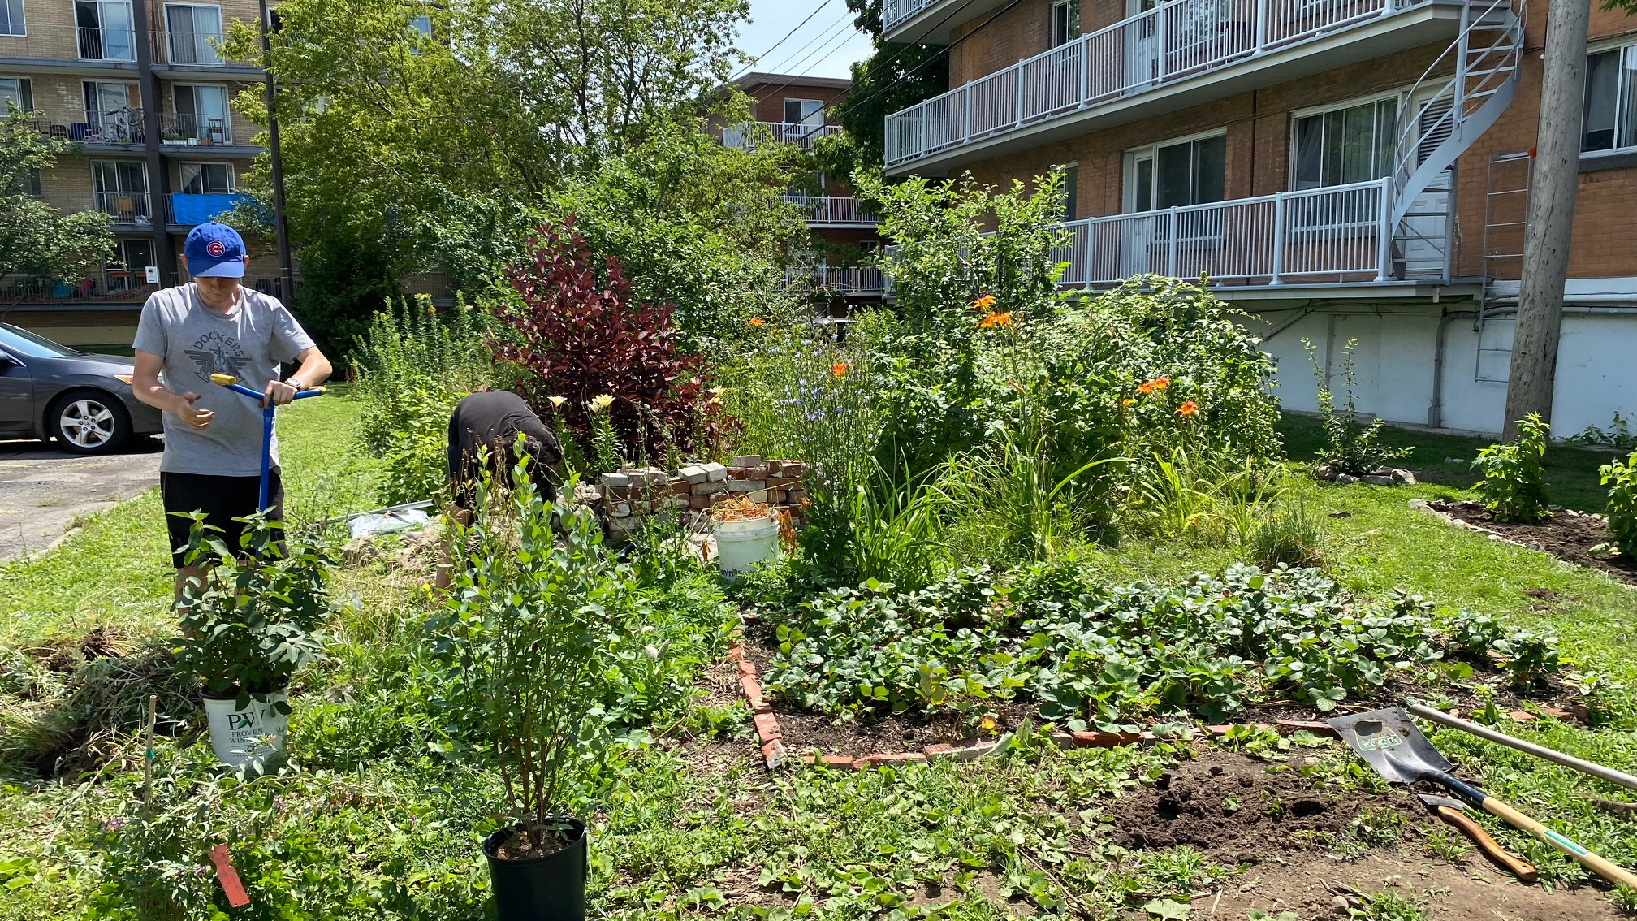

Slide 29
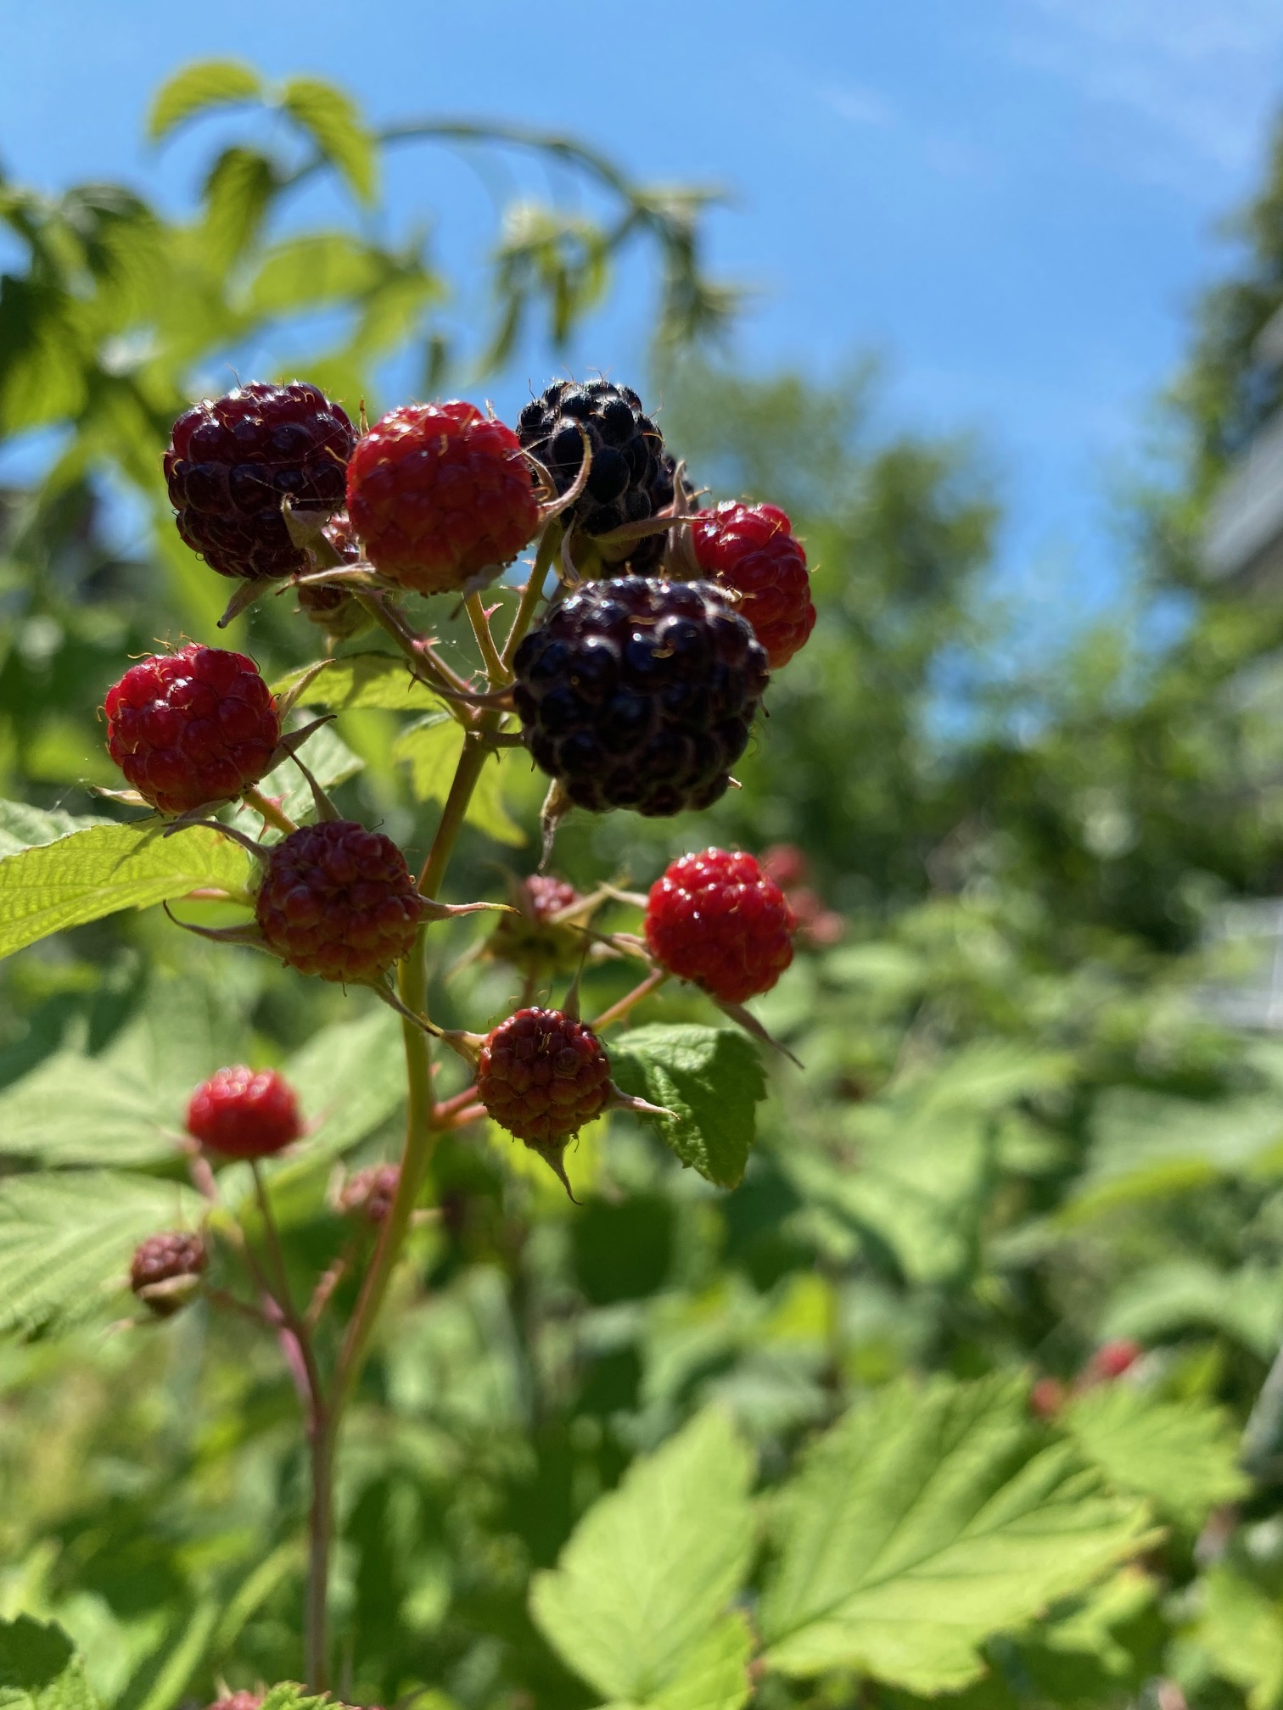
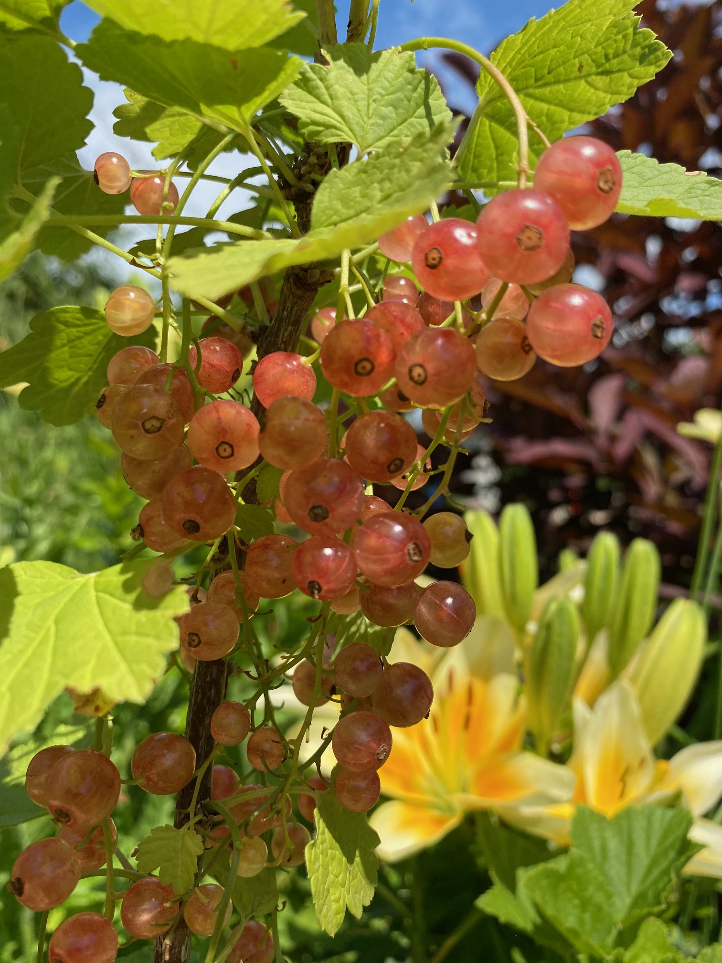

Slide 30
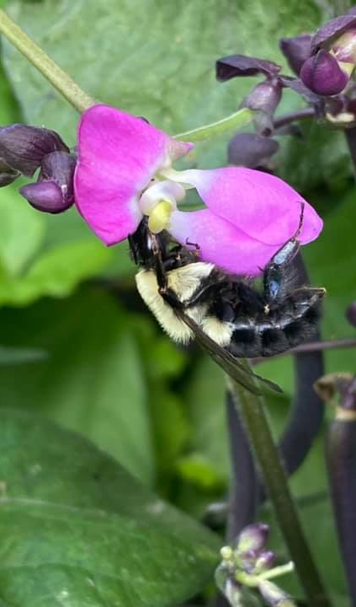
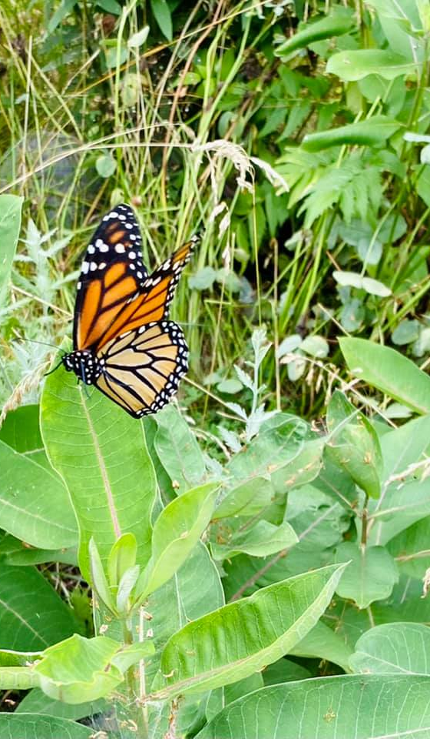
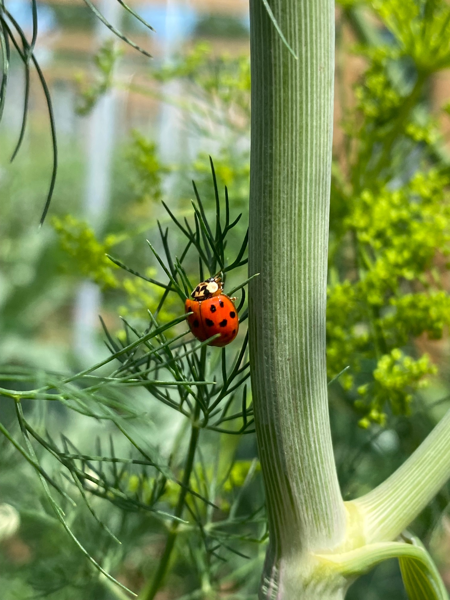

Slide 31
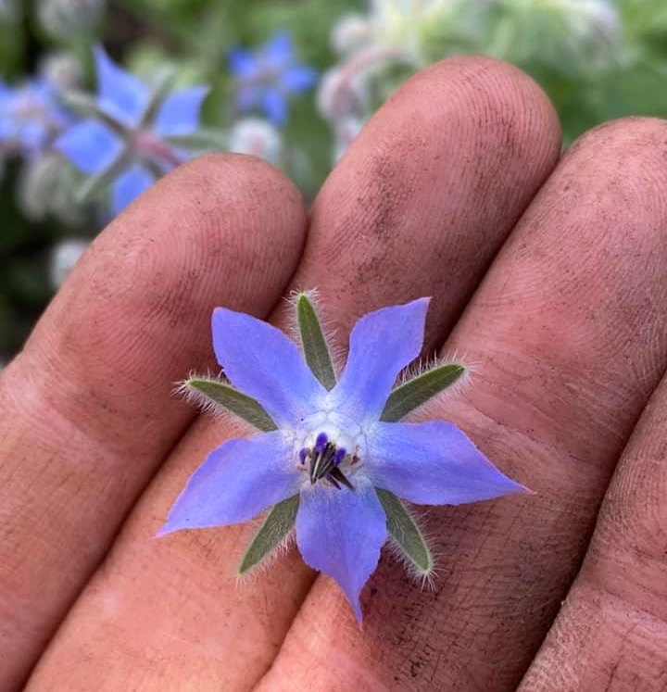
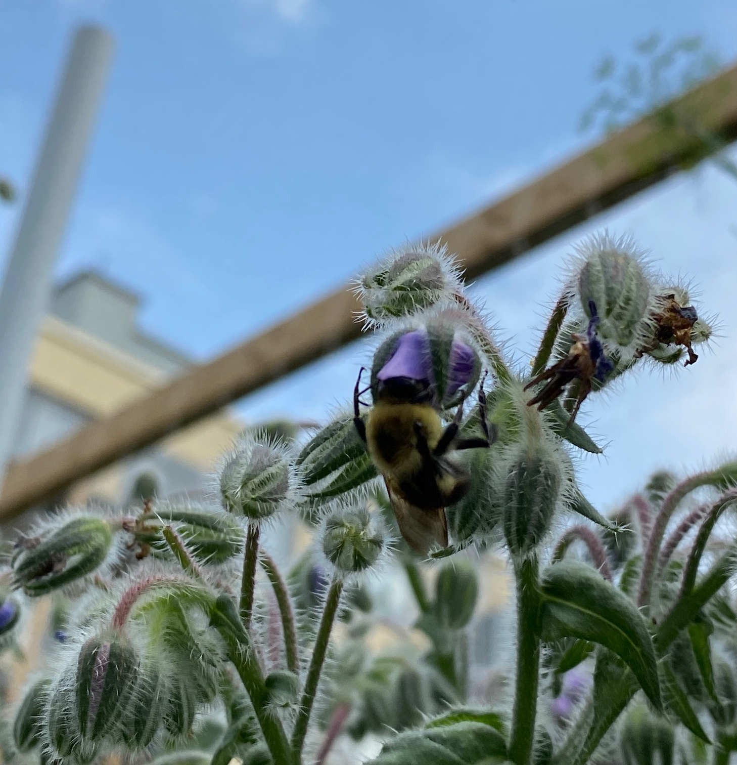

Slide 32
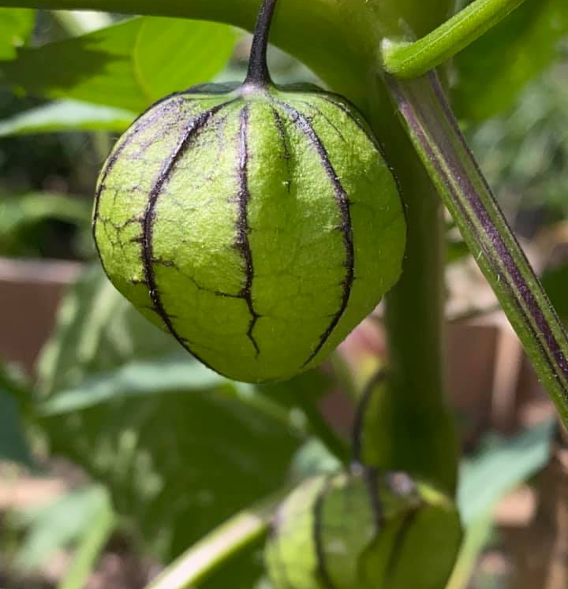
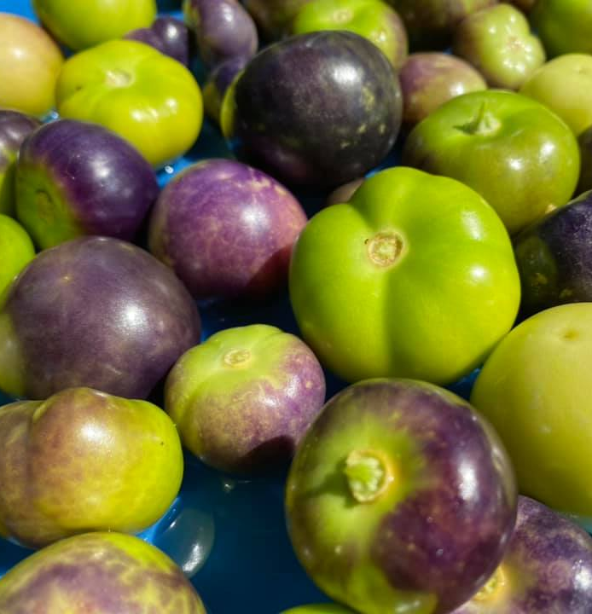

Slide 33
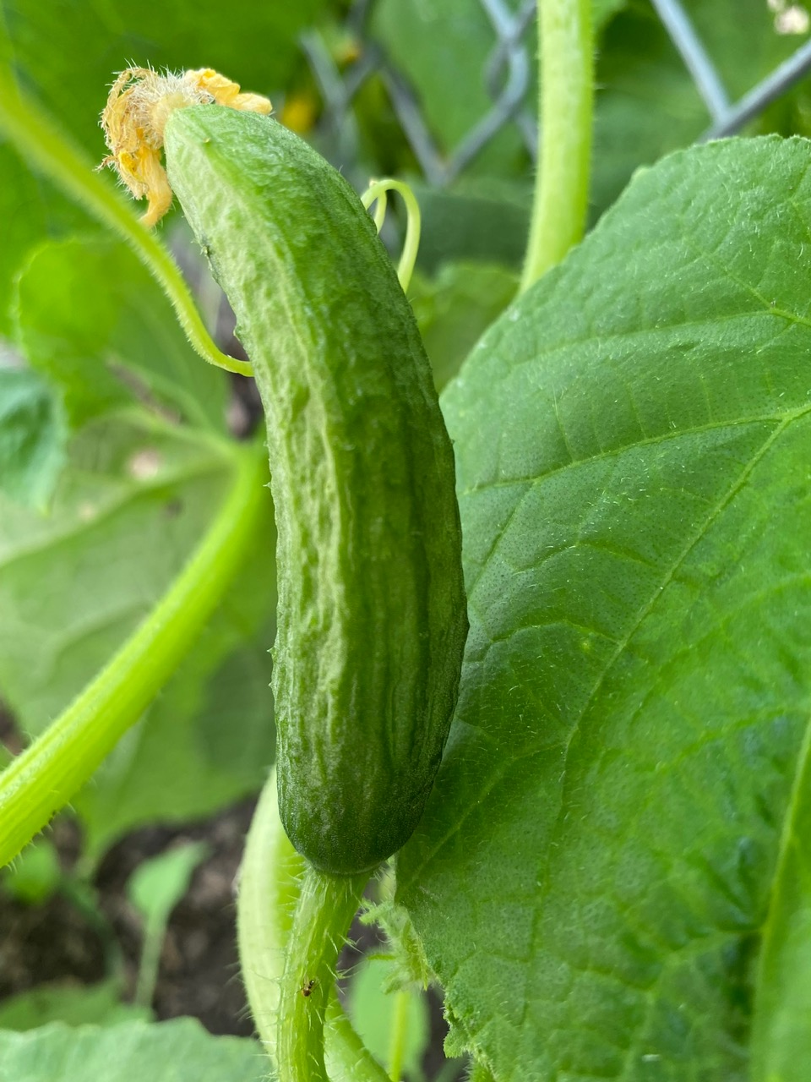
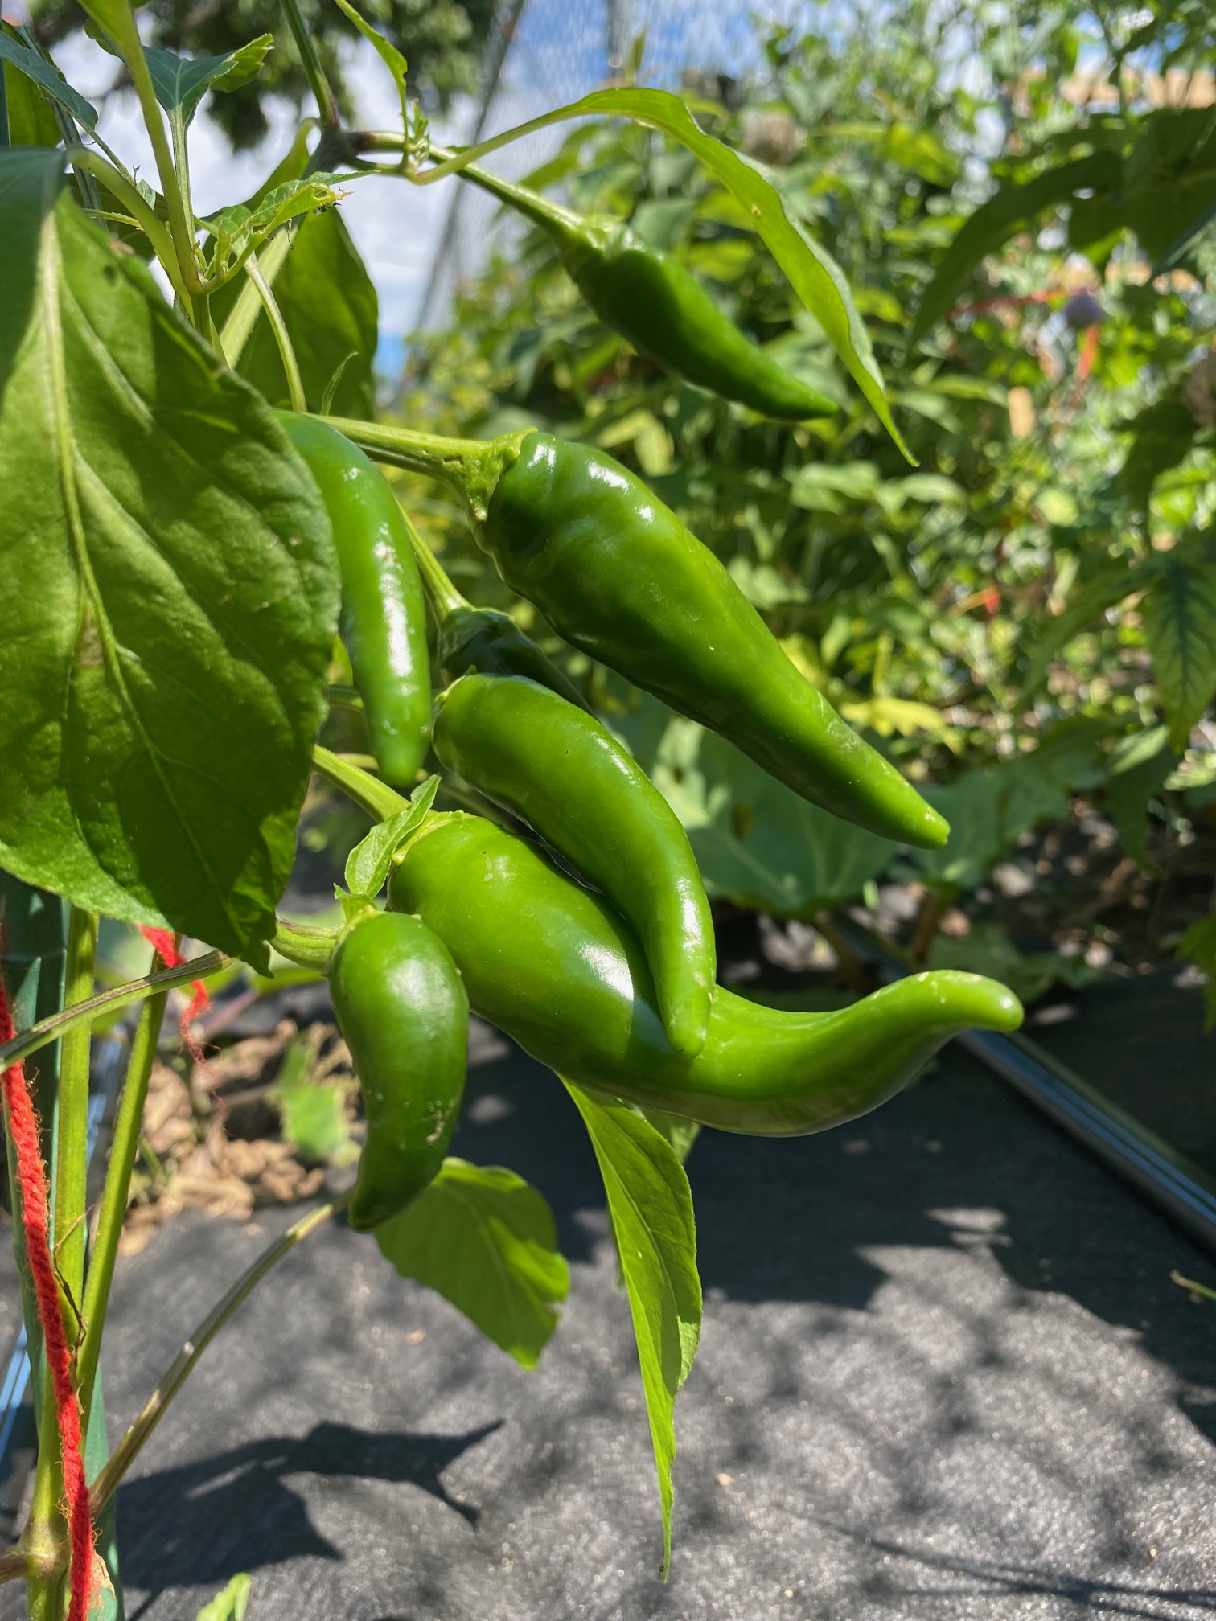

Slide 34
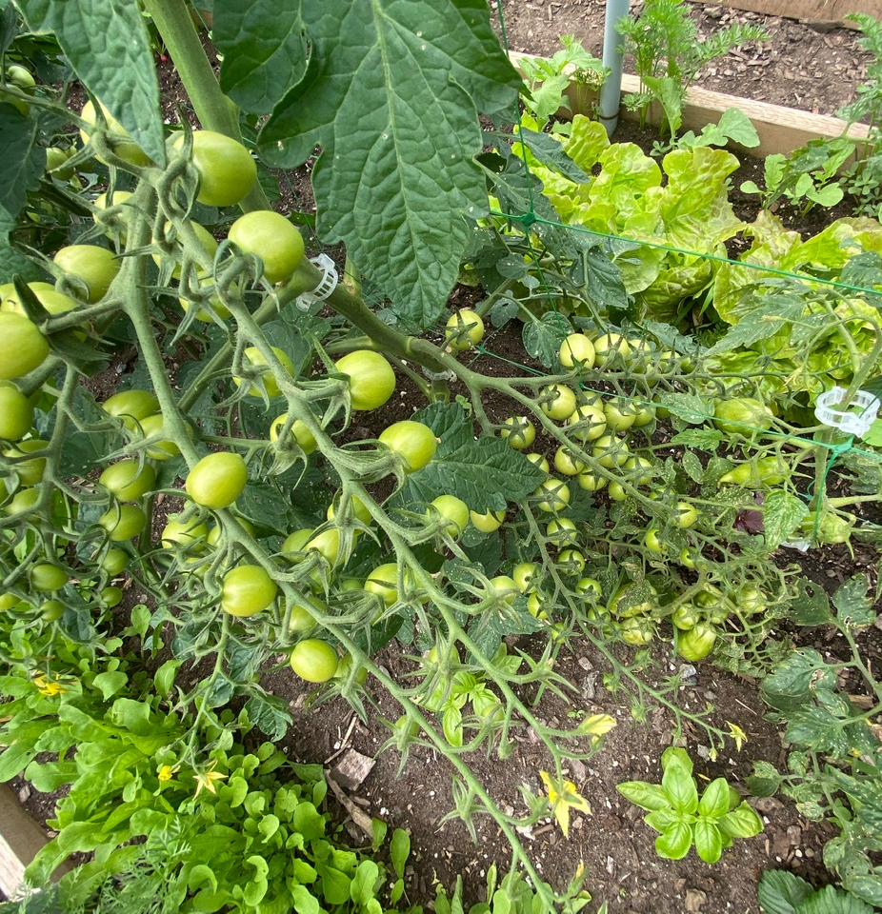
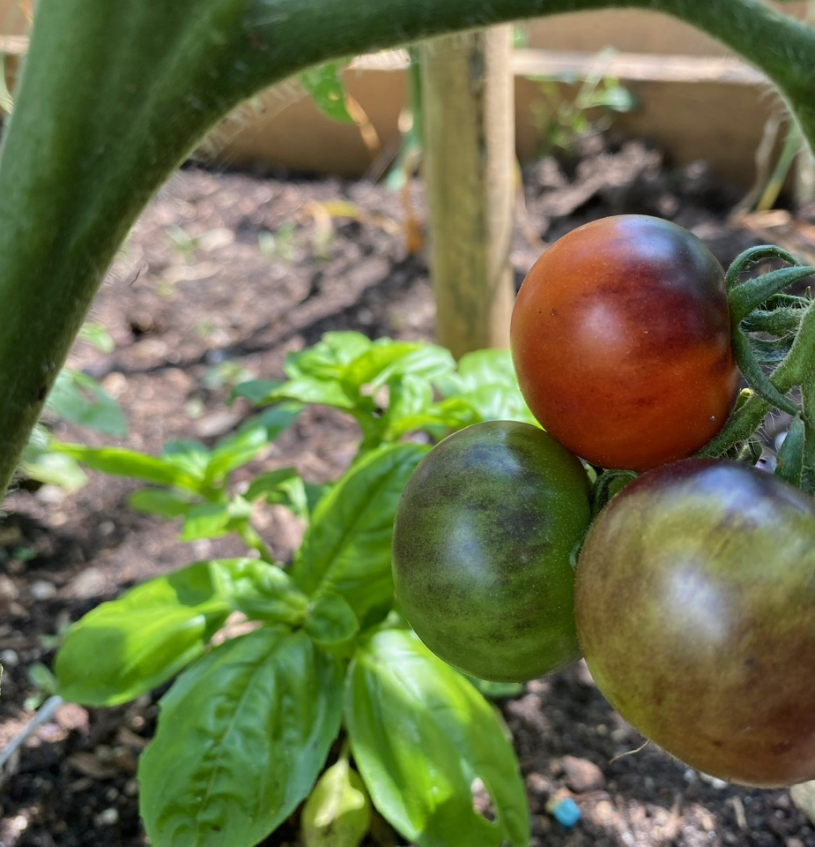

Slide 35
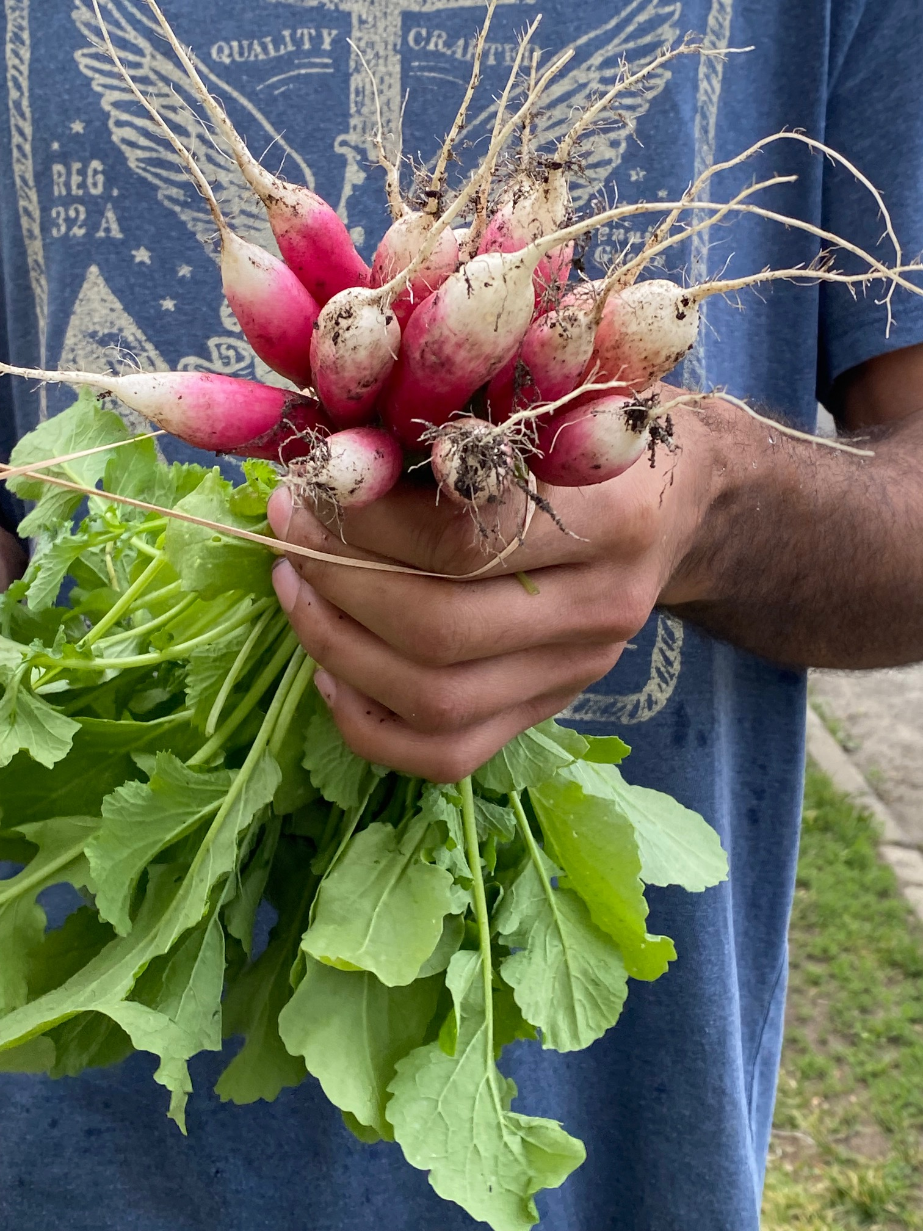
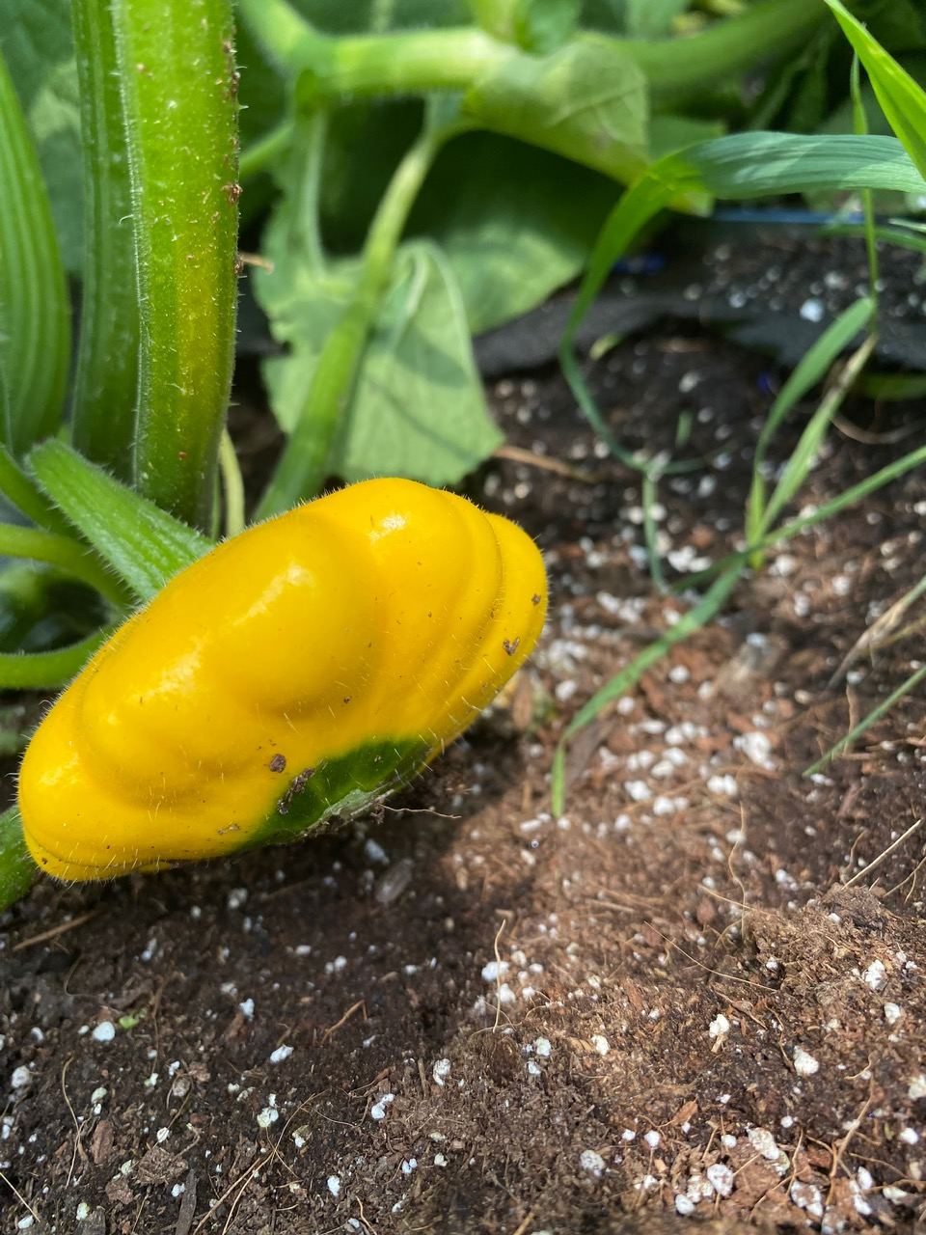

Slide 36
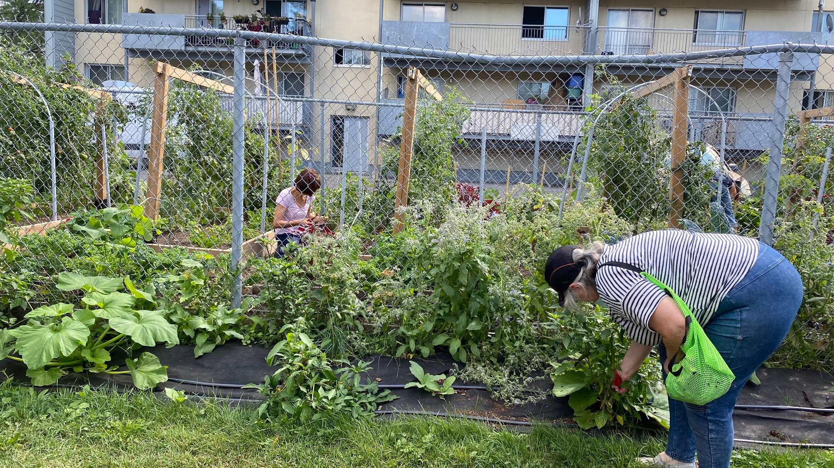

Slide 37
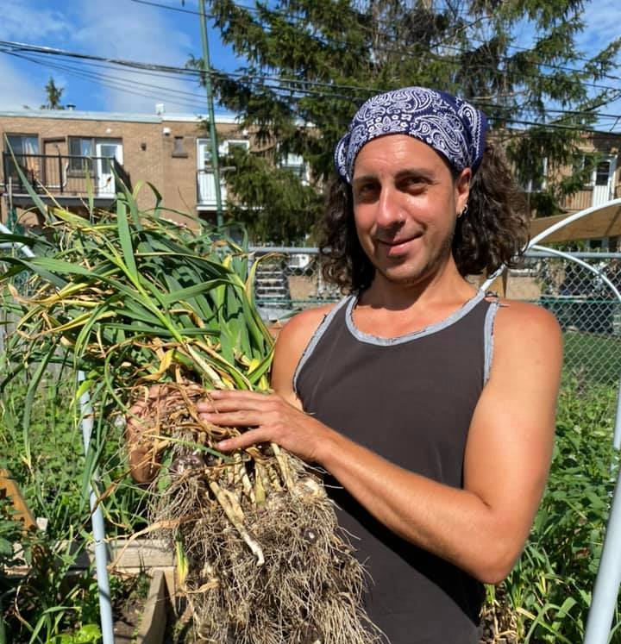
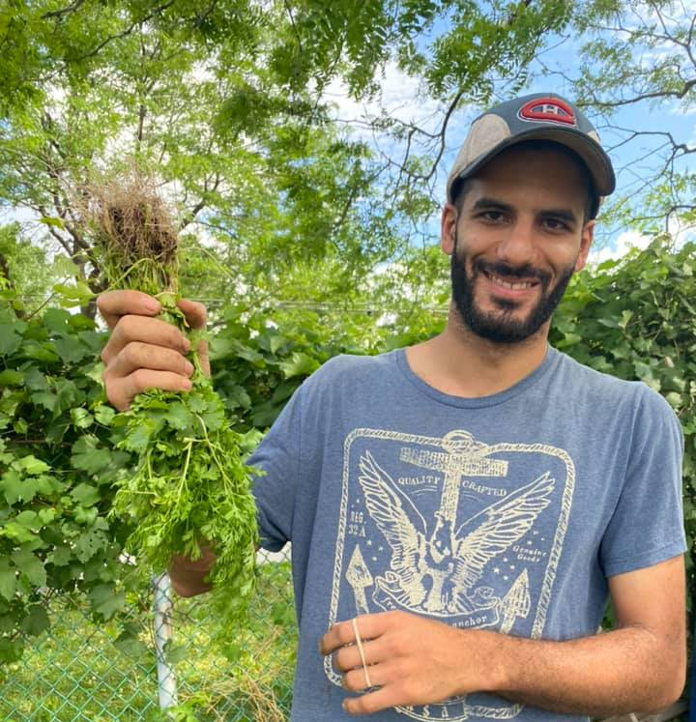

Slide 38
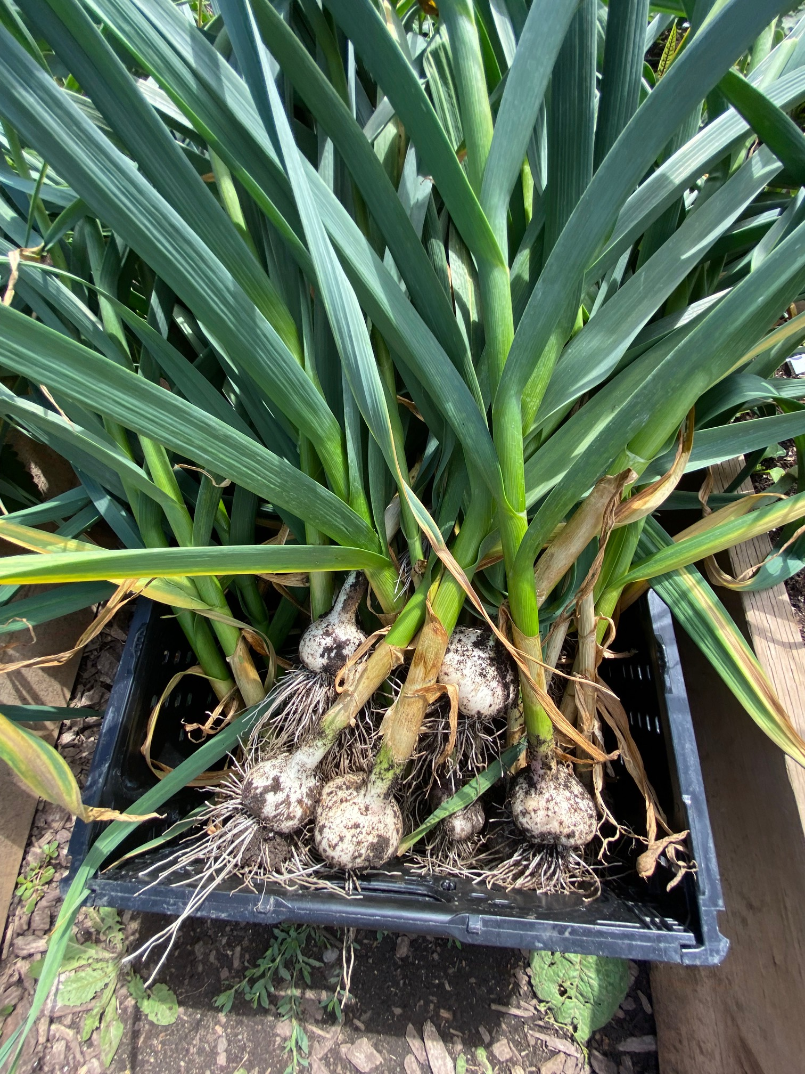
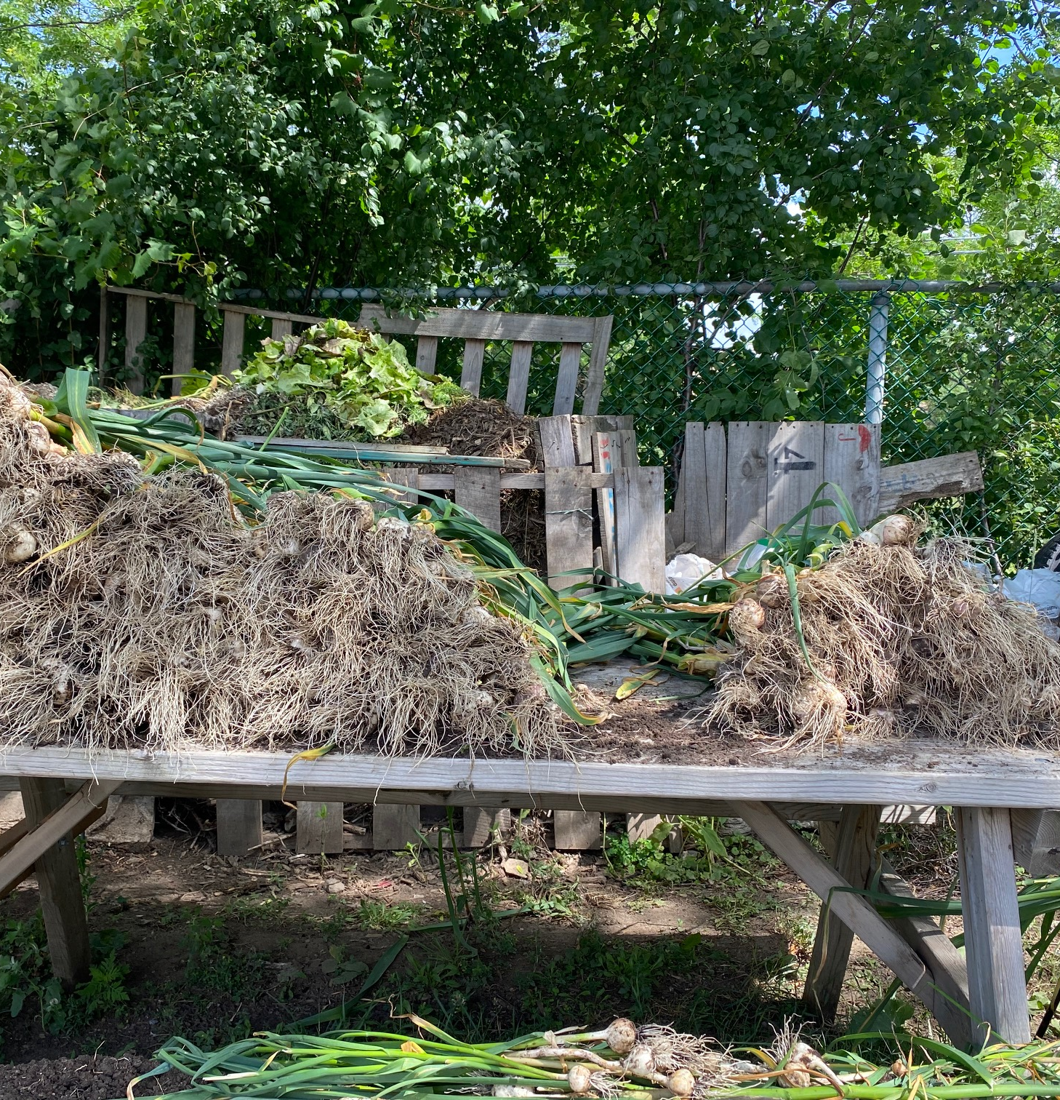

Slide 39
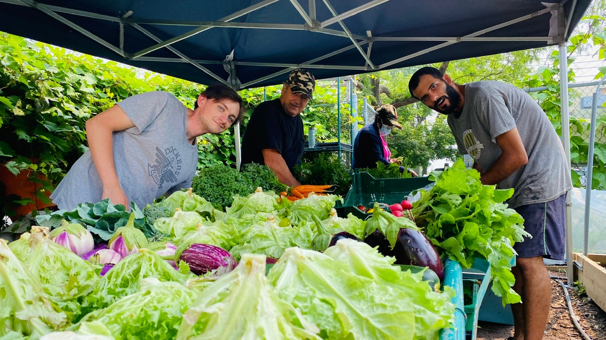

Slide 40
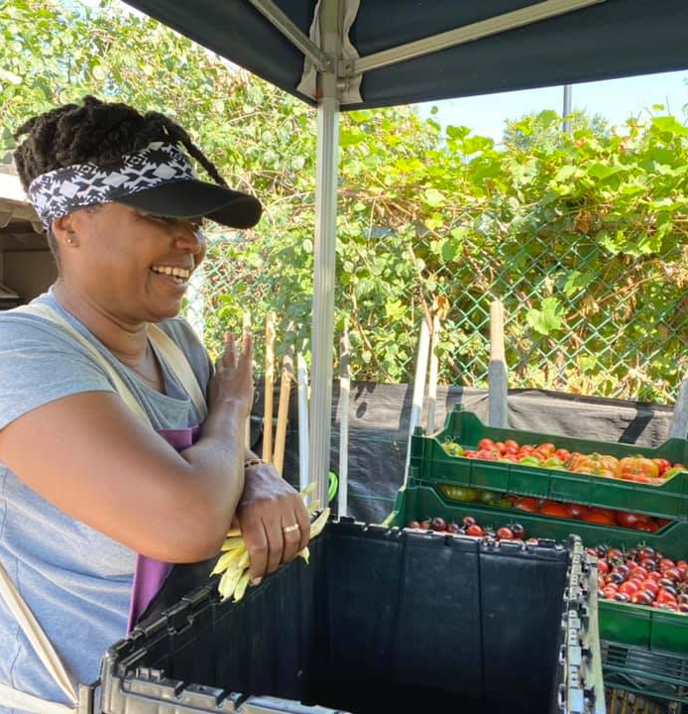
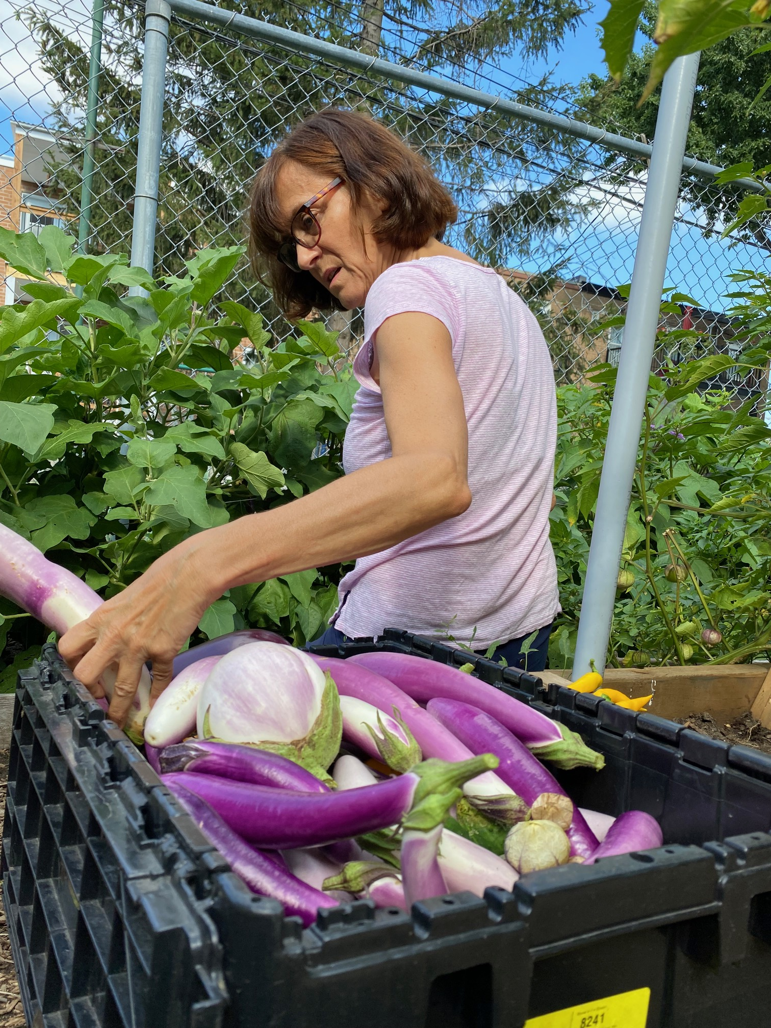

Slide 41
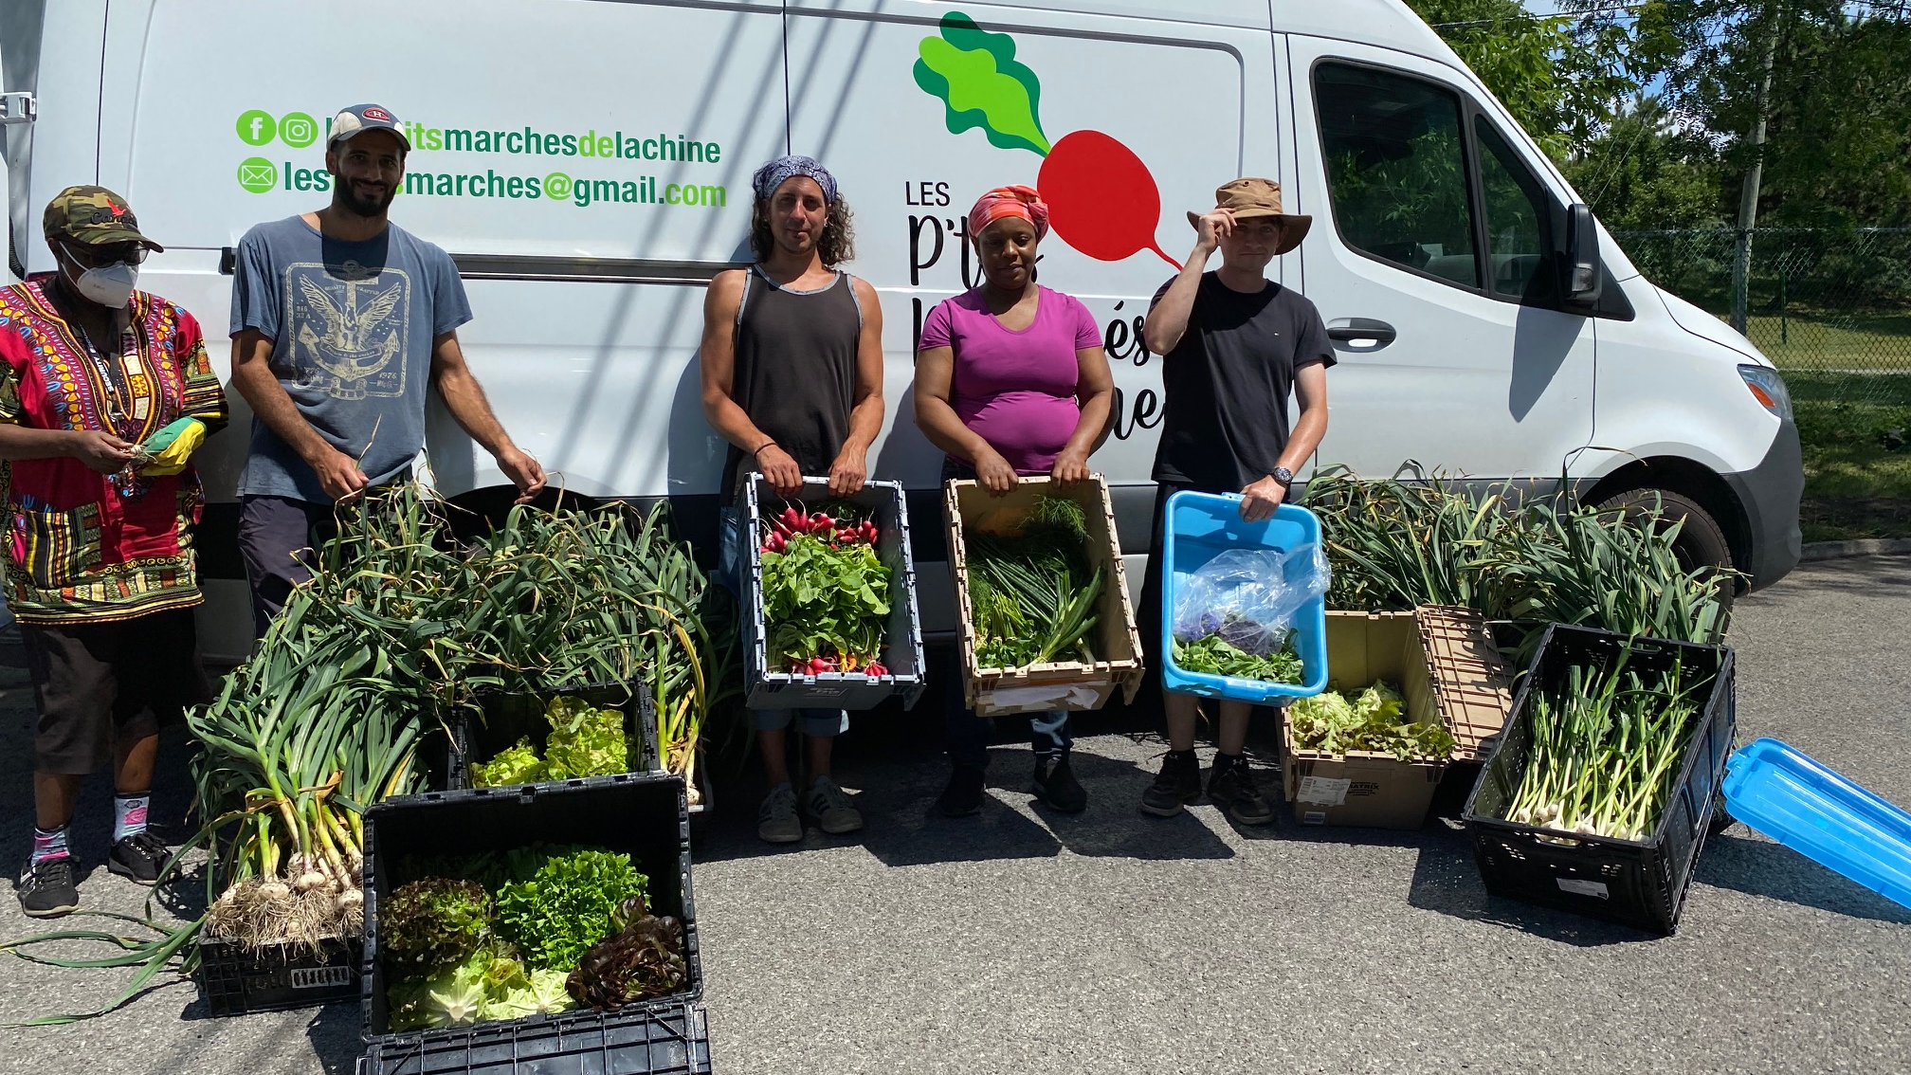

Slide 42
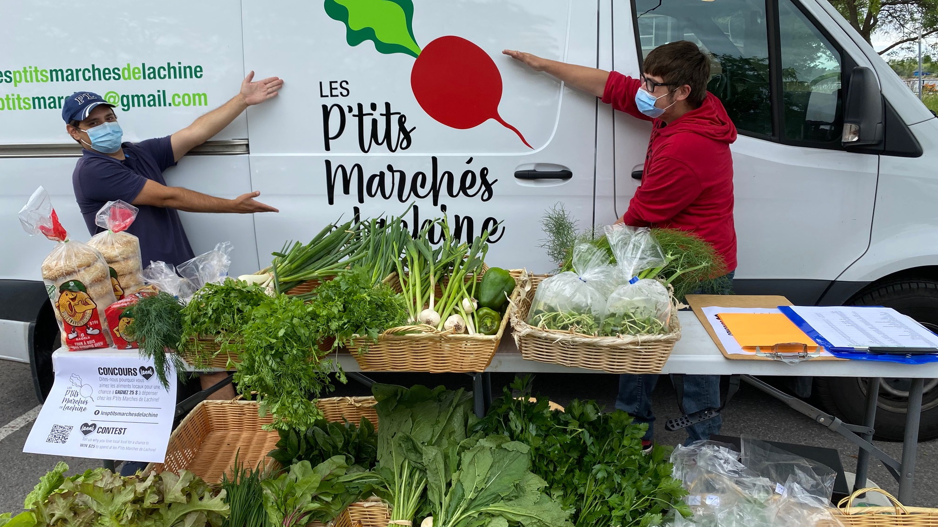

Slide 43



Slide 44



Slide 45



Slide 46


Slide 47


Slide 48


Slide 49
Mapping Community Food Systems
PRODUCTION | PROCESSING | DISTRIBUTION | WASTE MANAGEMENT | SUPPORT
Food | Cook | Market | Compost - Soil Building | Funding
Tools | Prepare | Redistribution | Water saving - Irrigation | Space
Knowledge | Ferment | Reciprocity | Seed Saving - Seed Sewing | Labour
Social Capital | Preserve | Self/community provisioning | Re-purpose food
 | Transform
 | Freeze/store
 | Dehydrate
 | Can

Slide 50


Slide 51

Building Food Sovereignty Through Action Research
Concordia Food Groups Project
Lachine Food System

Slide 52
Building a Food Sovereign Campus

Slide 53
Questions?
Have a great day!

