Slide 1
Chapter 1 and 2
Important Charts

Slide 2
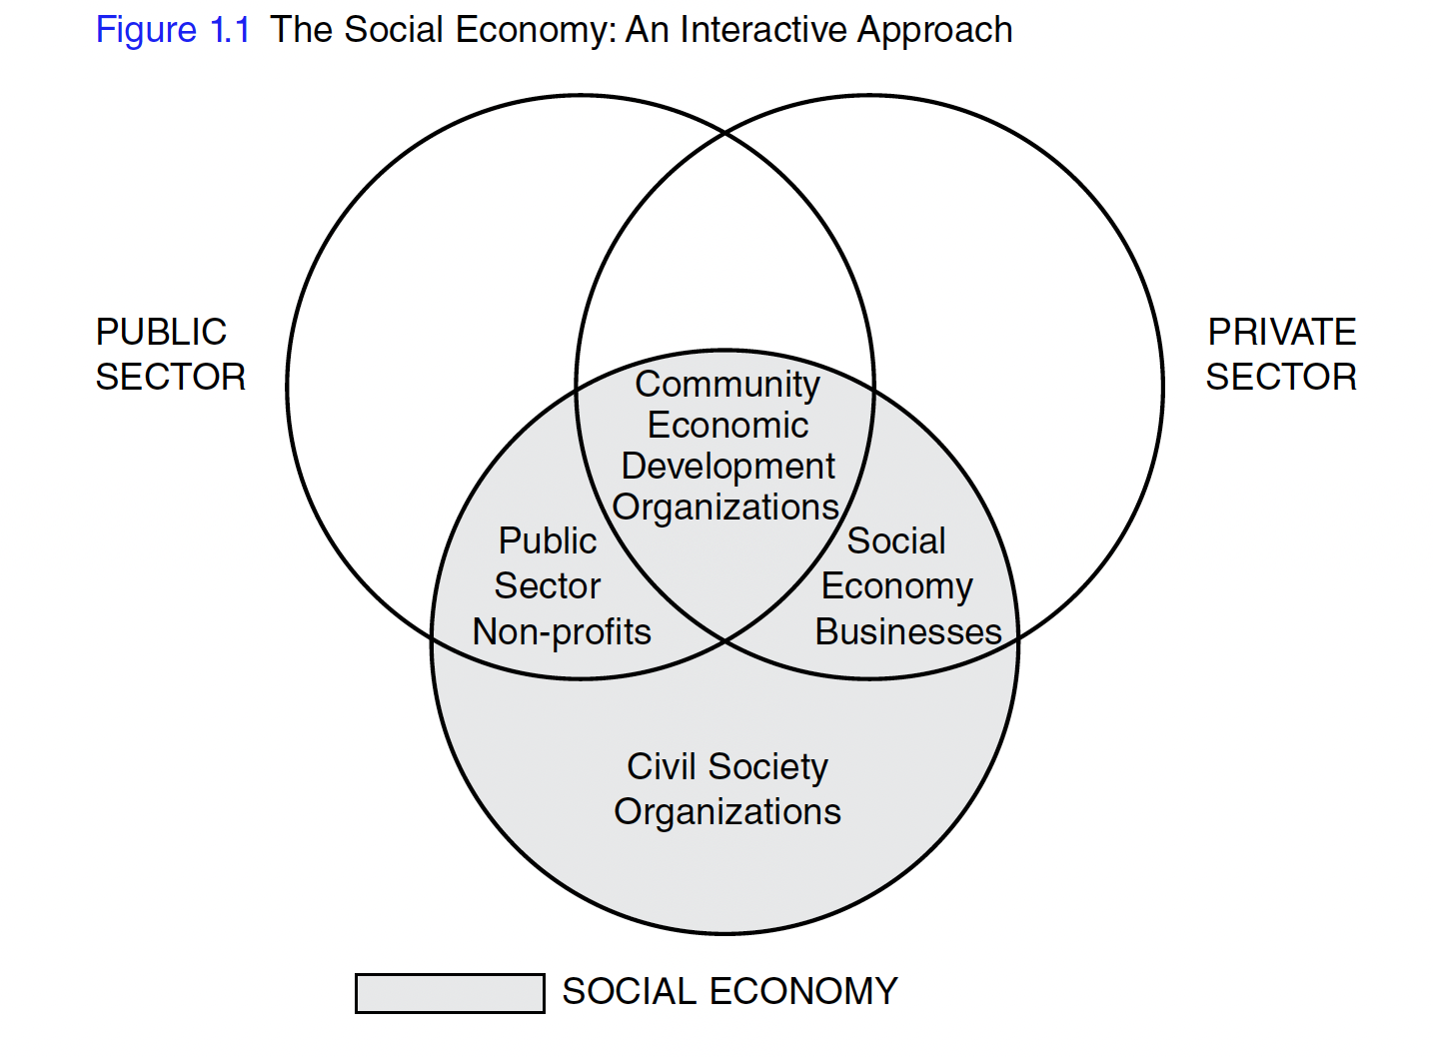

Slide 3
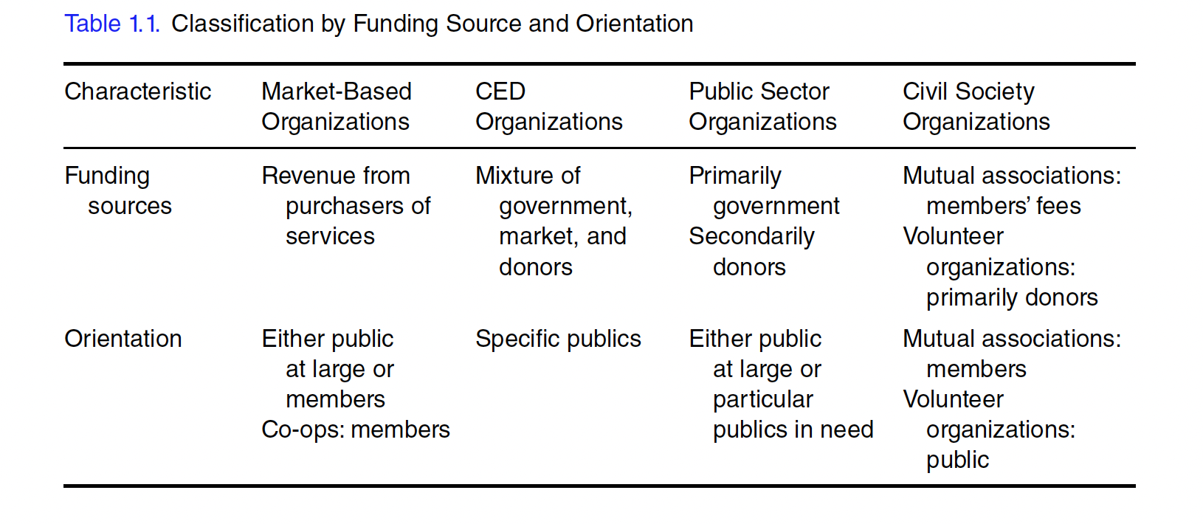

Slide 4
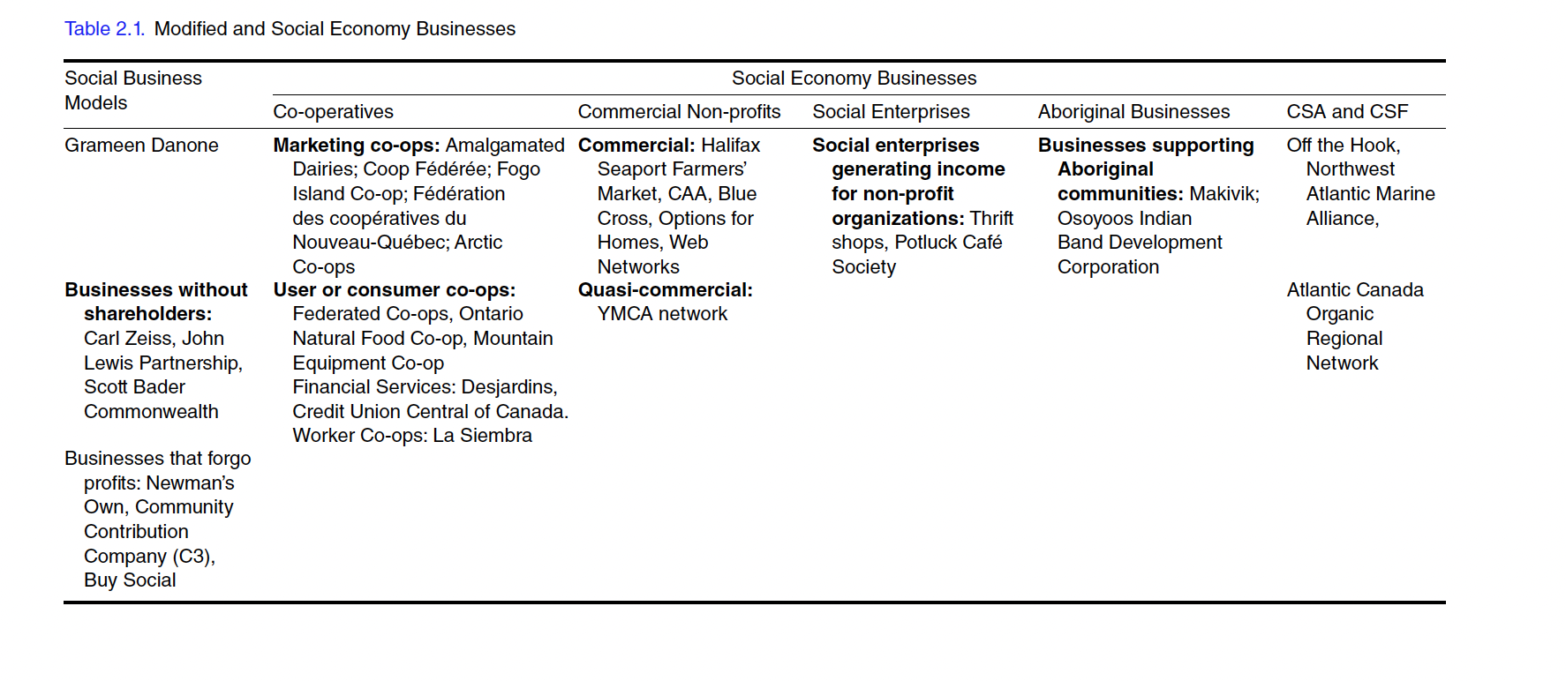

Slide 5
