Slide 1
Building Food Sovereign Campuses
Erik Chevrier
www.erikchevrier.ca

Slide 2
Discussion Question
What’s Wrong With Our Food System?

Slide 3
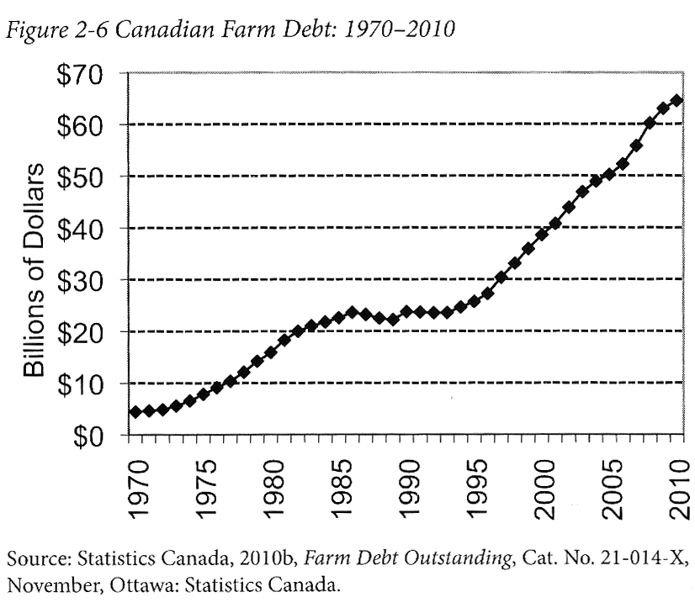
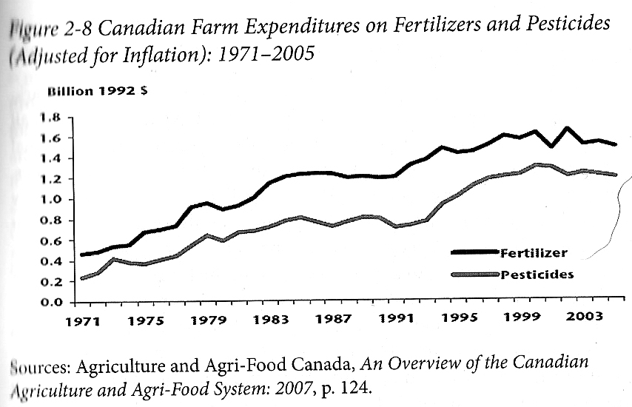
Who Benefits from Our Food System Economically? Qualman, D. (2011) Advancing Agriculture by Destroying Farms? The State of Agriculture in Canada, pp. 20 – 42. In, Wittman, H., Desmarais, A. A., & Wiebe, N. (2011) Food Sovereignty in Canada: Creating Just and Sustainable Food Systems, Fernwood Publishing

Slide 4
Only A Few Large Corporations Own Most of the Agrochemical Market

Slide 5
Companies of War, Destruction and Death
These are a few examples:
Monsanto still uses chemicals that were used to kill people, but in our food
Monsanto Ghostwriting Academic Papers
Is Round-Up safe to drink?
Farmer won lawsuit against Monsanto – Glyphosate causes cancer
The World According to Monsanto
Monsanto is now owned by Bayer who used to be part of I.G. Farben, manufacturing poisonous gas (Zyklon B) for concentration camps during the World War.
BASF was also part of IG Farben a company who worked with the Nazis and tested chemicals and drugs on people including Zyklon B
Dow Chemical Invented Agent Orange
Dow Chemical now owns Union Carbide who was responsible for a large devastating explosion in Bhopal, India:
The Bhopal disaster: Toxic legacy
One Night in Bhopal
The Bhopal Disaster

Slide 6
Issues With Our Current Food System
Issues with food security – there are over 800 million people starving in the world today! Issues with food sovereignty – peasants and farmers are being affected by trade agreements and food dumping! Issues with genetic modification process – epigenetics matter! Issues with use of herbicides – glyphosates are being identified as cancer causing! Issues with privatization – restricted access! Issues with cost on farmers – family farms are not sustainable! Issues with reduction of biodiversity – we are destroying nature! Issues with unwanted genetics spreading onto non-GMO farms – lawsuits! Issues with loss of Indigenous farming methods – on stolen land! Issues with soil arability – we are killing our soil! Issues with killing pollinators – fruits need bees! Issues with water ‘dead zones’ – we are polluting our water! Issues with corporate concentration of agribusinesses – former war companies are now food chemical companies! Issues with health – our food contains toxins! Foundations on structural racism, colonialism and patriarchy – glaring systemic issues! Rising cost of seed and chemicals – we don’t need to buy seeds! Research funding being directed to GMOs instead of traditional breeding methods – ‘science’ is not only about GMOs! Pest and weed resistance to Bt crops and glyphosate! There are so many more critiques!

Slide 7
Is The Food System Broken?
Calls to “fix a broken food system” assume that the capitalist food system used to work well. This assumption ignores the food systems long, racialized history of mistreatment of people of colour. The food system is unjust and unsustainable, but it is not broken. It functions precisely as the capitalist food system has always worked, concentrating power in the hands of the privileged minority and passing off the social and environmental “externalities” disproportionately to racially stigmatized groups. (Holt-Gimenez, 2017, p. 160)
How we produce and consume determines how our society is organized, but how we organize socially and politically can also determine how we produce and consume. The implications of this are profound: our food systems are vessels of unmatched social and economic power and pivotal sites for systemic transformation. (Holt-Gimenez, 2017, p. 214)
Holt-Gimenez, E. (2017) A Foodie’s Guide to Capitalism: Understanding the Political Economy of What We Eat, Monthly Review Press, New York.

Slide 8
Problems – Symptoms – Root Causes

Slide 9
Building Food Sovereign Campuses
Our current food system is not sustainable
Universities are contributing to these problems by hiring Aramark, Chartwells-Compass, Sodexo
Universities are great sites to transform food practices
Universities are not implementing transformative approaches
Concordia students and faculty have developed a vast campus-community food system and advocated against multinational foodservice corporations since the 1990s.
If universities want a ‘truly’ sustainable campus food system, they should adopt food sovereignty frameworks.

Slide 10
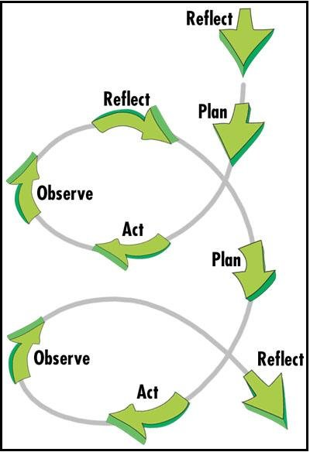
Methodology
Concordia Campus-Community Food Groups Research Project
Ongoing project
Approach
Critical-participatory-action-research
Three phases
Gather information
Produce multimedia content
Hold public conversations about our findings and create an action plan

Slide 11
Research Questions
Mapping
What campus-community food organizations exist at Concordia as of 2018?
What factors facilitated and hindered the development and viability of the campus-community food system at Concordia University.
How does the Concordia campus-community food system contribute to understanding how to build food sovereign campuses?
Historical Analysis
How did the Concordia campus-community food organizations come into existence?
What factors that prevented food activists from replacing multinational foodservice corporations with a local, ethical, social enterprise?
What does the history of the campus-community food system contribute to understanding how to build food sovereign campuses?
Public Discussion
What can we learn from the campus-community organizations about building a food sovereign campus?
Food Sovereignty Framework
How could previous literature and the case-study of the campus-community food groups help construct a framework for building food sovereign campuses?

Slide 12
Concordia Campus-Community Food System Map

Slide 13
Concordia Food Coalition Map
LINK TO MAP
Lachine Map

Slide 14
Facilitating the Creation and Perpetuation of the Campus-Community Food System
Student activism
Community service learning and community-campus engagement
Fee levies
Robust support system

Slide 15
Impeding the Development and Viability of the Campus-Community Food System
Challenging fee levies
Processing limitations
Gap between production and processing
Students graduate and move on
Some students lacked expertise
Relying on volunteers was not always viable
No agriculture schools or food studies program
Not always easy to negotiate with the Concordia administration
Large foodservice providers
Alternatives not always viable

Slide 16
Historical Analysis
Seven trends:
The Beginning – Founding Concordia, the Greenhouse, Food Services, and Student-Run Café/Bar and COOP (1966‑1979)
Concordia Students Form Associations and Businesses – Foundation of the Concordia University Student Association and CUSACorps (1979‑1990)
Fighting for Food Justice – Creating Le Frigo Vert and MoHubs (1990‑1997)
Building a Food Collective – Forming the Concordia Food Collective and The People’s Potato (1998‑2003)
Focusing on Sustainability and Urban Agriculture – Foundation of Sustainable Concordia and Revitalization of the Concordia Greenhouse (2003‑2007)
Expansion of Urban Farming, Reinvigorating Food Activism and Mass Mobilization (2008‑2012)
Creating a Vibrant Campus-Community Food System (2012‑2018)

Slide 17
Reasons Why Student Activists Were Not Successful in Preventing Multinational Foodservice Corporations
Administration
Risk aversion
Viability of foodservice operations
Corporate model of university foodservices
View of sustainability
Request for proposal process
Students
Anti-activists
Conflict amongst activists
Student turnover & lack of experience
Faculty
Lack of engagement
Multinational Corporations
Skewed competition

Slide 18
Contributing to Food Sovereignty
Transformative policies, practices and principles
Desire to eliminate contracts with multinational foodservice providers
Right to food
Considerations
Transformative food movements go by different names
Action research can help advance the process of food sovereignty
Critique of applying food sovereignty to university campuses

Slide 19
Key Findings
Food sovereignty can describe the social justice outcomes on campus, like policies, organizational procedures (reflected through by-laws and constitutions), bans on harmful practices (i.e. selling bottled water), among others.
Campus food sovereignty is an ongoing process of negotiating with others who are actively trying to transform the food system.
Food sovereignty is not a reformist movement, it is transformational.
A food sovereign campus is controlled by students, faculty, the Concordia community and community at large and should create positive value to these constituencies.
A food sovereign campus does not force students onto a meal plan so that large multinational corporations, and universities (through a profit and loss model) can receive financial returns.
Food sovereign campuses are made up of social enterprises that practice an array of diverse economy practices.
A food sovereign campus is more radical than corporate and weak sustainability approaches and can be differentiated through the framework provided in this thesis.
Even though food sovereignty is hard to define and apply to university campuses, sustainability is equally confusing and often used to uphold unsustainable practices.

Slide 20
Key Differences Between Corporate, Weak Sustainability and
Food Sovereignty Approaches to University Food Services
^{Campus Food Issues}

Slide 21
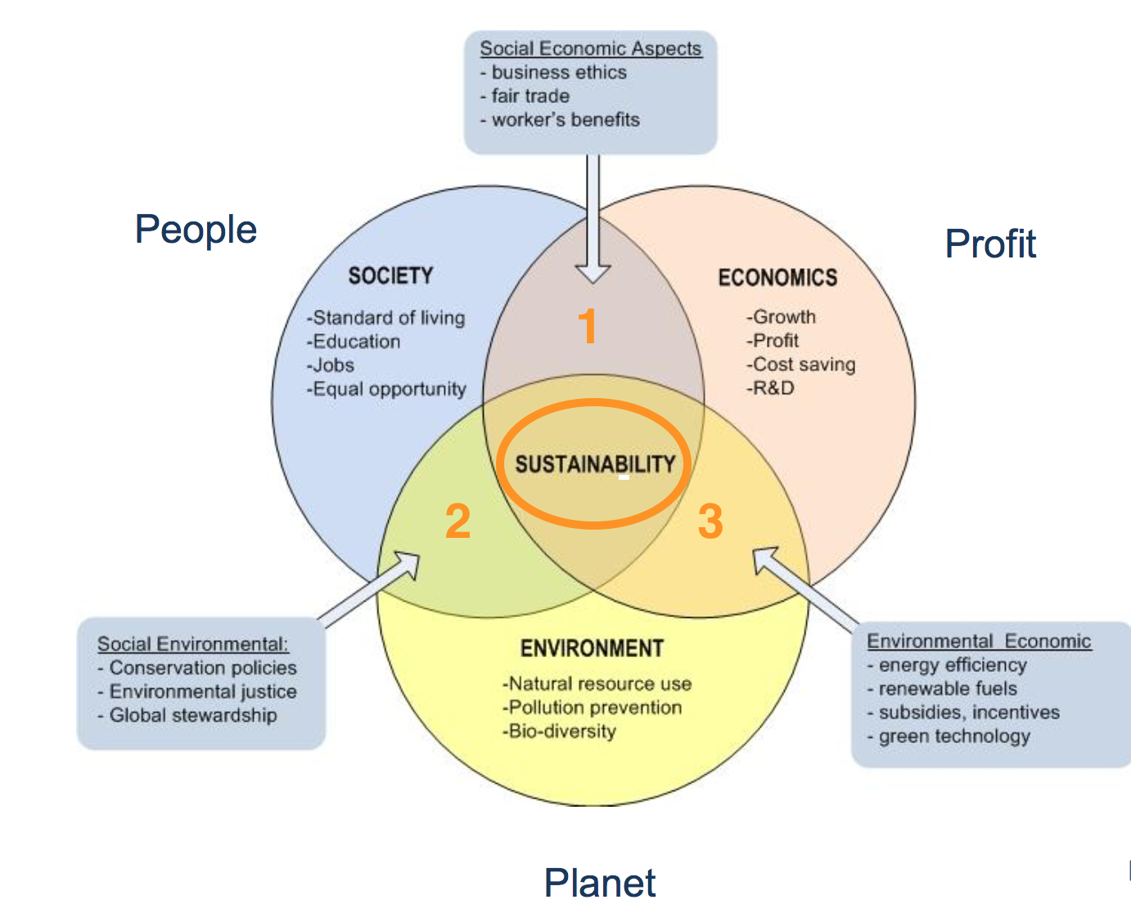
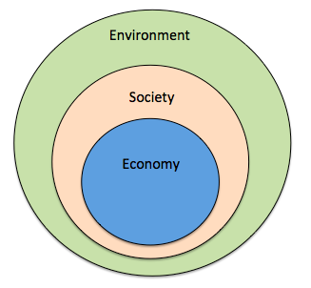
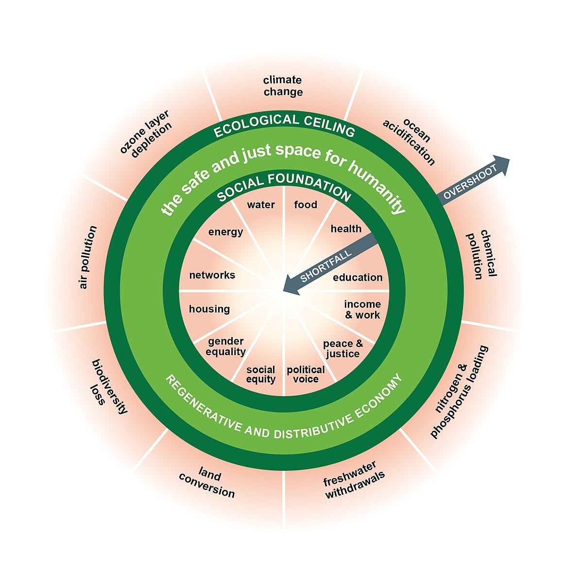
Prioritize the Biosphere and Social Relations Over the Market
Triple Bottom line
Nested model
DOUGHNUT MODEL

Slide 22
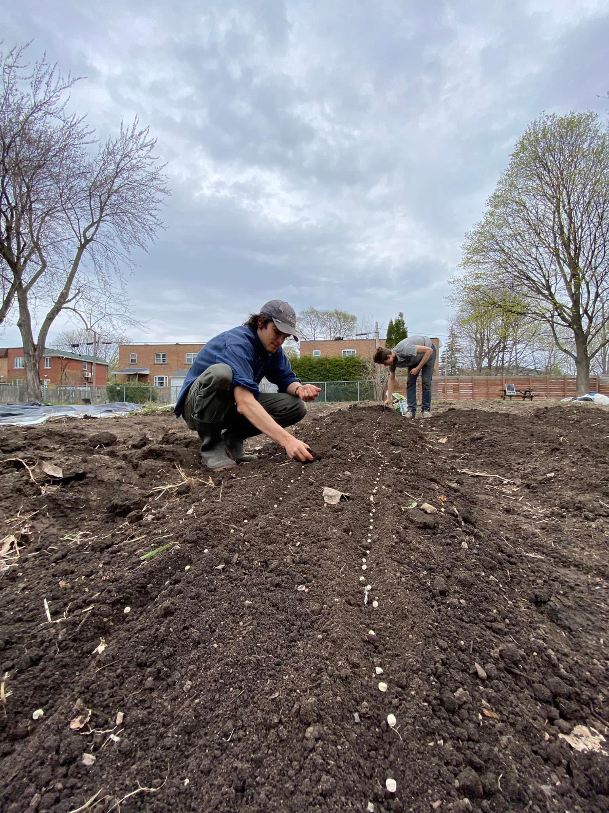

Slide 23
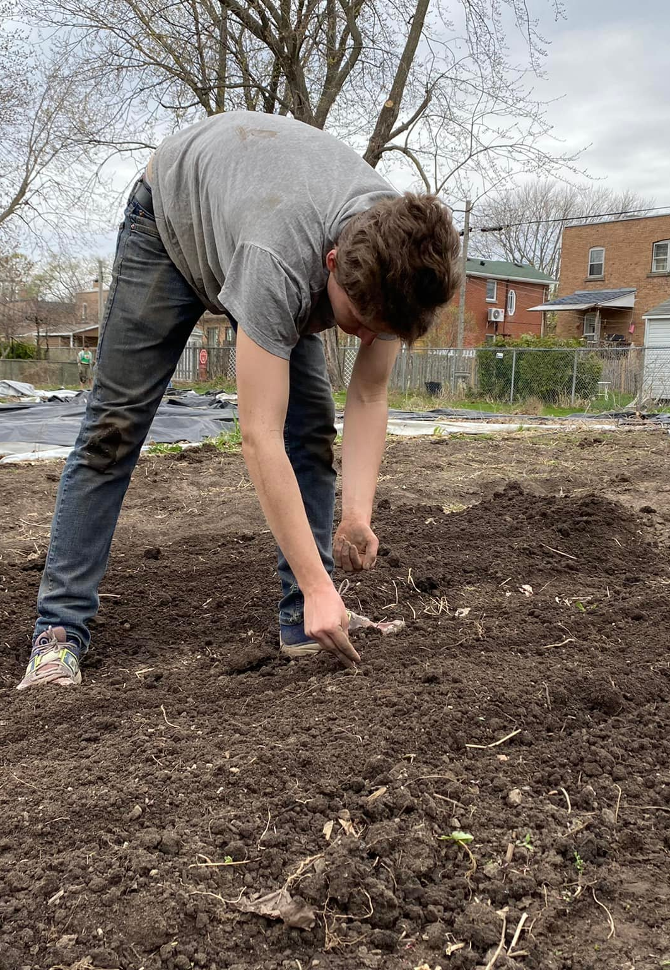
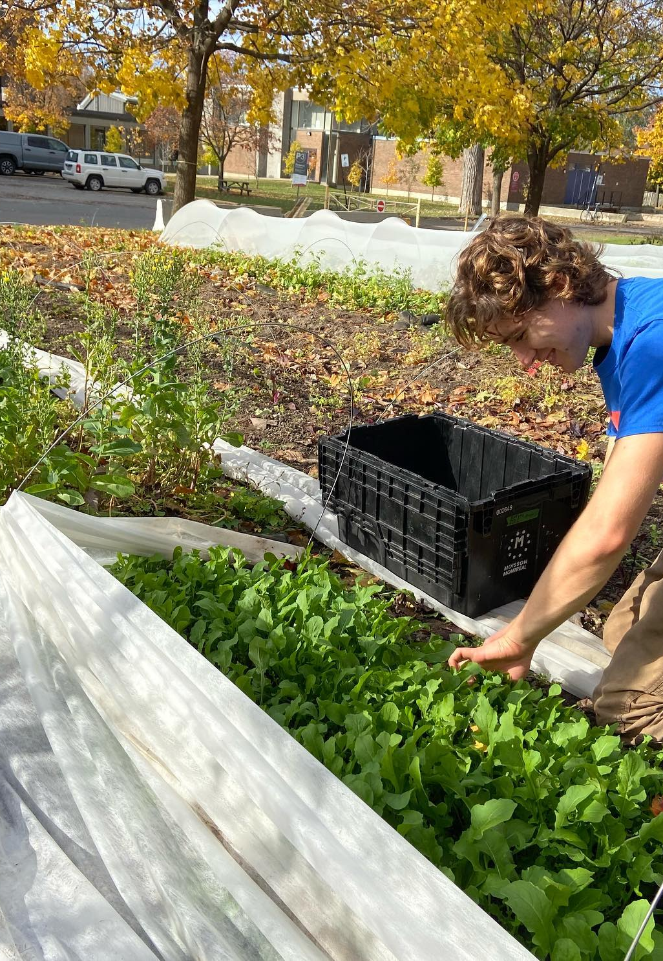

Slide 24
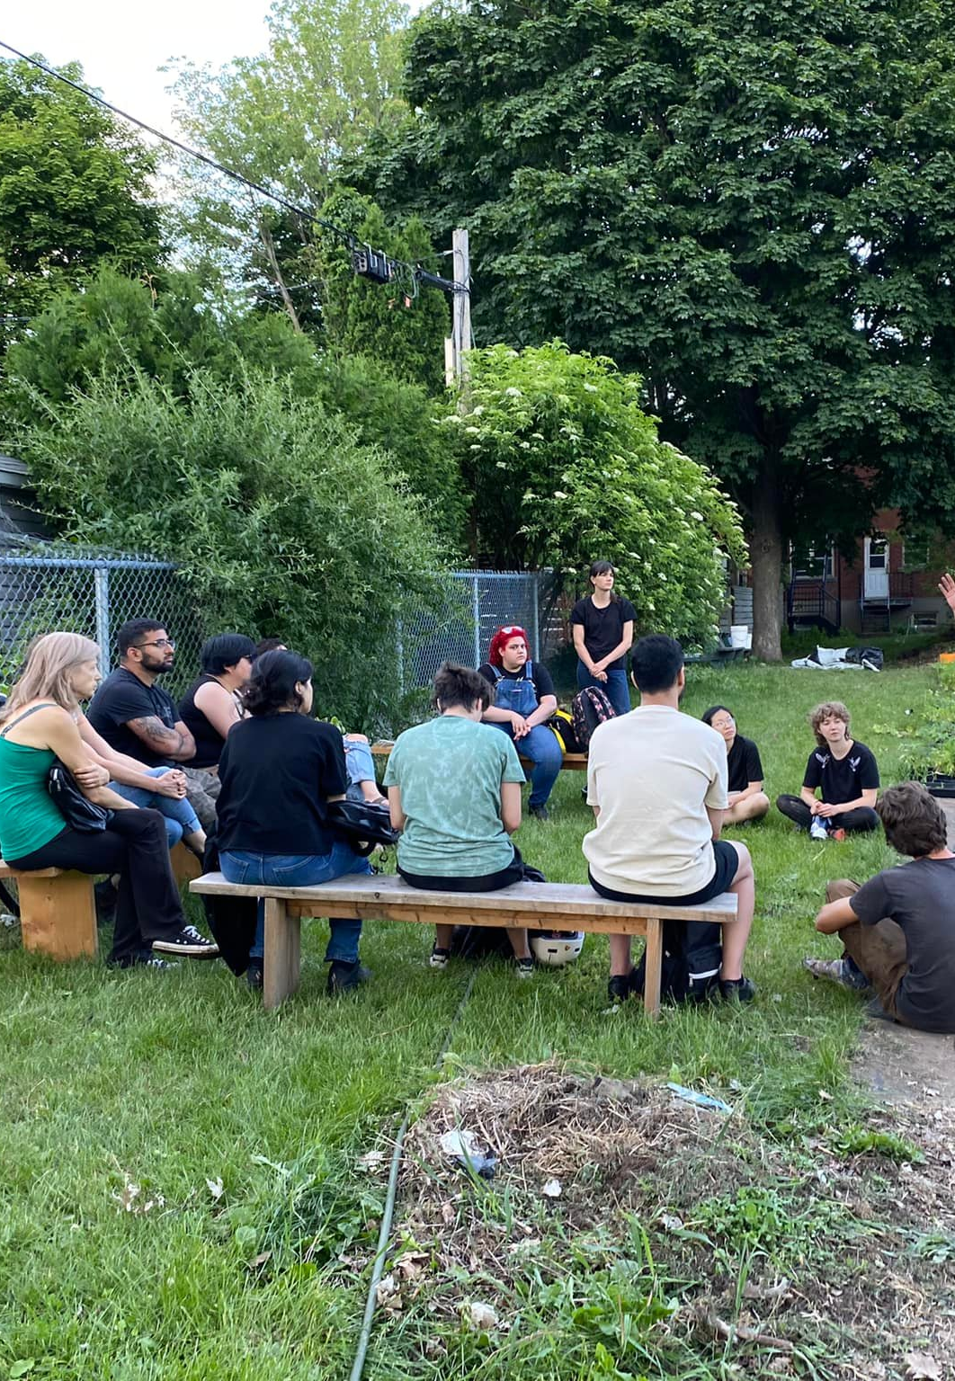

Slide 25
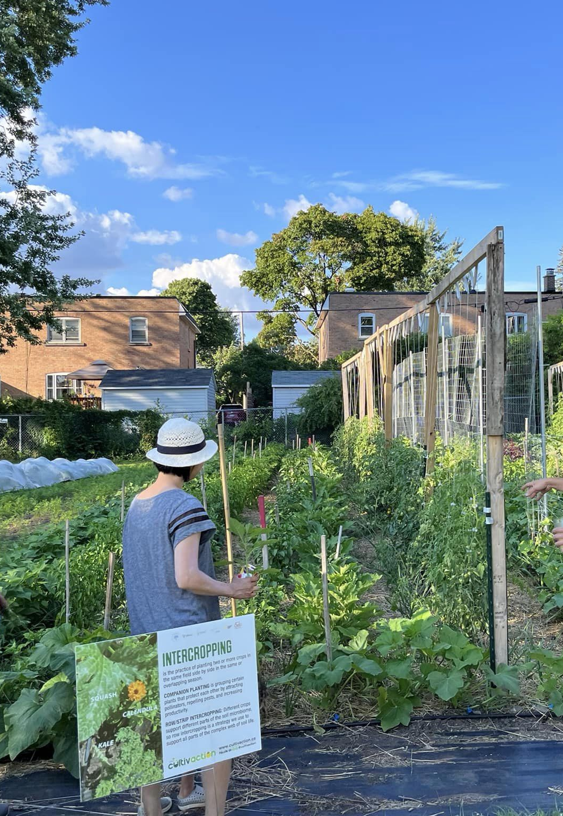

Slide 40
Questions or Concerns?
Thank you!
Register for these Workshops:
Mushroom Growing
Microgreen Growing

