Slide 1
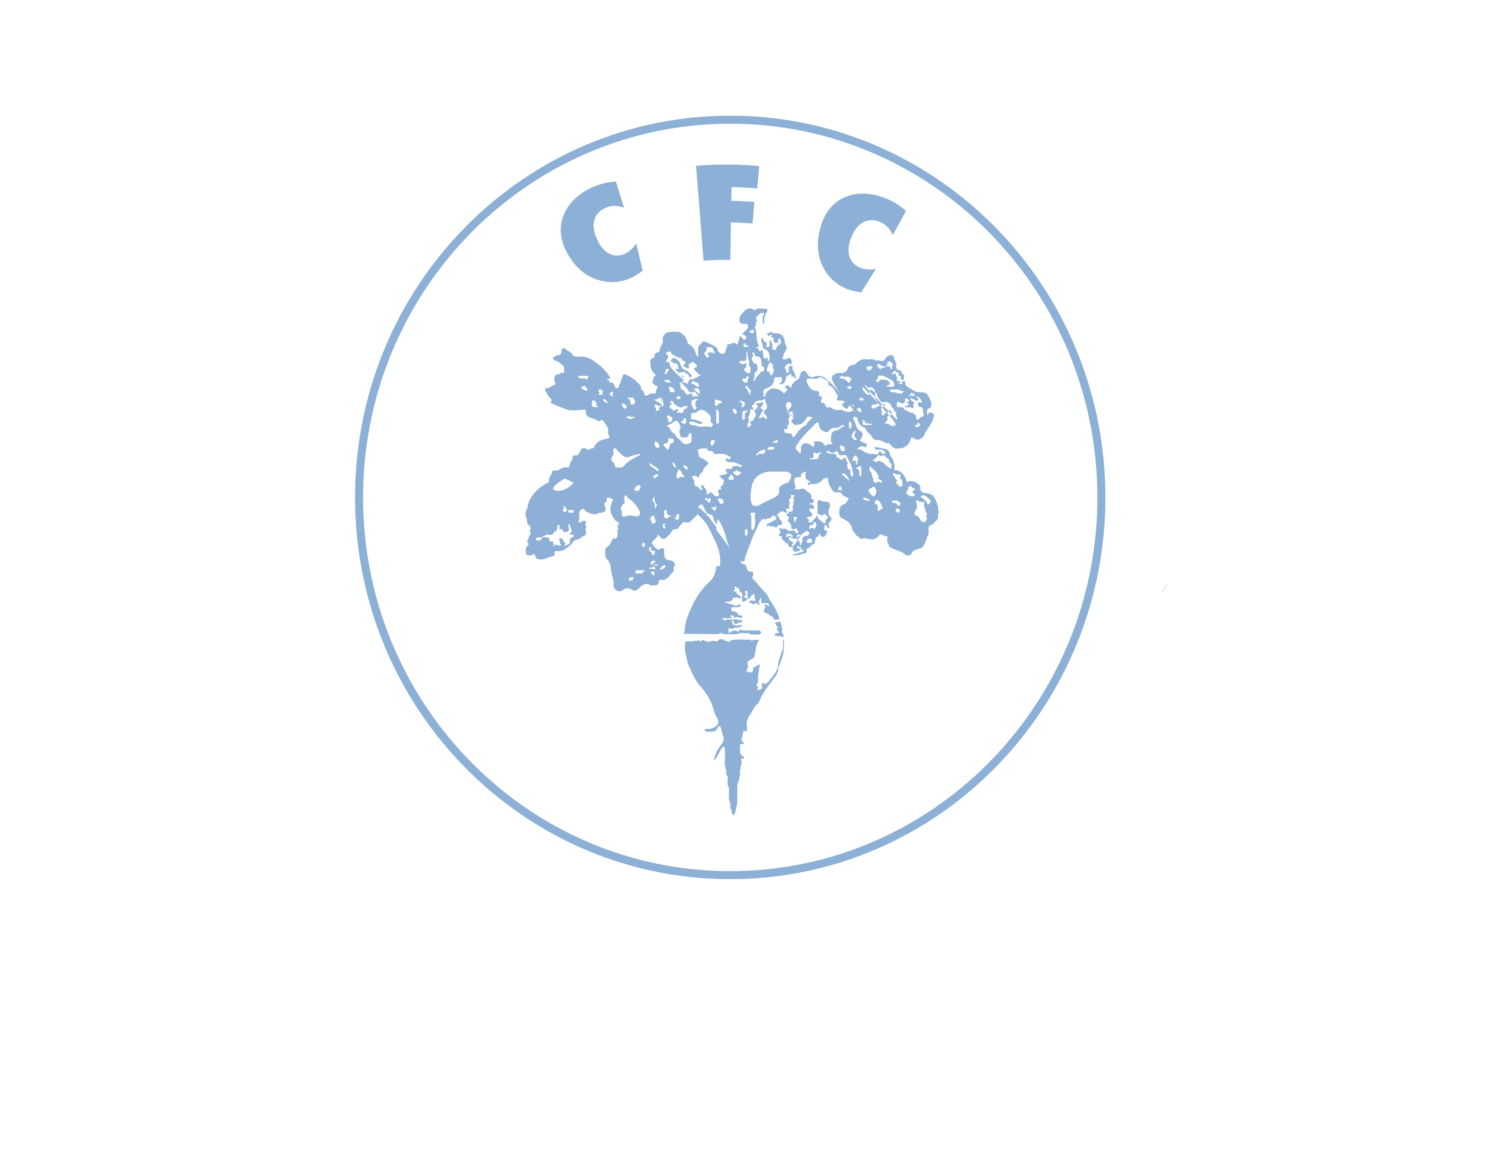
Building Food Sovereign Campuses
Erik Chevrier, Ph.D.
www.erikchevrier.ca
www.concordiafoodcoalition.com

Slide 2
Territorial Acknowledgement
I acknowledge that Concordia University is located on unceded Indigenous lands. The Kanien’kehá:ka Nation is recognized as the custodians of the lands and waters on which we gather today. Tiohtiá:ke/Montreal is historically known as a gathering place for many First Nations. Today, it is home to a diverse population of Indigenous and other peoples. We respect the continued connections with the past, present and future in our ongoing relationships with Indigenous and other peoples within the Montreal community. (Indigenous Directions Leadership Group, Feb. 16, 2017)

Slide 3
Why are Campus-Community Food Systems Important
The global food system is causing social and environmental harm
Most Canadian universities hire large multinational corporations that contribute to these harms
Universities can act as transition sites to create socially and environmentally just community-campus food systems
We need to go beyond notions of sustainability and apply food sovereignty frameworks

Slide 4
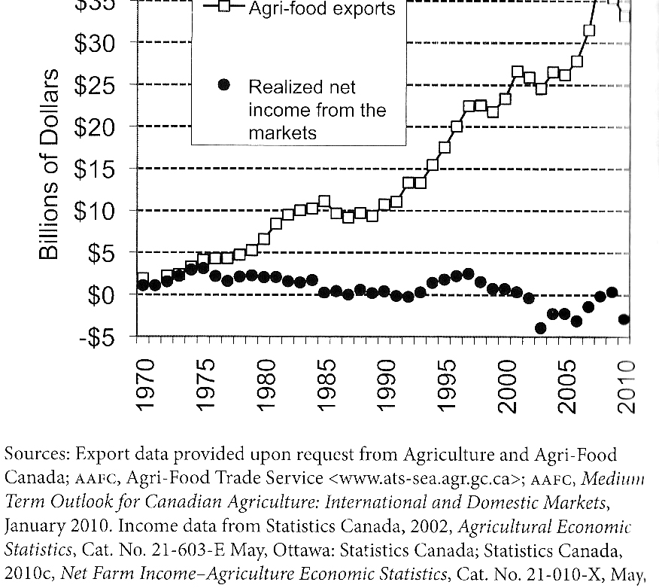
The Global Food System is Not Economically Viable
Qualman, D. (2011) Advancing Agriculture by Destroying Farms? The State of Agriculture in Canada, pp. 20 – 42. In, Wittman, H., Desmarais, A. A., & Wiebe, N. (2011) Food Sovereignty in Canada: Creating Just and Sustainable Food Systems, Fernwood Publishing

Slide 5
Corporate Concentration of the Agrochemical Market
The Global Food System Becoming Increasingly Concentrated

Slide 6
The Global Food System is Rooted in War, Death and Destruction
Monsanto still uses chemicals that were used to kill people, but in our food
Monsanto Ghostwriting Academic Papers
Is Round-Up safe to drink?
Farmer won lawsuit against Monsanto – Glyphosate causes cancer
The World According to Monsanto
Monsanto is now owned by Bayer who used to be part of I.G. Farben, manufacturing poisonous gas (Zyklon B) for concentration camps during the World War.
BASF was also part of IG Farben a company who worked with the Nazis and tested chemicals and drugs on people including Zyklon B
Dow Chemical Invented Agent Orange
Dow Chemical now owns Union Carbide who was responsible for a large devastating explosion in Bhopal, India:
The Bhopal disaster: Toxic legacy
One Night in Bhopal
The Bhopal Disaster

Slide 7
Harms of the Global Food System
Food insecurity – there are over 800 million people starving in the world today! Lack of food sovereignty – peasants and farmers are being affected by trade agreements and food dumping! Herbicides – glyphosates are being identified as cancer causing! GMOs and privatization – restricted access! Cost on farmers – family farms are not sustainable! Reduction of biodiversity – we are destroying nature! Unwanted genetics spreading onto non-GMO farms – lawsuits! Loss of Indigenous farming methods – on stolen land! Soil arability – we are killing our soil! Pesticides kill pollinators – fruits need bees! Creating dead zones in waterways – we are polluting our water! Corporate concentration of agribusinesses – former war companies are now food chemical companies! Health – our food contains toxins! Carbon intensive practices – agroecology and permaculture methods can sequester carbons! Structural racism, colonialism and patriarchy – glaring systemic issues! Rising cost of seed and chemicals – we don’t need to buy seeds! Research funding being directed to GMOs instead of traditional breeding methods – ‘science’ is not only about GMOs! Pest and weed resistance to Bt crops and glyphosate! There are so many more critiques!

Slide 8
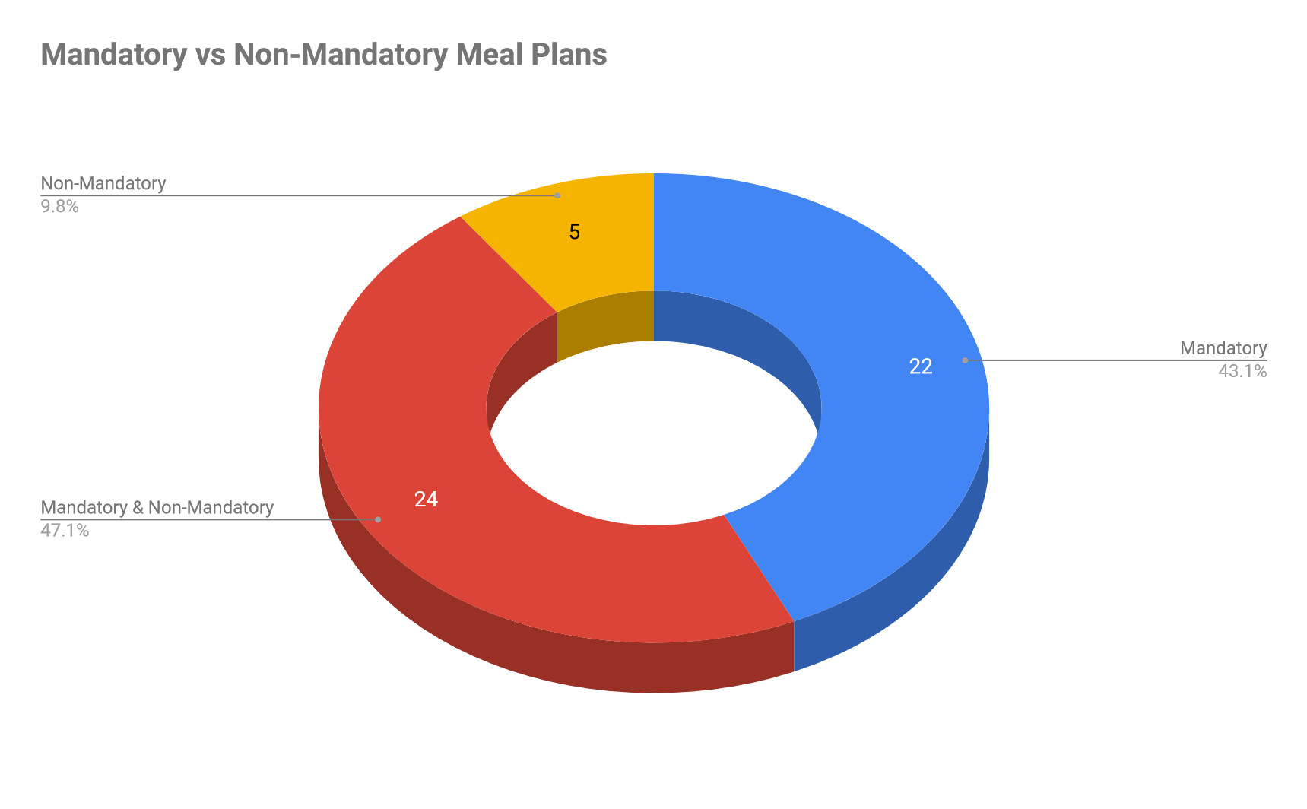
Canadian University Foodservices

Slide 9
What’s Wrong With Aramark, Chartwells, Sodexo?
Sodexo owns private prisons
Business comes from ‘captive markets’
Issues with food quality
Issues with labour conditions
Contribute to unsustainable global food practices
Profits derive from cost externalization (social and environmental)
Aramark is responsible for causing the largest prison strike in the USA because of the conditions of their food

Slide 10
Universities Can Act as Transition Sites to Transform Community Foodscapes
Teaching and Research
Universities create opportunities for experiential learning and participatory-action research, which in return, can be useful in developing better food practices on campus and in the community (Andree, Kepkiewicz, Levkoe, Brynne, & Kneen, 2016; Levkoe, et al., 2016).
Universities bring together professors, researchers, resources, funding, space, and other assets, making them ideal places to ‘experiment’ with food practices (Barlett, 2011)
Duty to Enhance Communities
Pothukuchi and Molnar (2015) and Pothukuchi (2012) argue that universities have a responsibility to foster democratic and social justice, especially in enhancing inner-city food projects.

Slide 11
Why Food Sovereignty Frameworks for University Food Services?
At the World Food Summit in 1996, La Via Campesina declared that "Food sovereignty is a precondition for food security". (Via Campesina 1996 cited in Patel, 2009)
I argue that developing a food sovereign campus is a precondition for offering 'truly' sustainable university food services.
Food sovereignty is a transformative movement, while sustainability refers to a vast spectrum of corporate, reformist, transitional and transformative approaches. Sustainability is also frequently used to purposefully disguise harmful business practices – this is known as greenwashing.
Despite Canadian Universities committing to be sustainable, none have achieved transformative, holistic, in-depth sustainability (Bieler and McKenzie, 2017)
Although most research about university foodservices focuses on reforming multinational foodservice corporations, new researchers are focusing on transformative approaches (Bohunicky, Desmarais and Entz, 2019)

Slide 12
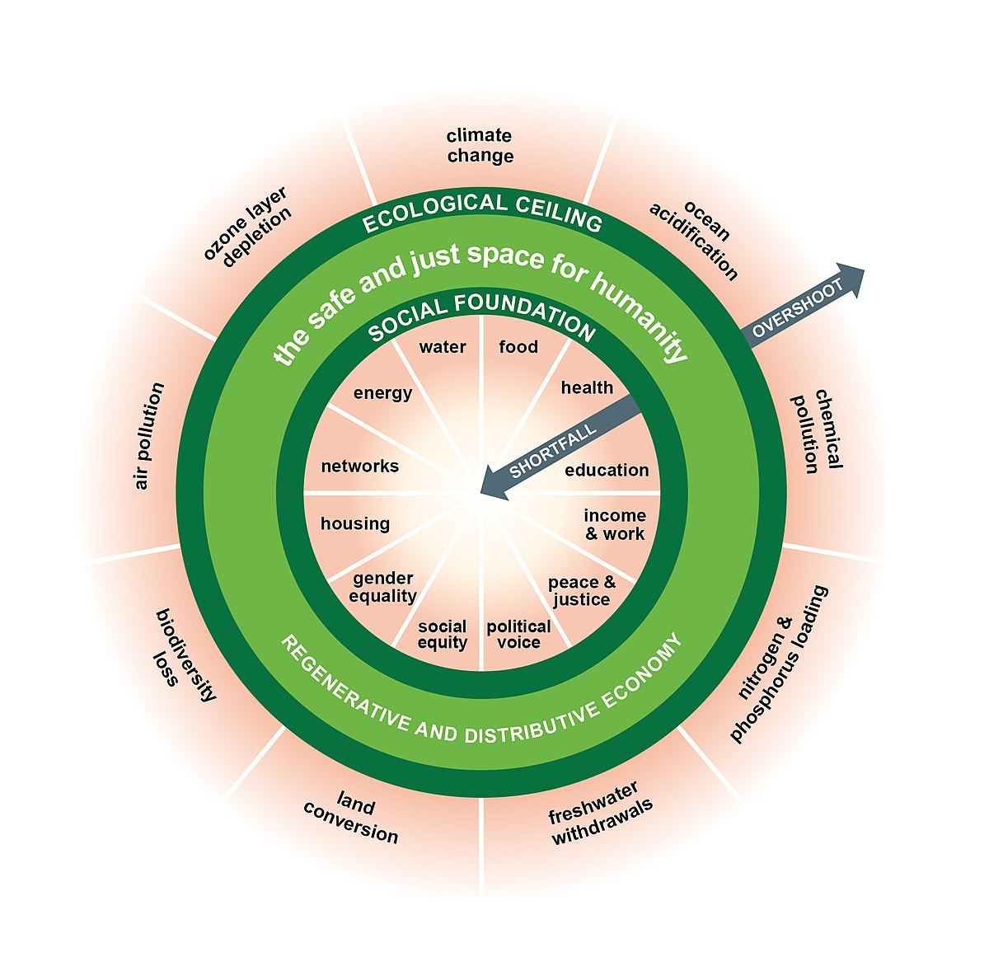
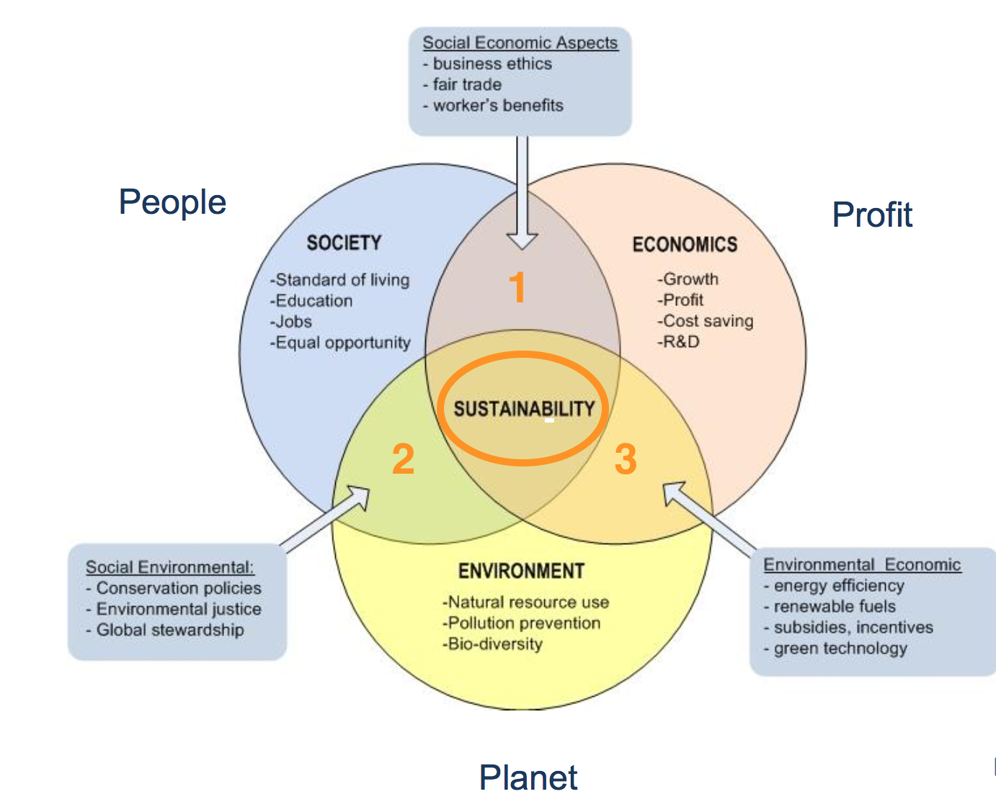
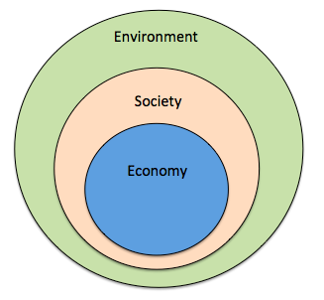
From Sustainability to Food Sovereignty
Triple Bottom Line
Nested Model
Doughnut Model

Slide 13
What is Food Sovereignty?
Food sovereignty is a multidimensional concept that refers to a process, an outcome and comparative framework
Process – it describes a movement, a struggle, a democratic process perpetually in negotiation and always in motion.
Outcomes – agreed upon declarations of rights, codes of ethics and guiding principles. These declarations are debated at conferences, meetings, and public forums and carried out by the parties (who agree with the declarations) in local communities, i.e. Nyéléni Declaration 2007
Comparative frameworks – food regimes scholars have created frameworks to compare corporate, reformist, food justice and food sovereignty regimes.
Food sovereignty refers to:
the rights of nations and people to control their own food economy – to decide how food is produced, consumed, processed, and distributed.
a paradigm, trend, framework, discourse, regime and model. It is the most radical food movement discourse and rivals the corporate neoliberal food system.
a right to food that is of quality, healthy, and culturally appropriate
recognition and respect of women’s role in food production
social justice
environmental sustainability
recognition and respect for traditional knowledge and Indigenous Peoples
agrarian reform including collective land rights and protection of Indigenous Peoples’ Lands
‘re-commoning’ land and right to defend land from transnational corporations
against trade liberation

Slide 14
Food Regimes (Wittman, 2011)

Slide 15
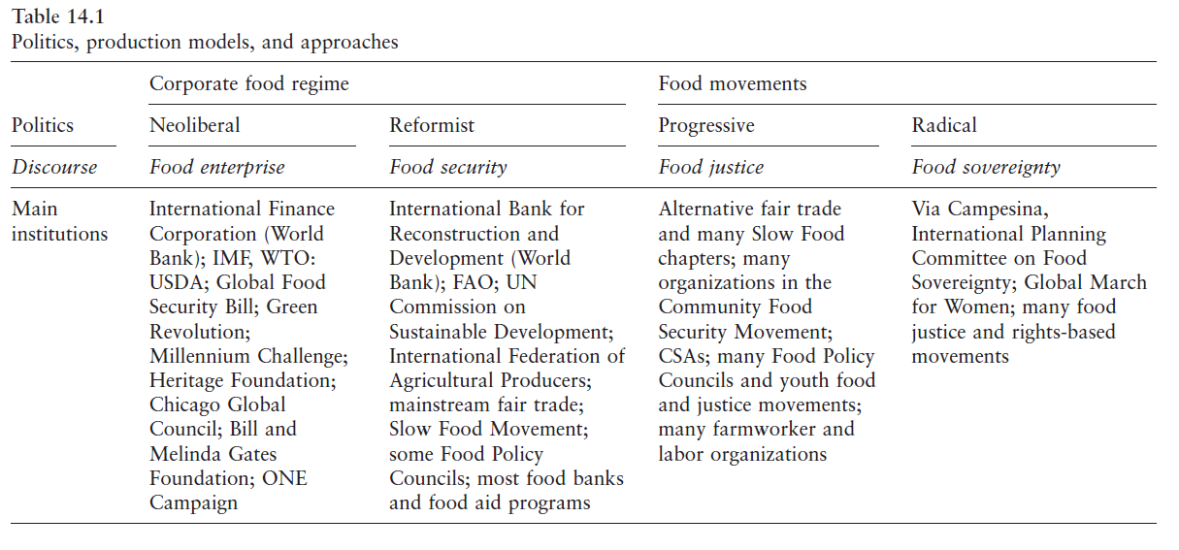
Food Regimes Framework Holt-Giménez and Shattuck (2011)

Slide 16
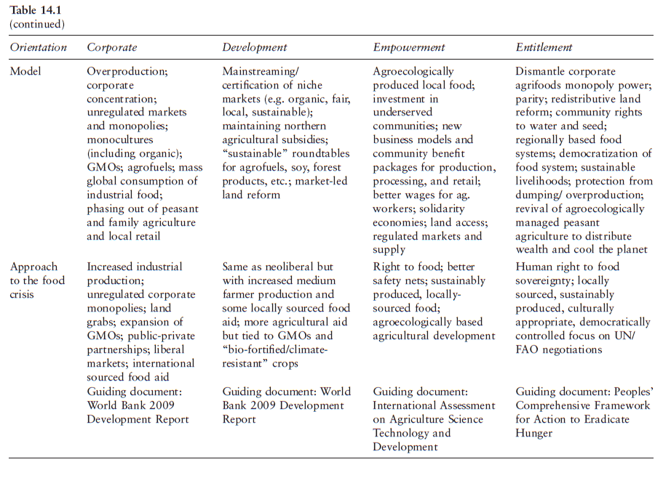
Food Regimes Framework Holt-Giménez and Shattuck (2011)

Slide 17
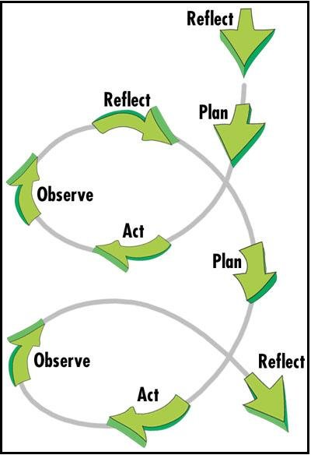
Concordia Campus-Community Food Groups Research Project
Methods
Ongoing project
Approach
Critical-participatory-action-research
Three phases
Gather information
Produce multimedia content
Hold public conversations about our findings and create an action plan

Slide 18
Research Questions
Mapping
What campus-community food organizations exist at Concordia as of 2018?
What factors facilitated and hindered the development and viability of the campus-community food system at Concordia University.
How does the Concordia campus-community food system contribute to understanding how to build food sovereign campuses?
Historical Analysis
How did the Concordia campus-community food organizations come into existence?
What factors that prevented food activists from replacing multinational foodservice corporations with a local, ethical, social enterprise?
What does the history of the campus-community food system contribute to understanding how to build food sovereign campuses?
Public Discussion
What can we learn from the campus-community organizations about building a food sovereign campus?
Food Sovereignty Framework
How could previous literature and the case-study of the campus-community food groups help construct a framework for building food sovereign campuses?

Slide 19
Concordia Campus-Community Food Groups Map

Slide 20
Facilitating the Creation and Perpetuation of the Campus-Community Food System
Student activism
Community service learning and community-campus engagement
Fee levies
Robust support system

Slide 21
Impeding the Development and Viability of the Campus-Community Food System
Challenging fee levies
Processing limitations
Gap between production and processing
Students graduate and move on
Some students lacked expertise
Relying on volunteers was not always viable
No agriculture schools or food studies program
Not always easy to negotiate with the Concordia administration
Large foodservice providers
Alternatives not always viable

Slide 22
Reasons Why Student Activists Were Not Successful in Preventing Multinational Foodservice Corporations
Administration
Risk aversion
Viability of foodservice operations
Corporate model of university foodservices
View of sustainability
Request for proposal process
Students
Anti-activists
Conflict amongst activists
Student turnover & lack of experience
Faculty
Lack of engagement
Multinational Corporations
Skewed competition

Slide 23
Key Findings
Food sovereignty can describe the social justice outcomes on campus, like policies, organizational procedures (reflected through by-laws and constitutions), bans on harmful practices (i.e. selling bottled water), among others.
Campus food sovereignty is an ongoing process of negotiating with others who are actively trying to transform the food system.
Food sovereignty is not a reformist movement, it is transformational.
A food sovereign campus is controlled by students, faculty, the Concordia community and community at large and should create positive value to these constituencies.
A food sovereign campus does not force students onto a meal plan so that large multinational corporations, and universities (through a profit and loss model) can receive financial returns.
Food sovereign campuses are made up of social enterprises that practice an array of diverse economy practices.
A food sovereign campus is more radical than corporate and weak sustainability approaches and can be differentiated through the framework provided in this thesis.
Even though food sovereignty is hard to define and apply to university campuses, sustainability is equally confusing and often used to uphold unsustainable practices.

Slide 25
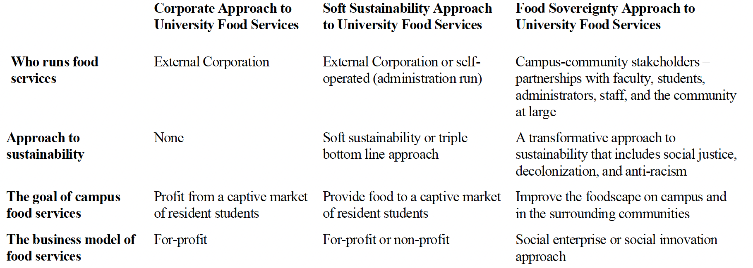

Slide 26
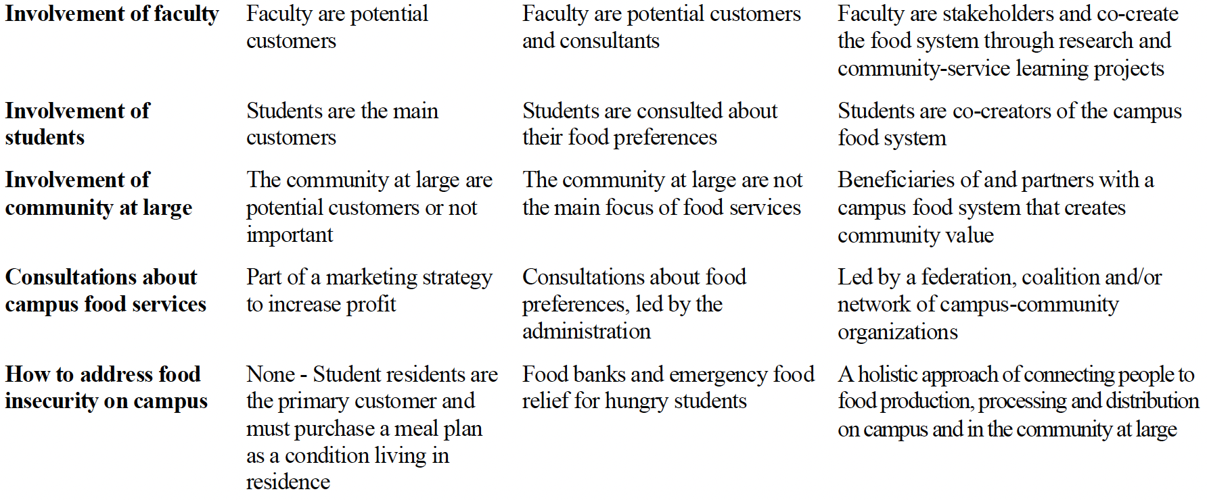

Slide 27
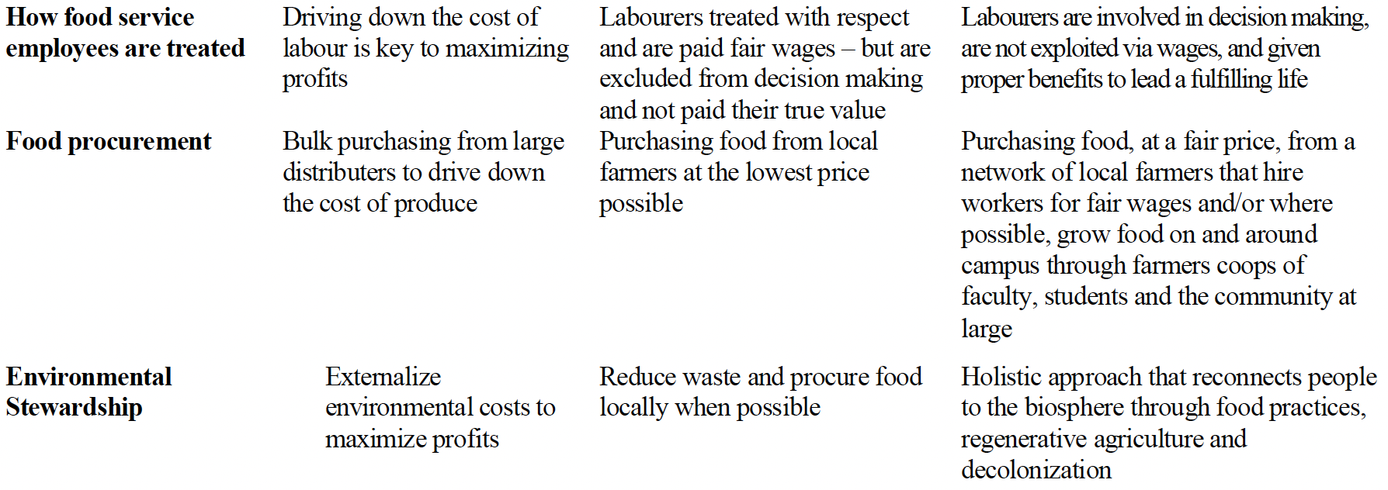

Slide 28
Starting Points for Developing Food Sovereign Campuses?
Students
Develop an alternative campus-community food system
Challenge oppressive campus food practices
Create food coalitions and food groups assemblies
Set conditions (like the Nyéléni declaration)
Faculty
Practice critical-participatory-action research and involve campus-community food organizations
Assign community-service learning, community-campus engagement and community-based learning projects
Direct research funds and other resources towards campus-community food systems
Administration
Adopt a food sovereignty approach (instead of soft-sustainability and/or corporate approach) to campus foodservices
Do not force students in residence to purchase a meal plan
Build or hire a social economy-based foodservice provider

Slide 29
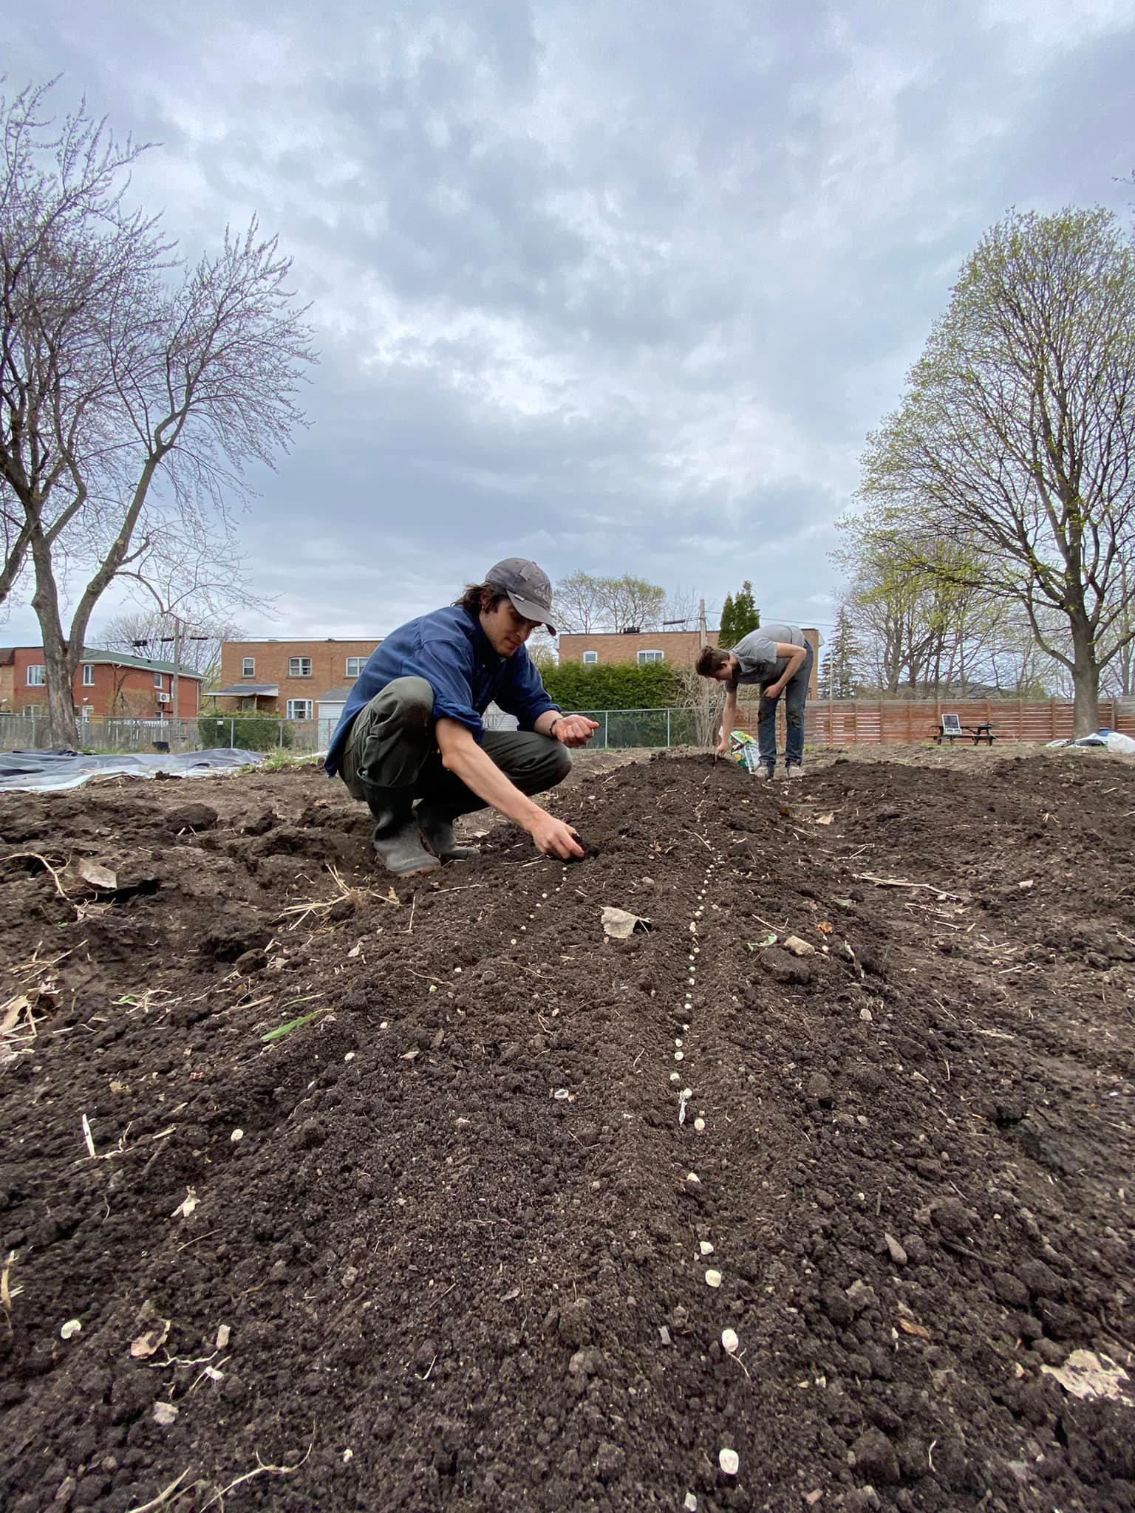

Slide 30
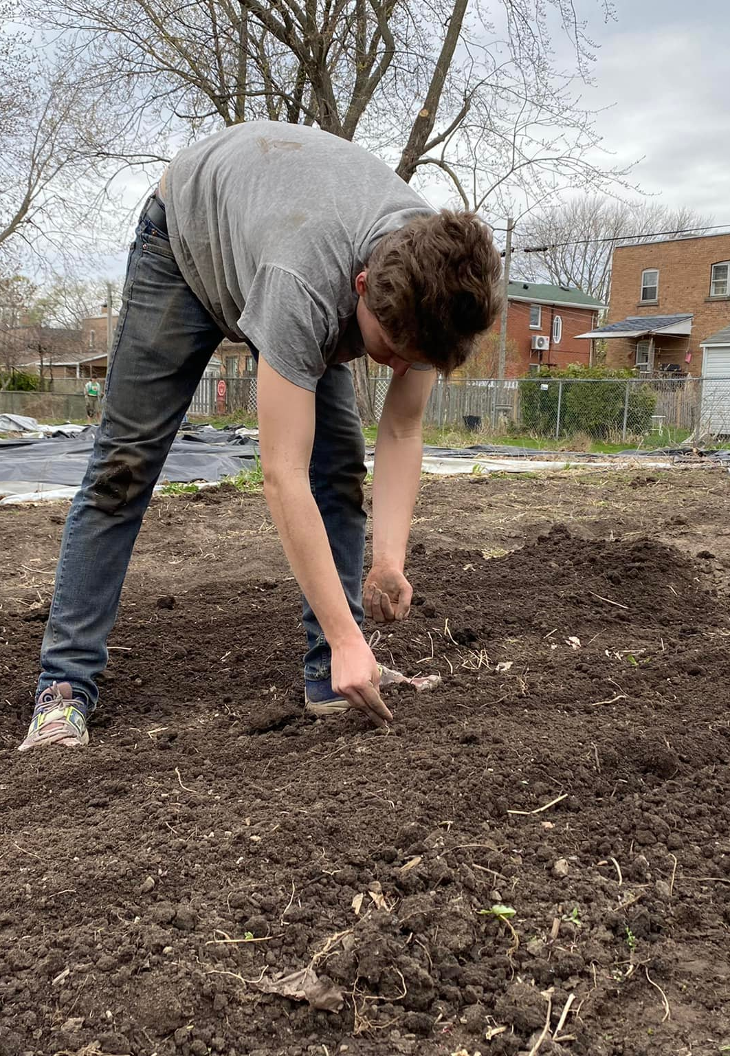
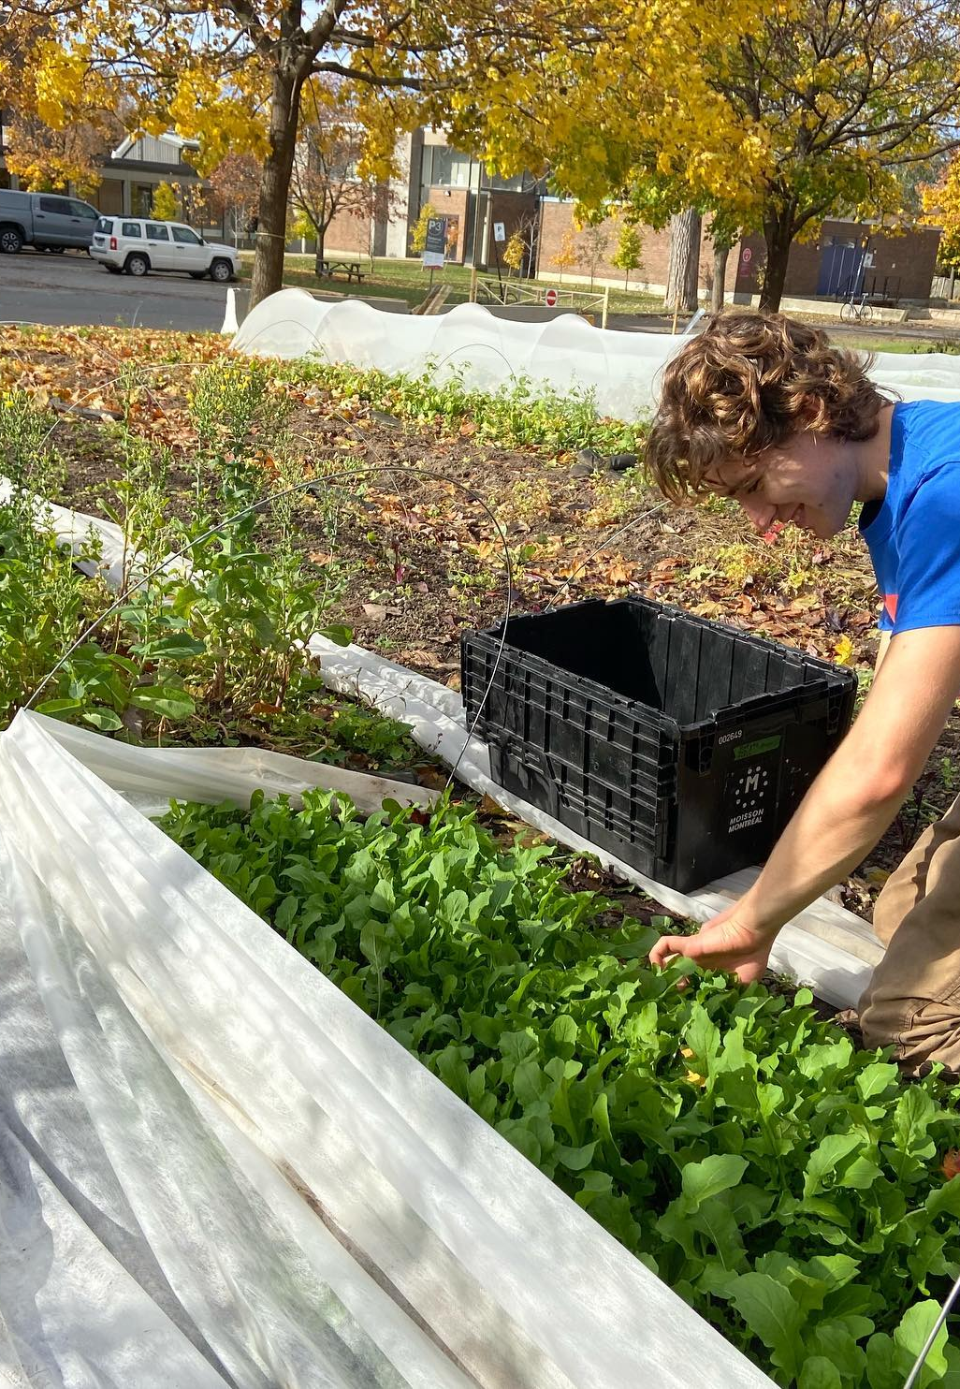

Slide 31
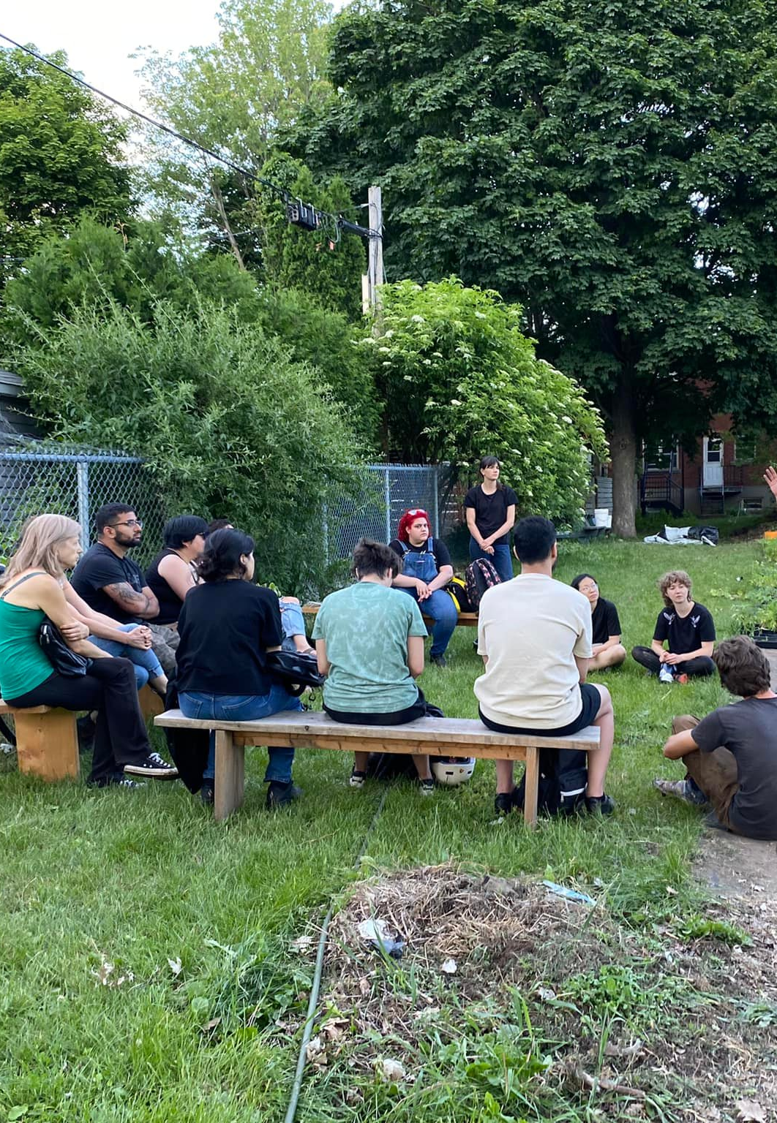

Slide 32
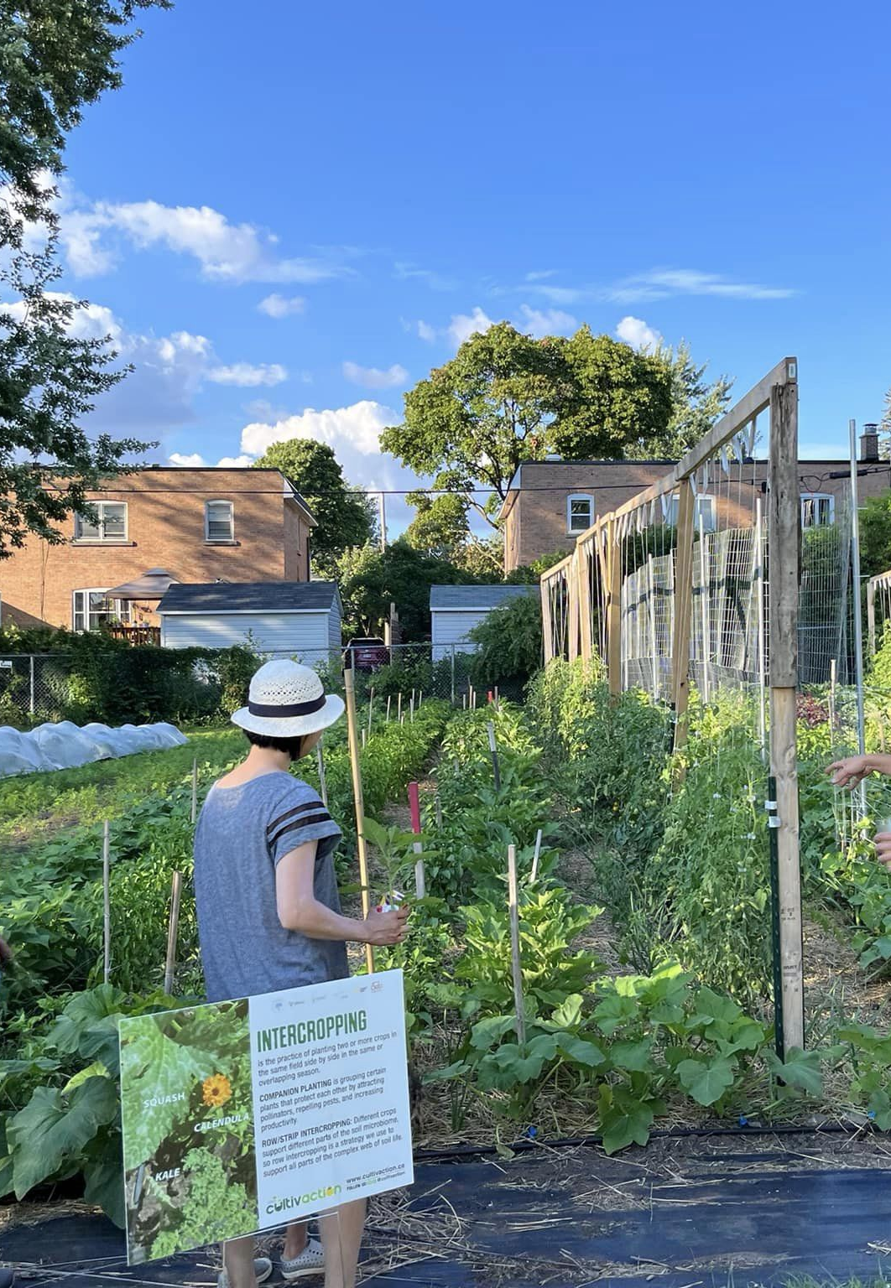

Slide 47
Thank you!
Questions, concerns?

