Slide 1
Building Food Sovereign Communities
Erik Chevrier
Building Ethical Economies

Slide 2
Is The Food System Broken?
Calls to “fix a broken food system” assume that the capitalist food system used to work well. This assumption ignores the food systems long, racialized history of mistreatment of people of colour. The food system is unjust and unsustainable, but it is not broken. It functions precisely as the capitalist food system has always worked, concentrating power in the hands of the privileged minority and passing off the social and environmental “externalities” disproportionately to racially stigmatized groups. (Holt-Gimenez, 2017, p. 160)
How we produce and consume determines how our society is organized, but how we organize socially and politically can also determine how we produce and consume. The implications of this are profound: our food systems are vessels of unmatched social and economic power and pivotal sites for systemic transformation. (Holt-Gimenez, 2017, p. 214)
Holt-Gimenez, E. (2017) A Foodie’s Guide to Capitalism: Understanding the Political Economy of What We Eat, Monthly Review Press, New York.

Slide 3
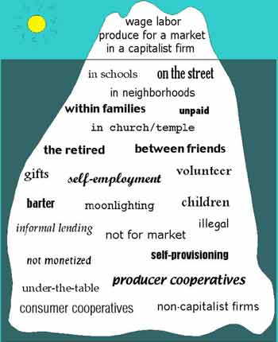
What is an Economy? Gibson-Graham, J.K., Cameron, J., Healy, S. (2013) Take Back the Economy: An Ethical Guide for Transforming Communities, University of Minnesota Press
Katherine Gibson Interview Playlist

Slide 4
Take back the Economy Gibson Graham Gibson-Graham, J.K., Cameron, J., Healy, S. (2013) Take Back the Economy: An Ethical Guide for Transforming Communities, University of Minnesota Press

Slide 5
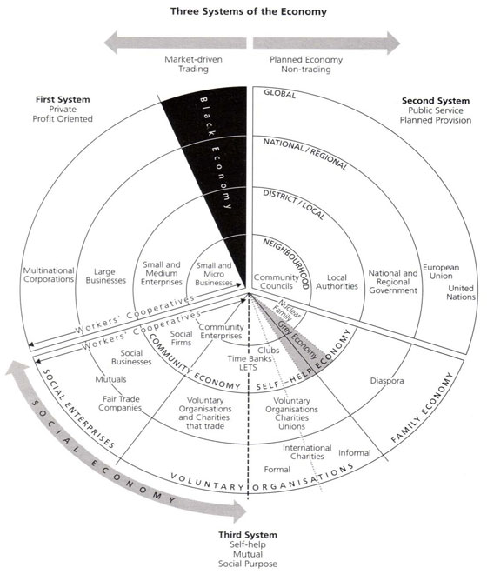
Three Systems of an Economy Pearce, J. (2009) Social Economy: Engaging as a Third System, In Amin, A. The Social Economy; International Perspectives on Economic Solidarity, p. 26.

Slide 6
Types of Urban Agriculture
For-Profit
Not-For Profit
Subsistence Farms
Cooperatives
Hobby Farms
Squat Gardens
Edible Foraging
Community Gathering Places
Edible Landscapes

Slide 7
Market Farm Practices
Direct sales
CSA
Farmers market
Other markets
Wholesale
Distributers
Restaurants
Other sales
Transformed goods
Compost and other values
Education
Contradictions
Labour vs food price
Soil regeneration time vs market readiness
Growing time vs productivity
Food donations vs sales
Farmers markets vs increased labour
Food waste!
Market Secrets
Cash crops
Reduce inputs
Reduce labour necessities
Holistic approach

Slide 8
Non-Market Farm Practices
Volunteer labour
Community involvement
Foraging
Soil building
Incorporating animals
Funding sources
Contradictions
Free labour vs viability
Free food vs revenue
Community involvement vs community interest
Soil building vs time
Animals vs care
Funding sources vs stability
Non-Market Secrets
Sweat equity
Stable funding
Improved community space
Building a sense of community

Slide 9
Alternative Market Farm Practices
Cooperative ownership
Different types of membership
Hybrid of markets and non markets
Ethical principles (social economy)
Fair treatment of employees
Rooted in community
Market viability and non-market advantages
Contradictions
Community value vs profit
Volunteers and paid workers
Markets vs donations
Internal conflicts
Alternative Market Secrets
Community support
Can take positive elements of both
More resilient to market failures
Provides community benefits

Slide 10
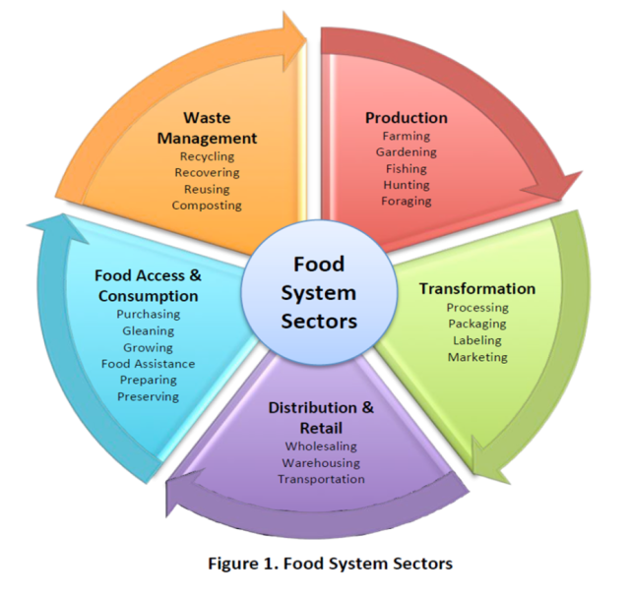

Slide 11
Mapping Community Food Systems
PRODUCTION | PROCESSING | DISTRIBUTION | WASTE MANAGEMENT | SUPPORT
Food | Cook | Market | Compost - Soil Building | Funding
Tools | Prepare | Redistribution | Water saving - Irrigation | Space
Knowledge | Ferment | Reciprocity | Seed Saving - Seed Sewing | Labour
Social Capital | Preserve | Self/community provisioning | Re-purpose food
 | Transform
 | Freeze/store
 | Dehydrate
 | Can

Slide 13
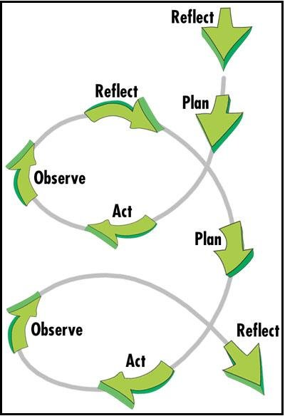
Building Food Sovereignty Through Action Research
Concordia Food Groups Project
Lachine Food System

Slide 14
Questions?
Have a great day!

