Slide 1
Social Economy of Sustainable Futures
Erik Chevrier
September 7, 2023

Slide 2
Introduction
What is your name?
What is something interesting about you?
What do you expect to get out of this course?
Why did you take this course?
What is your level of experience with topics related to ‘social economy and sustainable futures’?
What is your interest level in topics related to ‘social economy and sustainable futures’?
What specific topics are you interested you most? What topics interest you least?

Slide 3
Question?
What is an economy?
What is capitalism?
What are classical, neo-classical and neo-liberal economics?
What is Marxism?
What is a social economy? What are examples of social economies?
What are externalities? Why are they important to social economies and sustainable futures?
What practices are performed in an economy?
What problems exist with the way the global economy functions?
What is ‘value’? How do economists understand value? What types of value are there? How can we compare value?
What is ecological economics and how does it differentiate from traditional economics?

Slide 4
Aristotle Aristotle. Aristotle in 23 Volumes, Vol. 21, translated by H. Rackham. Cambridge, MA, Harvard University Press; London, William Heinemann Ltd. 1944.
Chrematistics – art of acquisition – limitless accumulation unnatural and problematic
Oikonomia – management of the household – true form of an economy

Slide 5
Karl PolanyiPolanyi, K. (2001) The Great Transformation; The Political and Economic Origins of Our Time, Beacon Press
Types of economic practices:
Markets (exchange)
Household economy
Redistribution
Reciprocity

Slide 6
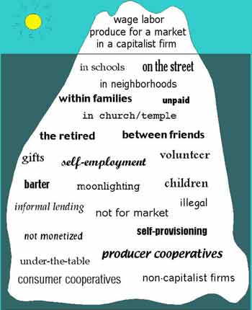
Gibson Graham – Take back the Economy Gibson-Graham, J.K., Cameron, J., Healy, S. (2013) Take Back the Economy: An Ethical Guide for Transforming Communities, University of Minnesota Press
Katherine Gibson Interview Playlist

Slide 7
Gibson Graham – Take back the Economy Gibson-Graham, J.K., Cameron, J., Healy, S. (2013) Take Back the Economy: An Ethical Guide for Transforming Communities, University of Minnesota Press

Slide 8
Envisioning Real Utopias – Erik Olin Wright Olin Wright, E. (2010) Envisioning Real Utopias, Verso

Slide 9
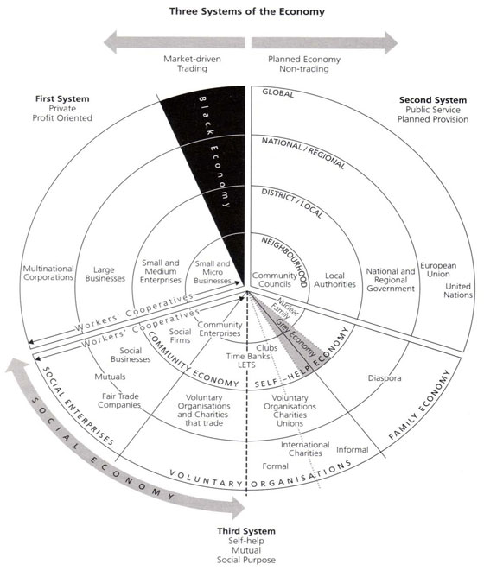
Three Systems of an Economy – John Pierce Pearce, J. (2009) Social Economy: Engaging as a Third System, In Amin, A. The Social Economy; International Perspectives on Economic Solidarity, p. 26.

Slide 10
Question?
What does sustainability mean?
What does it mean to be sustainable?
What is strong sustainability?
What is weak sustainability?

Slide 11
What does it Mean to be Sustainable?
The term sustainability has lost meaning because it has been used for corporate/political greenwashing.
We need to refocus the conversation on what we are sustaining.
Sustainability refers to the perpetuation of something…the something is the important factor!
Sustainability is an adjective/modifier (Sumner refers to Shearman 1990)
Sustainability as a modifier points out contradictions (suggests that the status quo is not sustainable)
Instead we should ask:
What social, environmental and political conditions does our economic practices sustain?
Effects can be positive and/or negative
Intended and/or unintended
We can be aware and/or unaware of these effects
Effects can take place on a macro and/or micro level

Slide 12
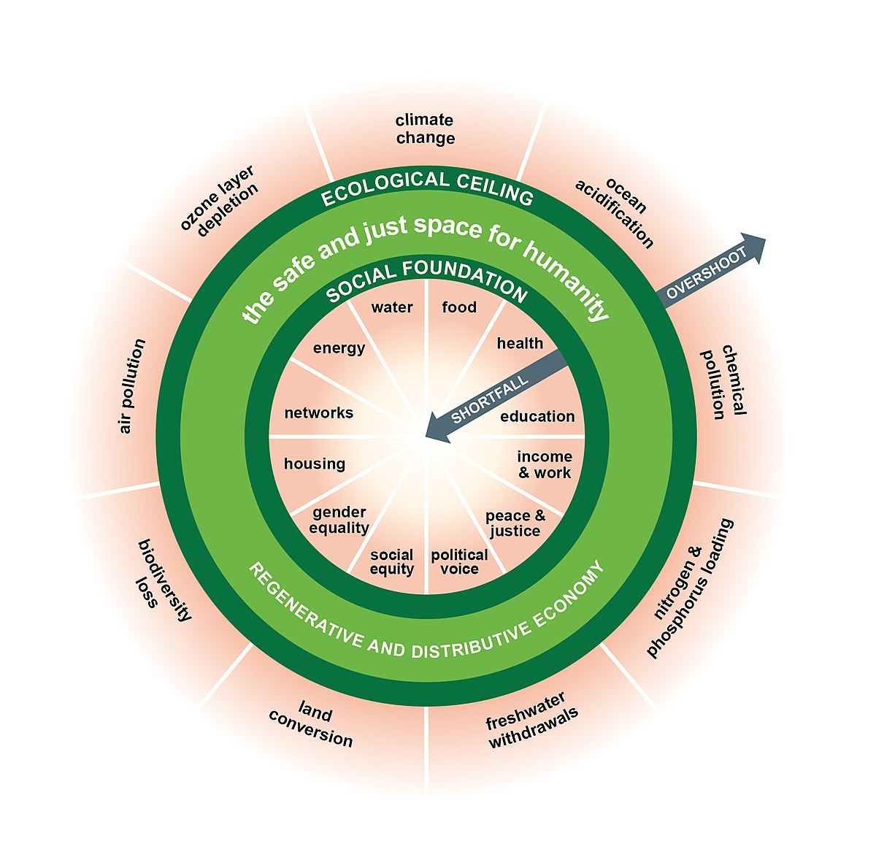
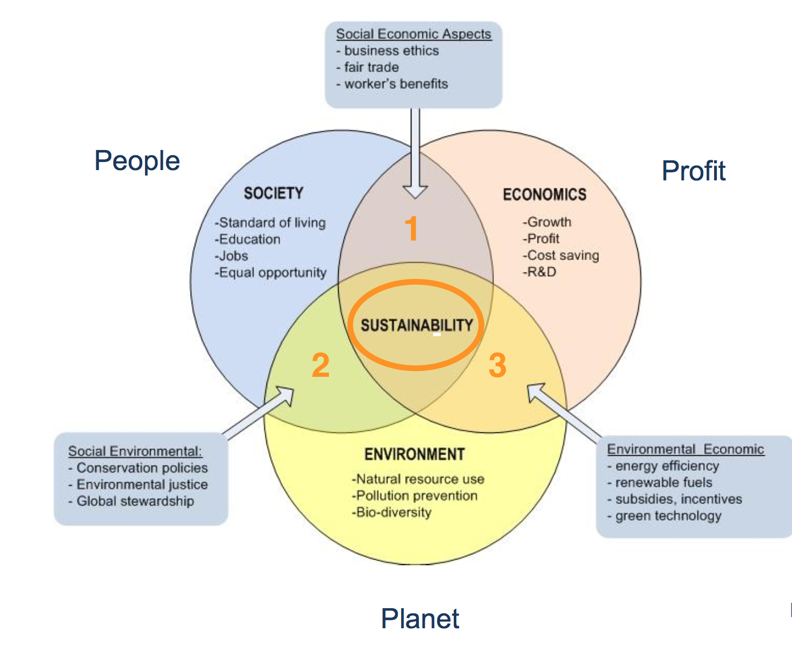
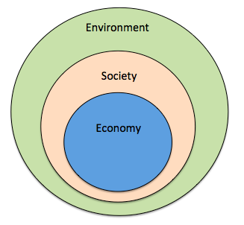
From Sustainability to Food Sovereignty
Triple Bottom Line
Nested Model
Doughnut Model

Slide 13
Questions?
Do you participate in ‘ethical’ economic practices or fight for economic/environmental/social justice?
1 – Cooperative movements
2 – Decolonial movements
3 – Feminist/gender/non-gendered movements
4 – Transformative movements
5 – Solidarity/social economy
6 – Radical social justice movements
7 – Community economies
8 – Other forms?

Slide 14
Feedback About Course
Give your impression:
Readings?
Assignments?
Structure?
Workload?
Grading?
Deadlines?
Content?
Other?

Slide 15
Questions or Concerns?
Thanks!

