Slide 1
Social Economy and Sustainable Futures
Erik Chevrier, Ph.D.
www.erikchevrier.ca

Slide 2
Real Hourly Wages Osberg, L. (2018) The Age of Increasing Inequality – The Astonishing Rise of Canada’s 1%, James Lorimer and Company.

Slide 3
Real vs Market Income Osberg, L. (2018) The Age of Increasing Inequality – The Astonishing Rise of Canada’s 1%, James Lorimer and Company.

Slide 4
Real Income Osberg, L. (2018) The Age of Increasing Inequality – The Astonishing Rise of Canada’s 1%, James Lorimer and Company.

Slide 5
Average Wage Osberg, L. (2018) The Age of Increasing Inequality – The Astonishing Rise of Canada’s 1%, James Lorimer and Company.

Slide 6
Growth Rates of Real Market Incomes Osberg, L. (2018) The Age of Increasing Inequality – The Astonishing Rise of Canada’s 1%, James Lorimer and Company.

Slide 7
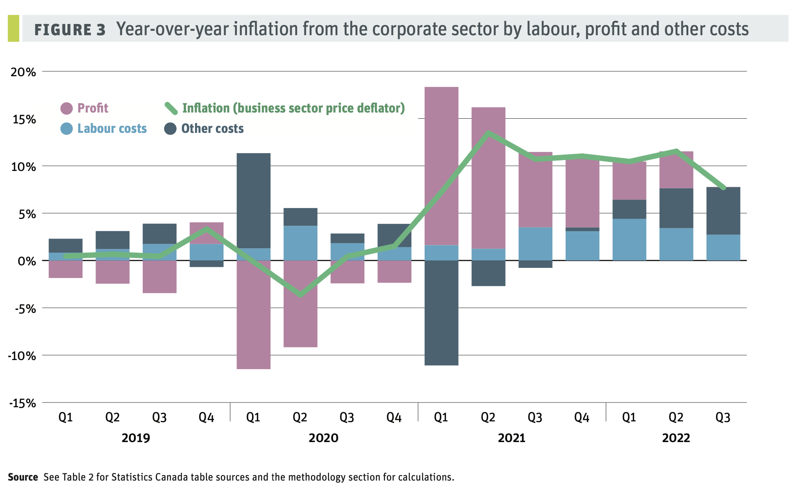
Inflation Since the Pandemic

Slide 8
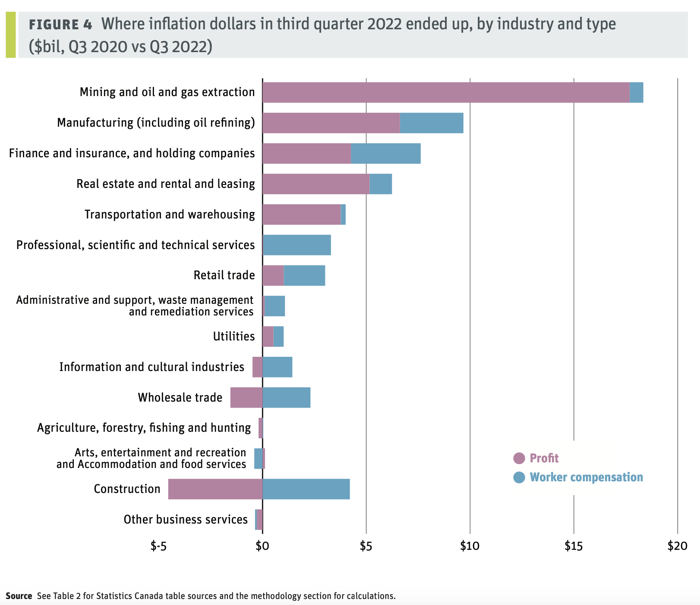

Slide 9
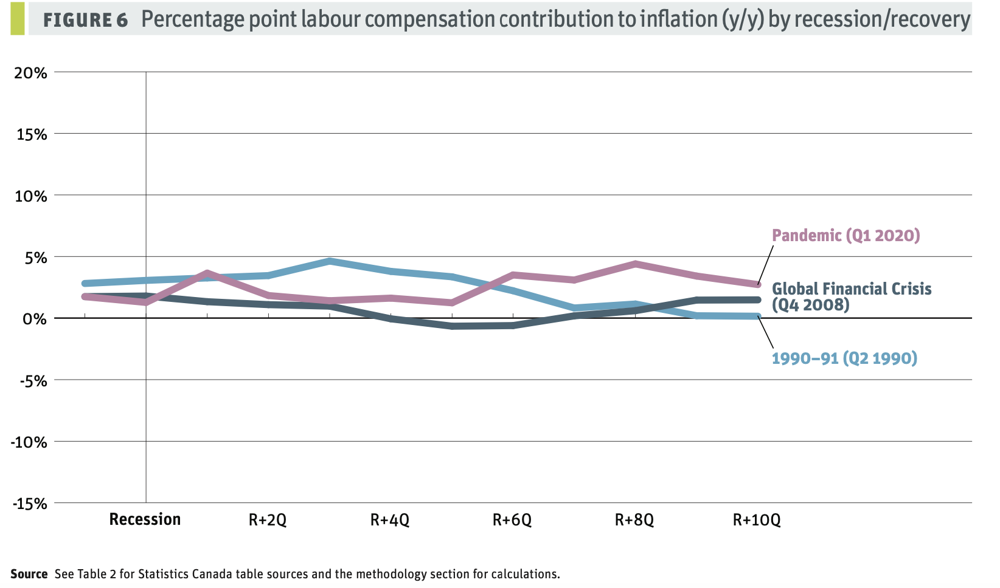
Who is Paying for Recovery?

Slide 10
Food Price Inflation

Slide 11
More Links and Sources
Housing Affordability September 2023
World Inequality
Sources
Where are your inflation dollars going?
Canadian Grocery Profitability: Inflation, Wages and Financialization
Inequality in Canada
Inequality in Canada
Bank Bailouts During Economic Crisis

Slide 12
Videos and Discussion
Crises of Capitalism
Beware, Fellow Plutocrats, the Pitchforks are Coming

