Slide 1
Urban Agriculture
Erik Chevrier

Slide 2
Take back the Economy Gibson-Graham, J.K., Cameron, J., Healy, S. (2013) Take Back the Economy: An Ethical Guide for Transforming Communities, University of Minnesota Press

Slide 3
Mapping Community Food Systems
PRODUCTION | PROCESSING | DISTRIBUTION | WASTE MANAGEMENT | SUPPORT
Food | Cook | Market | Compost - Soil Building | Funding
Tools | Prepare | Redistribution | Water saving - Irrigation | Space
Knowledge | Ferment | Reciprocity | Seed Saving - Seed Sewing | Labour
Social Capital | Preserve | Self/community provisioning | Re-purpose food
 | Transform
 | Freeze/store
 | Dehydrate
 | Can

Slide 5
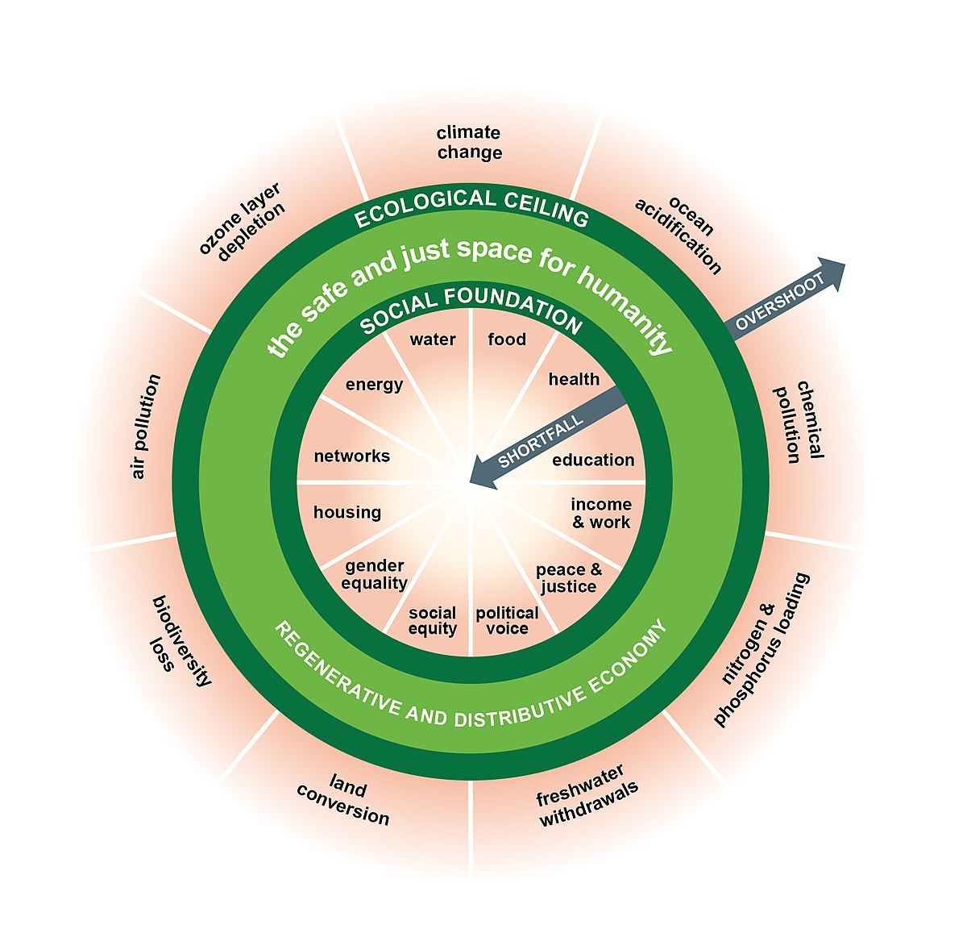
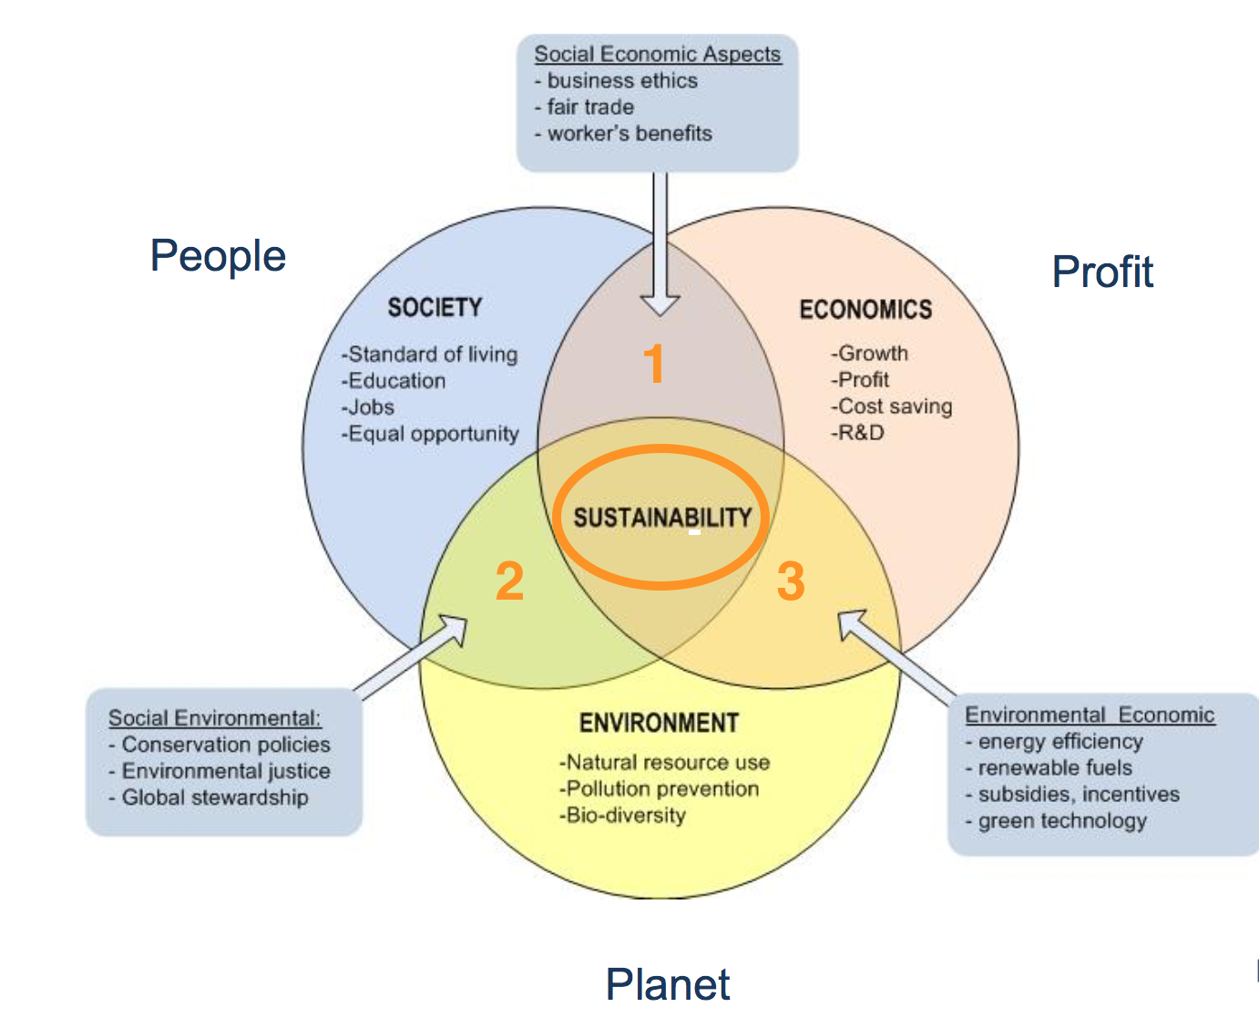
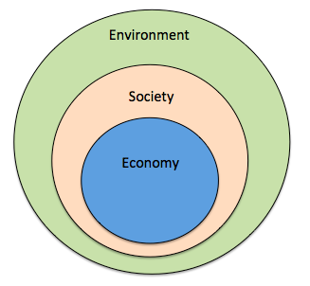
From Sustainability to Food Sovereignty
Triple Bottom Line
Nested Model
Doughnut Model

Slide 6
Plant Hardiness Zones

Slide 8
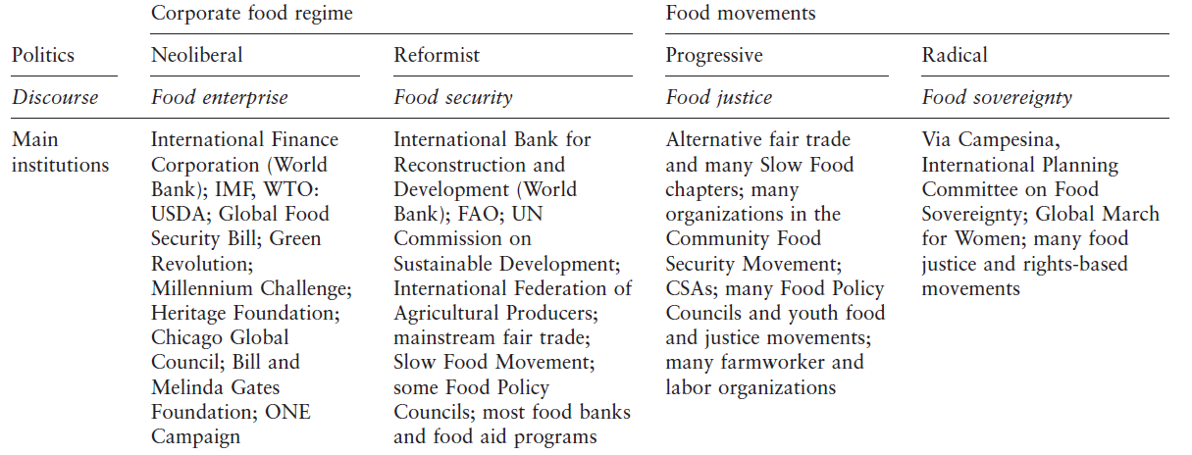

Slide 9
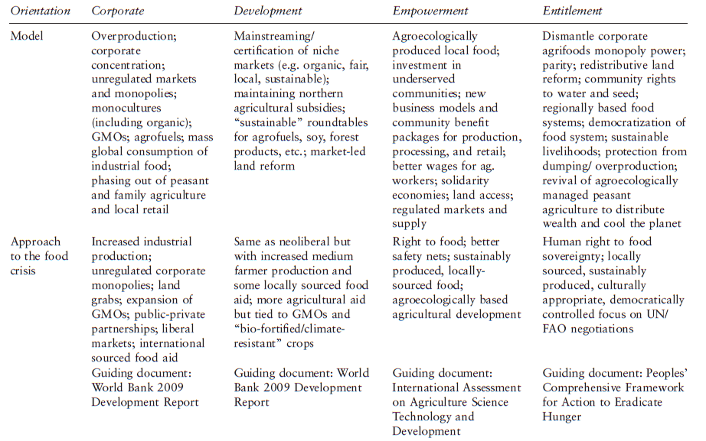

Slide 10
Questions?
Have a great day!

