Slide 1
Urban Agriculture
Food systems and cycles
www.erikchevrier.ca

Slide 2
Discussion
What is a food system?

Slide 3
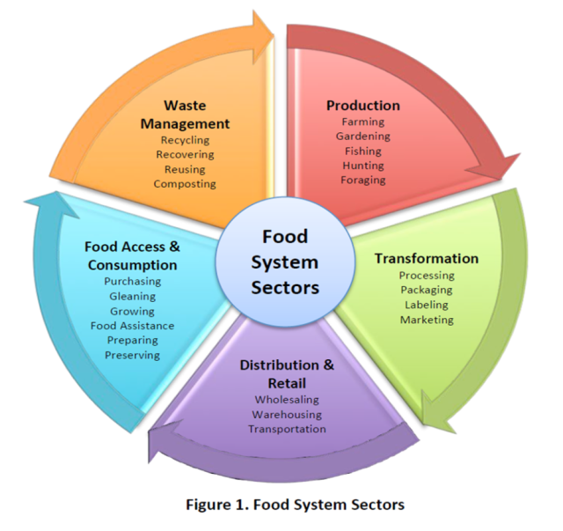

Slide 4
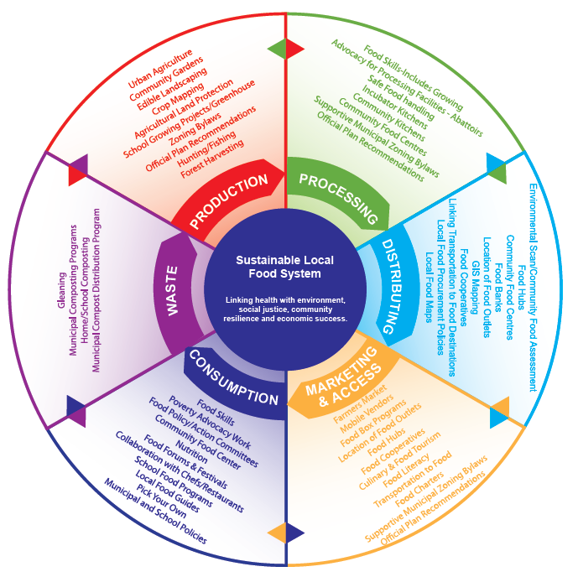

Slide 5
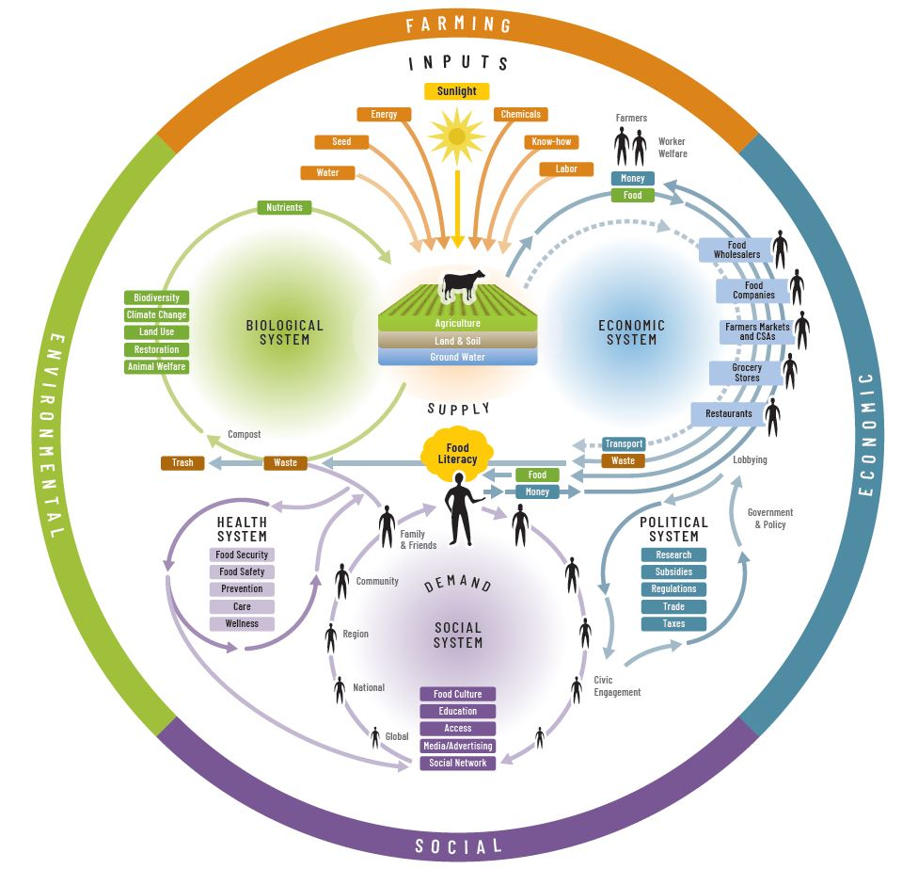

Slide 6
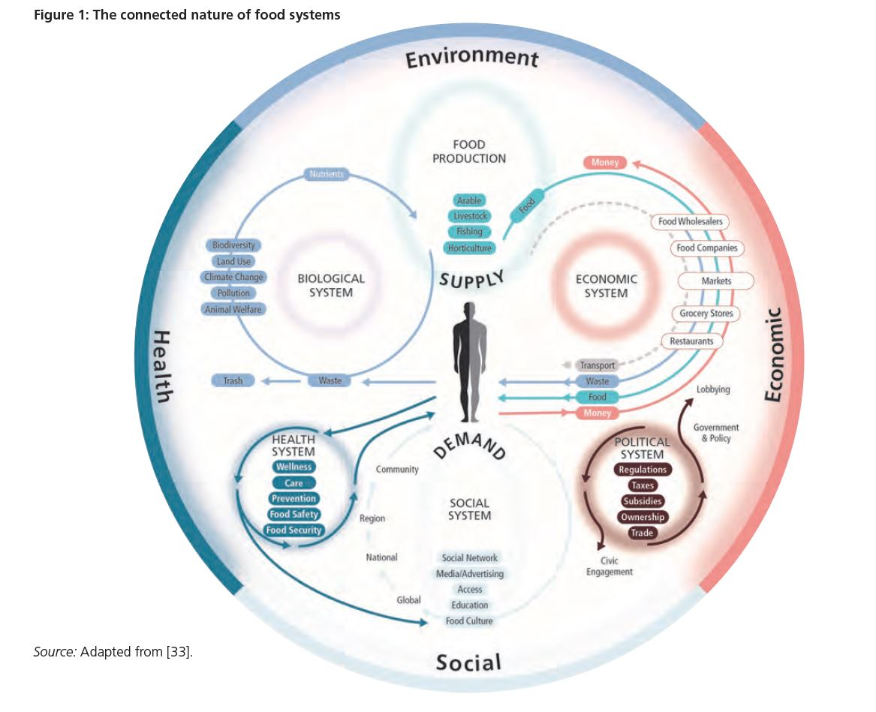
Food Systems
Parsons, Corinna (2018) Connecting food systems for co-benefits: How can food systems combine diet-related health with environmental and economic policy goals? Policy Brief 31, World Health Organization
Nourished Food System (nourishedlife.org)

Slide 7
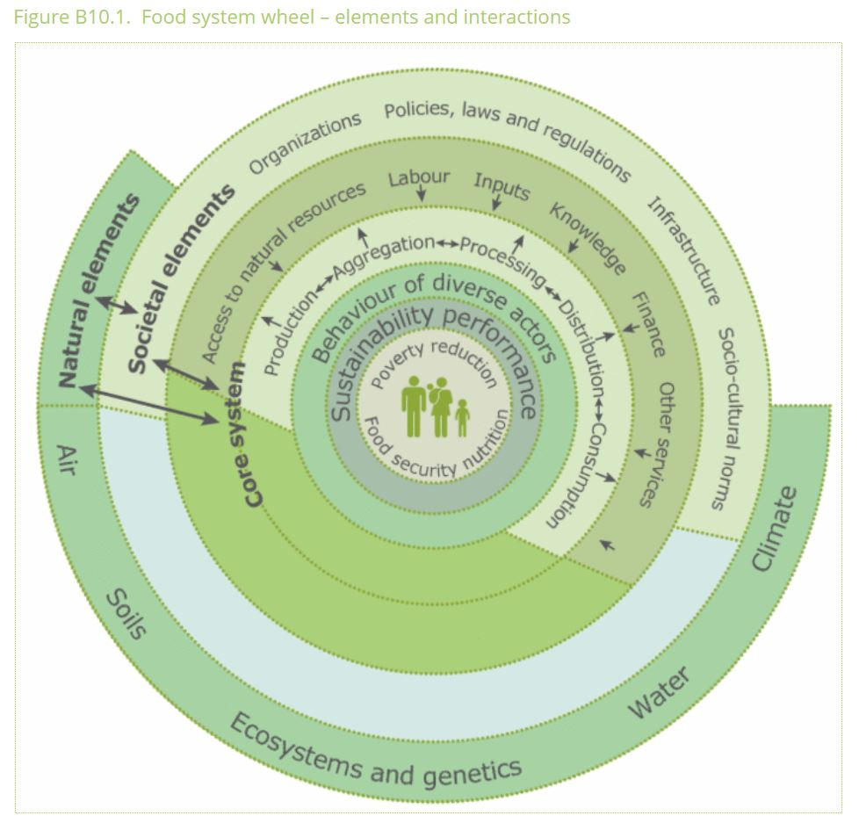
Source

Slide 8
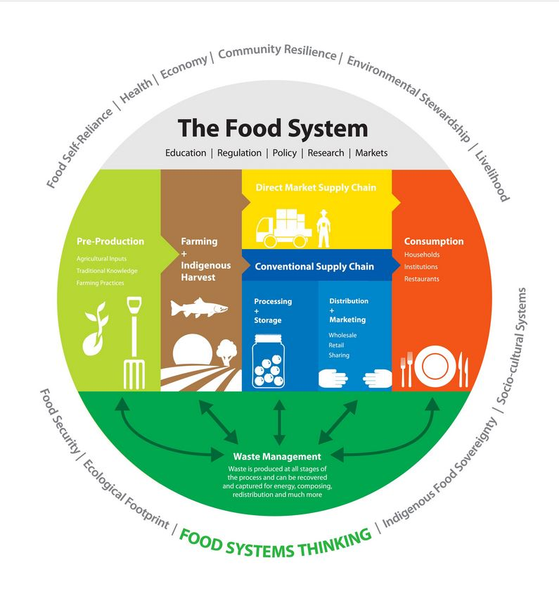

Slide 9
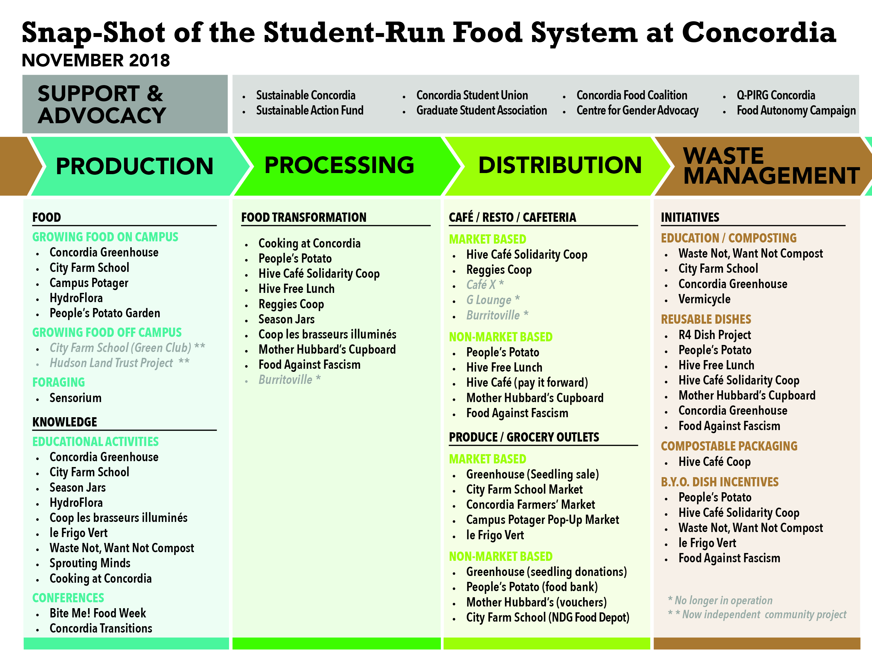

Slide 10
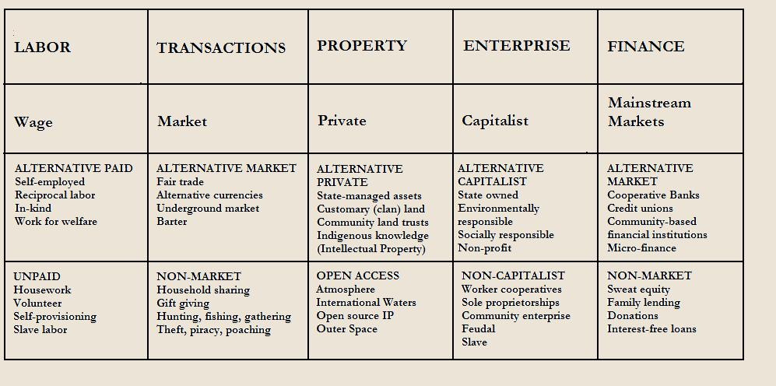
Take back the Economy
Gibson-Graham, J.K., Cameron, J., Healy, S. (2013) Take Back the Economy: An Ethical Guide for Transforming Communities, University of Minnesota Press

Slide 11
Mapping Community Food Systems
PRODUCTION | PROCESSING | DISTRIBUTION | WASTE MANAGEMENT | SUPPORT
Food | Cook | Market | Compost - Soil Building | Funding
Tools | Prepare | Redistribution | Water saving - Irrigation | Space
Knowledge | Ferment | Reciprocity | Seed Saving - Seed Sewing | Labour
Social Capital | Preserve | Self/community provisioning | Re-purpose food
 | Transform
 | Freeze/store
 | Dehydrate
 | Can

Slide 12
Ecological Cycles
Seasons & Planting Calendar
  Planting Calendar – For Montreal (Great Resource)
  Planting Chart – West Coast Seeds
Seed saving/sewing
Building soil/nutrient replenishing
Running water
Harvesting/culling
Succession planting
Attracting pollinators/beneficial insects
Crop rotations
Balance and biodiversity

Slide 13
Polycultures
How to create polycultures (Hemenway)
1 – Seed several varieties of each species
2 – Don’t sew seeds too thickly
3 – Begin harvest early
4 – Mix plant families, not just species
5 – Include many seeds of fast-growing, shallow-rooted species
6 – Overlap harvests
7 – Avoid root and light competition
8 – Harvest whole plants
9 – Save a few plants for seed
10 – Examine your polyculture every day

Slide 14
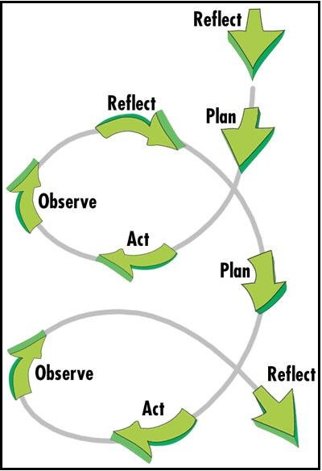
Designing an Ecological Garden
Observation
Visioning
Planning
  Conceptual design
  Schematic design
Development
Implementation

