Slide 1
Urban Agriculture
Urban Agriculture and Sustainability
www.erikchevrier.ca

Slide 2
What does it Mean to Have a Sustainable Diet?
Is your diet sustainable?

Slide 3
What does it Mean to Have a Sustainable Diet?
The term sustainability has lost meaning because it has been used for corporate/political greenwashing.
We need to refocus the conversation on what we are sustaining.
Sustainability refers to the perpetuation of something…the something is the important factor!
Sustainability is an adjective/modifier (Sumner refers to Shearman 1990)
Sustainability as a modifier points out contradictions (suggests that the status quo is not sustainable)
Instead we should ask:
What social, environmental and political conditions does our food practices sustain?
Effects can be positive and/or negative
Intended and/or unintended
We can be aware and/or unaware of these effects
Effects can take place on a macro and/or micro level

Slide 4
What does it Mean to Have a Sustainable Diet?
Digging deeper, we can ask:
Political economic conditions:
What were the labour conditions of the farmers that produced your food?
What social inequalities are expressed via your food consumption?
Individual and Social Health
How does your diet contribute to your individual health?
How does your diet impact the health of the community and the world at large?
Environmental Health
How does your diet affect biodiversity?
What is the environmental impact of your diet?

Slide 5
The Basics
What is food?
Substance with essential nutrients that sustain life
What is a food system?
An interdependent web of activities that include production, processing, distribution, consumption, and disposal of food. (Sumner, 2017)
What do we mean by sustainability?
We will explore this for the remainder of the course!

Slide 6
What’s Wrong With the Global Food System?

Slide 7
Issues With Our Current Food System
Issues with food security – there are close to 1 billion people starving in the world today! Issues with food sovereignty – peasants and farmers are being affected by trade agreements and food dumping! Issues with use of herbicides – glyphosates are being identified as cancer causing! Issues with privatization – restricted access! Issues with cost on farmers – family farms are not sustainable! Issues with reduction of biodiversity – we are destroying nature! Issues with unwanted genetics spreading onto non-GMO farms – lawsuits! Issues with loss of Indigenous farming methods – on stolen land! Issues with soil arability – we are killing our soil! Issues with killing pollinators – fruits need bees! Issues with water ‘dead zones’ – we are polluting our water! Issues with corporate concentration of agribusinesses – former war companies are now food chemical companies! Issues with health – our food contains toxins! Drain on resources – Over 50% of most countries’ fresh water supplies are used for agriculture! Major contributor to climate change – carbon and methane intensive farming! Foundations on structural racism, colonialism and patriarchy – glaring systemic issues! Rising cost of seed and chemicals – we don’t need to buy seeds! Research funding being directed to GMOs instead of traditional breeding methods – ‘science’ is not only about GMOs! Pest and weed resistance to Bt crops and glyphosate! There are so many more critiques! What others can you think of?

Slide 8
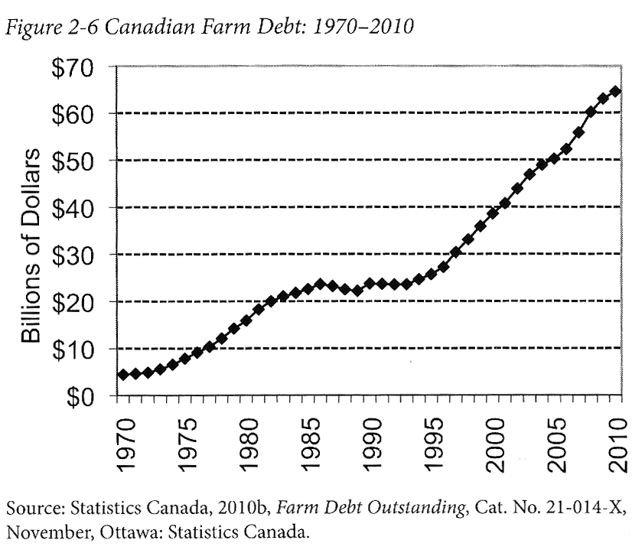
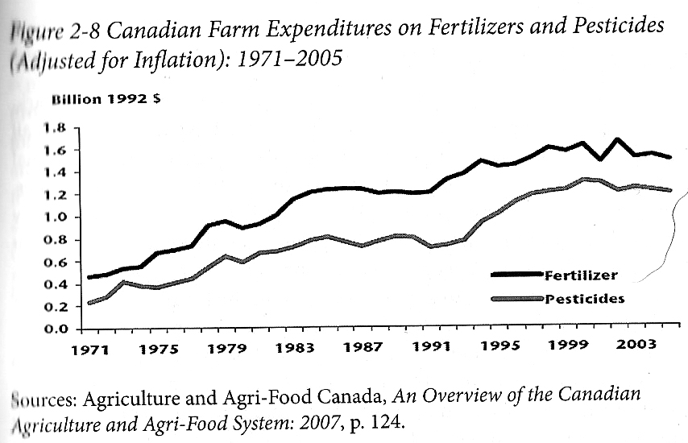
Who Benefits from Our Food System Economically? Qualman, D. (2011) Advancing Agriculture by Destroying Farms? The State of Agriculture in Canada, pp. 20 – 42. In, Wittman, H., Desmarais, A. A., & Wiebe, N. (2011) Food Sovereignty in Canada: Creating Just and Sustainable Food Systems, Fernwood Publishing

Slide 9
Only A Few Large Corporations Own Most of the Agrochemical Market https://cban.ca/gmos/issues/corporate-control/

Slide 10
Companies of War, Destruction and Death
These are a few examples:
Monsanto still uses chemicals that were used to kill people, but in our food
Monsanto Ghostwriting Academic Papers
Is Round-Up safe to drink?
Farmer won lawsuit against Monsanto – Glyphosate causes cancer
The World According to Monsanto
Monsanto is now owned by Bayer who used to be part of I.G. Farben, manufacturing poisonous gas (Zyklon B) for concentration camps during the World War.
BASF was also part of IG Farben a company who worked with the Nazis and tested chemicals and drugs on people including Zyklon B
Dow Chemical Invented Agent Orange
Dow Chemical now owns Union Carbide who was responsible for a large devastating explosion in Bhopal, India:
The Bhopal disaster: Toxic legacy
One Night in Bhopal
The Bhopal Disaster

Slide 11
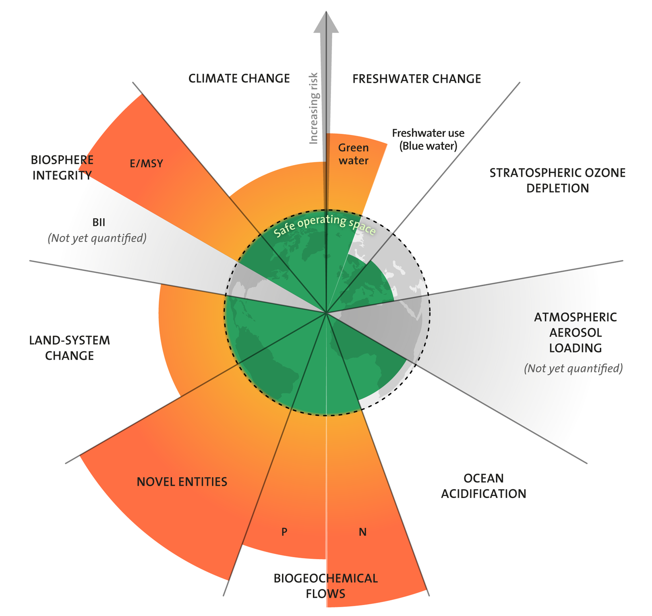
Source

Slide 13
Reports About Rapid Ecological Change
Millennium Ecosystem Assessment
International Geosphere-Biosphere Program
IPCC Reports

Slide 14
Global Temperature Rise
Global Temperature Rise
Ice Sheets Melting
Greenland Melting at Faster Rates
Artic Sea Ice Sheets Melting
Carbon Dioxide Production
Sea Level Rise
Ocean Heat

Slide 15
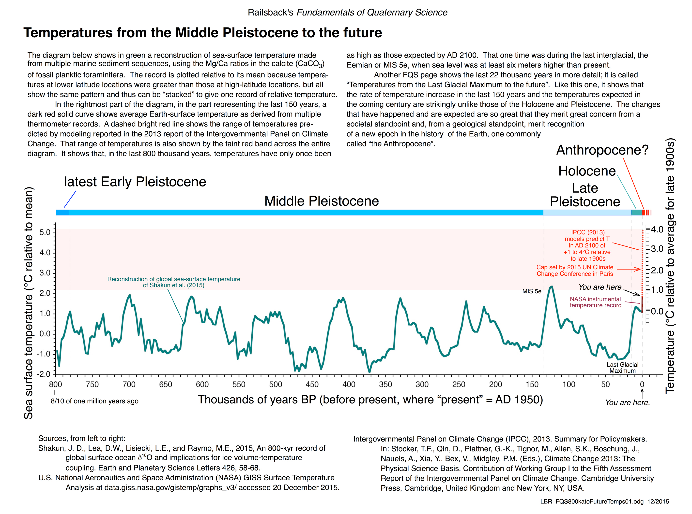

Slide 16
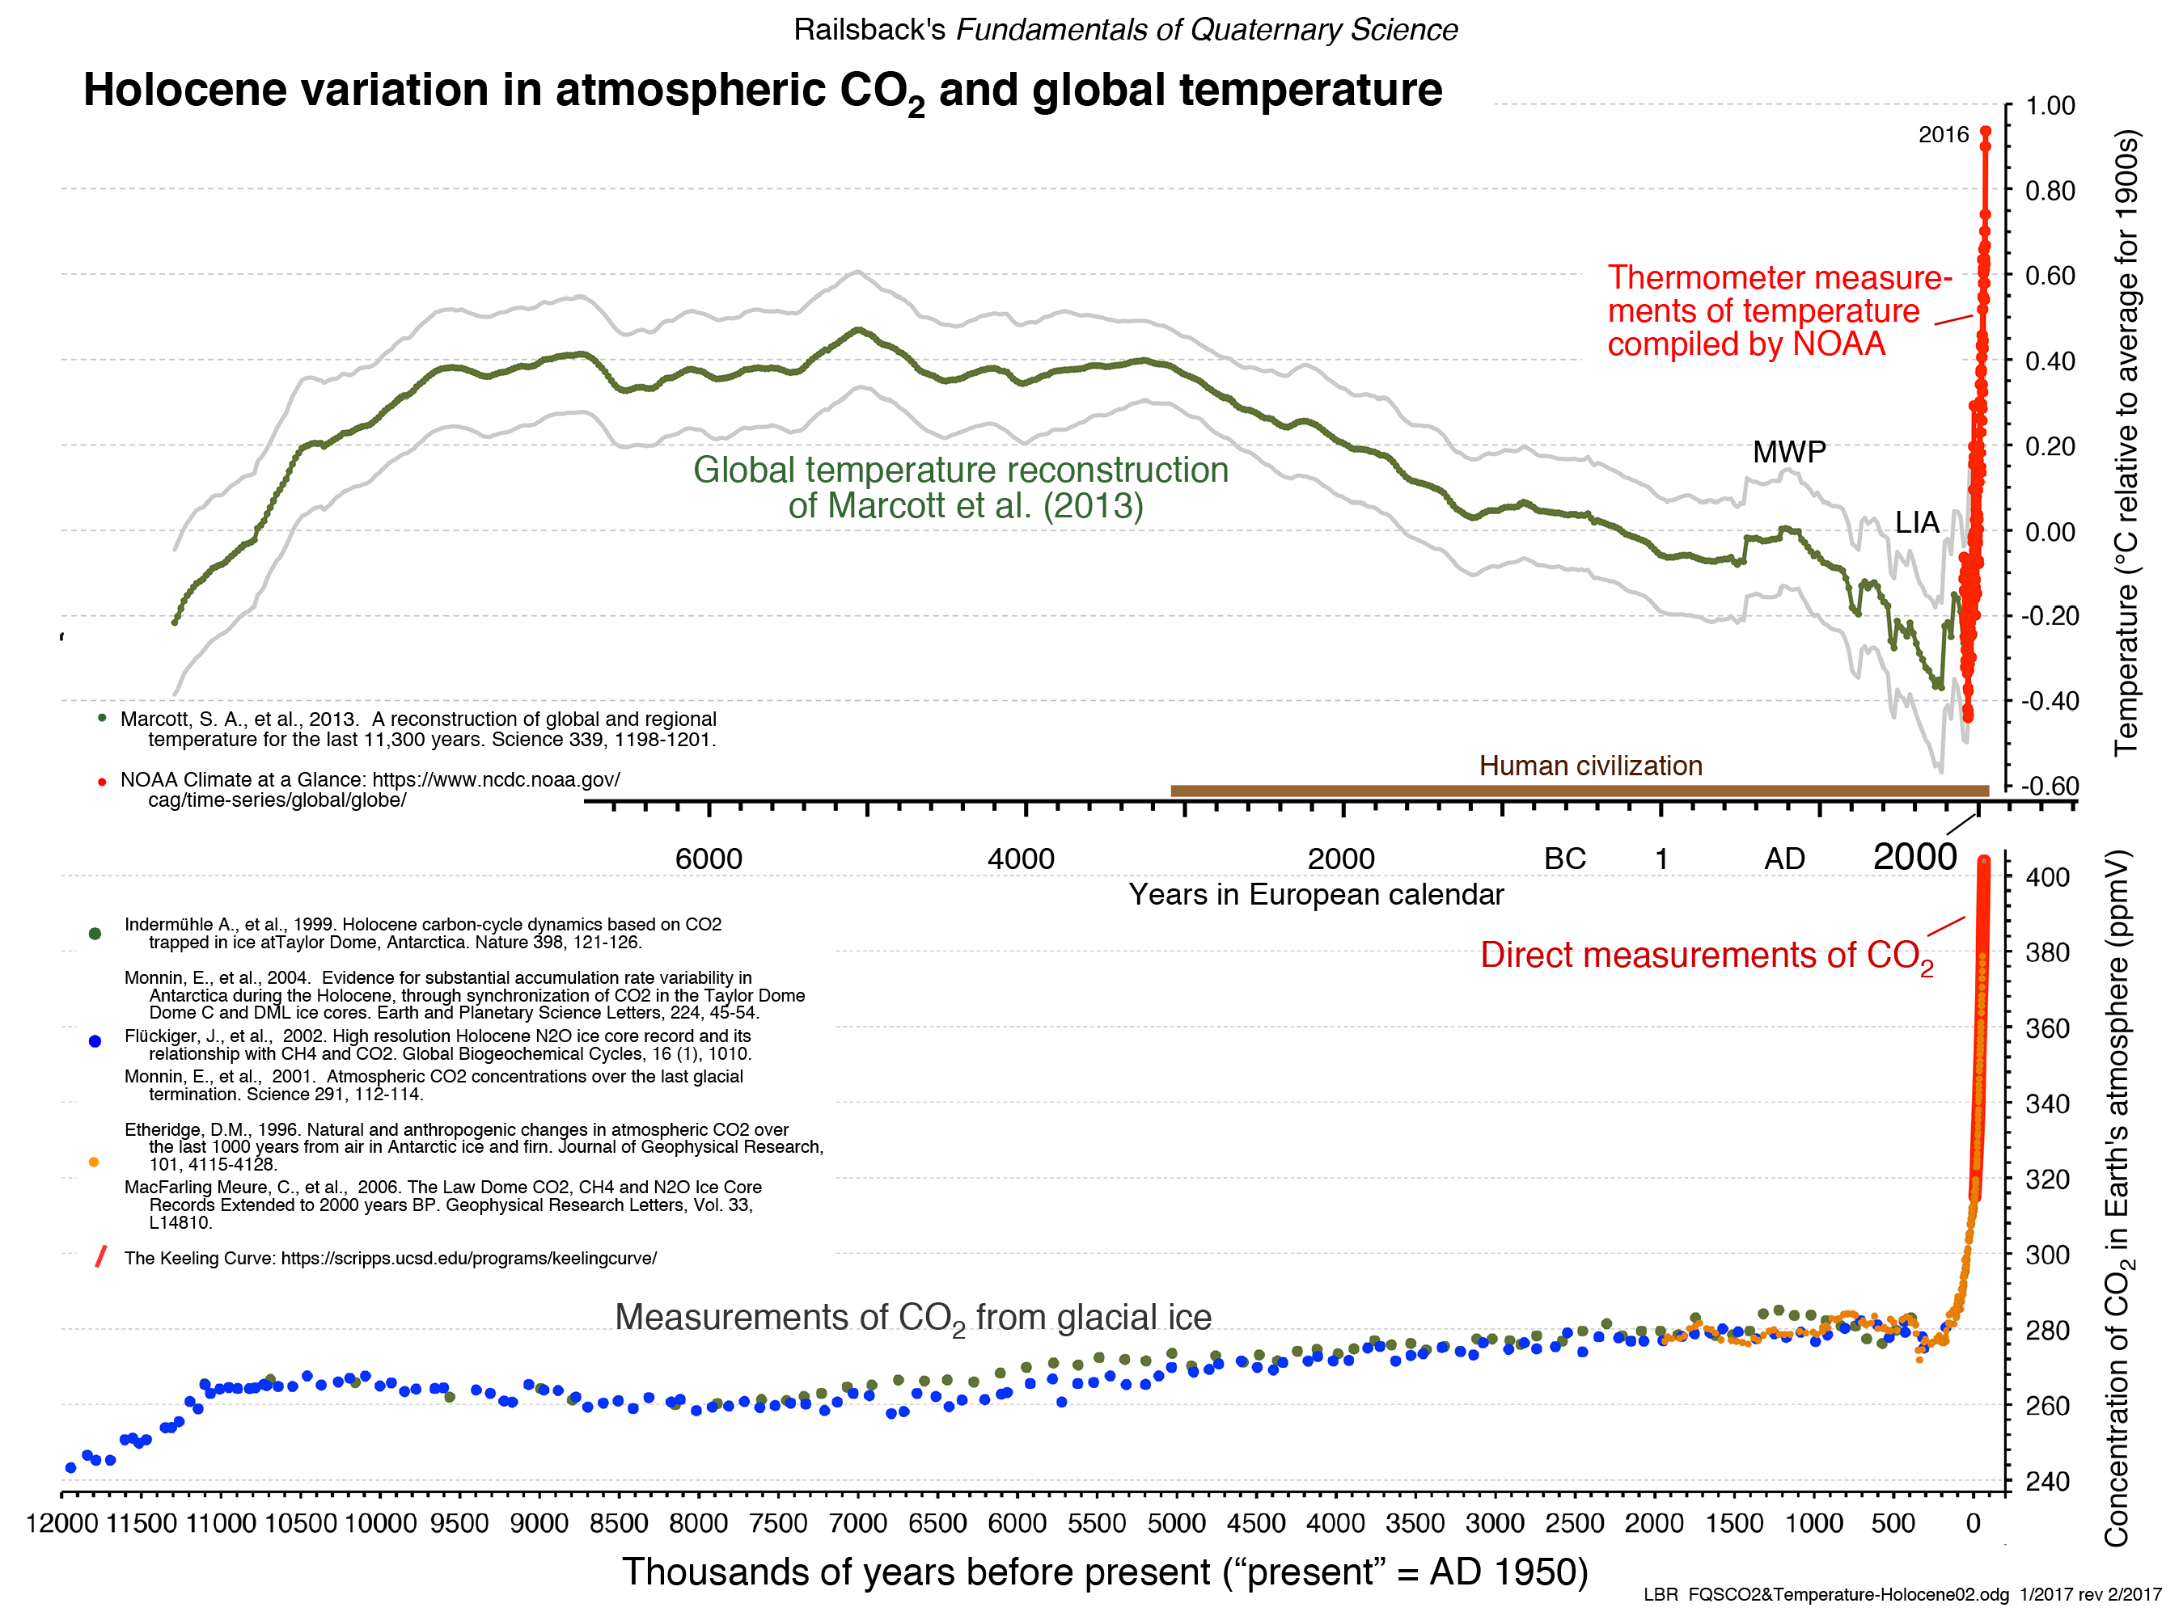

Slide 17
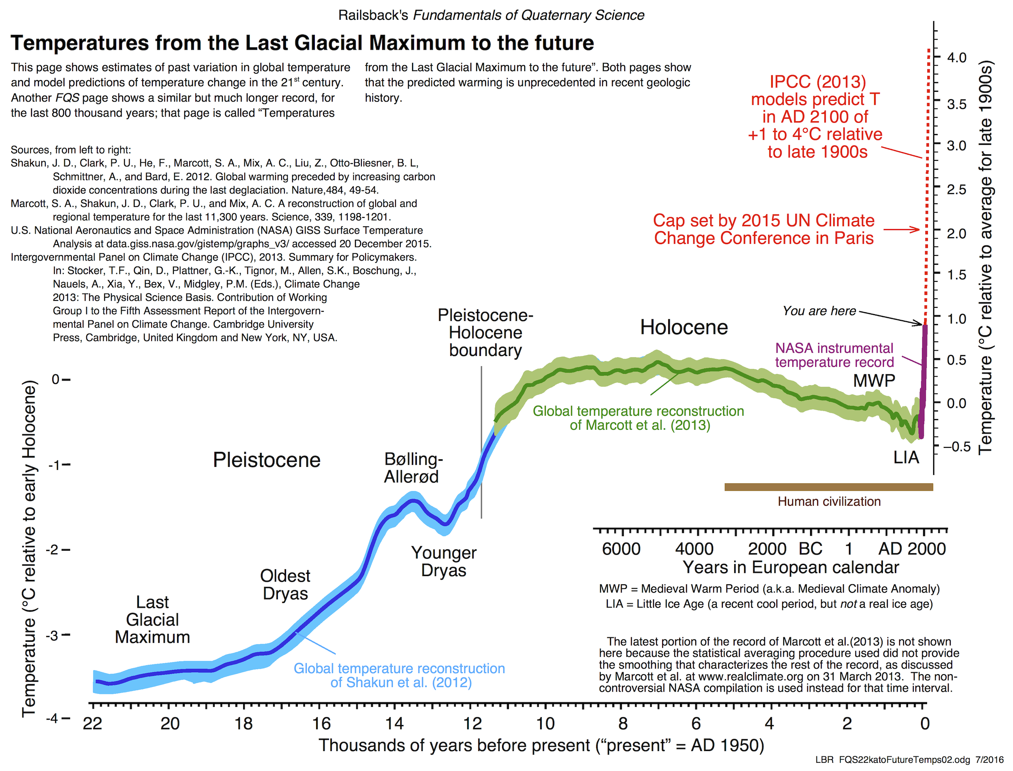

Slide 18
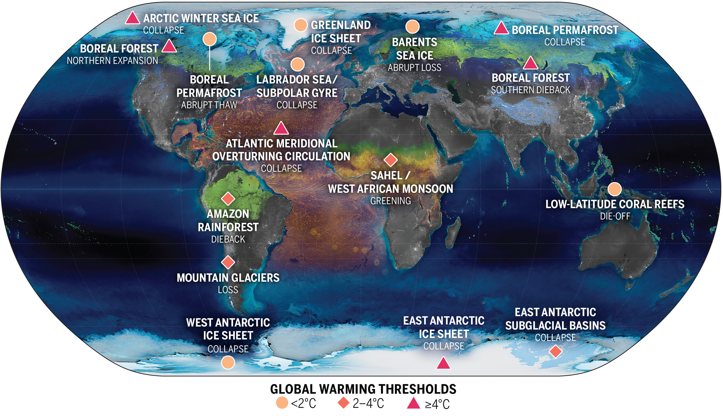

Slide 19
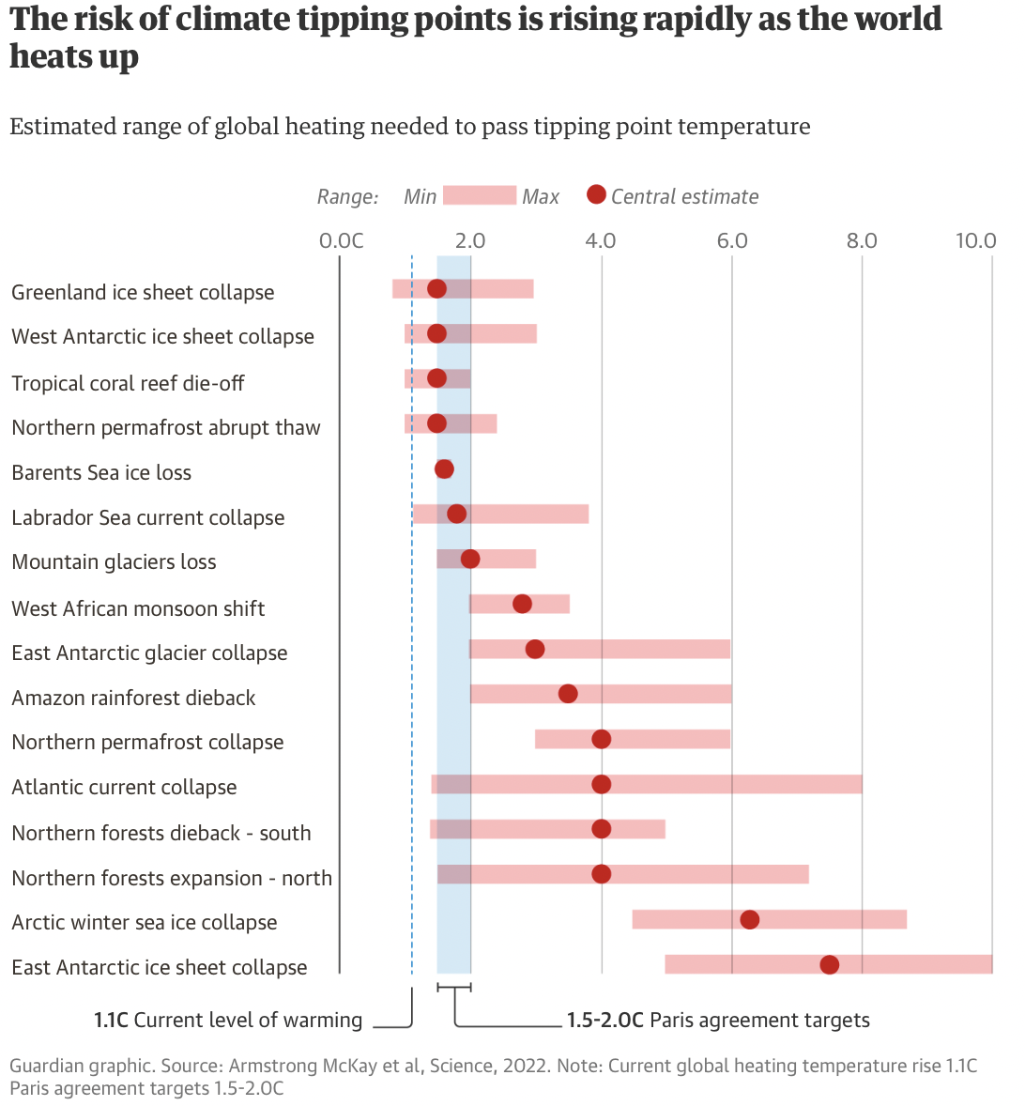

Slide 20
Discussion Question 2
How can we develop food systems that are part of the solution to ecological, social and economic issues?

Slide 21
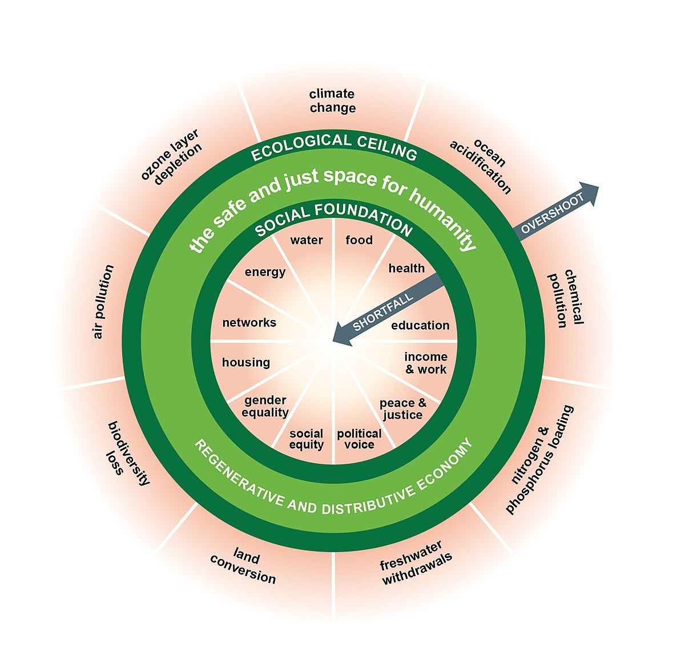
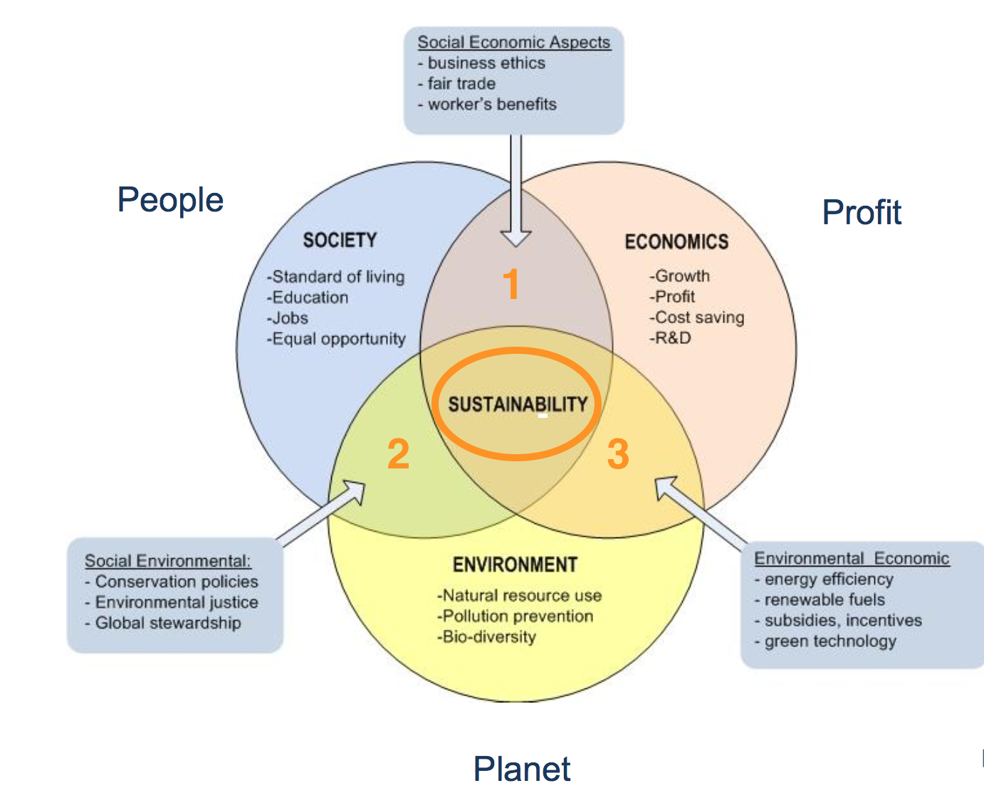
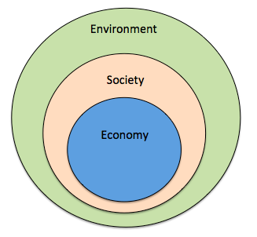
From Sustainability to Food Sovereignty
Triple Bottom Line
Nested Model
Doughnut Model

Slide 22
Source

Slide 23
Is The Food System Broken?
Calls to “fix a broken food system” assume that the capitalist food system used to work well. This assumption ignores the food systems long, racialized history of mistreatment of people of colour. The food system is unjust and unsustainable, but it is not broken. It functions precisely as the capitalist food system has always worked, concentrating power in the hands of the privileged minority and passing off the social and environmental “externalities” disproportionately to racially stigmatized groups. (Holt-Gimenez, 2017, p. 160)
How we produce and consume determines how our society is organized, but how we organize socially and politically can also determine how we produce and consume. The implications of this are profound: our food systems are vessels of unmatched social and economic power and pivotal sites for systemic transformation. (Holt-Gimenez, 2017, p. 214)
Holt-Gimenez, E. (2017) A Foodie’s Guide to Capitalism: Understanding the Political Economy of What We Eat, Monthly Review Press, New York.

Slide 24
Problems – Symptoms – Root Causes

Slide 25
Living Economies – Vandana Shiva

Slide 26
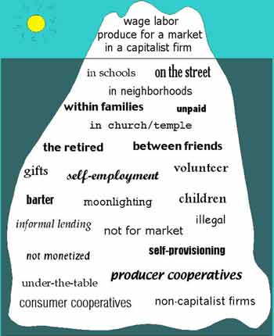
Take back the Economy Gibson Graham Gibson-Graham, J.K., Cameron, J., Healy, S. (2013) Take Back the Economy: An Ethical Guide for Transforming Communities, University of Minnesota Press
Katherine Gibson Interview Playlist

Slide 27
New Economic Models Take back the Economy Gibson-Graham, J.K., Cameron, J., Healy, S. (2013) Take Back the Economy: An Ethical Guide for Transforming Communities, University of Minnesota Press

Slide 28
Beneficial Practices
Agroecology
Permaculture
Foraging
Food sovereignty
Eliminating the metabolic rift
Reconnecting with community, food and nature
Incorporating ontological knowledge, especially Indigenous knowledge
Incorporating critical-participatory-action research
Incorporating critical education paradigms
Incorporating diverse economies

Slide 30
Mapping Community Food Systems
PRODUCTION | PROCESSING | DISTRIBUTION | WASTE MANAGEMENT | SUPPORT
Food | Cook | Market | Compost - Soil Building | Funding
Tools | Prepare | Redistribution | Water saving - Irrigation | Space
Knowledge | Ferment | Reciprocity | Seed Saving - Seed Sewing | Labour
Social Capital | Preserve | Self/community provisioning | Re-purpose food
 | Transform
 | Freeze/store
 | Dehydrate
 | Can
Community-Campus Engagement Project

Slide 31
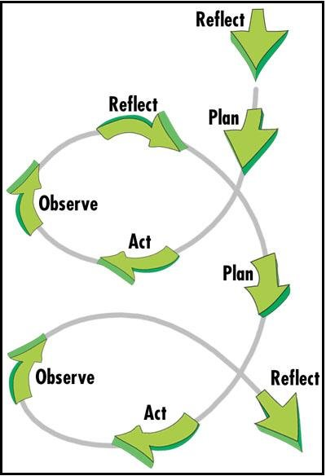
Action Research and Designing an Ecological Garden
Observation
Visioning
Planning
Conceptual design
Schematic design
Development
Implementation

Slide 32
Questions?
Thanks!

