Slide 1
Urban Agriculture
Building Food Sovereign Communities
Erik Chevrier
www.erikchevrier.ca

Slide 2
Discussion?
What is Food Sovereignty?

Slide 3
What is Food Sovereignty?
Food sovereignty is difficult to define because it has come to mean many different overlapping ideas.
Patel (2009)
  Food sovereignty is, if anything, over defined. There are so many versions of the concept, it is hard to know exactly what it means. The proliferation of overlapping definitions is, however, a symptom of food sovereignty itself, woven into the fabric of food sovereignty by necessity. (p. 664).
Alonso-Fradejas, Borras Jr, Holmes, Holt-Gimanez, and Robbins (2015)
  The term has become a challenging subject for social science research, and has been interpreted and reinterpreted in various ways by different groups and individuals. Indeed, as it is a concept that is so broadly defined, it spans issues such as food politics, agroecology, land reform, pastoralism, fisheries, biofuels, genetically modified organisms (GMOs), urban gardening, the patenting of life forms, labour migration, the feeding of volatile cities, community initiatives and state policies, public health, climate change, ecological sustainability, and subsistence rights. (p. 443)
Qualman (2011)
  Food sovereignty…is many things depending on place, time, culture, needs and so on. As with many forward-looking ideas, it is difficult to predict exactly what food sovereignty will look like in practice – to provide an exact blueprint of food sovereignty is not only difficult but also counter-productive. So it might be easier to define what it isn’t. (p.20)

Slide 4
What is Food Sovereignty?
Food sovereignty is a multidimensional concept that refers to a process and an outcome.
  Process – it describes a movement, a struggle, a democratic process perpetually in negotiation and always in motion.
  Outcomes – agreed upon declarations of rights, codes of ethics and guiding principles. These declarations are debated at conferences, meetings, and public forums and carried out by the parties (who agree with the declarations) in local communities.
    Nyéléni Declaration 2007
  Framework – Food regimes frameworks for comparative analyses.
Food sovereignty refers to:
  the rights of nations and people to control their own food economy – to decide how food is produced, consumed, processed, and distributed.
  a paradigm, trend, framework, discourse, regime and model. It is the most radical food movement discourse and rivals the corporate neoliberal food system.
  a right to food that is of quality, healthy, and culturally appropriate
  recognition and respect of women’s role in food production
  social justice
  environmental sustainability
  recognition and respect for traditional knowledge and Indigenous Peoples
  agrarian reform including collective land rights and protection of Indigenous Peoples’ Lands
  ‘re-commoning’ land and right to defend land from transnational corporations
  against trade liberation

Slide 5
Food Sovereignty (Patel)
Food Security – Food and Agriculture Organization of the UN (FAO):
  Food security, at the individual level, household, national, regional and global level [is achieved] when all people, at all times, have physical and economic access to sufficient, safe and nutritious foods to meet their dietary needs and food preferences for an active and healthy life (1996)
Via Campesina (1996)
  Long-term food security depends on those who produce food and care for the natural environment. As stewards of food producing resources we hold the following principles as the necessary condition for achieving food security…Food is a basic human right. This can only be realized in a system where food sovereignty is guaranteed. Food sovereignty is the right of each nation to maintain and develop its own capacity to produce its basic foods respecting cultural and productive diversity. We have the right to produce our own food in our own territory. Food sovereignty is a precondition to genuine food security

Slide 6
Post-Capitalist Approaches - Trends
No Change → Corporations are amazing, capitalism is great.
Reformist → Corporations and capitalism can do/be bad but can be improved.
Interstitial → We need alternatives that are democratic and community-based (crack theory)
Revolutionary → We need to overthrow the system.
No change → The contradictions of capitalism will eventually lead to its own demise.

Slide 7
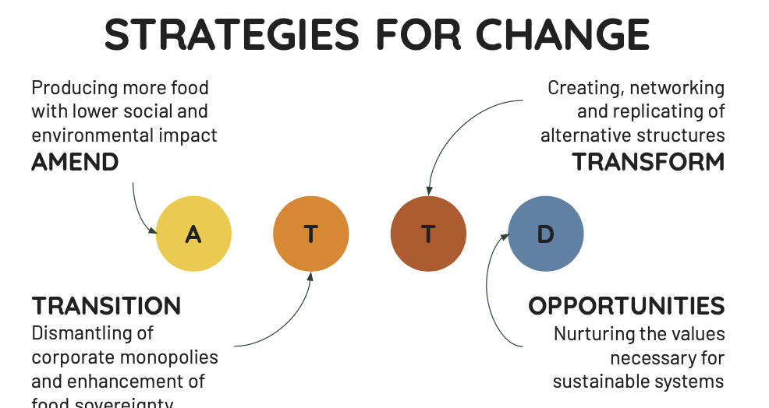

Slide 8
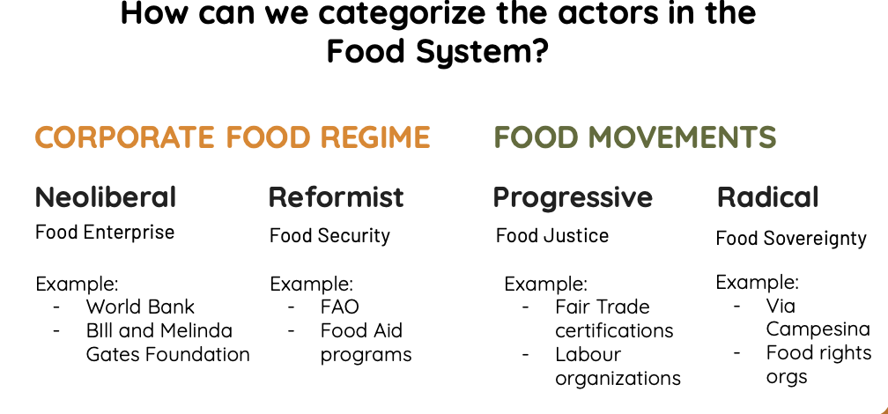

Slide 9
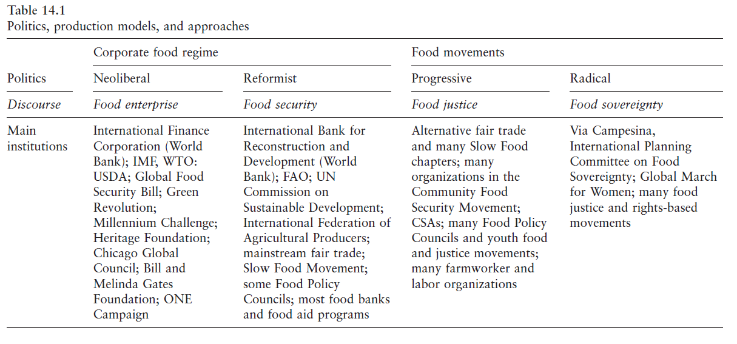

Slide 10
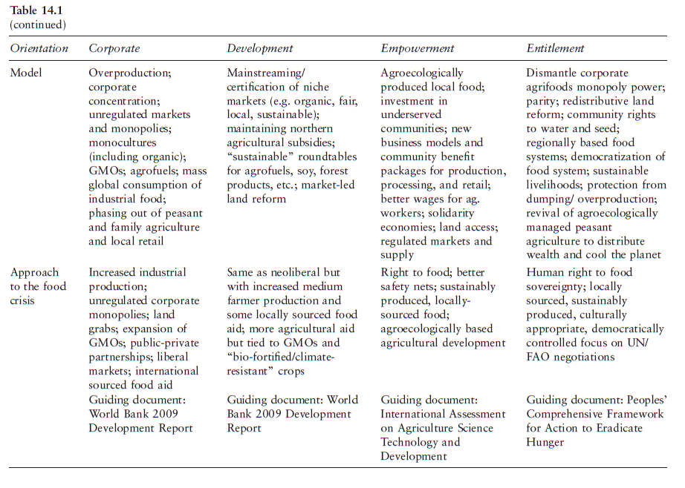

Slide 11
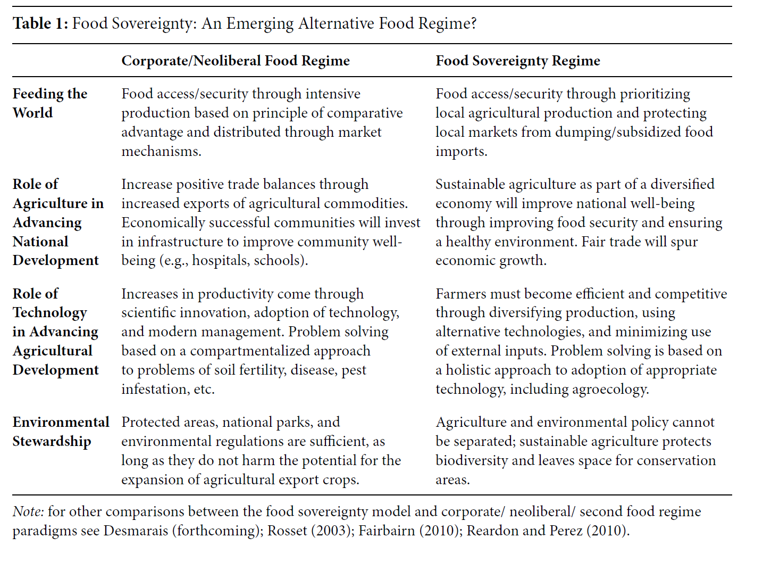
Food Regimes (Wittman, 2011)

Slide 12
Community Food Sovereignty
Communities can control food production, processing, distribution and waste management.
  Urban Farms, edible community landscapes, collective growing spaces
  Food Hubs and/or Community Food Centres
  Collective kitchens
  Cooperative food distribution organizations
  Local markets and CSA
  Regenerative agriculture
  Food banks (surplus from distribution organizations and urban farms)
  Food advocacy organizations
  Social justice!

Slide 13
Discussion?
What are Instances of Food Sovereignty in Your Community?

Slide 14
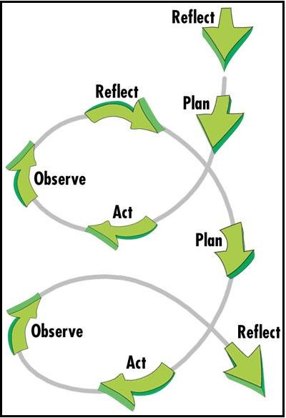
Building Food Sovereignty Through Action Research
Concordia Food Groups Project
Lachine Food System

Slide 15
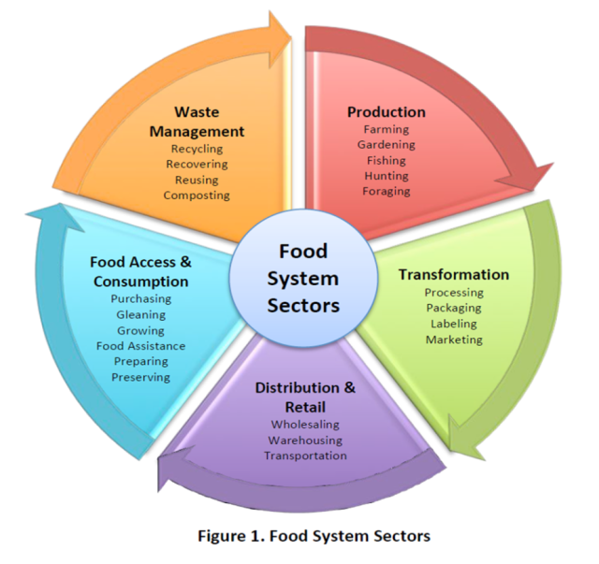

Slide 16
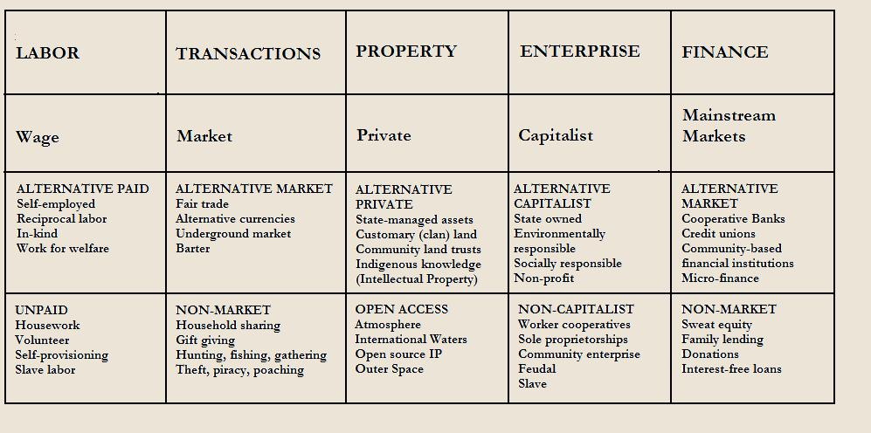
Take back the Economy
Gibson-Graham, J.K., Cameron, J., Healy, S. (2013) Take Back the Economy: An Ethical Guide for Transforming Communities, University of Minnesota Press

Slide 17
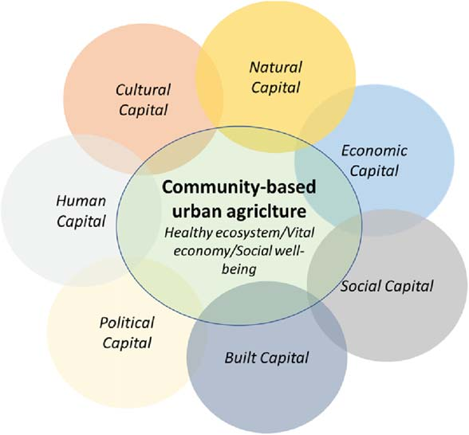

Slide 18
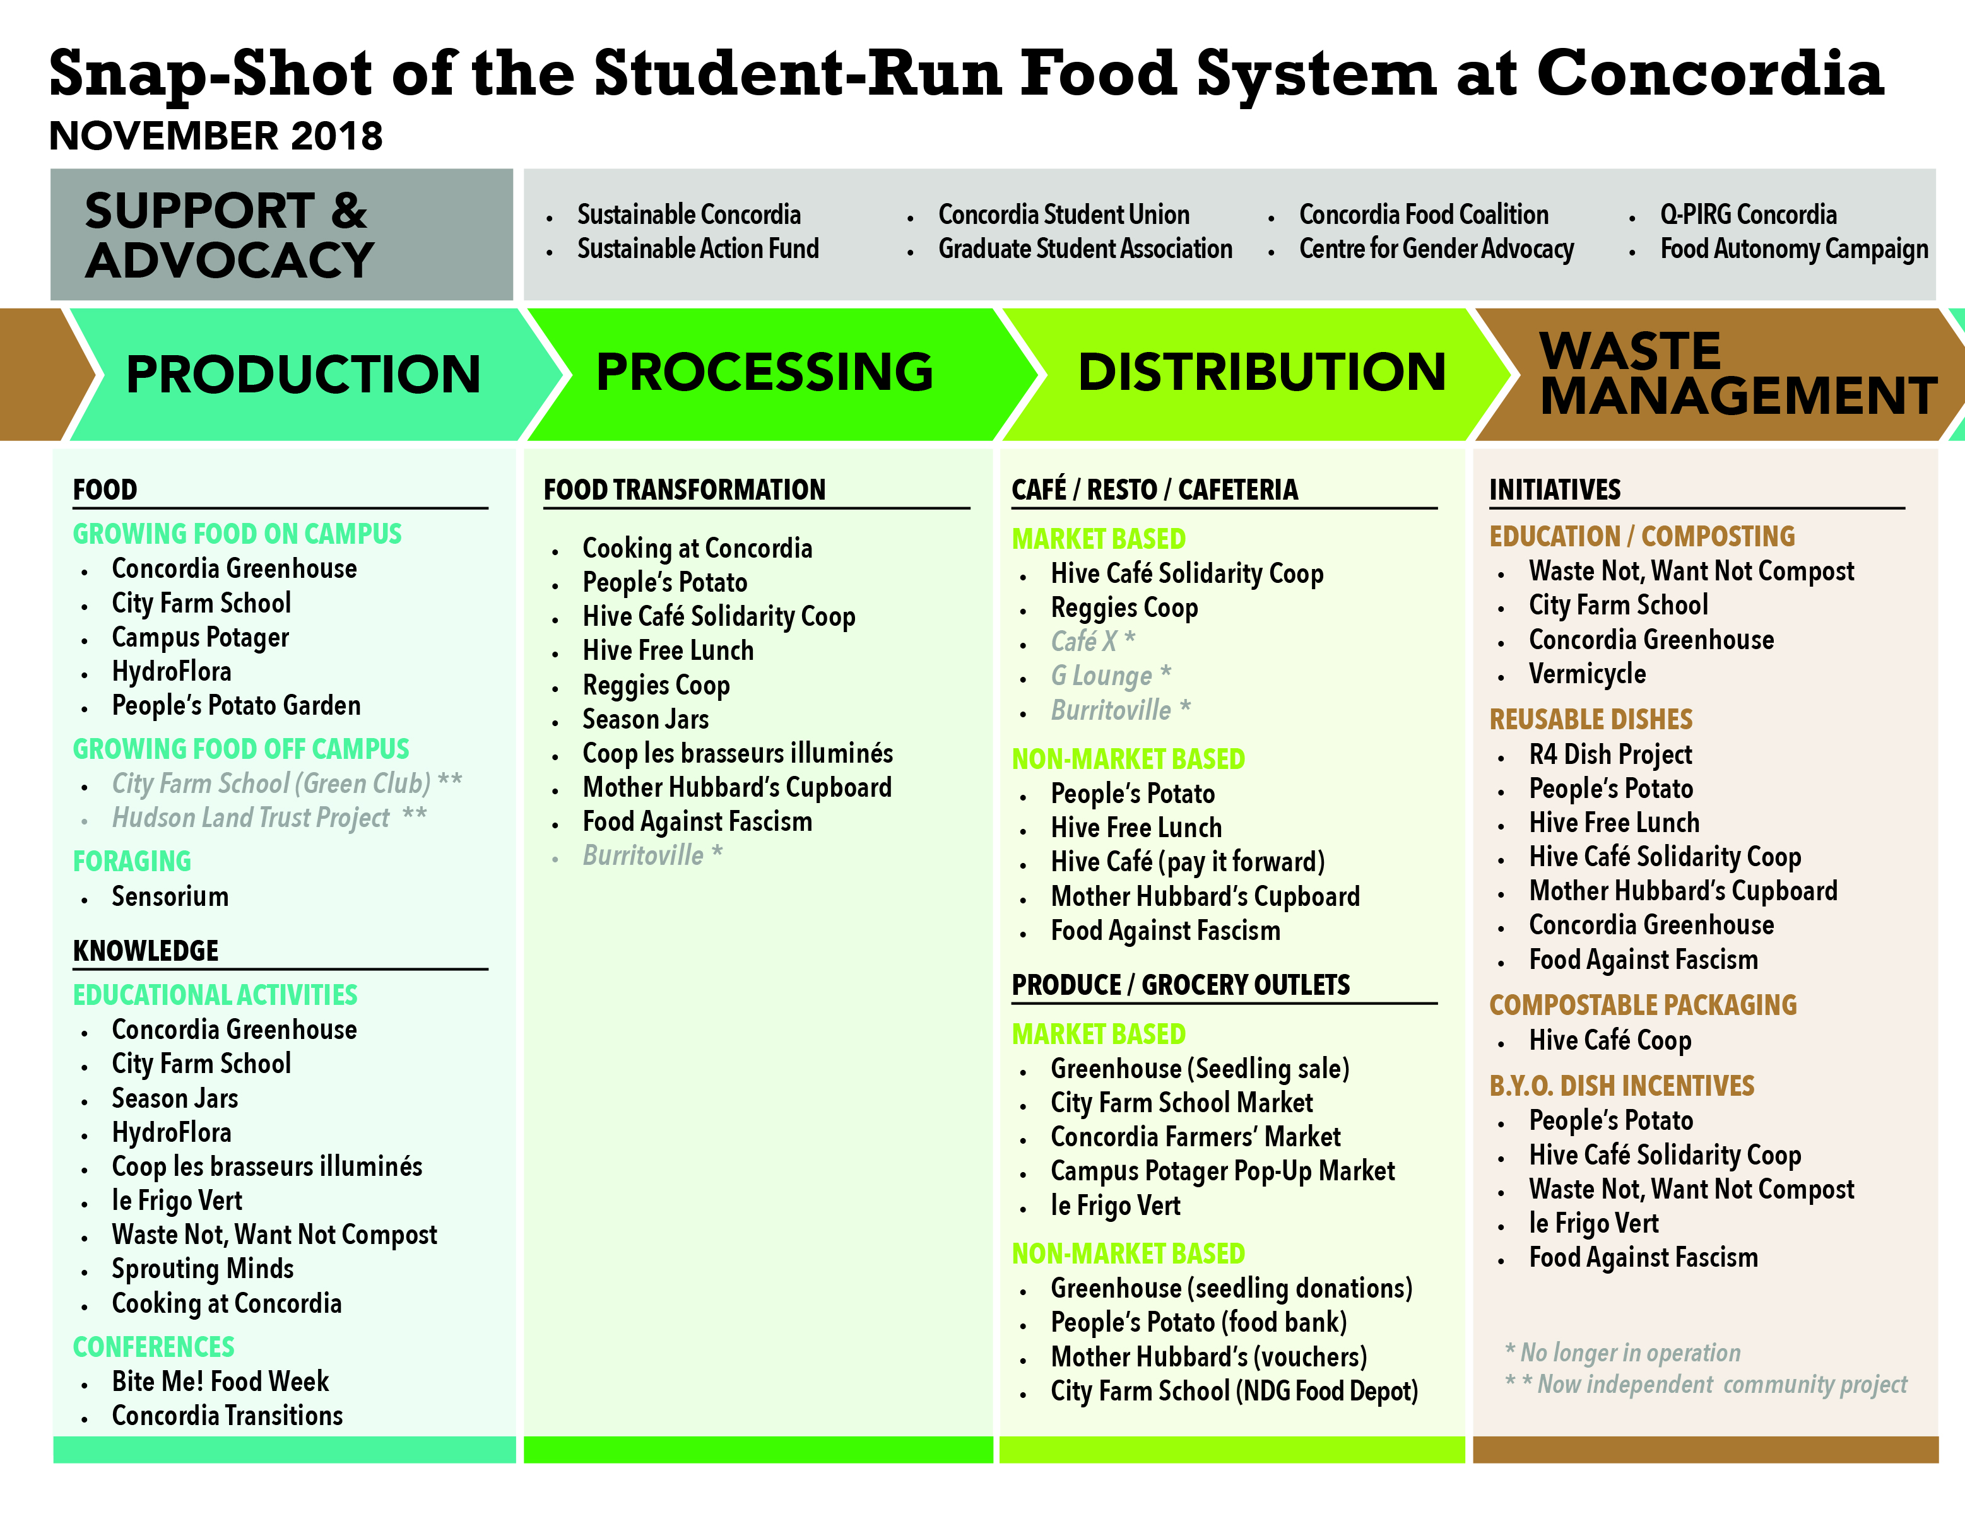

Slide 19
Mapping Community Food Systems
PRODUCTION | PROCESSING | DISTRIBUTION | WASTE MANAGEMENT | SUPPORT
Food | Cook | Market | Compost - Soil Building | Funding
Tools | Prepare | Redistribution | Water saving - Irrigation | Space
Knowledge | Ferment | Reciprocity | Seed Saving - Seed Sewing | Labour
Social Capital | Preserve | Self/community provisioning | Re-purpose food
 | Transform
 | Freeze/store
 | Dehydrate
 | Can

Slide 20
Building Food Sovereignty Through Action Research
Concordia Food Groups Project
Lachine Food System

Slide 21
Action Spirals
Food Group Assemblies
- Create action plan
- Create a list of demands?
- Discuss campus-community FOOD SYSTEMS
- Track progress

Slide 22
Information about Food Sovereignty
La Via Campesina
Nyéléni Newsletter
People’s Coalition for Food Sovereignty
International Planning Committee for Food Sovereignty
Video La Via Campesina TV

Slide 23
Thanks!
Questions or concerns?

