Slide 1
Urban Agriculture
Economic Sustainability of Urban Farms
Erik Chevrier
www.erikchevrier.ca

Slide 2
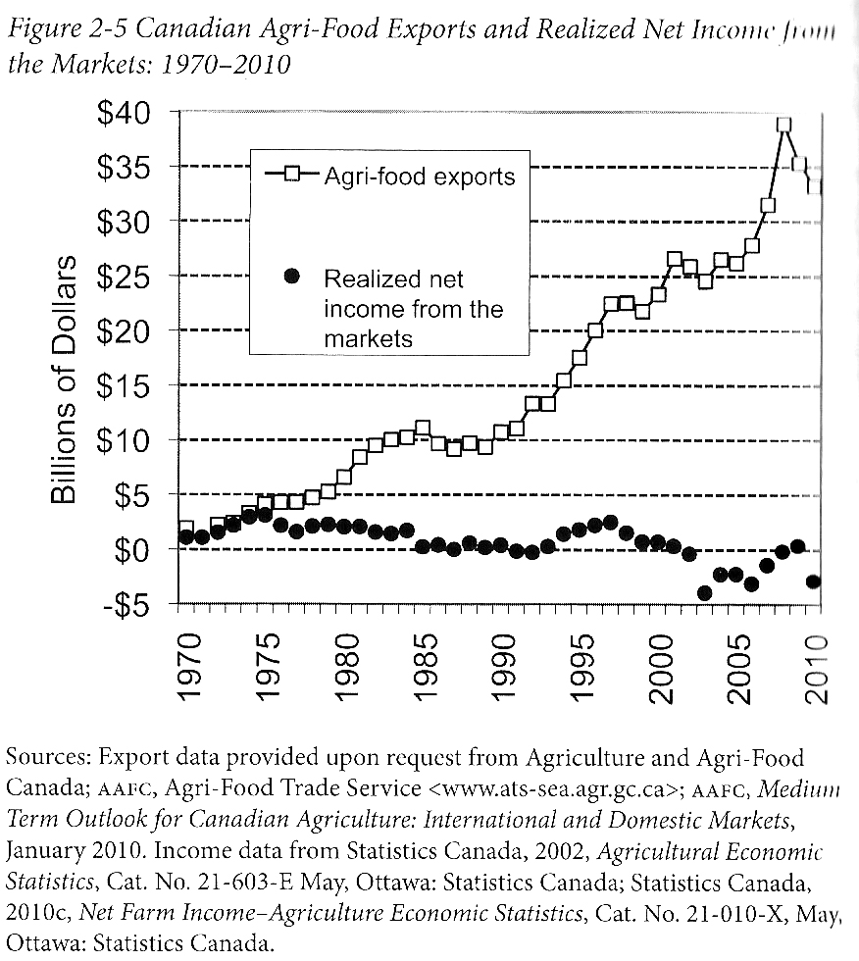
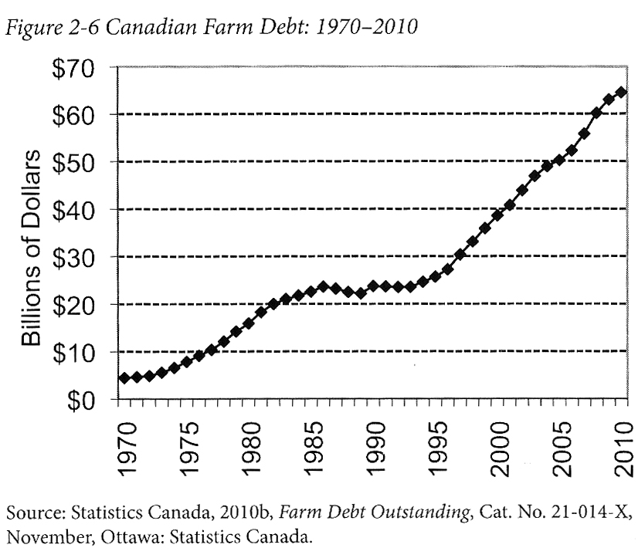
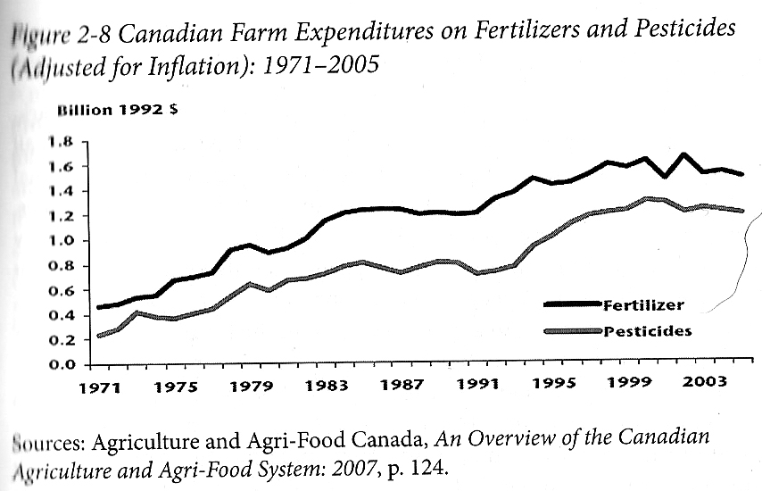
Who Benefits from Our Food System Economically?
Qualman, D. (2011) Advancing Agriculture by Destroying Farms? The State of Agriculture in Canada, pp. 20 – 42. In, Wittman, H., Desmarais, A. A., & Wiebe, N. (2011) Food Sovereignty in Canada: Creating Just and Sustainable Food Systems, Fernwood Publishing

Slide 3
Question?
What is an economy?

Slide 4
Aristotle Aristotle. Aristotle in 23 Volumes, Vol. 21, translated by H. Rackham. Cambridge, MA, Harvard University Press; London, William Heinemann Ltd. 1944.
Chrematistics – art of acquisition – limitless accumulation unnatural and problematic
Oikonomia – management of the household – true form of an economy

Slide 5
Karl PolanyiPolanyi, K. (2001) The Great Transformation; The Political and Economic Origins of Our Time, Beacon Press
Types of economic practices:
  Markets (exchange)
  Household economy
  Redistribution
  Reciprocity

Slide 6
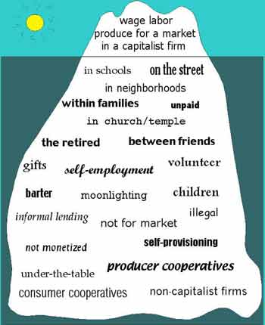
What is an Economy?
Gibson-Graham, J.K., Cameron, J., Healy, S. (2013) Take Back the Economy: An Ethical Guide for Transforming Communities, University of Minnesota Press
Katherine Gibson Interview Playlist

Slide 7
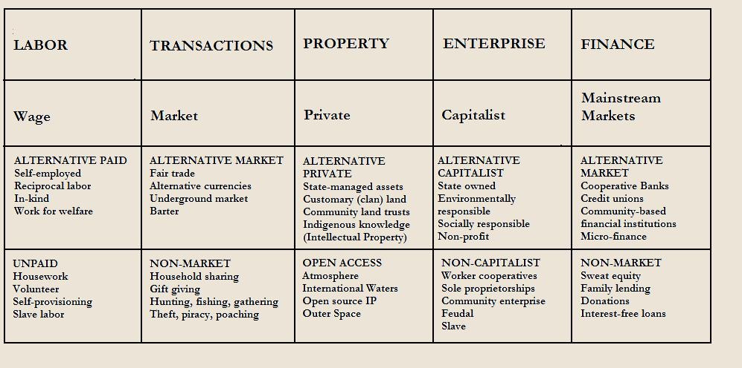
Take back the Economy
Gibson Graham
Gibson-Graham, J.K., Cameron, J., Healy, S. (2013) Take Back the Economy: An Ethical Guide for Transforming Communities, University of Minnesota Press

Slide 8
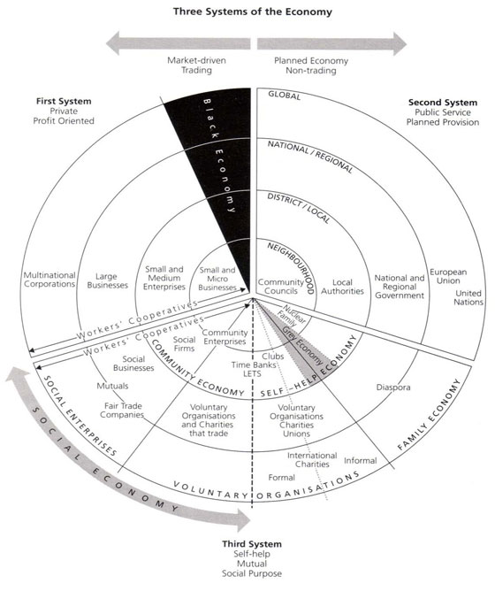
Three Systems of an Economy
Pearce, J. (2009) Social Economy: Engaging as a Third System, In Amin, A. The Social Economy; International Perspectives on Economic Solidarity, p. 26.

Slide 9
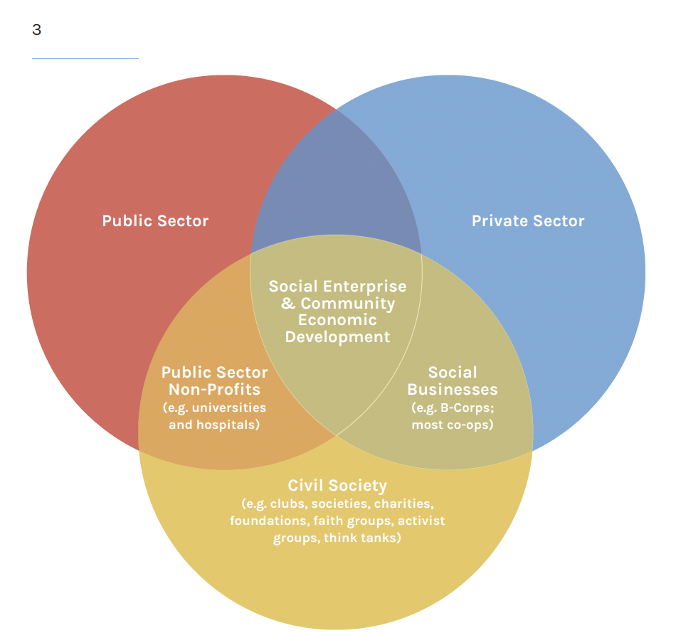

Slide 10
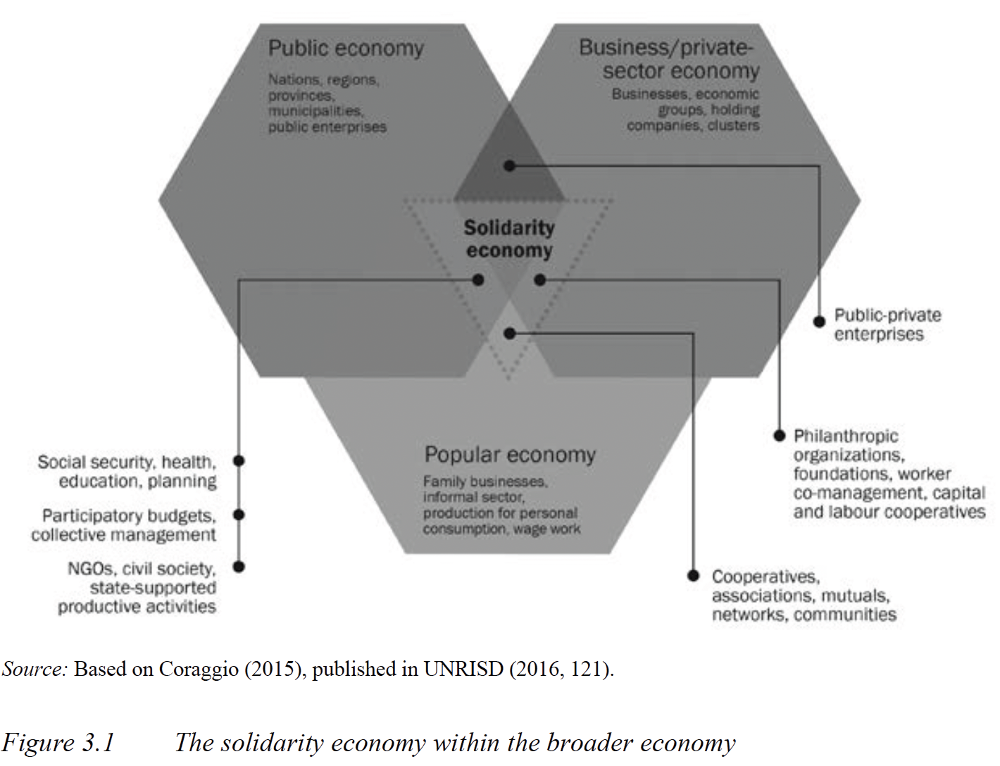

Slide 11
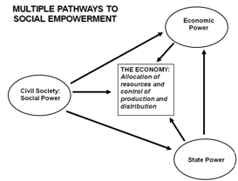
Envisioning Real Utopias – Erik Olin Wright
Olin Wright, E. (2010) Envisioning Real Utopias, Verso

Slide 12
Take back the Economy
Gibson Graham
Gibson-Graham, J.K., Cameron, J., Healy, S. (2013) Take Back the Economy: An Ethical Guide for Transforming Communities, University of Minnesota Press

Slide 13
Types of Urban Agriculture
For-Profit
Not-For Profit
Subsistence Farms
Cooperatives
Hobby Farms
Squat Gardens
Edible Foraging
Community Gathering Places
Edible Landscapes

Slide 14
Market Farm Practices
Direct sales
  CSA
  Farmers market
  Other markets
Wholesale
  Distributers
  Restaurants
Other sales
  Transformed goods
  Compost and other values
  Education
Contradictions
  Labour vs food price
  Soil regeneration time vs market readiness
  Growing time vs productivity
  Food donations vs sales
  Farmers markets vs increased labour
  Food waste!
Market Secrets
  Cash crops
  Reduce inputs
  Reduce labour necessities
  Holistic approach

Slide 15
Non-Market Farm Practices
Volunteer labour
Community involvement
Foraging
Soil building
Incorporating animals
Funding sources
Contradictions
  Free labour vs viability
  Free food vs revenue
  Community involvement vs community interest
  Soil building vs time
  Animals vs care
  Funding sources vs stability
Non-Market Secrets
  Sweat equity
  Stable funding
  Improved community space
  Building a sense of community

Slide 16
Alternative Market Farm Practices
Cooperative ownership
Different types of membership
Hybrid of markets and non markets
Ethical principles (social economy)
Fair treatment of employees
Rooted in community
Market viability and non-market advantages
Contradictions
  Community value vs profit
  Volunteers and paid workers
  Markets vs donations
  Internal conflicts
Alternative Market Secrets
  Community support
  Can take positive elements of both
  More resilient to market failures
  Provides community benefits

Slide 17
Questions or Concerns?
Have a great day!

