Slide 1
Urban Agriculture
Erik Chevrier, Ph.D.
www.erikchevrier.ca

Slide 2
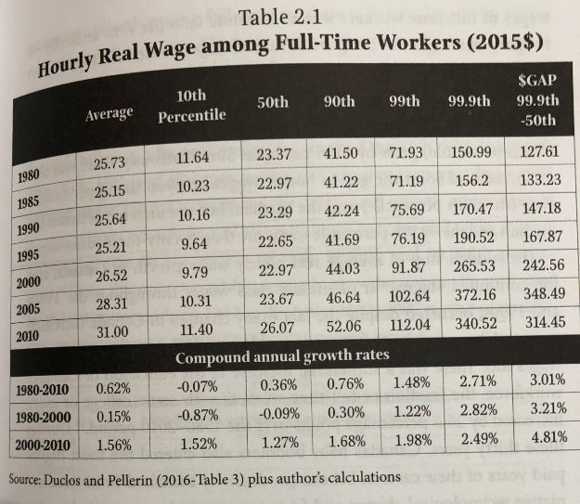
Real Hourly Wages
Osberg, L. (2018) The Age of Increasing Inequality – The Astonishing Rise of Canada’s 1%, James Lorimer and Company.

Slide 3
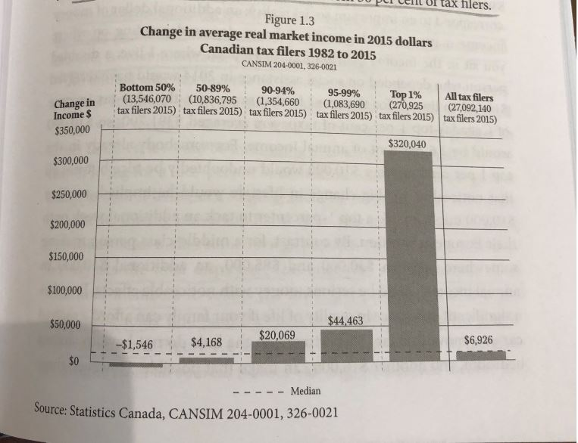
Real vs Market Income
Osberg, L. (2018) The Age of Increasing Inequality – The Astonishing Rise of Canada’s 1%, James Lorimer and Company.

Slide 4
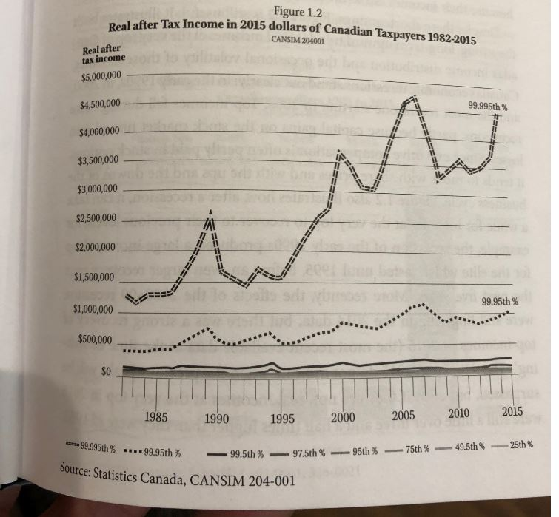
Real Income
Osberg, L. (2018) The Age of Increasing Inequality – The Astonishing Rise of Canada’s 1%, James Lorimer and Company.

Slide 5
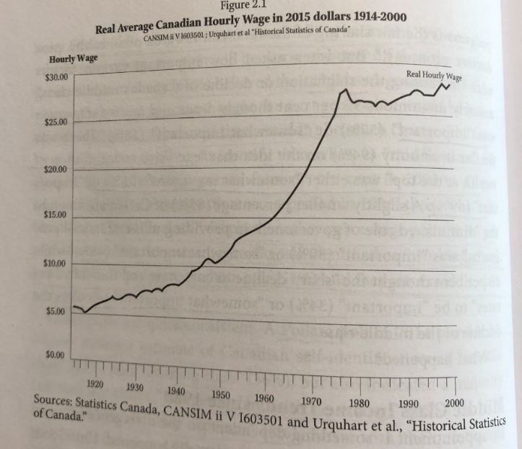
Average Wage
Osberg, L. (2018) The Age of Increasing Inequality – The Astonishing Rise of Canada’s 1%, James Lorimer and Company.

Slide 6
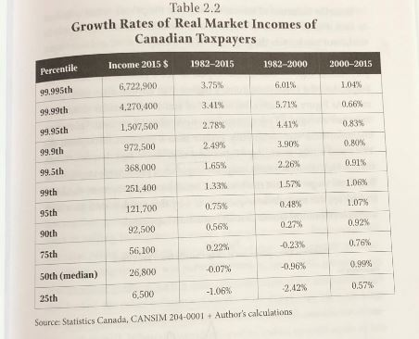
Growth Rates of Real Market Incomes
Osberg, L. (2018) The Age of Increasing Inequality – The Astonishing Rise of Canada’s 1%, James Lorimer and Company.

Slide 7
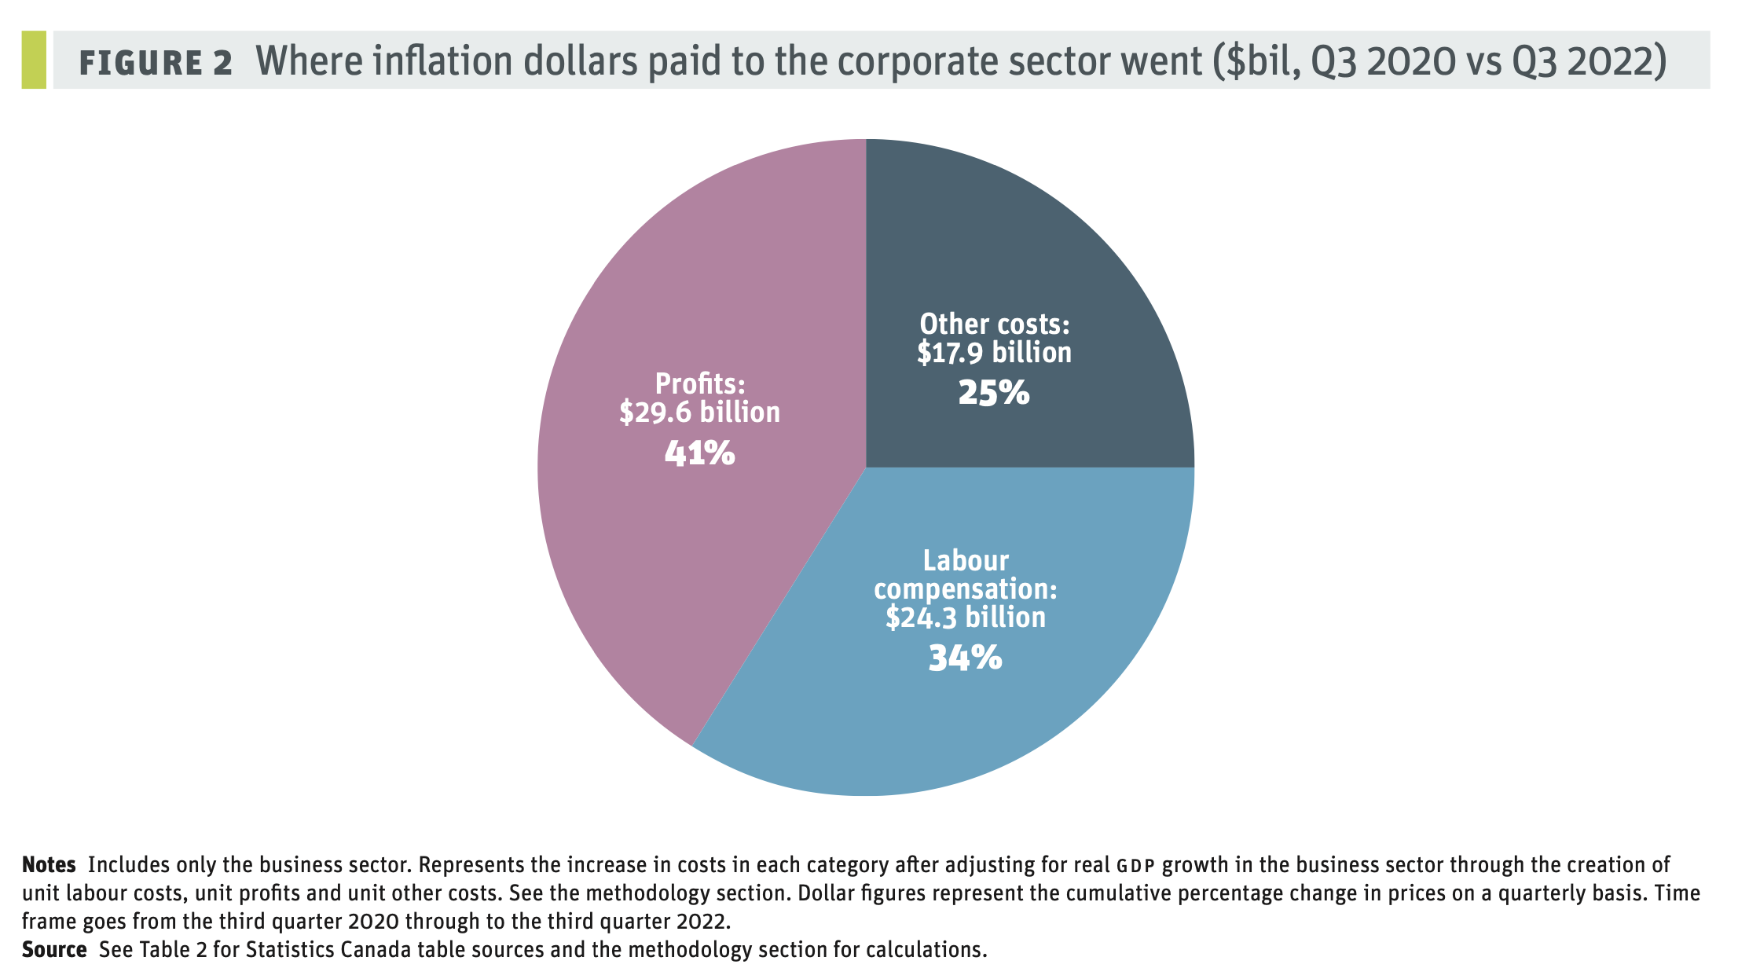
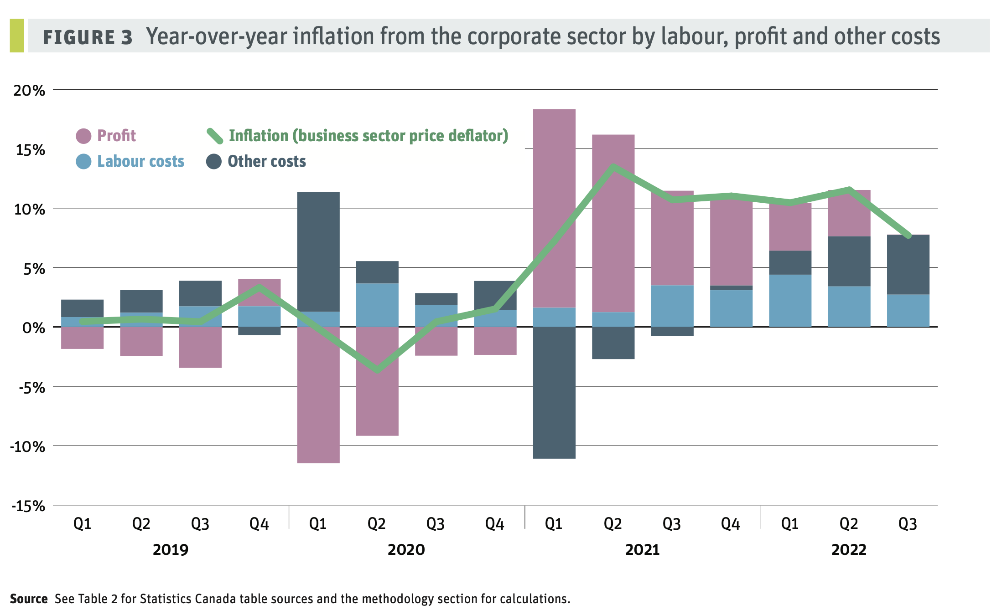
Inflation Since the Pandemic

Slide 8
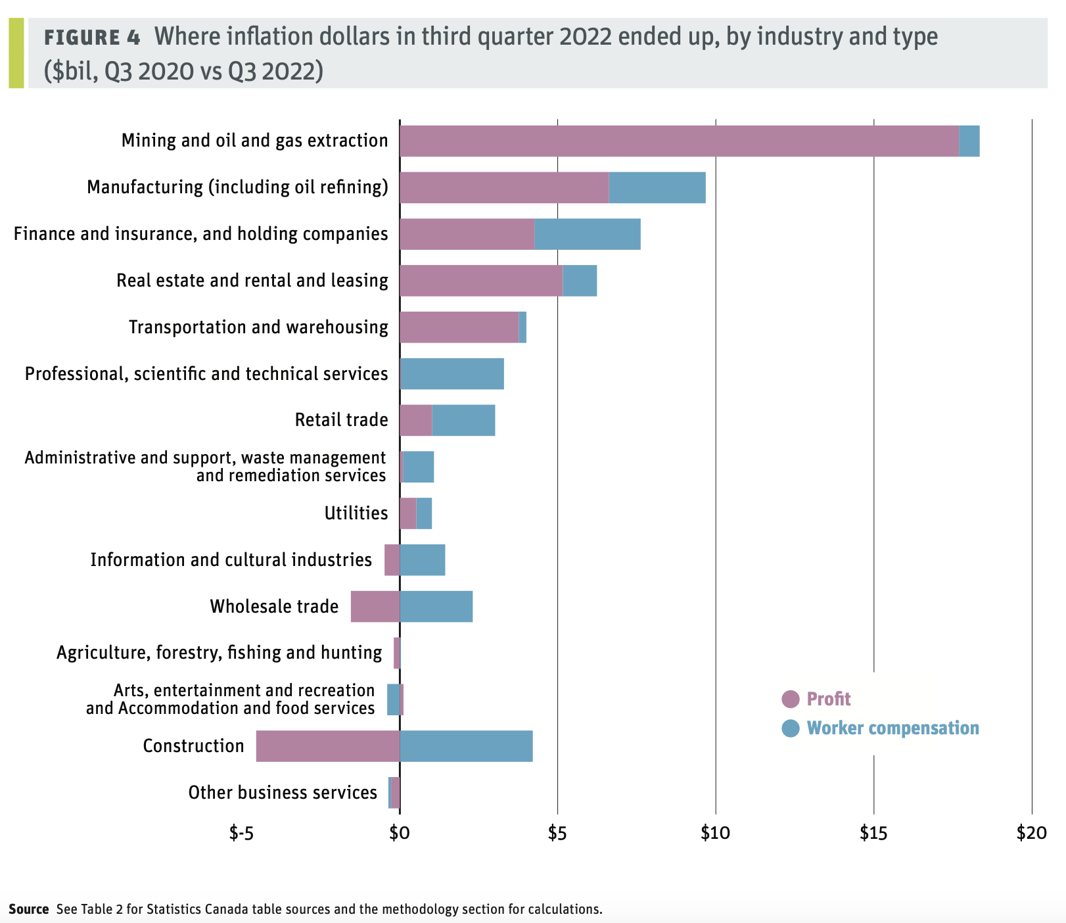

Slide 9
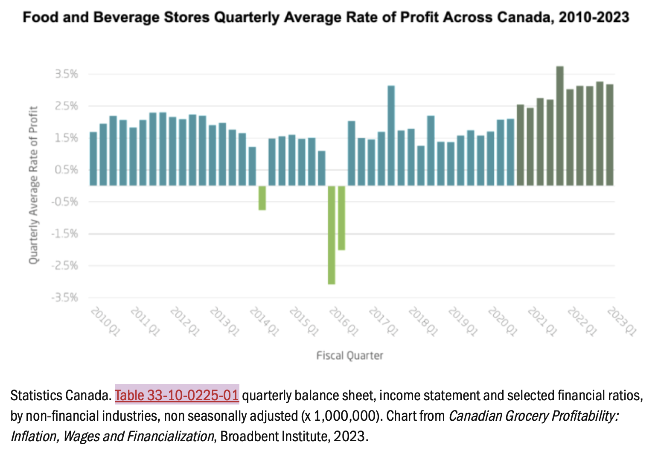
Food Price Inflation

Slide 10
More Links and Sources
Housing Affordability September 2023
Rental Price Increases
World Inequality
Sources
Where are your inflation dollars going?
Canadian Grocery Profitability: Inflation, Wages and Financialization
Canada Food Price Report 2024
Inequality in Canada
Inequality in Canada
Bank Bailouts During Economic Crisis

Slide 11
Videos and Discussion
Crises of Capitalism
Beware, Fellow Plutocrats, the Pitchforks are Coming

