Slide 1
Urban Agriculture
Regenerative Urban Agriculture
www.erikchevrier.ca

Slide 2
Discussion
What does it mean to cultivate a diverse food system?

Slide 3
Diversity
Agroecology and Regenerative Agriculture (Shiva, 2022)
Ecosystem diversity
Farming system diversity
Species diversity
Variety and genetic diversity
Output diversity
Other
Economic diversity
  Property, labour, enterprise, finance, transactions
  Social material, financial, living, intellectual, experiential, spiritual, cultural

Slide 4
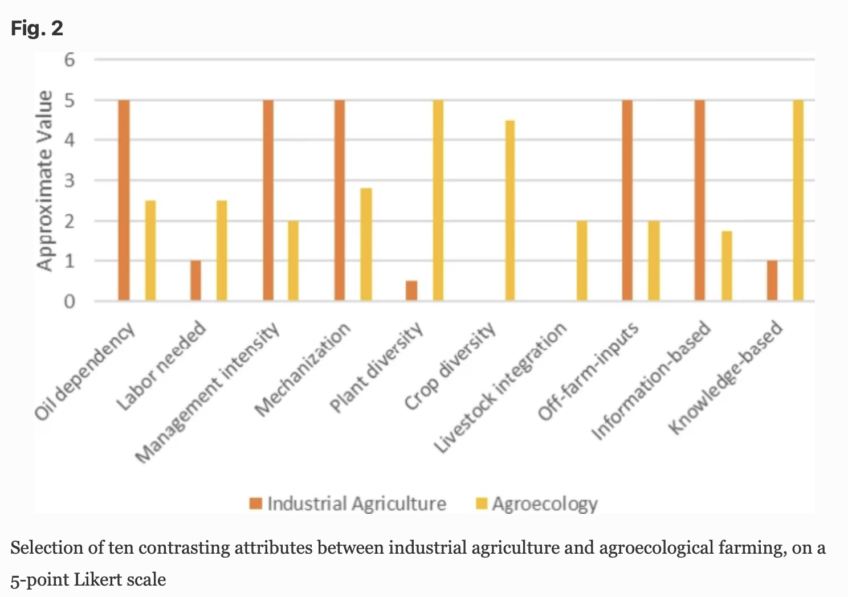

Slide 5
Principles of Agroecology (Shiva, 2022)
Enhancing the recycling of biomass, optimizing nutrient availability and balancing nutrient flow.
Securing favourable soil conditions for plant growth, managing organic matter, and enhancing soil biotic activity.
Minimizing losses due to flows of solar radiation, air and water through microclimate management, water harvesting and soil management through increased soil cover.
Species and genetic diversification of the agroecosystem.
Increasing the beneficial biological interactions and synergism among agrobiodiverse components that result in the promotion of key ecological processes and services.

Slide 6
Goals of Agroecology While Increasing Farm Productivity (Shiva, 2022)
Integrate components so the overall biological efficiency is improved.
Preserve biodiversity
Maintain agroecosystem productivity and self-sustaining capacity
Design a range of agroecosystems within a landscape unit, each mimicking the structure and function of natural ecosystems.
Enhance ecological integrity for food production sustainability.
Create socioeconomic and cultural environments for food sovereignty to prevail.
Build up the microclimate.
Increase carbon sequestration to effectively deal with climate change.

Slide 7
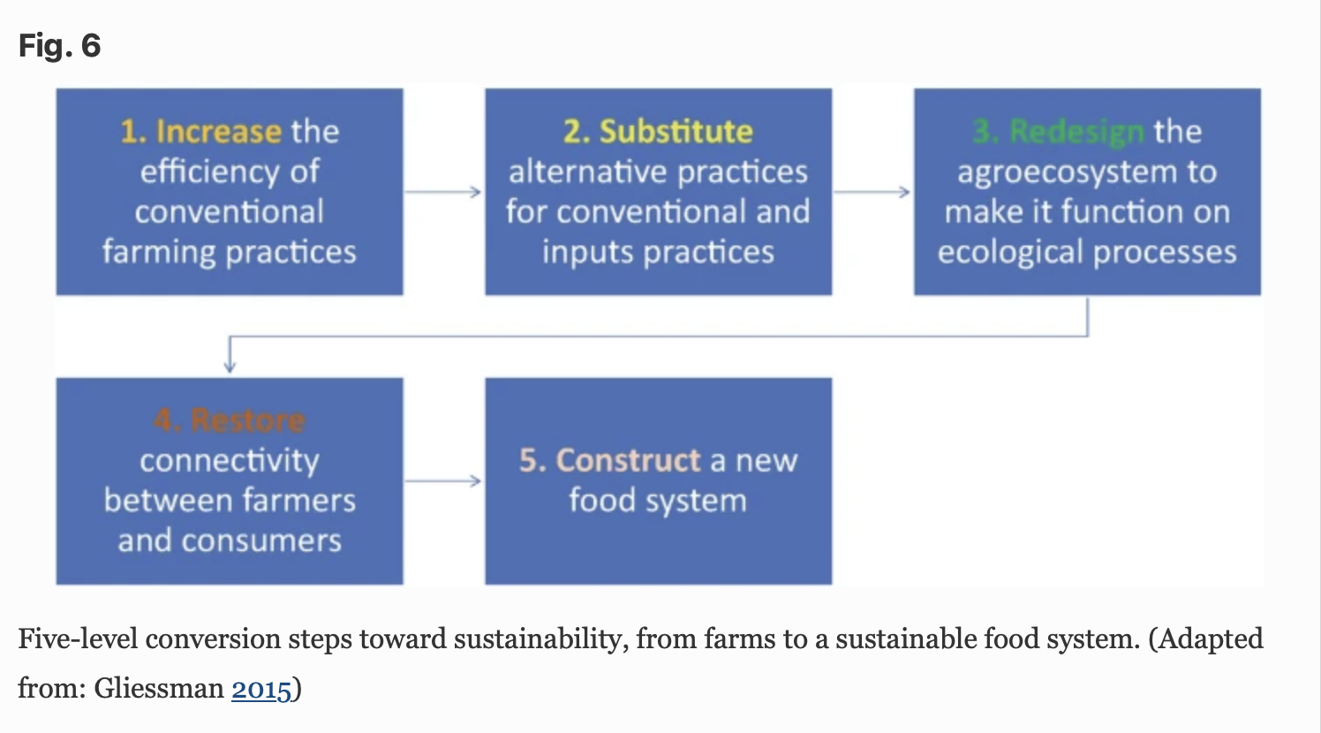

Slide 8
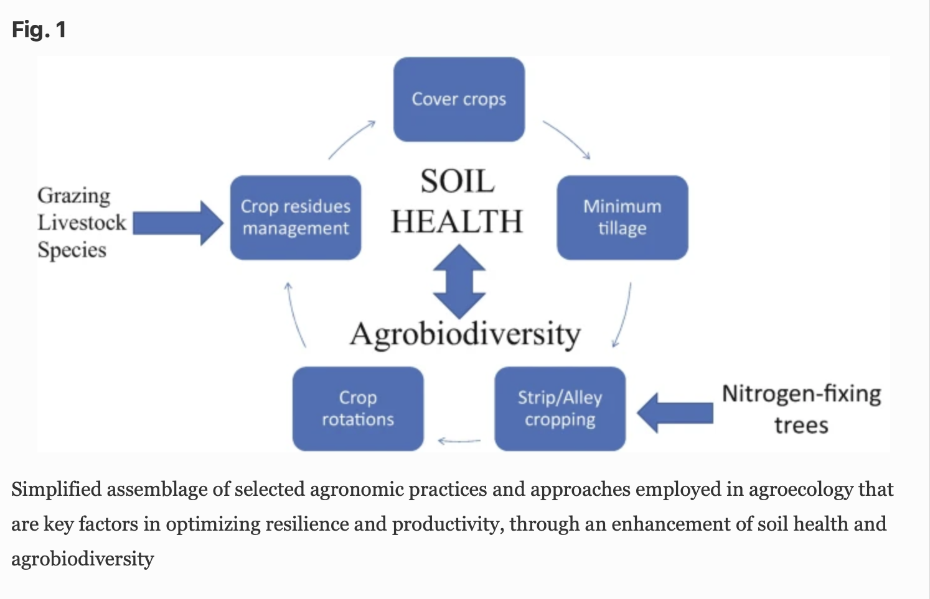

Slide 9
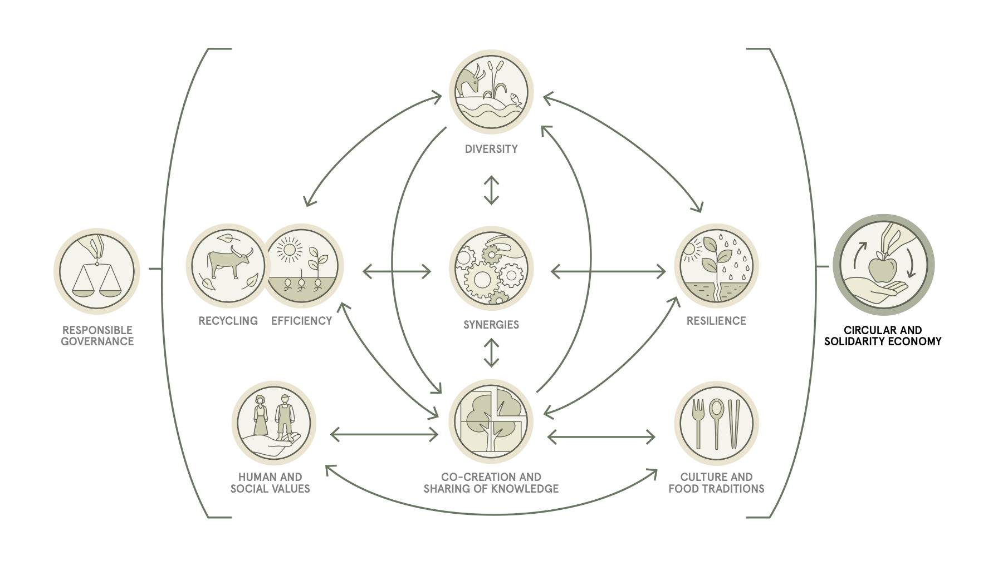
Source

Slide 10
Principles of Agroecology and Sustainable Agriculture
How can urban agriculture…
  Maintain an ecological balance?
  Enhance ecological processes?
  Implement mechanisms to improve agroecosystem resilience?
  Optimize the use of locally available resources?
  Reduce the use of off-farm external, non-renewable inputs?

Slide 11
References
Borsari, B. (2022) From Agroecology to Food Systems Sustainability: An Evolutionary Path Shifting Toward Sustainable Agriculture and Development, Handbook of Sustainability Science in the Future, pp. 1 – 18.
Food and Agriculture Organization of the United Nations, The 10 Elements of Agroecology Guiding the Transition to Sustainable Food and Agricultural Systems. https://www.fao.org/3/i9037en/i9037en.pdf
Shiva, V. (2022) Agroecology and Regenerative Agriculture: Sustainable Solutions for Hunger, Poverty, and Climate Change, Synergetic Press.

