Slide 1
Economic Transformations in Capitalist Society
Erik Chevrier, Ph.D.

Slide 2
Diverse Economies
What is a Diverse Economy?

Slide 3
Gibson Graham – Take back the Economy Gibson-Graham, J.K., Cameron, J., Healy, S. (2013) Take Back the Economy: An Ethical Guide for Transforming Communities, University of Minnesota Press

Slide 4
Social Economy
What is a (the) social economy?

Slide 5
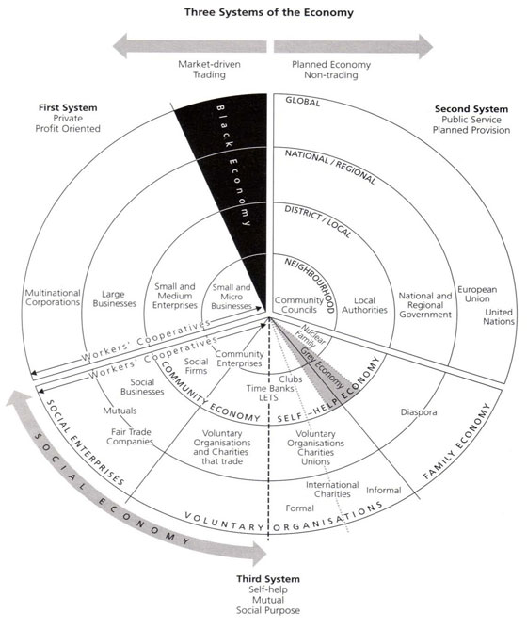
Three Systems of an Economy – John Pierce Pearce, J. (2009) Social Economy: Engaging as a Third System, In Amin, A. The Social Economy; International Perspectives on Economic Solidarity, p. 26.

Slide 6
Planetary Limits
What are the planetary limits, and which have we currently surpassed?
Bonus – what is a tipping point?

Slide 7
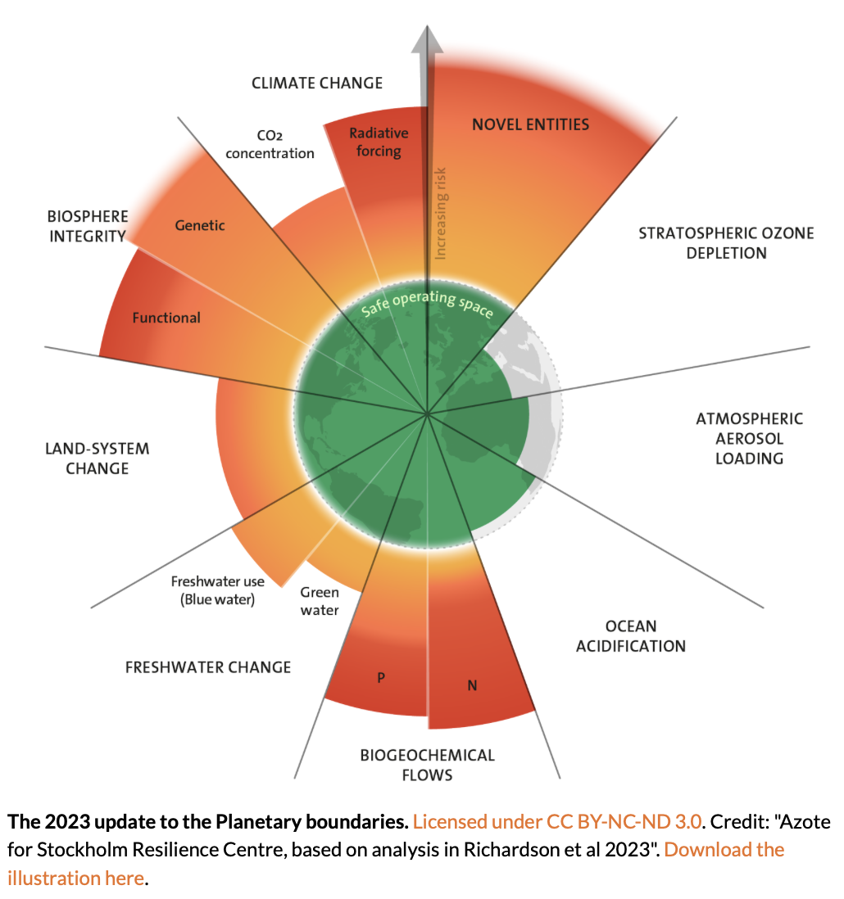
Source

Slide 8
Sustainability
What does it mean to be sustainable?
Juxtapose the triple bottom line (PPP), with strong sustainably and the doughnut model of sustainability

Slide 9
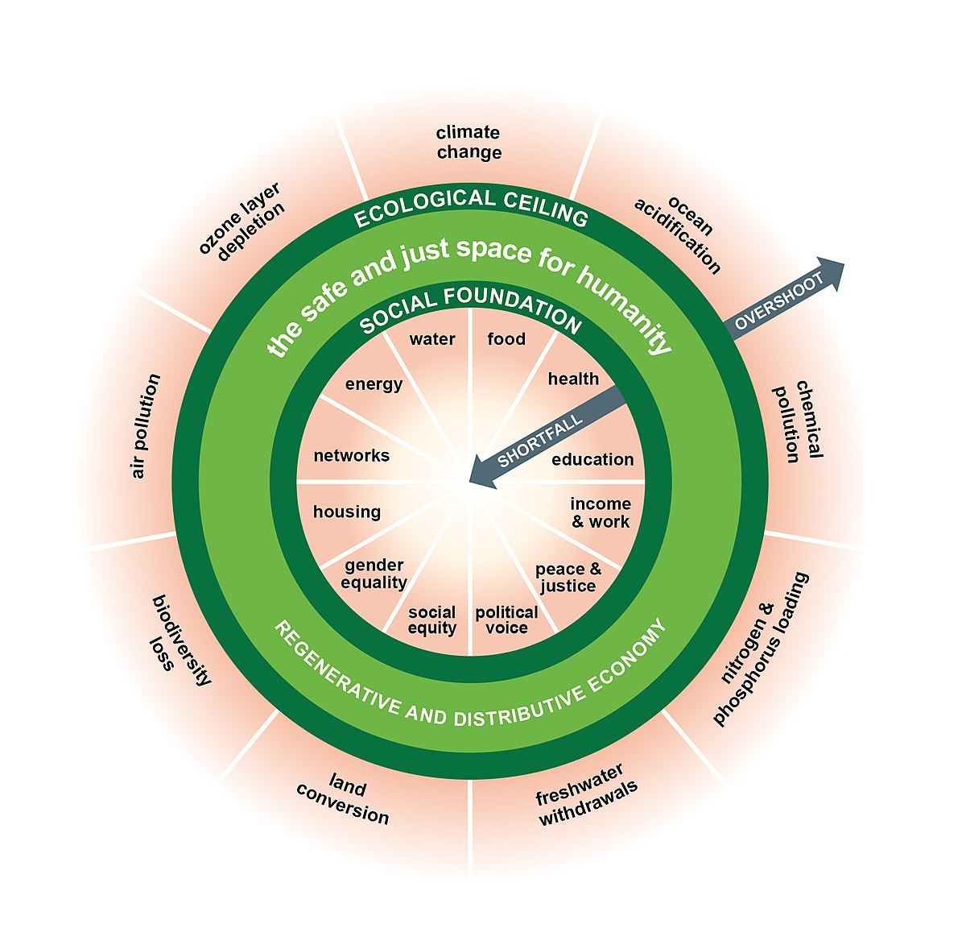
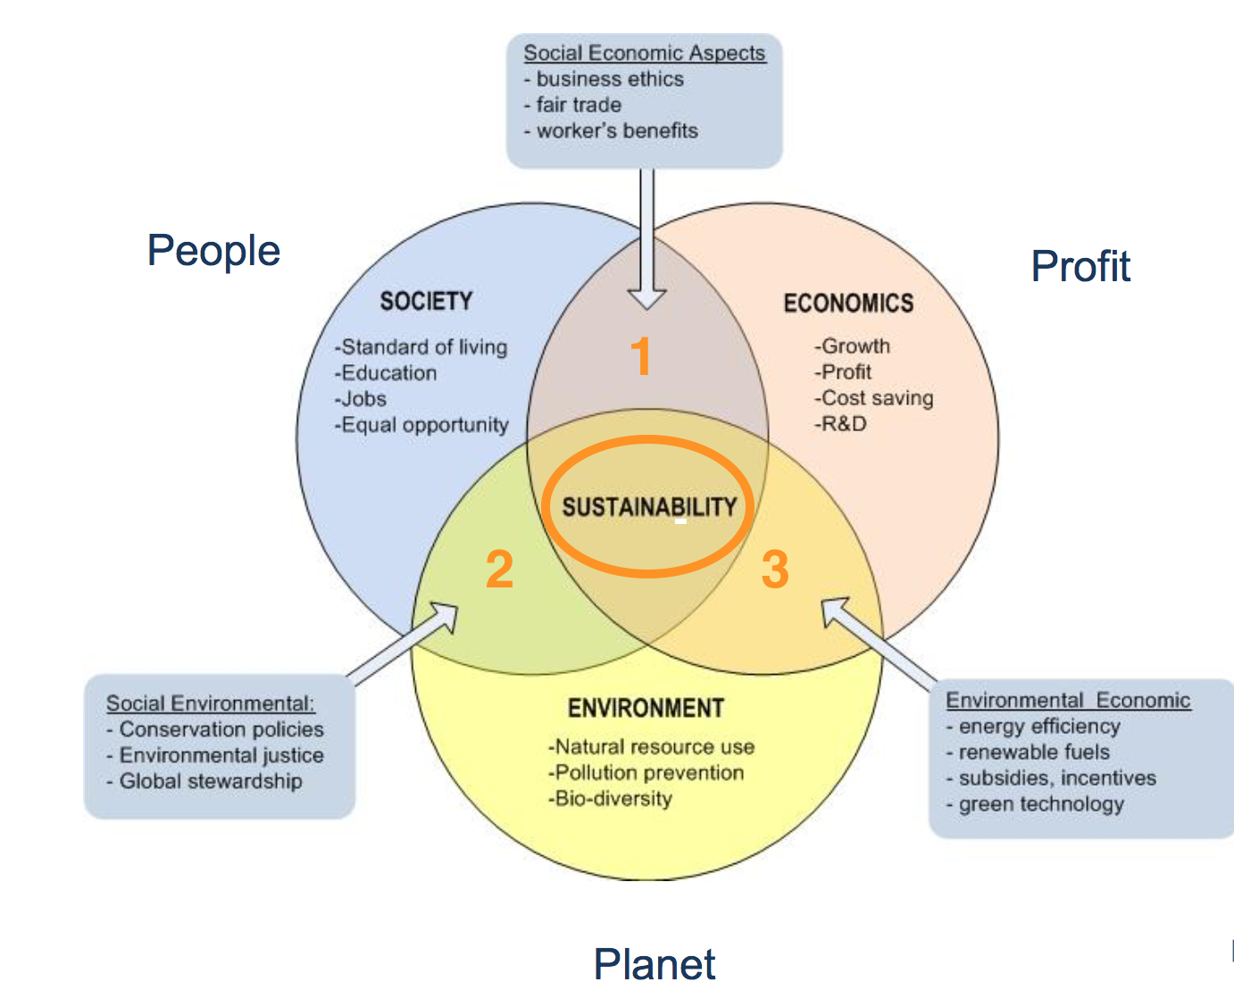
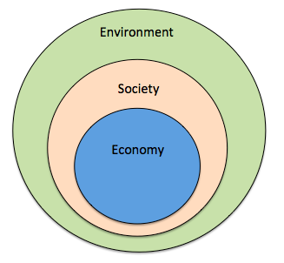
From Sustainability to Food Sovereignty
Triple Bottom Line
Nested Model
Doughnut Model

Slide 10
Value and Social Reproduction
What is the value of a commodity?
Bonus: Why should we be concerned with incommensurable forms of economic value?

Slide 11
Value
What is commodity fetishism and why is the concept important for understanding the relationship between social relationships and market products?

Slide 12
Commodity Fetishism

Slide 13
Value
What kinds of value exist?

Slide 14
Many Types of Value
Social capital
Financial capital
Living capital
Intellectual capital
Experiential capital
Spiritual capital
Cultural capital
Roland, E.C., Lanuda, G. (2013) Regenerative Enterprise. Optimizing for Multi-Capital Abundance

Slide 15
Degrowth
What is degrowth and how can it be achieved?

Slide 16
What is Degrowth?
The planned and democratic reduction of production and consumption as a solution to the social and ecological crises (Fitzpatrick, Parrique, Cosme, 2022).
Sustainable degrowth is an equitable downscaling of production and consumption that increases human well-being and enhances ecological conditions at the local and global level, in the short and long term (Schmelzer, Vetter, Vansinjan, 2022).
Degrowth challenges the hegemony of growth and calls for a democratically led redistributive downscaling of production and consumption in industrialized countries as a means to achieve environmentally sustainability, social justice and well-being (Schmelzer, Vetter, Vansinjan, 2022).
Sustainable degrowth is a multi-faceted political project that aspires to mobilize support for a change of direction, at the macro-level of economic and political institutions and at the micro-level of personal values and aspirations. Income and material comfort is to be reduced for many along the way, but the goal is that this is not experienced as welfare loss (Schmelzer, Vetter, Vansinjan, 2022).

Slide 17
What is Degrowth?
Degrowth proposes as an alternative a radically democratic reorganization of the political and economic structures of industrialized societies, aiming at drastic reductions in resource and energy throughput while furthering a good life for all…Degrowth requires fundamental changes in everyday social practices as well as a profound cultural, social and economic transformation that overcomes the capitalist mode of production (Schmelzer, Vetter, Vansinjan, 2022).

Slide 18
Degrowth Visions (Schmelzer, Vetter, Vansinjan, 2022)
Common Degrowth Principles
Enables global ecological justice
Strengthen social justice and collective self-determination
Redesigns its institutions and infrastructure so they are not dependent on growth and continuous expansion

Slide 19
Pathways to Degrowth (Schmelzer, Vetter, Vansinjan, 2022)
Six possible pathways to degrowth
Democratic economy, expand commons, solidarity-based economy
Social security, redistribute wealth, caps on wealth
Convivial democratic technology
Redistribution and reevaluation of labour
Equitable dismantling and reconstruction of production
International solidarity

Slide 20
Ten Most Frequently Mentioned Objectives of Degrowth
1 – Reduce time in paid labour
2 – Redistribute income, labour, knowledge, land, etc. within and between countries.
3 – Decommodify human needs
4 – Decentralize decision making
5 – Promote shared housing
6 – Support non-speculative exchange systems
7 – Prioritize small self-sufficient communities
8 – Create culture of sufficiency and self-limits
9 – Re-localize activities
10 – Defend and reclaim the commons

Slide 21
Alternatives to Capitalism
What alternatives exist to capitalism?
What are ways of transcending capitalism?

Slide 22
Making Degrowth Real (Schmelzer, Vetter, Vansinjan, 2022)
Real Ways to Implement Degrowth
Nowtopias
Non-reformist reforms (change institutions)
Counter-hegemony (build a counter movement)
Confronting crises (by design or disaster?)

Slide 23
Overview of Ways to Transition out of Capitalism
1 – Reform capitalism – mitigate against harms.
Reform social regulations, e.g. wealth caps, salary caps, increase social services
Regulate corporations.
2 – Create alternative organizations (interstitial, progressive).
Cracks theory
Create worker-driven cooperatives and community organizations.
3 – Transform capitalism (institutions, government, regulation bodies).
Replace current system
Replace current institutions and regulatory bodies
4 – Do nothing; capitalism will transcend.

Slide 24
Things to Consider
Desirable
Viable
Achievable as a System

